Slide 1


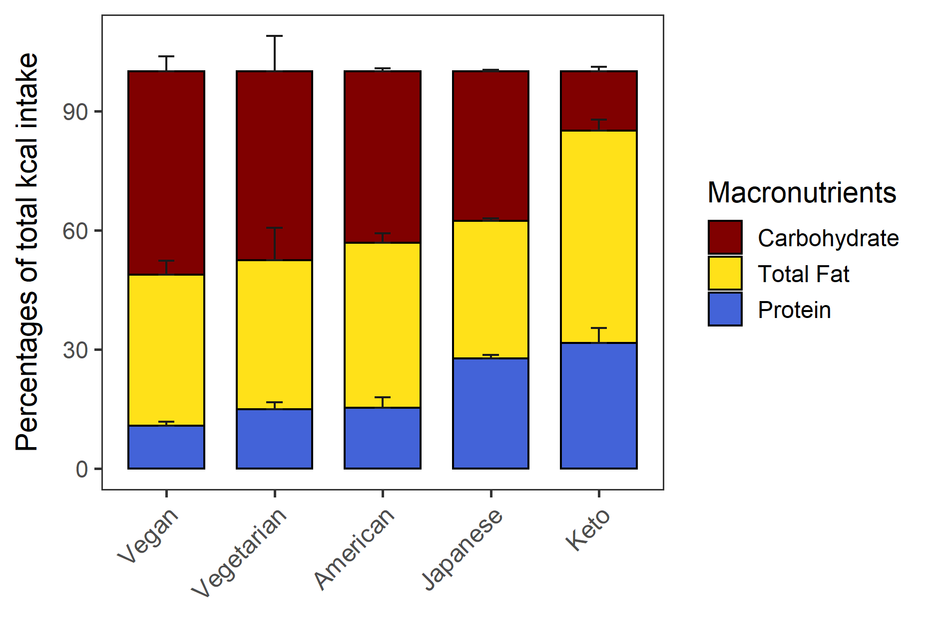
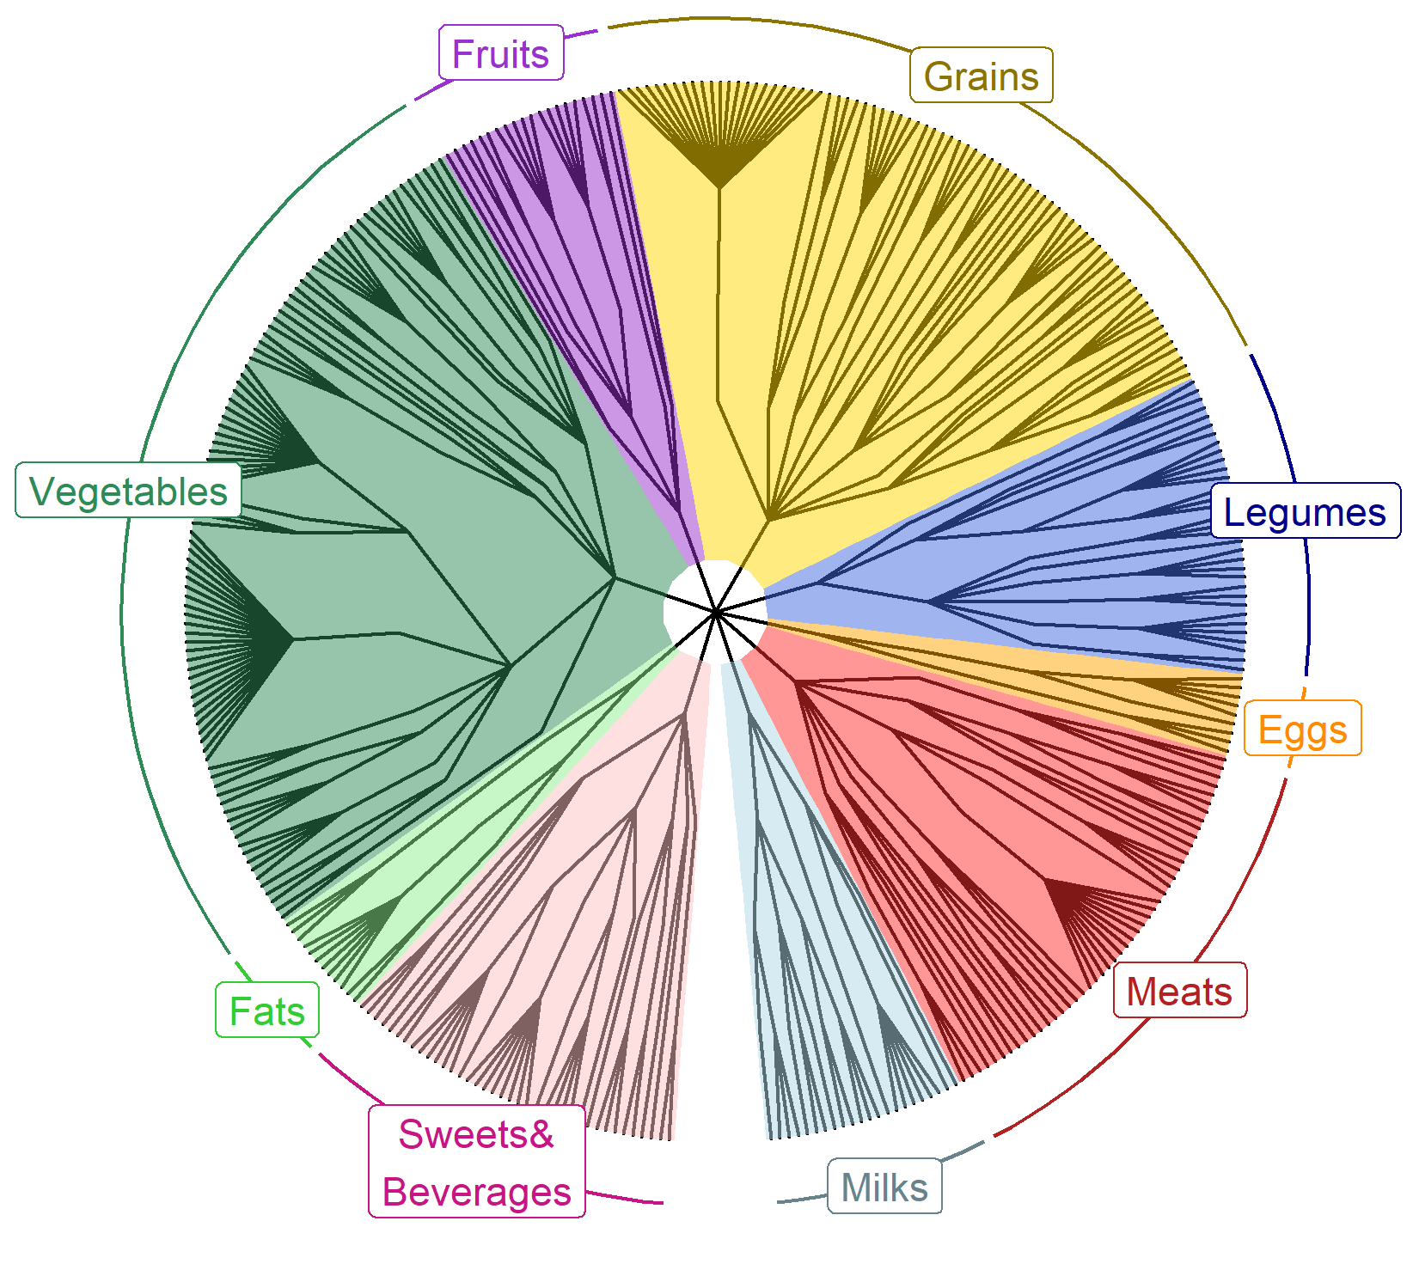

DietR –
A dietary analysis tool for ASA24 and NHANES in R
Rie Sadohara¹ , Abigail Johnson²
¹Kyoto-city, Kyoto, Japan ²Division of Epidemiology & Community Health, University of Minnesota
Background
Functionality
ASA24 and National Health And Nutrition Examination Survey (NHANES) are designed to be analyzed by using SAS
But R is open-source and customizable with packages
We developed a package “DietR” to analyze NHANES and ASA24 data with R
Data preparation | Load, filter, compute total food intake for each participant and day, compute means of food intake across days, QC the total data for outliers and/or based on metadata
Data overview | Data summary, % KCAL by macronutrients in barcharts
Clustering analyses | Principal component analysis (PCA), k=means, select the optimal k
Foodtree | Build foodtrees where foods in FNDDS are hierarchically grouped, visualize, generate food OTU table
Ordination | Principal Coordinate Analysis (PCoA) based on their food intake (foodtree, OTU table) with the similarity of foods taken into account
Data overview
Clustering analyses
Foodtree
Ordination
Need figs with bigger letters
Case study – nuts/seeds/legumes consumption diversity & body measures
Availability
Research question
GitHub repo
Previous studies suggest nuts/seeds/legumes have positive impacts on health
Does diversity of nuts/seeds/legumes consumption matter?
https://github.com/computational-nutrition-lab/DietR
Methods
DivGroup | n | nuts/seeds/legumes consumed | Diversity index
DivNA | 2,012 | 0 | NA
Div0 | 1,246 | 1 | 0
Div1 | 387 | >1 | 0.027 - 0.66
Div2 | 393 | >1 | 0.66 - 1.95
Website with tutorial
NHANES15-16, n=4,038, 18+ yo, with waist circumference & BMI
Foodcode 4xxxxxxx: nuts/seeds/legumes.
Extracted reported food items with their foodcode starting from 4.
https://computational-nutrition-lab.github.io/DietR/
References
ref
Acknowledgements
This project was supported by internal institutional start-up funds from the University of Minnesota. The authors would like to thank Mo Hutti for the create_corr_frame function which generates a correlation table with ordination axes and variables; Pajau Vangay for the collapse_by_correlation function which removes correlated variables; and Suzie Hoops for the matrix multiplication operation and her insights into statistical analyses.

