Slide 1


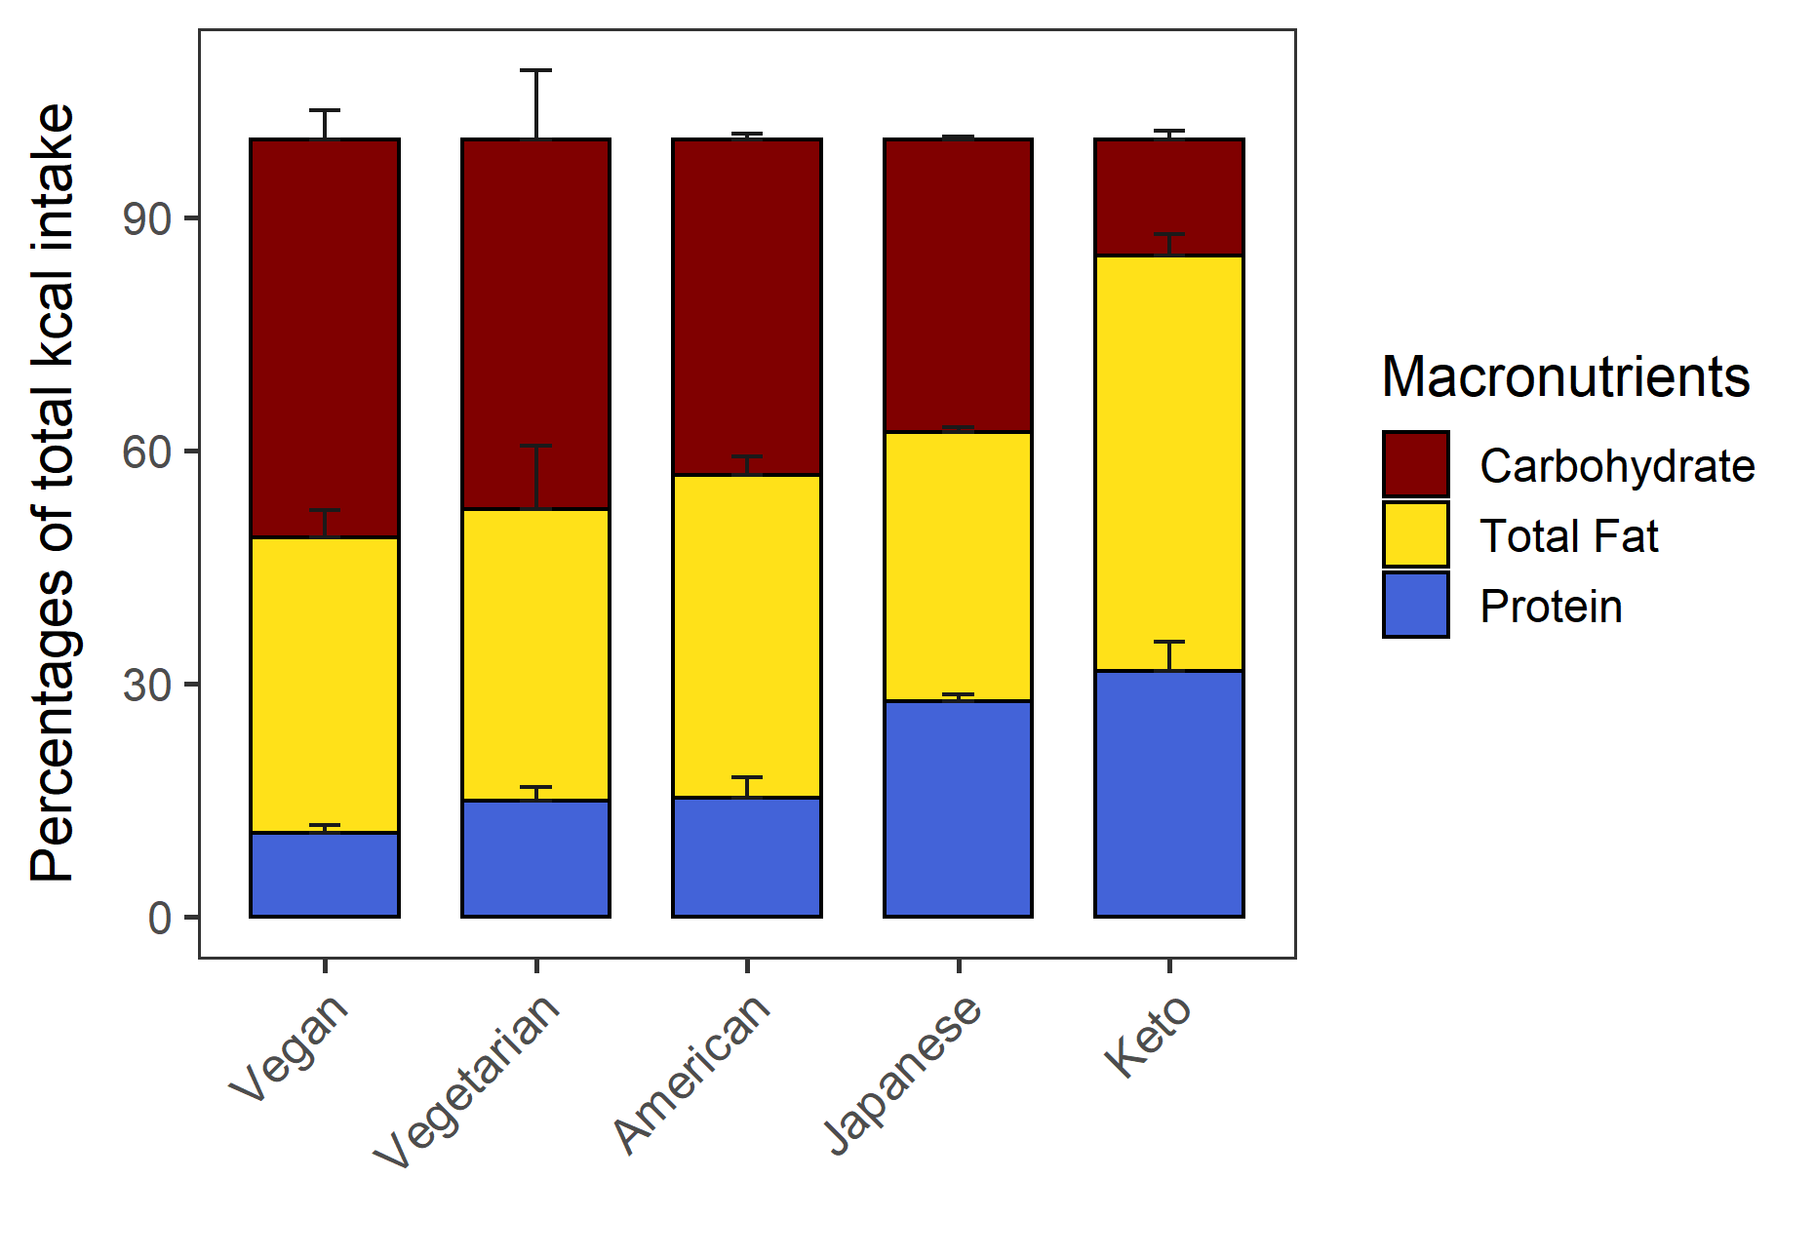
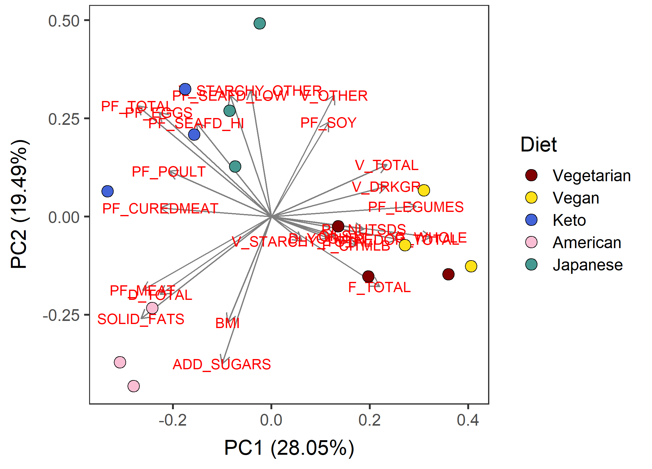
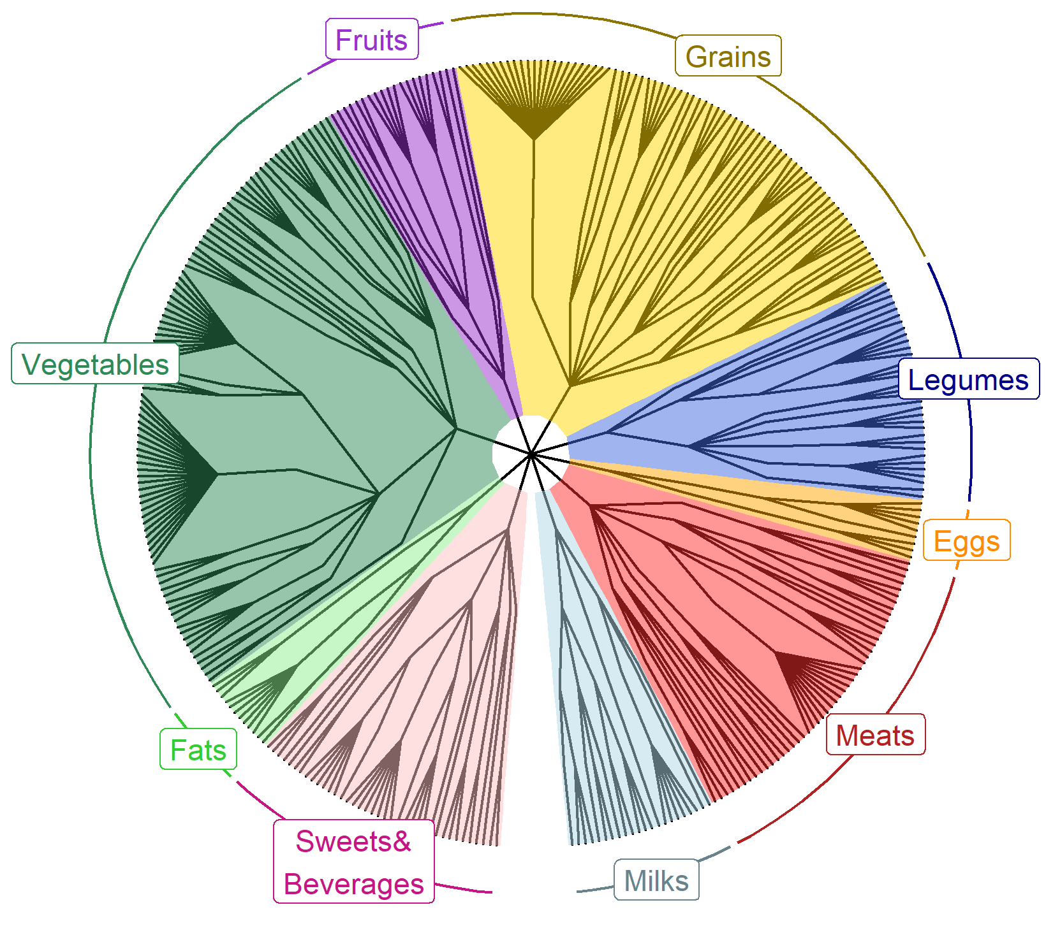
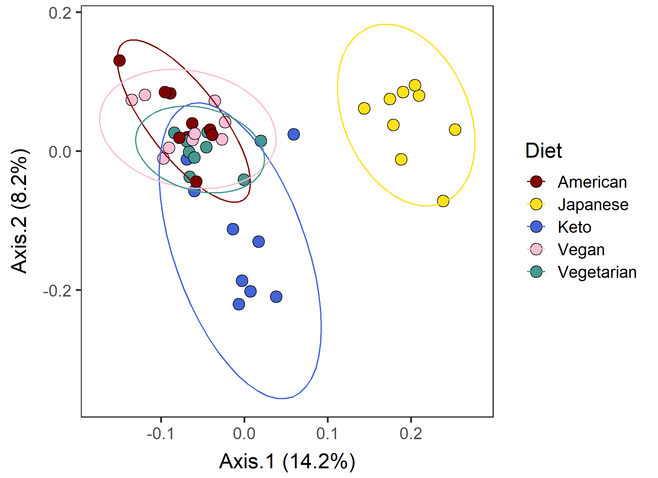






DietR –
A dietary analysis tool for ASA24 and NHANES in R
Rie Sadohara¹ , Abigail Johnson²
¹Kyoto-city, Kyoto, Japan ²Division of Epidemiology & Community Health, University of Minnesota
Background
Functionality
ASA24 and National Health And Nutrition Examination Survey (NHANES) are designed to be analyzed by using SAS
R is open-source and customizable with packages
We developed a package “DietR” to analyze NHANES and ASA24 data with R
Data preparation | Load, filter, compute total food intake for each participant and day, compute means of food intake across days/groups, filter the total data for outliers
Data overview | Data summary, % KCAL by macronutrients in barcharts
Diversity | Compute diversity indeces of dietary records
Clustering | Principal component analysis (PCA), k-means, select the optimal k
Foodtree | Build foodtrees where foods in FNDDS are hierarchically grouped, visualize foodtrees, generate food OTU table
Ordination | Principal Coordinate Analysis (PCoA) based on their food intake (foodtree, OTU table) with the similarity of foods taken into account
Demonstration
Example dataset VVKAJ contains ASA24 dietary records of 15 people with 5 different diets, Vegetarian, Vegan, Keto, American, and Japanese for 3 days.
Data overview
Clustering
Foodtree
Ordination
%KCAL from three macronutrients. Errorbars: standard deviation.
PCA based on food categories averaged across 3 days.
4-level hierarchical grouping of all reported food items.
PCoA with consumption and food hierarchy
Case study: nuts/seeds/legumes consumption diversity & body measures
Availability
Research question
GitHub repo
Previous studies suggest nuts/seeds/legumes have positive impacts on health
Does diversity of nuts/seeds/legumes consumption matter?
https://github.com/computational-nutrition-lab/DietR
Methods
Website with tutorials
NHANES15-16, n=4,038, 18+ yo, with waist circumference & BMI
Foodcode 4xxxxxxxx: nuts/seeds/legumes.
Extracted reported food items with their foodcodes starting from 4.
Analysis of covariance (ANCOVA) with Age + Gender + Fiber/1000kcal + PF_ALL
DivGroup | n | nuts/seeds/legumes consumed | Diversity index
DivNA | 2,012 | 0 | NA
Div0 | 1,246 | 1 | 0
Div1 | 387 | >1 | 0.027 - 0.66
Div2 | 393 | >1 | 0.66 - 1.95
https://computational-nutrition-lab.github.io/DietR/
Preprint
https://
Results & Discussion
References
The more diverse nuts/seeds/legumes consumption, the lower the waist circumference and BMI.
ref
< 0.0001
< 0.0001
the high nuts/seeds/legume consumers perhaps included health-conscious population
Diversity in consumption of specific food groups instead of all foods may give new insights
< 0.0001
< 0.0001
Acknowledgements
0.04
This project was supported by internal institutional start-up funds from the University of Minnesota. The authors would like to thank Mo Hutti for the create_corr_frame function which generates a correlation table with ordination axes and variables; Pajau Vangay for the collapse_by_correlation function which removes correlated variables; and Suzie Hoops for the matrix multiplication operation and her insights into statistical analyses.
Emmeans ± SE; pairwise comparisons with no p-values are not significantly different.
For both models, KCAL did not have a major effect, therefore was not included.

