Slide 1
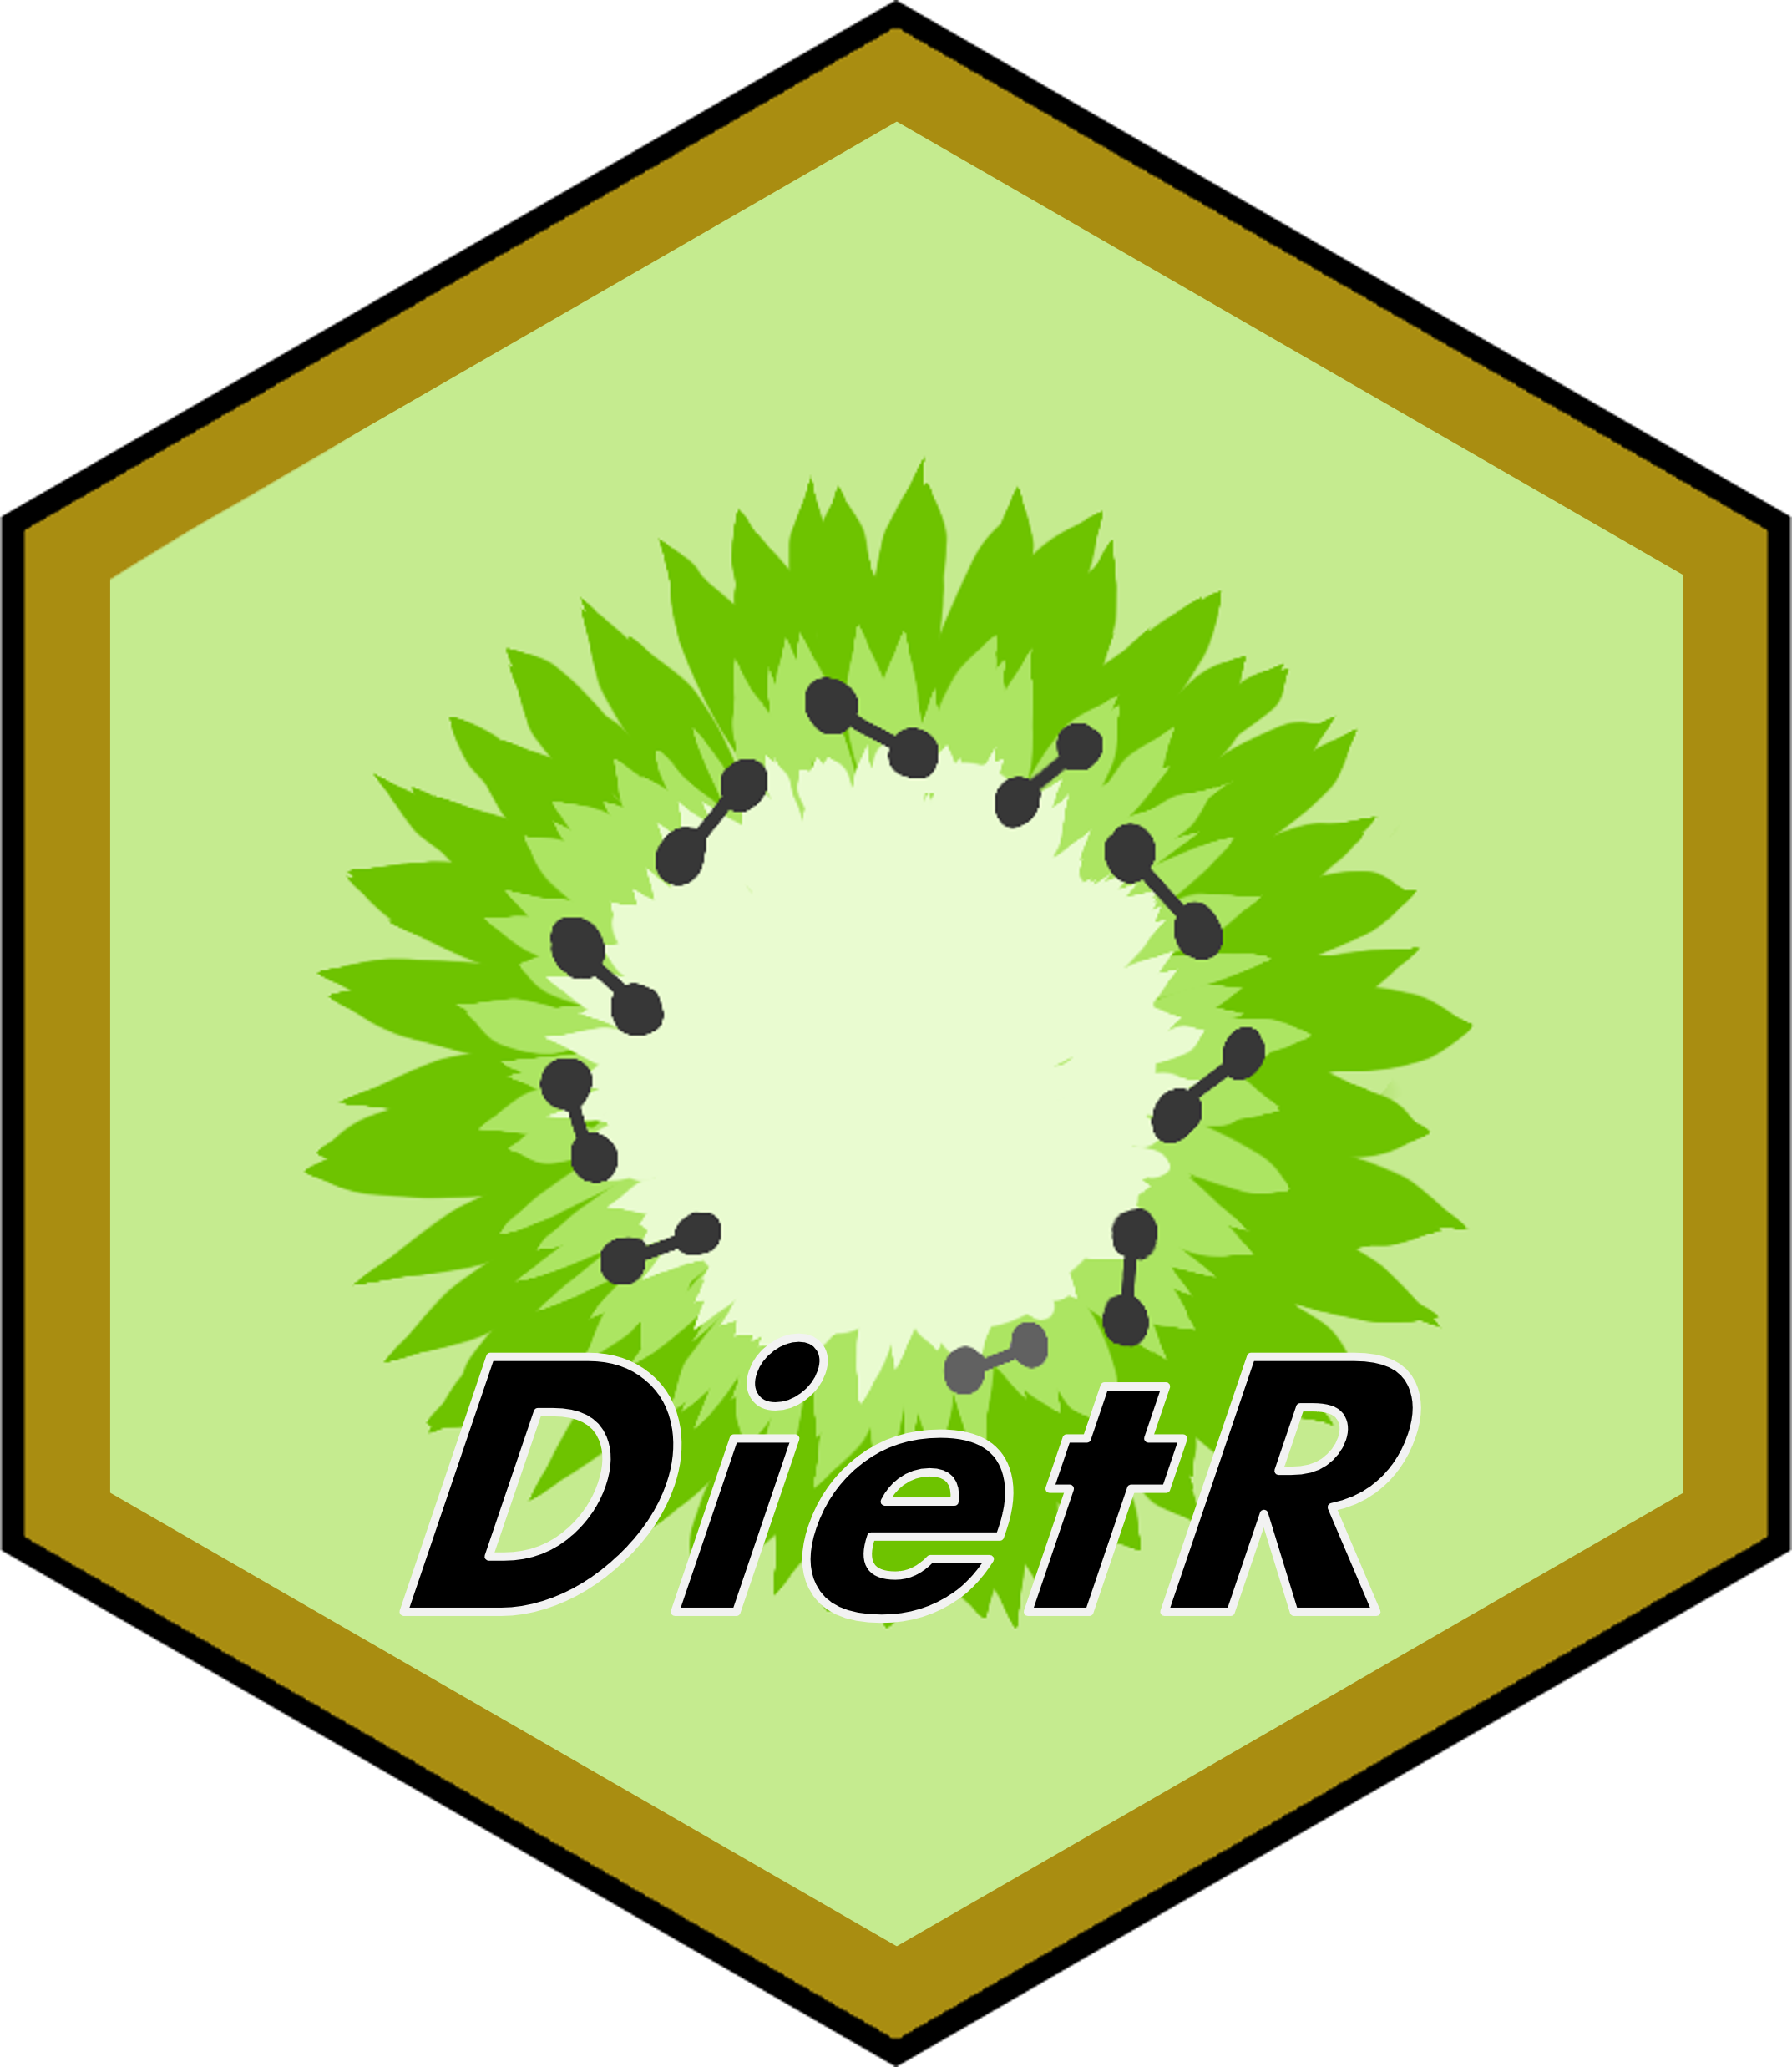


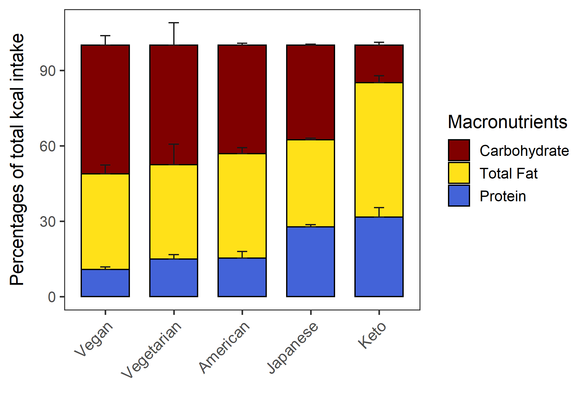
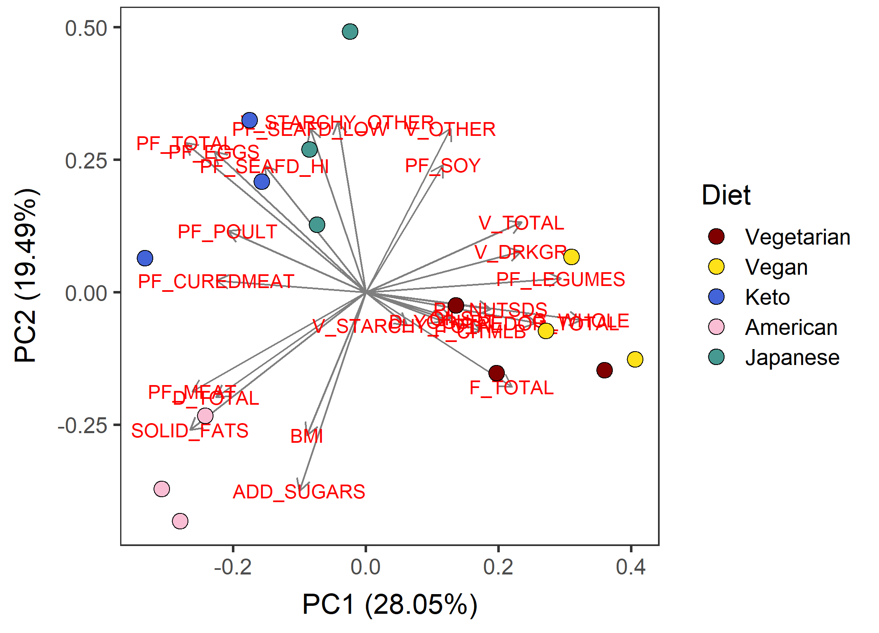
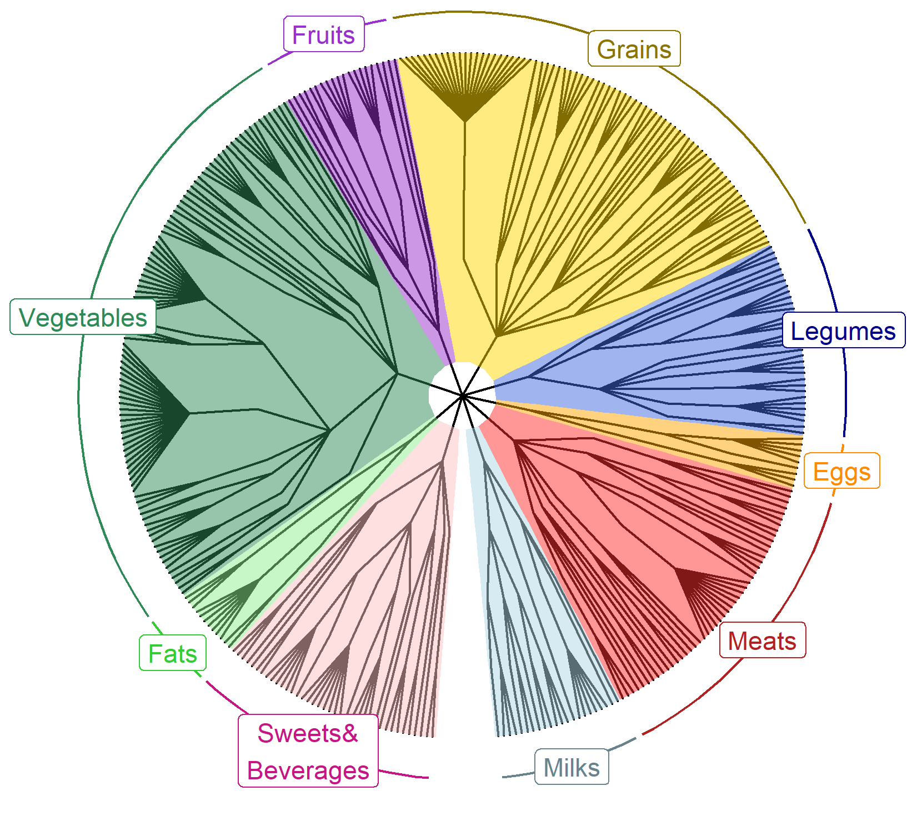
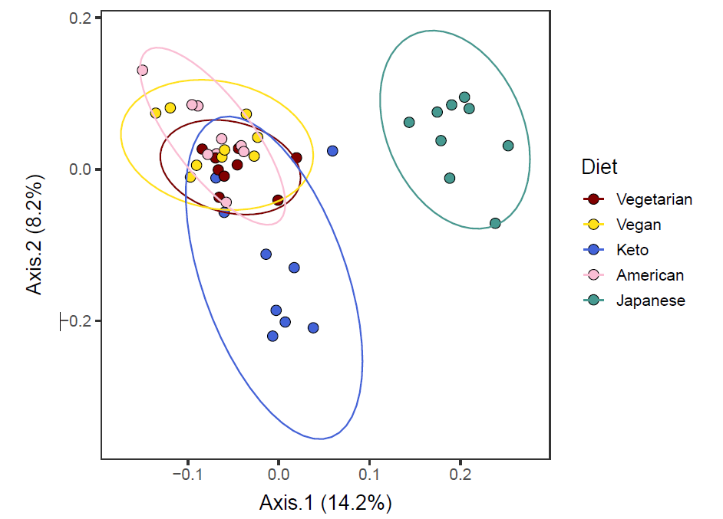








DietR –
A dietary analysis tool for ASA24 and NHANES in R
Rie Sadohara¹, David Jacobs², Mark A. Pereira², Abigail Johnson²
¹Kyoto-city, Kyoto, Japan ²Division of Epidemiology & Community Health, University of Minnesota
Background
Functionality of DietR
Analysis of 24-hour recall data can be complicated and difficult.
Many dietary datasets and dietary analysis tools are written in SAS.
R is open-source and customizable with packages.
We developed a package “DietR” to analyze NHANES and ASA24 data with R.
Data preparation | Load, filter, compute total food intake for each participant, compute means of food intake across days/groups, filter the total data for outliers.
Data overview | Data summary, % KCAL by macronutrients in barcharts.
Diversity | Compute α−diversity indices for dietary records, participants, or food groups.
Clustering | Principal component analysis (PCA), k-means, select the optimal k
Foodtree | Build foodtrees [1] where foods in FNDDS are hierarchically grouped, visualize foodtrees, generate individual food consumption tables (“vegan” package [2]).
Ordination | Principal Coordinate Analysis (PCoA) based on their food consumption amount and the similarity of foods taken into account (“vegan” package [2]).
Demonstration
Clustering
Foodtree
Ordination
Data overview
%KCAL from three macronutrients. Error bars: standard deviation.
PCA based on food categories averaged across 3 days.
4-level hierarchical grouping of all reported food items.
PCoA with consumption and food hierarchy.
Figure 1: Examples of plots created with DietR using a set of simulated ASA24 dietary records designed to show differences in eating patterns. The example dataset includes 15 imagined people with 5 different diets: Vegetarian, Vegan, Keto, American, and Japanese.
Use case vignette: nuts/seeds/legumes diversity & body measures
Availability
Background and Research question
GitHub repo
Previous studies suggest nuts/seeds/legumes have positive impacts on health [3].
Is diversity of nuts/seeds/legumes consumption related to body measures, e.g. waist size or BMI?
https://github.com/computational-nutrition-lab/DietR
Methods
Website with tutorials
NHANES 2015−16, n=3,641, 18+ yo, with waist circumference & BMI.
Extracted reported food items with their foodcodes starting with 4 (Foodcode 4xxxxxxxx: nuts/seeds/legumes) from 2 days of recalls.
Calculated nuts/seeds/legumes α−diversity.
Defined diversity groups (Table 1).
Analysis of covariance (ANCOVA) with Age, Sex, Race, Income, Education, KCAL as covariates
DivGroup | n | nuts/seeds/legumes consumed | Diversity index
DivNA | 1,819 | 0 | NA
Div0 | 1,105 | 1 | 0
Div1 | 360 | >1 | 0.027 − 0.66
Div2 | 357 | >1 | 0.66 − 1.95
https://computational-nutrition-lab.github.io/DietR/
Preprint on medRxiv
https://doi.org/10.1101/2023.07.07.23292390
Table 1: α−diversity groups. DivNA represents no intake of nuts/seeds/legumes. Div0 are individuals who consumed 1 type of nuts/seeds/legumes. Div1 and Div2 consumed more than 1 type of nuts/seeds/legumes.
References
[1] Johnson AJ, Vangay P, Al-Ghalith GA, et al. Daily sampling reveals personalized diet-microbiome associations in humans. Cell Host Microbe. 2019;25(6):789-802.
[2] Simpson GL, Minchin PR, De Caceres M, et al. vegan: Community Ecology Package. 2022.
[3] Karlsen MC, Ellmore GS, McKeown N. Seeds—Health benefits, barriers to incorporation, and strategies for practitioners in supporting consumption among consumers. Nutr Today. 2016;51(1):50-59.
[4] Mitchell DC, Marinangeli CPF, Pigat S, et al. Pulse intake improves nutrient density among US adult consumers. Nutrients. 2021;13(8):2668.
Results & Discussion
More diverse nuts/seeds/legumes consumption is associated with lower waist circumference.
Div2 had 3.8 cm lower waist circumference than DivNA (p<0.001) and 3.4 cm lower than Div0 (p<0.01).
Div2 had 1.4 lower BMI than DivNA and Div0 (p<0.01 for both).
In contrast, higher KCAL intake was associated with increased nuts/seeds/legume diversity.
Pulse intake in NHANES is associated with better quality diets [4]. Thus, nuts/seeds/ legumes diversity could be a useful index to explore the health-promoting effects of this food group.
Physical exercise, drinking, and smoking habits may be confounders.
2 day-data may have been insufficient to capture nuts/seeds/legumes diversity.
A
−3.8 ***
B
−1.4 **
−3.4 **
−1.4 **
−3.2 *
Acknowledgements
This project was supported by internal institutional start-up funds from the University of Minnesota. The authors would like to thank Mo Hutti for the create_corr_frame function which generates a correlation table with ordination axes and variables; Pajau Vangay for the collapse_by_correlation function which removes correlated variables; and Suzie Hoops for the matrix multiplication operation and her insights into statistical analyses.
Figure 2: Bar charts showing emmeans ± SE for ANCOVA models for (A) waist circumference and (B) BMI; pairwise differences shown are significantly different.
***: p<0.001, **: p<0.01, *: p<0.05.

