Slide 1

Active inference (theory)
Karl Friston, University College London
Abstract: I will consider prediction and choice based upon the minimisation of expected free energy. Crucially, (negative) free energy can always be decomposed into pragmatic (extrinsic) and epistemic (intrinsic) value. Minimising expected free energy is therefore equivalent to maximising extrinsic value, while maximising information gain or intrinsic value; i.e., reducing uncertainty about the causes of sensory samples. This decomposition resolves the exploration-exploitation dilemma; where epistemic value is maximised until there is no further resolution of uncertainty, after which exploitation is assured through maximisation of extrinsic value. This is formally consistent with the principle of maximum mutual information, generalising formulations of active vision based upon salience (Bayesian surprise) and optimal decisions based on expected utility and risk sensitive (KL) control – using Hamilton's principle of least action.. I will briefly review the normative theory – illustrating the minimisation of expected free energy using simulations and then turn to neuronal processes theories. In brief, the implicit (neuronally plausible) belief propagation offers a form of predictive coding, when hidden causes and outcomes are treated as discrete states.
Key words: active inference ∙ cognitive ∙ dynamics ∙ free energy ∙ epistemic value ∙ self-organization

Slide 2
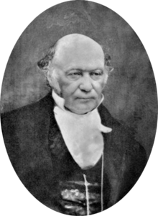
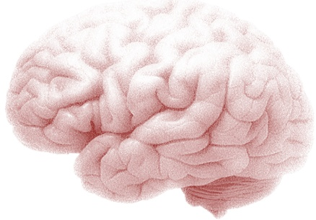
Active inference
Action and the path of least resistance
Generative models and active inference
From principles to process theories
Some empirical predictions
Artificial insight and aha moments

Slide 3
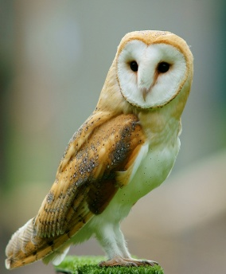
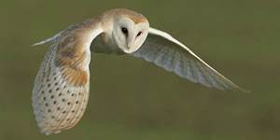
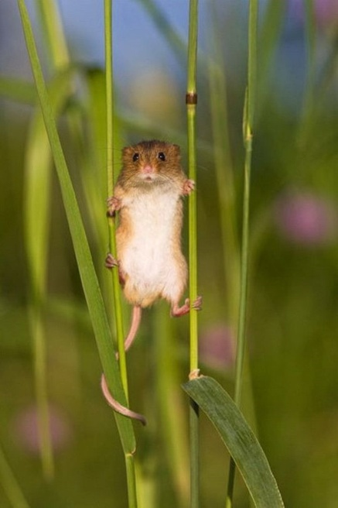
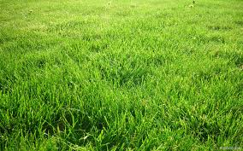
Imagine you are an owl – and you are hungry…

Slide 4
Optimal action depends on the state of the world
Optimal action depends on beliefs about the state of the world
Optimal action depends on beliefs about the state of the world and subsequent action
Bellman’s Optimality Principle:
Optimal control theory
Bayesian decision theory
Reinforcement learning
….
Hamilton's Principle of least Action:
The free energy principle
Active inference
Active learning
….

Slide 5

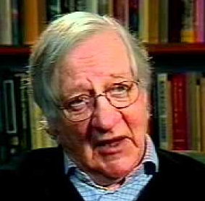
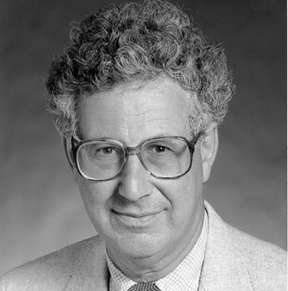
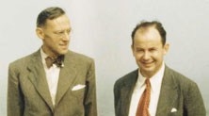
Prior beliefs about policies
Quality of a policy = (negative) expected free energy
X
X
X
Extrinsic value
Epistemic value or information gain
Bayesian surprise and Infomax
In the absence of prior beliefs about outcomes:
KL or risk-sensitive control
In the absence of ambiguity (known states):
Expected utility theory
In the absence of uncertainty or risk:
Bayesian surprise
Expected value
Predicted divergence
Mutual information

Slide 6
Overview
Action and the path of least resistance
Generative models and active inference
From principles to process theories
Some empirical predictions
Artificial insight and aha moments

Slide 7
A (Markovian) generative model
Likelihood
Empirical priors – hidden states
Precision
– control states
Policy
Full priors
Hidden states
Approximate posterior

Slide 8
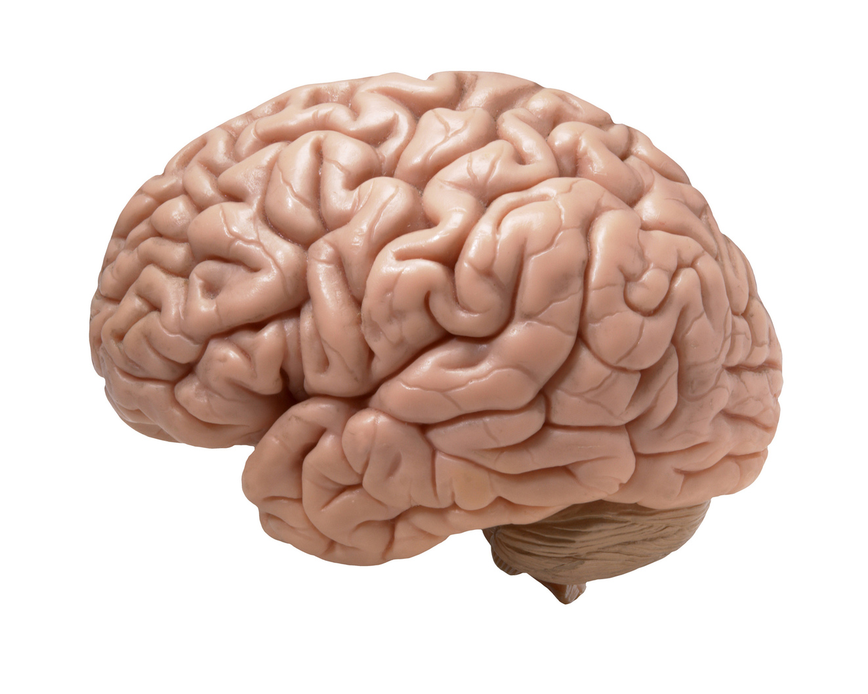
Variational updates
Functional anatomy
Perception
Action selection
Incentive salience
motor Cortex
striatum
occipital Cortex
prefrontal Cortex
Performance
hippocampus
FE
VTA/SN
80
KL
RL
60
DA
success rate (%)
40
20
0
0
0.2
0.4
0.6
0.8
1
Prior preference
Simulated behaviour

Slide 9
Functional anatomy
Predicted action
Dorsal prefrontal
Motor Cortex
Bayesian model average of next state
Policy
selection
Precision
Hippocampus
State estimation under plausible policies
Ventral prefrontal
Striatum & VTA/SN
Occipital Cortex
Evaluation of policies
Sensory input
Habit learning
Cerebellar or parietal cortex

Slide 10

Two-step maze task
Control states
Generative model
1 2 3 4
location
US
US
Hidden states
CS
location
context
Outcomes

Slide 11


Initial state and policy selection
2
US
Policy
4
US
6
8
10
5
10
15
20
25
30
Trial
Final outcome, performance and reaction times
4
2
Expected utility
CS
0
CS
-2
5
10
15
20
25
30
State estimation (ERPs)
0.2
Response
0
-0.2
200
400
600
800
1000
1200
1400
Precision (dopamine)
1
0.5
Precision
0
-0.5
200
400
600
800
1000
1200
1400
Learning (C and D)
2
4
Hidden state
6
8
5
10
15
20
25
30

Slide 12
Overview
Action and the path of least resistance
Generative models and active inference
From principles to process theories
Some empirical predictions
Artificial insight and aha moments

Slide 13
Variational updates
Functional anatomy
Functional anatomy
Perception
Action selection
Incentive salience
motor Cortex
motor Cortex
occipital Cortex
striatum
occipital Cortex
striatum
prefrontal Cortex
hippocampus
Performance
hippocampus
FE
VTA/SN
80
KL
VTA/SN
RL
60
DA
success rate (%)
40
20
0
0
0.2
0.4
0.6
0.8
1
Prior preference
Simulated behaviour

Slide 14

Variational updating
Functional anatomy
Functional anatomy
Perception
Action selection
Incentive salience
motor Cortex
motor Cortex
occipital Cortex
striatum
occipital Cortex
striatum
prefrontal Cortex
hippocampus
30
hippocampus
25
20
15
VTA/SN
10
VTA/SN
5
0.2
0.4
0.6
0.8
1
1.2
1.4
0.08
0.06
0.04
0.02
0
-0.02
0.25
0.5
0.75
1
1.25
1.5
0.2
0.15
0.1
0.05
0
-0.05
10
20
30
40
50
60
70
80
90
Simulated neuronal behaviour

Slide 15
US
Initial state and policy selection
2
Policy
4
6
8
10
5
10
15
20
25
30
CS
Trial
Final outcome, performance and reaction times
4
2
Expected utility
0
-2
5
10
15
20
25
30
Inference
(state estimation)
State estimation (ERPs)
0.2
Response
0
-0.2
200
400
600
800
1000
1200
1400
Precision (dopamine)
Policy selection
1
0.5
Precision
0
-0.5
200
400
600
800
1000
1200
1400
Learning (D)
Learning
2
4
Hidden state
6
8
5
10
15
20
25
30

Slide 16
Overview
Action and the path of least resistance
Generative models and active inference
From principles to process theories
Some empirical predictions
Artificial insight and aha moments

Slide 17

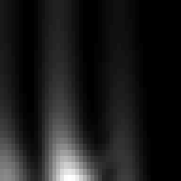
Unit responses
Firing rates
Evidence accumulation
Phase precession
Place cell activity
Cross frequency coupling
Perceptual categorisation
Oddball (MMN) responses
Violation (P300) responses
Dopamine transfer
Reversal learning
US
1
8
0.8
unit
0.6
Chosen option
Response
16
0.4
Unchosen
0.2
CS
24
0
0.25
0.5
0.75
0.25
0.5
0.75
time (seconds)
time (seconds)
Time-frequency response
Local field potentials
30
0.12
25
0.1
Phase precession
20
0.08
frequency
0.06
Response
15
0.04
10
0.02
5
0
0.25
0.5
0.75
-0.02
0.25
0.5
0.75
time (seconds)
time (seconds)
Phasic dopamine responses
0.5
0.4
US
0.3
0.2
change in precision
0.1
0
-0.1
-0.2
10
20
30
40
time (updates)
CS

Slide 18
Evidence accumulation
Phase precession
Place cell activity
Cross frequency coupling
Perceptual categorisation
Oddball (MMN) responses
Violation (P300) responses
Dopamine transfer
Reversal learning
Expectations about the past (memory)
Unit responses
2
Place field responses
1.5
8
1
unit
0.5
0
16
-0.5
1
2
3
-1
24
-1.5
0.25
0.5
0.75
-2
-2
-1
0
1
2
Expectations about the future (planning)
time (seconds)
Unit responses
Place field responses
2
1.5
8
1
unit
1
2
3
0.5
0
16
-0.5
-1
24
-1.5
0.25
0.5
0.75
-2
-2
-1
0
1
2
time (seconds)

Slide 19
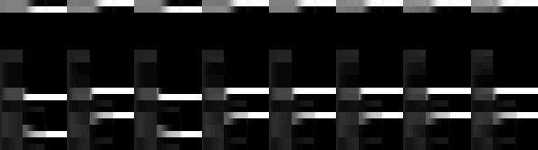

Unit responses
Evidence accumulation
Phase precession
Place cell activity
Cross frequency coupling
Perceptual categorisation
Oddball (MMN) responses
Violation (P300) responses
Dopamine transfer
Reversal learning
8
unit
16
24
0.25
0.5
0.75
1
1.25
1.5
1.75
2
2.25
2.5
2.75
3
3.25
3.5
3.75
4
4.25
4.5
4.75
5
5.25
5.5
5.75
6
time (seconds)
Time-frequency response
30
25
20
frequency
15
10
5
0.25
0.5
0.75
1
1.25
1.5
1.75
2
2.25
2.5
2.75
3
3.25
3.5
3.75
4
4.25
4.5
4.75
5
5.25
5.5
5.75
6
time (seconds)
Local field potentials
0.2
0.1
Response
0
-0.1
-0.2
0.25
0.5
0.75
1
1.25
1.5
1.75
2
2.25
2.5
2.75
3
3.25
3.5
3.75
4
4.25
4.5
4.75
5
5.25
5.5
5.75
6
time (seconds)
Phasic dopamine responses
0.4
0.2
change in precision
0
-0.2
50
100
150
200
250
300
350
time (updates)

Slide 20


Repetition suppression and DA transfer
Evidence accumulation
Phase precession
Place cell activity
Cross frequency coupling
Perceptual categorisation
Oddball (MMN) responses
Violation (P300) responses
Dopamine transfer
8
unit
16
24
0.25
0.5
0.75
1
1.25
1.5
time (seconds)
Time-frequency response
30
25
Difference waveform (MMN)
20
frequency
0.08
15
10
0.06
oddball
5
0.25
0.5
0.75
1
1.25
1.5
0.04
time (seconds)
Local field potentials
LFP
0.02
standard
0.05
0
Response
0
-0.02
MMN
-0.05
-0.04
-0.06
0.25
0.5
0.75
1
1.25
1.5
50
100
150
200
250
300
350
time (seconds)
Time (ms)
Phasic dopamine responses
0.5
US
oddball
standard
change in precision
0
-0.5
10
20
30
40
50
60
70
80
90
time (updates)
CS

Slide 21


Violation response (P300)
Evidence accumulation
Phase precession
Place cell activity
Cross frequency coupling
Perceptual categorisation
Oddball (MMN) responses
Violation (P300) responses
Dopamine transfer
Reversal learning
8
unit
16
24
0.25
0.5
0.75
1
1.25
1.5
US
time (seconds)
Time-frequency response
30
25
20
frequency
15
CS
10
5
0.25
0.5
0.75
1
1.25
1.5
time (seconds)
P300
US
Local field potentials
0.02
Response
0
-0.02
CS
0.25
0.5
0.75
1
1.25
1.5
time (seconds)
standard
violation
Phasic dopamine responses
0.4
0.2
change in precision
0
-0.2
10
20
30
40
50
60
70
80
90
time (updates)

Slide 22


Evidence accumulation
Phase precession
Place cell activity
Cross frequency coupling
Perceptual categorisation
Oddball (MMN) responses
Violation (P300) responses
Dopamine transfer
Reversal learning
Initial state and policy selection
2
Policy
4
6
8
10
10
20
30
40
50
60
context
Trial
Final outcome, performance and reaction times
4
2
Expected utility
0
-2
-4
10
20
30
40
50
60
State estimation (ERPs)
0.4
Reversal learning
0.2
Response
0
-0.2
500
1000
1500
2000
2500
3000
10
Precision (dopamine)
9
1.5
8
Precision
1
7
0.5
6
0
-0.5
Trials until reversal
500
1000
1500
2000
2500
3000
5
Learning (C and D)
4
3
2
2
4
Hidden state
1
6
0
8
10
20
30
40
50
60
2
6
10
14
18
22
26
30
Previous exposures

Slide 23
Overview
Action and the path of least resistance
Generative models and active inference
From principles to process theories
Some empirical predictions
Artificial insight and aha moments

Slide 24
A game (abstract rule)

Slide 25
Expected free energy and novelty
So far, we have considered expected free energy in terms of risk and ambiguity that reflect uncertainty about states. Exactly the same principles can be applied to model parameters leading to epistemic policies that resolve ignorance; i.e., search out novel contingencies.

Slide 26







Our game
Hidden states
rule
colour
where
centre
left
start
right
choice
Sample: left - center - right
Priors
r
g
b
r
Rule: left - center - right
Rule: left - center - right
g
b
r
what
g
b
r
g
b
r
g
b
r
g
b
Correct color
Correct color
where
centre
left
start
right
feedback
Outcomes

Slide 27

Rule learning
Initial state and policy selection
Policy
2
4
6
5
10
15
20
25
30
Final outcome and performance
5
Expected utility
0
-5
5
10
15
20
25
30
Free energy
34
nats
32
30
28
26
5
10
15
20
25
30
Confidence
nats
-6.5
-7
-7.5
5
10
15
trial
20
25
30

Slide 28




Epistemic learning
A
B
Hidden states - rule
Inferred and selected action - where
Hidden states - rule
Inferred and selected action - where
1
1
1
1
2
2
3
1
2
3
4
5
6
2
3
1
2
3
4
5
6
2
action
action
Hidden states - colour
3
Hidden states - colour
3
1
4
1
4
2
2
3
1
2
3
4
5
6
1
2
3
4
5
3
1
2
3
4
5
6
1
2
3
4
5
Hidden states - where
Inferred and selected action - decision
Hidden states - where
Inferred and selected action - decision
2
1
2
1
4
1
2
3
4
5
6
2
4
1
2
3
4
5
6
2
action
action
Hidden states - decision
3
Hidden states - decision
3
2
4
2
4
4
1
2
3
4
5
6
1
2
3
4
5
4
1
2
3
4
5
6
1
2
3
4
5
time
time
time
time

Slide 29


The neural correlates of insight
A
B
Unit responses
Firing rates
Unit responses
Firing rates
1
1
3
past
0.8
3
0.8
6
0.6
6
0.6
unit
9
Response
unit
9
Response
0.4
12
0.4
12
0.2
0.2
15
future
15
18
0
18
0
0.25
0.5
0.75
1
1.25
1.5
0.25
0.5
0.75
1
1.25
1.5
0.25
0.5
0.75
1
1.25
1.5
0.25
0.5
0.75
1
1.25
1.5
time (seconds)
time (seconds)
time (seconds)
time (seconds)
trial 1
Local field potentials
trial 31
0.2
Local field potentials
0.2
0.15
0.15
0.1
0.1
Response
0.05
0.05
0
0
-0.05
-0.05
-0.1
0.25
0.5
0.75
1
1.25
1.5
-0.1
0.25
0.5
0.75
1
1.25
1.5
time (seconds)
time (seconds)

Slide 30
Bayesian model reduction and insight
So far, we have considered optimising expectations about states and parameters ; however, we can also optimise the model itself with respect to free energy. This is known as Bayesian model comparison or reduction that can proceed in the absence of new information. For example, the awake brain learns causal associations in synaptic connections, while during sleep redundant connections are removed (Tononi and Cirelli, 2006) to minimise complexity (Hobson and Friston, 2012) – literally to ‘clear one's mind’. Here, plausible models are implicitly defined under the prior belief that there is a rule (i.e. a symmetry or invariance of contingencies in the likelihood mapping)
By applying Bayes rules to the full and reduced models it is straightforward to show that the change in free energy can be expressed in terms of posterior concentration parameters a, prior concentration parameters a and the prior concentration parameters that define a reduced or simpler model a’:
This equation returns the difference in free energy we would have observed, had we started observing outcomes with simpler prior beliefs.

Slide 31


The emergence of insight
Sample: left - center - right
Priors
r
g
b
r
Rule: left - center - right
Rule: left - center - right
g
b
r
g
b
r
g
b
r
g
b
r
g
b
Correct color
Correct color
Posteriors
Reduced
Rule: left - center - right
Rule: left - center - right
Correct color
Correct color

Slide 32
Sleep
A
B
Free energy (with sleep)
34
32
nats
30
28
26
5
10
15
trial
20
25
30
Confidence (with sleep)
-6.5
nats
-7
-7.5
5
10
15
trial
20
25
30
C
Free energy (instruction)
Confidence (instruction)
34
32
-6.5
nats
30
-7
28
-7.5
26
2
4
6
8
10
12
14
16
2
4
6
8
10
12
14
16
trial
trial

Slide 33
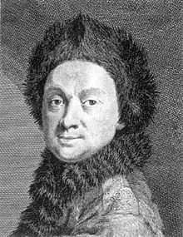
“There are certain general principles or theorems in mechanics, such as Lagrange's equations, Hamilton's principle, the principle of least work, and Gauss' principle of least constraint, which afford general solutions of certain types of problems. Such general principles have therefore the advantage over ordinary methods in that once having found the general solution, any particular problem may be solved by merely routine processes.”
Stephen Elmer Slocum, The Theory and Practice of Mechanics (1913) pp. 309-310.
Pierre Louis Maupertuis (1698–1759)
William Rowan Hamilton (1805–1865)

Slide 34
Thank you
And thanks to collaborators:
Rick Adams
Ryszard Auksztulewicz
Andre Bastos
Sven Bestmann
Harriet Brown
Jean Daunizeau
Mark Edwards
Chris Frith
Thomas FitzGerald
Xiaosi Gu
Stefan Kiebel
James Kilner
Christoph Mathys
Jérémie Mattout
Rosalyn Moran
Dimitri Ognibene
Sasha Ondobaka
Will Penny
Giovanni Pezzulo
Lisa Quattrocki Knight
Francesco Rigoli
Klaas Stephan
Philipp Schwartenbeck
And colleagues:
Micah Allen
Felix Blankenburg
Andy Clark
Peter Dayan
Ray Dolan
Allan Hobson
Paul Fletcher
Pascal Fries
Geoffrey Hinton
James Hopkins
Jakob Hohwy
Mateus Joffily
Henry Kennedy
Simon McGregor
Read Montague
Tobias Nolte
Anil Seth
Mark Solms
Paul Verschure
And many others

