Slide 1


Tutorial
MLDS and MLCM: two scaling methods to study stimulus appearance
Guillermo Aguilar
Technische Universität Berlin
ECVP 2025 Mainz
24th August 2025

Slide 2
Program
General introduction to scaling methods
Maximum Likelihood Difference Scaling (MLDS)
  Theory
  Exercise: acquire your own data
  Live coding: analyzing data in R (MLDS package)
  Exercise: analyze your data
Maximum Likelihood Conjoint Measurement (MLCM)
  Theory
  Live coding: analyzing data in R (MLCM package)
  Exercise: acquire and analyze your own data
To keep in mind: assumptions, goodness of fit evaluation, practical tips, etc.

Slide 3
Intro: psychophysical methods
Kingdom classification

Slide 4
Intro: scaling methods
Kingdom classification
Goal: mapping s to psi(s).
Give example

Slide 5
MLDS and MLCM
Table comparison
Stimulus dimensions
Task

Slide 6
MLDS: experimental design
Task: method of triads or quadruples.
Stimuli varying along a single stimulus dimension
Triads
Quadruples
Which pair is more different?

Slide 7
MLDS: experimental design
Triads are always ascending
or descending
Number of unique triads
for N stimuli
Repeat in block or random sampling

Slide 8
Maximum Likelihood Difference Scaling (MLDS)
Published example: Contrast perception

Slide 9
Exercise: acquire your own data
Go to <URL>
and run the MLDS experiment with the method of triads
Image here

Slide 10
MLDS observer model and estimation
Observer model visualization and formulas
GLM and estimation routine

Slide 11
Confidence intervals
Logic of confidence interval calculation

Slide 12
Live coding: analyzing MLDS data in R

Slide 13
Exercise: analyze your own data

Slide 14
MLCM: experimental design
Stimuli vary in two or more dimensions
Paired comparisons
Dim 2 (e.g. Michelson contrast)
...
Which stimulus is / has more
<insert here perceptual dimension> ?
Dim 1
(e.g. spatial frequency)
...
e.g. :
Brighter, higher perceived contrast, glossier, etc.
...
...
...

Slide 15
MLCM: experimental design
Stimuli vary in two or more dimensions
Dim 2 (e.g. Michelson contrast)
...
Number of unique stimuli N = (n ⋅ m)
Present all possible paired comparisons
Dim 1
(e.g. spatial frequency)
...
...
...
Repeat in block or random sampling
...

Slide 16

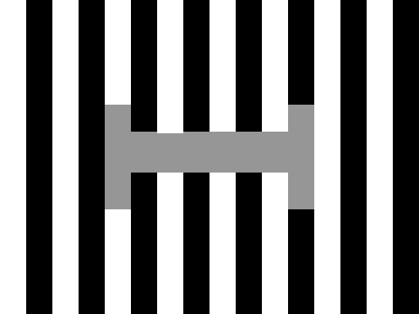
Maximum Likelihood Conjoint Measurement (MLCM)
Published example studying White’s illusion
White (1979)

Slide 17
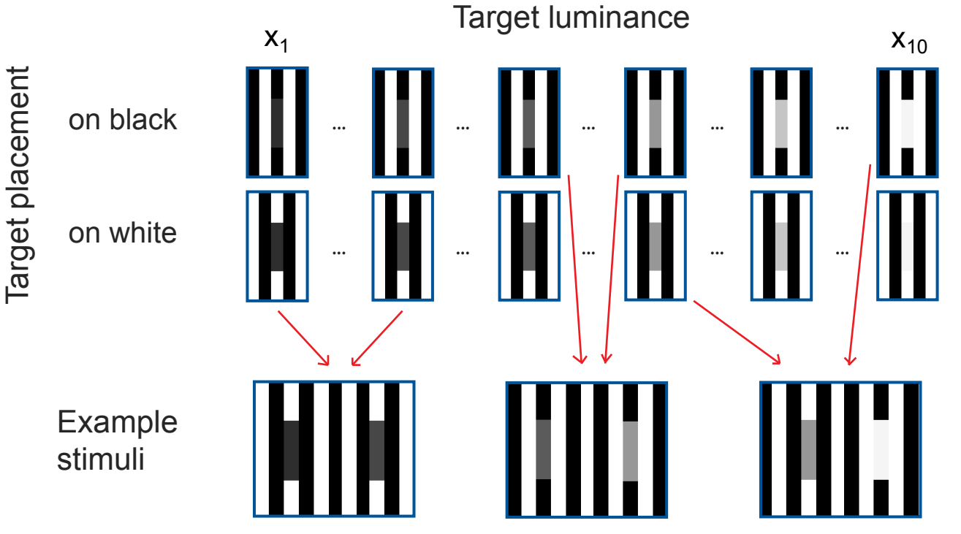
Maximum Likelihood Conjoint Measurement (MLCM)
Published example studying White’s illusion
Vincent, Maertens & Aguilar (2024)

Slide 18
MLCM observer models
Three models:
Independent
Additive
Full (or also called “saturated”)
Model comparison
(GLM and estimation routine)

Slide 19
Live coding: analyzing MLCM data in R

Slide 20
Exercise: acquire and analyze your own MLCM data

Slide 21
To keep in mind - Model assumptions
Assumptions
- axiomatic (order), able to judge differences
- independence (no learning)
-

Slide 22
Testing model assumptions: goodness of fit evaluation
Logic of GoF evaluation

Slide 23
To keep in mind – Practical considerations
Choice of stimuli: one should be able to order the stimuli (perceptually). That means spacing should be supra-threshold
Repeats: fixed repeat number vs random sampling.
Results from Maloney & Yang 2003 on random sampling. Our results

