Slide 1

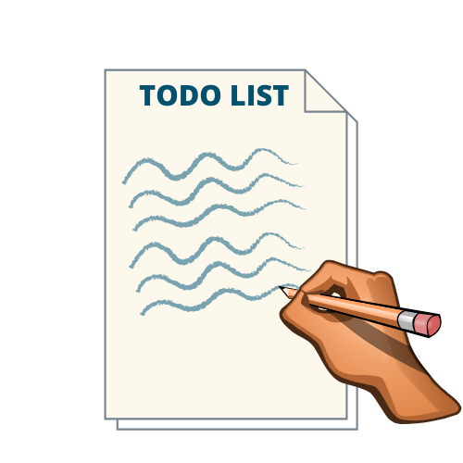

MAD 6123
(Mobile Backend Development)
FINAL PROJECT
Devesh Verma : c0758340
Kapil Padaliya : c0761312

Slide 2


ToDo List app is built using Node.js, Express.js and MongoDB.

Slide 3
PRODUCT DEVELOPMENT ROADMAP
TO-DO List Node.js/Express.js/MongoDB
Study Analysis/Designing UI (View)
Testing/Deploying
Step1
Step3
Step2
Coding (Controller)/Integrating (Model) MongoDB Backend

Slide 4


Usage/User Story
How it works:
1
User launch/open the Web App, It loads the tasks from DB if it exists
2
User enter the task in the input box and click > ADD
3
Task saved to BACKEND (MONGODB), show the added task on screen
4
User click DELETE, to delete the task and click EDIT to edit the task
5
Close the app

Slide 5


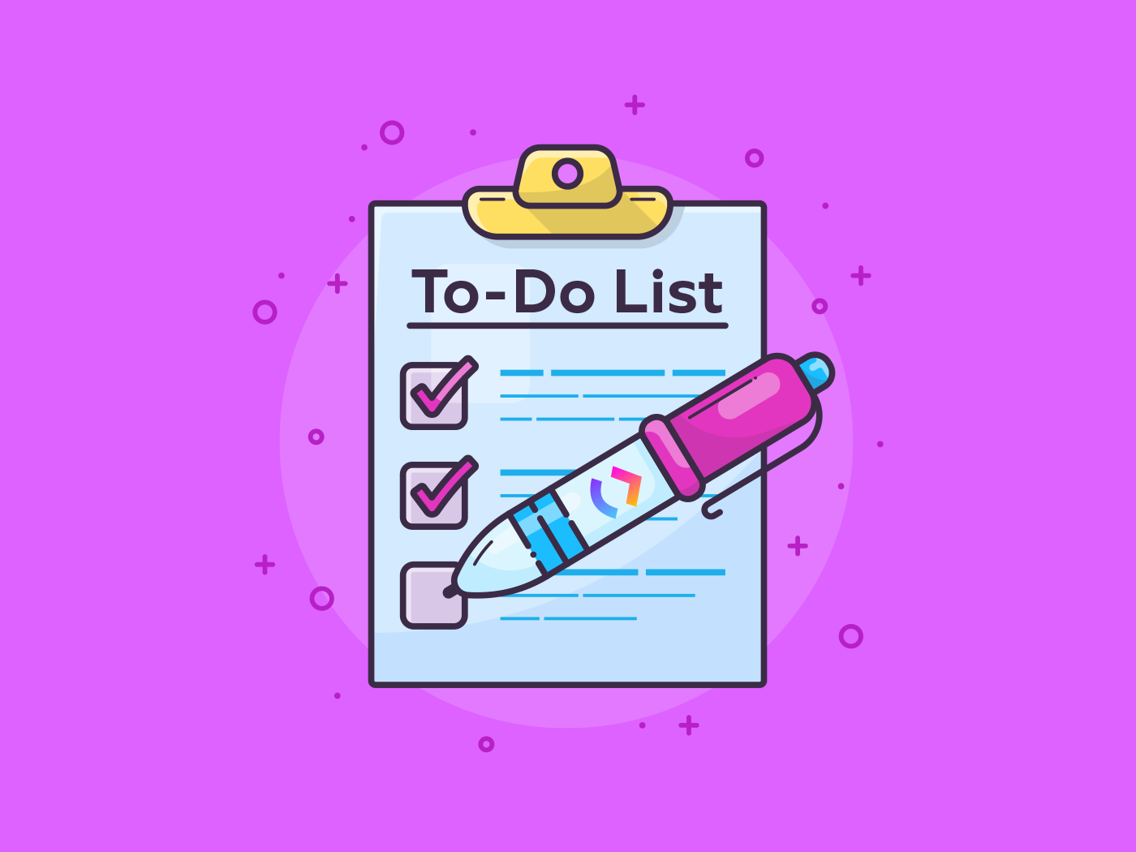




Features
Some simple features outlined:
1
Save Tasks
2
Read Tasks
3
Update Tasks
4
Delete Tasks
Best Feature: FREE!

Slide 6




To-Do List
To-Do List is extremely easy to use web app built using Node.js and Express.js, it allows to Read/Save/Update/Delete the tasks using MongoDB as the backend database to store the data.
It has simple and very intuitive User Interface.

Slide 7
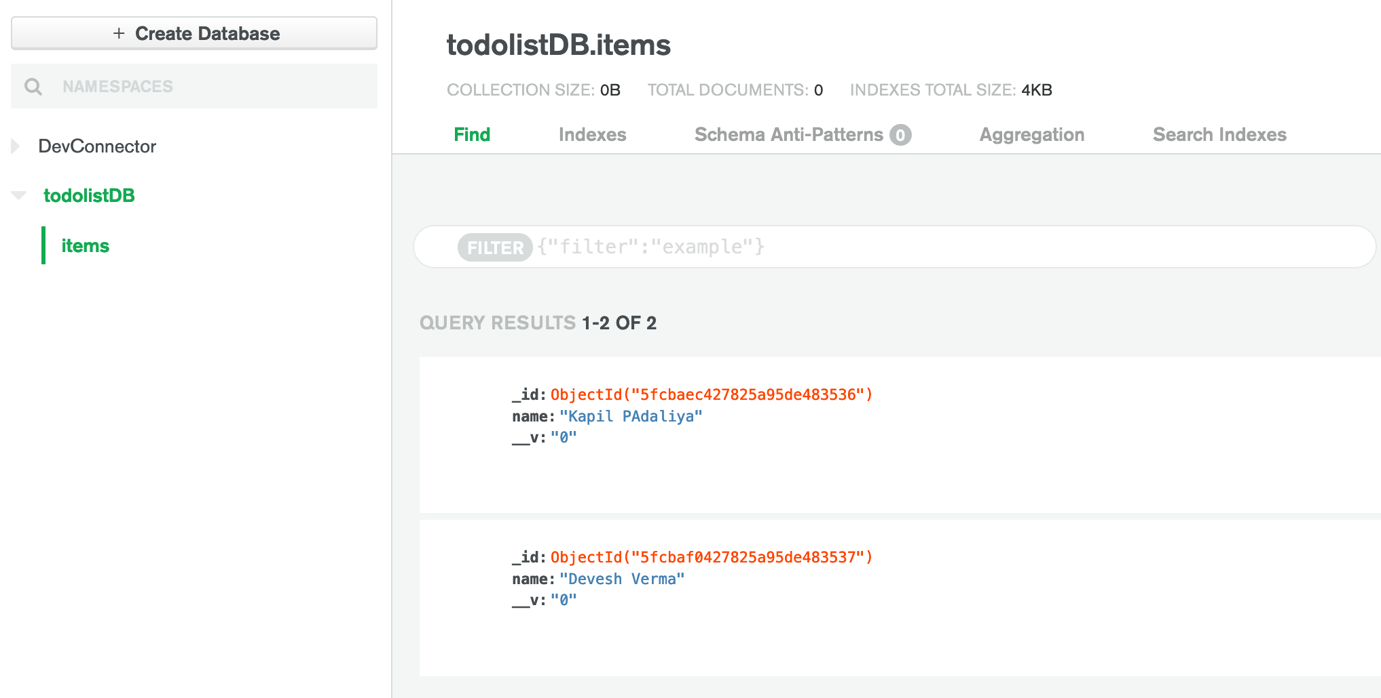
Database Backend (MongoDB)

Slide 8
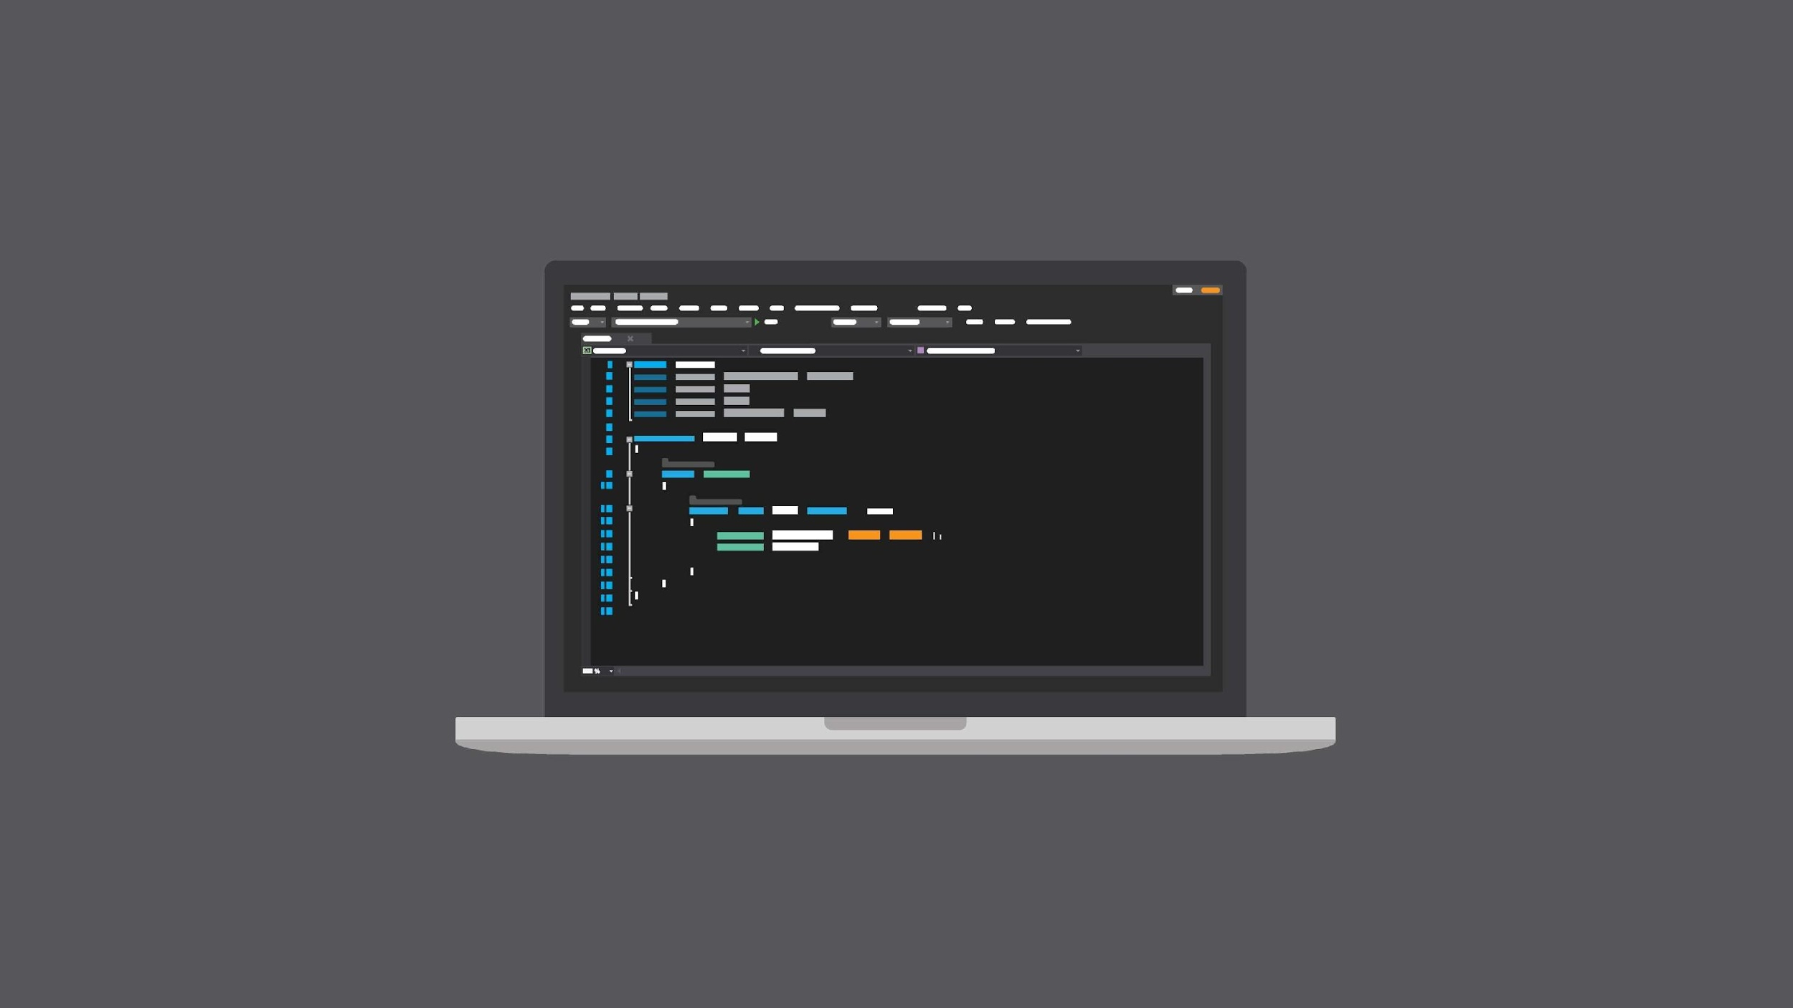

SOURCE CODE

Slide 9
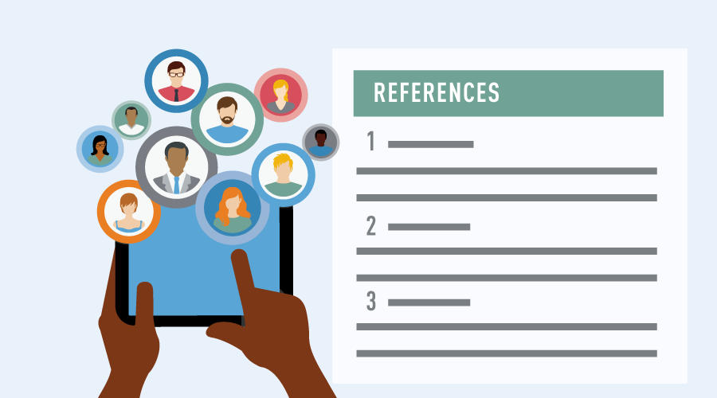
REFERENCES
https://geekflare.com/getting-started-mongodb/
https://www.youtube.com/watch?v=h6izHR1d-HM
https://www.youtube.com/watch?v=meJf53tvsWw
https://zellwk.com/blog/crud-express-mongodb/
http://dreamerslab.com/blog/en/write-a-todo-list-with-express-and-mongodb

Slide 10
THANK YOU

