Slide 1


NASA SPACE APPS CHALLENGE 2026
MITOCHONDRIA
Astronaut Health Intelligence Platform
An open-source research prototype that keeps the crew health loop working when Earth is far away — offline-first, explainable and human-supervised.
OPEN SOURCE
OFFLINE FIRST
HUMAN OVERSIGHT
https://mitochondria.edocinfo.com
Research prototype · synthetic data · not NASA-endorsed · not clinically validated
Final Competition Edition · 14 November 2026 · Background: illustrative artwork from the project site
Notes:
Welcome to MITOCHONDRIA, our astronaut health intelligence platform for the NASA Space Apps Challenge 2026. It is an open-source research prototype that keeps the crew health loop working when Earth is far away: offline first, explainable, and always supervised by people. Everything we show uses synthetic data. MITOCHONDRIA is not clinically validated and is not endorsed by NASA.

Slide 2





Spaceflight stresses the body on five interacting fronts
THE ASTRONAUT HEALTH MONITORING CHALLENGE
Space radiation
Isolation & confinement
Distance from Earth
Altered gravity
Closed environment
Dose and dose rate kept as separate quantities
Fatigue, sleepiness, stress and workload as private context
Delayed or absent ground support
Bone, muscle and cardiovascular adaptation
CO₂, O₂, pressure, temperature, noise, light
The challenge: gather health indicators so crews can evaluate and act — far from Earth.
Source: NASA Human Research Program — hazards of human spaceflight; NASA Space Apps Challenge 2026
Notes:
Spaceflight stresses the body on five interacting fronts: space radiation, isolation and confinement, distance from Earth, altered gravity, and a closed, hostile environment. Together they change bone, the heart and circulation, immunity, sleep and the mind. A useful monitoring tool must see these systems together, not one at a time.

Slide 3

Distance turns health monitoring into an autonomy problem
WHY THE PROBLEM MATTERS
Mission constraints → design
Delayed / absent ground link
Distance → local monitoring and protocol access
Intermittent links → store-and-forward with idempotency
Many devices → adapter contract + canonical model
Artifacts → quality states, no silent imputation
Adaptation → personal, phase-aware baselines
High stakes → explainability, audit, human authority
Real-time ground medicine cannot be assumed
≈ 98 ms median, 0 backend calls
Local action → visible update (validation ledger, self-check path)
Encrypt first, sync later
AES-GCM local store; authorised synchronisation
Source: Product thesis; data/validation (latency criterion)
Notes:
As missions move farther from Earth, real-time medical support can no longer be assumed. Communication delays and blackouts mean the crew must capture, review and understand health evidence locally. That turns health monitoring into an autonomy problem: the system has to keep working, safely and transparently, without a ground link.

Slide 4
Today’s health evidence is fragmented — and easy to over-interpret
CURRENT FRAGMENTATION AND LIMITATIONS
Source | Typical problem | MITOCHONDRIA response
Wearables / phone sensors | Vendor algorithms, artifacts, missing samples | Quality levels; freshness; transport ≠ sample ≠ stored
Laboratory reports | Unstructured PDFs; units; reference ranges | Exact name + unit matching; ranges never imported
Questionnaires | Treated as diagnoses | Labelled self-report; not clinical instruments
Habitat telemetry | Implied causality | Shared timeline, explicitly non-causal
Research datasets | Mistaken for crew data | Research-only labels; no crew binding
Source: docs/CANONICAL_HEALTH_DATA.md; src/domain/biomarkers
Notes:
Today, health evidence is fragmented. Wearables, laboratory reports, questionnaires and habitat sensors arrive in different formats, units and quality. It is easy to over-interpret a single number. MITOCHONDRIA keeps every value with its source, unit, time and quality, and labels research-only or synthetic evidence so that it is never mistaken for a clinical finding.

Slide 5
One loop: Monitor → Personalize → Correlate → Detect → Explain → Act → Learn
THE MITOCHONDRIA SOLUTION
01
02
03
04
05
06
07
Monitor
Governed adapters
Personalize
Phase-aware baselines
Correlate
One timeline, non-causal
Detect
Reviewed patterns only
Explain
Evidence, gaps, uncertainty
Act
Protocol categories
Learn
Provenance + audit
OFFLINE-FIRST OPERATION
MISSION-SCOPED GOVERNANCE
EXPLAINABLE, RESEARCH-ONLY SCIENCE
Source: src/components/app-shell.tsx (health loop); docs/HEALTH_INTELLIGENCE_V1.md
Notes:
Our answer is one continuous loop: monitor, personalise, correlate, detect, explain, act and learn. Signals are captured through governed adapters, compared with each astronaut's own baseline, placed on one mission timeline, and explained with their evidence and uncertainty. Actions remain human decisions, guided by approved protocols.

Slide 6





What the platform gives each stakeholder
PLATFORM VALUE PROPOSITION
Crew Self
Mission Operator
Ground Medical
Researcher
Integrators
Local, encrypted, offline capture
Own evidence; self-assessment
Synthetic lab-report review
Missions, crew, invites
Settings + redacted audit log
Synthetic demo launchpad
Mission snapshot
Independent synthetic review queue
Research-only decisions
Aggregate-only export
54-proposal Research Explorer
Adapter SDK, canonical model
Apache-2.0, self-host, CI
Source: Master Manual §09.5 (role-based access); research privacy workspace
Notes:
Each role gets what it needs. Crew Self members see their own data, even offline. Mission Operators run missions, crews and invitations, with every action audited. Ground Medical reviewers inspect synthetic batches read-only. Researchers receive only privacy-protected aggregates. And integrators can add new devices through an open adapter contract.

Slide 7

Science leads — and every scientific claim carries its review state
SCIENTIFIC FOUNDATION
Source | Size | Platform use
Biomarker Matrix v1.1 | 70 metrics | Canonical catalogue
Bone Health Handbook v7 (GR → EN) | 63 variables | Reference + bone entry
Cardiovascular Handbook (GR → EN) | 96 + 8 examples | Reference + exact matching
Nikolas immune + behavioural | 117 + 99 records | Research-only intake
Provisional semantic proposals | 54 | Research Explorer
Boundaries
No diagnosis or risk score
No causation from association
No clinical thresholds
Baseline deviation ≠ diagnosis
Questionnaires ≠ clinical instruments
Synthetic ≠ astronaut evidence
Source: src/domain/catalog/reviewed-mvp-v1.1.ts; data/scientific/*
Notes:
Science leads the software. The canonical catalogue is derived from the team's Astronaut Biomarker Matrix, version 1.1, and every scientific source carries its review state. The bone and cardiovascular handbooks are displayed with their original Greek text preserved. Nikolas' immune and behavioural research is integrated as research-only proposals. Nothing scientific is activated without independent review.

Slide 8



Four integrated health domains
IMMUNE · BONE · CARDIOVASCULAR · BEHAVIOURAL
Bone
Cardiovascular
Immune & microbiome
Behavioral, sleep & cognitive
Entry, CSV, document extraction
Local evidence summary
Handbook v7: 63 variables (EN/GR)
Mission-scoped HR/HRV/BP context
Handbook: 96 measurements + 8 examples
No arrhythmia inference from PPG
Evidence summary + missing signals
117 handbook records (research)
Microbiome–immune: research only
Readiness check-in context
99 handbook records (research)
No mental-health diagnosis
Source: src/components/health-domain-workspace.tsx, bone-health-entry.tsx; data/scientific/nikolas-*-intake.v1.json
Notes:
Evidence is organised into the four domains highlighted by the challenge: bone; cardiovascular; immune and microbiome; and behavioural, sleep and cognitive health. Each domain has reference content, governed measurement entry and a shared evidence panel. All four share one mission timeline: a common research context, never a diagnosis.

Slide 9

Explainability and personal baselines: compare each astronaut with themselves
SCIENTIFIC EXPLAINABILITY
Preflight
Launch transition
Early adaptation
Stable mission
Return / recovery
Layer | Object | Rule
Personal baseline | PersonalBaselineComparison | Deviation + uncertainty, never “abnormal”
Clinical reference | ClinicalReferenceInterval | Assay interval; context only
Mission limit | MissionOperationalLimit | Programme rule with authority
Every finding explains
What changed and why
Missing evidence, confounders
Confidence breakdown
Uncertainty + source IDs
Source: src/domain/baseline; docs/HEALTH_INTELLIGENCE_V1.md
Notes:
Each astronaut is compared with themselves. The personal baseline engine keeps the pre-flight reference fixed, so adaptation in flight cannot silently normalise a deterioration. A single measurement is never a baseline. Personal baselines, clinical reference intervals and mission limits remain three separate layers, and a missing baseline is shown as missing.

Slide 10

Biomarkers are matched exactly — relationships are shown, never inferred
BIOMARKERS AND CROSS-DOMAIN RELATIONSHIPS
Relationship | Evidence | Platform behaviour
Sleep ↔ sleepiness ↔ vigilance | supported | Research display; DATA QUALITY prompts
Workload ↔ sleep ↔ HR/HRV | supported / limited | No stress label
Bone unloading ↔ urine calcium | supported | No renal-stone score
Bone ↔ vascular (CTX, PWV…) | exploratory | Display only
Microbiome ↔ immune | research only | Never operational
CO₂ ↔ cognition | conflicting | No causal rule
Exact matching
159 registry entries
96 metric/unit pairs accepted
63 bone: advisory hints
Ranges never imported
No fuzzy or filename routing
Source: data/scientific (biomarker source registry); src/domain/health-intelligence/patterns.ts
Notes:
Biomarkers are matched exactly, by catalogue name and original unit. Nothing is guessed or converted. Relationships between domains, such as sleep, fatigue and vigilance, are shown with their evidence level, and research-only links, such as microbiome and immunity, never become operational rules.

Slide 11
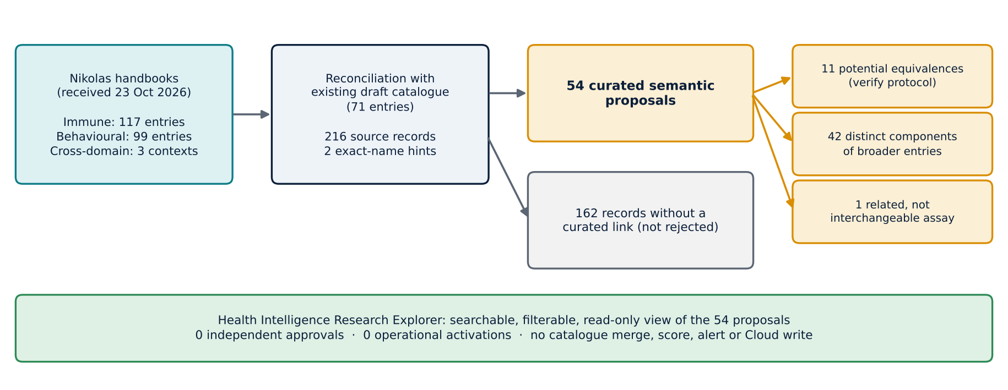
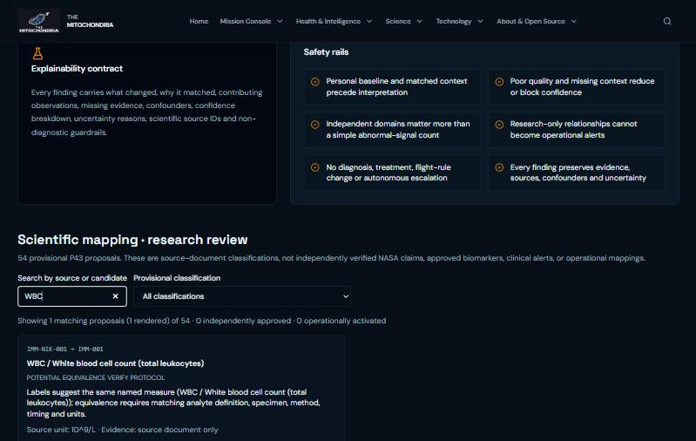
Nikolas’ biological research, integrated as a searchable Research Explorer
RESEARCH-ONLY SCIENTIFIC INTELLIGENCE
216
54
11 · 42 · 1
0 · 0
Research Explorer — search “WBC” (live site)
source records
provisional proposals
equivalence · component · related
approvals · activations
Source: data/scientific/nikolas-*-intake.v1.json, p43-semantic-decision-proposals.v1.json; src/components/scientific-research-candidates.tsx
Notes:
Nikolas' immune and behavioural handbooks entered the platform as 216 source records. Reconciled with the catalogue, they became 54 provisional proposals, each with its rationale, searchable in the Research Explorer. The owner reports a verbal scientific review, but no signed per-entry record exists yet, so all 54 remain unapproved and inactive.

Slide 12



Every claim traces back to a file, a hash or a ledger
SCIENTIFIC PROVENANCE
Scientific sources
Evidence records
Governed ledgers
Greek handbooks byte-identical (SHA-256 tests)
English layers joined by ID
Source evidence labels attributed, not endorsed
Source SHA-256 + excerpt
Submitter / reviewer snapshots
Decision receipt + one event
Audit rows without values
Validation and usability criteria
Scientific review workbook (216 rows)
Evidence freeze + submission handoff
12 automated scientific verifiers
Source: src/domain/scientific-localization; data/scientific/*; data/submission/*; scripts/verify-*.mjs
Notes:
Every claim traces back to a file, a hash or a ledger. Scientific sources keep byte-identical originals and recorded fingerprints. Evidence records carry submitter and reviewer snapshots. Validation, scientific review and submission ledgers are versioned in the repository, and automated verifiers check that they stay consistent.

Slide 13
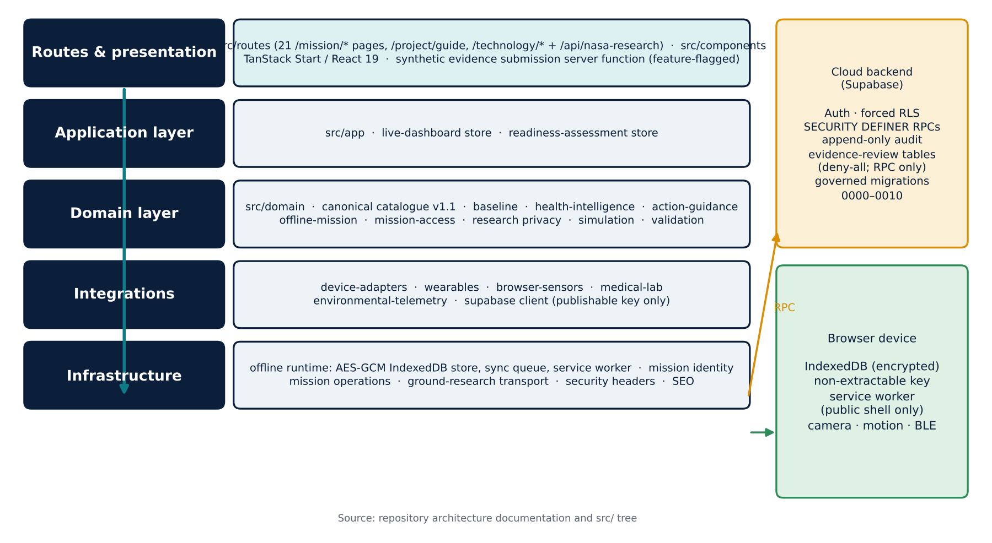
Architecture: the cloud is not in the sensor-to-astronaut path
SYSTEM ARCHITECTURE AND OPEN-SOURCE IMPLEMENTATION
Open-source implementation
Apache-2.0 on GitHub
TanStack Start · React 19 · Supabase
Forced RLS; RPC-only writes
Governed migrations 0000–0010
Self-hosting with Docker
Source: github.com/computech-gr/astro-vitality-core; docs/ARCHITECTURE.md; drizzle/migrations
Notes:
The architecture keeps the cloud out of the sensor-to-astronaut path. In the browser sit the adapters, the canonical model and an encrypted local store. The cloud database, with forced row-level security and governed functions, is reached only through authorised synchronisation. The whole system is open source under the Apache 2.0 licence.

Slide 14
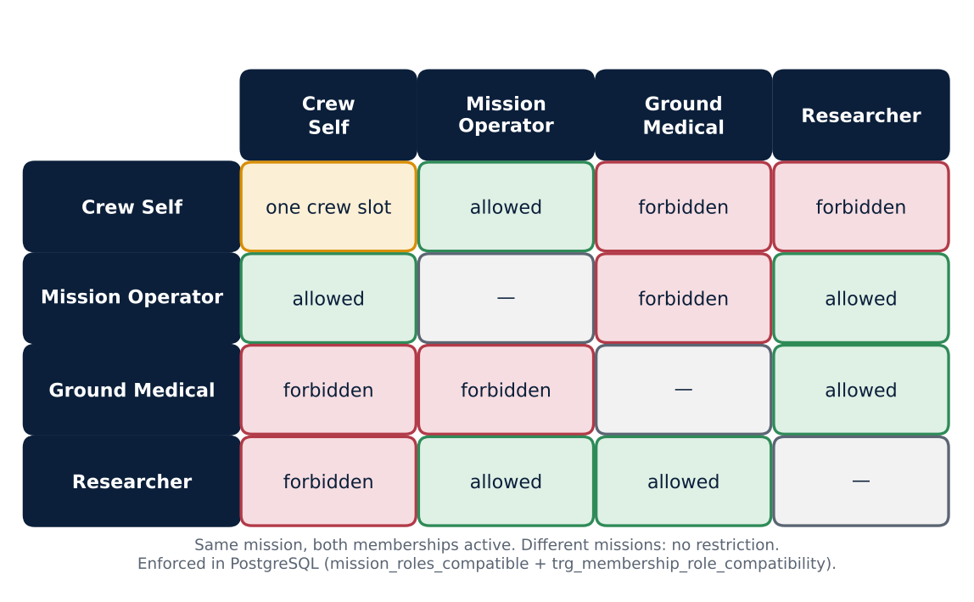

Four mission-scoped roles, enforced in the database
ROLES, IDENTITY AND SEPARATION OF DUTIES
Identity and rules
Generic sign-in error (no enumeration)
Self-service password change
One-time, hashed, expiring invites
GM invite: bind + independent approval
Reviewer ≠ submitter; instant revocation
Source: src/infrastructure/mission-identity.ts; supabase/migrations (multi-role hardening)
Notes:
Four mission-scoped roles are enforced inside the database: Crew Self, Mission Operator, Ground Medical and Researcher. Separation of duties is explicit. A reviewer can never decide their own submission, there is no platform super-user, and a deactivated membership is refused on every new request.

Slide 15
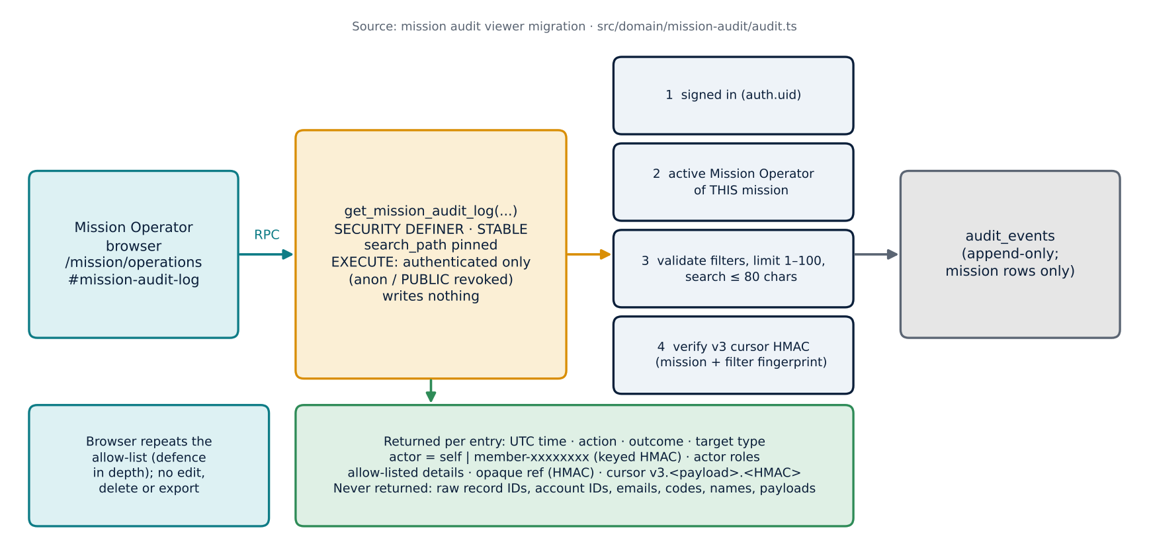
Operators administer missions — and every action is audited
MISSION OPERATIONS
Recorded in production
Mission Settings (view)
Mission Audit Log
Crew, invitations, memberships
Every mutation audited
Source: src/components/mission-operations.tsx, mission-settings-panel.tsx, mission-audit-log.tsx
Notes:
Mission Operators create missions, register crews, issue one-time invitations and manage mission settings. Every action is written to an append-only audit log that operators can review, with sensitive fields redacted. New health records are accepted only while a mission is open.

Slide 16
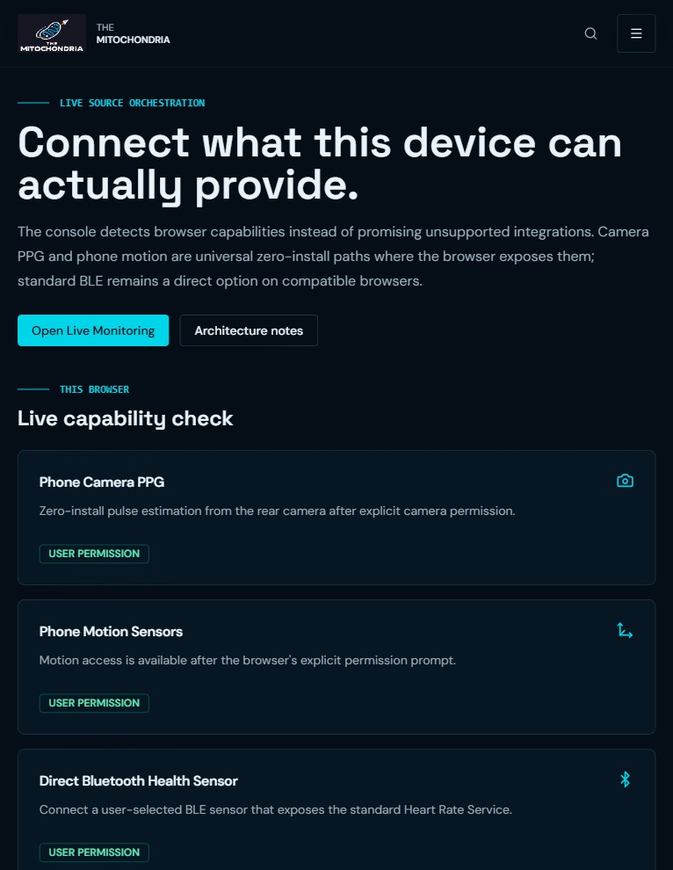
Wearables and phone sensors with honest states — nothing is fabricated
DEVICES: CAMERA PPG, MOTION AND BLUETOOTH
Source | Evidence | Notes
Camera PPG | Physical phone | Pulse estimate · not ECG
Phone motion | Physical phone | Clear error if no events
Web Bluetooth HR | Implemented | Standard Heart Rate Service
Health Connect / HealthKit | Adapter contract | Needs native host
Habitat & dosimetry | Adapter contract | Synthetic tests
Device Integration Center — live site
Source: src/integrations/browser-sensors; real-device evidence record (data/submission)
Notes:
Device integration is honest about what each browser can provide. The phone camera gives a pulse estimate, motion sensors give movement context, and Bluetooth heart-rate sensors work where the browser supports them. Unconnected sources stay disconnected; the platform never fabricates a reading. Native health platforms are defined as adapter contracts.

Slide 17
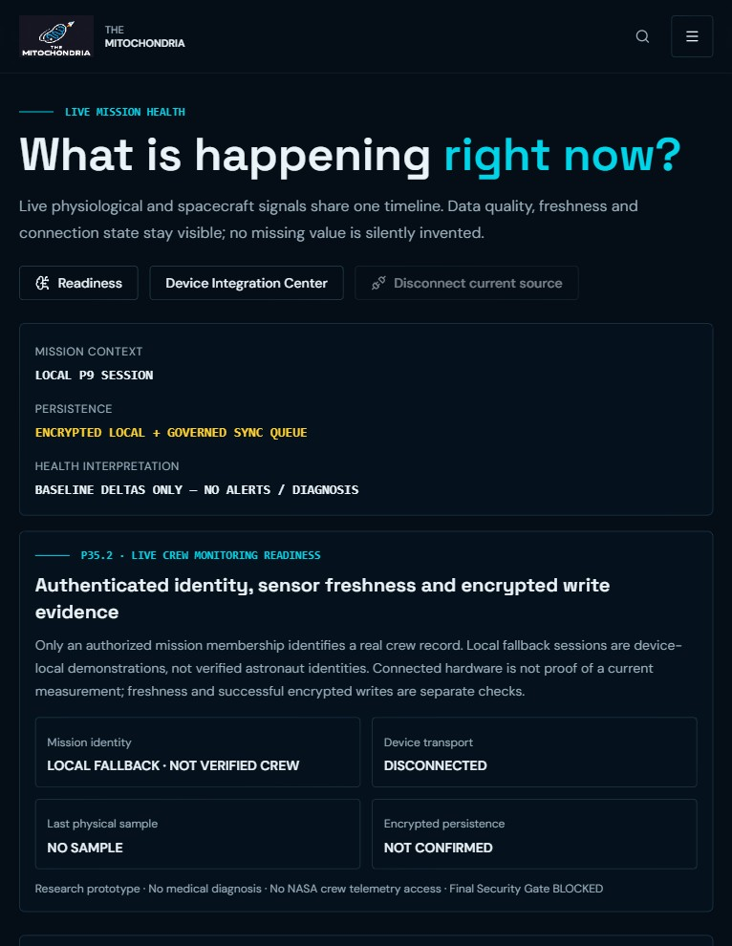
Live monitoring separates identity, transport, sample and storage
LIVE PHYSIOLOGICAL AND ENVIRONMENTAL MONITORING
Mission identity
Device transport
Freshness
AUTHENTICATED MEMBERSHIP · LOCAL FALLBACK
Connected ≠ sample received
LIVE · STALE · WAITING · DISCONNECTED
90 s physio / 180 s env
Technical only
Last physical sample
Encrypted persistence
Timestamp or NO SAMPLE
Confirmed count · WRITE FAILED
Live Monitoring — live site
Source: src/components/live-dashboard.tsx; src/app/live-dashboard/store.ts
Notes:
Live monitoring separates four questions: who is signed in, whether a device is connected, when the last physical sample arrived, and whether it was stored encrypted. Each card shows freshness and quality. If something is missing, the screen says so, instead of showing a reassuring number.

Slide 18
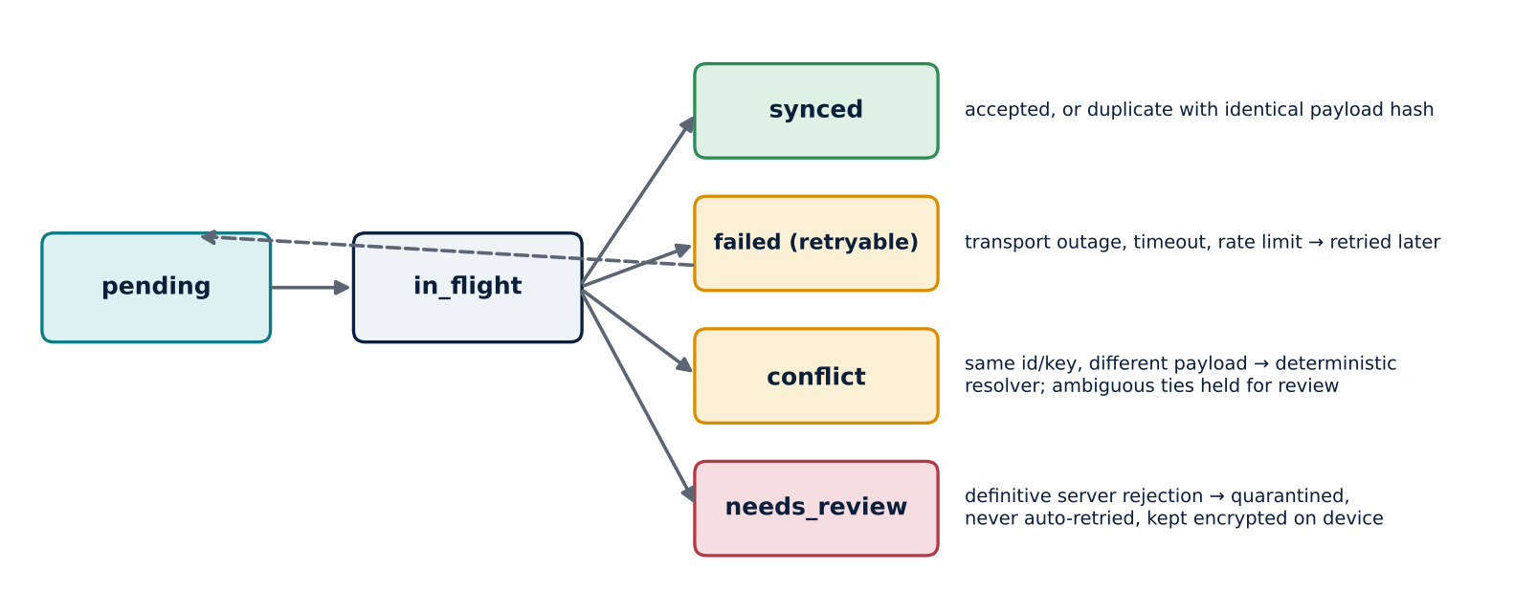

Offline first: encrypt locally, synchronise with authority
OFFLINE OPERATIONS AND GOVERNED SYNC
Guarantees
AES-GCM, non-extractable key
Idempotency + payload hash
No anonymous cloud writes
Service worker: public shell only
No data loss: records stay encrypted on the device until an authorised sync succeeds
Source: src/infrastructure/offline/*; docs/OFFLINE_MISSION_MODE.md
Notes:
Offline first means every record is encrypted on the device before anything else happens. A store-and-forward queue synchronises later, only for a signed-in, authorised member, with idempotent writes and explicit conflict states. Nothing is silently overwritten while the crew is out of contact.

Slide 19
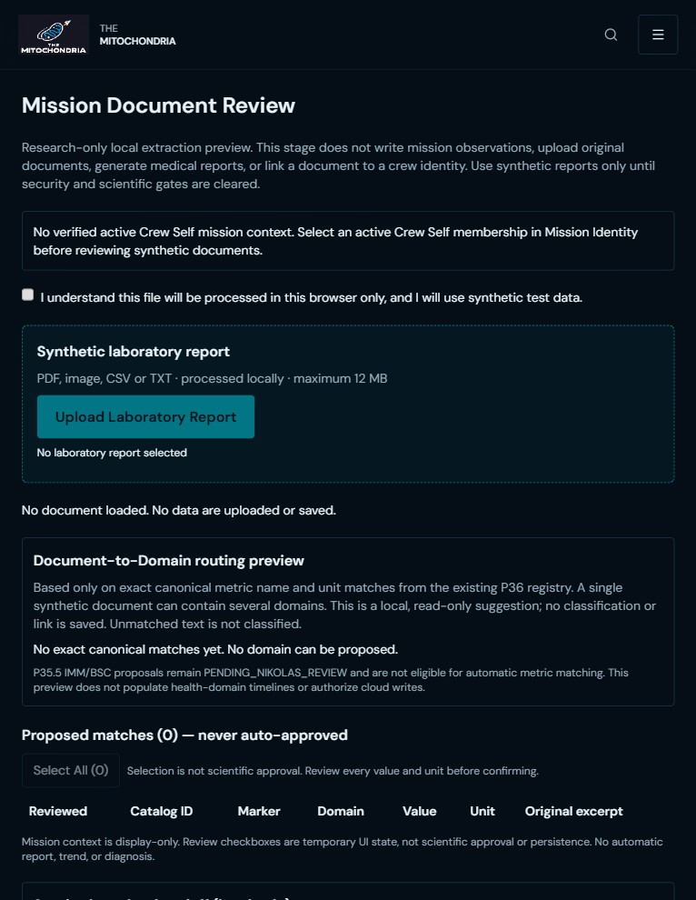

Laboratory evidence: synthetic reports reviewed in the browser
CREW SELF · MISSION DOCUMENTS
1 Crew Self + consent
2 Local extraction
3 Exact name + unit
4 Human selection
5 Date + confirmation
6 Preview or submit
Accepted input
Never
PDF, image, CSV, TXT ≤ 12 MB · synthetic only
Upload of the original · unit guessing
Mission Documents — live site
Source: src/components/mission-document-review-workbench.tsx; src/domain/biomarkers
Notes:
Laboratory evidence is reviewed in the browser. In Mission Documents and the Unified Data Intake, synthetic reports are parsed on the device, and only exact catalogue matches become candidates. A person checks each value, unit and date before anything is stored. Where enabled, reviewed synthetic batches can be submitted for independent research review. Original documents never leave the device.

Slide 20
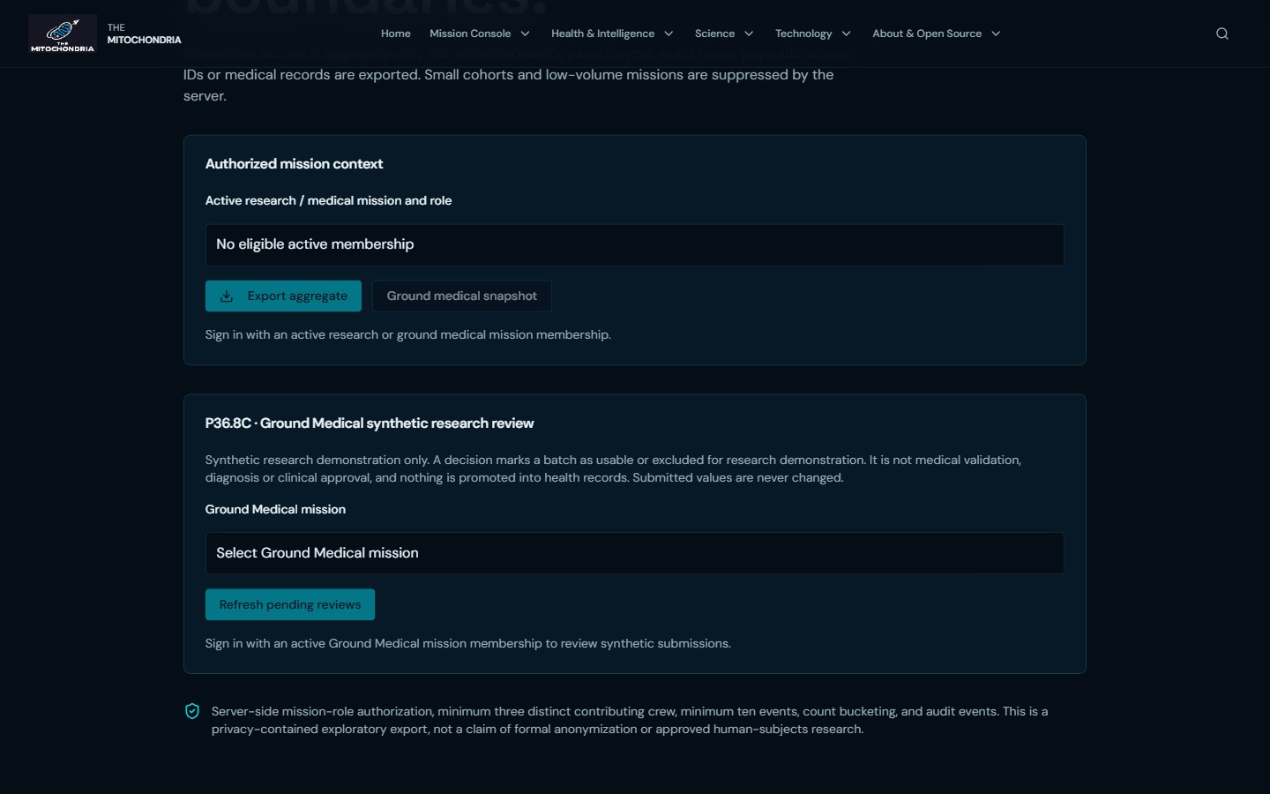

Ground Medical review — eight synthetic values, read-only, session-safe
GROUND MEDICAL WORKFLOW
1
2
3
4
Ground Medical Workspace
Refresh → 8 values · pending
View values + excerpts
Decide only if authorized
Session safety
Tab return: rows hidden, re-checked, same batch restored
Sign-in change, revocation or mission switch: rows cleared
Stale responses discarded; neutral status texts
Ground & Research Console before sign-in — live site
Research-only · no clinical meaning · never promoted to health records
Source: src/components/p368b-ground-medical-review.tsx; drizzle/migrations/0009–0010; tests/integration-pg
Notes:
On the ground, a Ground Medical reviewer opens the Ground Medical Workspace. A pending synthetic batch holds eight biomarker values, shown read-only with their units and source excerpts. That batch stays pending; we never decide it in a demonstration. After a tab switch, the batch is restored once authorisation is checked again. A mission switch or revoked access clears every private row.

Slide 21
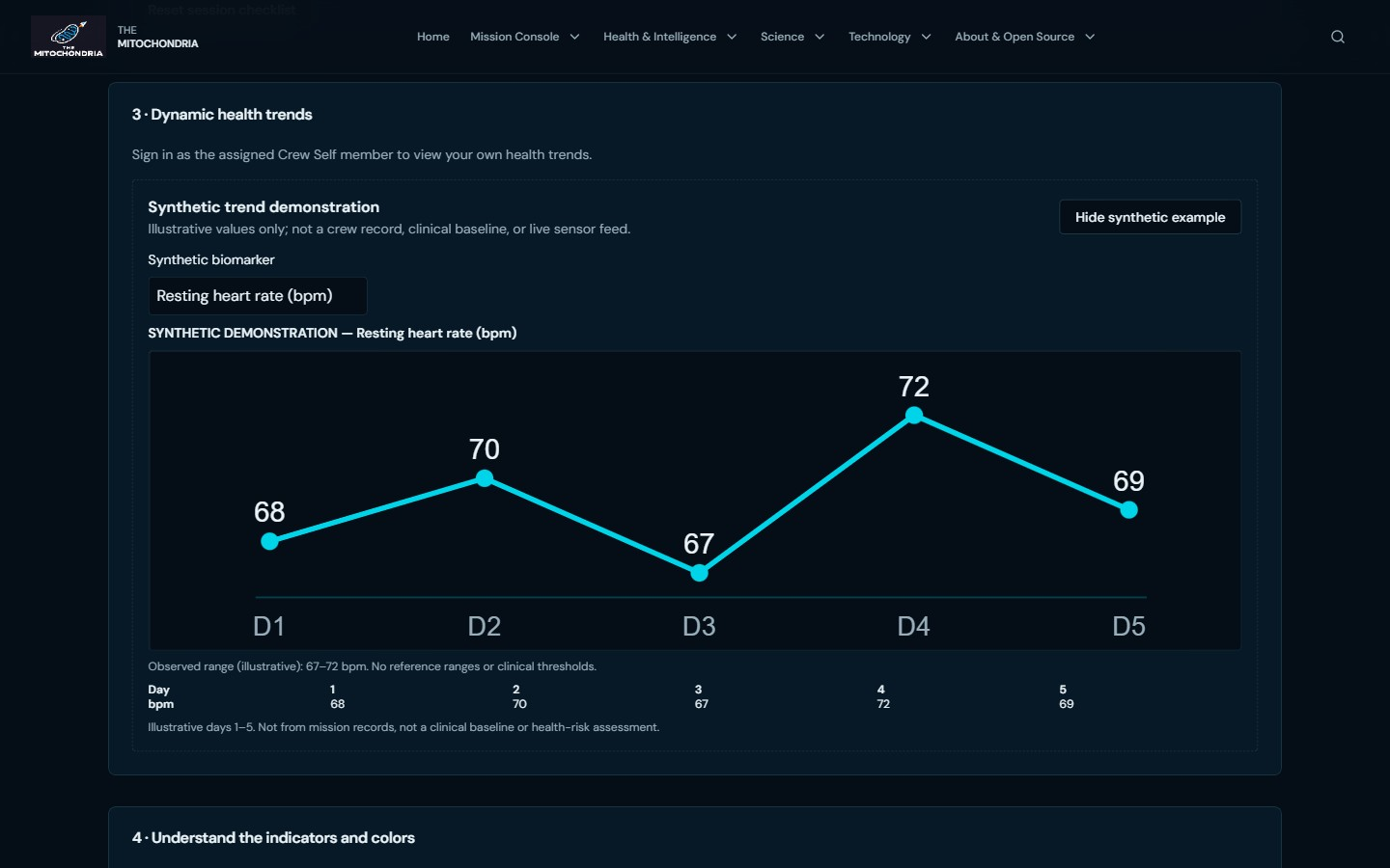
Daily Health Companion: the astronaut’s day, with honest data
CREW SELF · DAILY SUPPORT
What it offers
By design, never
5 mission environments
4-item routine · participation only
Reminders 1 min (demo) – 4 h
Own trends: unit · time · source · quality
7 / 30 / 90-day and source filters
Health or readiness scores
Prescribed schedules
Push or background alerts
Mixing synthetic and crew data
Synthetic trend example (labelled) — live site
Real-account check (development environment): Crew A 27 charted · B 23 · C 51 — no foreign identifiers
Source: src/components/astronaut-daily-health-companion.tsx; src/domain/companion; docs/P49_DEMO_READINESS_RESULTS.md
Notes:
The Daily Health Companion supports the astronaut's day. Five mission environments provide context without changing interpretation. A short routine and optional reminders count participation, never health. A signed-in crew member sees only their own trends, with source, unit and data quality. Public visitors can open a clearly labelled synthetic example that is never stored.

Slide 22

A private view must never outlive its authorization
SESSION INTEGRITY · MISSION SWITCHING · STALE RESPONSES
Event | What the user sees
Tab hidden → shown | Rows hidden · re-check · restored if still authorized
Sign-in / sign-out / user update | Fail closed at once, then re-read memberships
Revoked or different user | All private rows cleared · neutral status
Mission / scope switch | Queue, values, filters cleared
Late response | Dropped unless latest request + same scope
Enforcement point
Row-level security in PostgreSQL; the client rules only stop rendered data outliving authorization
Not claimed
Real-time revocation of an idle visible page; signed-in revocation acceptance (pending)
Source: src/domain/companion/crew-revalidation.ts; src/components/p368b-ground-medical-review.tsx; Master Manual §31.4
Notes:
A private view must never outlive its authorisation. When a tab is hidden or the session changes, private data is hidden first, then access is checked again. Values return only for the same user and scope, and late responses are discarded. One limit remains: a page left continuously visible notices a revocation at the next interaction, while the database still blocks every new read.

Slide 23
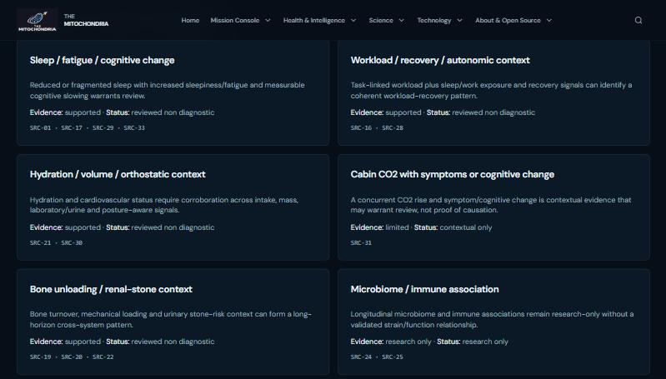
Health intelligence explains — it never diagnoses
EXPLAINABLE HEALTH INTELLIGENCE
Pattern | Evidence | Status
Sleep / fatigue / cognition | supported | non-diagnostic
Workload / recovery / autonomic | supported | non-diagnostic
Hydration / orthostatic | supported | non-diagnostic
CO₂ with symptoms | limited | contextual only
Bone unloading / renal | supported | non-diagnostic
Microbiome / immune | research only | never operational
Reviewed pattern catalogue — live site
Source: src/domain/health-intelligence/patterns.ts; src/components/explainable-alerts.tsx
Notes:
Health intelligence explains; it never diagnoses. Six reviewed pattern definitions describe evidence requirements and guardrails. Confidence is broken down into completeness and data quality, not the probability of disease. Operational alerts are disabled, and protocol guidance offers review categories, while escalation stays a human decision.

Slide 24
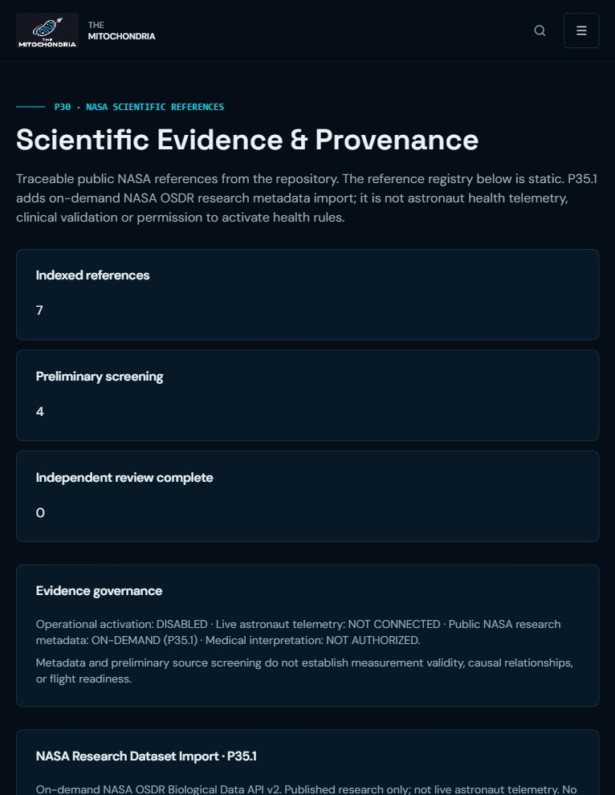

NASA OSDR: real research metadata, clearly not crew data
NASA RESEARCH DATASET IMPORT
Bounded proxy
Labels on every package
GET /api/nasa-research
Fixed origin; 12 s; 1 MiB
Accession OSD-<n>; ≤ 500 rows
No credentials; no-store
classification: research_only
subjectBinding: none
clinicalActivation: false
Not astronaut telemetry
NASA Scientific Evidence — live site
Source: src/routes/api.nasa-research.ts; src/domain/nasa-research/import.ts
Notes:
The platform can import public study metadata from NASA's Open Science Data Repository through a bounded server route. Every package is labelled research-only, with no link to any crew member, and the example study is animal research. This is real public research metadata, clearly separated from astronaut data, and it implies no NASA endorsement.

Slide 25
Mission-scoped privacy and governance, enforced where data lives
PRIVACY, SECURITY AND GOVERNANCE
Controls
Privacy
Governance
Forced RLS; RPC-only writes
Evidence tables deny-all
Audit without values
CSP, HSTS, Permissions-Policy
Documents stay in the browser
Research Workspace: aggregate-only
Suppressed below 3 crew / 10 events
Counts rounded down to tens
Owner approval per migration
Separation of duties
Instant revocation
Ethical use: synthetic only
Source: docs/SECURITY_MODEL.md; src/security/headers.ts; .github/workflows
Notes:
Privacy and governance are enforced where the data lives. Records are encrypted in the browser, evidence tables are reachable only through narrow functions, and audit rows never contain values. Researchers receive aggregate-only exports, suppressed below three crew or ten events. Every migration and publication requires explicit owner approval.

Slide 26
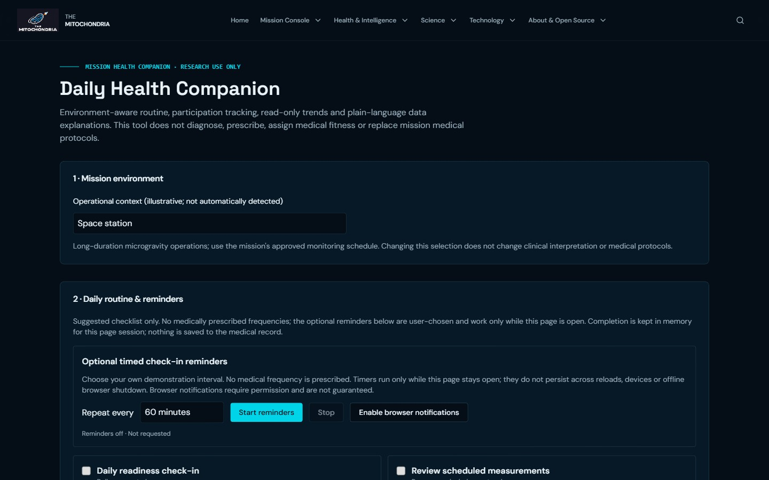
Live demonstration: 15–20 minutes, no admin access, no real data
LIVE DEMONSTRATION
Path | Time | Route
A · Public | ~8 min | Menu → Companion → Live → Research Explorer → Intake/Report → Ground console → Validation
B · Crew Self | ~4 min | Sign-in → own trends + filters → tab switch → isolation check
B · Ground Medical | ~3 min | Workspace → 8 values → tab switch → mission switch
B · Researcher | ~1.5 min | Aggregate export or suppression
B · Operator (optional) | ~1.5 min | Launchpad tracker and offline report
Daily Health Companion — live site
https://mitochondria.edocinfo.com · NASA Evaluator Quick Start Guide (FINAL)
Source: NASA Evaluator Quick Start Guide (FINAL), Section 5
Notes:
The live demonstration takes fifteen to twenty minutes and needs no administrator access. The public path shows the Companion, live monitoring, the Research Explorer and the Ground Medical console before sign-in. With synthetic role accounts, evaluators see personal trends, the eight-value review with safe tab and mission switching, and an aggregate research export.

Slide 27
Engineering evidence — reported as it is
FINAL COMPETITION EDITION · AUTOMATED VERIFICATION
✓
✓
864
305 / 305
Quality #338 — release commit 4e448ea
Security Scan #326 — Trivy
tests passing (162 files, dev env.)
database integration assertions
Evidence | Result
Crew Self intake — disposable PostgreSQL | PASS 14/14
Typecheck · lint · build (dev env.) | PASS
Medical v3 Release Gate #75 | BLOCKED BY DESIGN
Owner gates P3663 · P3664 · P20 | PENDING EVIDENCE
Clinical activation | DISABLED
Public evidence
github.com/computech-gr/astro-vitality-core/actions — runs for commit 4e448ea
Source: GitHub Actions runs #338, #326, #75; docs/P52_1_CI_REPAIR.md; docs/P53_MEDICAL_EVIDENCE_OWNER_READINESS.md
Notes:
We report engineering evidence as it is. On the release commit, the GitHub Quality workflow and the Security Scan both pass. The development environment reports 864 passing tests, and a separate database integration suite covers 305 assertions. The Medical v3 release gate stays blocked by design, until owner evidence for restore, risk acceptance and the official rules exists.

Slide 28
Scientific limitations and future validation
WHAT THIS RELEASE DOES NOT CLAIM
Owner-evidence gates
Signed-in revocation test
Not claimed
P3663 restore · P3664 risk · P20 official rules
Dedicated accounts; Crew Self and Ground Medical
Clinical validation
Regulatory clearance
Flight qualification
Astronaut deployment
NASA endorsement
Independent science review
Device and live acceptance
54 proposals: 0 approved, 0 activated
Offline OCR, two-account isolation, phone notifications, live review
Source: data/submission/p46-acceptance-evidence.v1.json, p47-competition-handoff.v1.json; Master Manual §32 and §39
Notes:
We are equally clear about limits. MITOCHONDRIA is not clinically validated, not a medical device, not flight-qualified and not endorsed by NASA. Independent scientific approval, signed-in revocation tests, offline text recognition on a real device and two-account isolation tests remain open. Synthetic intake and research AI stay switched off in production.

Slide 29


Mission impact and future potential
WHY IT MATTERS BEYOND THE COMPETITION
Crew autonomy
Personal, not population
Explainable by design
Health loop works without a ground link
Phase-aware baselines per astronaut
Evidence, gaps and uncertainty on every finding
Research-ready
Open and extensible
Trustworthy
Analog missions, research teams, education
New sensors and catalogues via contracts
Governance and provenance built in
Source: Master Manual §02 and §39.3
Notes:
The pattern we demonstrate will matter for future crews: a health loop that works without Earth, interprets each astronaut against their own history, explains its reasoning, and leaves decisions to qualified people. Because it is open and vendor-neutral, it can serve analogue missions, research teams and education.

Slide 30
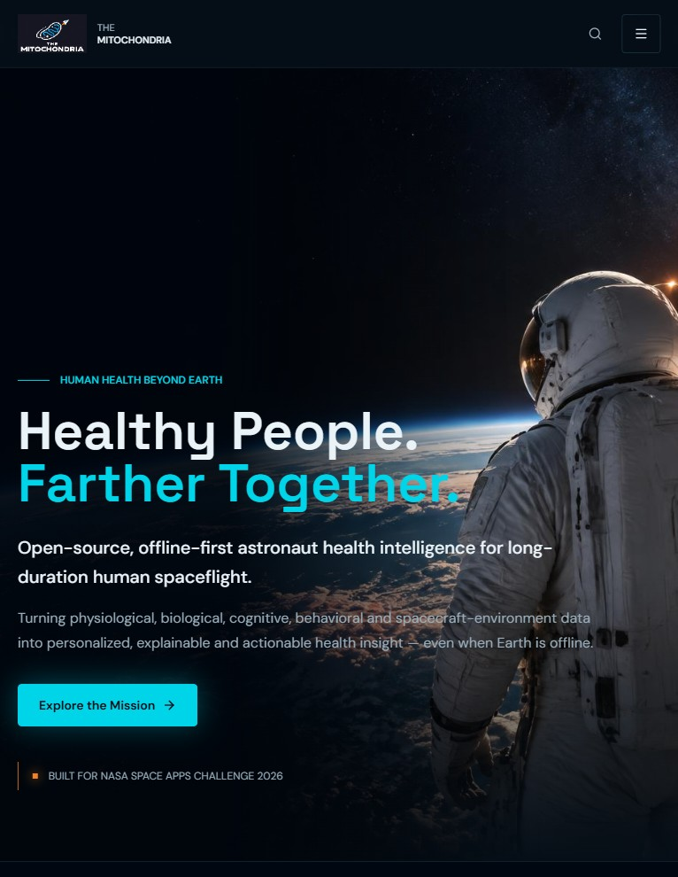
Healthy people. Farther together — with evidence you can check.
CLOSING
Try it
Read and review
mitochondria.edocinfo.com
Public path: no account
Evaluator guide: 15–20 min
Master Operations & Technical Manual
github.com/computech-gr/astro-vitality-core
Apache-2.0 · contributions welcome
Research prototype · synthetic data only · not NASA-endorsed · not clinically validated
Home — live site
Notes:
MITOCHONDRIA. Healthy people, farther together. Try the live application at mitochondria.edocinfo.com, and review the open-source code on GitHub. Thank you from team The Mitochondria.

