Slide 1
CS 561: OSS dev
Patrick McCormick
patm@pdx.edu
S-keys
(github.com/computee/s-keys)

Slide 2
Outline
Description
Process / implementation
Status
Future work
Conclusion:
  Other ideas
  Implementation details

Slide 3
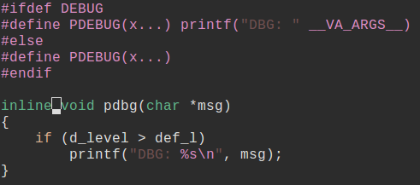
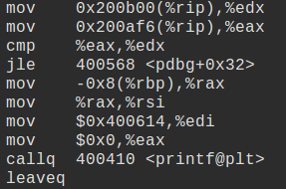
Description / Motivation
''Jump labels provide an interface to generate dynamic branches using self-modifying code.''

Slide 4
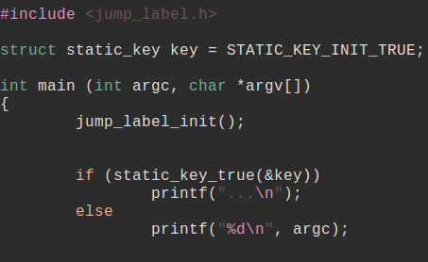
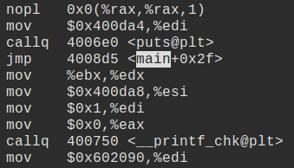
Process / Implementation
Jared Baron, Peter Ziljstra, kernel ~2.6.37

Slide 5
Process / Implementation
Depends on things:
Special elf section
GCC asm goto extension
.pushsection, .popsection
__always_inline
C99, gcc > 4.8.1

Slide 6
Process / Implementation
Translate kernel → C99/posix
Translate config options to CPP
Re-structure to library
Implement missing pieces
Rename
Create tests
re-license

Slide 7
Status
Almost working!
Talking about re-licensing
Still some diffucult things:
  Linker error without use
  Needs optimization to compile

Slide 8
Future work
Create tests
Re-license
Header only library
Basic logging framework
Locking / rate-limiting ?
Nop database
packaging
ccan

Slide 9
Conclusion
Harder than I thought.

Slide 10
Other ideas
KNN and stocks with Python/Pandas
3d printable record improvements
Integrate DS PM w/ distro PM
C like language w/ LLVM
Something with git

Slide 11
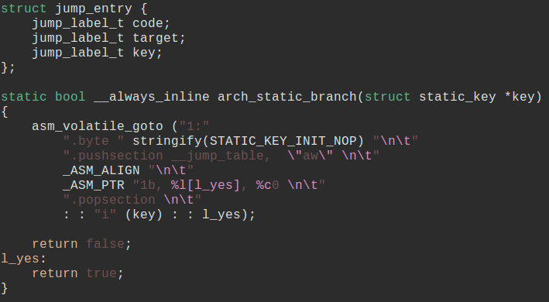
Jump Label details

