Slide 1

Secure Image Processing Platform
Goal:
Build a full-stack, production-minded workflow
Challenge:
Security, scalability, and usability
Need:
reliable image upload, processing, and result delivery
Ryan Yang

Slide 2
High Level Architecture
Frontend: HTML/CSS/JavaScript multi-page UI
Backend: FastAPI API services
Need:
Reliable image upload, processing, and result delivery
Challenge:
Security, scalability, and usability
Goal:
Build a full-stack, production-minded workflow
Data: SQLite metadata + filesystem artifacts
HTTPS: Caddy reverse proxy

Slide 3
High Level Architecture
Core User Workflow
Frontend: HTML/CSS/JavaScript multi-page UI
Login
Upload Image
Create Processing Job
Track job status
View results and metrics
Backend: FastAPI API services
Data: SQLite metadata + filesystem artifacts
HTTPS: Caddy reverse proxy

Slide 4
Backend Processing Flow
Core User Workflow
Login
Upload Image
Create Processing Job
Track job status
View results and metrics
POST /api/images > validate + store + segment
POST /api/jobs > queue background job
Job states: queued > running > done/failed
GET /api/jobs/{job_id} for status/detail

Slide 5
Backend Processing Flow
Core User Workflow
POST /api/images > validate + store + segment
POST /api/jobs > queue background job
Job states: queued > running > done/failed
GET /api/jobs/{job_id} for status/detail
Login
Upload Image
Create Processing Job
Track job status
View results and metrics

Slide 6
Features Delivered
Upload preview and job creation
Jobs list and result page
Admin dashboard with stats
Multi-user ownership controls
User management (create/list/delete)
Segmentation artifact endpoint
Security Model
Bearer token authentication
Password hash support (PBKDF2 format)
Upload hardening (size/type/signature checks)
Rate limiting on sensitive routes
Tiered file access (low, medium, hIgh,quarantinE)

Slide 7
Features Delivered
Security Model
Upload preview and job creation
Jobs list and result page
Admin dashboard with stats
Multi-user ownership controls
User management (create/list/delete)
Segmentation artifact endpoint
Bearer token authentication
Password hash support (PBKDF2 format)
Upload hardening (size/type/signature checks)
Rate limiting on sensitive routes
Tiered file access (low, medium, hIgh,quarantinE)

Slide 8
Segmentation Pipeline
Phase 1: Frontend prototype + mock API
Phase 2: Real backend + persistence + async jobs
Phase 3: security hardening + HTTPS + admin auth
Phase 4: segmentation + multi-user ownership controls
Lightweight CPU-friendly segmentation
SLIC + region scoring + fallback methods
Outputs: foreground, background, mask, original
API: GET /api/images/{image_id}/segments

Slide 9
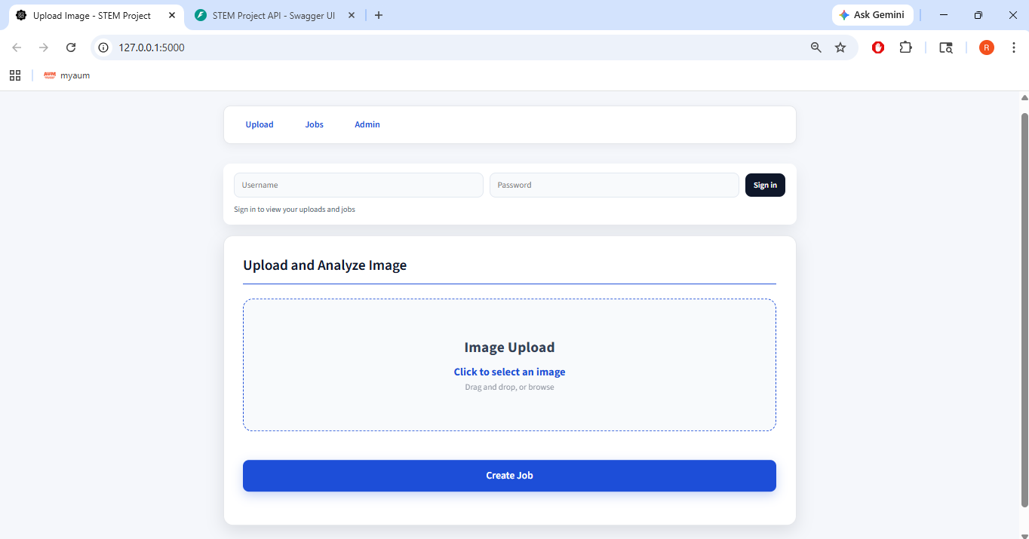
Segmentation Pipeline
Phase 1: Frontend prototype + mock API
Phase 2: Real backend + persistence + async jobs
Phase 3: security hardening + HTTPS + admin auth
Phase 4: segmentation + multi-user ownership controls
Upload Demo - 1
Lightweight CPU-friendly segmentation
SLIC + region scoring + fallback methods
Outputs: foreground, background, mask, original
API: GET /api/images/{image_id}/segments

Slide 10
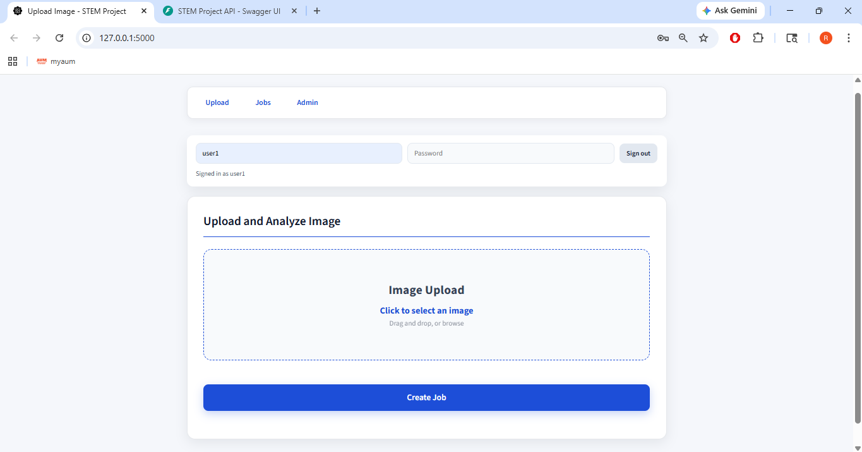
Segmentation Pipeline
Phase 1: Frontend prototype + mock API
Phase 2: Real backend + persistence + async jobs
Phase 3: security hardening + HTTPS + admin auth
Phase 4: segmentation + multi-user ownership controls
Upload Demo - 1
Upload Demo -2
Lightweight CPU-friendly segmentation
SLIC + region scoring + fallback methods
Outputs: foreground, background, mask, original
API: GET /api/images/{image_id}/segments

Slide 11
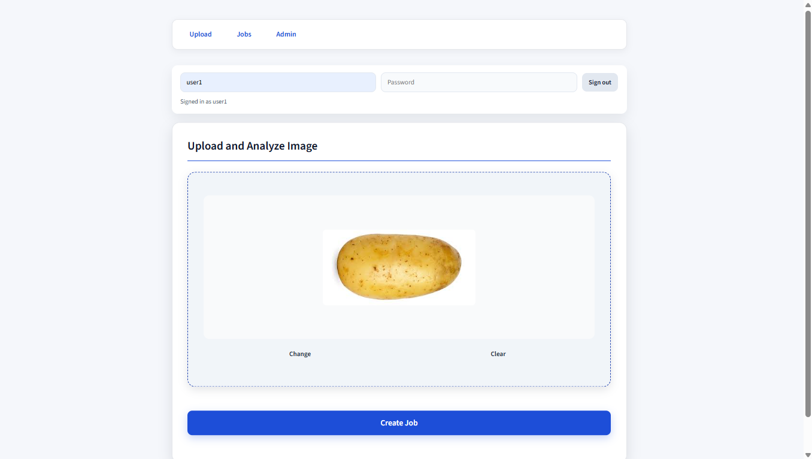
Segmentation Pipeline
Phase 1: Frontend prototype + mock API
Phase 2: Real backend + persistence + async jobs
Phase 3: security hardening + HTTPS + admin auth
Phase 4: segmentation + multi-user ownership controls
Upload Demo -2
Upload Demo - 1
Upload Demo - 3
Lightweight CPU-friendly segmentation
SLIC + region scoring + fallback methods
Outputs: foreground, background, mask, original
API: GET /api/images/{image_id}/segments

Slide 12
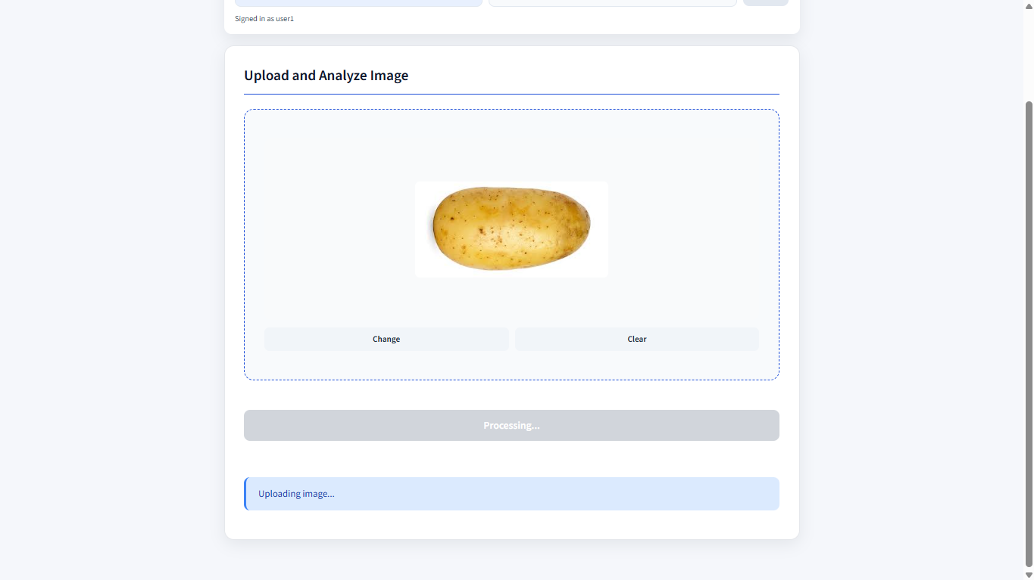
Segmentation Pipeline
Phase 1: Frontend prototype + mock API
Phase 2: Real backend + persistence + async jobs
Phase 3: security hardening + HTTPS + admin auth
Phase 4: segmentation + multi-user ownership controls
Upload Demo -2
Upload Demo - 1
Upload Demo - 3
Upload Demo - 4
Lightweight CPU-friendly segmentation
SLIC + region scoring + fallback methods
Outputs: foreground, background, mask, original
API: GET /api/images/{image_id}/segments

Slide 13
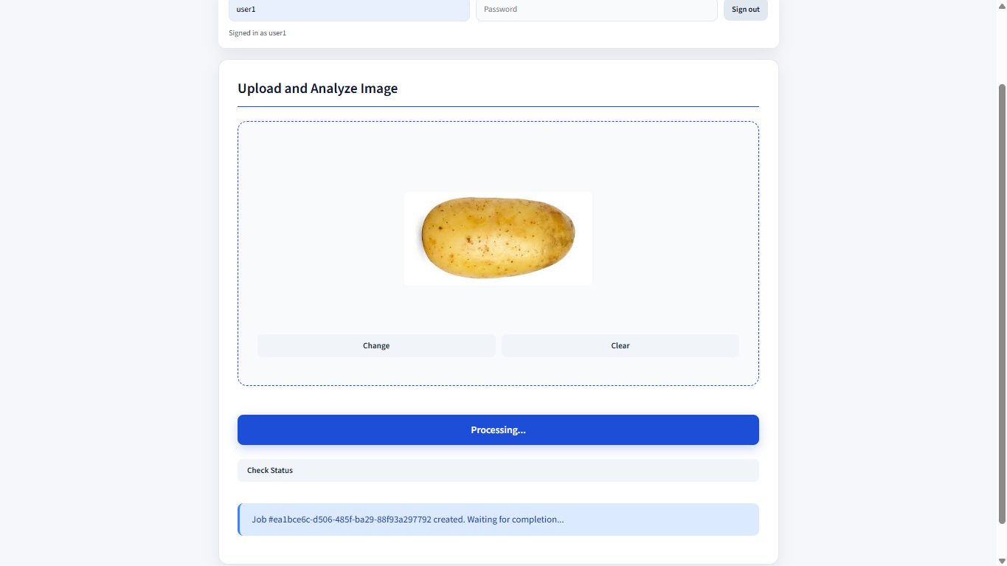
Segmentation Pipeline
Phase 1: Frontend prototype + mock API
Phase 2: Real backend + persistence + async jobs
Phase 3: security hardening + HTTPS + admin auth
Phase 4: segmentation + multi-user ownership controls
Upload Demo - 4
Upload Demo - 5
Upload Demo -2
Upload Demo - 1
Upload Demo - 3
Lightweight CPU-friendly segmentation
SLIC + region scoring + fallback methods
Outputs: foreground, background, mask, original
API: GET /api/images/{image_id}/segments

Slide 14
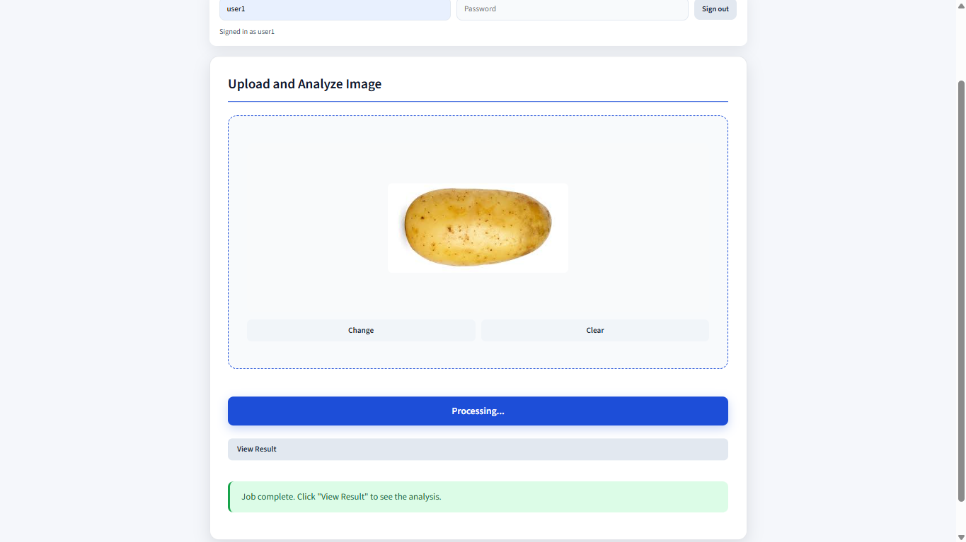
Segmentation Pipeline
Phase 1: Frontend prototype + mock API
Phase 2: Real backend + persistence + async jobs
Phase 3: security hardening + HTTPS + admin auth
Phase 4: segmentation + multi-user ownership controls
Upload Demo - 4
Upload Demo -2
Upload Demo - 5
Upload Demo - 1
Upload Demo -6
Upload Demo - 3
Lightweight CPU-friendly segmentation
SLIC + region scoring + fallback methods
Outputs: foreground, background, mask, original
API: GET /api/images/{image_id}/segments

Slide 15
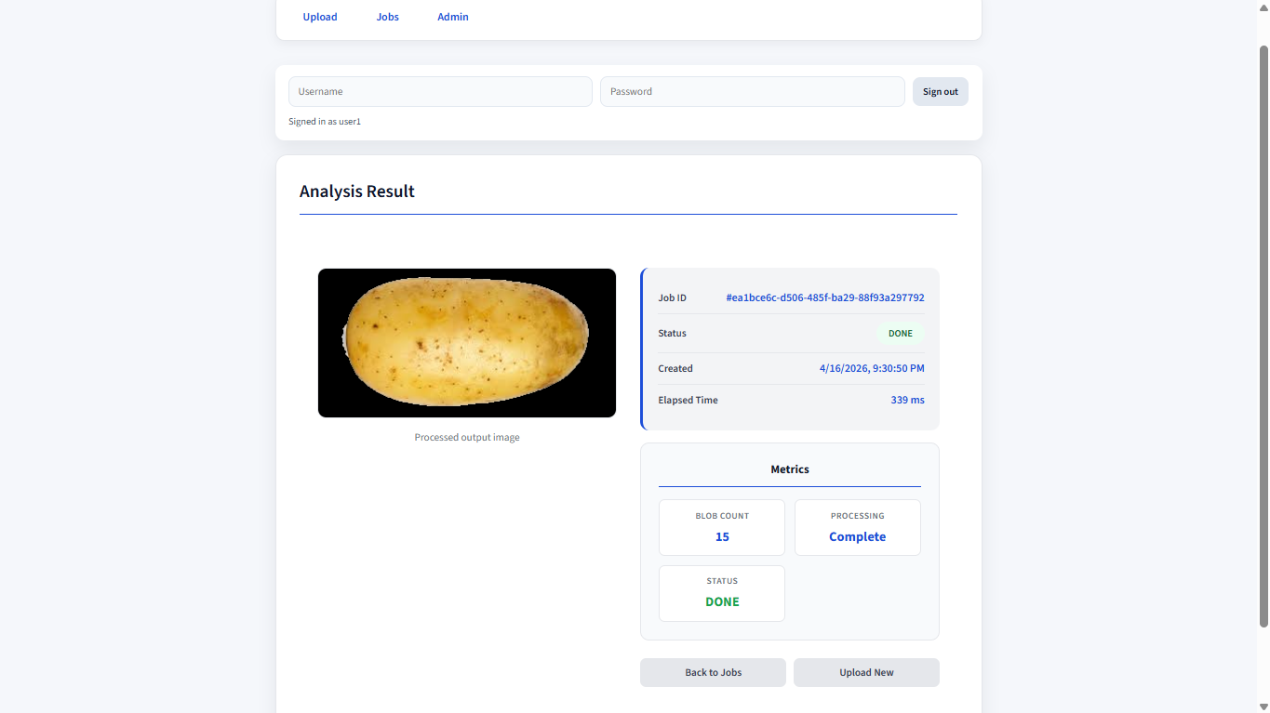
Segmentation Pipeline
Phase 1: Frontend prototype + mock API
Phase 2: Real backend + persistence + async jobs
Phase 3: security hardening + HTTPS + admin auth
Phase 4: segmentation + multi-user ownership controls
Upload Demo - 4
Upload Demo -2
Upload Demo - 5
Upload Demo - 1
Upload Demo - 7
Upload Demo -6
Upload Demo - 3
Lightweight CPU-friendly segmentation
SLIC + region scoring + fallback methods
Outputs: foreground, background, mask, original
API: GET /api/images/{image_id}/segments

Slide 16
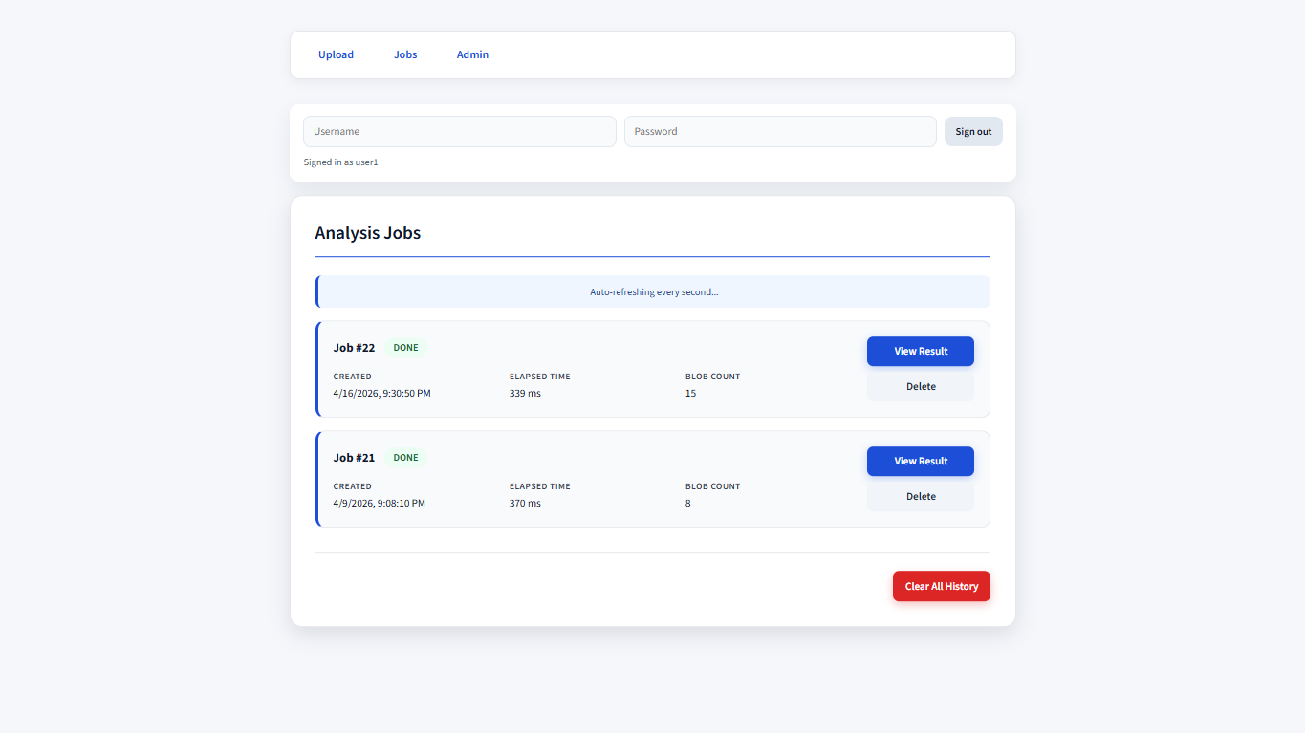
Segmentation Pipeline
Phase 1: Frontend prototype + mock API
Phase 2: Real backend + persistence + async jobs
Phase 3: security hardening + HTTPS + admin auth
Phase 4: segmentation + multi-user ownership controls
Upload Demo - 4
Upload Demo -2
Upload Demo - 5
Upload Demo - 1
Upload Demo - 7
Upload Demo -6
Upload Demo - 3
Upload Demo - 8
Lightweight CPU-friendly segmentation
SLIC + region scoring + fallback methods
Outputs: foreground, background, mask, original
API: GET /api/images/{image_id}/segments

Slide 17
Segmentation Pipeline
Phase 1: Frontend prototype + mock API
Phase 2: Real backend + persistence + async jobs
Phase 3: security hardening + HTTPS + admin auth
Phase 4: segmentation + multi-user ownership controls
Upload Demo - 4
Upload Demo -2
Upload Demo - 5
Upload Demo - 1
Upload Demo - 7
Upload Demo - 8
Upload Demo -6
Upload Demo - 3
Lightweight CPU-friendly segmentation
SLIC + region scoring + fallback methods
Outputs: foreground, background, mask, original
API: GET /api/images/{image_id}/segments

Slide 18
Known Limitations
In-process background jobs (not distributed queue)
Polling (not WebSockets)
Process-local rate limiting
Heuristic segmentation needs broader validation datasets

Slide 19
Future Development
Future Development
End-to-end secure image processing platform
Distributed workers/task queue
Deep-learning segmentation models
WebSocket real-time updates
Cloud storage/deployment
Expanded editing and annotation workflows
Enhanced security/compliance controls
Scalable, modular architecture
Strong foundation for future enhancements
Questions?

Slide 20
Future Development
Future Development
End-to-end secure image processing platform
Scalable, modular architecture
Strong foundation for future enhancements
Questions?

