Slide 1
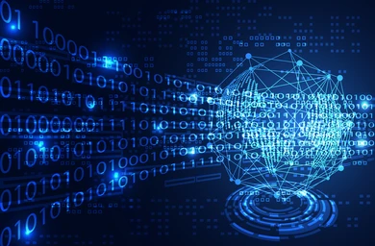

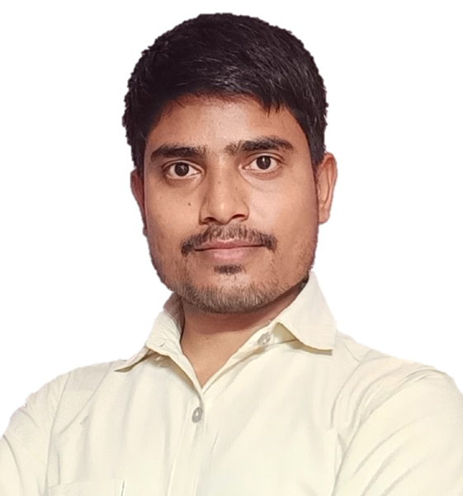
Day-14
Function
User define function, Function Declaration,Definition and call

