Slide 1
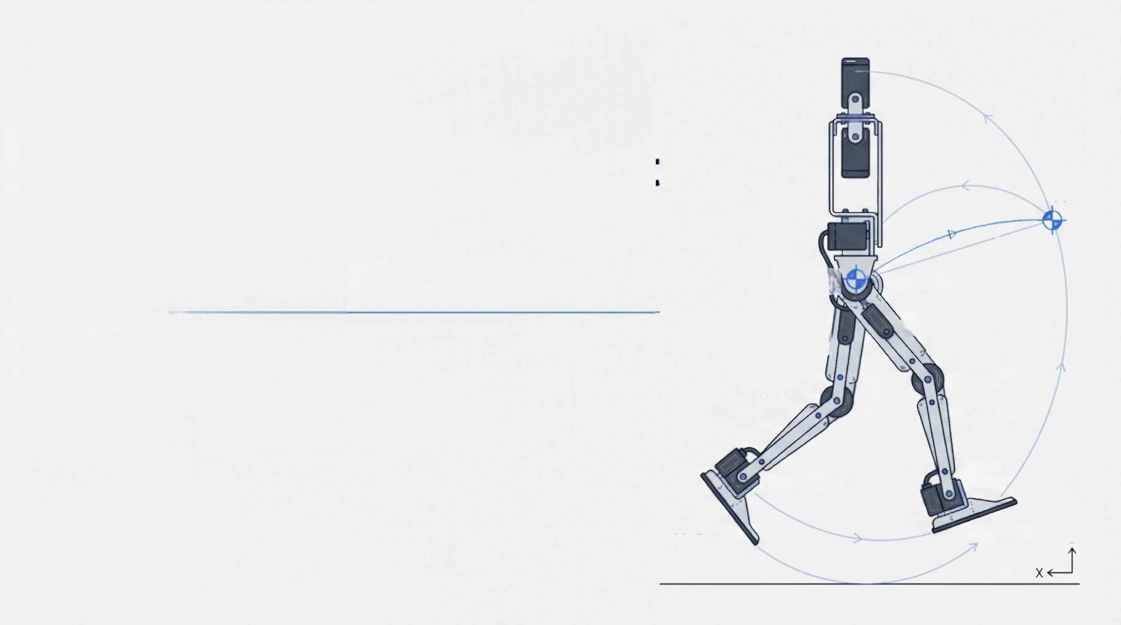
FDDP Trajectory Planning &FIR-QP-MPC Simulation Verification for a Low-Cost Position-Controlled
Planar Biped
From Contact-Aware Trajectory
Optimisation to Online Disturbance
Recovery
Body Link
Hip Joint R
Thigh Link R
Knee Joint R
Shank Link R
Ankle Joint R
COM
Hip Joint L
Thigh Link L
Knee Joint L
Shank Link L
Ankle
Joint L
Zhijian Kang
MSc Electronics and Electrical Engineering Group Meeting·July 2026
Foot Link R Foot Link L
Z
A NotebookLM

Slide 2
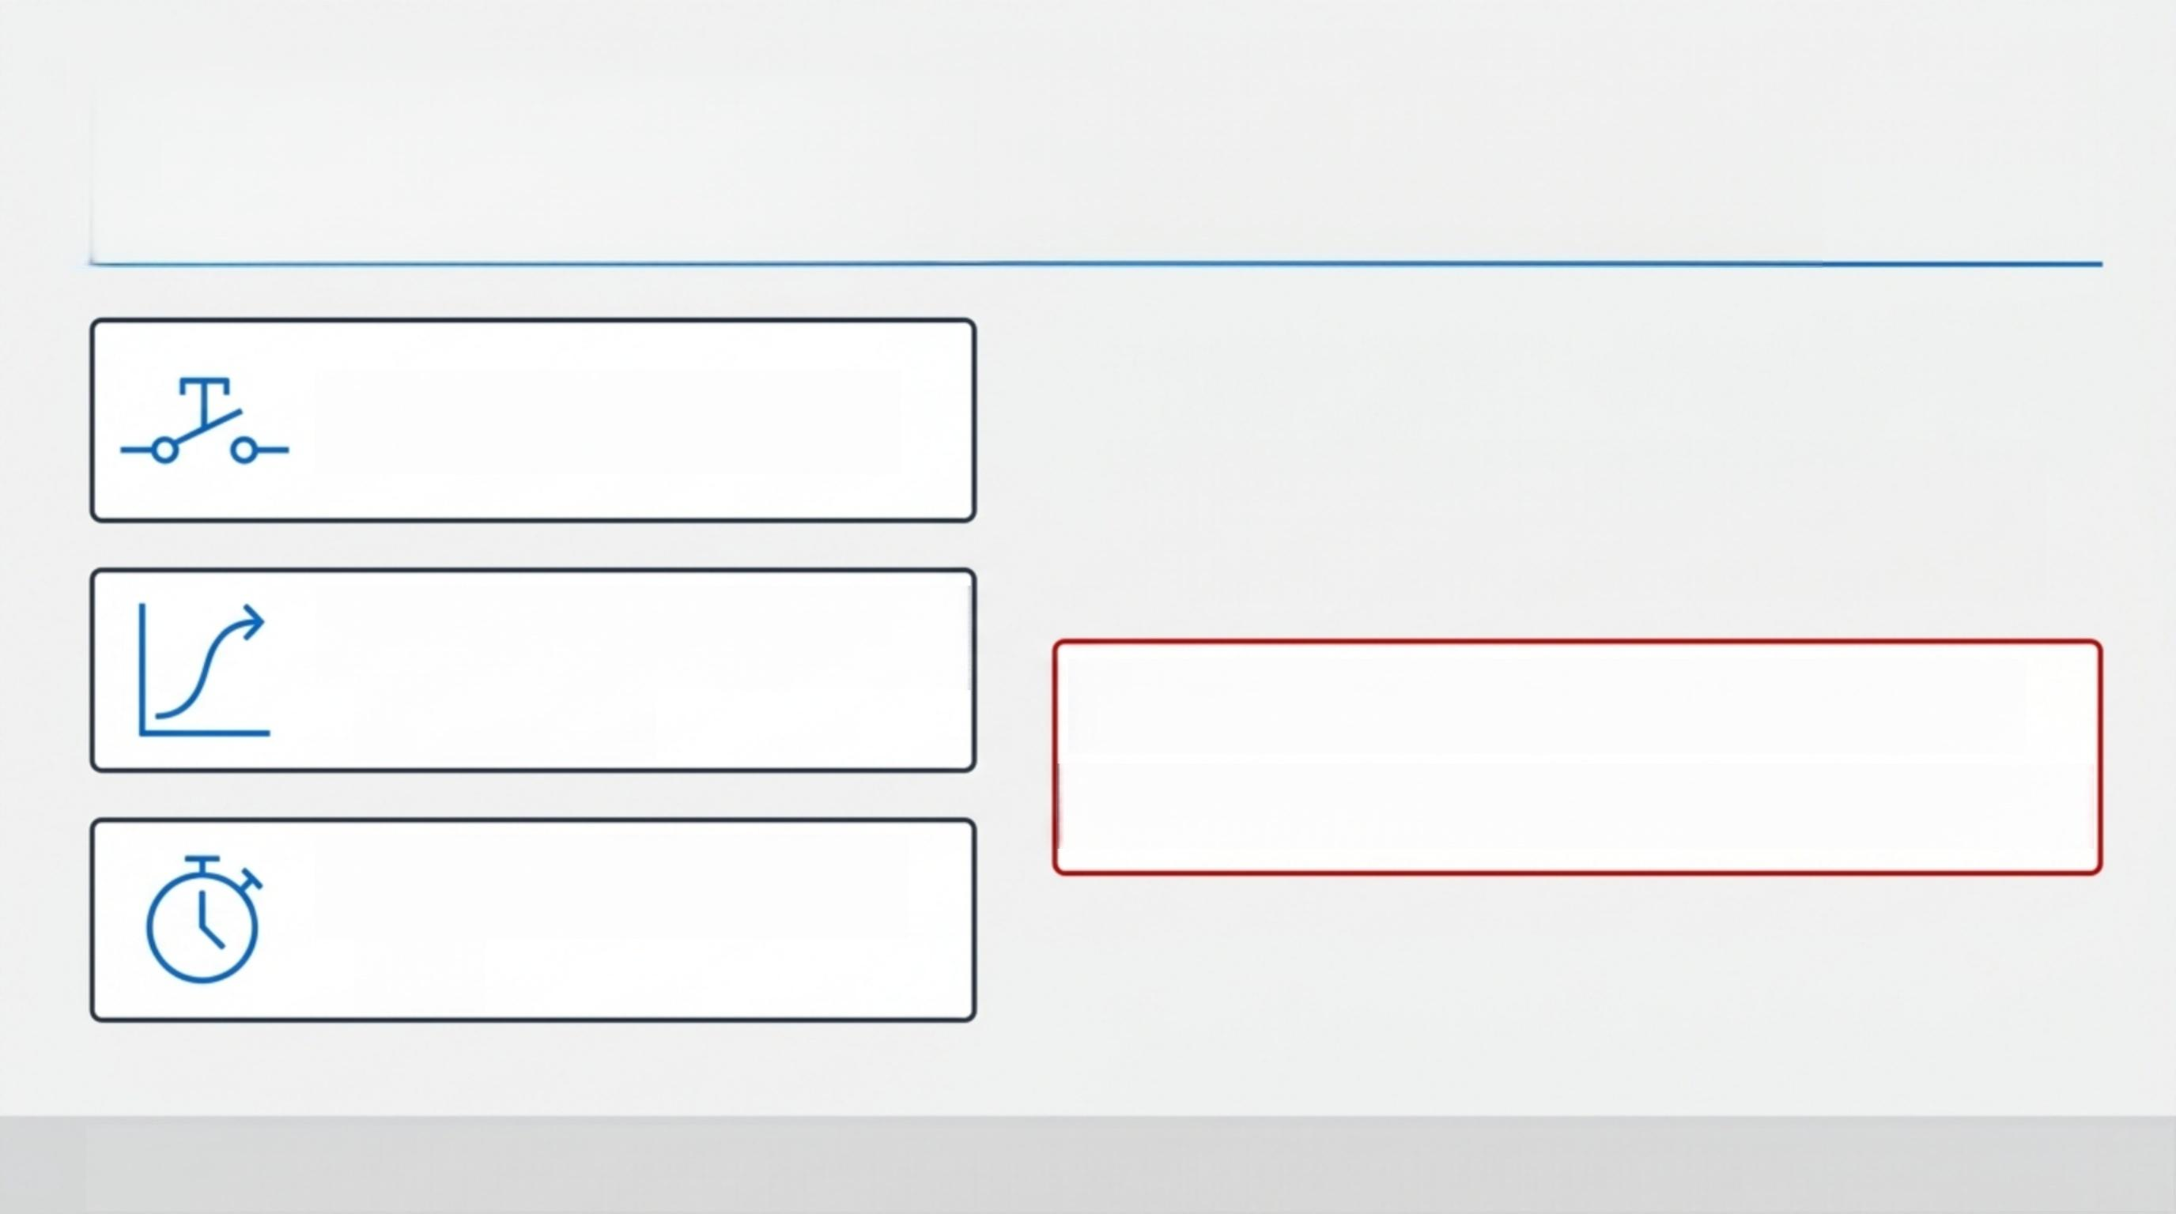
Position-controlled actuators limit the control interface, but cannot reduce bipedal dynamics complexity
·Contact Switching
qcmd = qref+△q
Tref: FDDP planning/analysis output only.
qcmd: Position-controlled actuator command.
·Nonlinear Rigid-Body Dynamics
·Actuator Delay and Lag
Current conclusion proves simulation validation only; hardware walking is not yet claimondcteboulu

Slide 3
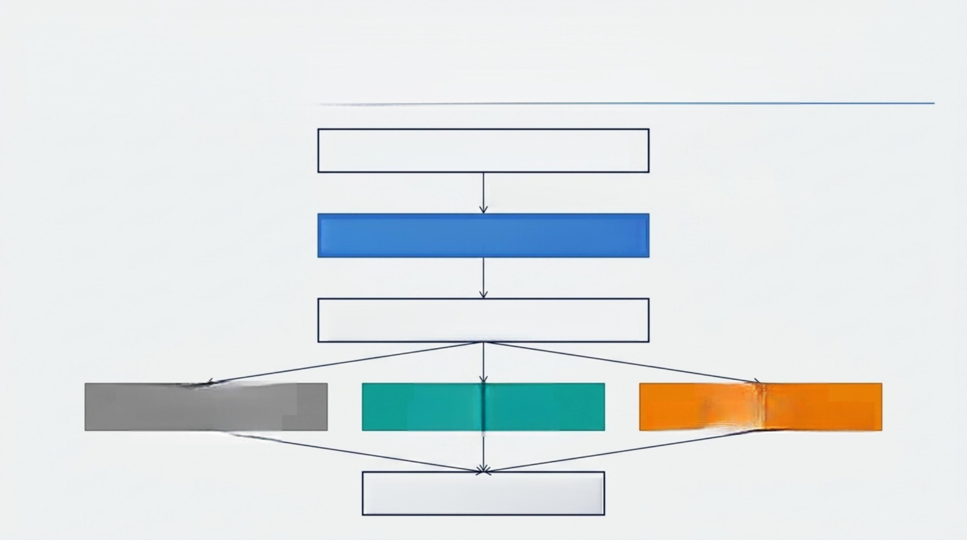
The system combines offline planning and online correction to balance dynamic quality and real-time execution
URDF/Pinocchio Rigid-Body Model
Output:qref,dqref (Note: Tref for analysis only)
Crocoddyl FDDP Trajectory Optimisation
MuJoCo Actuator-Aware Replay Proxy
CO:Nominal Tracking C1:FIR-QP-MPC C2:Phase Sync
→Qcmd=Qref → ^{Pitch} ^{Recovery} ^{→Contact} ^{Event} ^{Alignment}
Qcmd = Qref(t+△t)+△ qMPC
A NotebookLM

Slide 4
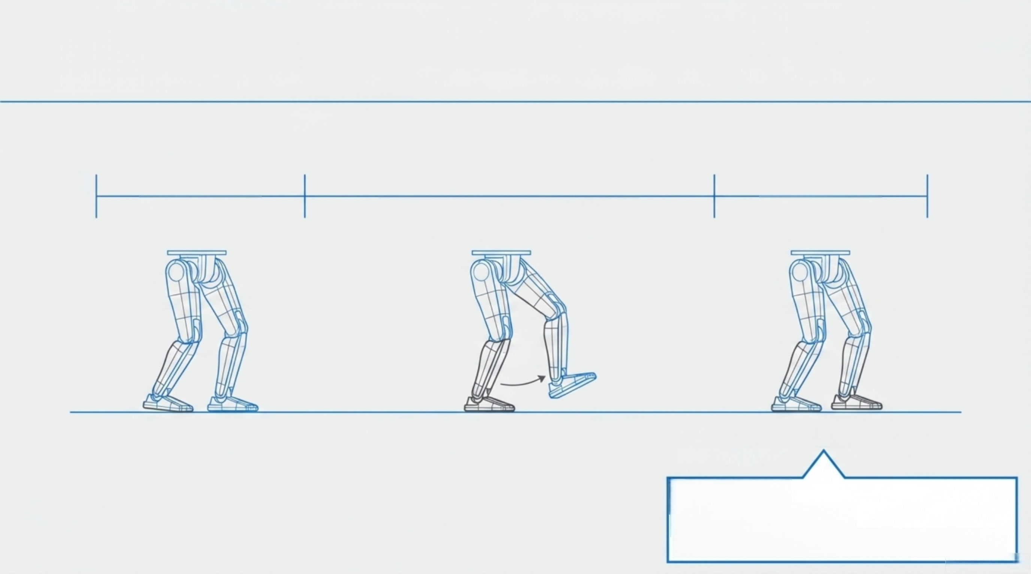

The contact model at each node determines if the robot is in Double or Single Support
0.0 s 0.2 s 0.9 s 1.2 s
DS(20 nodes) Right SS/Left Swing(70 nodes) DS(30 nodes)
1.Initial Double Support(DS) 2.Right Single Support/Left Swing (SS) 3.Landing Double Support (DS)
△t=0.01 s
·Forward (+Y),Vertical(+Z),Pitch(+X)
ANotebookLM
120 running nodes

Slide 5
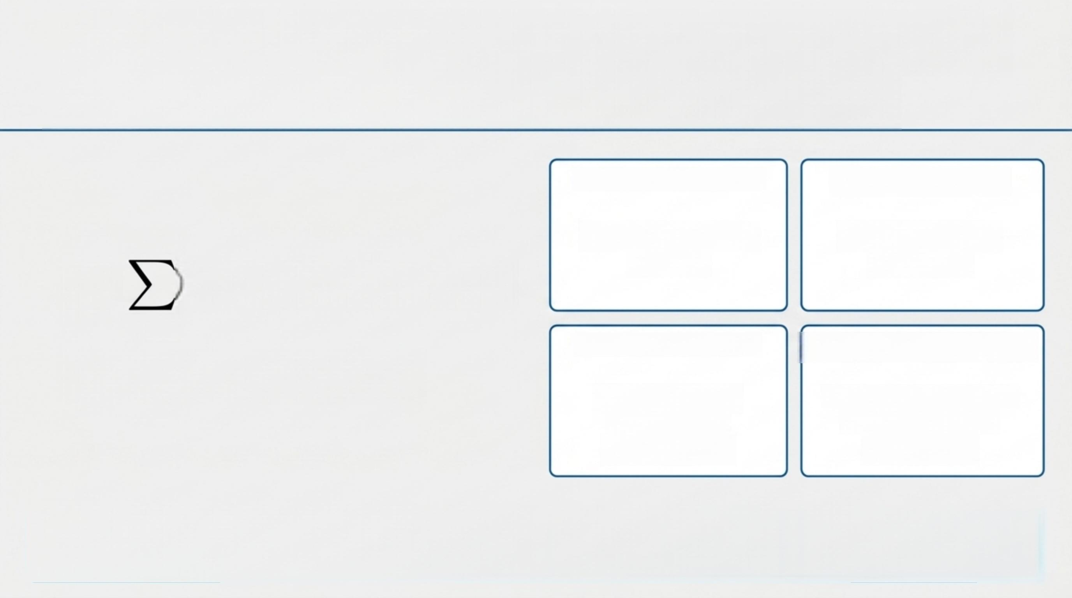
FDDP jointly reduces task cost and dynamics defects under a fixed contact sequence
1.Contact Residuals
Support-foot SE(3) tracking
3.Motion Residuals
CoM tracking + state/control regularisation
2.Swing Residuals
Swing-foot SE(3) placement
4.Feasibility Constraints
Joint limits +contact
force+friction +
CoP margin
N-1
min Ck(Xk,uk)+ln(xN) X,U
k=0
s. t. X k+1= fk( Xk,uk)
Shooting gap=0 guarantees dynamic continuity,but does NOT automatically
prove friction,CoP,and landing gates are passed.
ANotebookLM

Slide 6
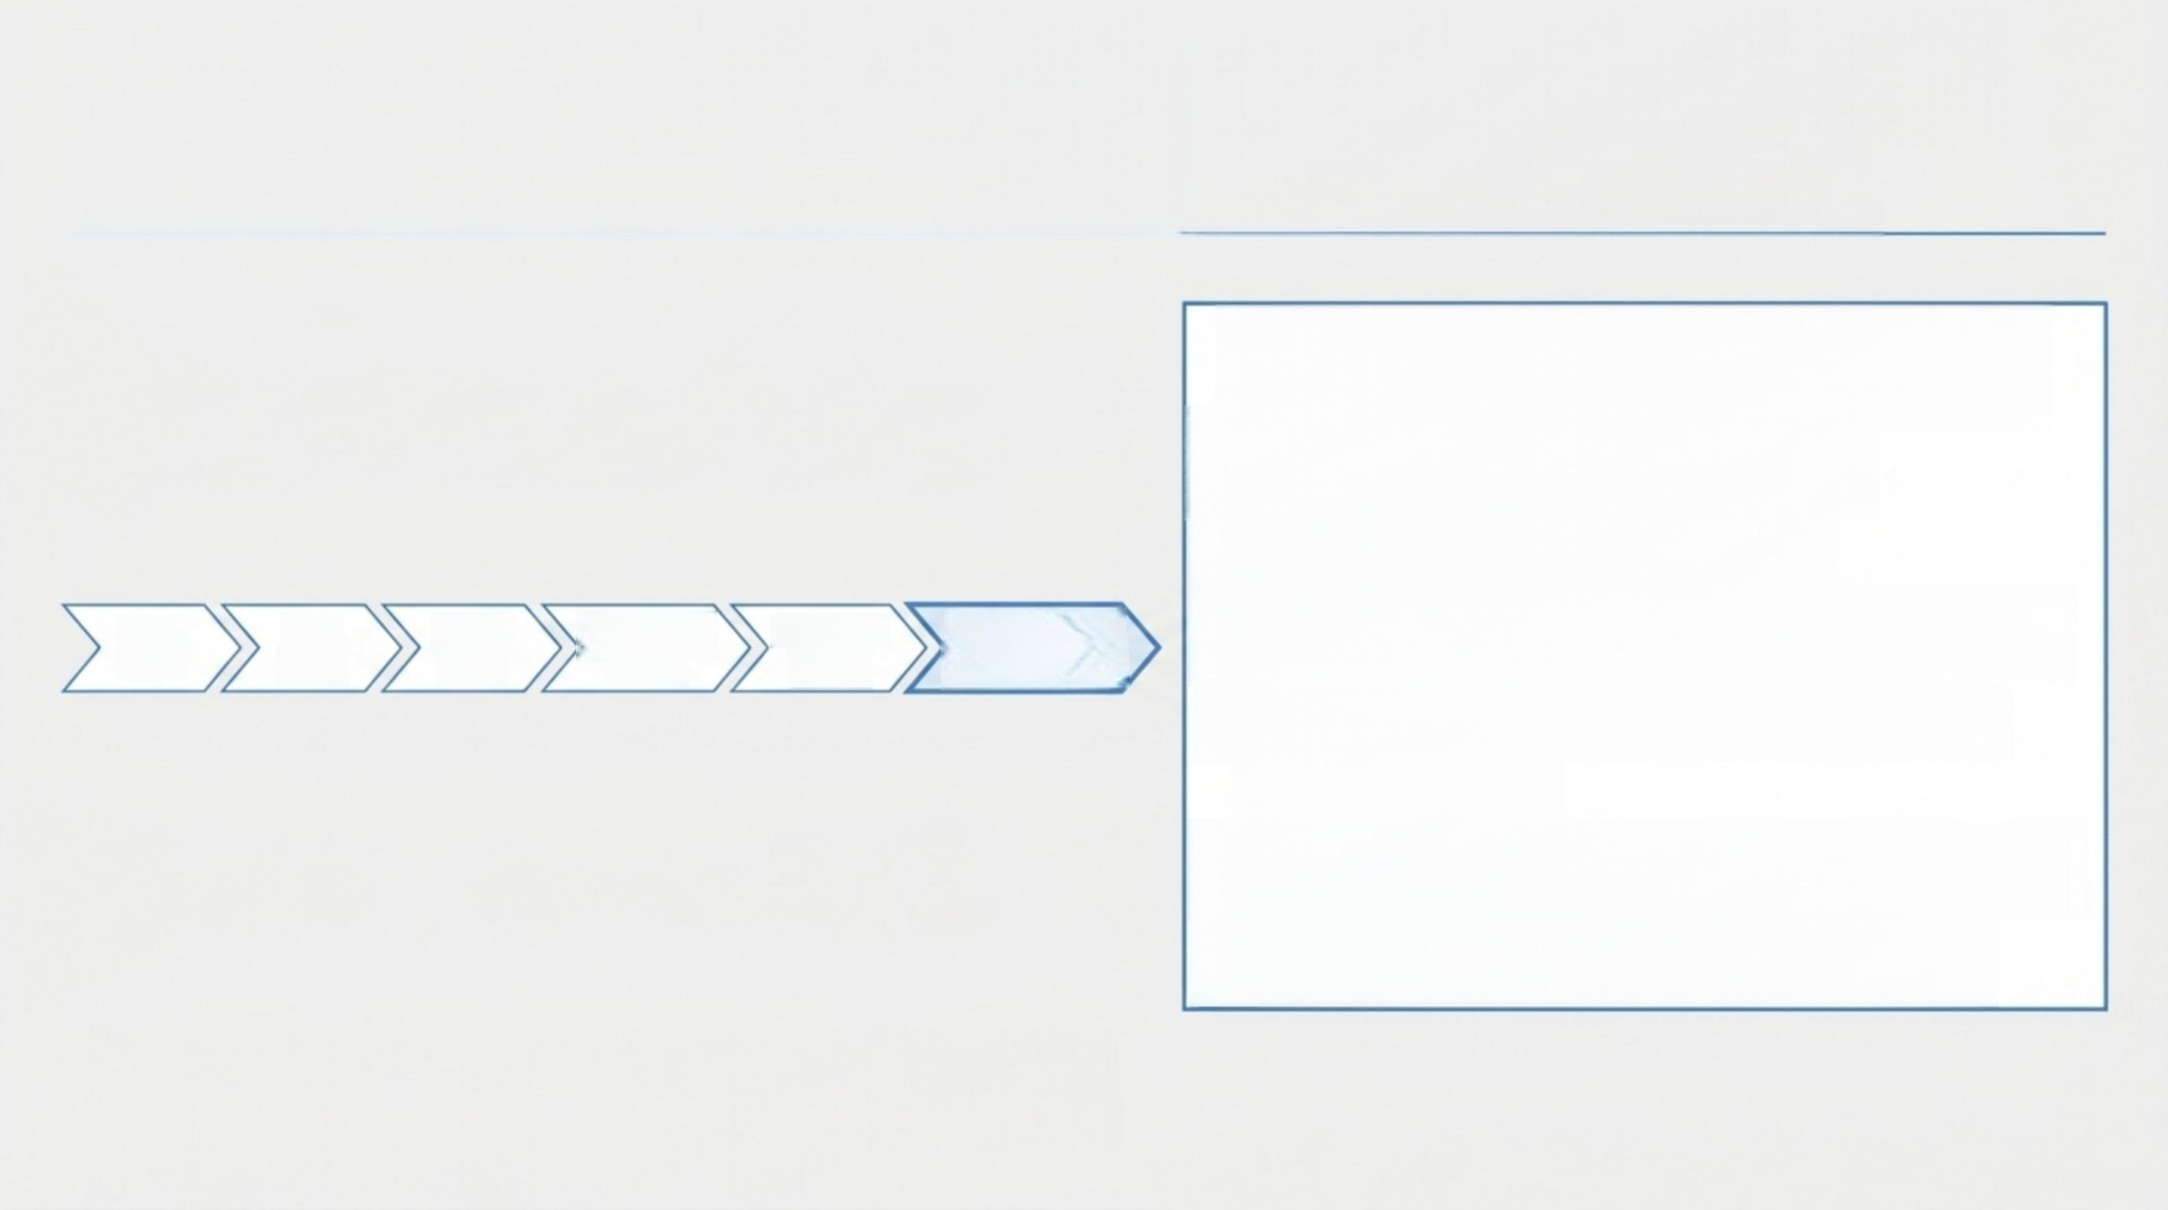
The project has progressed from double-support CoM shifts to contact-feasible 10-step periodic planning
10-Step Validation Data
·Solver Stop:9.90×10-8
·Shooting Gap:0( Pass)
· Contact Violations: 0/200( Pass)
· Max Friction Utilisation:0.320 (Limit:< 0.9)
·Minimum CoP Margin: 2.079 mm
· Swing Clearance: 19.998 mm
A NotebookLM
CoM shift | Left step | Right step | Two-step | Periodic cycle | 4/6/10-step continuation
cycle
The 10-step formulation passes the independent contact
gate in runtime probes, but formal production integration
and independent final promotion are pending.

Slide 7

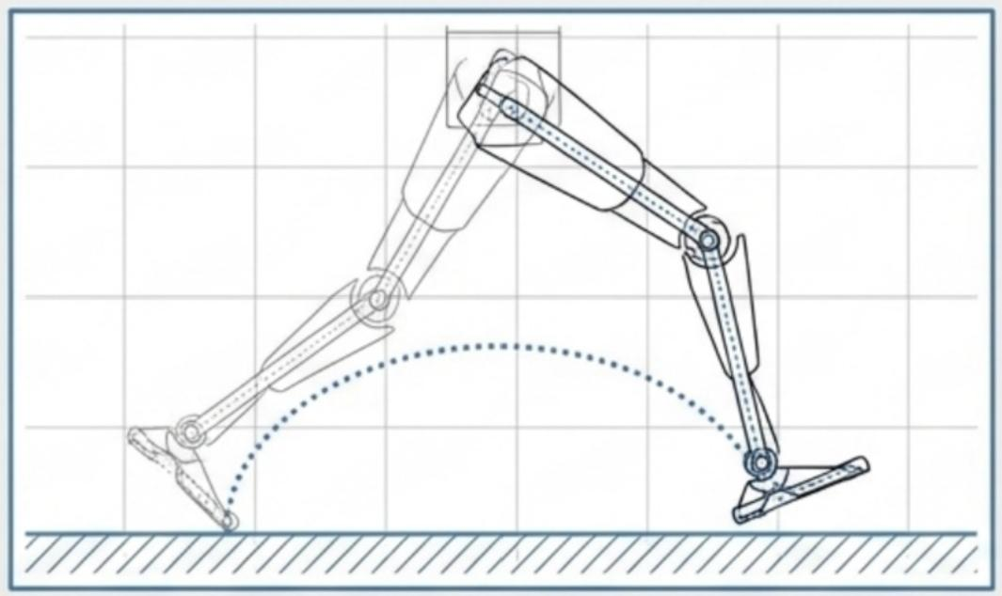
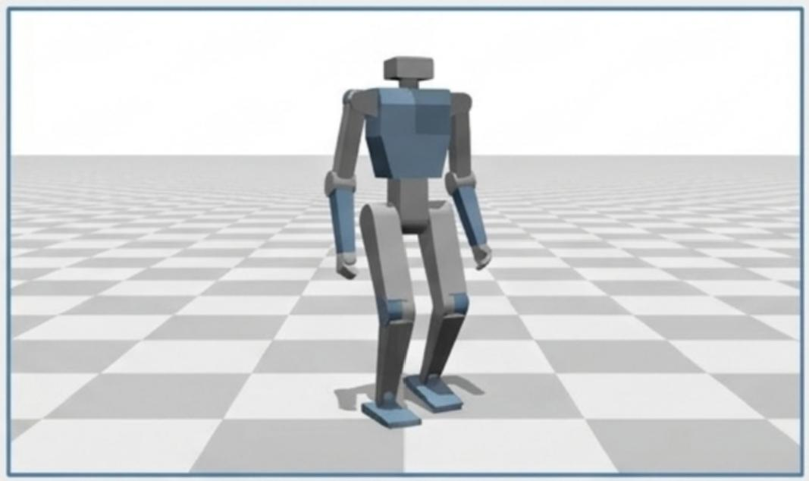
The left-step trajectory passes physical validation gates and executes successfully via position-command replay
Source:fddp_single_step_left_swing_com_clearance.png
Source:fddp_single_step_left_swing_mujoco_replay.png
· | Shooting | Gap:0 | · | Swing | Clearance:20 mm
· | Support | Error:5.62μm | · | CoM | Forward Shift:4.71 | mm
· | Landing | Error:0.08μm | · | Joint | RMSE Max:3.96°
*Note: Passing physical gates is evaluated independently of first-order solver convergence flags.* _{A} _{NotebookLM}

Slide 8

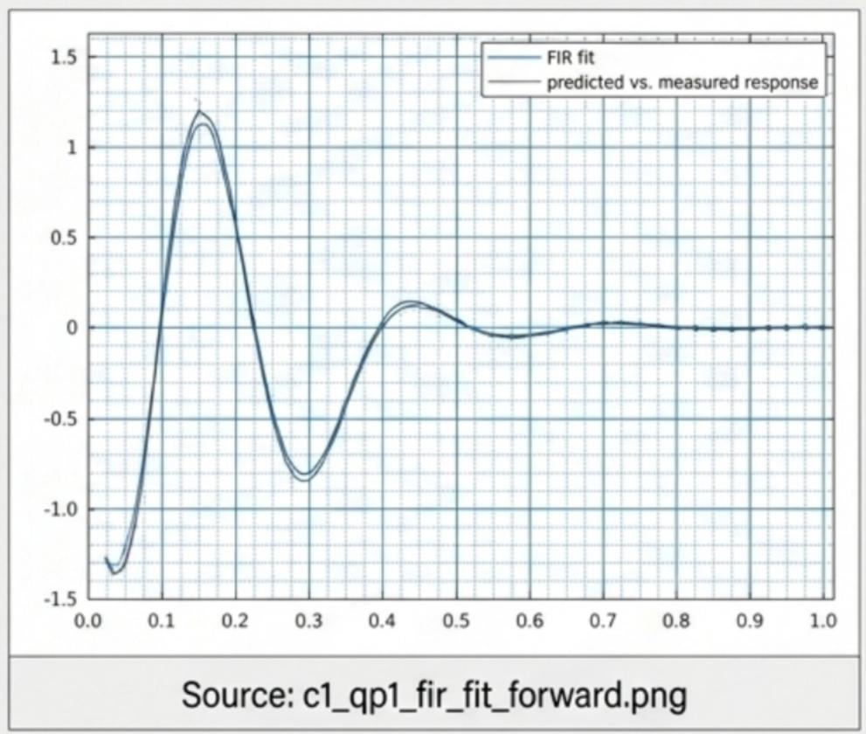
The MPC calculates micro-corrections over the
nominal reference rather than replanning the full gait
qcmd=Qref +Gα
·G:Fixed 6-joint correction mapping
·α:Scalar correction optimized via QP
·FIR Model:Predicts the delayed effect of corrections on future torso pitch
·QP Solver:Constrains correction magnitude and slew rate
FDDP handles the nonlinear nominal motion;FIR-QP-MPC handles local pitch disturbance re _{l}
NoteboOKLM

Slide 9




CO,C1,and C2 independently validate nominal tracking,
disturbance recovery,and phase synchronisation
CO:Reference Baseline
·Command:△q=0
·Function:Nominal position tracking in MuJoCo replay
·Role:Proves the FDDP reference and actuator proxy are viable
C1:Pitch Recovery
·Command:FIR-QP- MPC
·Function:Calculates
△q based on torso
pitch error
·Role:Improves
disturbance recovery via amplitude
correction
C2:Phase +Amplitude
·Command:C1+
Contact Observer
·Function:Retimes
reference phase (t+△t) based on
touchdown/liftoff events
·Role:Handles contact timing mismatch
Fair Comparison Protocol:All controllers evaluated under:
Same Reference·Same Disturbance·Same Actuator Proxy·Same Initial State
A NotebookLM

Slide 10
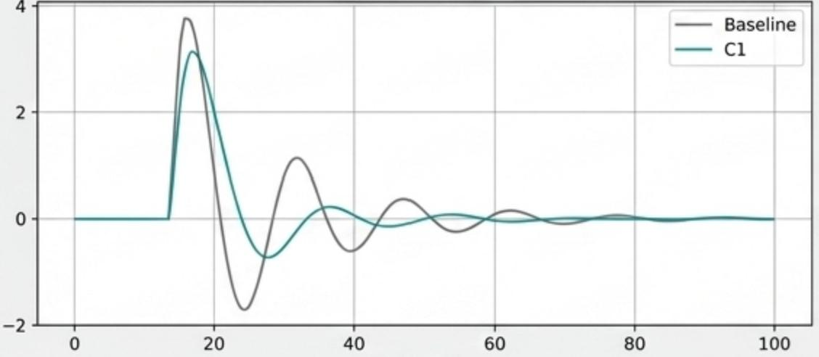
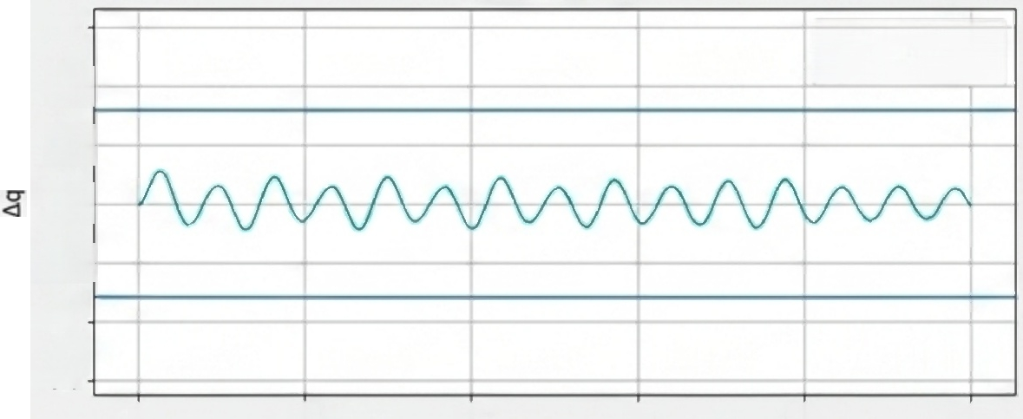
C1 reduces pitch Integral Absolute Error(IAE)and
settling time following a disturbance
Pitch Comparison
Corrections
一 U
一
0.4
0.2
0.0
-0.2
-0.4
-0.6
20 40 60 80
0.6
pper Lower
Limit
Limit
Pch
0 20 40 60 80 Time( s)
0
Time (s)
Source:c1_qp2_forward_corrections.png
100
Source:c1_qp2_forward_pitch_comparison.png
Key Observations
1.C1 does not reliably reduce the initial peak at the exact moment of disturbance.
2.The primary benefit of C1 is accelerated settling time and improved overall IAE(8.7%- 14.4%improvement).
3.Joint corrections(△q)safely respect position-command bounds(Max correction:0.711).
*FIR holdout validates local prediction;it does not assume global nonlineari A NotebookLM

Slide 11

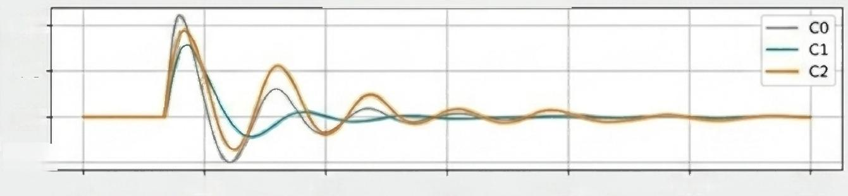
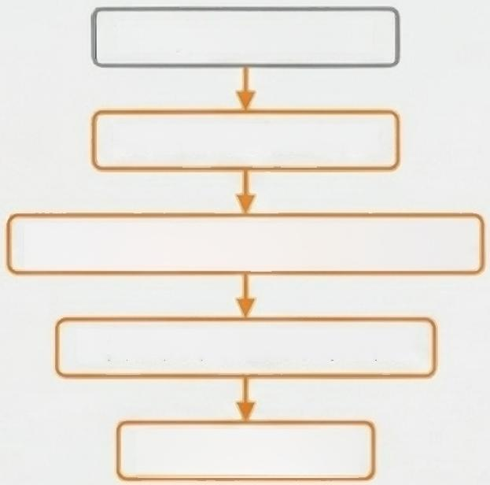
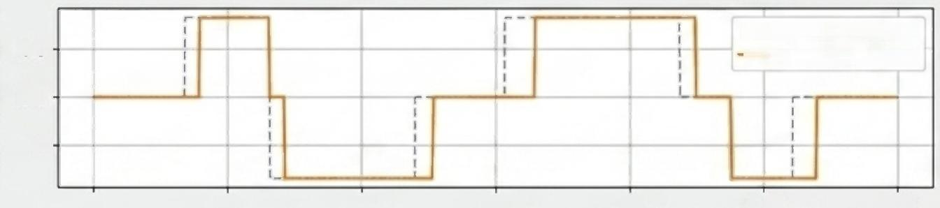
C2 synchronises contact timing,though phase alignment does not guarantee improved pitch IAE over C1
Pitch Error Comparison
0.4
0.2
0.0
-0.2七
40 60 80 100 120
C2 Sequence
Toe/Heel Sensor
Contact Observer
Expected vs.Observed Event
Bounded Phase Offset
Retimed q_ref
(peJ)JO3 4PHd
0
20
0.5
0.0
-0.5-
0
---Expected Event
— Observed Event
100 120
Contact Phase Oet
20
40
60
Time (s)
80
Sources:fddp_two_step_c0_c1_c2_pitch.png/fddp_two_step_natural_contact_c2.png
^{Key} ^{Insights}
correct natural contact sequence. A NotebookLM
C2's direct optimization target is phase alignment,not strictly pitch stability.
· Superior phase accuracy does not inherently yield smaller pitch IAE.
· Global contact counts alone cannot verify that each individual foot experienced the

Slide 12

The next phase upgrades 'feasible trajectories'to statistically robust multi-step simulation validation
Completed milestones
√ Contact-switching FDDP single step
√ Left/right step and two-step planning
√ Contact-feasible periodic cycle formulation
√ MuJoCo position-command replay(C0)
√ C1 FIR-QP-MPC pitch recovery
√ C2 event-layer validation prototype
√ E1/E4/E5/E6 supporting evidence
Next Steps &Final Validation
→ Formal 10-step gated nominal trajectory
→ 10s MuJoCo CO/C1/C2-final validation → Natural early/late touchdown handling
→ Robustness batch:Friction,slope,step, delay,4N push
→ Multi-seed success rates and confidence intervals
→Visual walking and recovery animations
The project has proven FDDP generates viable real-contact single steps;the next
imperative is proving multi-step repeatability under unmodeled disturbances. _{A} _{NotebookLM}

Slide 13

Backup B1:Independent Physical Verification Gates
Gate Metric Threshold Limit
Shooting gap | ≤10-7
Support translation error | ≤0.5 mm
Support rotation error | ≤0.5°
Landing position error | ≤1.0 mm
Landing rotation error | ≤1.0°
Swing foot clearance | ≥10.0 mm
Joint limit margin | ≥10.0 mrad
Forward CoM advancement | ≥2.0 mm
Friction utilisation ≤0.90
CoP margin ≥2.0 mm
*Evaluated externally in Python;cannot be bypassed by Crocoddyl solver success flags.
A NotebookLM

Slide 14

Backup B2:Controller Fair Comparison Protocol
To isolate the specific contributions of C0,C1,and C2,all comparative simulations strictly enforce:
· Identical FDDP nominal reference trajectory
· Identical initial starting state
·Identical disturbance parameters [direction,amplitude,injection time]
·Identical actuator proxy characteristics [delay,lag,speed limits]
· ldentical contact model thresholds
· Identical simulation duration〔horizon〕
· Identical performance metrics [IAE,settling time]
A NotebookLM

Slide 15

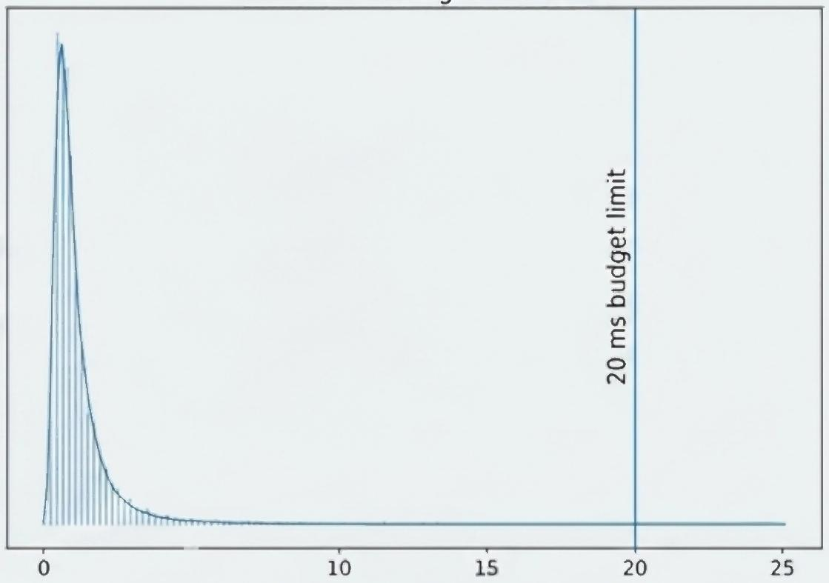
Backup B3:Controller Timing &System Real-Time Evidence
Precision Histogram Chart
0 5 10 15
Execution Time(ms)
Key Timing Metrics
· Controller Frequency:50 Hz (20 ms budget)
· C295th Percentile Execution: ~0.75-0.77 ms
· C2 Maximum Execution:
~0.90-0.93 ms
· Total Updates Sampled: 61
● Deadline Misses:O
Frequency
20
Source:e6_controller_timing_distribution.png
Hardware real-time claims are pending physical deployment;these metrics confirm the FIR-QP-MPC algorithm computes well within standard bounds.
A NotebookLM

