Slide 1

Lesson-17 After Dev: Environment, Container, Docker, Logging

Slide 2
Python Environment
1. Virtual Env
2. Conda
Determined by:
 | Version | Depedancy Pakcage

Slide 3
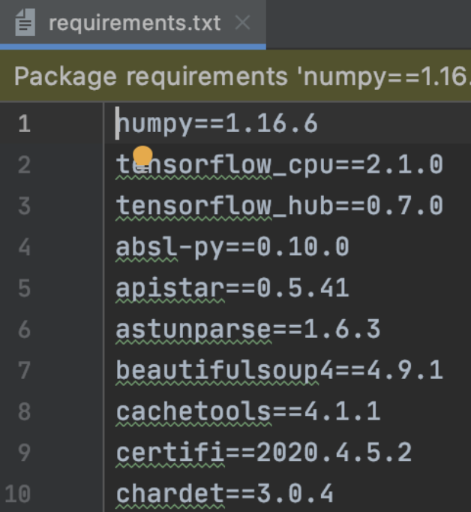
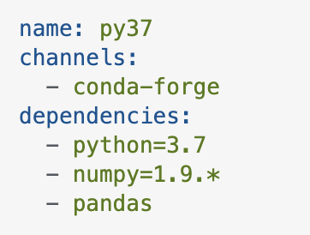
Environment Dependancy
1. Requirements.txt
$ pip install –r requirements.txt
2. environment.yml
$ conda install - -file environment.yml

Slide 4
Get dependancy
1. env1/bin/python -m pip freeze > requirements.txt
2. conda env export --from-history>ENV.yml # plateform non specific
3. conda env export ENVNAME>ENV.yml

Slide 5
Install when some files error
cat requirements.txt | xargs -n 1 pip install

Slide 6
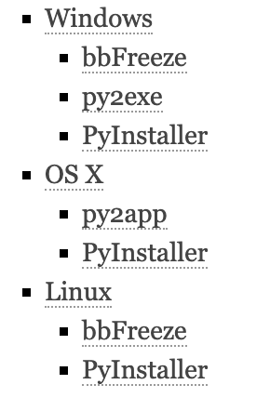
Publish your work
Source code -> application

Slide 7
Deploy with Running Isolation
How to install python project in a non-internet environment?
1. With Virtual Environment: # 课间休息
1. download all the dependancy to a package
$ cat requirements.txt | xargs -n 1 pip download --plateform <manylinux1_x86_64>
2. $ pip install -r requirements.txt --no-index --find-links file:///tmp/packages

Slide 8
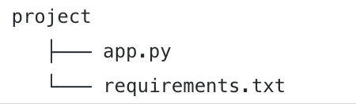
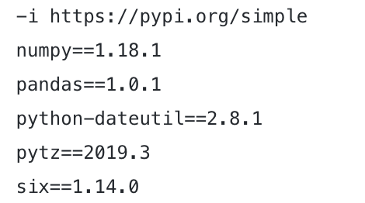
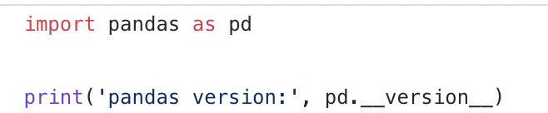
Run Python in Docker

Slide 9
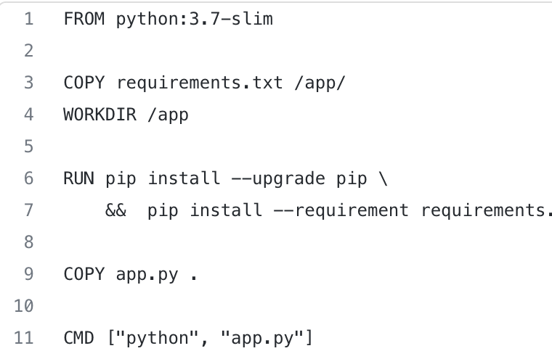
Create a docker file
a valid Dockerfile must start with a FROM instruction that sets the parent image. Parent images are hosted on Docker Hub, so you don’t need to store them locally. Parent images are based on an OS (e.g. Debian, Alpine Linux, etc.). Each subsequent instruction in the Dockerfile modifies this parent image
COPY the app.py to the working directory (i.e.app folder) in the parent image

Slide 10
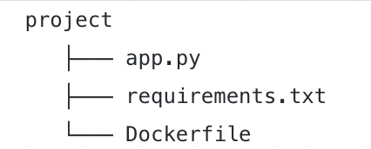
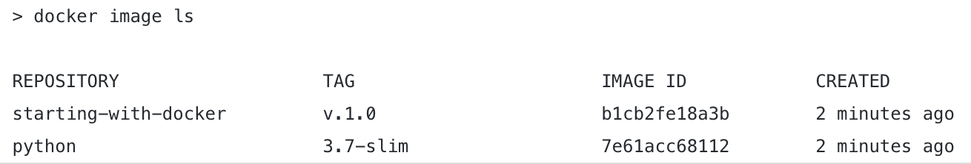
$ > docker build --tag=<image-name:tag> .

Slide 11
> docker run --rm <image-name:tag>
> docker run --rm starting-with-docker:v.1.0
>> pandas version: 1.0.1

Slide 12
Push docker
> docker tag starting-with-docker:v.1.0 your-id/starting-with-docker:v.1.0
> docker push your-id/starting-with-docker:v.1.0

Slide 13
Use your docker
$ docker pull your-id/starting-with-docker:v.1.0
$ docker run --rm your-id/starting-with-docker:v.1.0

Slide 14
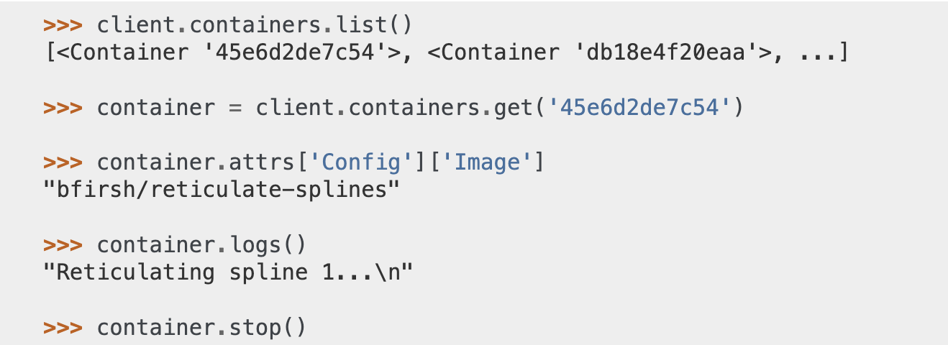
Python call Docker
$ pip install docker

Slide 15
Python Logging
import logging
- DEBUG
- INFO
- WARNING
- ERROR
- CRITICAL

Slide 16
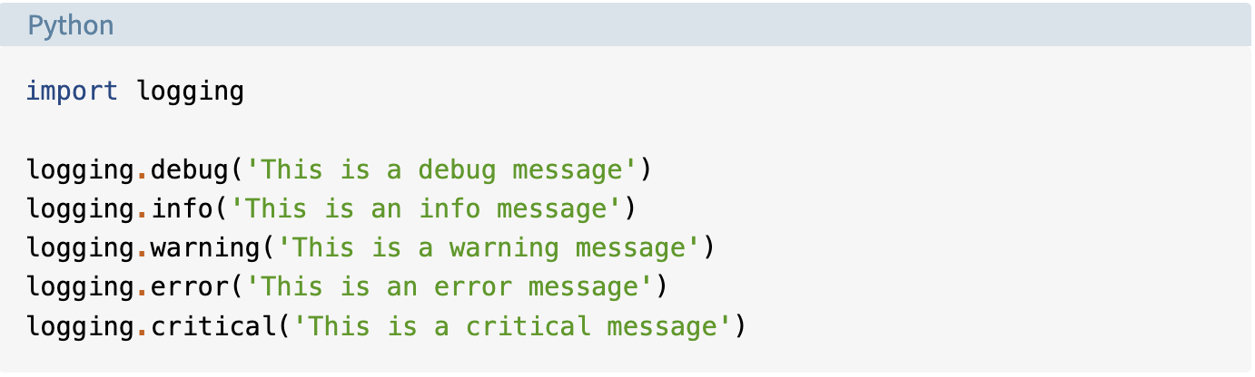
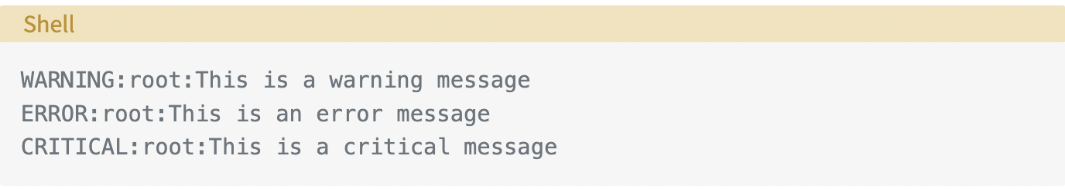

Slide 17
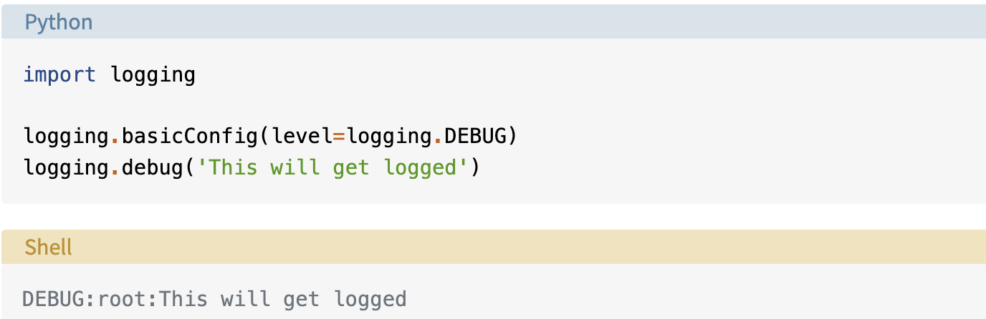

Slide 18
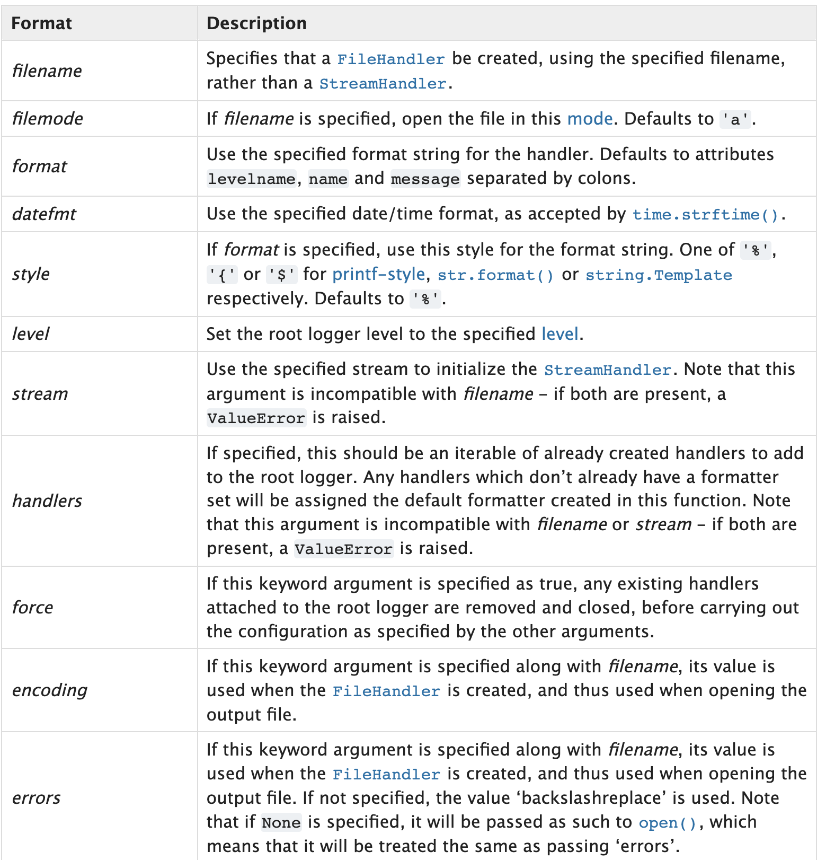
import logging
logging.basicConfig(filename='app.log', filemode='w', format='%(name)s - %(levelname)s - %(message)s’)
logging.warning('This will get logged to a file')

Slide 19
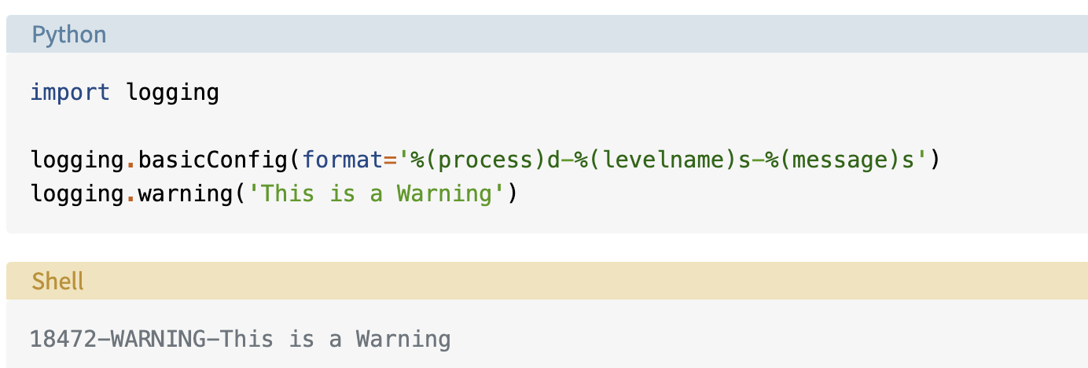
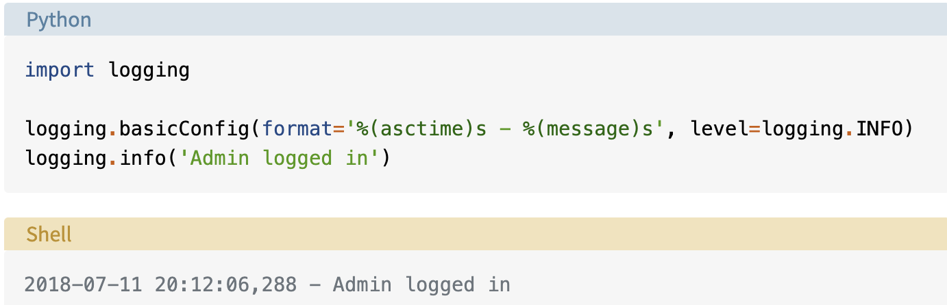
Logging Format

Slide 20
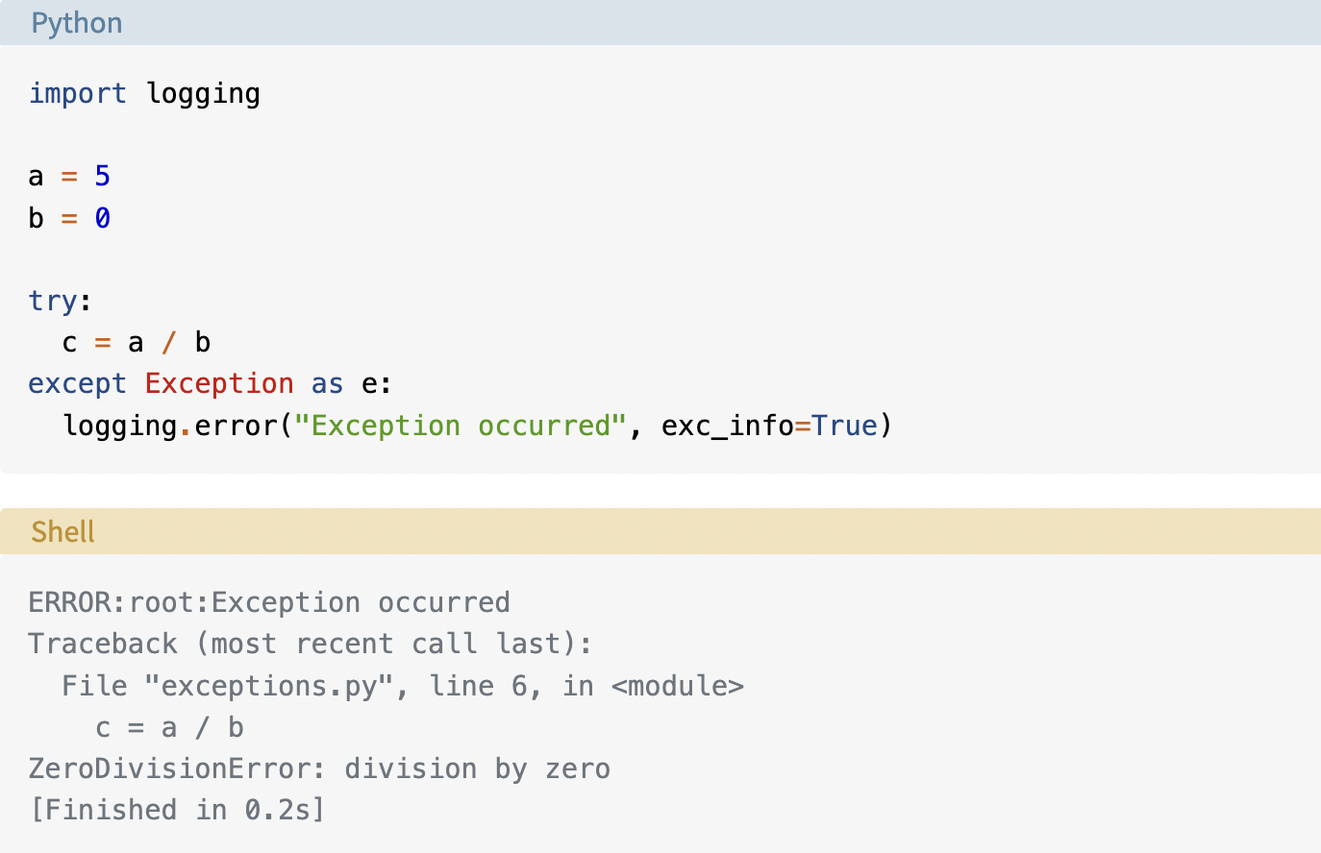
Stack Over

Slide 21
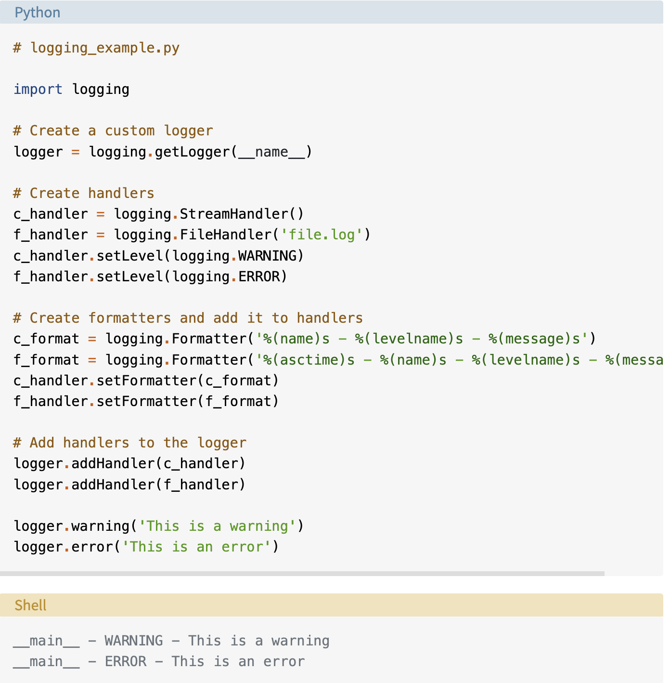
handler

Slide 22
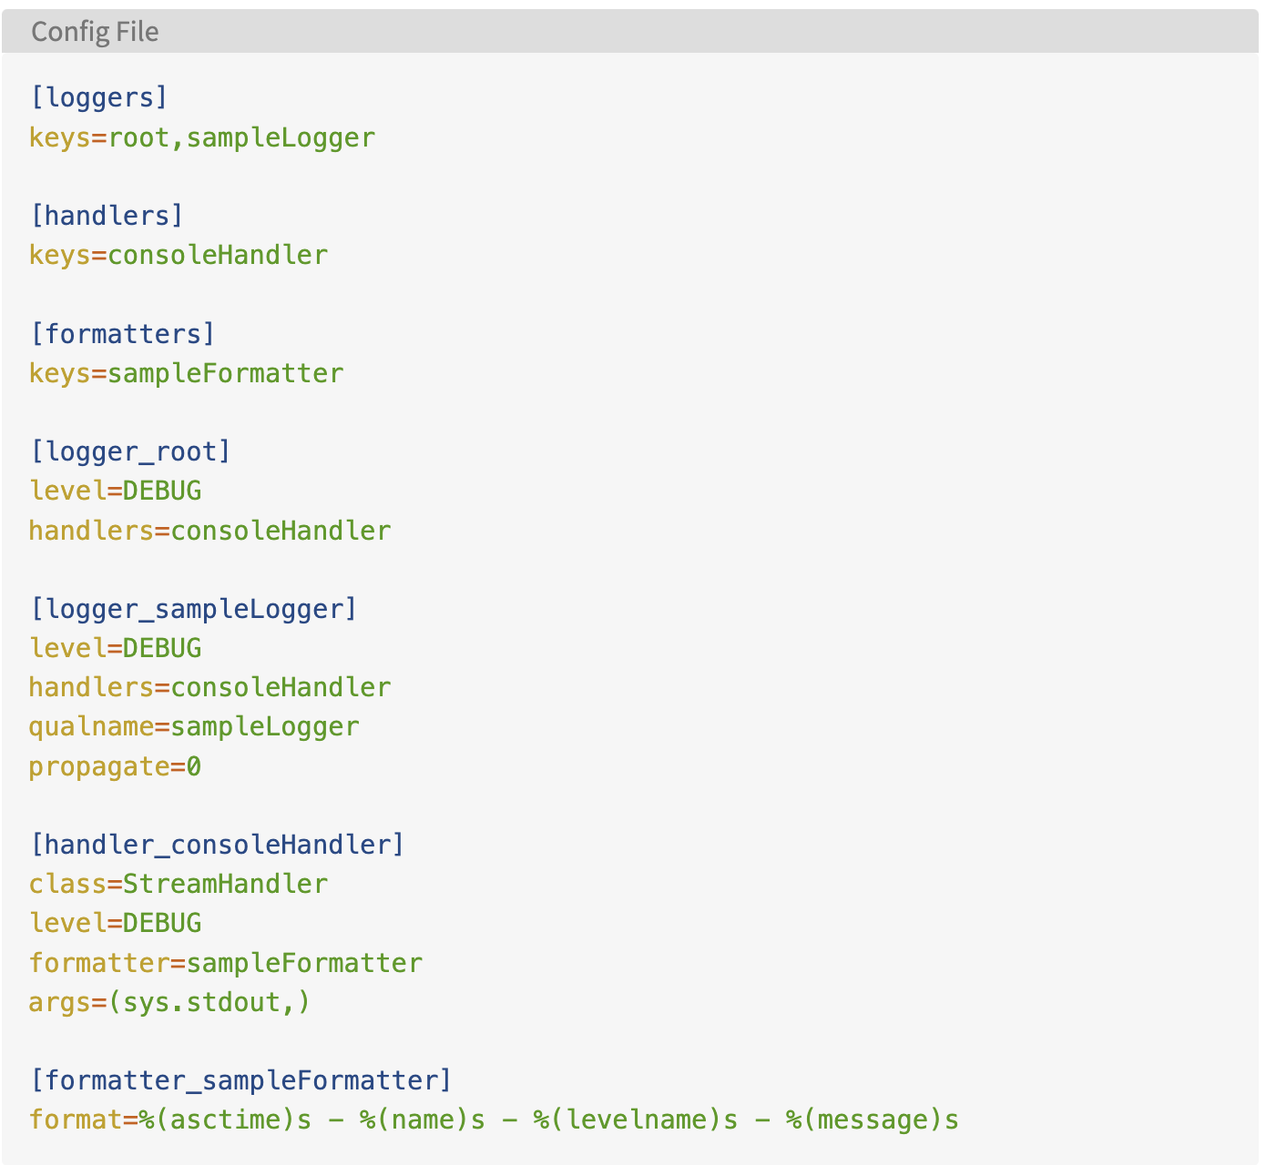
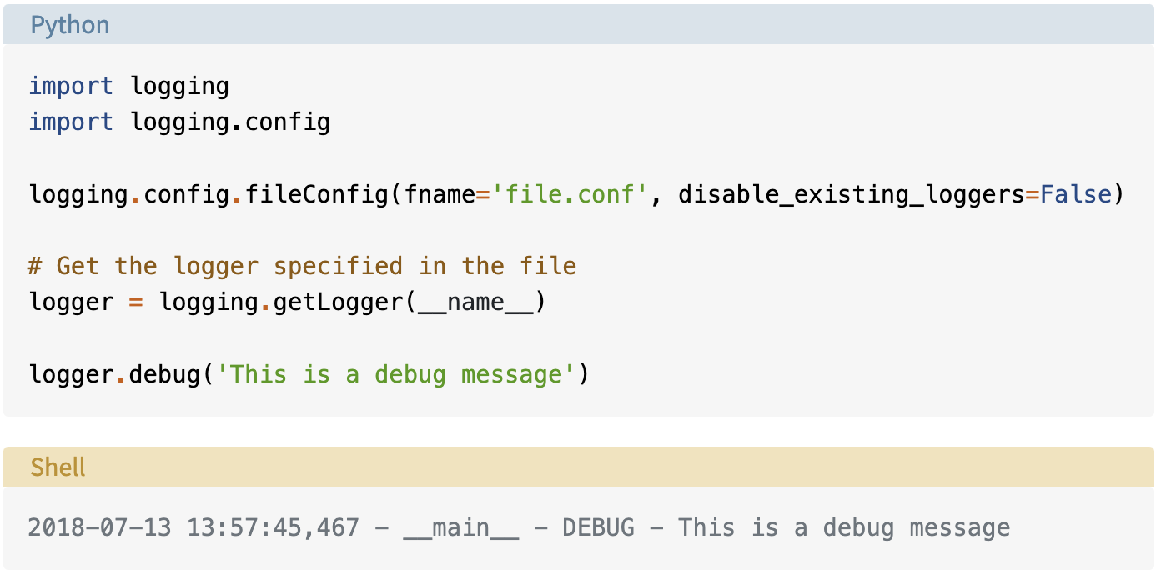
Config file

Slide 23
A useful cmd
$ tail –f somefile.log

Slide 24

Thanks

