Slide 1

Lesson-16 Enterprise Experience for Python
Minquan

Slide 2
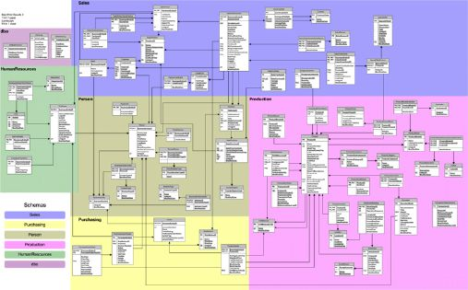
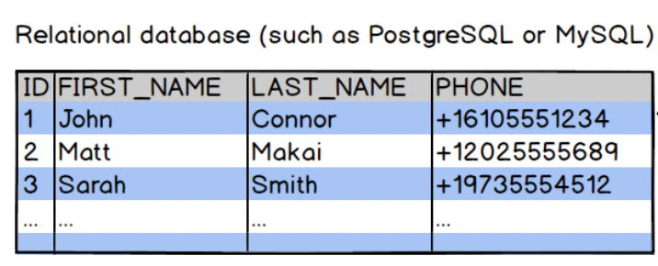

1. ORM
Relational database

Slide 3
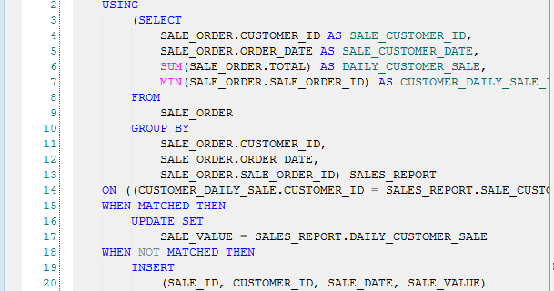

SELECT * FROM USERS WHERE zip_code=94107;
SELECT DATE_FORMAT(co.order_date, '%Y-%m') AS order_month, DATE_FORMAT(co.order_date, '%Y-%m-%d') AS order_day, COUNT(DISTINCT co.order_id) AS num_orders, COUNT(ol.book_id) AS num_books, SUM(ol.price) AS total_price FROM cust_order co INNER JOIN order_line ol ON co.order_id = ol.order_id GROUP BY DATE_FORMAT(co.order_date, '%Y-%m'), DATE_FORMAT(co.order_date, '%Y-%m-%d') ORDER BY co.order_date ASC;

Slide 4
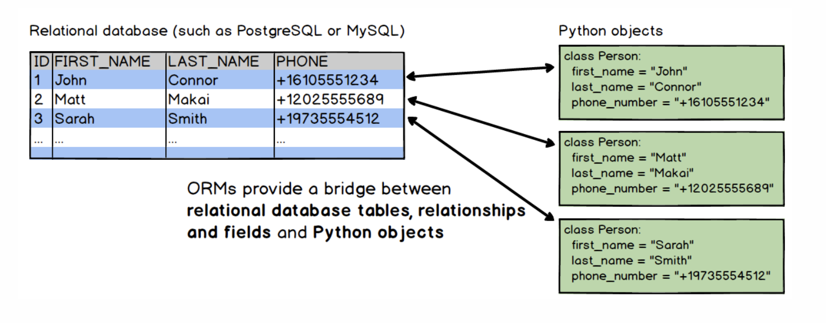


Slide 5


SELECT * FROM USERS WHERE zip_code=94107;
=>
users = Users.objects.filter(zip_code=94107)

Slide 6
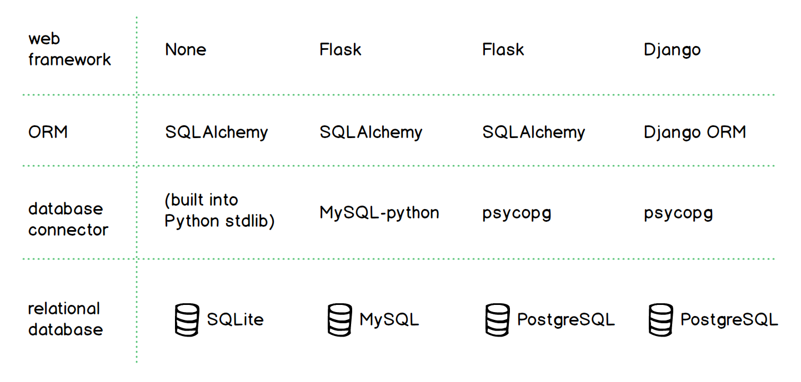


Slide 7
>> SQLAlchmy Doc

Slide 8

2. Ray Machine Leanring

Slide 9

Ray – Distributed Environment
1. Deep Learning
2. Hyperparameter Tuning
3. Model Serving
4. Reinforcement Learning
5. General Python Apps
6. Data Processing

Slide 10
01
Deep learning example <jupyter notebook>

Slide 11
02
Tuning example < jupyter notebook>

Slide 12
03
End-to-End Serving <Pycharm>

Slide 13
04
Rlib <Pycharm>

Slide 14

3. Python RPC

Slide 15


>>> doc introduction: https://rpyc.readthedocs.io/en/latest/tutorial/tut1.html

Slide 16

4. Python & Celery
https://levelup.gitconnected.com/celery-python-guide-basics-and-examples-8795933400ef

