Slide 1
Serial Communication Interface

Slide 2
Outline
Serial vs Parallel Communication
Synchronous vs Asynchronous
Data Format
Baud rate
Register descriptions
Implementation Specific Features
Examples

Slide 3
Introduction to Data Transmission
Ta Kim
“transfer of data from point-to-point”
http://en.wikipedia.org/wiki/Data_transmission
PURPOSE: It provides a method for electronic devices to communicate with each other

Slide 4
Parallel Data Transmission
RECEIVER
N bits transmitted at a time over N data lines
Synchronization among all N bits
Note: each N bit is called a word
TRANSMITTER
Ta Kim

Slide 5
Serial Data Transmission
RECEIVER
Transfers one bit at a time on one data line
TRANSMITTER
Ta Kim

Slide 6
Parallel vs. Serial
Serial requires less transfer lines
Transfers one bit at a time
Slow comparatively, but less expensive
Parallel requires more transfer lines
Bits have to be synchronized
Fast, but expensive
Ta Kim

Slide 7
Bit Rate Comparison
Interface | Bit Rate (Mbits/sec) | Max. Cable Length (m)
Ultra-320 SCSI | 2560 | 12
P ATA | 1064 | 0.46 (18 in.)
S ATA | 1500 | 1
FireWire | 786 | 100
USB | 480 | 5
Parallel
Serial
Ta Kim

Slide 8
Synchronous Serial Communication
Ta Kim
Requires clock signal to synchronize transmitter and receiver
Continuous transmission to keep clock synchronized
Data transfer rate is determined by clock rate

Slide 9
Asynchronous Serial Communication
Ta Kim
Transmitter and Receiver operate independently
Transmitter sends data at any time
Receiver is ready to accept data at all times
No need for clock signals
…but during transmission, format and transfer rate of data must match

Slide 10
Asynchronous Transmission
Ta Kim
Word contains information that specifies the beginning and end of word to synchronize transmitter and receiver while exchanging data
Bit transfer rate is determined programmer (but also limited by interface) and must match between transmitter and receiver

Slide 11
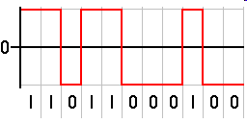
Data Encoding Scheme
Ta Kim
NRZ = Non-Return-to-Zero
Uses a (+) voltage for 1
Uses a (-) voltage for 0

Slide 12
Data Format
Ta Kim
Start bit – indicates the beginning of word
Data bit – data user is transmitting
Parity bit – checks integrity of data
Stop bit – indicates the end of word

Slide 13
Data Format
Idle 1
Start bit 0
Data bit 0 or 1
Parity 0 or 1
Stop bit 1
Idle
Data
Bit 1
Data
Bit 3
Data
Bit 6
Parity
Bit
HIGH
Stop Bit
LOW
Start
Bit
Data
Bit 0
Data
Bit 2
Data
Bit 4
Data
Bit 5
Data
Bit 7
Ta Kim

Slide 14
Example of Data Bit Formats
 | Start Bit | Data Bit | Parity Bit | Stop Bit
8 Bit Data Format | 1 | 8 | 0 | 1
 | 1 | 7 | 1 | 1
9 Bit Data Format | 1 | 9 | 0 | 1
 | 1 | 8 | 1 | 1
Ta Kim

Slide 15
Parity
Hardware supports both odd and even parity
When enabled, MSB is parity bit
Even Parity
Parity bit is set to 1 when the number of 1 bits is an odd number (when including the parity bit, is then even)
Nick Earnhart

Slide 16
Parity
Odd Parity
Parity bit is set to 1 when the number of 1 bits is even (when including the parity bit, is then odd)
Example – Even Parity
0101010101 4 1’s in data → 0
Data
Stop Bit
Start Bit
Parity Bit
Nick Earnhart

Slide 17
Error and Issues
Nick Earnhart
Noise Detection
Overrun
Framing Error
Parity Error

Slide 18
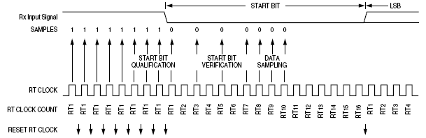
Noise Detection for Start Bit
NOT the same frequency as the bus clock
RT Clock = baud rate * 16
Nick Earnhart

Slide 19
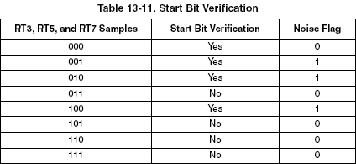
Noise Detection for Start Bit
Samples taken after the signal falls to 0 to verify if it is indeed a start bit
RT3, RT5, RT7 are samples taken
If two “1”s in sample, then flagged & not a start bit
Nick Earnhart

Slide 20
Overrun
RECEIVER
Software fails to read the SCI data register before it receives the next frame
SOFTWARE
REGISTER
TRANSMITTER
Nick Earnhart

Slide 21
Framing Error
RECEIVER
Data sent are not in proper format
Start bit is indicate the beginning of each frame and a reference point for the other bits in the frame
Stop bit is not where it’s expected to be
FORMAT RECIEVER EXPECTS
FORMAT TRANSMITTER SENDS
TRANSMITTER
Nick Earnhart

Slide 22
Parity Error
RECEIVER
Data sent are not in proper format
Parity bit does not match with what is expected
Example:
Transmitter is sending #$99
Not set up with same parity as receiver
0
1
0
0
1
1
0
0
1
0
0
0
1
0
0
1
1
0
0
1
1
0
What it thinks it should get…
What it gets…
TRANSMITTER
Nick Earnhart

Slide 23
Baud & Bitrate
Baud rate and bit rate are NOT the same
Baud rate (Bd) is the number of line state changes possible per second
Bit rate (bps) is the number of bits transmitted per second
The hardware we are using has two line states (high/low)
Two line states can be represented with one bit
In our hardware, 1 baud = 1 bit
Nick Earnhart

Slide 24
Baud & Bitrate
Other hardware can produce and recognize more than two line states using voltage, frequency, or phase modulation resulting in more bits per baud
bps = baud rate x number of bits per baud
In our hardware, given a 9600 baud rate
Nick Earnhart

Slide 25
Baud & Bitrate
Not all bits transmitted are data
Start/stop/parity bits are transmission overhead
Throughput = data transmission excluding overhead
A useful unit for describing throughput is characters per second (cps)
A standard character is one byte of data
cps is not the same as bytes per second
bytes per second is ambiguous on whether overhead is subtracted out or not.
Nick Earnhart

Slide 26
Baud & Bitrate
Assuming 9600bd line speed, 8 bit data format with no parity, 1 start bit and 1 stop bit, calculate the throughput in cps using the following equation
Nick Earnhart

Slide 27
Baud & Bitrate
Assuming 9600bd line speed, 8 bit data format with no parity, 1 start bit and 1 stop bit, calculate the throughput in cps using the following equation
Don’t forget to convert bauds to bits per second first!
Nick Earnhart

Slide 28
Baud & Bitrate
Baud set by the equation:
Where BR is the content of Baud Rate Register (described later)
Value 0 to 8191
Serial communication uses only 2 line states thus Bd = bps
Nick Earnhart

Slide 29
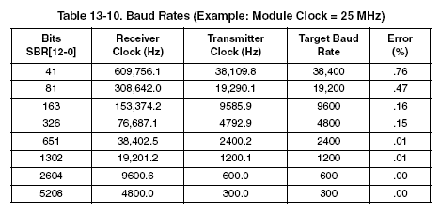
Baud & Bitrate
Table with sample Baud Rates
Can’t always get the exact baud rate due to division of the clock
Nick Earnhart

Slide 30
Implementation Specific Features (S12SCIV2)
Full Duplex
13-bit baud rate selection
8- or 9-bit data format
Separate TxD and RxD enable
Programmable output parity and Hardware parity checking
Two receiver wake up methods
Interrupt driven operation with 8 flags
8 registers used to control SCI ($00C8-$00CF)
Uses Port S pins 0 & 1 for RXD and TXD respectively
Razid Ahmad

Slide 31
Register descriptions
Key settings will be discussed in detail
Safe to use defaults for all other settings
Summarizes pages 383-393 in Family Reference Manual
Razid Ahmad

Slide 32
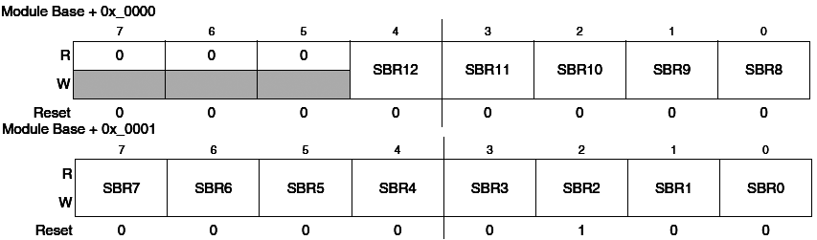
$00C8/C9 – SCIBDH/SCIBDL
13-Bit register determines SCI Baud rate
Baud rate generator is Disabled until TE or RE bit is set after reset.
You MUST write to SCIBDH and then SCIBDL.
Baud rate generator is turned off when this register contains $0000
Razid Ahmad

Slide 33
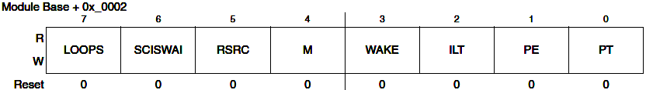
$00CA – SCICR1
M (data format mode) – 0: 8-bit, 1: 9-bit. Both 8- and 9-bit data have 1 start and 1 stop bit.
PE (parity enable) – 0: OFF, 1: ON
PT (parity type) – 0: EVEN, 1: ODD
Razid Ahmad

Slide 34
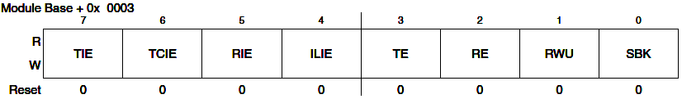
$00CB – SCICR2
TIE (transmit interrupt enable) – 0: disables interrupts for transmit data register empty, 1: enables
TCIE (transmit complete interrupt enable) – 0: disables interrupts for transmit complete, 1: enables
RIE (receiver interrupt enable) – 0: disables interrupts for receiver full and overrun , 1: enables
Razid Ahmad

Slide 35
$00CB – SCICR2
ILIE (idle line interrupt enable) – 0: disables interrupts for idle line, 1: enables
TE (transmit enable) – 0: disable transmitter, 1: enable
RE (receiver enable) – 0: disable receiver, 1: enable
Razid Ahmad

Slide 36

$00CC – SCISR1
Read only
TDRE (transmit data register empty) – 1: byte successfully transferred to transmit shift register
TC (transmit complete) – 0: no transmit in progress, 1: transmit in progress
RDRF (receive data register full) – 0: no data in SCIDRL, 1: data in SCIDRL
Razid Ahmad

Slide 37
$00CC – SCISR1
OR (overrun) – 0: no overrun, 1: overrun (overrun happens when new data is received before old data is read)
NF (noise flag) – 0: disable, 1: enable
FE (framing error flag) – 0: disable, 1: enable
PF (parity error) – 0: No parity error, 1: parity error
Razid Ahmad

Slide 38
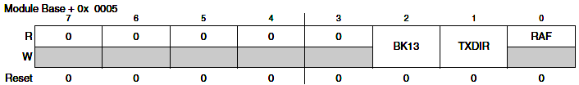
$00CD – SCISR2
Not a very interesting register
TXDIR (transmitter pin direction) – 0: TXD pin used as input, 1: TXD pin used as output. (used only in single wire mode)
Razid Ahmad

Slide 39
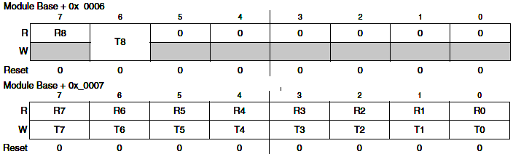
$00CE/CF – SCIRDH/SCIRDL
SCIRDL contains incoming bytes of data from serial port
R8 – bit 8 of received 9-bit data
T8 – bit 8 of transmitted 9-bit data
Razid Ahmad

Slide 40
SCI is easy
SCI module makes it easy to send/receive data
SCI module encodes data into standard NRZ format!
Hardest part is setting up baud rate
Can use either flag based or interrupt based logic to drive SCI
One interrupt vector associated with all 8 flags
SCIDRH/SCIDRL are like two registers in one.
Read this register to receive data
Write to this register to send data
Razid Ahmad

Slide 41
Example
First, calculate baud rate. Assume 8MHz bus and desired baud rate is 9600
SCI module runs at bus speed
Razid Ahmad

Slide 42
Example
First, calculate baud rate. Assume 8MHz bus and desired baud rate is 9600
SCI module runs at bus speed
Desired value for SCIBR is 52
You will have some error margin
Exact solution is 52.0833
Actual baud rate is 9615.3 (0.160% error)
Razid Ahmad

Slide 43
Example
Write SCIBR ($34) to SCIBDH/SCIBDL
For 8-bit, no parity, no interrupts, default values will work
Simply enable transmit and receive in SCICR2
Read from SCIDRL to receive 8-bit data
Write data to SCIDRL to send 8-bit data
Program will do a remote echo
Razid Ahmad

Slide 44
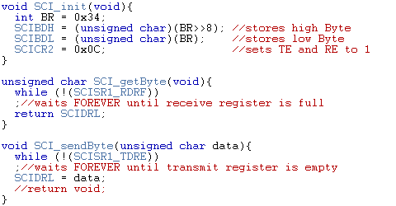
Code Example
Razid Ahmad

Slide 45
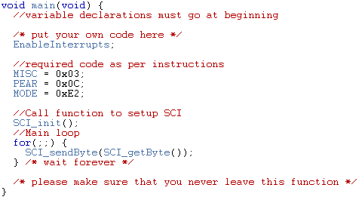
Code Example
Razid Ahmad

Slide 46
References
MC9S12C Family Reference Manual
Previous semester slides
Wikipedia

Slide 47
#include <hidef.h> /* common defines and macros */
#include <mc9s12c32.h> /* derivative information */
#pragma LINK_INFO DERIVATIVE "mc9s12c32"
void SCI_init(void){
int BR = 0x34;
SCIBDH = (unsigned char)(BR>>8); //stores high Byte
SCIBDL = (unsigned char)(BR); //stores low Byte
SCICR2 = 0x0C; //sets TE and RE to 1
}
unsigned char SCI_getByte(void){
while (!(SCISR1_RDRF))
;//waits FOREVER until receive register is full
return SCIDRL;
}
void SCI_sendByte(unsigned char data){
while (!(SCISR1_TDRE))
;//waits FOREVER until transmit register is empty
SCIDRL = data;
//return void;
}
void main(void) {
//variable declarations must go at beginning
/* put your own code here */
EnableInterrupts;
//required code as per instructions
MISC = 0x03;
PEAR = 0x0C;
MODE = 0xE2;
//Call function to setup SCI
SCI_init();
//Main loop
for(;;) {
SCI_sendByte(SCI_getByte());
} /* wait forever */
/* please make sure that you never leave this function */
}

