Slide 1
I²C

Slide 2
Inter-Integrated Circuit
Developed and patented by Philips for connecting low speed peripherals to a motherboard, embedded system or cell phone
Multi-master, two wire bus , up to 100 Kbits/sec
One data line (SDA)‏
One clock line (SCL)‏
Master controls clock for slaves
Each connected slave has a unique 7-bit address

Slide 3
Protocol
Transfers are byte oriented, msb first
Start: SDA goes low while SCL is high
Master sends address of slave (7-bits) on next 7 clocks
Master sends read/write request bit
0-write to slave
1-read from slave
Slave ACKs by pulling SDA low on next clock
Data transfers now commence

Slide 4
Terminology
Transmitter – The device sending data to the bus
Receiver – Device receiving data from the bus
Master – device initiating a transfer, generates to clock and terminates a transfer
Slave – Device addressed by the master
Multi-master – more than one master can attempt to control the bus
Arbitration – procedure to insure that only one master has control of the bus at any instant
Synchronization – procedure to sync the clocks of two or more devices

Slide 5
Master-to-Slave Data Transfer
Clock is controlled by master
Data is written to slave on next 8 clock pulses
Data receipt is ACKed by slave on 9th pulse by pulling SDA low
When slave releases SDA master can send next byte
Master will eventually set a Stop condition by making a low to high transition on SDA with SCL is high

Slide 6
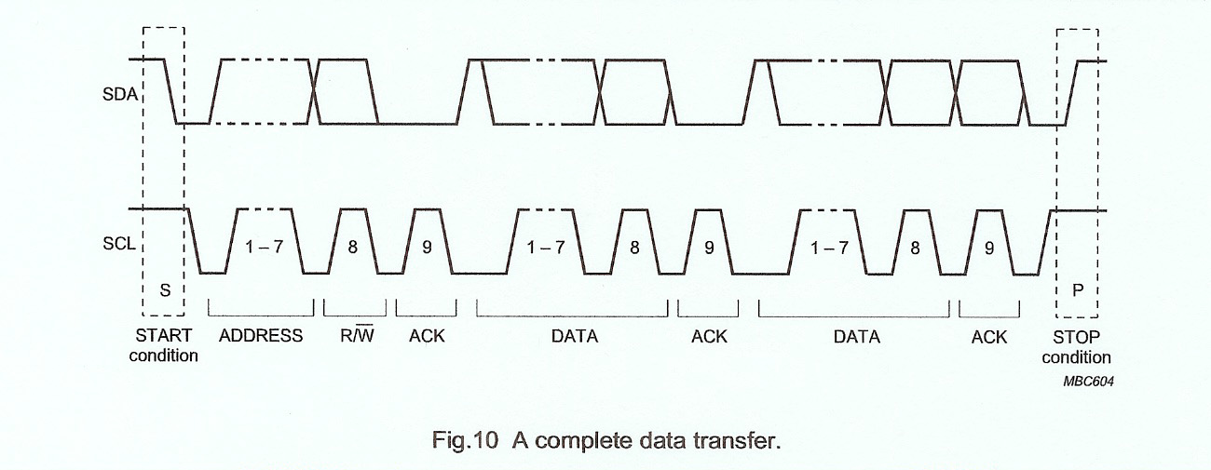
Complete I2C Transfer

Slide 7
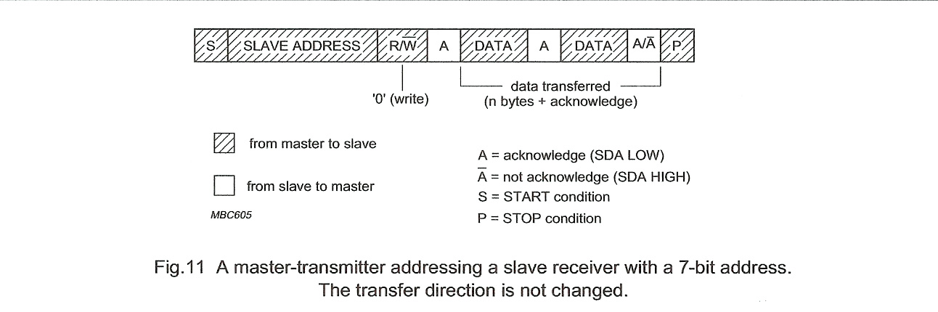
Master Writes to Slave

Slide 8
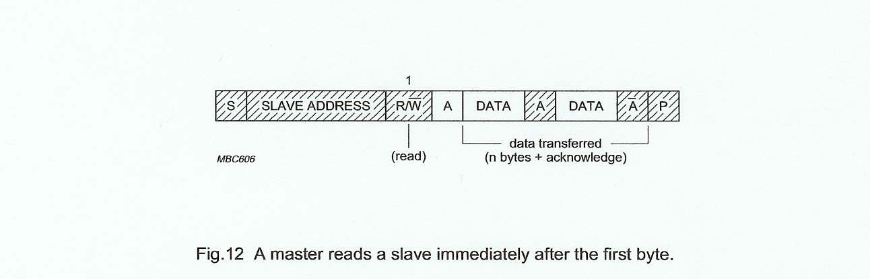
Master Reads from Slave

Slide 9
I2C Extensions
10 bit addressing (up to 1024 addresses)‏
Fast mode – up to 400 kbits/sec
High-Speed – up to 3.4 Mbits/sec

