Slide 1
An Overview of Peer-to-Peer

Slide 2
Outline
P2P Overview
What is a peer?
Example applications
Benefits of P2P
Is this just distributed computing?
P2P Challenges
Distributed Hash Tables (DHTs)

Slide 3
What is Peer-to-Peer (P2P)?
Napster?
Gnutella?
Most people think of P2P as music sharing

Slide 4
What is a peer?
Contrasted with Client-Server model
Servers are centrally maintained and administered
Client has fewer resources than a server

Slide 5
What is a peer?
A peer’s resources are similar to the resources of the other participants
P2P – peers communicating directly with other peers and sharing resources
Often administered by different entities
Compare with DNS

Slide 6
P2P Application Taxonomy
P2P Systems
Distributed Computing
SETI@home
File Sharing
Gnutella
Collaboration
Jabber
Platforms
JXTA

Slide 7
Distributed Computing

Slide 8
Collaboration
sendMessage
receiveMessage
sendMessage
receiveMessage
Notes:
anyone have an objection to this model

Slide 9
Collaboration
sendMessage
receiveMessage
sendMessage
receiveMessage

Slide 10
Platforms
Gnutella
Instant Messaging
Find Peers
…
Send Messages

Slide 11
P2P Goals/Benefits
Cost sharing
Resource aggregation
Improved scalability/reliability
Increased autonomy
Anonymity/privacy
Dynamism
Ad-hoc communication

Slide 12
P2P File Sharing
Centralized
Napster
Decentralized
Gnutella
Hierarchical
Kazaa
Incentivized
BitTorrent
Distributed Hash Tables
Chord, CAN, Tapestry, Pastry

Slide 13
Challenges
Peer discovery
Group management
Search
Download
Incentives

Slide 14
Metrics
Per-node state
Bandwidth usage
Search time
Fault tolerance/resiliency

Slide 15
Centralized
Bob
Alice
Napster model
Server contacted during search
Peers directly exchange content
Benefits:
Efficient search
Limited bandwidth usage
No per-node state
Drawbacks:
Central point of failure
Limited scale
Judy
Jane
Notes:
Upload index to central server when you come online
To search, consult central server
Request doc directly

Slide 16
Decentralized (Flooding)
Carl
Jane
Gnutella model
Search is flooded to neighbors
Neighbors are determined randomly
Benefits:
No central point of failure
Limited per-node state
Drawbacks:
Slow searches
Bandwidth intensive
Bob
Alice
Judy
Notes:
Everyone knows about some small number of nodes
To find a file, ask everyone you know
When you find out who has the doc, ask directly

Slide 17
Hierarchical
Jane
Alex
Kazaa/new Gnutella model
Nodes with high bandwidth/long uptime become supernodes/ultrapeers
Search requests sent to supernode
Supernode caches info about attached leaf nodes
Supernodes connect to eachother (32 in Limewire)
Benefits:
Search faster than flooding
Drawbacks:
Many of the same problems as decentralized
Reconfiguration when supernode fails
SuperTed
SuperBob
SuperFred
Andy
Alice
Carl
Judy
Notes:
Everyone knows about some small number of nodes
To find a file, ask everyone you know
When you find out who has the doc, ask directly

Slide 18
BitTorrent
.torrent server
1. Download torrent
Source
2. Get list of
peers and seeds
(the swarm)
3. Exchange vector
of content downloaded
with peers
4. Exchange content w/
peers
seed
5. Update w/
progress
tracker

Slide 19
BitTorrent
Key Ideas
Break large files into small blocks and download blocks individually
Provide incentives for uploading content
Allow download from peers that provide best upload rate
Benefits
Incentives
Centralized search
No neighbor state (except the peers in your swarm)
Drawbacks
“Centralized” search
No central repository

Slide 20
Distributed Hash Tables (DHT)
001
012
Chord, CAN, Tapestry, Pastry model
AKA Structured P2P networks
Provide performance guarantees
If content exists, it will be found
Benefits:
More efficient searching
Limited per-node state
Drawbacks:
Limited fault-tolerance vs redundancy
212 ?
212 ?
332
212
305
Notes:
More systematic approach
Ids for docs and nodes
Store doc at node with closest id
Keep track of small number of nodes with ids close to yours
Route requests toward the document

Slide 21
DHTs: Overview
Goal: Map key to value
Decentralized with bounded number of neighbors
Provide guaranteed performance for search
If content is in network, it will be found
Number of messages required for search is bounded
Provide guaranteed performance for join/leave
Minimal number of nodes affected
Suitable for applications like file systems that require guaranteed performance

Slide 22
Comparing DHTs
Neighbor state
Search performance
Join algorithm
Failure recovery

Slide 23
CAN
Associate to each node and item a unique id in an d-dimensional space
Goals
Scales to hundreds of thousands of nodes
Handles rapid arrival and failure of nodes
Properties
Routing table size O(d)
Guarantees that a file is found in at most d*n^{1/d} steps, where n is the total number of nodes
Slide modified from another presentation

Slide 24
CAN Example: Two Dimensional Space
Space divided between nodes
All nodes cover the entire space
Each node covers either a square or a rectangular area of ratios 1:2 or 2:1
Example:
Node n1:(1, 2) first node that joins → cover the entire space
7
6
5
4
3
n1
2
1
0
0
1
2
3
4
5
6
7
Slide modified from another presentation

Slide 25
CAN Example: Two Dimensional Space
Node n2:(4, 2) joins
n2 contacts n1
n1 splits its area and assigns half to n2
7
6
5
4
3
n1
n2
2
1
0
0
1
2
3
4
5
6
7
Slide modified from another presentation

Slide 26
CAN Example: Two Dimensional Space
Nodes n3:(3, 5) n4:(5, 5) and n5:(6,6) join
Each new node sends JOIN request to an existing node chosen randomly
New node gets neighbor table from existing node
New and existing nodes update neighbor tables and neighbors accordingly
before n5 joins, n4 has neighbors n2 and n3
n5 adds n4 and n2 to neighborlist
n2 updated to include n5 in neighborlist
Only O(2d) nodes are affected
7
6
n5
n3
n4
5
4
3
n1
n2
2
1
0
0
1
2
3
4
5
6
7
Slide modified from another presentation

Slide 27
CAN Example: Two Dimensional Space
Bootstrapping - assume CAN has an associated DNS domain and domain resolves to IP of one or more bootstrap nodes
Optimizations - landmark routing
Ping a landmark server(s) and choose an existing node based on distance to landmark
7
6
n5
n3
n4
5
4
3
n1
n2
2
1
0
0
1
2
3
4
5
6
7
Slide modified from another presentation

Slide 28
CAN Example: Two Dimensional Space
Nodes: n1:(1, 2); n2:(4,2); n3:(3, 5); n4:(5,5);n5:(6,6)
Items: f1:(2,3); f2:(5,1); f3:(2,1); f4:(7,5);
7
6
n5
n3
n4
5
f4
4
f1
3
n1
n2
2
f3
1
0
f2
0
1
2
3
4
5
6
7
Slide modified from another presentation

Slide 29
CAN Example: Two Dimensional Space
Each item is stored by the node who owns its mapping in the space
7
6
n5
n3
n4
5
f4
4
f1
3
n1
n2
2
f3
1
0
f2
0
1
2
3
4
5
6
7
Slide modified from another presentation

Slide 30
CAN: Query Example
Forward query to the neighbor that is closest to the query id (Euclidean distance)
Example: assume n1 queries f4
7
6
n5
n3
n4
5
f4
4
f1
3
n1
n2
2
f3
1
0
f2
0
1
2
3
4
5
6
7
Slide modified from another presentation

Slide 31
CAN: Query Example
Forward query to the neighbor that is closest to the query id
Example: assume n1 queries f4
7
6
n5
n3
n4
5
f4
4
f1
3
n1
n2
2
f3
1
0
f2
0
1
2
3
4
5
6
7
Slide modified from another presentation

Slide 32
CAN: Query Example
Forward query to the neighbor that is closest to the query id
Example: assume n1 queries f4
7
6
n5
n3
n4
5
f4
4
f1
3
n1
n2
2
f3
1
0
f2
0
1
2
3
4
5
6
7
Slide modified from another presentation

Slide 33
CAN: Query Example
Content guaranteed to be found in d*n^{1/d} hops
Each dimension has n^{1/d} nodes
Increasing the number of dimensions reduces path length but increases number of neighbors
7
6
n5
n3
n4
5
f4
4
f1
3
n1
n2
2
f3
1
0
f2
0
1
2
3
4
5
6
7
Slide modified from another presentation

Slide 34
Node Failure Recovery
Detection
Nodes periodically send refresh messages to neighbors
Simple failures
neighbor’s neighbors are cached
when a node fails, one of its neighbors takes over its zone
when a node fails to receive a refresh from neighbor, it sets a timer
many neighbors may simultaneously set their timers
when a node’s timer goes off, it sends a TAKEOVER to the failed node’s neighbors
when a node receives a TAKEOVER it either (a) cancels its timer if the zone volume of the sender is smaller than its own or (b) replies with a TAKEOVER
Slide modified from another presentation

Slide 35
Chord
Each node has m-bit id that is a SHA-1 hash of its IP address
Nodes are arranged in a circle modulo m
Data is hashed to an id in the same id space
Node n stores data with id between n and n’s predecessor
0 stores 4-0
1 stores 1
3 stores 2-3
0
7
1
6
2
5
3
4

Slide 36
Chord
Simple query algorithm:
Node maintains successor
To find data with id i, query successor until successor > i found
Running time?
0
7
1
6
2
5
3
4

Slide 37
Chord
1 | 1
2 | 3
4 | 0
2 | 3
3 | 3
5 | 0
In reality, nodes maintain a finger table with more routing information
For a node n, the i^{th} entry in its finger table is the first node that succeeds n by at least 2^{i-1}
Size of finger table?
0
7
1
6
2
5
3
4
4 | 0
5 | 0
7 | 0

Slide 38
Chord
1 | 1
2 | 3
4 | 0
2 | 3
3 | 3
5 | 0
In reality, nodes maintain a finger table with more routing information
For a node n, the i^{th} entry in its finger table is the first node that succeeds n by at least 2^{i-1}
Size of finger table?
O(log N)
0
7
1
6
2
5
3
4
4 | 0
5 | 0
7 | 0

Slide 39
Chord
1 | 1
2 | 3
4 | 0
2 | 3
3 | 3
5 | 0
query:
hash key to get id
if id == node id - data found
else if id in finger table - data found
else
p = find_predecessor(id)
n = find_successor(p)
find_predecessor(id):
choose n in finger table closest to id
if n < id < find_successor(n)
return n
else
ask n for finger entry closest to id and recurse
0
7
1
6
2
5
3
4
4 | 0
5 | 0
7 | 0

Slide 40
Chord
1 | 1
2 | 3
4 | 0
2 | 3
3 | 3
5 | 0
Running time of query algorithm?
Problem size is halved at each iteration
0
7
1
6
2
5
3
4
4 | 0
5 | 0
7 | 0

Slide 41
Chord
1 | 1
2 | 3
4 | 0
2 | 3
3 | 3
5 | 0
Running time of query algorithm?
O(log N)
0
7
1
6
2
5
3
4
4 | 0
5 | 0
7 | 0

Slide 42
Chord
1 | 1
2 | 3
4 | 6
2 | 3
3 | 3
5 | 6
Join
initialize predecessor and fingers
update fingers and predecessors of existing nodes
transfer data
7 | 0
0 | 0
2 | 3
0
7
1
6
2
5
3
4
4 | 6
5 | 6
7 | 0

Slide 43
Chord
1 | 1
2 | 3
4 | 6
2 | 3
3 | 3
5 | 6
Initialize predecessor and finger of new node n*
n* contacts existing node in network n
n does a lookup of predecessor of n*
for each entry in finger table, look up successor
Running time - O(mlogN)
Optimization - initialize n* with finger table of successor
with high probability, reduces running time to O(log N)
7 | 0
0 | 0
2 | 3
0
7
1
6
2
5
3
4
4 | 6
5 | 6
7 | 0

Slide 44
Chord
1 | 1
2 | 3
4 | 6
2 | 3
3 | 3
5 | 6
Update existing nodes
n* becomes ith finger of a node p if
p precedes n by at least 2^{i-1}
the ith finger of p succeeds n
start at predecessor of n* and walk backwards
for i=1 to 3:
find predecessor of n*-2^{i-1}
update table and recurse
Running time O(log²N)
7 | 0
0 | 0
2 | 3
0
7
1
6
2
5
3
4
4 | 6
5 | 6
7 | 0

Slide 45
Chord
1 | 1
2 | 3
4 | 6
2 | 3
3 | 3
5 | 6
Stabilization
Goal: handle concurrent joins
Periodically, ask successor for its predecessor
If your successor’s predecessor isn’t you, update
Periodically, refresh finger tables
Failures
keep list of r successors
if successor fails, replace with next in the list
finger tables will be corrected by stabilization algorithm
7 | 0
0 | 0
2 | 3
0
7
1
6
2
5
3
4
4 | 6
5 | 6
7 | 0

Slide 46
DHTs – Tapestry/Pastry
43FE
993E
13FE
Global mesh
Suffix-based routing
Uses underlying network distance in constructing mesh
73FE
F990
04FE
9990
ABFE
239E
1290

Slide 47
Comparing Guarantees
Model
Search
State
Chord
Uni-dimensional
log N
log N
Multi-dimensional
CAN
dN^{1/d}
2d
Tapestry
Global Mesh
log_{b}N
b log_{b}N
Pastry
Neighbor map
log_{b}N
b log_{b}N + b
Notes:
Most projects address the same goal
Slightly different models
Some specifics?
Main goals, minimize search time and routing state

Slide 48
Remaining Problems?
Hard to handle highly dynamic environments
Usable services
Methods don’t consider peer characteristics

Slide 49
Measurement Studies
“Free Riding on Gnutella”
Most studies focus on Gnutella
Want to determine how users behave
Recommendations for the best way to design systems

Slide 50
Free Riding Results
Who is sharing what?
August 2000
The top | Share | As percent of whole
333 hosts (1%) | 1,142,645 | 37%
1,667 hosts (5%) | 2,182,087 | 70%
3,334 hosts (10%) | 2,692,082 | 87%
5,000 hosts (15%) | 2,928,905 | 94%
6,667 hosts (20%) | 3,037,232 | 98%
8,333 hosts (25%) | 3,082,572 | 99%

Slide 51
Saroiu et al Study
How many peers are server-like…client-like?
Bandwidth, latency
Connectivity
Who is sharing what?

Slide 52
Saroiu et al Study
May 2001
Napster crawl
query index server and keep track of results
query about returned peers
don’t capture users sharing unpopular content
Gnutella crawl
send out ping messages with large TTL

Slide 53
Results Overview
Lots of heterogeneity between peers
Systems should consider peer capabilities
Peers lie
Systems must be able to verify reported peer capabilities or measure true capabilities

Slide 54
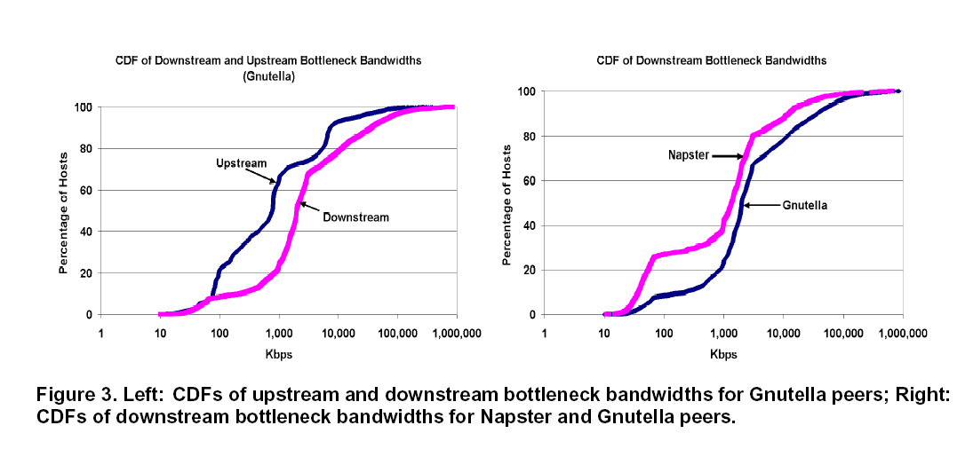
Measured Bandwidth

Slide 55
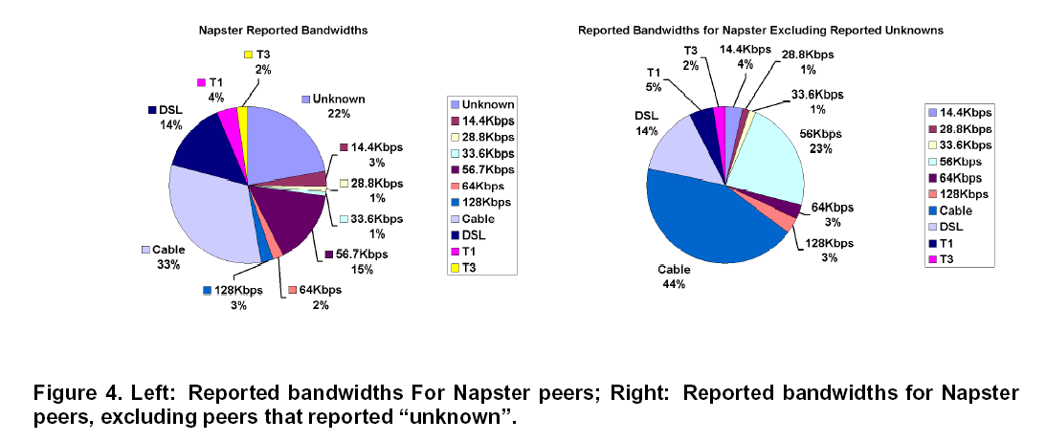
Reported Bandwidth

Slide 56
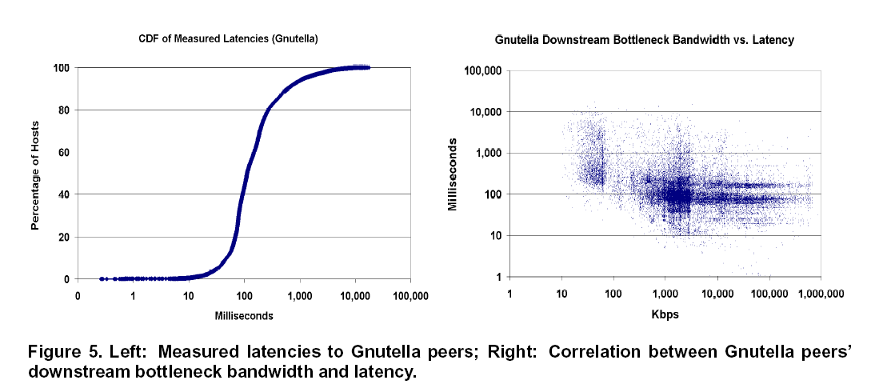
Measured Latency

Slide 57
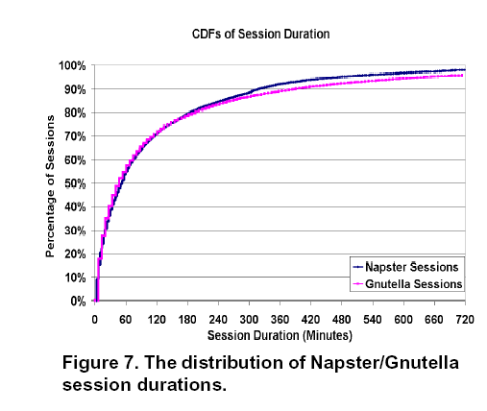
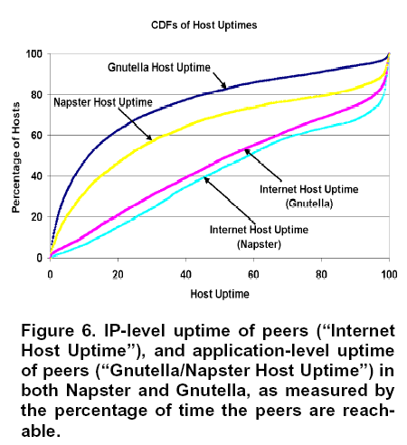
Measured Uptime

Slide 58
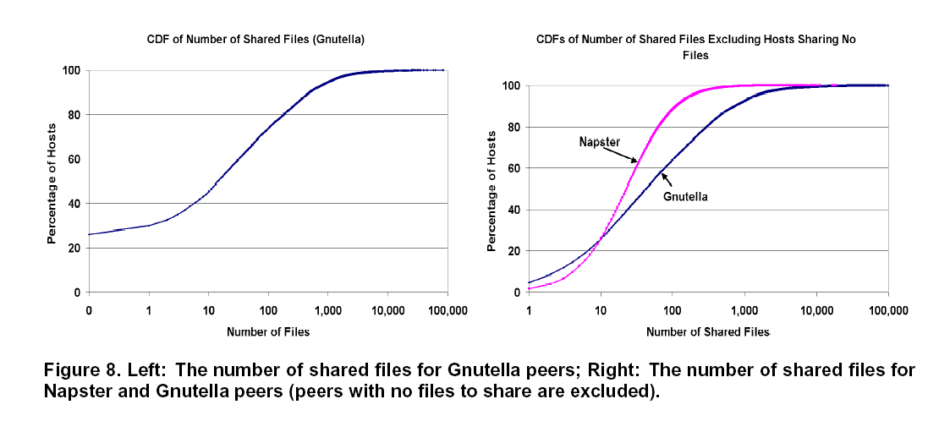
Number of Shared Files

Slide 59
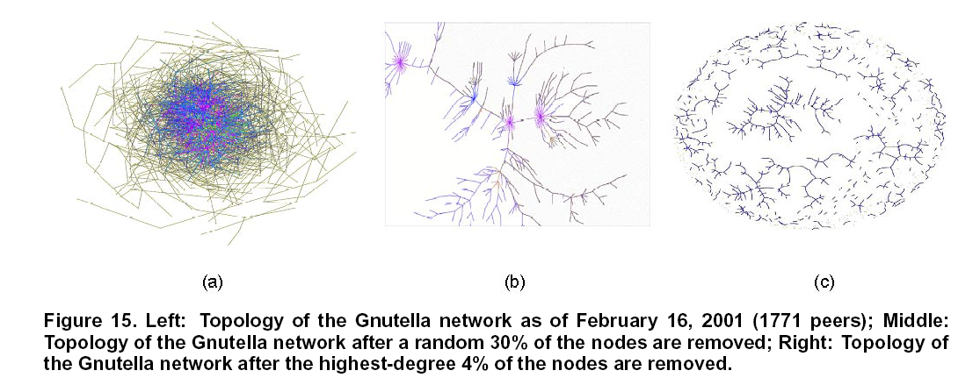
Connectivity

Slide 60
Points of Discussion
Is it all hype?
Should P2P be a research area?
Do P2P applications/systems have common research questions?
What are the “killer apps” for P2P systems?

Slide 61
Conclusion
P2P is an interesting and useful model
There are lots of technical challenges to be solved

