Slide 1
Publish-Subscribe Systems
Aseem Bajaj
March 18, 2004

Slide 2
About Pub-Sub
Event notification system
Producer publishes messages
Consumer waits for certain types of events by placing subscriptions
Think of “Linda”
Examples, stock exchange price info, news feed

Slide 3
Background
ISIS Project
Process groups & group communication
ISIS Toolkit, 1989
Reliable multicast of events using TCP overlay mesh, 1993
Tibco
The Information Bus – An Architecture for Extensible Distributed Systems, 1993

Slide 4
Background (cont.)
Gryphon Project, IBM
Matching Events in Content-based Subscription System, 1999
Enterprise Middleware
Siena Project, Univ of Colorado
Design of Wide Area Event Service, 1998
XML Event Routing
Mesh based Content Routing using XML, 2001

Slide 5
Issues
Matching & Dispatching
Choice of ‘information spaces’
Complexity of subscriptions
Performance
Distributed Control
Application Level Routing
Reliability & Sequencing

Slide 6
Information Bus
Introduces publish subscribe as a model for distributed systems
Introduces a framework around the information bus: types, classes, objects, services
Shows how to use such a bus to build distributed applications
Introduces Anonymous Communication & Subject Based Addressing

Slide 7
Content-based Subscription System
Assumes publish-subscribe as an accepted model
Concentrates on the message publishing & subscription
Suggests Content based subscription system
Addresses scalability & performance

Slide 8
The Information Bus - An Architecture for Extensible Distributed Systems
by Brian Oki, Manfred Pfluegl, Alex Siegel & Dale Skeen
Teknekron Software Systems Inc
(now TIBCO)

Slide 9
Extensible Distributed Systems: Requirements
Continuous Operations
No system downtime for upgrades or maintenance
Dynamic System Evolution
Adapting to changes in system
Allow dynamic integration of new components
Adoption of running Legacy System

Slide 10
Extensible Distributed Systems: Principles
Minimal Core Semantics
Communication system makes least possible assumptions about the application
Self-Describing Objects
Objects support queries about meta-information like type, attribute names & types, operation signatures
Dynamic Classing
Introduction of classes at runtime supported by TDL, a small interpreted language
Anonymous Communication
Subject Based Addressing. Messages sent and received by subject rather than identities.

Slide 11
Anonymous Communication
Subject Based Addressing
Publisher produces content without knowing the consumer, labels the content with hierarchically structured subject like news.equity.YHOO
Consumer accepts content based on the Content
Subscription can be wild carded
System evolution
Subscriber can be introduced anytime, starts consuming
Publisher can be introduced anytime, start publishing

Slide 12
Architecture
Types are like interfaces
Classes implement types
Objects are instances of classes
Service Objects
Encapsulate & control access to system resources e.g. database system, print service
Cannot be transferred to nodes other than where they reside, invoked from their location using some kind of RPC

Slide 13
Architecture (cont.)
Data Objects
At granularity of typical C++ objects or database records
Can be copied to other nodes
Each object labeled with a hierarchically structured subject string like news.equity.YHOO
Adapters
Integrate Legacy systems with Information Bus
Convert output from legacy system to data objects and publish them on information bus
Convert data objects received from subscription on the information bus to the input of legacy system

Slide 14
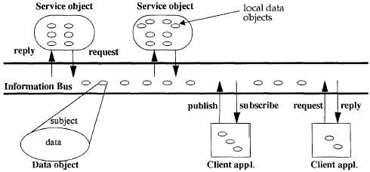
Bus Architecture

Slide 15
Network Implementation
Local Area Networks
Each node has a daemon running
Applications register, place subscriptions on daemon
Ethernet broadcasts
Daemon gets all messages on Ethernet, forwards to applications based on subscriptions
Wide Area Networks
Application Level Information Routers
Routers receive messages by placing subscriptions
Pass on messages to other routers that then get re-published on another ‘bus’.
Messages only republished on buses that have subscriptions for that subject

Slide 16
Reliability
No sender-receiver crash, no long-term network partition
Message delivered to subscriber exactly once
Order maintained for same sender, not multiple
Either sender-receiver crash or long-term network partition
Message delivered to subscriber at most once
Guaranteed Message Delivery
Message stored before sending
Publisher retransmits unless acknowledged
Message delivered to subscriber at least once

Slide 17
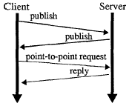
Dynamic Discovery & Remote Method Invocation
(Who’s out there?)
Dynamic Discovery
(I am)
RMI

Slide 18
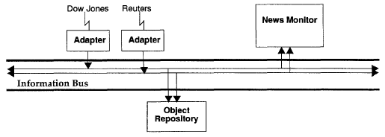
Brokerage Trading Floor

Slide 19
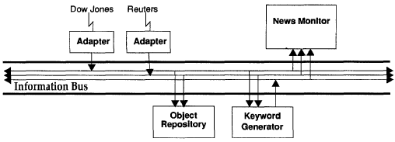
Brokerage Trading Floor
Introduce Keyword Generator
Subscribes and accepts stories
Publishes keywords as property objects
Monitors interprets & displays the property objects

Slide 20
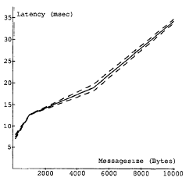
Latency
Sun SPARCstation 2s with 24MB RAM, Sun IPXs with 48MB RAM
Lightly loaded 10Mbps Ethernet
15 nodes: 1 publisher, 14 consumers
1 subject
Latency vs. message Size
*99% confidence intervals in dashed lines
Notes:
Latency=average time between sending and receiving of an event
Latency found to be independent of the number of consumers

Slide 21
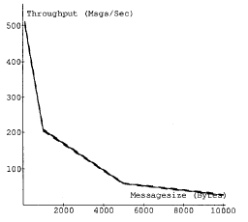
Throughput
Message volume vs. message Size
1 publisher
14 consumers
1 subject
Batch Processing Parameter on
Delays small messages
gathers them together
Improves throughput

Slide 22
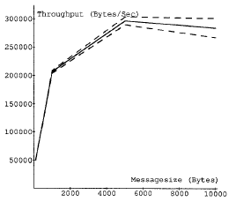
Throughput
Byte volume vs. message Size
1 publisher
14 consumers
1 subject
Batch processing parameter on

Slide 23
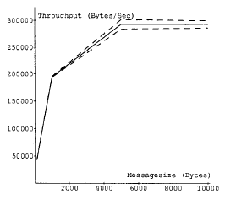
Throughput
Byte volume vs. Message Size
1 publisher
Publishes on 10,000 subjects
14 consumers
Consumer subscribe to all subjects
Batching processing parameter on

Slide 24
Information Bus
Discussion
Does it solve the system evolution problem?
Does the re-engineering of such systems become tough?

Slide 25
Matching Events in a Content-based Subscription System
By Marcos K. Aguilera, Robert E. Strom, Daniel C. Sturman & Mark Astley
IBM TJ Watson

Slide 26
Matching Events in a Content-based Subscription System
Subject based subscription systems might be restrictive
Content based subscription systems more generic, can subscribe to many orthogonal attributes attached to the event
But suffers from scaling problem, that’s what this paper addresses

Slide 27
The Matching Problem
Easiest way is to match for each subscription
But would take a lot of time for large number of subscriptions
Need to find a way to do matching in sub-linear time.
Intuitively, we can combine parts of subscription to reduce the number of tests for each event

Slide 28
Matching Algorithm
Analyze subscriptions
sub := pr₁ ^ pr₂ ^ pr₃
Conjunction of elementary predicates pr_{i} = test_{i}(e) -> res_{i}
e.g. (city=LA) and (temprature < 40)
pr₁ = test₁(…) -> LA
pr₂ = test₂(…) -> “<“
test₁ = “examine attribute city”
test₂ = “examine attribute temperature 40”

Slide 29
Matching Algorithm
Preprocess to make matching tree
Each non-leaf node is a test
Each edge from test node is a possible result
Each leaf node is a subscription
Pre-process each of the subscriptions and combine the information to prepare the tree
On receiving events, follow the sequence of test nodes and edges till a leaf node is reached

Slide 30
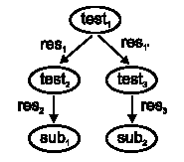
Matching Tree
sub₁=(test₁->res₁)^(test₂->res₂)
sub₂=(test₁->res₁’)^(test₃->res₃)

Slide 31
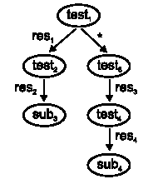
Matching Tree Don’t Care Edges
sub₃=(test₁->res₁)^(test₂->res₂)
sub₄=(test₃->res₃)^(test₄->res₄)

Slide 32
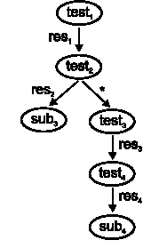
Matching Tree Related tests
sub₃=(test₁->res₁)^(test₂->res₂)
sub₄=(test₃->res₃)^(test₄->res₄)
(test₃->res₃) => (test₁->res₁)

Slide 33
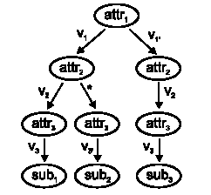
Matching Tree Equality tests
Conjugation of equality tests
sub₁=(attr₁=v₁)^(attr₂=v₂)^(attr₃=v₃)
sub₂=(attr₁=v₁)^(attr₂=*)^(attr₃=v₃’)
sub₃=(attr₁=v₁’)^(attr₂=v₂)^(attr₃=v₃)

Slide 34
Complexity: Assumptions
All attributes have the same value set
Attributes from set K
Values from same set V
Subscriptions from set S
Only equality tests being done
Events come from a uniform distribution

Slide 35
Pre-processing complexity
Time complexity
O(NK), where K attributes & N subscriptions
Linear in N
Space complexity
O(NK)
Linear in N

Slide 36
Matching Time Complexity
Expected time to match an arbitrary event against subscription set S
C(S) <= VK’[(VK’|S|-|S|+1)^{1-λ}–1]/(VK’-1)(1-λ)
where K’=K+1 and
λ = ln V / (ln V + ln K’), note 1> λ >0
C(S) is O(N ^{1-λ} ), sub linear

Slide 37
Optimizations
Collapse a chain of * edges (60% gain)
Example: collapse B to A
Statically pre-compute successor nodes
Assumption: non-* edges evaluated before *-edge
Idea is to use information about traversal to skip over tests including *-edges that are implied
Example: For any event <1,2,3,8,2> consider successors of node C <a1=1,a2=2,a3=3>
H:<a1=1,a2=2,a3=*>
G:<a1=1,a2=*,a3=3>
D:<a1=*,a2=2,a3=3>
Since D doesn’t exist, consider it’s successors
E:<a1=*,a2=*,a3=3>
F:<a1=*,a2=2,a3=*>

Slide 38
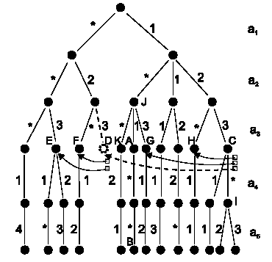
Optimizations

Slide 39
Optimizations
More aggressive static analysis (20% gain)
Separate sub-trees for attributes that rarely have don’t care in subscriptions

Slide 40
Performance
Pentium 100MHz, Java based prototype
Attributes vary in popularity, follow Zipf’s distribution
Tests for 30 attributes with 3 possible values
Distribution always got 100 matches per event

Slide 41
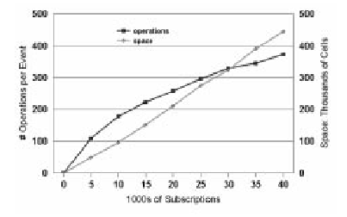
Performance
Operations
per Event
Space
(thousands of cells)
Operations per Event
Space per Event = Edges + Successor nodes
Latency: 4ms for 25,000 subscriptions

Slide 42
Content based subscription
Discussion
Is it possible to make efficient trees for non-equality based subscription?
If content based subscriptions are used with equality tests only, are there other ways to achieve sub-linear matching times?

Slide 43
Other Work in Pub Sub Space
Wide Area Event Notification Design & Evaluation of a Wide Area Event Notification Service Antonio Carzaniga, David Rosenblum & Alexender L. Wolf Univ of Colorado, Boulder & Univ of California at Irvine
XML Event Routing Mesh Based Content Routing using XML Alex C. Snoeren, Kenneth Conley & David K. Gifford MIT LCS

