Slide 1
USB 2.0 INTRODUCTION

Slide 2
Outline
History and Evolution
Why We Need USB？
Architectural Overview
USB communication flow
Protocol Layer
Conclusion

Slide 3
Key Word
Down：From host to device
Up：From device to host
Example
Down stream：data flow from host to device
Up stream： data flow from device to host

Slide 4
Outline
History and Evolution
Why We Need USB？
Architectural Overview
USB communication flow
Protocol Layer
Conclusion

Slide 5
History
USB—Universal Serial Bus
Invented and standardized by a group of computer and peripherals manufactures in 1995
Compete with IEEE1394

Slide 6
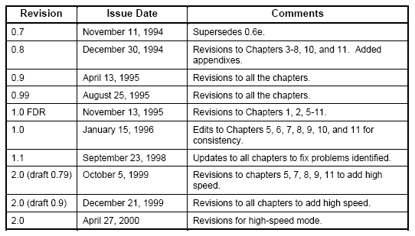
Evolution

Slide 7
Outline
History and Evolution
Why We Need USB？
Architectural Overview
USB communication flow
Protocol Layer
Conclusion

Slide 8
Characteristic (1)
Connection of the PC to the telephone：
=>In order to transmit data
Ease-of-use：
=>Support plug and play
Port expansion：
=>Up to 127 devices
=>Can add lots of device to a XX

Slide 9
Characteristic (2)
The logical topology of the USB is a star structure
It is similar to computer network
The USB uses a polling protocol
Up to 7 level

Slide 10
USB Can Do
Combines low speed and high speed bus activity , USB enables shared access for both speed
Automatic configuring of devices and a serial bus which is simplified and easy to plug into
Attach / detach easily without restarting system

Slide 11
Outline
History and Evolution
Why We Need USB？
Architectural Overview
USB communication flow
Protocol Layer
Conclusion

Slide 12
USB System Member (1)
Host：only one
=>The smartest element in the USB system
=>Responsible to the complexity of the
protocol to make devices design simple
and low cost
=>Control the media access（no one can
access the bus unless it get an approval required from the host )

Slide 13
USB System Member (2)
Hub：one or more
=>Like the hubs used for computer network
=>Enables many devices to connect to a single USB port

Slide 14
USB System Member (3)
Device：one or more
=>Everything in the USB system , which is
not a host , is a device ( include hubs)
=>A device may provides one or more USB
functions
=>Has an unique address at the end of the
enumeration process

Slide 15
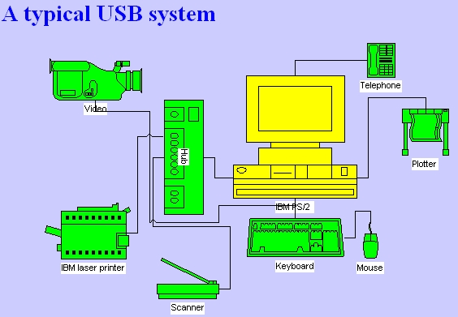
Typical Application

Slide 16
Outline
History and Evolution
Why We Need USB？
Architectural Overview
USB communication flow
Protocol Layer
Conclusion

Slide 17
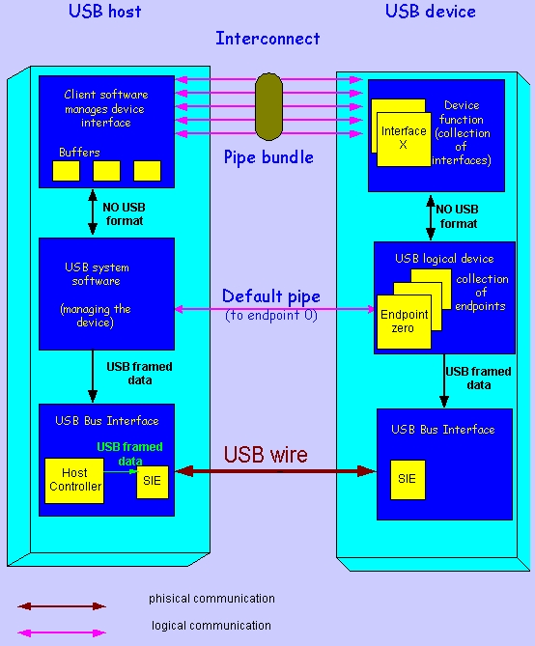
Communication Flow

Slide 18
Pipes (1)
The logic communication between the client
software on the host and the function on the
device is done through pipes
It is a association between a specific
endpoint on the device and the appropriate
software in the host

Slide 19
Pipes (2)
An endpoint is the source or destination of the data that transmitted on the USB cable
Two direction
=>OUT：
data flows from the host to the device
=>IN：
data flows from the device to the host

Slide 20
The Physical Layer

Slide 21
Signaling On The Bus
The USB cable is 4 wire cable
Signal on the bus is done by signaling over tow wires ( D₊ and D_ )
=>1： D_ low , D₊ high
=>0： D_ high , D₊ low
Data encoding and decoding is done using NRZI ( Non Return to Zero Inverted )

Slide 22
SIE
SIE：Serial Interface Engine
It is part of both the host’s and the device’s physical layer
=>Serialization and Deserialization
=>Encoding and Decoding
=>Generate(for out) and Verify(for in) CRC
=>Detect PID

Slide 23
HC
HC：Host Controller
=>It is an additional hardware to ensure that everything which is transmitted on the bus is correct
=>It serves both the USB and the host and has the same functionality in ever USB system

Slide 24
The Protocol Engine Layer

Slide 25
This Layer Handles
Responsible for the translating the data between the application layer and the USB transactions protocol .
Two Role
=>USB System Software (in the USB host)
=>USB Logical Device (in the USB device)

Slide 26
The USB System SW
Compose of The Host Controller Driver and The USB Driver
Responsible for
=>Bandwidth allocation
=>bus power management
Two of above are in order to enable devices to access the bus

Slide 27
The USB Logical Device
Compose of a collection of independent endpoints
Each endpoint has an unique Endpoint Number and is unidirectional(except endpoint zero and has two type--In/Out)
Default pipe is associated with endpoint zero

Slide 28
The Application Layer
Host end：Client Software
= >Manages the appropriate interface by
transferring data from its buffers to the
endpoint with the appropriate interface
Device end：Function
= >Composed of interfaces and controls the
functionality of the device

Slide 29
Outline
History and Evolution
Why We Need USB？
Architectural Overview
USB communication flow
Protocol Layer
Conclusion

Slide 30
Transaction
USB transactions are done through packets include three phases
=>Token phase：host initiates token
indicating the future transfer type
=>Data phase：actual data transmitted
=>Handshake phase：indicate the success or failure of the transaction

Slide 31
Transfer Types (1)
Control Transfer
=>Used to configure a device (enumeration)
=>Compose of three phases (setup,data,status)
Isochronous Transfer
=>Used for multimedia devices
=>It is guarantee the required bandwidth
=>No handshake phase

Slide 32
Transfer Types (2)
Bulk Transfer
=>Used for large burst data
=>Guarantee of delivery , no guarantee of
bandwidth or minimum latency
Interrupt Transfer
=>If there is a pending interrupt , the function
will send details to host after host poll it

Slide 33


Packet (1)
PID：Packet Identifier Field
Address Field
=>So , there are up to 127 devices in USB

Slide 34
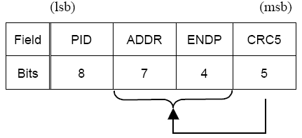
Packet (2)
Token Packet
=>ADDR & ENDP define an unique endpoint

Slide 35
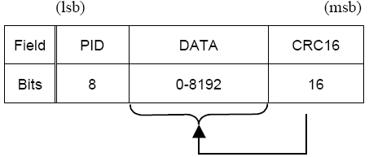
Packet (3)
Data Packet

Slide 36
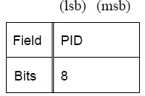
Packet (4)
Handshake Packet
=>Such as ACK 、NAK 、STALL…etc.

Slide 37
Outline
History and Evolution
Why We Need USB？
Architectural Overview
USB communication flow
Protocol Layer
Conclusion

Slide 38
Conclusion
USB is powerful and easy to use
The complex host make the device easy to design

Slide 39
The End
Thanks

Slide 40
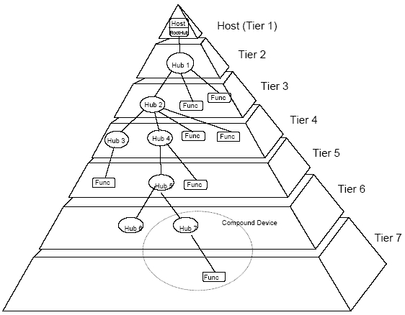
7 Level

Slide 41
Hub (1)
Detecting an attachment and detachment
of devices
Handling the power management for device
that are bus-powered
Responsibility for bus error detection and
recovery
Manage both full and low speed devices

Slide 42
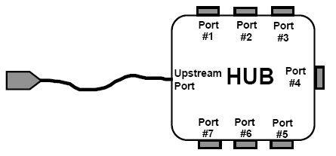
Hub (2)

Slide 43
Device Category (1)
By speed
=>High-speed：work in 480 MB/S
=>Full-speed ： work in 12 MB/S
=>Low-speed ： work in 1.5 MB/S
By power supply
=>Self powered
=>bus powered

Slide 44
Device Category (2)
By number of functions
=>Compound device
=>Composite device

Slide 45
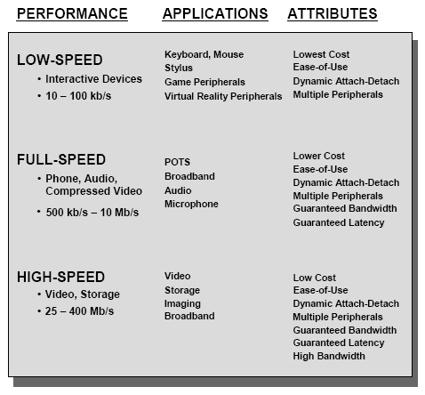
Device Category (3)

Slide 46
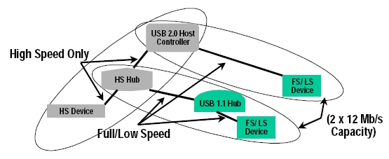
Device Category (4)

Slide 47
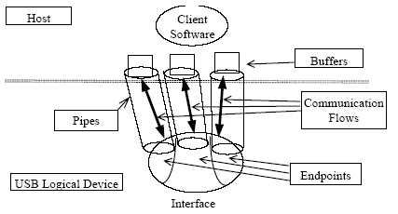
PIPE

Slide 48

Cable

Slide 49

NRZI (1)
Want to transmit：
=>1：without changing the level of the
level of the signaling
=>0：flip the value of the differential pair
example：

Slide 50
NRZI (2)
Problem：
When we send “1” stream , the transmission
line will stay static ( no change period )
Solution：
“Bit stuffing” , performed before the NRZI
example：
data：010111111101
send：0101111110101

Slide 51
HC Handles
Frame Generation：
=>Partition time units (each one is 1msec as
a frame)
Data Processing：
=>Handles the request for data to / from the host
Error Handling：
Such as Timeout、CRC error、Unexpected data payload
Remote wakeup

Slide 52
HCD && USBD
UCD：
=>An interface to the host controller
USBD：
=>Handle IRPS(I/O Request Packets) from
client software
=>Handle enumeration process , so it owns
default pipe (initial pipe)

Slide 53

Tree Phase

Slide 54
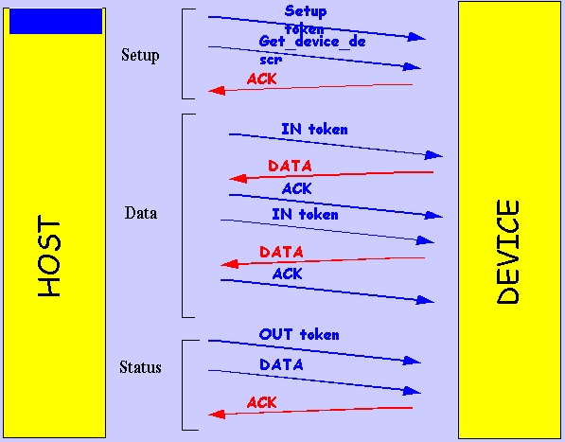
Control Transfer

Slide 55
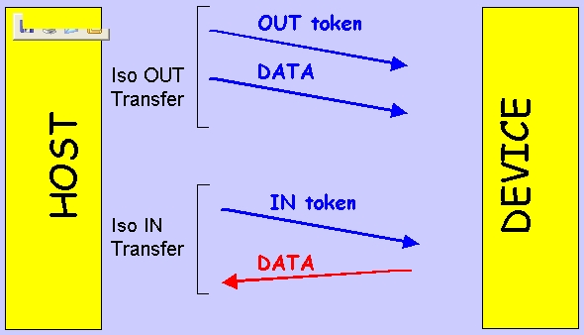
Isochronous Transfer

Slide 56
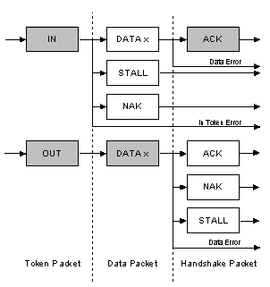
Bulk Transfer

Slide 57
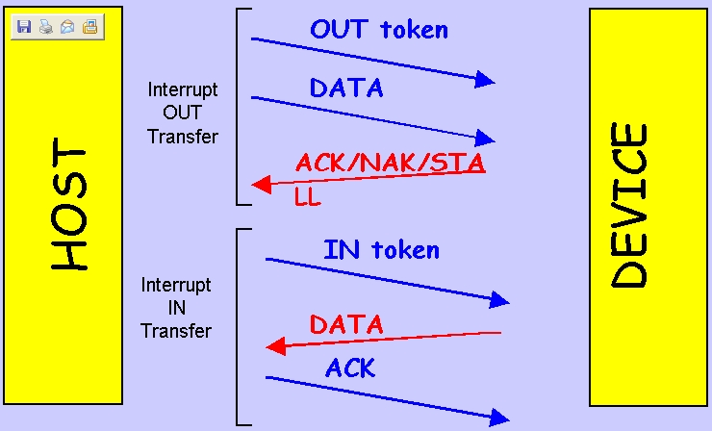
Interrupt Transfer

