Slide 1
Summary of Covid-19 literature extraction and question answering tools
Jack Fenton

Slide 2
Problems with Covid-19 specific tools
Recent Literature
Limited time frame
Annotated datasets

Slide 3
Extraction Tools
Biopython
Pymed
BEST

Slide 4
Biopython
Large complex tool with many sub tools
Utilizes Entrez for resource extraction
Can form advanced search queries
No returned rank

Slide 5
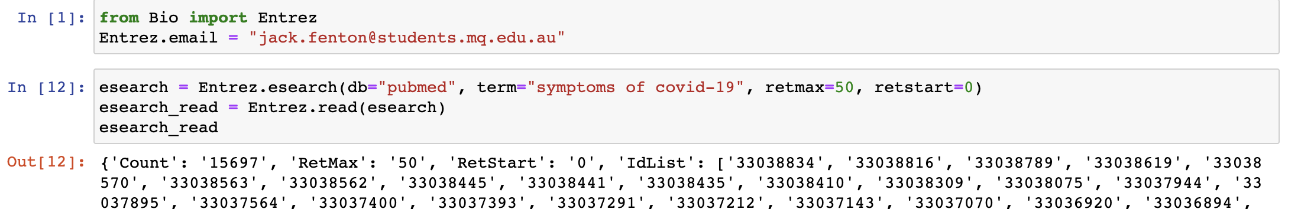
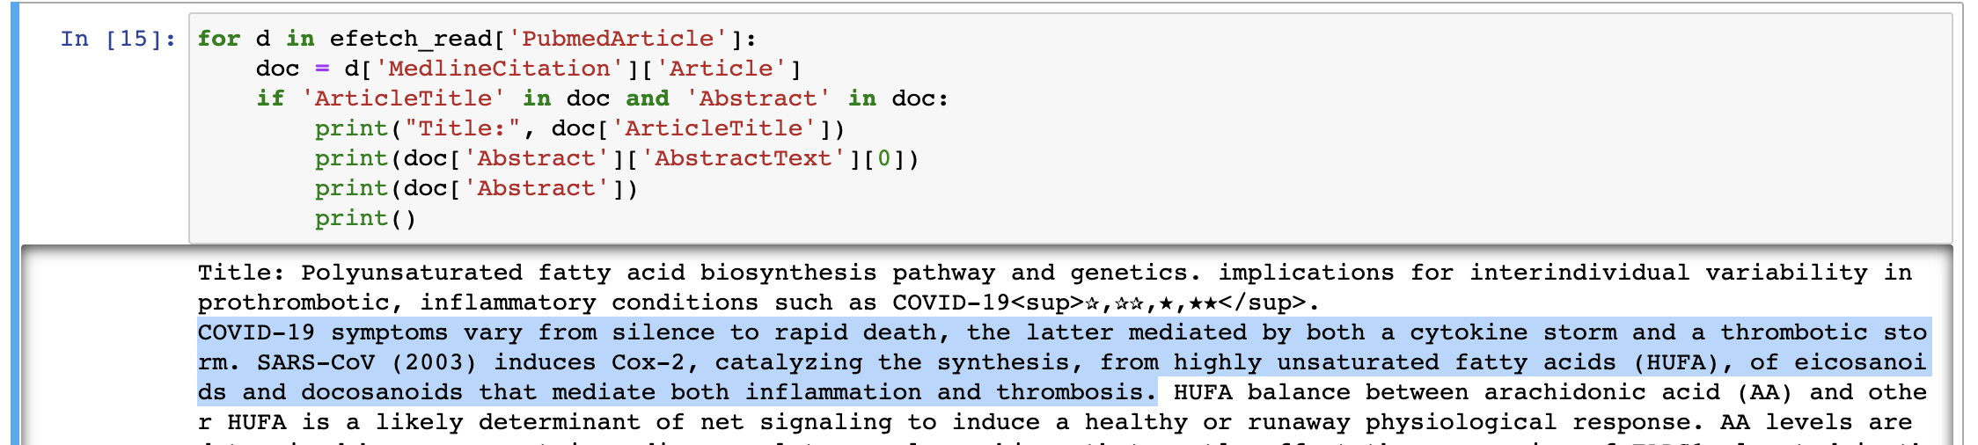
Biopython

Slide 6
PyMed
Simple python wrapper for PubMed API
Uses Biopython’s Entrez
Returns same results as Biopython for search query
Also doesn’t display a rank of the returned documents

Slide 7
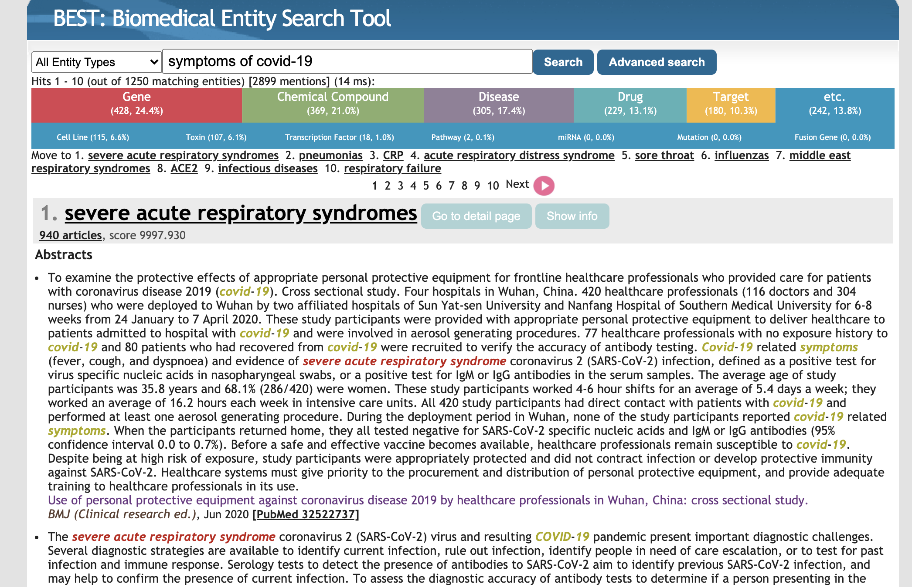
BEST: Biomedical Entity Search Tool

Slide 8
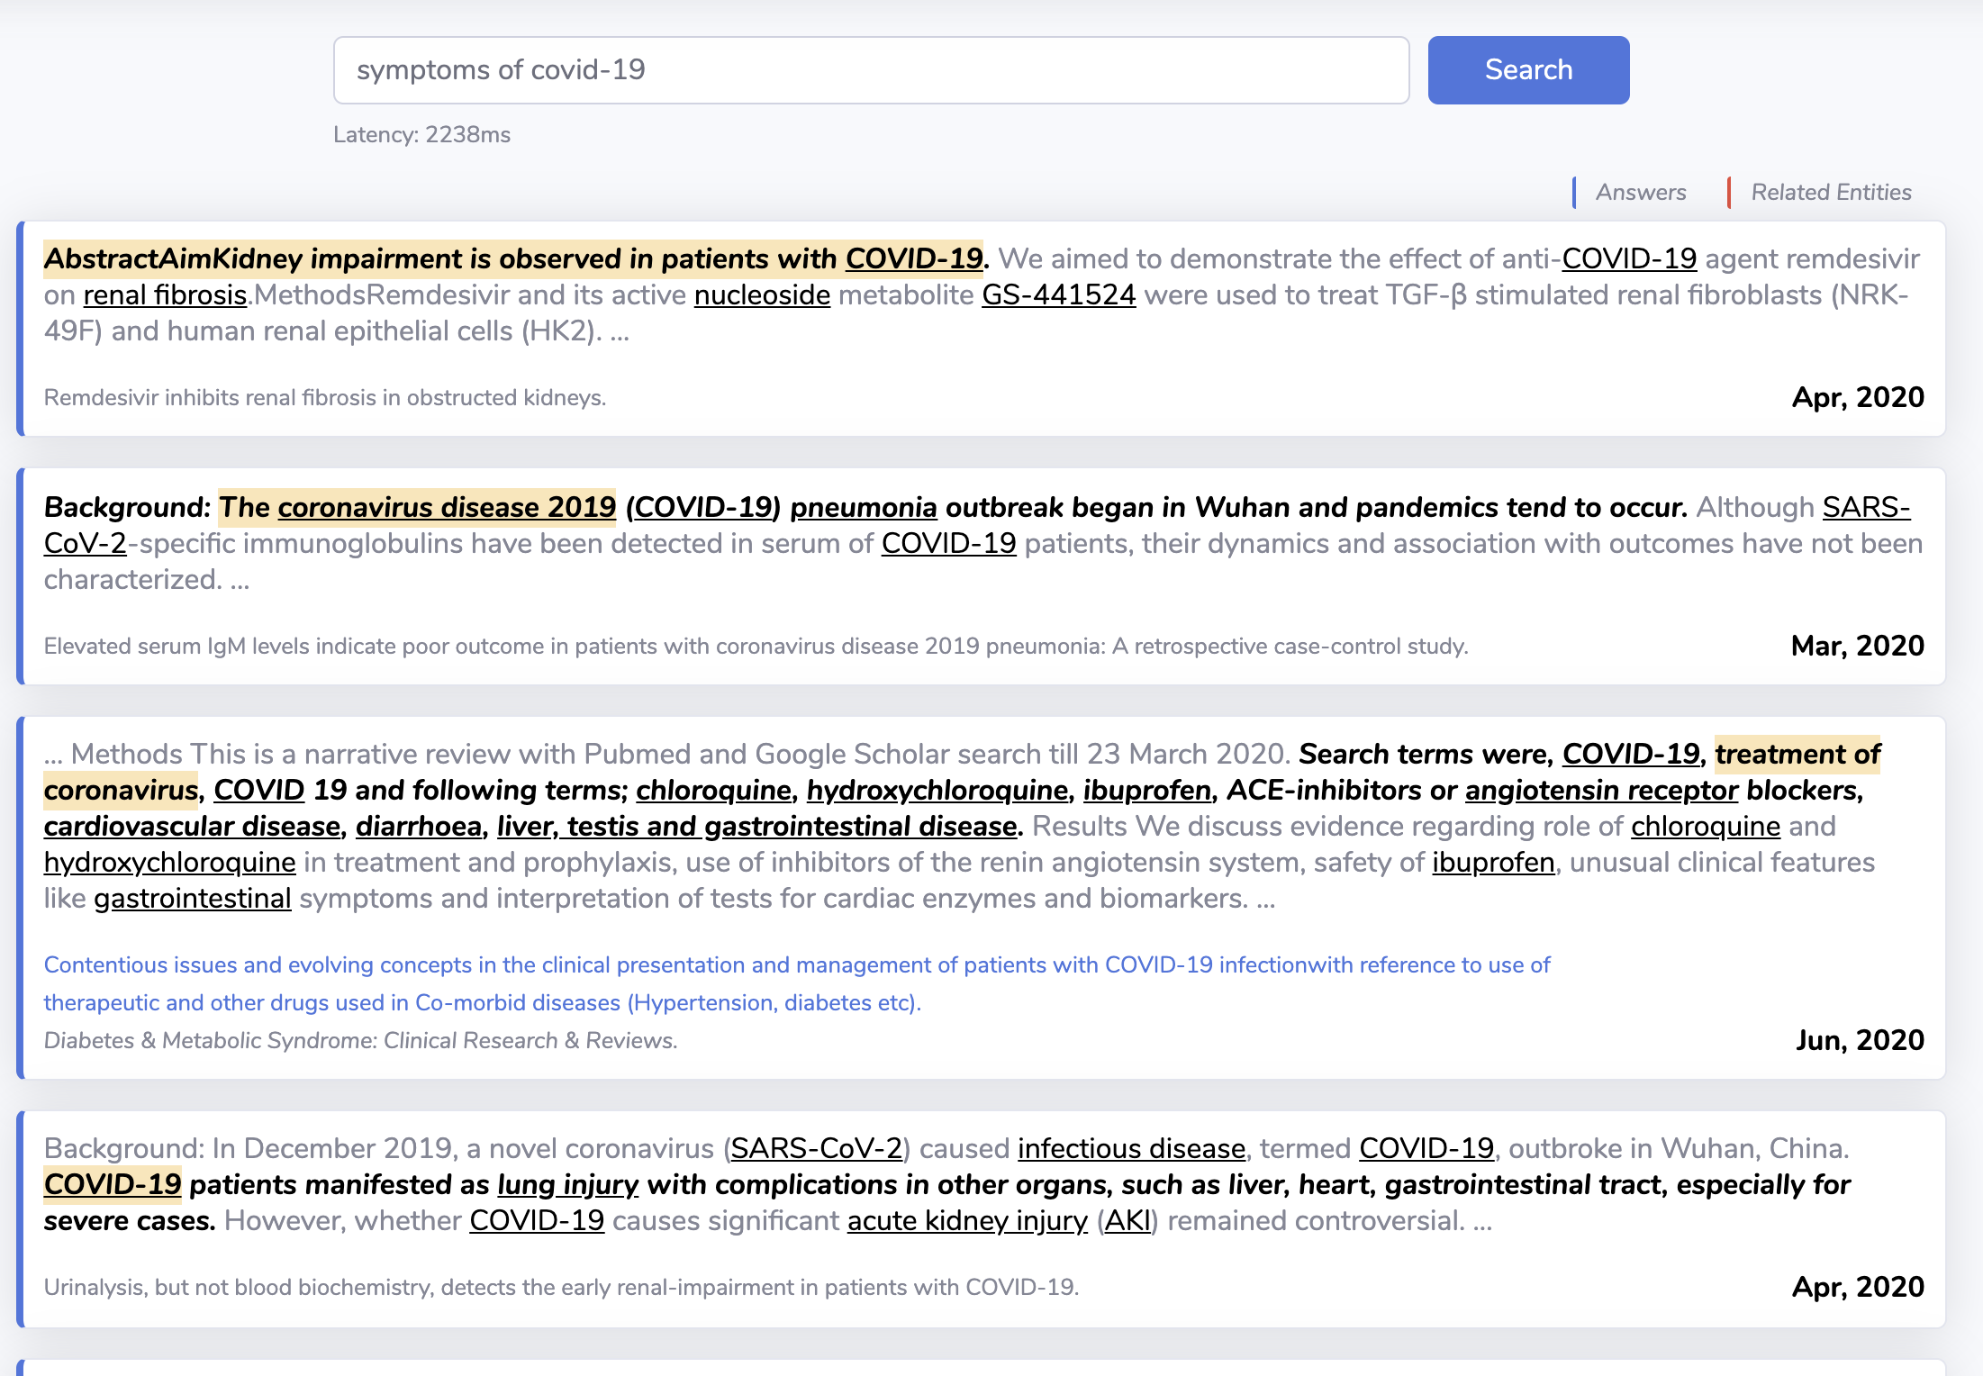
Question answering tool: CovidAsk

Slide 9
Conclusion
Pymed to extract relevant articles combined with CovidAsk’s DENSPI may be an automated way to acquire relevant sentences to the query

Slide 10
Questions/Suggestions

