Slide 1

Computing Expectations
1
Respect for Others
SLANT when the teacher is speaking.
Listen when others contribute.
Support the learning of others.
2
Respect for the Classroom Environment
Leave the desks as you found them.
Keep food and drink away from the desks.
Follow the Acceptable Use Agreement.
3
Respect for Learning
Be ready to answer questions and complete tasks.
Folders and Class Notebooks should be well presented.
Work hard even when you find it difficult.

Slide 2
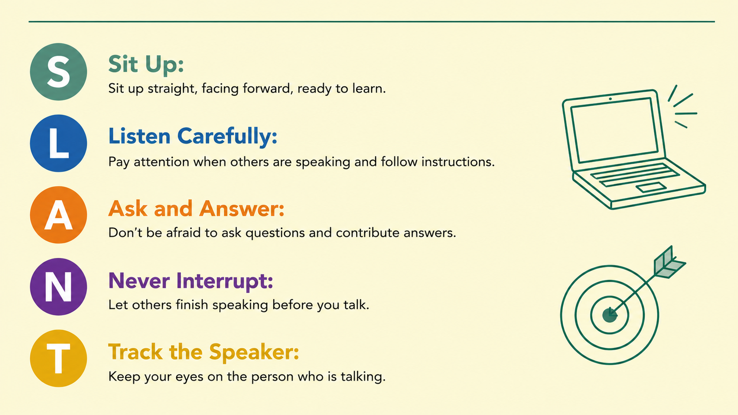

Slide 3
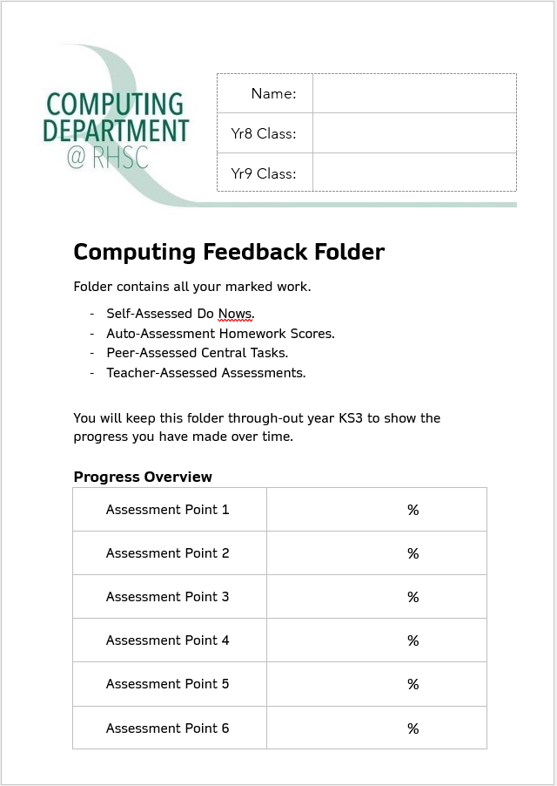


Welcome Back Year 8
Organisation
Today we need to:
  Complete the front page of your folder with your name, class and previous test scores.
  Review the ‘Acceptable Use Agreement’.
  Decide on a strong password and add your email, username and printer code to your planner.

Slide 4
Welcome Back Year 8
Presentation of Work
Green Folders
Completed cover page at the front of your folder.
Pages in chronological order (new work at the back).
Do Nows & Assessments
Write in black or blue ink.
Mark in coloured pen.
Your best handwriting (joined up or printed).
Mistakes crossed out with a single line.
No scribbles, doodles or graffiti.
Pages not torn, creased or stained.
Correct use of capital letters, full stops and commas etc.
Write in full sentences.
Paper Based Lessons
Previous plus the following:
Title and date at the top of each piece of work.
Underline title and headings with a ruler.
Diagrams or charts neatly drawn and labelled.
Class Notebook
Date added to each row.
Write in black font.
Mark in purple font.
Titles and headings in bold and/or underlined.
Unordered lists using bullet points.
Ordered lists using numbering.
Screenshots and images cropped and not distorted.
Use subheadings or write the question in your answer.

Slide 5
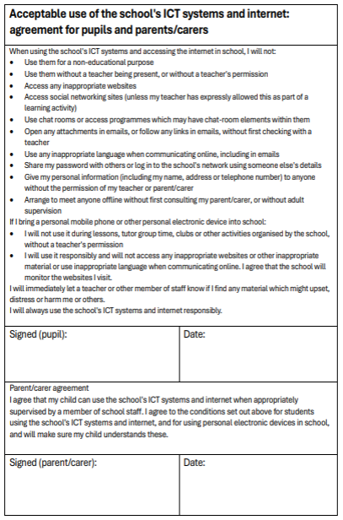
Welcome Back Year 8
Organisation
Today we need to:
  Complete the front page of your folder.
  Review the ‘Acceptable Use Agreement’.
  Decide on a strong password and add your email, username and printer code to your planner.

Slide 6
Welcome Back Year 8
What is filtering?
If you search and try and go on website that the school thinks is inappropriate, they will not allow you to access it.
If you think a website should/should not be blocked please let a teacher know.
What is monitoring?
Staff can see your school device screen, internet history files and emails at anytime. You should only be using these for schoolwork.
New This Year
If you break the Acceptable Use Agreement, either in lessons or through monitoring, you will receive a negative on Arbor.
Two negatives will trigger a Lunchtime Detention.

Slide 7
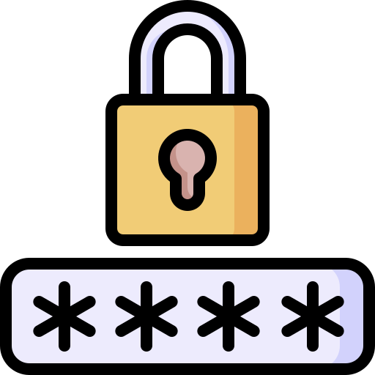
Welcome Back Year 8
Organisation
Today we need to:
  Complete the front page of your folder.
  Review the ‘Acceptable Use Agreement’.
  Decide on a strong password and add your email, username and printer code to your planner.
Passwords must have 10 characters and not need changing all year!

Slide 8


Welcome Back Year 8
Task
Log In
Write your username, email address and
printer code in the front of your planner.
You can find this information under
‘My Account Information’ in the start menu.
Aim to use your One Drive account to save work from all your subjects.
    Set up your Year 8 folder and inside create your Computing folder.

Slide 9

Welcome Back Year 8
Homework
  Homework will be set twice a half term.
  You will see it appear on Arbor and Wayground.
Join our class using this code:
Complete the ‘8.0 Welcome Back’ quiz that has been assigned to you.
D331678

Slide 10
Welcome Back Year 8
Emails
How should we use our school email addresses:
Do | Don't
Task
Now spend some time:
Deleting emails you don’t need.
Unsubscribing from websites you shouldn’t have joined.
Adding emails you want to keep into folders.

Slide 11



Welcome Back Year 8
End of the Lesson
Evidence
Add a screenshot of your work to your Class Notebook.
Ending on a high!
Who has done well?
How have we progressed?
Reminders
Toilets & Reception closed between lessons.
Self-Check your uniform.
If you arrive after the register has started, you are late.

