Slide 1


8.1 Lesson 1 - Computer Systems
Do Now
Complete in your booklet: 8.1 Lesson 1
Presentation:
  Write in black or blue ink.
  Mark in coloured pen.
  Your best handwriting (joined up or printed clearly).
  Mistakes crossed out with a single line.
  No scribbles, doodles or graffiti.
  Pages not torn, creased or stained.
  Correct use of capital letters, full stops and commas etc.
  Write in full sentences.
Classify devices as either input or output.
Explain the difference between an input/ output device and a computer system.
Identify the inputs and outputs of large computer systems such as a self checkout system.
Input Output
Device Processing
Memory Storage

Slide 2

8.1 Lesson 1 - Computer Systems
Review Now
True or False: Binary is made up of two numbers, 0 and 1.
What does the CPU stand for?
a) Center Power Unit b) Central Power Unit
c) Central Processing Unit d) Control Processing Unit
State what an ISP is.
Describe what you should look for when choosing an ISP.
Justify which ISP should be choosing using factors to help you to explain.
ISP
Availability
Speed – GBps
Contract

Slide 3

8.1 Lesson 1 - Computer Systems
Review Now
What should you do if something doesn’t feel right online?
  Confront the person online
  Delete your account
  Tell someone in the real world
  Ignore it
To log into Teams from my home computer I should…HAS CHANGED!
State what an ISP is.
Describe what you should look for when choosing an ISP.
Justify which ISP should be choosing using factors to help you to explain.
d) Go to the school website.
a) Click on “For Pupils” (Useful Links and Downloads)
b) Click on the Teams Icon
c) Log in using my email and password.
ISP
Availability
Speed – GBps
Contract

Slide 4

8.1 Lesson 1 - Computer Systems
Last Homework
Parent/Guardian signed Acceptable Use Agreement
Next Homework
Your next homework is due on Monday 28th September.
Computing - Yr8 Homework 1 on
Classify devices as either input or output.
Explain the difference between an input/ output device and a computer system.
Identify the inputs and outputs of large computer systems such as a self checkout system.
Input Output
Device Processing
Memory Storage

Slide 5


8.1 Lesson 1 - Computer Systems
Lesson Objectives
Classify devices as either input or output.
Classify devices as either input or output.
Explain the difference between an input/ output device and a computer system.
Explain the difference between an input/ output device and a computer system.
Identify the inputs and outputs of large computer systems such as a self checkout system.
Identify the inputs and outputs of large computer systems such as a self checkout system.
Input Output
Device Processing
Memory Storage

Slide 6

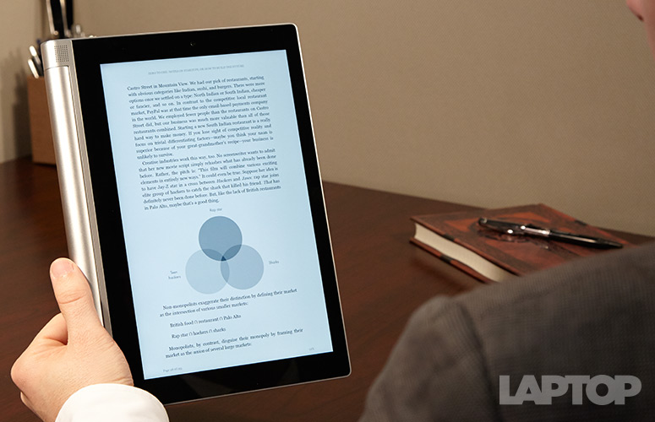
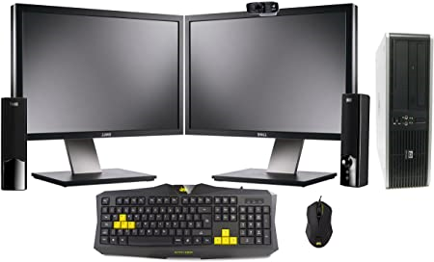
8.1 Lesson 1 - Computer Systems
Flashback
Classify devices as either input or output.
All ‘computer systems’ do these four things:
Input
Process
Output
Explain the difference between an input/ output device and a computer system.
Memory
Identify the inputs and outputs of large computer systems such as a self checkout system.
Some devices do all four functions.
Input Output
Device Processing
Memory Storage
Whereas others you plug in peripherals.

Slide 7

8.1 Lesson 1 - Computer Systems
Key Terms Retrieval
Classify devices as either input or output.
Input
Input
Process
Output
Output
Explain the difference between an input/ output device and a computer system.
Inputs allow the user to put data into a computer.
A computer will send data out to output devices.
Memory
Identify the inputs and outputs of large computer systems such as a self checkout system.
Storage
Storage holds the permanent data that will need to used in the computer system.
Input Output
Device Processing
Memory Storage

Slide 8

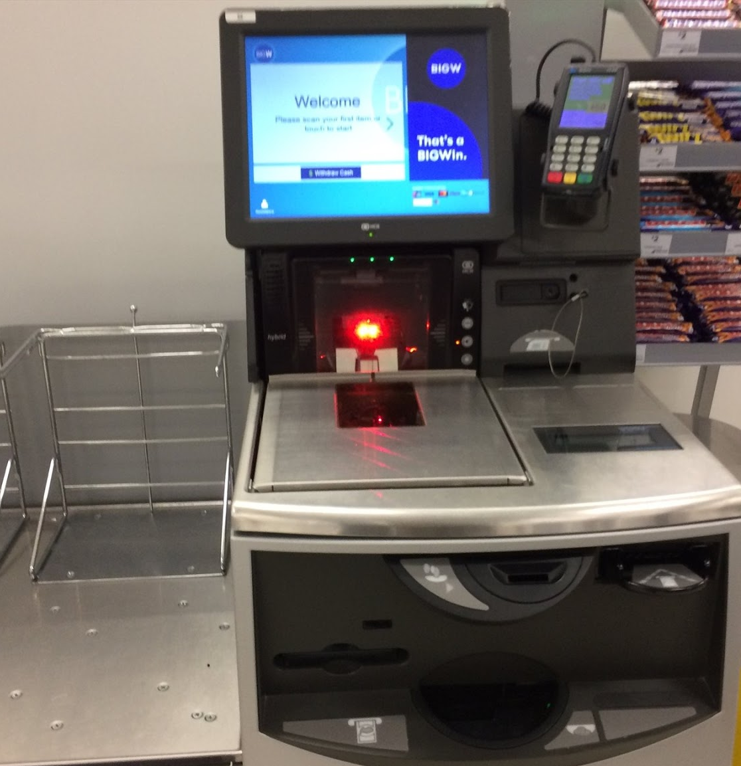


8.1 Lesson 1 - Computer Systems
We Do
Can you name the parts of this computer system?
Are what are the input, storage and output devices?
Classify devices as either input or output.
Explain the difference between an input/ output device and a computer system.
Identify the inputs and outputs of large computer systems such as a self checkout system.
Input Output
Device Processing
Memory Storage
Remember input devices put data into a computer.
Whereas a computer will send data out to an output device.

Slide 9
8.1 Lesson 1 - Computer Systems
We Do
Classify devices as either input or output.
Input | Output | Storage
Explain the difference between an input/ output device and a computer system.
Identify the inputs and outputs of large computer systems such as a self checkout system.
Input Output
Device Processing
Memory Storage
Remember input devices put data into a computer.
Whereas a computer will send data out to an output device.

Slide 10

8.1 Lesson 1 - Computer Systems
You Do
Independently in your class notebook:
  Explain the difference between input and output devices using paragraphs.
  Add examples of each type either within the sentence or as bullet points/table afterwards.
Classify devices as either input or output.
Explain the difference between an input/ output device and a computer system.
Class Notebook
Identify the inputs and outputs of large computer systems such as a self checkout system.
Presentation Reminder:
Date added to each row.
Write in black font.
Mark in purple font.
Titles and headings in bold and/or underlined.
Use subheadings or write the question in your answer.
Input Output
Device Processing
Memory Storage

Slide 11


8.1 Lesson 1 - Computer Systems
You Do
As you are watching the video, note down the input, output and storage devices you notice in the video.
Classify devices as either input or output.
Explain the difference between an input/ output device and a computer system.
Identify the inputs and outputs of large computer systems such as a self checkout system.
Input Output
Device Processing
Memory Storage

Slide 12




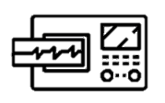

8.1 Lesson 1 - Computer Systems
Skills
Adding images to ppt
Cropping images
Adding and duplicating arrows
Textboxes
Format Painter
Using rotation/flipping
Task 3
Add a picture of a computer system of label it.
Red for Inputs
Blue for Storage
Green for Outputs
Challenge
Try a more complex system like an ECG machine in a hospital, the inside of a car or the inside of a plane.
Classify devices as either input or output.
Explain the difference between an input/ output device and a computer system.
Class Notebook
Identify the inputs and outputs of large computer systems such as a self checkout system.
Input Output
Device Processing
Memory Storage

Slide 13



8.1 Lesson 1 - Computer Systems
End of the Lesson
Classify devices as either input or output.
Explain the difference between an input/ output device and a computer system.
Identify the inputs and outputs of large computer systems such as a self checkout system.
Reminders
Toilets & Reception closed between lessons.
Self- Check your uniform.
Arrive during the Do Now, you are late.
Positive Note
Who has done well today?

Slide 14
Presentation of Work
Green Folders
Completed cover page at the front of your folder.
Pages in chronological order (new work at the back).
Do Nows & Assessments
Write in black or blue ink.
Mark in coloured pen.
Your best handwriting (joined up or printed clearly).
Mistakes crossed out with a single line.
No scribbles, doodles or graffiti.
Pages not torn, creased or stained.
Correct use of capital letters, full stops and commas etc.
Write in full sentences.
Paper Based Lessons
Previous plus the following:
Title and date at the top of each piece of work.
Underline title and headings with a ruler.
Diagrams or charts neatly drawn and labelled.
Class Notebook
Date added to each row.
Write in black font.
Mark in purple font.
Titles and headings in bold and/or underlined.
Unordered lists using bullet points.
Ordered lists using numbering.
Screenshots and images cropped and not distorted.
Use subheadings or write the question in your answer.

