Slide 1



8.1 Lesson 2 - RAM & ROM
Do Now
Complete in your booklet: 8.1 Lesson 2
Homework
Your next homework is due on Monday 28th September.
Yr8 Homework 1 on
Identify the key features of the RAM and ROM and their role in the computer system.
Explain the difference between the purpose of RAM and ROM.
Explain what reading and writing from memory means and how it is used.
Random Access Memory
Read Only Memory
Volatile
Read from / Write to

Slide 2

8.1 Lesson 2 - RAM & ROM
Review Now
True or False: You can use your email for personal use?
Last year we used a program called ALICE to write
algorithms. What sort of program was ALICE?
Word Processing Software b) Programming Software
Graphic Design Software c) Operating System
Identify the key features of the RAM and ROM and their role in the computer system.
Explain the difference between the purpose of RAM and ROM.
Explain what reading and writing from memory means and how it is used.
Random Access Memory
Read Only Memory
Volatile
Read from / Write to

Slide 3

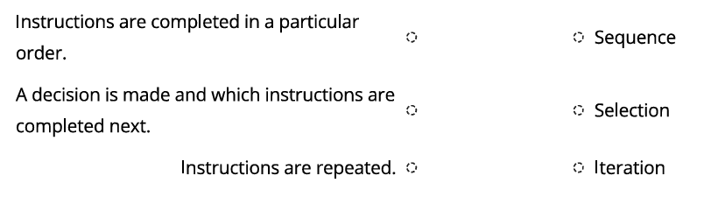
8.1 Lesson 2 - RAM & ROM
Review Now
An algorithm can be constructed using these three methods. Match the method with its description:
Categorise the following input, output and storage devices.
Identify the key features of the RAM and ROM and their role in the computer system.
Explain the difference between the purpose of RAM and ROM.
Explain what reading and writing from memory means and how it is used.
Input Device | Storage Device | Output Device
Keyboard | Hard Drive | Speaker
Mouse | USB Flash Drive | Monitor
Random Access Memory
Read Only Memory
Volatile
Read from / Write to

Slide 4



8.1 Lesson 2 - RAM & ROM
Lesson Objectives
Identify the key features of the RAM and ROM and their role in the computer system.
Identify the key features of the RAM and ROM and their role in the computer system.
Explain the difference between the purpose of RAM and ROM.
Explain the difference between the purpose of RAM and ROM.
Explain what reading and writing from memory means and how it is used.
Explain what reading and writing from memory means and how it is used.
Random Access Memory
Read Only Memory
Volatile
Read from / Write to

Slide 5


8.1 Lesson 2 - RAM & ROM
Flashback
Identify the key features of the RAM and ROM and their role in the computer system.
Input
Process
Output
Explain the difference between the purpose of RAM and ROM.
Memory
Directly access
the memory.
Explain what reading and writing from memory means and how it is used.
RAM & ROM are types of memory as your CPU will fetch all instructions directly from them.
Random Access Memory
Read Only Memory
Volatile
Read from / Write to

Slide 6

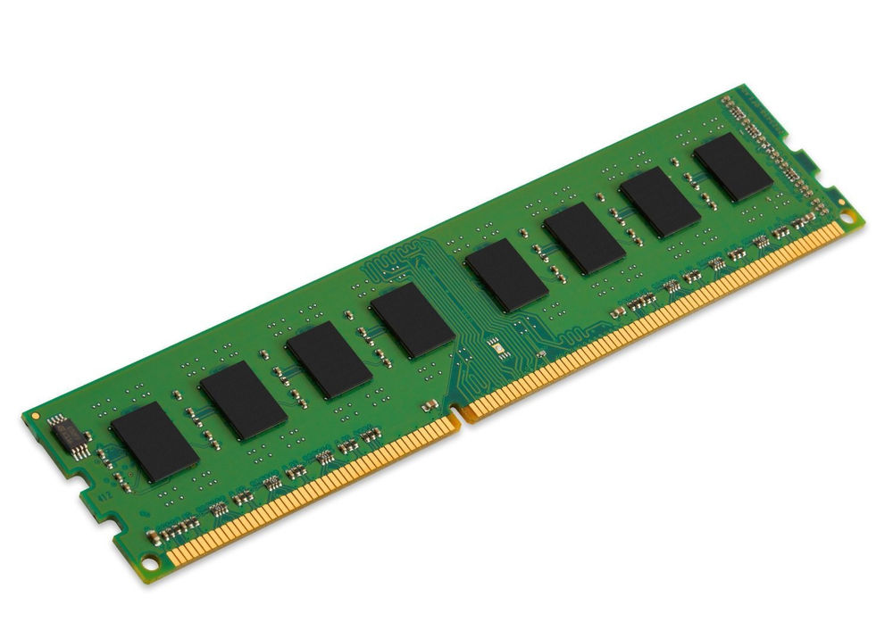
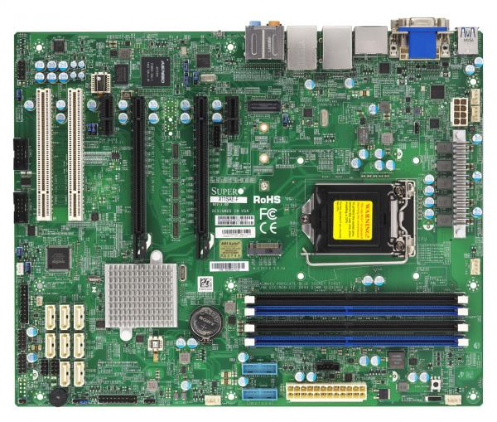
8.1 Lesson 2 - RAM & ROM
Key Knowledge
Identify the key features of the RAM and ROM and their role in the computer system.
Random Access Memory stores the data and programs that you are currently running.
Explain the difference between the purpose of RAM and ROM.
Explain what reading and writing from memory means and how it is used.
RAM is used to hold:
The Operating System
Open Documents
Running Programs
Random Access Memory
Read Only Memory
Volatile
Read from / Write to

Slide 7
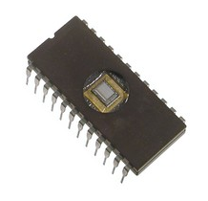
8.1 Lesson 2 - RAM & ROM
Key Knowledge
Identify the key features of the RAM and ROM and their role in the computer system.
Read Only Memory stores a program which takes the computer through all the steps to start up the computer.
Explain the difference between the purpose of RAM and ROM.
Explain what reading and writing from memory means and how it is used.
Random Access Memory
Read Only Memory
Volatile
Read from / Write to

Slide 8





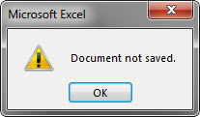

8.1 Lesson 2 - RAM & ROM
Key Terms
Identify the key features of the RAM and ROM and their role in the computer system.
Read from the memory.
Write to the memory.
Explain the difference between the purpose of RAM and ROM.
Explain what reading and writing from memory means and how it is used.
Volatile
Non-Volatile
Random Access Memory
Read Only Memory
Volatile
Read from / Write to

Slide 9



8.1 Lesson 2 - RAM & ROM
Whiteboard Quiz Time!
Identify the key features of the RAM and ROM and their role in the computer system.
Read from the memory.
Write to the memory.
Explain the difference between the purpose of RAM and ROM.
Explain what reading and writing from memory means and how it is used.
Volatile
Non-Volatile
Random Access Memory
Read Only Memory
Volatile
Read from / Write to

Slide 10



8.1 Lesson 2 - RAM & ROM
Task
Identify the key features of the RAM and ROM and their role in the computer system.
In your Class Notebook copy and complete this table.
 | ROM | RAM
Why is it needed? What does it store?
Volatile or Non-Volatile?
Write/Read?
Explain the difference between the purpose of RAM and ROM.
Class Notebook
Explain what reading and writing from memory means and how it is used.
What makes a table an appropriate way to present this information?
Before we start this task…
Random Access Memory
Read Only Memory
Volatile
Read from / Write to
Makes information easy to read and organised.
Shows a lot of information in a small area.
Help to quickly compare similarities & differences.

Slide 11

8.1 Lesson 2 - RAM & ROM
Task
Identify the key features of the RAM and ROM and their role in the computer system.
In your Class Notebook copy and complete this table.
 | ROM | RAM
Why is it needed? What does it store?
Volatile or Non-Volatile?
Write/Read?
Explain the difference between the purpose of RAM and ROM.
Class Notebook
Explain what reading and writing from memory means and how it is used.
Random Access Memory
Read Only Memory
Volatile
Read from / Write to

Slide 12
8.1 Lesson 2 - RAM & ROM
Task
Identify the key features of the RAM and ROM and their role in the computer system.
In your Class Notebook copy and complete this table.
 | ROM | RAM
Why is it needed? What does it store? | Stores a program to start up the computer. | Stores the data and programs that you are currently running.
Volatile or Non-Volatile? | Non-Volatile Data is not lost. | Volatile Data is wiped when it loses power.
Write/Read? | Read Only | Read & Write
Explain the difference between the purpose of RAM and ROM.
Class Notebook
Explain what reading and writing from memory means and how it is used.
Random Access Memory
Read Only Memory
Volatile
Read from / Write to

Slide 13

8.1 Lesson 2 - RAM & ROM
Challenge!
Identify the key features of the RAM and ROM and their role in the computer system.
Below your table explain what reading and writing from memory means and how it is used.
When you explain, you're helping someone understand how or why something works.
Explain the difference between the purpose of RAM and ROM.
Class Notebook
Consider:
  What data might we want to change?
  Will reading change the data?
  What happens when you write to something?
  What could go wrong?
Explain what reading and writing from memory means and how it is used.
Random Access Memory
Read Only Memory
Volatile
Read from / Write to

Slide 14



8.1 Lesson 2 - RAM & ROM
Lesson Objectives
Identify the key features of the RAM and ROM and their role in the computer system.
Explain the difference between the purpose of RAM and ROM.
Explain what reading and writing from memory means and how it is used.
Reminders
Toilets & Reception closed between lessons.
Self- Check your uniform.
Arrive during the Do Now, you are late.
Positive Note
Who has done well today?

