Slide 1


8.1.3 The CPU
Do Now
Complete in your booklet: Do Now 3
Homework
This will be set fortnightly on Quizizz, deadline details can be found on Arbor.
Name the parts of the CPU using the acronyms.
Describe the ways you can increase the performance of the CPU.
Explain why each method of CPU performance makes the CPU quicker.
Cores Cache
Clock Speed
Cycles Hertz Access
CPU CU ALU
Instructions

Slide 2

8.1.3 The CPU
Review Now 3
The function of the RAM is to store start up programs.
b – False
What does the ‘subject’ mean in an email?
d – Brief summary or topic of the email content
Name the parts of the CPU using the acronyms.
Describe the ways you can increase the performance of the CPU.
Explain why each method of CPU performance makes the CPU quicker.
RAM | ROM
Stores the data and programs that you are currently running. | Stores a program to start up the computer.
Read & Write | Read Only
Volatile – Data is wiped when it loses power. | Non-Volatile Data is not lost.
Cores Cache
Clock Speed
Cycles Hertz Access
CPU CU ALU
Instructions

Slide 3


8.1.3 The CPU
Instructions and data are processed by the CPU.
Flashback
Name the parts of the CPU using the acronyms.
Input
Process
Output
Describe the ways you can increase the performance of the CPU.
Memory
Explain why each method of CPU performance makes the CPU quicker.
CPU is an acronym for:
Central Processing Unit
Cores Cache
Clock Speed
Cycles Hertz Access
CPU CU ALU
Instructions

Slide 4

8.1.3 The CPU
Key Knowledge
Name the parts of the CPU using the acronyms.
The purpose of the CPU is to ‘fetch’ instructions from the memory, ‘decode’ and then ‘execute’ them.
Fetch
Describe the ways you can increase the performance of the CPU.
Decode
Explain why each method of CPU performance makes the CPU quicker.
Execute
Cores Cache
Clock Speed
Cycles Hertz Access
CPU CU ALU
Instructions

Slide 5
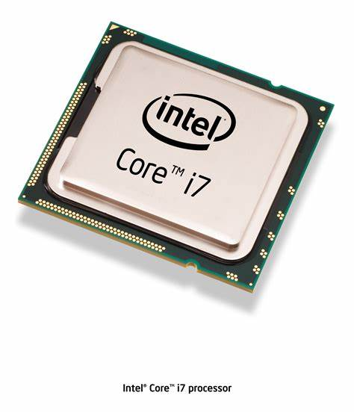


8.1.3 The CPU
CPU Components
Name the parts of the CPU using the acronyms.
CU
ALU
Control Unit
Controls the movement of data
around your CPU during the
fetch-decode-execute cycle.
Arithmetic Logic Unit
Carries out all the
calculations in the CPU.
Cache
Stores currently used data,
just like RAM. But it is closer
to the CPU so instructions
can be fetched faster!
Cache
Describe the ways you can increase the performance of the CPU.
Explain why each method of CPU performance makes the CPU quicker.
Task 1: Can you recreate my picture of a CPU?
Extension: Add descriptions of each part.
Cores Cache
Clock Speed
Cycles Hertz Access
CPU CU ALU
Instructions

Slide 6
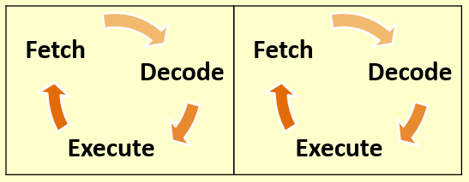

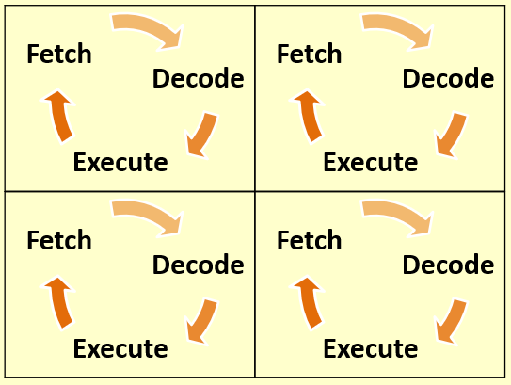
8.1.3 The CPU
Task 2
Using the key phrases, and the images to help you, explain in your eBook finish this sentence:
A better performing CPU will…
Name the parts of the CPU using the acronyms.
at the same time | quick access | cycles per second
Describe the ways you can increase the performance of the CPU.
2 cores
Cache
Explain why each method of CPU performance makes the CPU quicker.
Fetch
4 cores
Decode
Cache
Execute
Cores Cache
Clock Speed
Cycles Hertz Access
CPU CU ALU
Instructions

Slide 7
8.1.3 The CPU
A better performing CPU will…
Have more cores that process instructions at the same time as each other.
Have a bigger cache size to store more data to be fetched quickly.
Have a faster clock speed to complete more fetch-decode-execute cycles every second.
Name the parts of the CPU using the acronyms.
Describe the ways you can increase the performance of the CPU.
Explain why each method of CPU performance makes the CPU quicker.
Cores Cache
Clock Speed
Cycles Hertz Access
CPU CU ALU
Instructions

Slide 8
Silent Working – 10 Minutes
CPU: Central Processing Unit, the computer’s brain.
Cache: Small, fast memory inside the CPU.
ALU: Arithmetic Logic Unit, does maths and logic.
Clock Speed: How many instructions the CPU runs each second.
CU: Control Unit, tells parts of the CPU what to do.
Notes:
Learners complete 10 minutes silent working to make short notes in books or e-books.
Cognitive science rationale: when learners actively write down or think about something, they are more likely to remember it later.
This period encourages focus, retrieval practice, and self-explanation — all linked to better long-term retention.
After the silent working, learners will complete a formative quiz on the key words to familiarise themselves with the content of the lesson.
EEF evidence: The Teaching and Learning Toolkit highlights that metacognition and self-regulation (e.g., summarising, note-making, retrieval) can add +7 months of progress when embedded effectively.

Slide 9



8.1.3 The CPU
End of the Lesson
Name the parts of the CPU using the acronyms.
Evidence
Add a screenshot of your work to your Class Notebook.
Describe the ways you can increase the performance of the CPU.
Ending on a high!
Who has done well?
How have we progressed?
Explain why each method of CPU performance makes the CPU quicker.
Reminders
Toilets & Reception closed between lessons.
Self-Check your uniform
If you arrive after the register has started, you are late.
Cores Cache
Clock Speed
Cycles Hertz Access
CPU CU ALU
Instructions

