Slide 1


8.1.4 Sound & Binary
Do Now
Complete in your booklet: Do Now 4
Homework
This will be set fortnightly on Quizizz, deadline details can be found on Arbor.
Explain the term sampling and how it converts sound into binary.
Calculate using binary shift how to make a sound louder or quieter.
Explain the effect of changing a value on the sound wave.
Binary Sample
Analogue Digital
Shift Sound Wave

Slide 2
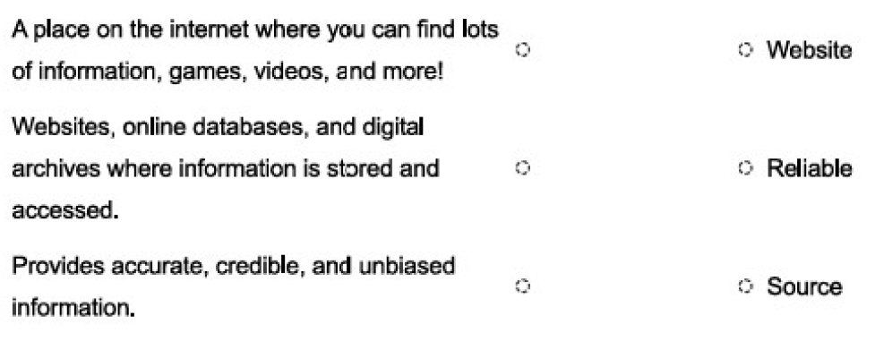

8.1.4 Sound & Binary
Review Now 4
The instructions in a computer are processed by the CPU? a – True
What happens when a CPU has a large cache size?
c – More data can be stored close to the CPU for quick access.
4. Email address format:
Explain the term sampling and how it converts sound into binary.
Calculate using binary shift how to make a sound louder or quieter.
Explain the effect of changing a value on the sound wave.
Binary Sample
Analogue Digital
Shift Sound Wave

Slide 3


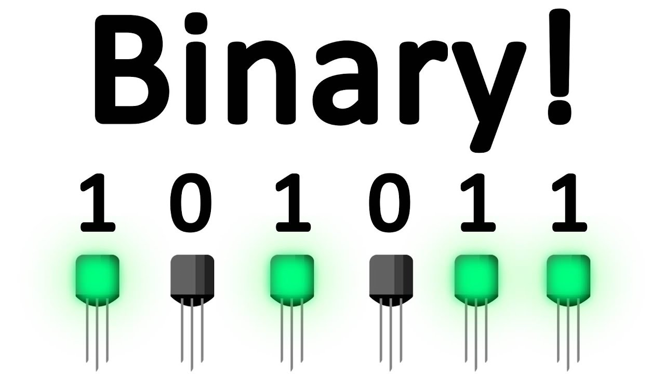
8.1.4 Sound & Binary
Instructions and data are processed by the CPU.
Flashback
Explain the term sampling and how it converts sound into binary.
Input
Process
Output
Calculate using binary shift how to make a sound louder or quieter.
Memory
Explain the effect of changing a value on the sound wave.
Everything that a computer processes is stored as:
Binary Sample
Analogue Digital
Shift Sound Wave

Slide 4

8.1.4 Sound & Binary
Flashback
Explain the term sampling and how it converts sound into binary.
Computer use millions of electronic circuits and switches which can either be On or Off.
Calculate using binary shift how to make a sound louder or quieter.
On is represented by 1.
Off is represented by 0.
 | Number to Convert: | 128 | 64 | 32 | 16 | 8 | 4 | 2 | 1
e.g. | 68 | 0 | 1 | 0 | 0 | 0 | 1 | 0 | 0
a. | 35
b. | 75
c. | 100
Explain the effect of changing a value on the sound wave.
Binary Sample
Analogue Digital
Shift Sound Wave

Slide 5

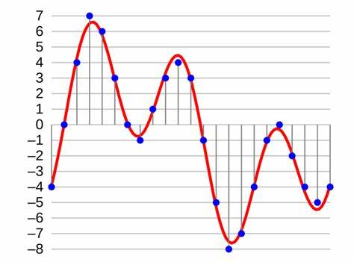
8.1.4 Sound & Binary
Key Knowledge
Explain the term sampling and how it converts sound into binary.
Here is an analogue sound wave.
Each blue dot is where the sound is sampled.
A sample is where the sound is converted into binary to store it.
Calculate using binary shift how to make a sound louder or quieter.
Explain the effect of changing a value on the sound wave.
Binary Sample
Analogue Digital
Shift Sound Wave

Slide 6

8.1.4 Sound & Binary
Key Knowledge
Explain the term sampling and how it converts sound into binary.
We can sample a sound by recording it using an analogue to digital converter.
The samples can then be converted to binary. They will be recorded to the nearest whole number.
_ 01100011_
Calculate using binary shift how to make a sound louder or quieter.
Explain the effect of changing a value on the sound wave.
Binary Sample
Analogue Digital
Shift Sound Wave

Slide 7
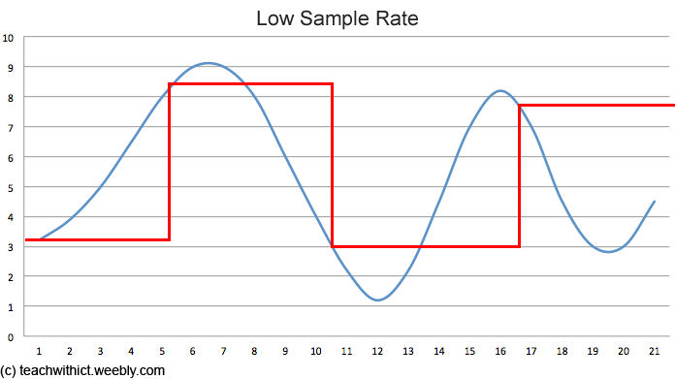
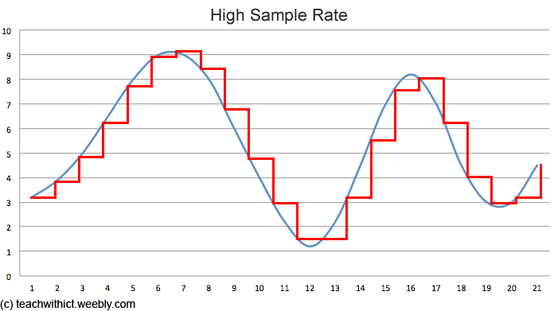
8.1.4 Sound & Binary
Key Knowledge
Explain the term sampling and how it converts sound into binary.
The more ‘samples’ are taken the closer the digital version will sound compared to the original.
Calculate using binary shift how to make a sound louder or quieter.
Blue = Analogue Original
Red = Digital Version
Explain the effect of changing a value on the sound wave.
Binary Sample
Analogue Digital
Shift Sound Wave

Slide 8

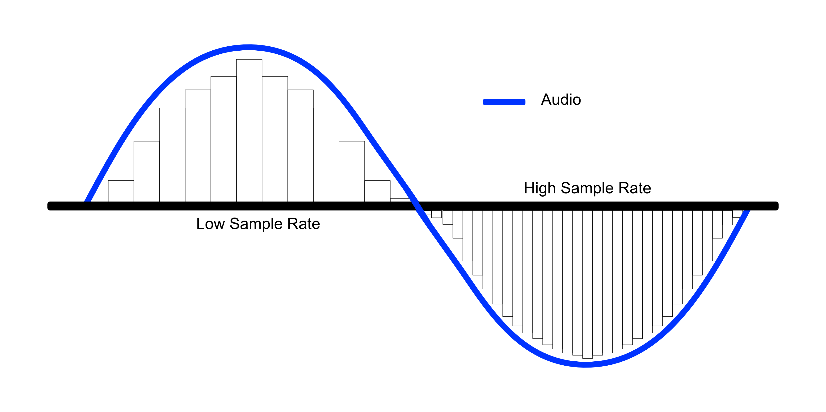
8.1.4 Sound & Binary
Task
Add an image like the one below to your Class Notebook by typing ‘sample rate’ into a search engine.
Explain what is happening in the picture you have chosen, the term sampling and how it converts sound in binary.
Explain the term sampling and how it converts sound into binary.
Calculate using binary shift how to make a sound louder or quieter.
Explain the effect of changing a value on the sound wave.
Binary Sample
Analogue Digital
Shift Sound Wave

Slide 9
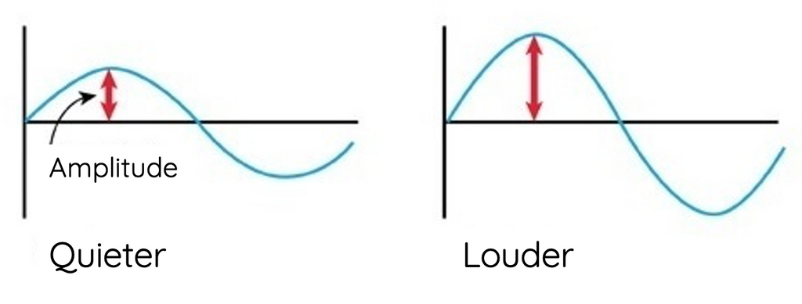


8.1.4 Sound & Binary
Key Knowledge
Explain the term sampling and how it converts sound into binary.
Today we are going to be focusing on the amplitude of the sound wave.
The higher the wave the louder the sound.
Calculate using binary shift how to make a sound louder or quieter.
Explain the effect of changing a value on the sound wave.
Binary Sample
Analogue Digital
Shift Sound Wave

Slide 10
8.1.4 Sound & Binary
Key Knowledge
Explain the term sampling and how it converts sound into binary.
What is the difference between the two amplitudes?
Calculate using binary shift how to make a sound louder or quieter.
Explain the effect of changing a value on the sound wave.
Wave 1 Amplitude:
00110001
Wave 2 Amplitude:
01100010
In Computer Science when the binary numbers have all been moved left or right we call this a ‘shift’.
Binary Sample
Analogue Digital
Shift Sound Wave

Slide 11
8.1.4 Sound & Binary
Key Knowledge
Explain the term sampling and how it converts sound into binary.
If we shift the bits to the left we multiply the number by 2.
This is exactly like denary except it is by 2 instead of 10.
Calculate using binary shift how to make a sound louder or quieter.
16 8 4 2 1
This is 8 + 1 = 9
1001
10010
Explain the effect of changing a value on the sound wave.
Shifted left:
This is 16 + 2 = 18
Binary Sample
Analogue Digital
Shift Sound Wave

Slide 12
8.1.4 Sound & Binary
Key Knowledge
Explain the term sampling and how it converts sound into binary.
If we shift the bits to the right we divide the number by 2.
This is exactly like denary except it is by 2 instead of 10.
Calculate using binary shift how to make a sound louder or quieter.
8 4 2 1
This is 8 + 2 = 10
1010
101
Explain the effect of changing a value on the sound wave.
Shifted right:
This is 4 + 1 = 5
Binary Sample
Analogue Digital
Shift Sound Wave

Slide 13
8.1.4 Sound & Binary
Whiteboard Task
Perform a left shift by 1 position:
Explain the term sampling and how it converts sound into binary.
128 64 32 16 8 4 2 1
Calculate using binary shift how to make a sound louder or quieter.
0 0 0 0 1 0 1 0
Explain the effect of changing a value on the sound wave.
Binary Sample
Analogue Digital
Shift Sound Wave

Slide 14
8.1.4 Sound & Binary
Whiteboard Task
Perform a left shift by 1 position:
Explain the term sampling and how it converts sound into binary.
128 64 32 16 8 4 2 1
Calculate using binary shift how to make a sound louder or quieter.
0 0 0 1 0 1 0 0
Explain the effect of changing a value on the sound wave.
Binary Sample
Analogue Digital
Shift Sound Wave

Slide 15
8.1.4 Sound & Binary
Whiteboard Task
Perform a left shift by 2 position:
Explain the term sampling and how it converts sound into binary.
128 64 32 16 8 4 2 1
Calculate using binary shift how to make a sound louder or quieter.
0 0 0 0 0 1 0 1
Explain the effect of changing a value on the sound wave.
Binary Sample
Analogue Digital
Shift Sound Wave

Slide 16
8.1.4 Sound & Binary
Whiteboard Task
Perform a right shift by 1 position:
Explain the term sampling and how it converts sound into binary.
128 64 32 16 8 4 2 1
Calculate using binary shift how to make a sound louder or quieter.
0 0 0 0 0 1 1 0
Explain the effect of changing a value on the sound wave.
Binary Sample
Analogue Digital
Shift Sound Wave

Slide 17
8.1.4 Sound & Binary
Whiteboard Task
Perform a right shift by 1 position:
Explain the term sampling and how it converts sound into binary.
128 64 32 16 8 4 2 1
Calculate using binary shift how to make a sound louder or quieter.
0 0 1 0 0 1 0 0
Explain the effect of changing a value on the sound wave.
Binary Sample
Analogue Digital
Shift Sound Wave

Slide 18
8.1.4 Sound & Binary
Whiteboard Task
Perform a right shift by 2 position:
Explain the term sampling and how it converts sound into binary.
128 64 32 16 8 4 2 1
Calculate using binary shift how to make a sound louder or quieter.
0 0 1 1 0 1 0 0
Explain the effect of changing a value on the sound wave.
Binary Sample
Analogue Digital
Shift Sound Wave

Slide 19
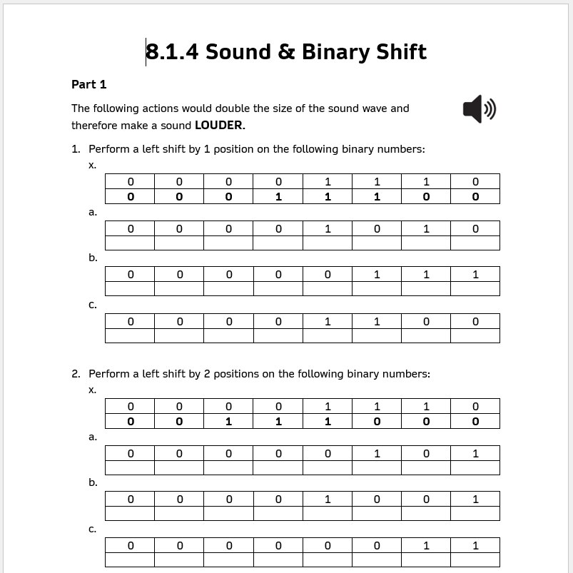
8.1.4 Sound & Binary
Task
Explain the term sampling and how it converts sound into binary.
Calculate using binary shift how to make a sound louder or quieter.
Explain the effect of changing a value on the sound wave.
Binary Sample
Analogue Digital
Shift Sound Wave

Slide 20
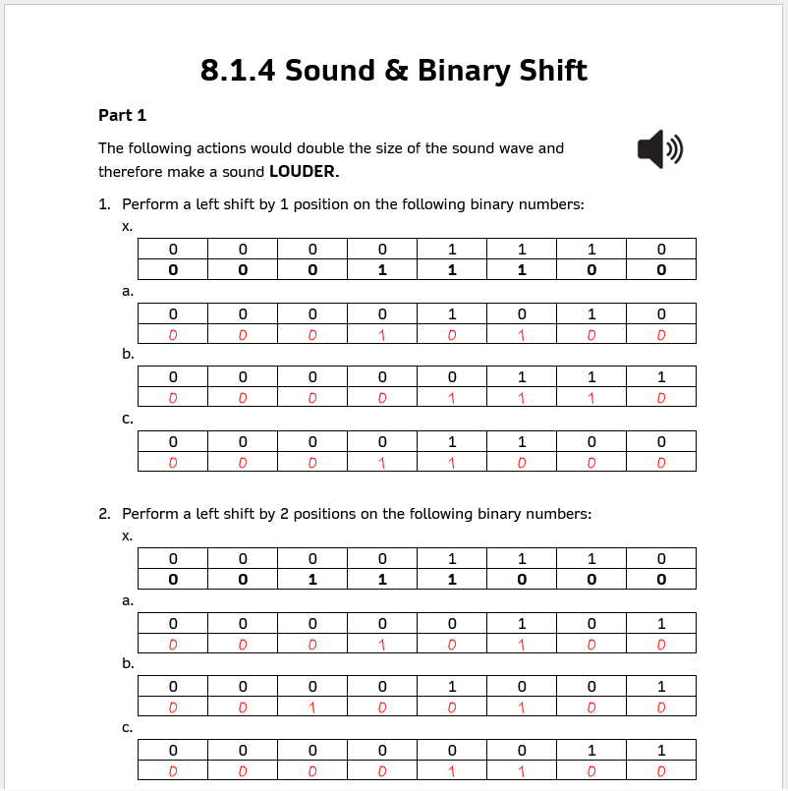
8.1.4 Sound & Binary
Answers
Explain the term sampling and how it converts sound into binary.
Calculate using binary shift how to make a sound louder or quieter.
Explain the effect of changing a value on the sound wave.
Binary Sample
Analogue Digital
Shift Sound Wave

Slide 21
Silent Working – 10 Minutes
Binary: A way of storing data using 1s and 0s.
Digital: Data stored as numbers, like 1s and 0s.
Sample: A measurement of sound taken at a point in time.
Shift: Moving binary digits left or right.
Analogue: A smooth signal, like real sound.
Notes:
Learners complete 10 minutes silent working to make short notes in books or e-books.
Cognitive science rationale: when learners actively write down or think about something, they are more likely to remember it later.
This period encourages focus, retrieval practice, and self-explanation — all linked to better long-term retention.
After the silent working, learners will complete a formative quiz on the key words to familiarise themselves with the content of the lesson.
EEF evidence: The Teaching and Learning Toolkit highlights that metacognition and self-regulation (e.g., summarising, note-making, retrieval) can add +7 months of progress when embedded effectively.

Slide 22



8.1.4 Sound & Binary
End of the Lesson
Explain the term sampling and how it converts sound into binary.
Evidence
Add a screenshot of your work to your Class Notebook.
Calculate using binary shift how to make a sound louder or quieter.
Ending on a high!
Who has done well?
How have we progressed?
Explain the effect of changing a value on the sound wave.
Reminders
Toilets & Reception closed between lessons.
Self-Check your uniform
If you arrive after the register has started, you are late.
Binary Sample
Analogue Digital
Shift Sound Wave

