Slide 1


Computing Expectations
1
Respect for Others
SLANT when the teacher is speaking.
Listen when others contribute.
Support the learning of others.
2
Respect for the Classroom Environment
Leave the desks as you found them.
Keep food and drink away from the desks.
Follow the Acceptable Use Agreement.
3
Respect for Learning
Be ready to answer questions and complete tasks.
Folders and Class Notebooks should be well presented.
Work hard even when you find it difficult.

Slide 2
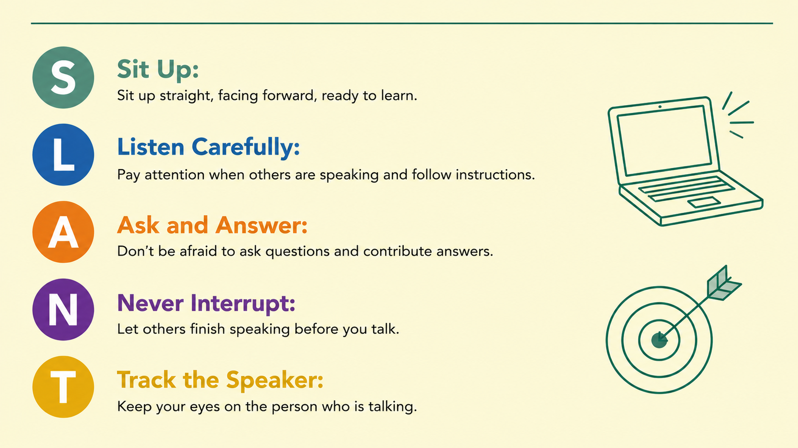

Slide 3
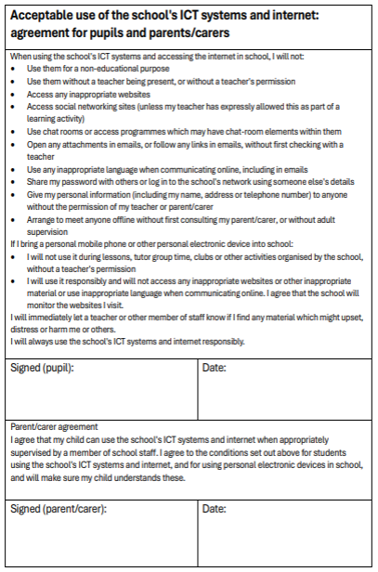


Welcome Back Year 7
Organisation
Today we need to:
  Review the ‘Acceptable Use Agreement’.
  Decide on a strong password.
  Complete your username, email and printer code in your planner.

Slide 4
Welcome Back Year 7
What is filtering?
If you search and try and go on website that the school thinks is inappropriate, they will not allow you to access it.
If you think a website should/should not be blocked please let a teacher know.
What is monitoring?
Staff can see your school device screen, internet history files and emails at anytime. You should only be using these for schoolwork.
Note:
If you break the Acceptable Use Agreement, either in lessons or through monitoring, you will receive a negative on Arbor.
Two negatives will trigger a Lunchtime Detention.

Slide 5

Welcome Back Year 7
Organisation
Today we need to:
  Review the ‘Acceptable Use Agreement’.
  Decide on a strong password.
  Complete your username, email and printer code in your planner.
Passwords must have 10 characters and not need changing all year!

Slide 6
Welcome Year 7
Logging In
Think of a strong password for your RHSC school account.
Your password should be at least ten character long.
You will not be asked to change it unless there is an issue with your account.
Example username: ewindsor21
Current password: Password1

Slide 7
Welcome Back Year 7
Organisation
Today we need to:
  Review the ‘Acceptable Use Agreement’.
  Decide on a strong password.
  Complete your username, email and printer code in your planner.

Slide 8



Welcome Year 7
End of the Lesson
M215880
Evidence
Add a screenshot of your work to your Class Notebook.
Ending on a high!
Who has done well?
How have we progressed?
Reminders
Toilets & Reception closed between lessons.
Self-Check your uniform.
If you arrive after the register has started, you are late.

Slide 9
Presentation of Work
Green Folders
Completed cover page at the front of your folder.
Pages in chronological order (new work at the back).
Do Nows & Assessments
Write in black or blue ink.
Mark in coloured pen.
Your best handwriting (joined up or printed clearly).
Mistakes crossed out with a single line.
No scribbles, doodles or graffiti.
Pages not torn, creased or stained.
Correct use of capital letters, full stops and commas etc.
Write in full sentences.
Paper Based Lessons
Previous plus the following:
Title and date at the top of each piece of work.
Underline title and headings with a ruler.
Diagrams or charts neatly drawn and labelled.
Class Notebook
Date added to each row.
Write in black font.
Mark in purple font.
Titles and headings in bold and/or underlined.
Unordered lists using bullet points.
Ordered lists using numbering.
Screenshots and images cropped and not distorted.
Use subheadings or write the question in your answer.

