Slide 1
Eruler
Designed by w^w^w team
Yingkai Wang
Haonan Wang
Hongting Wang

Slide 2
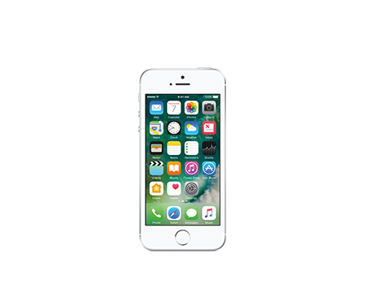
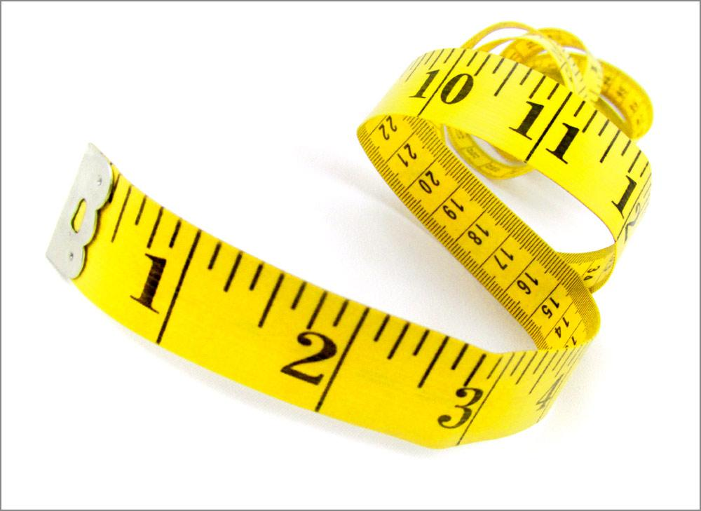
What is Eruler?
Innovative App
Measurement
Notes:
//add number for photos

Slide 3
Differences & Improvements
No reference input required
Precise distance measurement by built-in sensors

Slide 4
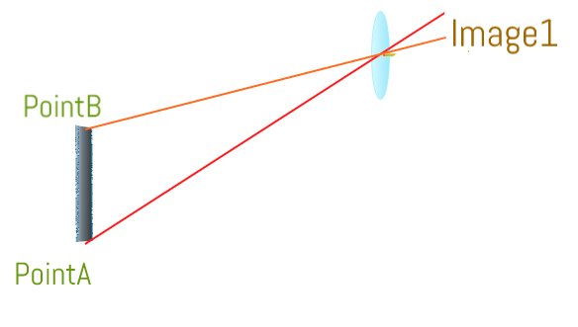
How it works
Take the first picture of the object.
Select the measuring object.

Slide 5
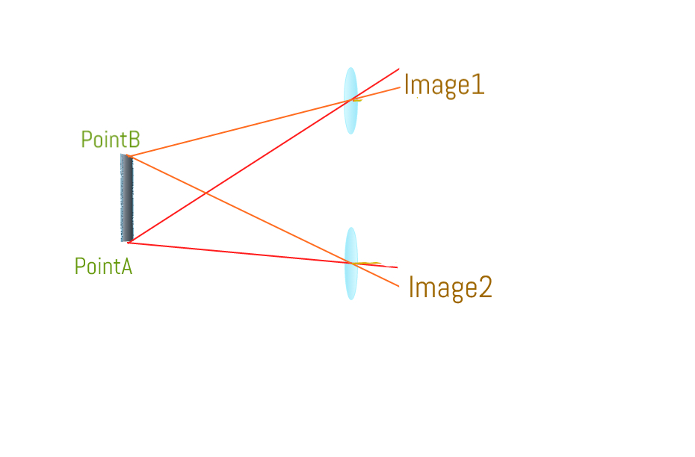
How it works
Move the camera down a few inches and take the second picture. The object still has to be in frame.

Slide 6
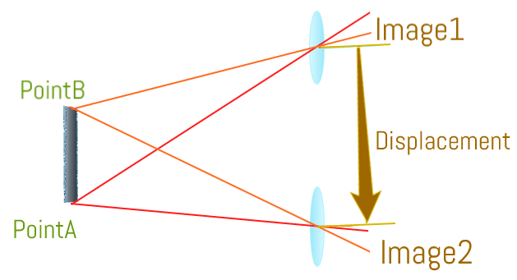
How it works
Eruler app will record the displacement and calculate the length of the object.

Slide 7
Current Stage
Error Range
Phone Displacement:
6.5%
Object length:
5.7%

Slide 8
Next Steps
Increase precision for measuring displacement in one dimension
Take three dimensions into account allowing users to take photos from other angles
Reduce errors caused by minor phone rotation

Slide 9
Thank You

Slide 12
Agenda
Introduction
Analyze
Conclusion
Reference

Slide 13
Test and Simulation
————displacement
Current app distance measurement
Method: barometer
Drawbacks: unstable
Error Range: N/A
Eruler
Method: build-in accelerometer, gyro
Benefit: stable and precise
Current error Range: 6.5%
Filter
／／draw a flow chart／／swift code －》get raw data －》plot raw acceleration －－》 smoother（）－》plot velocity －》data update？？－－》get distance
Current error range
Next Step goal：

Slide 14
Test and Simulation ———— calculate length from images//
Matlab
Method: Two Photos
Error range:
Next step: horizontal movement -> 3D

Slide 15
Reference
［1］http://www.sew4home.com/tips-resources/sewing-tips-tricks/deciphering-marks-measuring-tape
［2］
https://www.att.com/cellphones/iphone/iphone-se.html

