Slide 1
rsync Configuration Tool
Eric Henderson
Tom Most
Kevin Risden
Notes:
Eric

Slide 2
Background/Requirements
Provide a utility that will allow for easier configuration and visualization of rsync configuration flags
Requirements
Platform
Linux
Visualize
Directory tree including size and number of files
include/exclude rules
Internationalizable
Performance
Responsive to user input with background processes
Parse directory tree efficiently
Security
Observer user permissions in relation to directories and files
Generate properly escaped output
Maintainability
Open source
Others can modify and redistribute
Not Supported
Parsing shell script of rsync options
Configuration file non rsync utilities
Configuration for rsyncd
Recognition of common rsync errors
Notes:
Eric

Slide 3
Solution
Written in Python/GTK+
Visualizes directory tree and filter rules
Demonstration
Notes:
Tom

Slide 4

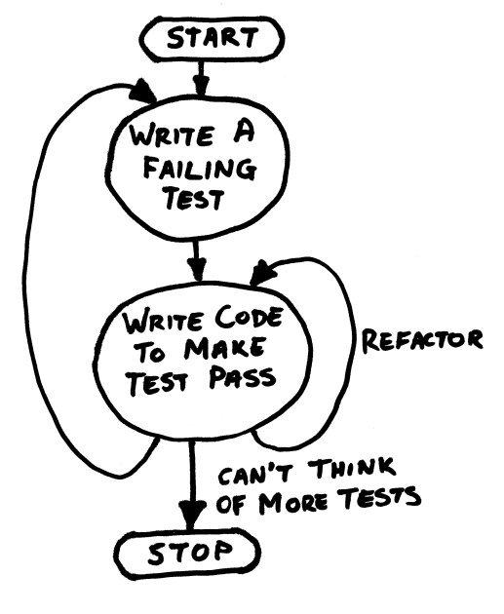
TDD Reflection
Notes:
All

Slide 5
Metrics
Test Coverage
Definition: This is defined to make sure that every line of code written is covered by at least one test case. This does not include each execution path, but makes sure that every executable line of code is run at least once.
Test Progress
Definition: Test progress is defined as the number of test cases expected to be finished, the number of test cases finished tracked over the course of the project, and the number of test cases that have been coded for and passed.
SLOC
Definition: The source lines of code metric will be the actual number of source code lines that do not include blank lines or comment lines. Line lengths are a maximum of 79 characters and since Python is white space delimited there will be no multiple statements on a single line.
Comments Lines/Method
Definition: This is defined as the total comment lines divided by the total number of methods. The length of a comment line should be no more than 79 characters in length so there will not be one long line of a single comment.
Cyclomatic Complexity
Definition: Cyclomatic Complexity is the measure of linearly independent paths through a program.
Notes:
Kevin

Slide 6
Metrics
Notes:
Kevin
345 346 359

