Slide 1
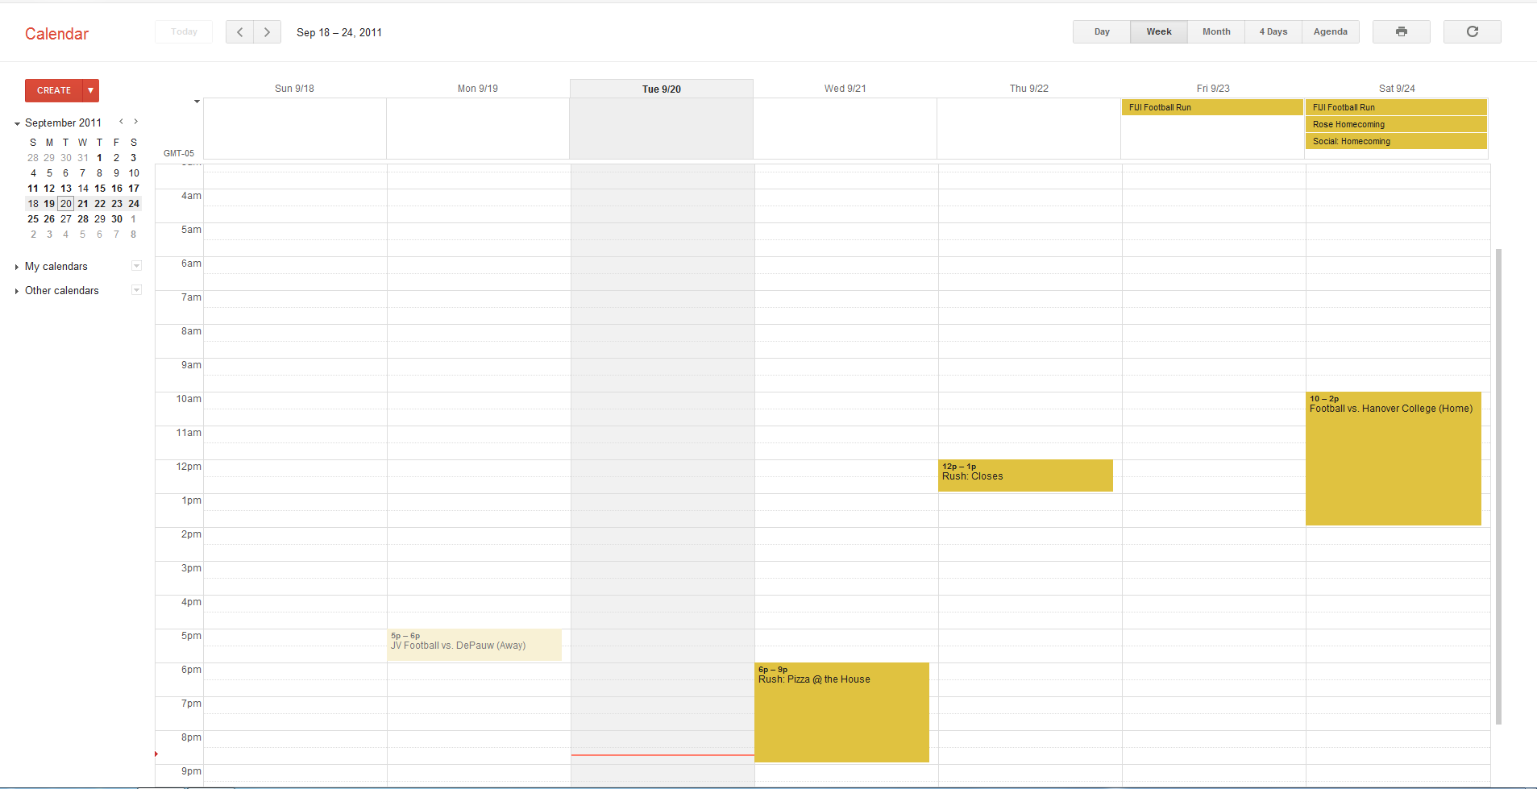
Human Computer Interaction Labs
Browse Experiments
Researcher Log In

Slide 2
Experiment X
Qualification #1
Qualification #2
Qualification #3
Qualification #4
Qualification #5
Qualification #6
Qualification #7
Notes:
Sign up for this Experiment
Notes:
List dates
Who is running it

Slide 3
Sign up Information for Experiment X
Name:
Cell Phone:
Email:
Submit
Notes:
Add “EULA” type consent

Slide 4
Researcher Log In
Username:
Password:
Log In

Slide 5

Experiments of <Username>
Filters
Date
Room
Etc
Etc
…
Create New Experiment
Notes:
Table based

Slide 6
Experiment X
Qualifications:
Age
Language
Etc
etc
Participant List
Name | Cell Phone | Email
Bill Bob | (555)555555 | bob@ma.com
Sparks Mcgee | (403)6185546 | sparks@ma.com
Shane Jermey | (209)4723882 | jermy@ma.com
Ricky Bobby | (123)3456789 | bobby@ma.com
Save
Notes:
Add Date time column
Add description

