Slide 1
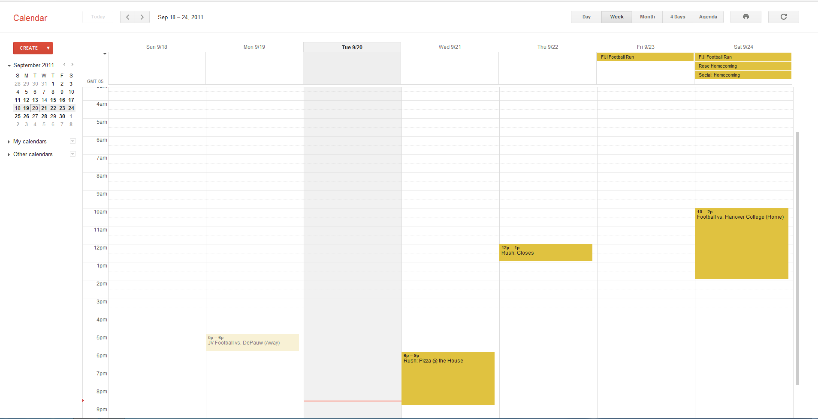
Human Computer Interaction Labs
Browse Experiments
Researcher Log In
From Here a user would select the date block of the experiment they wanted to sign up for.
Notes:
From Here a user would select the date block of the experiment they wanted to sign up for.

Slide 2
Experiment X
Qualification #1
Qualification #2
Qualification #3
Qualification #4
Qualification #5
Dates
Date 1
Time1
Time2
Time3
Date 2
Time1
Time2
Time3
Notes:
This Experiment is ran by <Researcher1, Researcher2,…,Researchern>
Sign up for this Experiment
This screen shows the experiment qualifications, the Dates and times of the experiment, what researcher is running the experiment, a section for notes and also a link to sign up for the experiment. A user would review the information and hopefully sign up.
Notes:
This screen shows the experiment qualifications, the Dates and times of the experiment, what researcher is running the experiment, a section for notes and also a link to sign up for the experiment. A user would review the information and hopefully sign up.

Slide 3
Sign up Information for Experiment X
Name:
Cell Phone:
Email:
By clicking this I have agreed that I meet all qualifications
Submit
This screen allows a participant to sign up for the experiment and agree to meet all the qualifications.
Notes:
This screen allows a participant to sign up for the experiment and agree to meet all the qualifications.

Slide 4
Researcher Log In
Username:
Password:
Log In
A researcher would log in to their account from here.
Notes:
A researcher would log in to their account from here.

Slide 5

Experiments of <Username>
Filters
Date
Room
Etc
Etc
…
Create New Experiment
A researcher’s possible screen after signing in.
Notes:
A researcher’s possible screen after signing in.

Slide 6
Experiment X
Save
Qualifications:
Age
Language
Etc
etc
Description/Notes
Participant List
Name | Cell Phone | Date/Time | Email
Bill Bob | (555)555555 | 5/5 – 14:00 | bob@ma.com
Sparks Mcgee | (403)6185546 | 5/6 – 13:30 | sparks@ma.com
Shane Jermey | (209)4723882 | 5/5 – 13:30 | jermy@ma.com
From this screen a researcher could add description or notes and also qualifications. Also, the researcher could view the participants.
Notes:
From this screen a researcher could add description or notes and also qualifications. Also, the researcher could view the participants.

Slide 7
Experiments of <Username>
Experiment | Date | Room
Robot Stuff | 5/5 | F 217
UI Stuff | 5/6 | F 322
10001010110 | 5/10 | O 231
Create New Experiment
This screen is an alternative to the calendar view for the researchers.
Notes:
This screen is an alternative to the calendar view for the researchers.

Slide 8
Human Computer Interaction Labs
Browse Experiments
Experiment Name | Date – Times | Notes
Robot Stuff | 5/5 – 13:00 | Etf
Less Robot Stuff | 5/5 – 14:00 | Etc
More Robot Stuff | 5/6 – 12:00 | Etc
UI | 5/6 – 9:00 | Etc
Dan Guiney | 5/8 – 20:00 | Etc
Computer Runs | 5/9 – 15:00 | etc
Researcher Log In
This screen is an alternative to the calendar view for the participants.
Notes:
This screen is an alternative to the calendar view for the participants.

