Slide 1
CONVERSATIONAL AI : Building Chatbots
Priyanka Shah

Slide 2
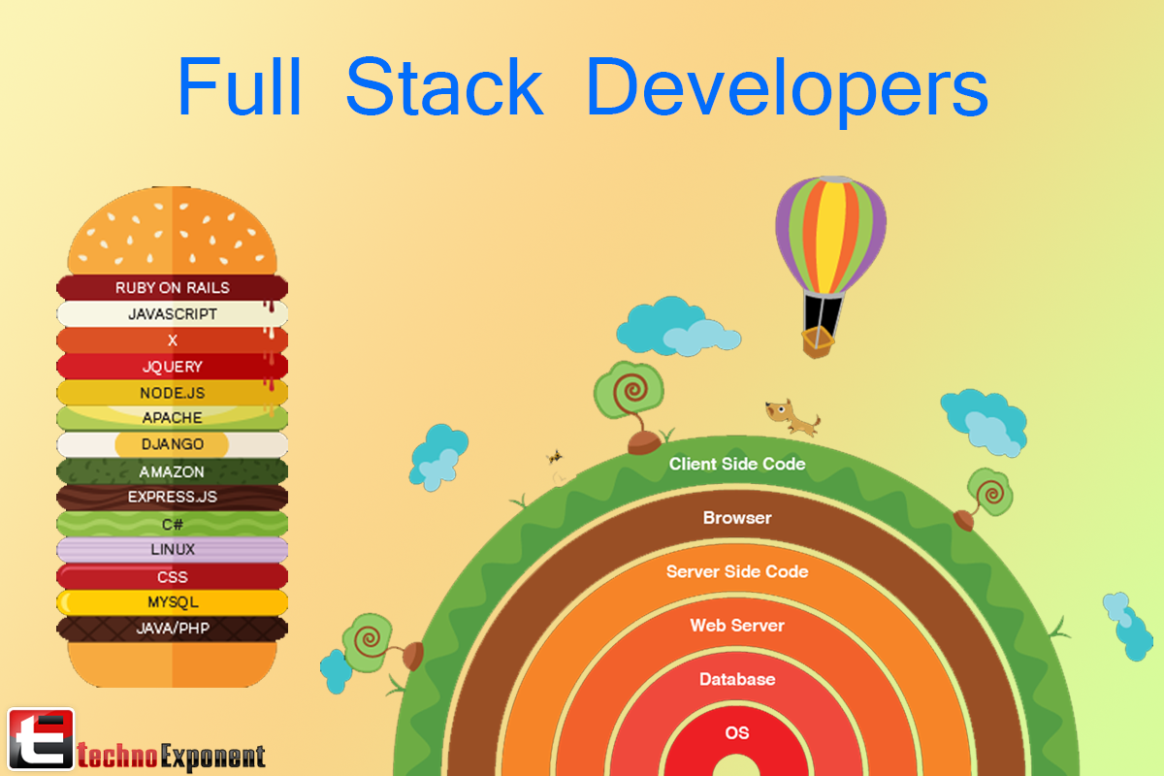
I AM…
Innovation and Technologies Head @ an investment firm
Full stack developer ( so I am expected to know everything under the sun… at least that’s what interviewers think!!)
Passionate about new technologies, love to code, blog / talk about AI, ML.NET, Microsoft technology stack.
Environment enthusiast
Twitter: @fuzzymind1

Slide 3
AGENDA
Session 1: Basics of Conversational AI services, Bot framework SDK, Bot emulator, Azure bot services etc.
Session 2: Build a basic bot and run it using the bot emulator. Add language recognition with LUIS (Language understanding and integration Services)
Session 3: Add visual response to the bot (image recognition and response) and adding knowledge to the bot with Q and A maker cognitive services.
Session 4: Implementing Personality chat and Deep Neural Networks (DNNs)
Session 5: Adding Speech support, speech translation and custom speech services to the bot.
Session 6: Conclusion with introduction to ethics in bot building and a peek into further advancements with Microsoft’s Overview of Project Conversation Learner and Semantic Machines.

Slide 4
WHAT IS A BOT?
Virtual, Intelligent assistants
New industry standard to respond to routine user queries and save on time and resources
Bots can
check the weather, traffic and sports scores.
play music, translate words and send text messages.
do math, tell jokes and read stories.
But, when it comes to conversations… Bots need to be imparted a human-like intelligence
Notes:
“You have to poke around for magic combinations of words to get various things to happen, and you find out that a lot of the functions that you expect the thing to do, it actually just can’t handle,” said Dan Roth, corporate vice president and former CEO of Semantic Machines, which Microsoft acquired in May 2018.
For example, he explained, systems today can add a new appointment to your calendar but not engage in a back-and-forth dialogue with you about how to juggle a high-priority meeting request. They are also unable to use contextual information from one skill to assist you in making decisions from another, such as checking the weather before scheduling an afternoon meeting on the patio of a nearby coffee shop.

Slide 5
CONVERSTIONAL AI
Combining skills and context
leverage machine learning to understand the intent of a user’s command
map people’s words to the computational steps needed to carry out requested tasks.
Hold Dynamic conversations
Personalized experience
Notes:
For example, instead of executing a hand-coded program to get the score of the football match, the Semantic Machines approach starts with people who show the system how to get sports scores across a range of example contexts so that the system can learn to fetch sports scores itself.
What’s more, machine learning methods then enable the system to generalize from contexts it has seen to new contexts, learning to do more things in more ways. If it learns how to get sports scores, for example, it can also get weather forecasts and traffic reports. That’s because the system has learned not just a skill, but the concept of how to gather data from a service and present it back to the user.
That’s missing in today’s intelligent assistants, which are programmed to do a list of isolated things that a programmer anticipated. The machine learning in these systems primarily focuses on words that trigger a skill, explained Microsoft technical fellow Dan Klein, a recognized leader in the field of natural language processing and a professor of computer science at the University of California at Berkeley.

Slide 6

HOW TO BUILD A BASIC BOT?
Microsoft offers:
Bot Framework SDK
Azure Web App Bot
Azure Bot Channels Registration
Azure Cognitive Services to build intelligent applications
Azure Storage for cloud storage solution

Slide 7
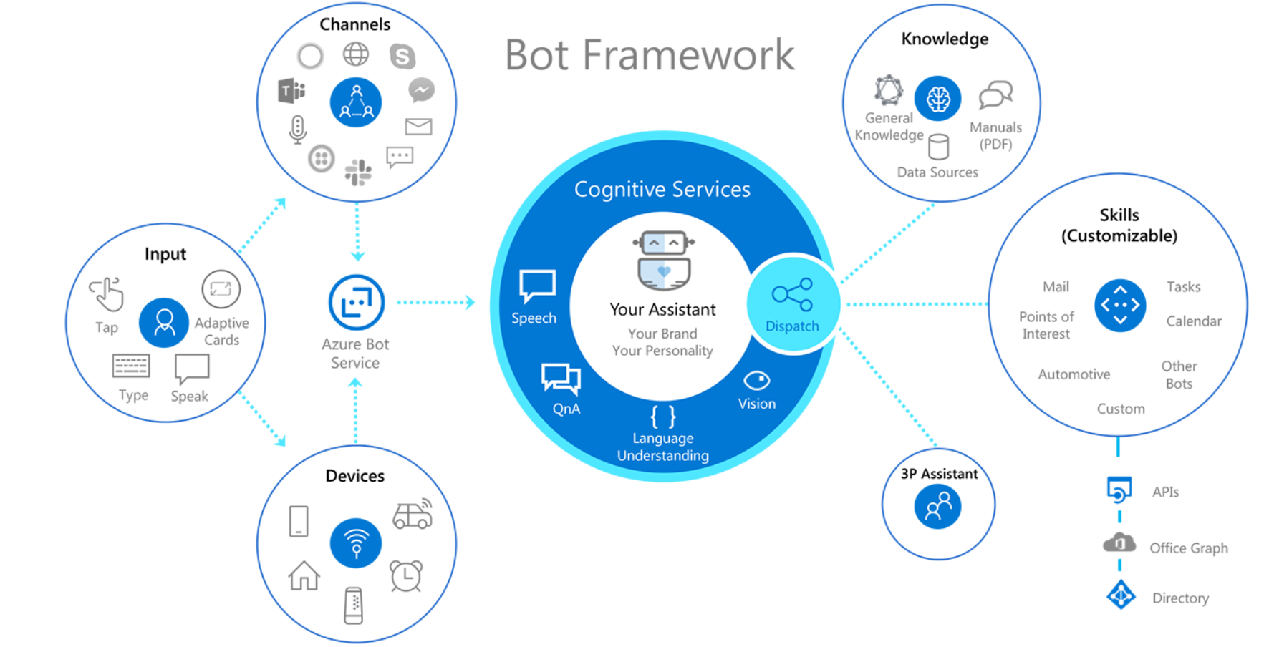
COMPONENTS OF A CONVERSATIONAL AI EXPERIENCE:

Slide 8
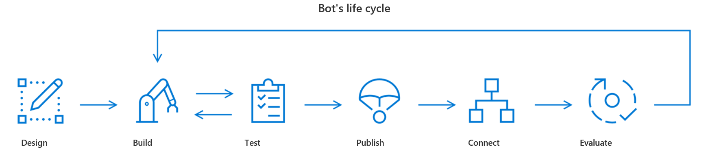
BOT : LIFECYCLE

Slide 9
PRINCIPLES OF BOT DESIGN:
Factors that do not guarantee a bot's success
How “smart” the bot is
How much natural language the bot supports
Voice
Factors that do influence a bot's success
Does the bot easily solve the user’s problem with the minimum number of steps?
Does the bot solve the user’s problem better/easier/faster than any of the alternative experiences?
Does the bot run on the devices and platforms the user cares about?
Is the bot discoverable? Do the users naturally know what to do when using it?
Notes:
How “smart” the bot is: In most cases, it is unlikely that making your bot smarter will guarantee happy users or adoption of your platform. In reality, many bots have little advanced machine learning or natural language capabilities. A bot may include those capabilities if they're necessary to solve the problems that it's designed to address, however you should not assume any correlation between a bot's intelligence and user adoption of the bot.
How much natural language the bot supports: Your bot can be great at conversations. It can have a vast vocabulary and can even make great jokes. But unless it addresses the problems that your users need to solve, these capabilities may contribute very little to making your bot successful. In fact, some bots have no conversational capability at all. And in many cases, that's perfectly fine.
Voice: It isn’t always the case that enabling bots for speech will lead to great user experiences. Often, forcing users to use voice can result in a frustrating user experience. As you design your bot, always consider whether voice is the appropriate channel for the given problem. Is there going to be a noisy environment? Will voice convey the information that needs to be shared with the user?

Slide 10
BOT DESIGN: Patterns
Knowledge Bots:
Fuzzy search
Azure search
LUIS
Q and A maker

Slide 11
HOW BOTS WORK?
A bot is an app that users interact with in a conversational way, using text, graphics (such as cards or images), or speech.
Every interaction between the user and the bot generates an activity
The Bot Framework Service, which is a component of the Azure Bot Service, sends information between the user's bot-connected app (such as Facebook, Skype, etc. which we call the channel) and the bot.
Each channel may include additional information in the activities they send.
Before creating bots, it is important to understand how a bot uses activity objects to communicate with its users.
Take a look at activities that are exchanged when we run a simple echo bot.

Slide 12
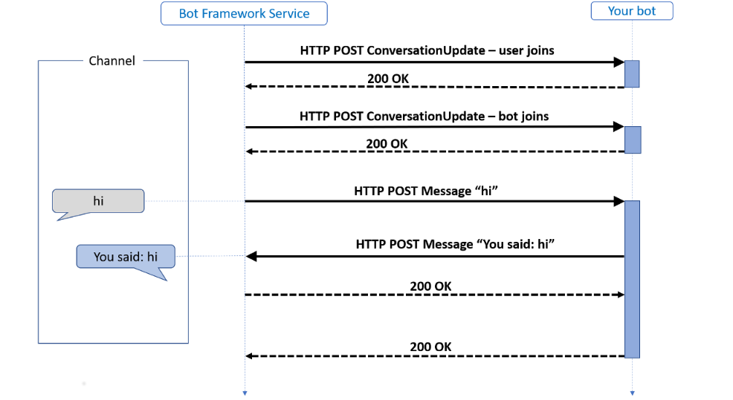
HOW BOTS WORK?
Notes:
Two activity types illustrated here are: conversation update and message.
The Bot Framework Service may send a conversation update when a party joins the conversation. For example, on starting a conversation with the Bot Framework Emulator, you will see two conversation update activities (one for the user joining the conversation and one for the bot joining). To distinguish these conversation update activities, check whether the members added property includes a member other than the bot.
The message activity carries conversation information between the parties. In an echo bot example, the message activities are carrying simple text and the channel will render this text. Alternatively, the message activity might carry text to be spoken, suggested actions or cards to be displayed.

Slide 13
HOW BOTS WORK?
HTTP Details:
Activities arrive at the bot from the Bot Framework Service via an HTTP POST request.
The bot responds to the inbound POST request with a 200 HTTP status code.
Activities sent from the bot to the channel are sent on a separate HTTP POST to the Bot Framework Service.
This is acknowledged with a 200 HTTP status code.
Conversation Turns:
a turn consists of the user's incoming activity to the bot and any activity the bot sends back to the user as an immediate response.
Notes:
In a conversation, people often speak one-at-a-time, taking turns speaking. With a bot, it generally reacts to user input. Within the Bot Framework SDK, a turn consists of the user's incoming activity to the bot and any activity the bot sends back to the user as an immediate response. You can think of a turn as the processing associated with the arrival of a given activity.
The turn context object provides information about the activity such as the sender and receiver, the channel, and other data needed to process the activity. It also allows for the addition of information during the turn across various layers of the bot.
The turn context is one of the most important abstractions in the SDK. Not only does it carry the inbound activity to all the middleware components and the application logic but it also provides the mechanism whereby the middleware components and the application logic can send outbound activities.

Slide 14
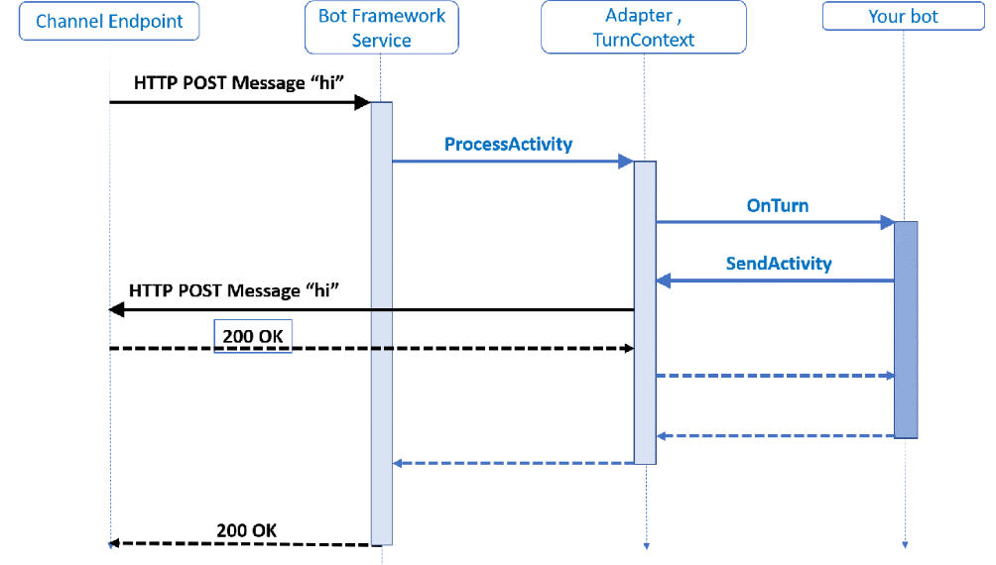
HOW BOTS WORK?
Activity Handlers:
Notes:
The adapter, an integrated component of the SDK, is the core of the SDK runtime. The activity is carried as JSON in the HTTP POST body. This JSON is deserialized to create the Activity object that is then handed to the adapter with a call to process activity method. On receiving the activity, the adapter creates a turn context and calls the middleware.
As mentioned above, the turn context provides the mechanism for the bot to send outbound activities, most often in response to an inbound activity. To achieve this, the turn context provides send, update, and delete activity response methods. Each response method runs in an asynchronous process

Slide 15
HOW BOTS WORK?
Activity handlers:
When the bot receives an activity, it passes it on to its activity handlers.
there is one base handler called the turn handler.
All activities get routed through there.
turn handler then calls the individual activity handler for whatever type of activity it received.
Notes:
For example, if the bot receives a message activity, the turn handler would see that incoming activity and send it to the OnMessageActivityAsync activity handler.
When building your bot, your bot logic for handling and responding to messages will go in this OnMessageActivityAsync handler. Likewise, your logic for handling members being added to the conversation will go in your OnMembersAddedAsync handler, which is called whenever a member is added to the conversation.
To implement your logic for these handlers, you will override these methods in your bot as seen in the Bot logic section below. For each of these handlers, there is no base implementation, so just add the logic that you want in your override.

Slide 16
BOT LOGIC (C# Code)
The handlers defined in ActivityHandler are:
Event | Handler | Description
Any activity type received | OnTurnAsync | Calls one of the other handlers, based on the type of activity received.
Message activity received | OnMessageActivityAsync | Override this to handle a message activity.
Conversation update activity received | OnConversationUpdateActivityAsync | On a conversationUpdate activity, calls a handler if members other than the bot joined or left the conversation.
Non-bot members joined the conversation | OnMembersAddedAsync | Override this to handle members joining a conversation.
Non-bot members left the conversation | OnMembersRemovedAsync | Override this to handle members leaving a conversation.
Event activity received | OnEventActivityAsync | On an event activity, calls a handler specific to the event type.
Token-response event activity received | OnTokenResponseEventAsync | Override this to handle token response events.
Non-token-response event activity received | OnEventAsync | Override this to handle other types of events.
Message reaction activity received | OnMessageReactionActivityAsync | On a messageReaction activity, calls a handler if one or more reactions were added or removed from a message.
Message reactions added to a message | OnReactionsAddedAsync | Override this to handle reactions added to a message.
Message reactions removed from a message | OnReactionsRemovedAsync | Override this to handle reactions removed from a message.
Other activity type received | OnUnrecognizedActivityTypeAsync | Override this to handle any activity type otherwise unhandled.

Slide 17
MANAGING STATE
a bot is inherently stateless; a different instance of your bot may handle any given turn of the conversation.
Why do we need a state?
The Bot Framework SDK includes some implementations for the storage layer:
Memory storage implements in-memory storage for testing purposes. In-memory data storage is intended for local testing only as this storage is volatile and temporary. The data is cleared each time the bot is restarted.
Azure Blob Storage connects to an Azure Blob Storage object database.
Azure Cosmos DB storage connects to a Cosmos DB NoSQL database.

Slide 18
MANAGING STATE
State management automates the reading and writing of your bot's state to the underlying storage layer.
State is stored as state properties: key-value pairs that your bot can read and write through the state management object
While saving state: Bot state implements a "last write wins" behavior, where the last write will stamp over the previously written state.
Notes:
User state
Conversation state
Private conversation state
All of these buckets are subclasses of the bot state class, which can be derived to define other types of buckets with different scopes.
These predefined buckets are scoped to a certain visibility, depending on the bucket:
User state is available in any turn that the bot is conversing with that user on that channel, regardless of the conversation
Conversation state is available in any turn in a specific conversation, regardless of user (i.e. group conversations)
Private conversation state is scoped to both the specific conversation and to that specific user

Slide 19
Quick start
Please check out the github repo for quick starts:
https://github.com/compuwizpiyu/CoreRepo

Slide 20
Coming up in next session…
Adding advanced capabilities to the bot
LUIS portal exploration
Knowledge based bot with LUIS

Slide 21
CONCLUSION…
If(questions)
{
Please ask!!
}
Else
{
GRACIAS
THANK YOU
MERCI
Unhandled language exception!!
}

