Slide 1
NLP: Topic Modelling with LDA
PRIYANKA H SHAH

Slide 2
Head of Innovation and Technology. Regional Head of Data Science for Emerging Markets
AI architect and Big data solution engineer.
Full stack developer.
Passionate about new technologies, love to code, blog / talk about AI, ML.NET, Microsoft technology stack.
Environment enthusiast
Twitter: @fuzzymind1
I am…

Slide 3
OUR REAL LIFE PROBLEM STATEMENT
Built a document text search engine (Elastic search)
Search efficiency for term search, phrase search, fuzzy search was quite good
Related terms search?
Example : Driverless cars -> Self driving cars, robotic cars
Lithium -> Other metals/ Utilities sector related information, dry cell or related industries
Recommend search terms for sematic searches… like were you looking for <term> OR
People who searched this report, also searched <list of related reports>

Slide 4
Other constraints
550,000 call reports available
Distributed across 11 sectors
New call reports added daily
Impossible to go through each document and identify the “tag” words
How to tag newly uploaded call reports?
How to establish word semantic relationships / build a word taxonomy for all documents

Slide 5
COMPLETE SOLUTION ARCHITECTURE
Identify topics using LDA
Build word taxonomy using the topics and the words occurring in each topic
For example : Insurance, premium, policy, claim, reinsurance can be added as synonyms
Use Azure Cognitive text Analytics services to get:
Sentiment for each document
Named Entity recognition
Key phrases
Contextual information about NERs
Use the text Analytics information to tag documents
Feed the tags and synonyms to Azure Cognitive search using Synonyms API
Iteratively build a more sophisticated taxonomy. Keep refining every month for new reports

Slide 6
Topic Modelling
Identifying topics in a set of documents.
Topics are statistical language models used for uncovering hidden structure in a collection of texts
Dimensionality Reduction
Unsupervised Learning,
Tagging, abstract “topics” that occur in a collection of documents that best represents the information in them.

Slide 7
More use cases for Topic Modelling
Topics can be defined as “a repeating pattern of co-occurring terms in a corpus”. A good topic model should result in – “health”, “doctor”, “patient”, “hospital” for a topic – Healthcare, and “farm”, “crops”, “wheat” for a topic – “Farming”.
Topic Models are very useful for the purpose for document clustering, organizing large blocks of textual data, information retrieval from unstructured text and feature selection.
For Example –
New York Times are using topic models to boost their user – article recommendation engines.
Various professionals are using topic models for recruitment industries where they aim to extract latent features of job descriptions and map them to right candidates.
They are being used to organize large datasets of emails, customer reviews, and user social media profiles.

Slide 8
Why do we need Topic Modelling
huge amount of textual data lying around us in an unstructured format in the form of news articles, research papers, social media posts etc
we need a way to understand, organize and label this data to make informed decisions
Topic modeling is used in various applications like finding questions on stack overflow that are similar, news flow aggregation and analysis, recommender systems etc.
All these focus on finding the hidden thematic structure in the text, as it is believed that every text that we write be it a tweet, post or a research paper is composed of themes like sports, physics, aerospace etc.

Slide 9
Latent Dirichlet Allocation
Latent: This refers to everything that we don’t know a priori and are hidden in the data.
Dirichlet: It is a ‘distribution of distributions’.
Allocation: This means that once we have Dirichlet, we will allocate topics to the documents and words of the document to topics.
That’s it. This is what LDA is in a nutshell.

Slide 10
LDA tenets
Every document is a mixture of topics.
We imagine that each document may contain words from several topics in particular proportions.
For example, in a two-topic model we could say “Document 1 is 90% topic A and 10% topic B, while Document 2 is 30% topic A and 70% topic B.”
Every topic is a mixture of words.
For example, we could imagine a two-topic model of news, with one topic for “politics” and one for “entertainment.”
The most common words in the politics topic might be “President”, “Congress”, and “government”
entertainment topic may be made up of words such as “movies”, “television”, and “actor”.
words can be shared between topics; a word like “budget” might appear in both equally.

Slide 11
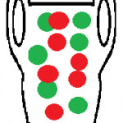
Polya’s Urn
Pólya’s urn is a famous sampling model used in probability.
Let’s say you had an urn with red and green balls.
You choose one ball at random, note the color, and replace the ball in the urn along with another ball of the same color.
The resulting model is called Polya’s urn process.

Slide 12
The Dirichlet Process
The Dirichlet process is a way to model randomness of a probability mass function(PMF) with unlimited options (e.g. an unlimited amount of dice in a bag).
The process is similar Polya’s Urn, only instead of having a set number of ball colors you have an unlimited amount.
Start out with an empty urn.
Randomly pick a colored ball and place it in the urn.
Then choose one option:
Randomly pick a colored ball and place it in the urn.
Randomly remove a colored ball from the urn, then put it back with another ball of the same color.
As the number of balls in the urn increase, the probability of picking a new color decreases. The proportion of balls in the urn after an infinite amount of draws is a Dirichlet process.

Slide 13
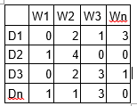
LDA Fundamentals
LDA assumes documents are produced from a mixture of topics.
Those topics then generate words based on their probability distribution.
Given a dataset of documents, LDA backtracks and tries to figure out what topics would create those documents in the first place.
LDA is a matrix factorization technique.
In vector space, any corpus (collection of documents) can be represented as a document-term matrix.

Slide 14
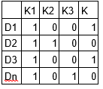
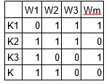
LDA Fundamentals
LDA converts this Document-Term Matrix into two lower dimensional matrices – M1 and M2. M1 is a document-topics matrix and
M2 is a topic – terms matrix with dimensions (N, K) and (K, M) respectively, where N is the number of documents, K is the number of topics and M is the vocabulary size.

Slide 15
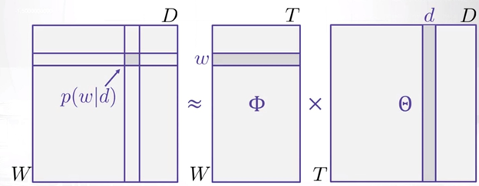
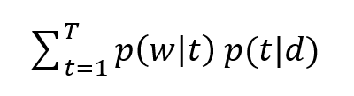
LDA Fundamentals
LDA says is that each word in each document comes from a topic and the topic is selected from a per-document distribution over topics. So we have two matrices:
1. ϴtd = P(t|d) which is the probability distribution of topics in documents
2. Фwt = P(w|t) which is the probability distribution of words in topics
And, we can say that the probability of a word given document i.e. P(w|d) is equal to:

Slide 16
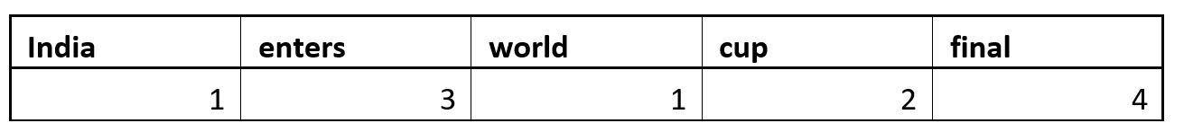
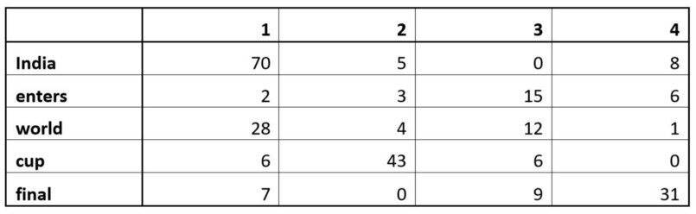
Gibbs Sampling
suppose we have a document with some random word topic assignment
We also have our count matrix v(k,w) as shown below:

Slide 17

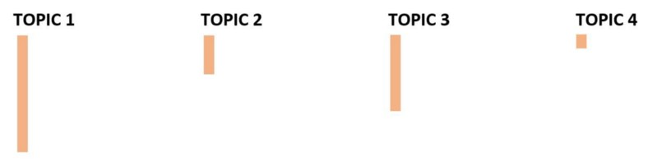
Gibbs Sampling
Lets say we come across the word “world” again
We assume it is a new word so we don’t know to what topic world belongs.
Second let’s represent the matrix n(d,k) in the following way to show how much a document use each topic
let’s represent v(k,w) in the following way to show how many times each topic is assigned to this word

Slide 18
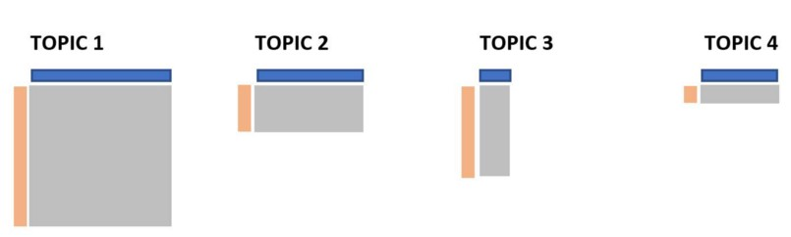
Gibbs Sampling
we will multiply these two matrices to get our conditional probabilities
we will randomly pick any of the topic and will assign that topic to world and we will repeat these steps for all other words as well.
topic with highest conditional probability should be selected but as we can see other topics also have some chance to get selected
After several iterations, a steady state is achieved where the document topic and topic term distributions are good.
This is the convergence point of LDA.

Slide 19
Parameters of LDA
Alpha represents document-topic density
Beta represents topic-word density.
Higher the value of alpha, documents are composed of more topics and lower the value of alpha, documents contain fewer topics.
Higher the beta, topics are composed of a large number of words in the corpus, and with the lower value of beta, they are composed of few words.
Number of Topics – Number of topics to be extracted from the corpus.
Number of Topic Terms – Number of terms composed in a single topic.
Number of Iterations / passes – Maximum number of iterations allowed to LDA algorithm for convergence.

Slide 20
LDA Implementation
The complete code is available as a Jupyter Notebook on GitHub
Loading data
Data cleaning
Exploratory analysis
Preparing data for LDA analysis
LDA model training
Analyzing LDA model results

