Slide 1

Introduction To Machine Learning: Part 2
PRIYANKA H SHAH

Slide 2

Head of Innovation and Technology
Data science and Big data solution engineer.
Full stack developer.
Passionate about new technologies, love to code, blog / talk about AI, ML.NET, Microsoft technology stack.
Environment enthusiast
Twitter: @fuzzymind1
I am…

Slide 3
Agenda
01
Introduction to Neural networks
02
Shortcoming for RNN
03
LSTM
04
PCA
05
Demo

Slide 4
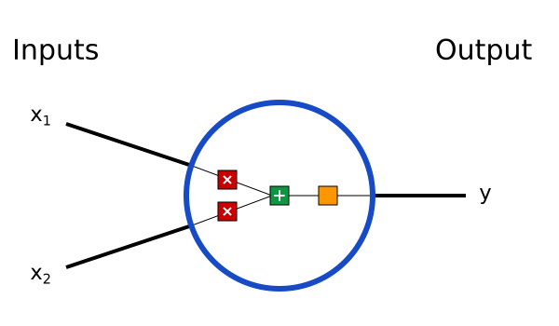
Neural Networks
Neurons, the basic unit of a neural network

Slide 5
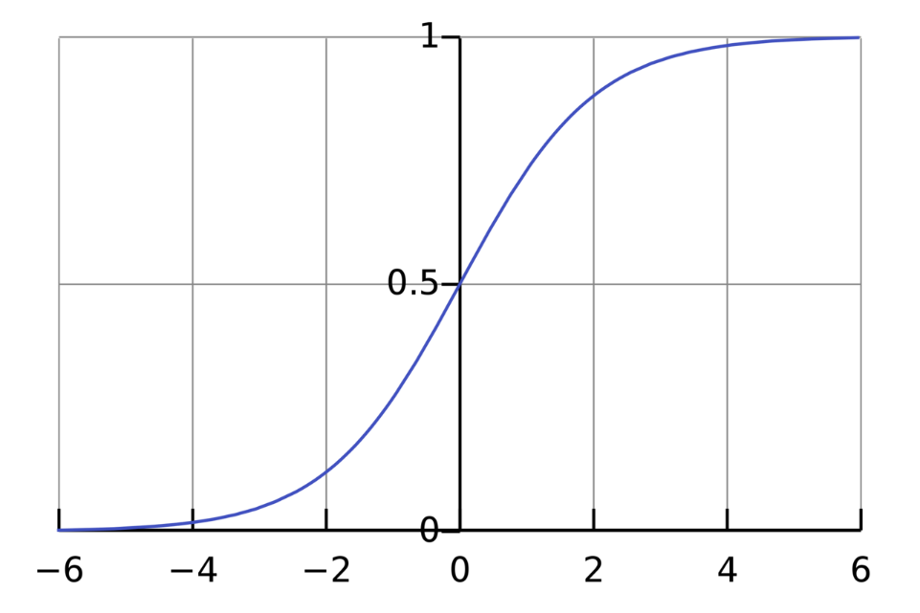
Neural Networks
Three things:
Each input is multiplied by weight:
X1*w1, x2*w2
All weighted inputs are added with a bias b
X1*w1 + x2*w2 +b
Sum is passed through an activation function
The activation function is used to turn an unbounded input into an output that has a nice, predictable form.
A commonly used activation function is the sigmoid function
This process of passing inputs forward to get an output is known as feedforward.

Slide 6
Why RNN? (Recurrent Neural networks)
Feed forward networks: Input examples are fed to the network and transformed to an output
With supervised learning, the output would be a label, like for example image recognition as Cat or elephant.
A feedforward network is trained on labeled images until it minimizes the error it makes when guessing their categories
With the trained set of parameters, the network categorizes data it has never seen
A trained feedforward network can be exposed to any random collection of photographs,
the first photograph it is exposed to will not necessarily alter how it classifies the second.
No notion of order and time.
Only input is the current example it has been exposed to.
Feed forward networks are amnesiacs!!!

Slide 7
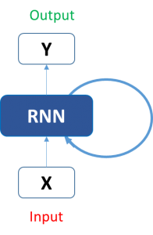
Recurrent Neural Networks
To overcome the amnesia of Feed forward networks, we have RNNs.
A simple machine learning model or an Artificial Neural Network may learn to predict the stock prices based on a number of features: the volume of the stock, the opening value etc.
It is also largely dependent on the stock values in the previous days (major factor)
This dependency on time is achieved via Recurrent Neural Networks. A typical RNN looks like:

Slide 8
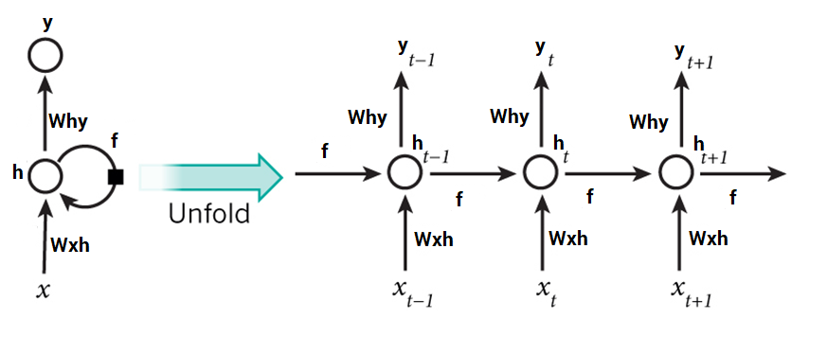
RNN unfolded…

Slide 9
LIMITATIONS OF RNNs
are great when it comes to short contexts
The color of the sky is… (will output blue in most cases without having to deal with previous context)
but in order to be able to build a story and remember it, we need our models to be able to understand and remember the context behind the sequences
vanilla RNNs fail to understand the context behind an input.
I was born in India. Then after 20 years, I moved to Ireland where I worked for underprivileged African children…. Blah blah… I speak fluent __________
The relevant information may be separated from the point where it is needed, by a huge load of irrelevant data.
This is where a Recurrent Neural Network fails!

Slide 10
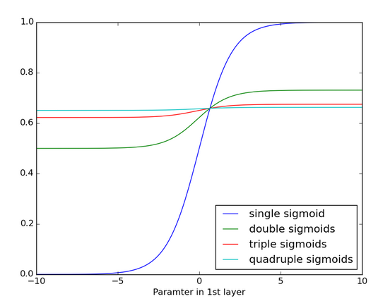
Vanishing Gradient problem in RNNs
In normal neural networks, the weight updating that is applied on a particular layer is a multiple of
the learning rate,
the error term from the previous layer
and the input to that layer.
The error term for a particular layer is somewhere a product of all previous layers’ errors
When applying sigmoid functions, the small values of its derivatives (occurring in the error function) gets multiplied multiple times as we move towards the starting layers.

Slide 11
LSTM (Long short-term Memory)
RNN does not have understanding of “important” and “not so important” information.
LSTMs make small modifications to the information by multiplications and additions
Information flows through a mechanism called as cell states.
LSTM can selectively remember or forget things
Taking a stock price analogy:
The stock price for today will depend on:
Previous day’s trends (the previous cell state, the information that was present in memory after the previous time step)
Previous day’s stock price (the previous hidden state)
Factors that can affect the stock price today (the input at the current time step)

Slide 12
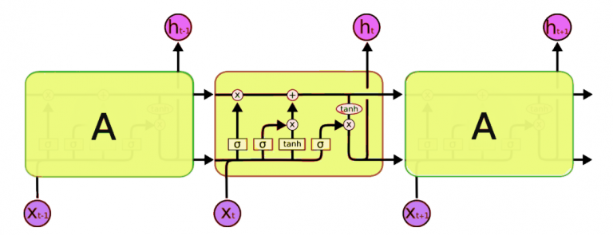
LSTM Architecture
Comparing LSTM to a news Coverage for better understanding!
LSTM network is comprised of different memory blocks called cells
2 states transferred to the next cell, cell state and hidden state
Memorization is done through “gates”

Slide 13
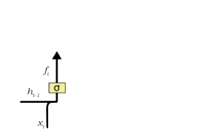
LSTM: Forget Gate
Rafael Nadal is a great player. But, Roger, is the best ever to play the sport.
As soon as the first full stop after “player” is encountered, the forget gate realizes that there may be a change of context in the next sentence.
Change of subject from Rafa to Roger…subject Rafa is forgotten and replaced by Roger.
Forget gate removes the less important, un-necessary or redundant information from LSTM.

Slide 14
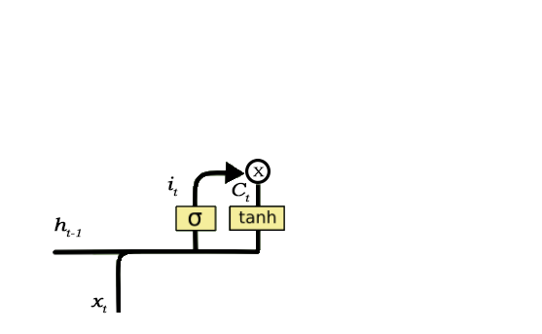
LSTM: Input gate
Novak is gluten free. He told me over the phone that he has lactose intolerance too, since last 4 years.
Important info is Novak in gluten free and lactose intolerant
The fact that I know this on phone, can be deemed un-important
The process of adding new information, is done through input gate:
Regulating what values need to be added to the cell state by involving a sigmoid function.
similar to the forget gate and acts as a filter for all the information from h_t-1 and x_t.
Creating a vector containing all possible values that can be added (as perceived from h_t-1 and x_t) to the cell state. This is done using the tanh function, which outputs values from -1 to +1.
Multiplying the value of the regulatory filter (the sigmoid gate) to the created vector (the tanh function) and then adding this useful information to the cell state via addition operation.

Slide 15
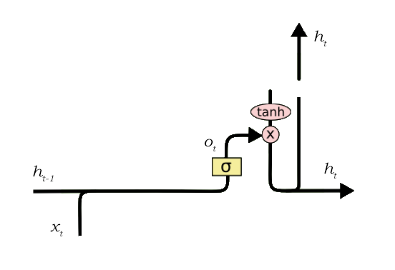
LSTM : Output Gate
Not all information that runs along the cell state, is fit for being output at a certain time.
Roger Federer is a legend of Tennis due to his skills. For his contributions, and elegant _____________
There could be a lot of possibilities to fill the blank…
Elegant is an adjective, hence strong probability that the blank should be a noun: ex skill, play, behavior etc.
Output gate does the job of selecting useful information and displaying it as output.

Slide 16
LSTM: Output gate
The functioning of an output gate can again be broken down to three steps:
Creating a vector after applying tanh function to the cell state, thereby scaling the values to the range -1 to +1.
Making a filter using the values of h_t-1 and x_t, such that it can regulate the values that need to be output from the vector created above. This filter again employs a sigmoid function.
Multiplying the value of this regulatory filter to the vector created in step 1, and sending it out as a output and also to the hidden state of the next cell.
The filter in the above example will make sure that it diminishes all other values but ‘skill’.
Thus the filter needs to be built on the input and hidden state values and be applied on the cell state vector.
https://www.datacamp.com/community/tutorials/lstm-python-stock-market

Slide 17
LSTM demo…
Kaggle competition live data…
LSTM for text generation
https://www.kaggle.com/ashutosh619sudo/learning-forecasting-with-keras

Slide 18
PCA: Principal component analysis.
Principal component analysis (PCA) is a technique used to emphasize variation and bring out strong patterns in a dataset.
It's often used to make data easy to explore and visualize.
https://setosa.io/ev/principal-component-analysis/
in large dimensional datasets, there might be lots of inconsistencies in the features or lots of redundant features in the dataset, which will only increase the computation time and make data processing and EDA more convoluted.
Principal components analysis (PCA) is a dimensionality reduction technique
Enables you to identify correlations and patterns in a data set so that it can be transformed into a data set of significantly lower dimension without loss of any important information.

Slide 19
PCA: Steps
The below steps need to be followed to perform dimensionality reduction using PCA:
Standardization of the data
Computing the covariance matrix
Calculating the eigenvectors and eigenvalues
Computing the Principal Components
Reducing the dimensions of the data set

Slide 20

PCA : Data Standardization
Standardization is all about scaling your data in such a way that all the variables and their values lie within a similar range.
Avoids bias

Slide 21

PCA: Computing co variance matrix
A covariance matrix expresses the correlation between the different variables in the data set.
It is essential to identify heavily dependent variables because they contain biased and redundant information which reduces the overall performance of the model.
The covariance value denotes how co-dependent two variables are with respect to each other
-ve cov – inverse proportion
+ve cov- Direct proportion
In the below matrix:
Cov(a, a) represents the covariance of a variable with itself, which is nothing but the variance of the variable ‘a’
Cov(a, b) represents the covariance of the variable ‘a’ with respect to the variable ‘b’. And since covariance is commutative, Cov(a, b) = Cov(b, a)

Slide 22
PCA: Calculating Eigen values and vectors
principal components are the new set of variables that are obtained from the initial set of variables
computed in such a manner that newly obtained variables are highly significant and independent of each other
compress and possess most of the useful information that was scattered among the initial variables.
Consider a 2-Dimensional data set, for which 2 eigenvectors (and their respective eigenvalues) are computed.
The idea behind eigenvectors is to use the Covariance matrix to understand where in the data there is the most amount of variance.
Since more variance in the data denotes more information about the data, eigenvectors are used to identify and compute Principal Components.

Slide 23
PCA: Compute Principal Axes
Order Computed Eigen values and Eigen vectors in descending order
eigenvector with the highest eigenvalue is the most significant and thus forms the first principal component.
The principal components of lesser significances can be removed in order to reduce the dimensions of the data.

Slide 24
PCA: Reducing the dimensions of the data set
The last step in performing PCA is to re-arrange the original data with the final principal components which represent the maximum and the most significant information of the data set
replace the original data axis with the newly formed Principal Components
Multiply the transpose of the original data set by the transpose of the obtained feature vector.

Slide 25
PCA Demo: Face Recognition….
https://github.com/xanmolx/FaceDetectorUsingPCA/blob/master/PCA_Face_Recognition_IIT2016040.ipynb
(Github code)

Slide 26
Q AND A
Any Questions?

Slide 27
Thank You

