Slide 1
Non-Parametric
16
Statistical tests
Probability
and
Statistics
COMS10011
Dr. Anne Roudaut
csxar@bristol.ac.uk
(Thanks S. Massa, Oxford)

Slide 2
continuous independent variable
What type of data?
discrete independent variable
continuous dependent variable
discrete dependent variable
Continuous dependent variable
Discrete/categorical dependent variable
regressions
logistic
regressions
normally distributed
skewed
2 grp
>2 grp
2 grp
>2 grp
2 grp
>2 grp
Non paired
paired
Non paired
paired
Non paired
paired
Non paired
paired
Counts >= 5 in >= 75% cells
Counts >= 5 in < 75% cells
T-test
ANOVA
Mann-Whitney Utest
Wilcoxon signed rank test
Kruskall-Wallis test
Chi-square test
Fisher’s exact test
Chi-square test
Paired-t-test
Friiedman test
McNemar’s test

Slide 3
today::
we will look at four non-parametric tests
do some recap games about what tests to use and when

Slide 4
comparing the means of two populations is very important
in the last lecture we saw what we can do if we assume that the samples are normally distributed
for large sample sizes, we can invoke the central limit theorem to claim that data are approximately normal
but in some cases the data are NOT normal, and
the sample size is too small to invoke the CLT

Slide 5
four non-parametric tests are very robust: the significance level is known regardless of the distribution of the data, but nothing is perfect: what you gain in robustness you lose in power.
2 grp
>2 grp
Non paired
paired
Non paired
paired
Mann-Whitney Utest
Wilcoxon signed rank test
Kruskall-Wallis test
Friiedman test

Slide 6
rank sum test (Mann Whitney)
Mann Whitney by hand
pdf in GitHub repository
http://www.real-statistics.com/non-parametric-tests/mann-whitney-test/
unpaired t-test equivalent

Slide 7
received drug A 9 9.50 9.75 10 13 9.50
(different sets of participants for each)
received drug B 11.50 12 9 11.50 13.25 13
1. rank the observations according to their size relative to the whole sample.
9 9 9.50 9.50 9.75 10 11.50 11.50 12 13 13 13.25
rank 1 2 3 4 5 6 7 8 9 10 11 12
modified rank 1.5 1.5 3.5 3.5 5 6 7.5 7.5 9 10.5 10.5 12
(when ties – average the rank)
Notes:
y1<- c(9,9.50, 9.75, 10,13, 9.50)
y2<- c(11.50 ,12,9,11.50,13.25, 13)
wilcox.test(y1,y2,paired=FALSE)

Slide 8

2. add up the ranks for the observations which came from smaller group. The sum of ranks in sample 2 is now determinate, since the sum of all the ranks equals N(N + 1)/2 where N is the total number of observations.
our statistic R is
here we have the same sample size for each group so we can take any, e.g. R (drug B) = 9
9 9 9.50 9.50 9.75 10 11.50 11.50 12 13 13 13.25
modified rank 1.5 1.5 3.5 3.5 5 6 7.5 7.5 9 10.5 10.5 12

Slide 9
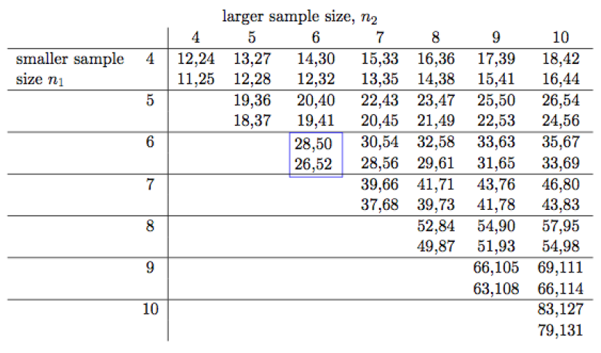
3. we then look in the critical table
rows and columns correspond to the sizes of the smaller and larger samples, respectively.
… why two values?

Slide 10

the top gives the 10% critical values = one-tail test
the bottom the 5% ones = two-tail test
R = 9 < 26.52 (let’s say we do a two tails)
so we reject the null hypothesis and conclude that the two groups are significantly different

Slide 11
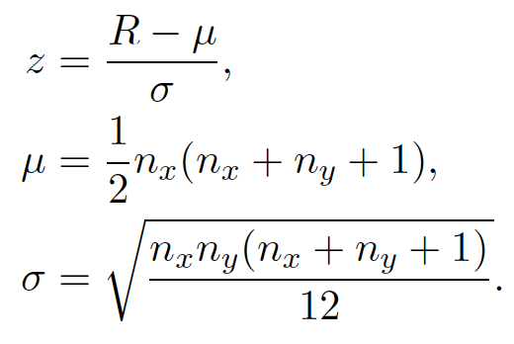
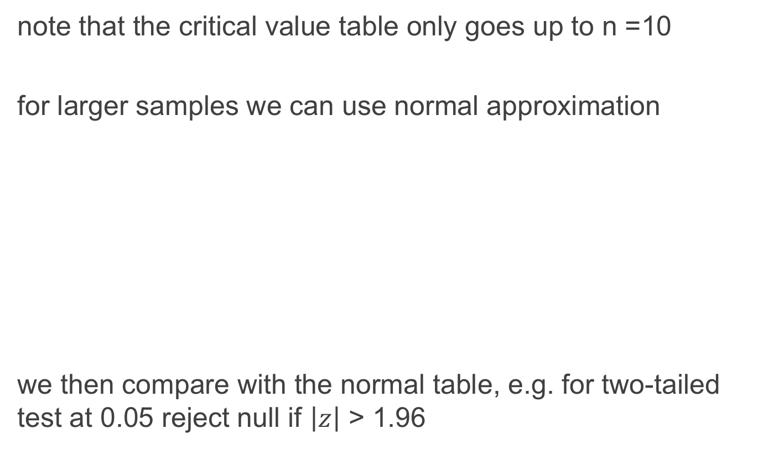
note that the critical value table only goes up to n =10
for larger samples we can use normal approximation
we then compare with the normal table, e.g. for two-tailed test at 0.05 reject null if $\left|z\right|$ > 1.96

Slide 12
R
#wilcox.test do both paired (Mann whitney test) and unpaired, so paired = TRUE would run the Wilcoxon sign rank test, otherwise the Mann Whitney (sometime called Wilcoxon sum rank test)
y1<- c(9,9.50, 9.75, 10,13, 9.50)
y2<- c(11.50,12,9,11.50,13.25, 13)
wilcox.test(y1,y2,paired=FALSE)
data: y1 and y2
W = 9, p-value = 0.1705
alternative hypothesis: true location shift is not equal to 0
Notes:
kruskal.test(weight ~ group, data = my_data)

Slide 13
signed rank test (Wilcoxon)
Wilcoxon by hand
pdf in GitHub repository
http://www.real-statistics.com/non-parametric-tests/wilcoxon-signed-ranks-test/
paired t-test equivalent

Slide 14
very quite similar but this time our data are paired (each participants made the two conditions so we have two data points per participants)
example: we measured the effect of two car seats on level of discomfort, here are the differences for 19 participants
-0.525, 0.172, -0.577, 0.200, 0.040, -0.143, 0.043, 0.010, 0.000, -0.522, 0.007, -0.122, -0.040, 0.000, -0.100, 0.050, -0.575, 0.031, -0.060

Slide 15
1. rank the observations by absolute values and removing the zeros
0.007 0.010 0.031 0.040 -0.040 0.043 0.050 -0.060 -0.100
1 2 3 4.5 4.5 6 7 8 9
-0.122 -0.143 0.172 0.200 -0.522 -0.525 -0.575 -0.577
10 11 12 13 14 15 16 17
2. we then compute R+ (sum of ranks for only positive differences) and R- (sum of ranks for negative differences)
3. We take the min of the two (call this T)
R+ = 48.5
R- = 104.5
T = 48.5

Slide 16
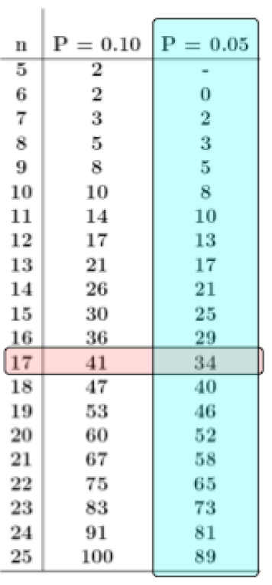
4. we then compare with appropriate table
we computed T = 48:5
since we dropped two values (zeros) our sample size is 19-2=17.
we found the critical value of 34 at the 5% level.
since 48.5 > Tcric of 34, we can’t reject the null hypothesis, therefore effect of these seats are not significantly different

Slide 17
rather simple no?
Kruskal Wallis and Friedman, which are the non-parametric ANOVA equivalent, work on a very similar principles but for more groups depending if they are paired or not (within or between)

Slide 18
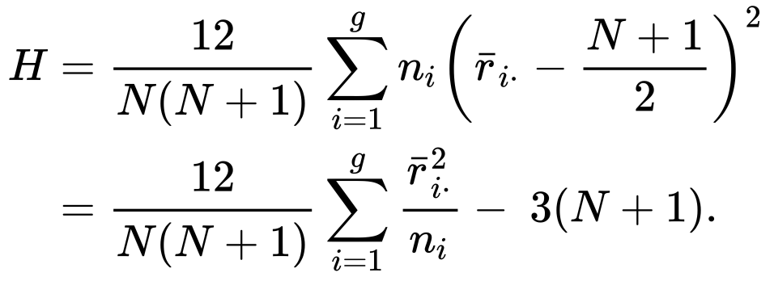
Kruskal Wallis
Kruskal Wallis by hand
pdf in GitHub repository
http://www.real-statistics.com/one-way-analysis-of-variance-anova/kruskal-wallis-test/
ANOVA between subject equivalent

Slide 19
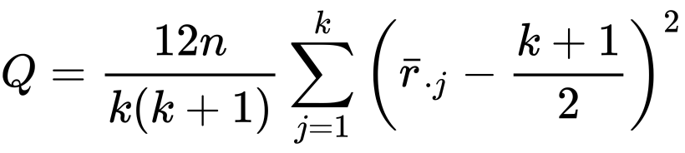
Friedman
Friedman by hand
pdf in GitHub repository
http://www.real-statistics.com/anova-repeated-measures/friedman-test/
ANOVA within subject (also called repeated measure ANOVA) equivalent

Slide 20
practically

Slide 21
one dataset we know well: our experiment on reward vs. punishment
remember we assume the data was normal but it was not
so now we will finally be able to conclude!

Slide 22
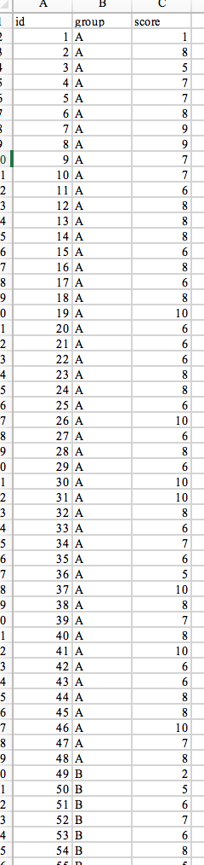
here is our data (chocolate vs. baseline)
2 grp
>2 grp
Non paired
paired
Non paired
paired
Mann-Whitney Utest
Wilcoxon signed rank test
Kruskall-Wallis test
Friiedman test

Slide 23
R
#wilcox.test do both paired (Mann whitney test) and unpaired
dat = read.csv("HCI2018results.csv", header = TRUE)
wilcox.test(dat$score[dat$group == "A"], dat$score[dat$group =="B"],paired=FALSE)
Wilcoxon rank sum test with continuity correction
data: dat$score[dat$group == "A"] and dat$score[dat$group == "B"]
W = 1290, p-value = 0.6408
alternative hypothesis: true location shift is not equal to 0
Notes:
kruskal.test(weight ~ group, data = my_data)

Slide 24
now let’s add the hypothetical group (punishment)
2 grp
>2 grp
Non paired
paired
Non paired
paired
Mann-Whitney Utest
Wilcoxon signed rank test
Kruskall-Wallis test
Friiedman test

Slide 25
R
dat = read.csv("HCI2018results.csv", header = TRUE)
kruskal.test(score ~ group, data = dat)
data: score by group
Kruskal-Wallis chi-squared = 44.77,
df = 2, p-value = 1.898e-10
pairwise.wilcox.test(dat$score, dat$group, p.adjust.method = "bonferroni")
A B
B 1 -
C 1.6e-09 2.6e-09

Slide 26
here turns out we get the same tendencies than with parametric tests, i.e. there is no evidences of significant effect of chocolate reward on memorization
but there is an effect of punishment

Slide 27
R
#for friedman test (source in GitHub)
dat = read.csv("friedmanExample.csv", header = TRUE)
friedman.test(dat$count, dat$year, dat$month)
data: dat$count, dat$year and dat$month
Friedman chi-squared = 7.6, df = 2, p-value = 0.02237
# note there is a real drop in statistical power when using a Friedman test. There are methods that enable post-hoc tests but the power is such that obtaining significance is well nigh impossible. The best you can do is to present a boxplot of the data (dependent ~ group).

Slide 28
ok so now you know almost all the tests needed!

Slide 29
continuous independent variable
What type of data?
discrete independent variable
continuous dependent variable
discrete dependent variable
Continuous dependent variable
Discrete/categorical dependent variable
regressions
logistic
regressions
normally distributed
skewed
2 grp
>2 grp
2 grp
>2 grp
2 grp
>2 grp
Non paired
paired
Non paired
paired
Non paired
paired
Non paired
paired
Counts >= 5 in >= 75% cells
Counts >= 5 in < 75% cells
T-test
ANOVA
Mann-Whitney Utest
Wilcoxon signed rank test
Kruskall-Wallis test
Chi-square test
Fisher’s exact test
Chi-square test
Paired-t-test
Friiedman test
McNemar’s test

Slide 30
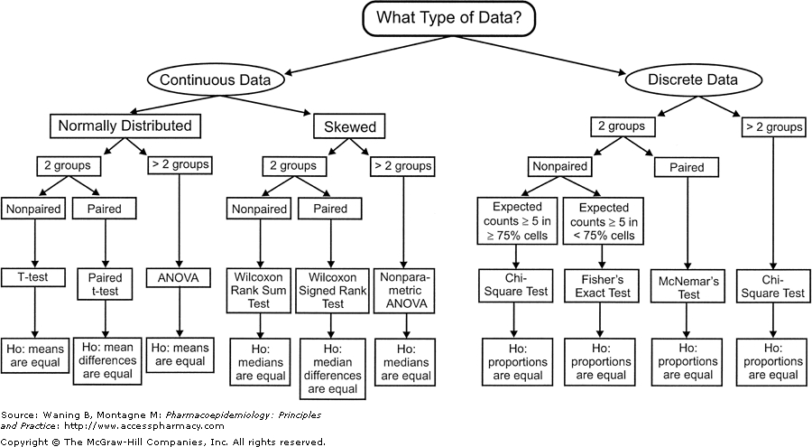
continuous independent variable
What type of data?
discrete independent variable
continuous dependent variable
discrete dependent variable
Continuous dependent variable
Discrete/categorical dependent variable
regressions
logistic
regressions
normally distributed
skewed
2 grp
>2 grp
2 grp
>2 grp
2 grp
>2 grp
Non paired
paired
with different null hypothesis and work on different types of measure
Non paired
paired
Non paired
paired
Non paired
paired
Counts >= 5 in >= 75% cells
Counts >= 5 in < 75% cells
T-test
ANOVA
Mann-Whitney Utest
Wilcoxon signed rank test
Kruskall-Wallis test
Chi-square test
Fisher’s exact test
Chi-square test
Paired-t-test
Friiedman test
McNemar’s test

Slide 31
the most important is not that you do these by hands but that you understand the intuition behind them and more importantly when to use them

Slide 32
quiz

Slide 33
20 participants were asked to write text using two different keyboard layouts (A and B). Half of the participants started the task on the A layout and then the B and the other half of the participants started the task on the B layout and then the A. The number of words typed per minute was collected for each participant and layout. Choose the most appropriate procedure to decide which layout allow participants to type the fastest. Assumption normality and homogeneity are verified.
Paired T-test
Unpaired T-test
One-Way Anova (between)
Repeated Anova (within)
Mann Whitney
Wilcoxon
Kruskal Wallis
Friedman
Linear regression
Kolmogorov-Smirnov
Shapiro-Wilk

Slide 34
20 participants were asked to write text using two different keyboard layouts (A and B). Half of the participants started the task on the A layout and then the B and the other half of the participants started the task on the B layout and then the A. The number of words typed per minute was collected for each participant and layout. Choose the most appropriate procedure to decide which layout allow participants to type the fastest. Assumption normality and homogeneity are verified.
Paired T-test
Unpaired T-test
One-Way Anova (between)
Repeated Anova (within)
Mann Whitney
Wilcoxon
Kruskal Wallis
Friedman
Linear regression
Kolmogorov-Smirnov
Shapiro-Wilk

Slide 35
40 participants were randomized to two groups. One group received a drug to decrease hair loss and the other group received a placebo (a pill of sugar). At the end of the program, the percentage hair loss for each patient was recorded. Choose the most appropriate procedure to decide if there is a relationship between the use of the drug and the percentage of hair loss. Assumption normality and homogeneity are verified.
Paired T-test
Unpaired T-test
One-Way Anova (between)
Repeated Anova (within)
Mann Whitney
Wilcoxon
Kruskal Wallis
Friedman
Linear regression
Kolmogorov-Smirnov
Shapiro-Wilk

Slide 36
40 participants were randomized to two groups. One group received a drug to decrease hair loss and the other group received a placebo (a pill of sugar). At the end of the program, the percentage hair loss for each patient was recorded. Choose the most appropriate procedure to decide if there is a relationship between the use of the drug and the percentage of hair loss. Assumption normality and homogeneity are verified.
Paired T-test
Unpaired T-test
One-Way Anova (between)
Repeated Anova (within)
Mann Whitney
Wilcoxon
Kruskal Wallis
Friedman
Linear regression
Kolmogorov-Smirnov
Shapiro-Wilk

Slide 37
A study attempted to find out if the age of an animal had any relationship to their athletic ability. The researchers took the data of 104 cheetahs, calculating their age and running a test to measure their speed. Choose the most appropriate procedure to decide if the age has any relationship with the run speed.
Paired T-test
Unpaired T-test
One-Way Anova (between)
Repeated Anova (within)
Mann Whitney
Wilcoxon
Kruskal Wallis
Friedman
Linear regression
Kolmogorov-Smirnov
Shapiro-Wilk

Slide 38
A study attempted to find out if the age of an animal had any relationship to their athletic ability. The researchers took the data of 104 cheetahs, calculating their age and running a test to measure their speed. Choose the most appropriate procedure to decide if the age has any relationship with the run speed.
Paired T-test
Unpaired T-test
One-Way Anova (between)
Repeated Anova (within)
Mann Whitney
Wilcoxon
Kruskal Wallis
Friedman
Linear regression
Kolmogorov-Smirnov
Shapiro-Wilk

Slide 39
20 participants were asked to type of their phone touchscreen in four different postures (sitting, lying down, standing and running). The number of words typed per minute was collected for each participant and postures. Choose the most appropriate procedure to decide which posture allow participants to type the fastest. Assumption normality and homogeneity are verified.
Paired T-test
Unpaired T-test
One-Way Anova (between)
Repeated Anova (within)
Mann Whitney
Wilcoxon
Kruskal Wallis
Friedman
Linear regression
Kolmogorov-Smirnov
Shapiro-Wilk

Slide 40
20 participants were asked to type of their phone touchscreen in four different postures (sitting, lying down, standing and running). The number of words typed per minute was collected for each participant and postures. Choose the most appropriate procedure to decide which posture allow participants to type the fastest. Assumption normality and homogeneity are verified.
Paired T-test
Unpaired T-test
One-Way Anova (between)
Repeated Anova (within)
Mann Whitney
Wilcoxon
Kruskal Wallis
Friedman
Linear regression
Kolmogorov-Smirnov
Shapiro-Wilk

Slide 41
20 participants were asked to run as fast as possible using two different pairs of shoes. Their speed was collected for each pairs of shoes. Choose the most appropriate procedure to decide which shoes allow participants to run the fastest. Assumption normality is verified but not the assumption of homogeneity.
Paired T-test
Unpaired T-test
One-Way Anova (between)
Repeated Anova (within)
Mann Whitney
Wilcoxon
Kruskal Wallis
Friedman
Linear regression
Kolmogorov-Smirnov
Shapiro-Wilk

Slide 42
20 participants were asked to run as fast as possible using two different pairs of shoes. They tested both pairs of shoes and each time their speed was collected. Choose the most appropriate procedure to decide which shoes allow participants to run the fastest. Assumption normality is verified but not the assumption of homogeneity.
Paired T-test
Unpaired T-test
One-Way Anova (between)
Repeated Anova (within)
Mann Whitney
Wilcoxon
Kruskal Wallis
Friedman
Linear regression
Kolmogorov-Smirnov
Shapiro-Wilk

Slide 43
20 participants were asked to type of their phone touchscreen in four different postures (sitting, lying down, standing and running). They were asked to rate their comfort for each posture using a Likert Scale questionnaire. Choose the most appropriate procedure to decide which posture was most comfortable.
Paired T-test
Unpaired T-test
One-Way Anova (between)
Repeated Anova (within)
Mann Whitney
Wilcoxon
Kruskal Wallis
Friedman
Linear regression
Kolmogorov-Smirnov
Shapiro-Wilk

Slide 44
20 participants were asked to type of their phone touchscreen in four different postures (sitting, lying down, standing and running). They were asked to rate their comfort for each posture using a Likert Scale questionnaire. Choose the most appropriate procedure to decide which posture was most comfortable.
Likert scale – special case of ordinal data that
can be considered as continuous variable!
Paired T-test
Unpaired T-test
One-Way Anova (between)
Repeated Anova (within)
Mann Whitney
Wilcoxon
Kruskal Wallis
Friedman
Linear regression
Kolmogorov-Smirnov
Shapiro-Wilk

Slide 45
A study has gathered 10000 observations of computer performances (speed) in three different room of varying temperature (15, 25 and 35 degrees Celsius). Choose the most appropriate procedure to decide if the data follows a normal distribution.
Paired T-test
Unpaired T-test
One-Way Anova (between)
Repeated Anova (within)
Mann Whitney
Wilcoxon
Kruskal Wallis
Friedman
Linear regression
Kolmogorov-Smirnov
Shapiro-Wilk

Slide 46
A study has gathered 10000 observations of computer performances (speed) in three different room of varying temperature (15, 25 and 35 degrees Celsius). Choose the most appropriate procedure to decide if the data follows a normal distribution.
(because more than 50 observations!)
Paired T-test
Unpaired T-test
One-Way Anova (between)
Repeated Anova (within)
Mann Whitney
Wilcoxon
Kruskal Wallis
Friedman
Linear regression
Kolmogorov-Smirnov
Shapiro-Wilk

Slide 47
summary

Slide 48
take away
Give the four non parametric tests seen today
Explain the basis of Mann Whitney and Wilcoxon test, aka that they use ranks rather than mean
I won’t ask you to do it by hand in the exam
Be able to read a design protocol and figure out what statistic tests to use

Slide 49
next
continuous independent variable
What type of data?
discrete independent variable
continuous dependent variable
discrete dependent variable
Continuous dependent variable
Discrete/categorical dependent variable
regressions
logistic
regressions
normally distributed
skewed
2 grp
>2 grp
2 grp
>2 grp
2 grp
>2 grp
Non paired
paired
Non paired
paired
Non paired
paired
Non paired
paired
Counts >= 5 in >= 75% cells
Counts >= 5 in < 75% cells
T-test
ANOVA
Mann-Whitney Utest
Wilcoxon signed rank test
Kruskall-Wallis test
Chi-square test
Fisher’s exact test
Chi-square test
Paired-t-test
Friiedman test
McNemar’s test

Slide 50
end

Slide 51
quiz to print

Slide 52
continuous independent variable
What type of data?
discrete independent variable
continuous dependent variable
discrete dependent variable
Continuous dependent variable
Discrete/categorical dependent variable
regressions
logistic
regressions
normally distributed
skewed
2 grp
>2 grp
2 grp
>2 grp
2 grp
>2 grp
Non paired
paired
Non paired
paired
Non paired
paired
Non paired
paired
Counts >= 5 in >= 75% cells
Counts >= 5 in < 75% cells
T-test
ANOVA
Mann-Whitney Utest
Wilcoxon signed rank test
Kruskall-Wallis test
Chi-square test
Fisher’s exact test
Chi-square test
Paired-t-test
Friiedman test
McNemar’s test

Slide 53
20 participants were asked to write text using two different keyboard layouts (A and B). Half of the participants started the task on the A layout and then the B and the other half of the participants started the task on the B layout and then the A. The number of words typed per minute was collected for each participant and layout. Choose the most appropriate procedure to decide which layout allow participants to type the fastest. Assumption normality and homogeneity are verified.
Paired T-test
Unpaired T-test
One-Way Anova (between)
Repeated Anova (within)
Mann Whitney
Wilcoxon
Kruskal Wallis
Friedman
Linear regression
Kolmogorov-Smirnov
Shapiro-Wilk

Slide 54
40 participants were randomized to two groups. One group received a drug to decrease hair loss and the other group received a placebo (a pill of sugar). At the end of the program, the percentage hair loss for each patient was recorded. Choose the most appropriate procedure to decide if there is a relationship between the use of the drug and the percentage of hair loss. Assumption normality and homogeneity are verified.
Paired T-test
Unpaired T-test
One-Way Anova (between)
Repeated Anova (within)
Mann Whitney
Wilcoxon
Kruskal Wallis
Friedman
Linear regression
Kolmogorov-Smirnov
Shapiro-Wilk

Slide 55
A study attempted to find out if the age of an animal had any relationship to their athletic ability. The researchers took the data of 104 cheetahs, calculating their age and running a test to measure their speed. Choose the most appropriate procedure to decide if the age has any relationship with the run speed.
Paired T-test
Unpaired T-test
One-Way Anova (between)
Repeated Anova (within)
Mann Whitney
Wilcoxon
Kruskal Wallis
Friedman
Linear regression
Kolmogorov-Smirnov
Shapiro-Wilk

Slide 56
20 participants were asked to type of their phone touchscreen in four different postures (sitting, lying down, standing and running). The number of words typed per minute was collected for each participant and postures. Choose the most appropriate procedure to decide which posture allow participants to type the fastest. Assumption normality and homogeneity are verified.
Paired T-test
Unpaired T-test
One-Way Anova (between)
Repeated Anova (within)
Mann Whitney
Wilcoxon
Kruskal Wallis
Friedman
Linear regression
Kolmogorov-Smirnov
Shapiro-Wilk

Slide 57
20 participants were asked to run as fast as possible using two different pairs of shoes. Their speed was collected for each pairs of shoes. Choose the most appropriate procedure to decide which shoes allow participants to run the fastest. Assumption normality is verified but not the assumption of homogeneity.
Paired T-test
Unpaired T-test
One-Way Anova (between)
Repeated Anova (within)
Mann Whitney
Wilcoxon
Kruskal Wallis
Friedman
Linear regression
Kolmogorov-Smirnov
Shapiro-Wilk

Slide 58
20 participants were asked to type of their phone touchscreen in four different postures (sitting, lying down, standing and running). They were asked to rate their comfort for each posture using a Likert Scale questionnaire. Choose the most appropriate procedure to decide which posture was most comfortable.
Paired T-test
Unpaired T-test
One-Way Anova (between)
Repeated Anova (within)
Mann Whitney
Wilcoxon
Kruskal Wallis
Friedman
Linear regression
Kolmogorov-Smirnov
Shapiro-Wilk

Slide 59
A study has gathered 10000 observations of computer performances (speed) in three different room of varying temperature (15, 25 and 35 degrees Celsius). Choose the most appropriate procedure to decide if the data follows a normal distribution.
Paired T-test
Unpaired T-test
One-Way Anova (between)
Repeated Anova (within)
Mann Whitney
Wilcoxon
Kruskal Wallis
Friedman
Linear regression
Kolmogorov-Smirnov
Shapiro-Wilk

