Slide 1
Sample Size
18
Estimation, Type I & II errors, power, effect size
COMS10011
Luluah Albarrak
https://github.com/coms10011/

Slide 2

Random Sample
Population
Population: is a set of all units of interest.
Sample: a subset of the population.
Random sample: a sample collected in such a way that every member of the population is equally likely to be selected.
Sample

Slide 3
Random Sample
Population
Sample
The goal is to make estimates and predictions about a population based on information from a sample. In particular, we want to estimate the population mean µ , and the population standard deviation σ.
Notes:
Since Collecting research information from the whole population is not possible and it is time consuming and expensive. Thus, we need an appropriate sample size so that we can make inferences about the population based on that sample.

Slide 4
Sample Size Calculation
The main aim of a sample size calculation is to determine the number of participants needed to detect a scientifically relevant treatment effect.
Sample size is too small → one may not be able to detect an important existing effect.
Sample size is too large → waste of time, resources and money.
Notes:
Factors such as time, cost, and how many subjects are actually available are constraints that often have to be taken account of when designing a study, but these should not dictate the sample size — there is no point in carrying out a study that is too small, only to come up with results that are inconclusive, since you will then need to carry out another study to confirm or refute your initial results

Slide 5
Components of sample size calculations
Type I error (alpha)
Power
Sample size
The smallest effect of interest
“Standarised Effect Size” Cohen’s d
Variability

Slide 6
Components of sample size calculations
Type I error (alpha)
Power
Sample size
The smallest effect of interest
“Standarised Effect Size” Cohen’s d
Variability

Slide 7
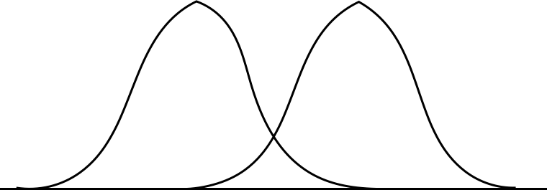
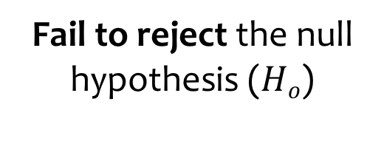
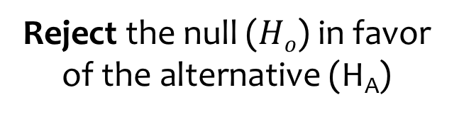


Type I & Type II Errors
Hypothesis testing
When we conduct a test of any hypothesis regardless of the test used we make one of two possible decisions:
$Hο$:${ μ}_{1}−μ_{2}=0$
H_{A}:${ μ}_{1}−μ_{2}≠0$
Reject the null ($Hο$) in favor of the alternative (H_{A})
Fail to reject the null hypothesis ($Hο$)
OR

Slide 8
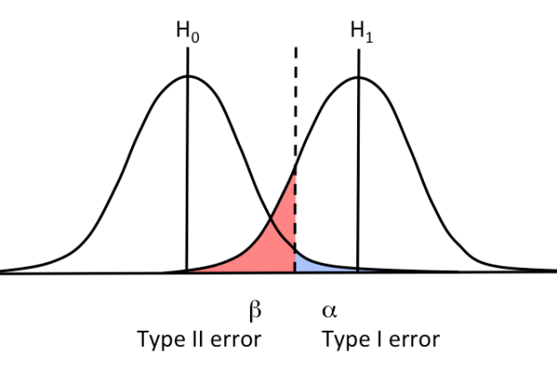
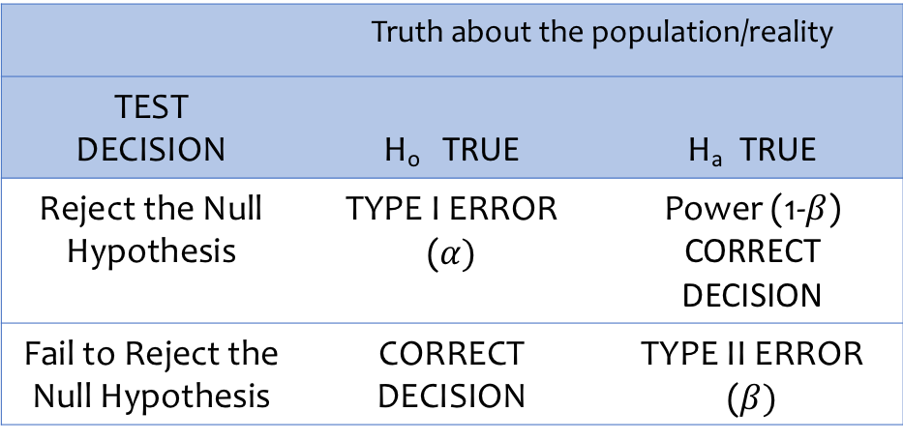
Type I Errors
 | Truth about the population/reality
TEST DECISION | H_{o} TRUE | H_{a} TRUE
Reject the Null Hypothesis | TYPE I ERROR ($α)$ | Power (1-$β$) CORRECT DECISION
Fail to Reject the Null Hypothesis | CORRECT DECISION | TYPE II ERROR ($β)$
Type I error: the chance of detecting a statistically significant difference when there is no real difference between treatments (The risk of a false positive result).
Notes:
The type 1 error is also known as p value which is the “level of significance” we set prior to starting a study. For example, a p value of 0.05 as significant means that we are ready to accept that the probability that the result is observed due to chance (and NOT due to our intervention) is 5% (5 out of 100 times) when actually no difference exists.

Slide 9
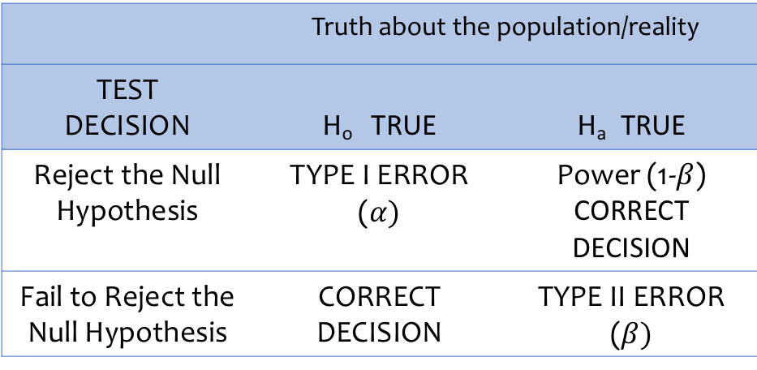
Type II Errors
 | Truth about the population/reality
TEST DECISION | H_{o} TRUE | H_{a} TRUE
Reject the Null Hypothesis | TYPE I ERROR ($α)$ | Power (1-$β$) CORRECT DECISION
Fail to Reject the Null Hypothesis | CORRECT DECISION | TYPE II ERROR ($β)$
Type II error: the chance of not detecting a significant difference when there really is a difference (The risk of a false negative result).

Slide 10

Type I & Type II Errors
We choose P(Type I Error) = $α$ Typically $α$ = .05 or .01 or .10
However we do NOT directly choose $β$ = P(Type II Error)

Slide 11
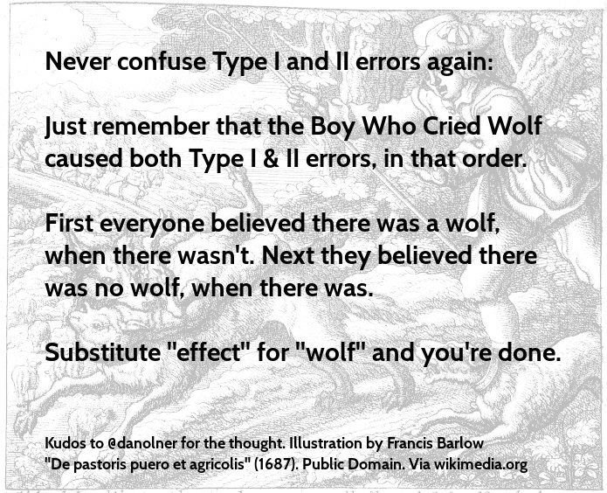
Type I & Type II Errors

Slide 12
Question
It has been shown many times that on a certain memory test, recognition is substantially better than recall. However, the probability value for the data from your sample was 0.12, so you were unable to reject the null hypothesis that recall and recognition produce the same results. What type of error did you make?
Type I or Type II Error?

Slide 13
Question
It has been shown many times that on a certain memory test, recognition is substantially better than recall. However, the probability value for the data from your sample was 0.12, so you were unable to reject the null hypothesis that recall and recognition produce the same results. What type of error did you make?
Type I or Type II Error?
Type II Error
Notes:
In this example, there is really a difference in the population between recognition and recall, but you did not find a significant difference in your sample. Failing to reject a false null hypothesis is a Type II error.

Slide 14
Question
In the population, there is no difference between men and women on a certain test. However, you found a difference in your sample. The probability value for the data was 0.03, so you rejected the null hypothesis. What type of error did you make?
Type I or Type II Error?

Slide 15
Question
In the population, there is no difference between men and women on a certain test. However, you found a difference in your sample. The probability value for the data was 0.03, so you rejected the null hypothesis. What type of error did you make?
Type I or Type II Error?
Type I Error
Notes:
There is no difference in the population, but you found a difference in your sample. A Type I error occurs when a significance test results in the rejection of a true null hypothesis.

Slide 16
How p-value affects sample size?
As the p-value decreases, the necessary sample size increases.

Slide 17
Components of sample size calculations
Type I error (alpha)
Power
Sample size
The smallest effect of interest
“Standarised Effect Size” Cohen’s d
Variability

Slide 18
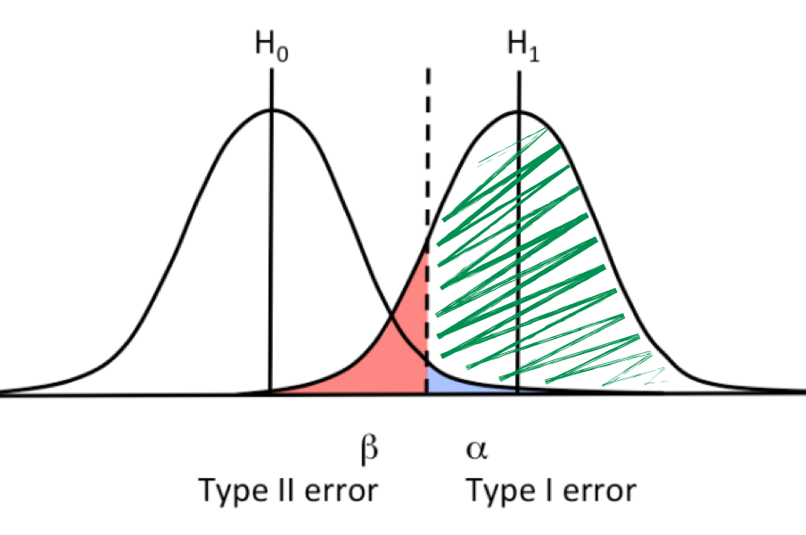
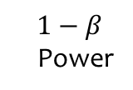
Power
$$1−β$$
Power
The power of a hypothesis test is the probability of making the correct decision if the alternative hypothesis is true. That is, the power of a hypothesis test is the probability of rejecting the null hypothesis H₀ when the alternative hypothesis H_{A} is true.

Slide 19
Power
Higher power is better (the closer the power is to 1.0 or 100%).
The ideal power is considered to be 80% → we are accepting that one in five times (20%) we will miss the difference.

Slide 20
Power
To increase power (and hence decrease type 2 error rate):
Increase the sample size
Decrease the standard deviation of the sample
Increase α
Consider a larger effect size

Slide 21
How power affects sample size?
As the power increases, the necessary sample size increases.

Slide 22
Components of sample size calculations
Type I error (alpha)
Power
Sample size
The smallest effect of interest
“Standarised Effect Size” Cohen’s d
Variability

Slide 23
Smallest Effect of Interest
The smallest effect of interest is the minimal difference between the studied groups that the investigator wishes to detect.

Slide 24
Smallest Effect of Interest
For continuous outcome variables, the minimal scientifically relevant difference is a numerical difference. For example, if body weight is the outcome of a trial, an investigator could choose a difference of 5 kg as the minimal scientifically relevant difference.
For binary outcome variables, the minimal difference is expressed in rates. For example, in the case of studying the effect of a drug on weight loss (yes/no), an investigator could choose a difference of 10% between the treatment group and control group as the minimal scientifically relevant difference .

Slide 25
How effect of interest affects sample size?
As the effects of interest between the study groups increases, the necessary sample size decreases.

Slide 26
Components of sample size calculations
Type I error (alpha)
Power
Sample size
The smallest effect of interest
“Standarised Effect Size” Cohen’s d
Variability

Slide 27
Variability
Sample size calculation is based on using the population variance of a given outcome variable that is estimated by means of the standard deviation (SD) in case of a continuous outcome.
Because the variance is usually an unknown quantity, investigators often use an estimate obtained from a pilot study or use information from a previous study.

Slide 28
How variance affects sample size?
As the variance increases, the necessary sample size increases.

Slide 29
Components of sample size calculations
Type I error (alpha)
Power
Sample size
The smallest effect of interest
“Standarised Effect Size” Cohen’s d
Variability

Slide 30
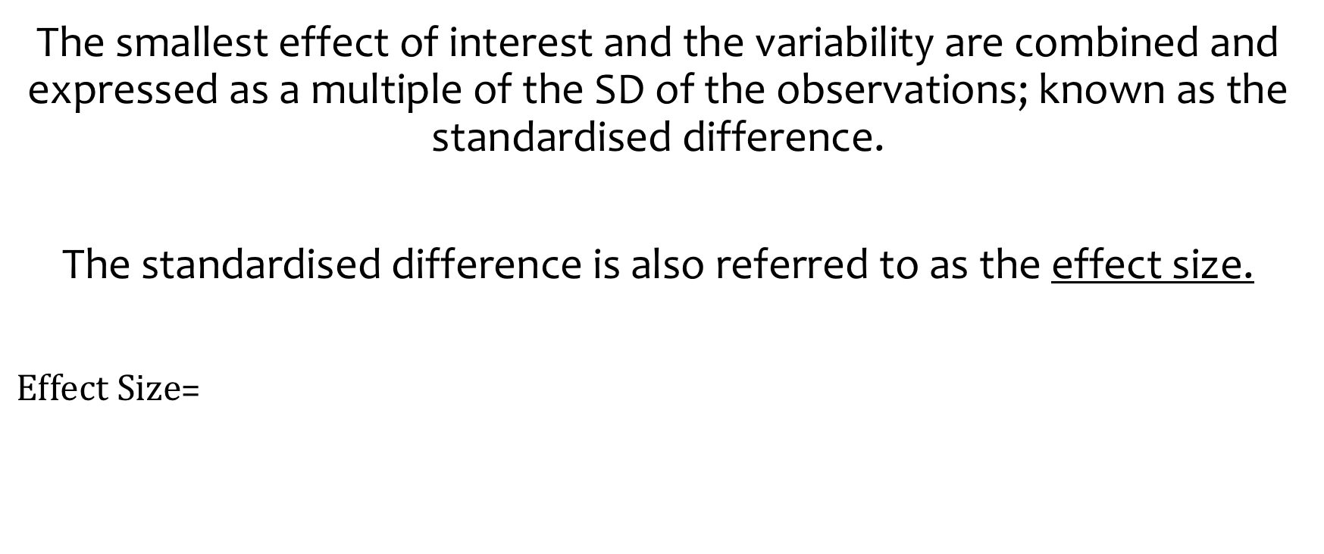
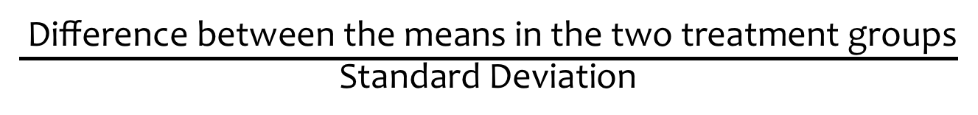
Effect Size
The smallest effect of interest and the variability are combined and expressed as a multiple of the SD of the observations; known as the standardised difference.
The standardised difference is also referred to as the effect size.
$Effect Size$=
$\frac{ \text{Difference} \text{between} \text{the} \text{means} \text{in} \text{the} \text{two} \text{treatment} \text{groups}}{\text{S}\text{tandard} \text{Deviation}}$

Slide 31
Effect Size
Effect size is a way of quantifying the difference between two or more groups, or a measure of the difference in the outcomes of the experimental and control groups.
For example, if one group has a new treatment and the other has not (control group), then the effect size is a measure of the effectiveness of the treatment.

Slide 32
Effect Size
A statistically significant result does not mean it is substantive in effect. For example, two treatments could be shown to be significantly different, but their clinical effects may be so small as to be unimportant.
Notes:
The effect size can be adjusted by the researcher in terms of whether a small, medium or large effect size is expected.

Slide 33
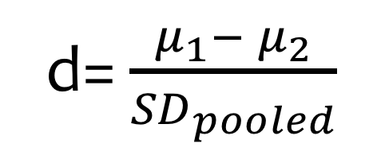
Cohen’s d Effect Size
Depending on the type of study, effect size is estimated with different measures.
The most straightforward effect size measure is the difference between two means.
Cohen’s d is a good example of a standardized effect size measurement.
Cohen (1988) proposed a simple categorisation of small, moderate and large effect size.
Effect | Cohen’s d
Small | 0.20
Medium | 0.50
Large | 0.80
d= $\frac{μ_{1}− μ_{2}}{{SD}_{pooled}}$
Notes:
Formula for t-tests: cohen’s d
Pooled Standard Deviation is a weighted average of standard deviations for two or more groups. The weights depend on the sample size, more weight is given to larger samples

Slide 34
Sample Size Estimation

Slide 35
Components of sample size calculations
Type I error (alpha)
Power
Sample size
The smallest effect of interest
“Standarised Effect Size” Cohen’s d
Variability

Slide 36
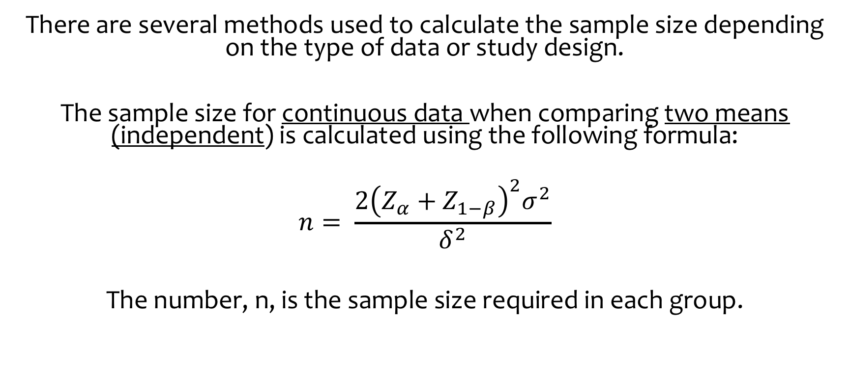
Sample Size for Continuous Data
There are several methods used to calculate the sample size depending on the type of data or study design.
The sample size for continuous data when comparing two means (independent) is calculated using the following formula:
$$n= \frac{{2{\left(Z_{α}+Z_{1−β}\right)}^{2}σ}^{2}}{δ^{2}}$$
The number, n, is the sample size required in each group.

Slide 37
Example
In a sample of inactive overweight men aged between 50 and 60, suppose we wish to compare the mean blood pressure of Group 1 who underwent a calorie-controlled diet to Group 2 undertook the exercise-training programme.
Let, 𝜇₁=𝑚𝑒𝑎𝑛 blood pressure 𝑜𝑓 group 1 𝜇₂=𝑚𝑒𝑎𝑛 blood pressure 𝑜𝑓 group 2

Slide 38
Example
Then,
𝐻₀: 𝜇₁ = 𝜇₂
𝐻_{a}: 𝜇₁ ≠ 𝜇₂
Suppose researchers would like to have a power of 80% to detect a difference of 5 mmHg between these two population means at the 𝛼=.05 level. The standard deviation (based on data in a published paper) would be approximately 20 mmHg.
What samples sizes (𝑛₁) and (𝑛₂) should they use?

Slide 39
Example
Then,
𝐻₀: 𝜇₁ = 𝜇₂
𝐻_{a}: 𝜇₁ ≠ 𝜇₂
Suppose researchers would like to have a power of 80% to detect a difference of 5 mmHg between these two population means at the 𝛼=.05 level. The standard deviation (based on data in a published paper) would be approximately 20 mmHg.
What samples sizes (𝑛₁) and (𝑛₂) should they use?

Slide 40
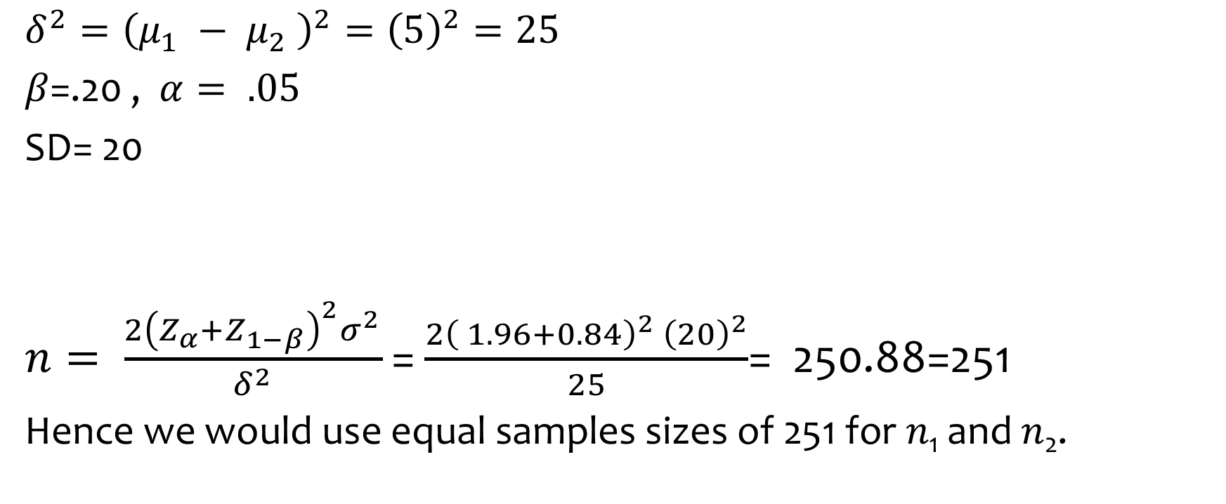
Example
α-error | 5% | 1%
2-sided | 1.96 | 2.5758
1-sided | 1.65 | 2.33
$${δ^{2}=\left(μ_{1} − μ_{2} \right)}^{2}={\left(5\right)}^{2}=25$$
𝛽=.20 , $α= .05$
SD= 20
$n= \frac{{2{\left(Z_{α}+Z_{1−β}\right)}^{2}σ}^{2}}{δ^{2}}$ = $\frac{2{\left( 1.96+0.84\right)}^{2} {\left(20\right)}^{2}}{25}$= 250.88=251
Hence we would use equal samples sizes of 251 for 𝑛₁ and 𝑛₂.
Power | 80% | 85% | 90% | 95%
Value | 0.8416 | 1.0364 | 1.2816 | 1.6449

Slide 41
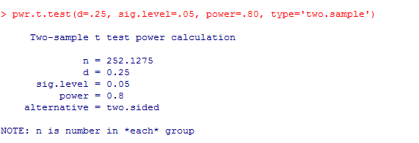
Solving in R
Install pwr package
R
Notes:
The alert reader has, by now, noticed a discrepancy: when we manually calculated the desired sample size. Why? The simple answer is that R is not using the above formula. pwr.t.test in R uses the uniroot() function to calculate n.
D=5/20=.25

Slide 42
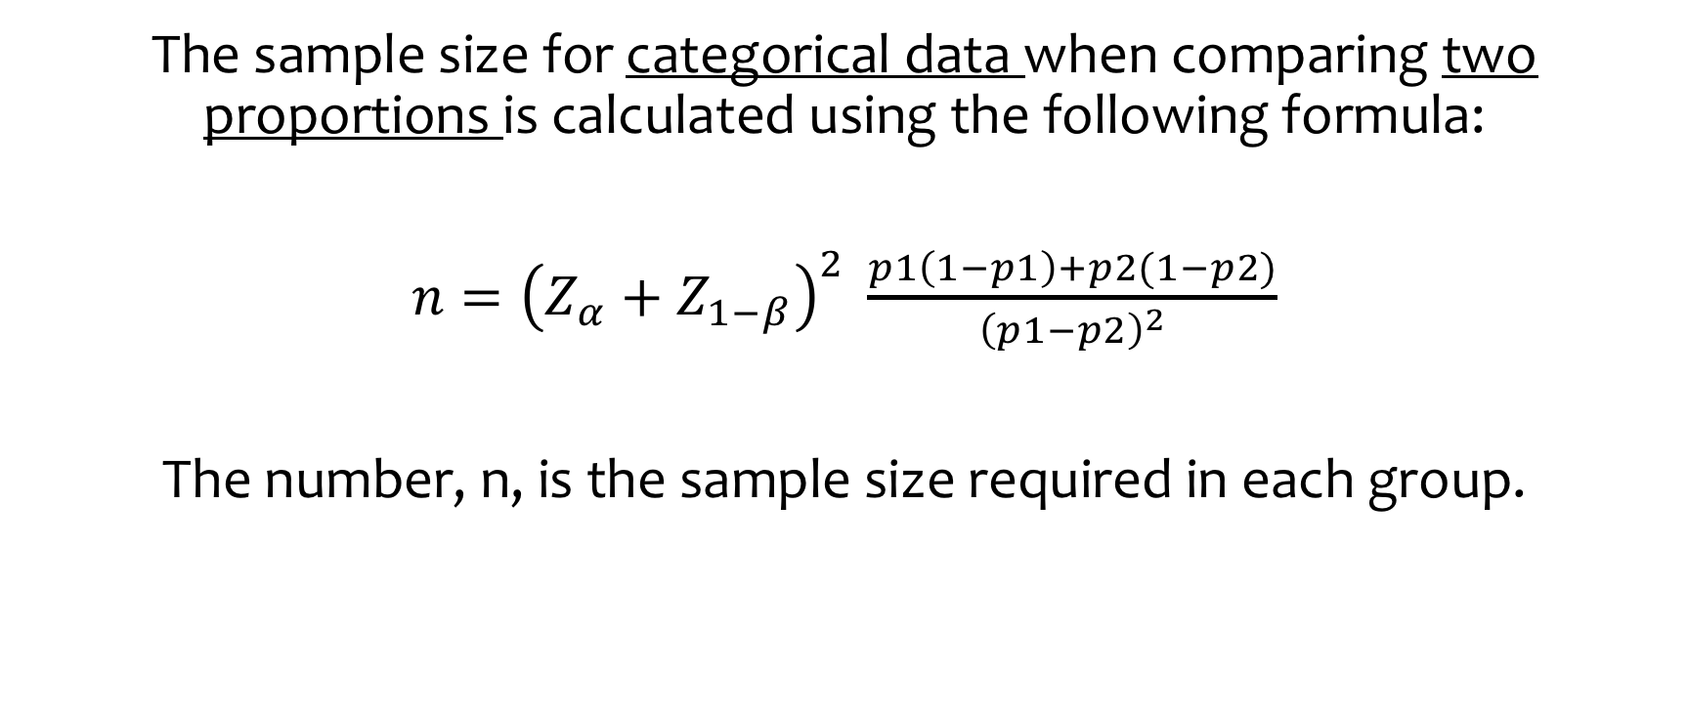
Sample Size for Categorical Data
The sample size for categorical data when comparing two proportions is calculated using the following formula:
$n={\left(Z_{α}+Z_{1−β}\right)}^{2} \frac{p1\left(1−p1\right)+p2(1−p2)}{{\left(p1−p2\right)}^{2}}$
The number, n, is the sample size required in each group.

Slide 43
Example
A new treatment has been developed for patients who’ve had a heart attack. It is known that 10% of people who’ve suffered from a heart attack die within one year. It is thought that a reduction in deaths from 10% to 5% would be clinically important to detect.
Let,
P₁ = proportion of deaths in placebo group = 0.1
P₂ = proportion of deaths in treatment group = 0.05.

Slide 44
Example
Then,
𝐻₀: P₁ = P₂
𝐻_{a}: P₁ ≠ P₂
It is thought that a reduction in deaths from 10% to 5% would be clinically important to detect. Using α = 0.05 and β = 0.10, What samples sizes (𝑛₁) and (𝑛₂) should they use ?

Slide 45
Example
Then,
𝐻₀: P₁ = P₂
𝐻_{a}: P₁ ≠ P₂
It is thought that a reduction in deaths from 10% to 5% would be clinically important to detect. Using α = 0.05 and β = 0.10, What samples sizes (𝑛₁) and (𝑛₂) should they use ?

Slide 46
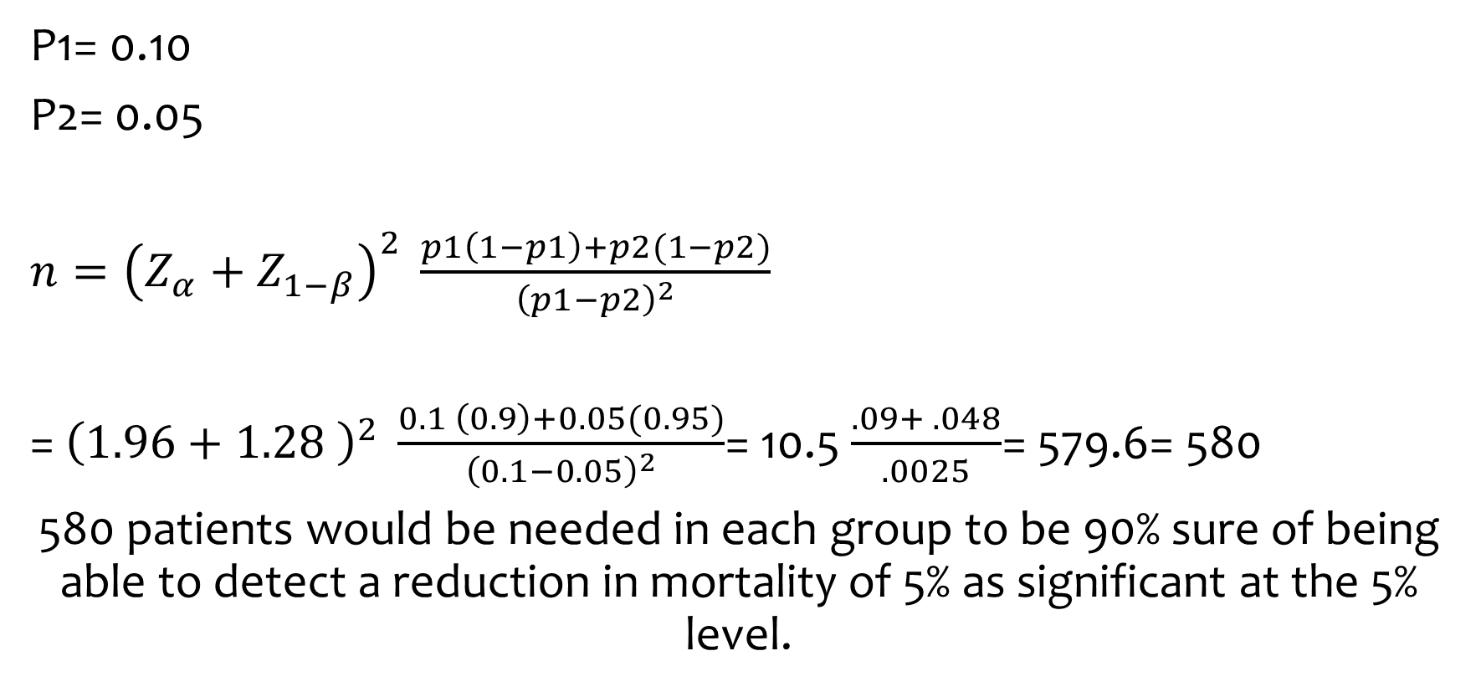
Example
P1= 0.10
P2= 0.05
$n={\left(Z_{α}+Z_{1−β}\right)}^{2} \frac{p1\left(1−p1\right)+p2(1−p2)}{{\left(p1−p2\right)}^{2}}$
= ${\left(1.96+1.28 \right)}^{2} \frac{0.1 \left(0.9\right)+0.05(0.95)}{{\left(0.1−0.05\right)}^{2}}$= 10.5 $\frac{.09+ .048}{.0025}$= 579.6= 580
580 patients would be needed in each group to be 90% sure of being able to detect a reduction in mortality of 5% as significant at the 5% level.
α-error | 5% | 1%
2-sided | 1.96 | 2.5758
1-sided | 1.65 | 2.33
Power | 80% | 85% | 90% | 95%
Value | 0.8416 | 1.0364 | 1.2816 | 1.6449

Slide 47
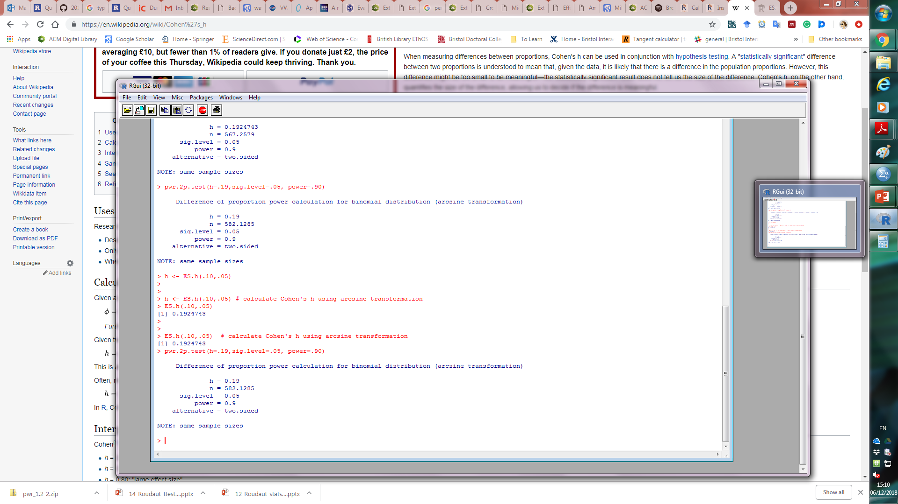
Solving in R
R
Notes:
ES.h to compute effect size h for two proportions
Pwr.2p.test → for two proportions

Slide 48
Other Outcome Types
In many studies, the outcomes may not be continuous or categorical. In these cases, the details of calculation differ, but using the four aforementioned components, persist through calculations with other types of outcomes.

Slide 49
Summary

Slide 50
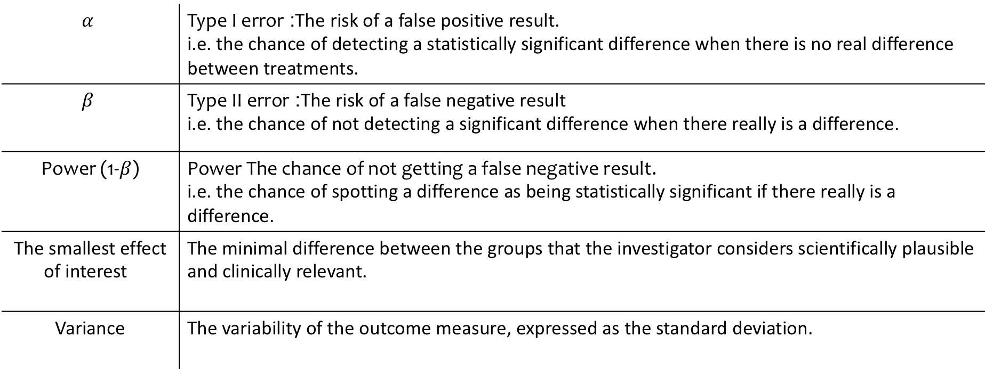
Definitions
$$α$$ | Type I error: The risk of a false positive result. i.e. the chance of detecting a statistically significant difference when there is no real difference between treatments.
$$β$$ | Type II error: The risk of a false negative result i.e. the chance of not detecting a significant difference when there really is a difference.
Power (1-$β$) | Power The chance of not getting a false negative result. i.e. the chance of spotting a difference as being statistically significant if there really is a difference.
The smallest effect of interest | The minimal difference between the groups that the investigator considers scientifically plausible and clinically relevant.
Variance | The variability of the outcome measure, expressed as the standard deviation.

Slide 51
Take Away
Explain the components of sample size calculations and how they affect the sample size
Explain the difference between Type I error, Type II error and power.
Explain effect size.
Calculate sample size for continuous and categorical data.

