Slide 1
Normality tests
15
and Homogeneity tests
Probability
and
Statistics
COMS10011
Dr. Anne Roudaut
csxar@bristol.ac.uk
(Thanks S. Massa, Oxford)

Slide 2
continuous independent variable
What type of data?
discrete independent variable
continuous dependent variable
discrete dependent variable
Continuous dependent variable
Discrete/categorical dependent variable
regressions
logistic
regressions
normally distributed
skewed
2 grp
>2 grp
2 grp
>2 grp
2 grp
>2 grp
Non paired
paired
Non paired
paired
Non paired
paired
Non paired
paired
Counts >= 5 in >= 75% cells
Counts >= 5 in < 75% cells
T-test
ANOVA
Mann-Whitney Utest
Wilcoxon signed rank test
Kruskall-Wallis test
Chi-square test
Fisher’s exact test
Chi-square test
Paired-t-test
Friiedman test
McNemar’s test

Slide 3
today::
test if data is normally distributed
use alternatives to non-parametric tests if data not normally distributed
other verifications (assumptions) we need to do on data prior to doing certain statistical tests

Slide 4
assumption of normality

Slide 5
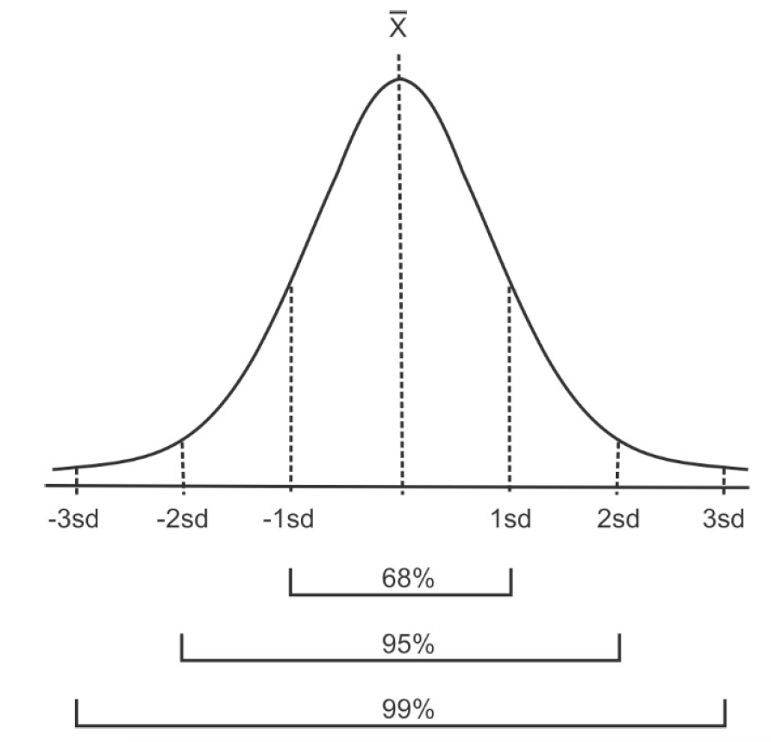
given the mean and standard deviation of a dataset = a theoretical normal distribution has those proportions

Slide 6
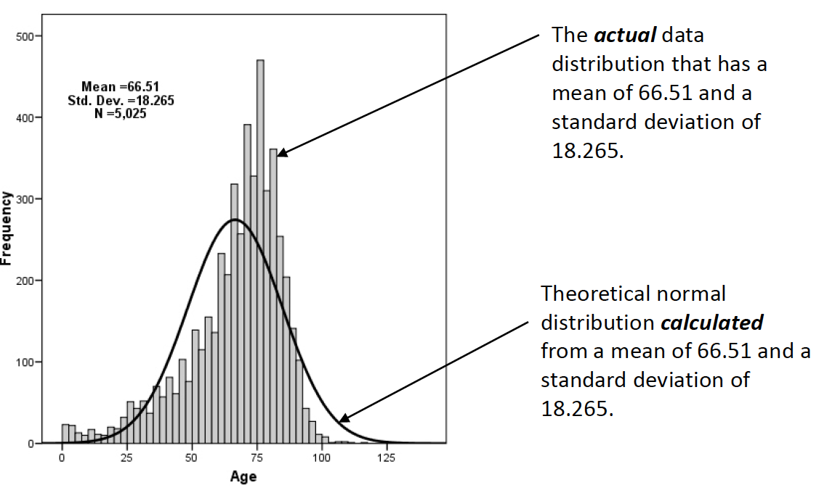
this theoretical normal distribution can then be compared to the actual distribution of the data.
<are the actual data statistically different than the computed normal curve? >

Slide 7
several methods to check that, we are only going to look at some of them: Q-Q probability plots, Kolmogorov-Smirnov test and Shapiro-Wilks test
(some others: W/S test, Jarque-Bera test, D’Agostino test)

Slide 8
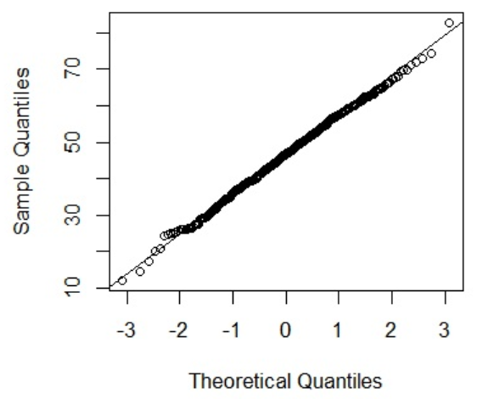
1
Quantile Quantile Probability Plots
if the two sets come from a population with the same distribution, the points should fall along a line
it is a plot of the quantiles of the first data set against the quantiles of the second data set

Slide 9
3.89 4.75 6.33 4.75 7.21 5.78 5.80 5.20 7.90
does the following sample comes from a normality distributed population?
1. order the data:
3.89 4.75 4.75 5.20 5.78 5.80 6.33 7.21 7.90
2. plot these against appropriate quantile from the standard normal distribution
… let’s look at this in detail

Slide 10
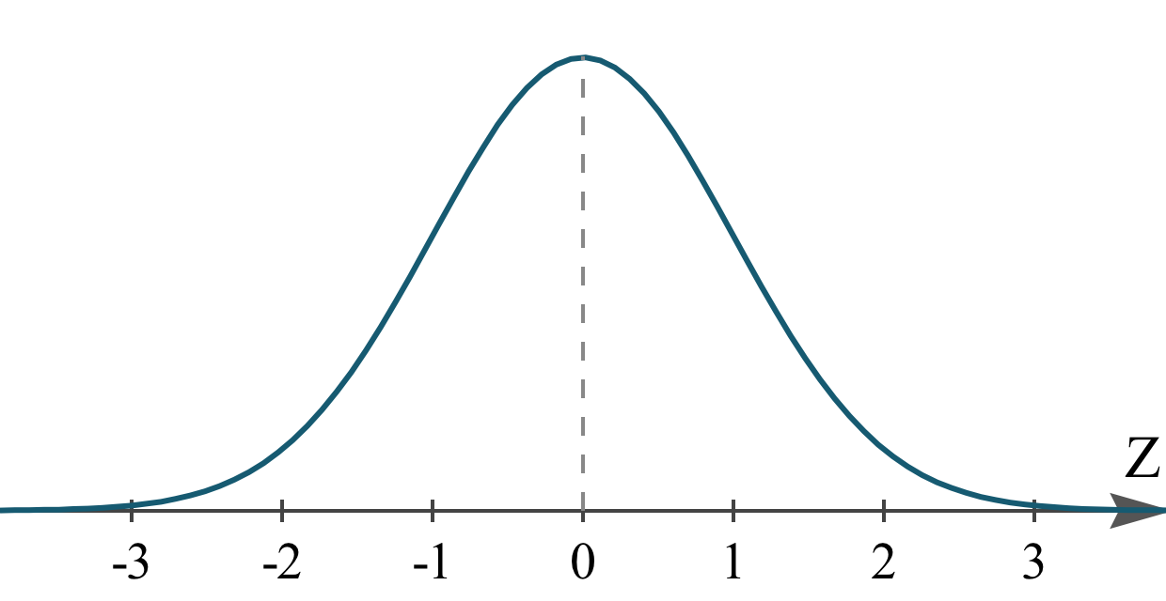
here a standard normal distribution truncated at -3 and 3
3. search for nine values on the normal distribution = split it in 10 areas
and here our nine sample values
3.89 4.75 4.75 5.20 5.78 5.80 6.33 7.21 7.90

Slide 11
here a standard normal distribution truncated at -3 and 3
each area under the curve is 1
1
1
1
1
1
1
1
1
1
1
3. search for nine values on the normal distribution = split it
in 10 areas
4. find the values that makes that happen
and here our nine sample values
3.89 4.75 4.75 5.20 5.78 5.80 6.33 7.21 7.90

Slide 12
here a standard normal distribution truncated at -3 and 3
each area under the curve is 1
1
1
1
1
1
1
1
1
1
1
-1.28 -0.84 -0.52 -0.25 0 0.25 0.52 0.84 1.28
and here our nine sample values
3.89 4.75 4.75 5.20 5.78 5.80 6.33 7.21 7.90
Notes:
So we are gonna plot the smallest value in our sample of size nine
Against what we would expect to get as the smaller value in a sample of the same size from the standard normal distribution

Slide 13
5. plot smallest value in our sample of size nine against what we expect to get as the smaller value in a sample of the same size from the standard normal distribution … we do that for all pairs
here what we would expect to get
-1.28 -0.84 -0.52 -0.25 0 0.25 0.52 0.84 1.28
and here our nine sample values
3.89 4.75 4.75 5.20 5.78 5.80 6.33 7.21 7.90
Notes:
y <- c(3.89, 4.75, 6.33, 4.75, 7.21, 5.78, 5.80, 5.20, 7.90)
qqnorm(y)
qqline(y)
data <- c(3.89, 4.75, 4.75, 5.20, 5.78, 5.80, 6.33, 7.21, 7.90)
expected <- c(-1.28, -0.84, -0.52, -0.25, 0, 0.25, 0.52, 0.84, 1.28)

Slide 14
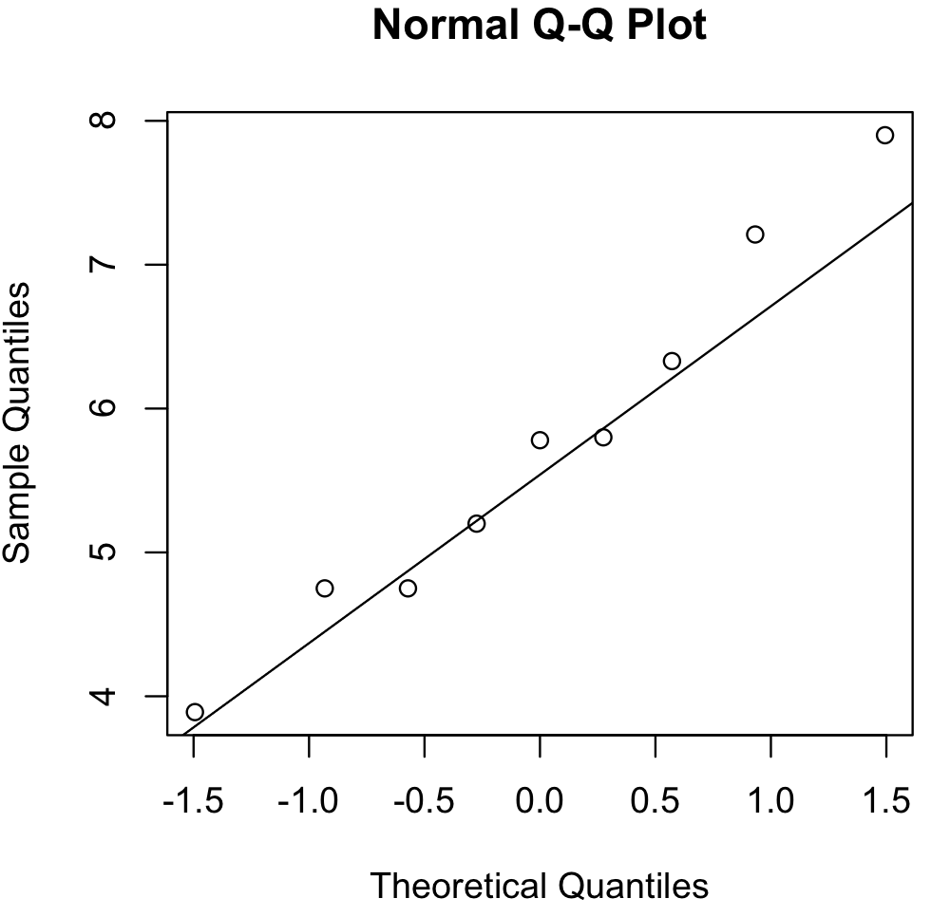

Slide 15
R
data <- c(3.89, 4.75, 4.75, 5.20, 5.78, 5.80, 6.33, 7.21, 7.90)
# generate expected from normal distribution
u=seq(0.1,0.9,by=0.1)
expected <- qnorm(u)
print(expected)
[1] -1.2815516 -0.8416212 -0.5244005 -0.2533471 0.0000000 0.2533471 0.5244005
[8] 0.8416212 1.281551
plot(expected,data)
#or simpler:
qqnorm(data)
qqline(data)

Slide 16
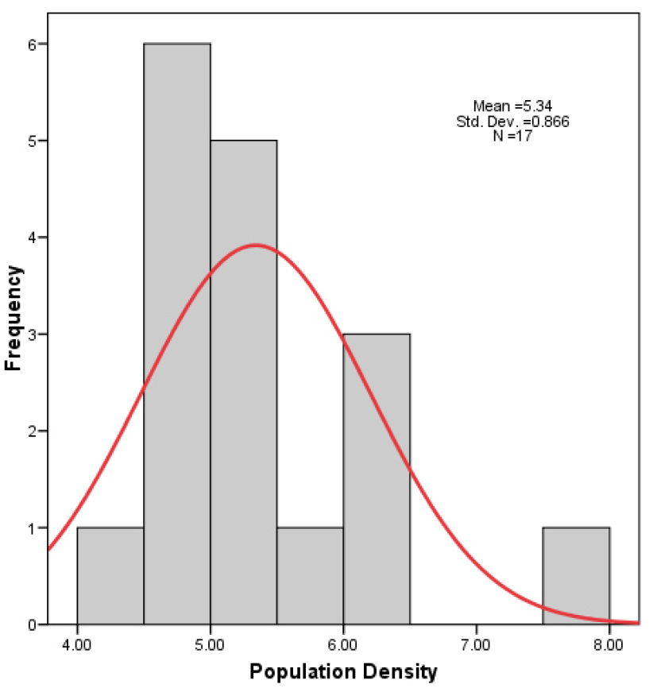
Q-Q plots are great graphical tools for large sample but not very useful for small sample size, e.g. this is the histogram of the last example: data do not ‘look’ normal, but they are not statistically different than normal.

Slide 17
statistical tests for normality are more precise since actual probabilities are calculated
Kolmogorov-Smirnov
works best for data sets with n > 50
not sensitive to problems in the tails
Shapiro-Wilks
works best for data sets with n < 50
doesn't work well if several values are same

Slide 18
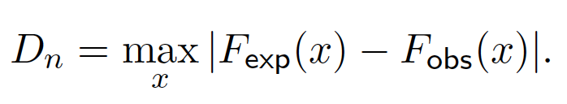
2
Kolmogorov-Smirnov test
cumulative distribution function observed
cumulative distribution function expected
can generate a p-value

Slide 19
0.16 -0.68 -0.32 -0.85 0.89 -2.28 0.63 0.41 0.15 0.74
1.30 -0.13 0.80 -0.75 0.28 -1.00 0.14 -1.38 -0.04 -0.25
-0.17 1.29 0.47 -1.23 0.21 -0.04 0.07 -0.08 0.32 -0.17
0.13 -1.94 0.78 0.19 -0.12 -0.19 0.76 -1.48 -0.01 0.20
-1.97 -0.37 3.08 -0.40 0.80 0.01 1.32 -0.47 2.29 -0.26
-1.52 -0.06 -1.02 1.06 0.60 1.15 1.92 -0.06 -0.19 0.67
0.29 0.58 0.02 2.18 -0.04 -0.13 -0.79 -1.28 -1.41 -0.23
0.65 -0.26 -0.17 -1.53 -1.69 -1.60 0.09 -1.11 0.30 0.71
-0.88 -0.03 0.56 -3.68 2.40 0.62 0.52 -1.25 0.85 -0.09
-0.23 -1.16 0.22 -1.68 0.50 -0.35 -0.35 -0.33 -0.24 0.25
does the following sample of n=100 comes from a normality distributed population?

Slide 20
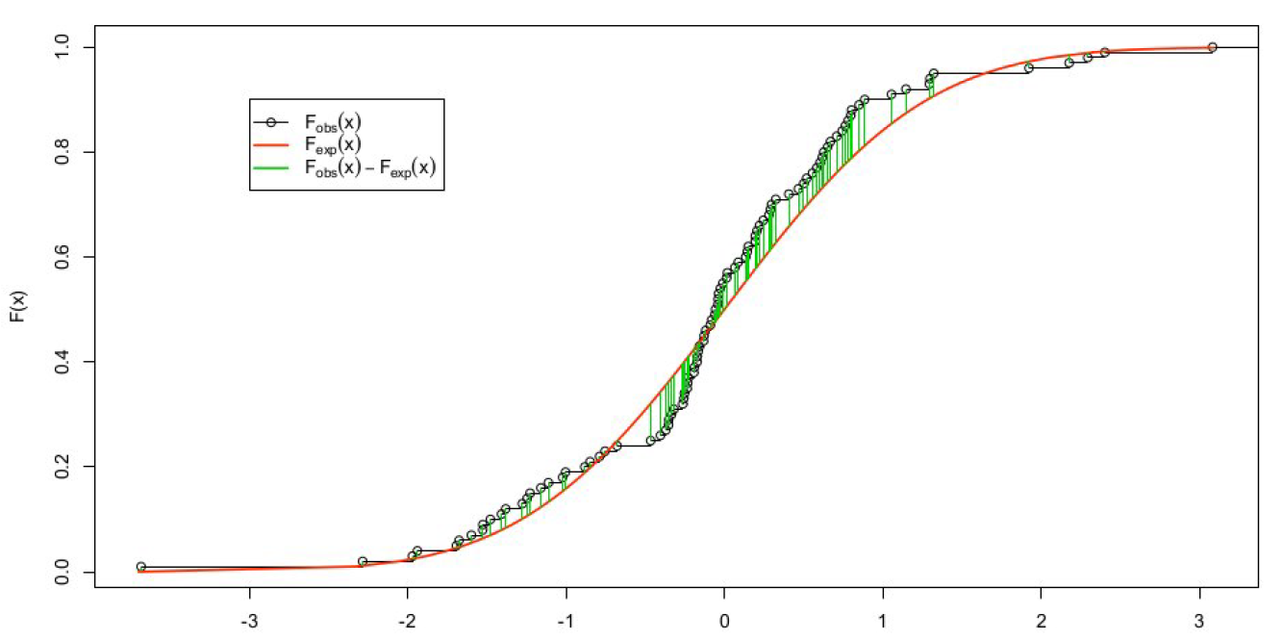
intuitively, we search for the maximum absolute distance between our data cumulative distribution function and the normal cumulative distribution function

Slide 21
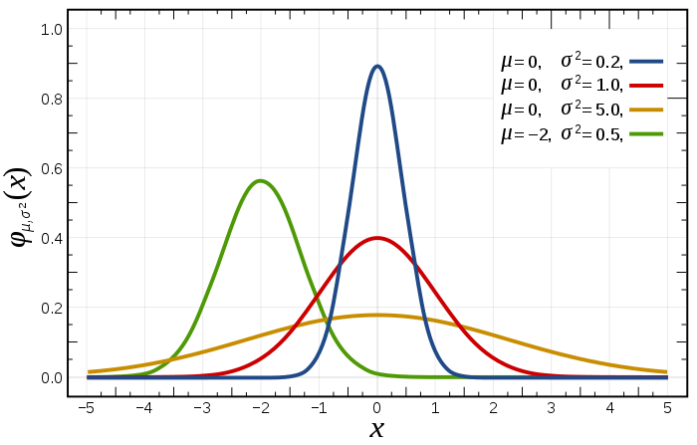
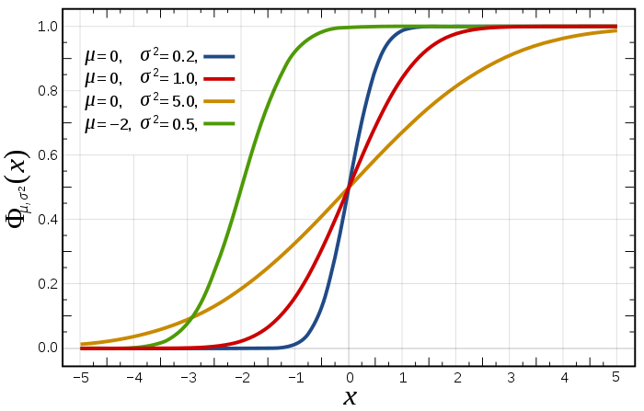
so far we looked at probability density function: represents probability that the variate has the value x
another way to look at this is the cumulative distribution function: represents probability that the variable takes a value less than or equal to x

Slide 22
0.16 -0.68 -0.32 -0.85 0.89 -2.28 0.63 0.41 0.15 0.74
1.30 -0.13 0.80 -0.75 0.28 -1.00 0.14 -1.38 -0.04 -0.25
-0.17 1.29 0.47 -1.23 0.21 -0.04 0.07 -0.08 0.32 -0.17
0.13 -1.94 0.78 0.19 -0.12 -0.19 0.76 -1.48 -0.01 0.20
-1.97 -0.37 3.08 -0.40 0.80 0.01 1.32 -0.47 2.29 -0.26
-1.52 -0.06 -1.02 1.06 0.60 1.15 1.92 -0.06 -0.19 0.67
0.29 0.58 0.02 2.18 -0.04 -0.13 -0.79 -1.28 -1.41 -0.23
0.65 -0.26 -0.17 -1.53 -1.69 -1.60 0.09 -1.11 0.30 0.71
-0.88 -0.03 0.56 -3.68 2.40 0.62 0.52 -1.25 0.85 -0.09
-0.23 -1.16 0.22 -1.68 0.50 -0.35 -0.35 -0.33 -0.24 0.25
does the following sample of n=100 comes from a normality distributed population?

Slide 23
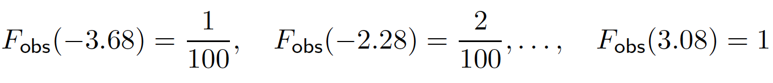
1. order the data:
-3.68 -2.28 -1.97 -1.94 -1.69 -1.68 -1.60 -1.53 -1.52 -1.48
-1.41 -1.38 -1.28 -1.25 -1.23 -1.16 -1.11 -1.02 -1.00 -0.88
-0.85 -0.79 -0.75 -0.68 -0.47 -0.40 -0.37 -0.35 -0.35 -0.33
-0.32 -0.26 -0.26 -0.25 -0.24 -0.23 -0.23 -0.19 -0.19 -0.17
-0.17 -0.17 -0.13 -0.13 -0.12 -0.09 -0.08 -0.06 -0.06 -0.04
-0.04 -0.04 -0.03 -0.01 0.01 0.02 0.07 0.09 0.13 0.14
0.15 0.16 0.19 0.20 0.21 0.22 0.25 0.28 0.29 0.30
0.32 0.41 0.47 0.50 0.52 0.56 0.58 0.60 0.62 0.63
0.65 0.67 0.71 0.74 0.76 0.78 0.80 0.80 0.85 0.89
1.06 1.15 1.29 1.30 1.32 1.92 2.18 2.29 2.40 3.08
2. compute the empirical distribution function
0.01 0.02 0.03 0.04 0.05 0.06 0.07 0.08 0.09 0.10 0.11 0.12 0.13 0.14 0.15 0.16 0.17 0.18 0.19 0.20 0.21 0.22 0.23 0.24 0.25 0.26 0.27 0.28 0.29 0.30 0.31 0.32 0.33 0.34 0.35 0.36 0.37 0.38 0.39 0.40 0.41 0.42 0.43 0.44 0.45 0.46 0.47 0.48 0.49 0.50 0.51 0.52 0.53 0.54 0.55 0.56 0.57 0.58 0.59 0.60 0.61 0.62 0.63 0.64 0.65 0.66 0.67 0.68 0.69 0.70 0.71 0.72 0.73 0.74 0.75 0.76 0.77 0.78 0.79 0.80 0.81 0.82 0.83 0.84 0.85 0.86 0.87 0.88 0.89 0.90 0.91 0.92 0.93 0.94 0.95 0.96 0.97 0.98 0.99 1.00
Notes:
y<-c(0.16,-0.68,-0.32,-0.85,0.89,-2.28,0.63,0.41,0.15,0.74,1.30,-0.13,0.80,-0.75,0.28,-1.00,0.14,-1.38,-0.04,-0.25,-0.17,1.29,0.47,-1.23,0.21,-0.04,0.07,-0.08,0.32,-0.17,0.13,-1.94,0.78,0.19,-0.12,-0.19,0.76,-1.48,-0.01,0.20,-1.97,-0.37,3.08,-0.40,0.80,0.01,1.32,-0.47,2.29,-0.26,-1.52,-0.06,-1.02,1.06,0.60,1.15,1.92,-0.06,-0.19,0.67,0.29,0.58,0.02,2.18,-0.04,-0.13,-0.79,-1.28,-1.41,-0.23,0.65,-0.26,-0.17,-1.53,-1.69,-1.60,0.09,-1.11,0.30,0.71,-0.88,-0.03,0.56,-3.68,2.40,0.62,0.52,-1.25,0.85,-0.09,-0.23,-1.16,0.22,-1.68,0.50,-0.35,-0.35,-0.33,-0.24,0.25)
ysorted <- sort(y)

Slide 24

3. for each observation xi from the data, compute:
(in this case, the expected distribution function is standard normal so use the normal table)
0.01 0.02 0.03 0.04 0.05 0.06 0.07 0.08 0.09 0.10 0.11 0.12 0.13 0.14 0.15 0.16 0.17 0.18 0.19 0.20 0.21 0.22 0.23 0.24 0.25 0.26 0.27 0.28 0.29 0.30
0.31 0.32 0.33 0.34 0.35 0.36 0.37 0.38 0.39 0.40 0.41 0.42 0.43 0.44 0.45 0.46 0.47 0.48 0.49 0.50 0.51 0.52 0.53 0.54 0.55 0.56 0.57 0.58 0.59 0.60
0.61 0.62 0.63 0.64 0.65 0.66 0.67 0.68 0.69 0.70 0.71 0.72 0.73 0.74 0.75 0.76 0.77 0.78 0.79 0.80 0.81 0.82 0.83 0.84 0.85 0.86 0.87 0.88 0.89 0.90
0.91 0.92 0.93 0.94 0.95 0.96 0.97 0.98 0.99 1.00

Slide 25

now we have two tables Fobs and Fexp …
4. lets compute the absolute difference between the two and find the highest value
0.01 0.02 0.01 0.01 0.02 0.02 0.02 0.03 0.04 0.04
0.04 0.05 0.04 0.04 0.05 0.06 0.07 0.07 0.08 0.08
0.09 0.09 0.09 0.06 -0.04 -0.05 -0.05 -0.04 -0.03 -0.04
-0.03 -0.04 -0.03 -0.02 -0.01 0.00 0.01 0.01 0.02 0.03
0.04 0.05 0.03 0.04 0.05 0.06 0.06 0.06 0.07 0.08
0.09 0.10 0.11 0.12 0.11 0.12 0.12 0.13 0.13 0.11
0.12 0.12 0.13 0.14 0.15 0.16 0.17 0.18 0.19 0.19
0.18 0.12 0.11 0.10 0.11 0.10 0.08 0.09 0.08 0.09
0.09 0.09 0.10 0.10 0.10 0.11 0.11 0.12 0.13 0.11
0.06 0.06 0.04 0.05 0.06 -0.02 -0.03 -0.02 -0.01 0.00
this is the D searched

Slide 26
we have calculated the maximum absolute distance between expected and observed distribution functions

Slide 27
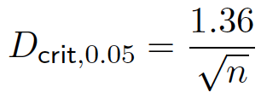
5. at 95% level the critical value is approximately given by
we have a sample size of n = 100 so Dcrit = 0.136
and 0.19 > 0.136

Slide 28
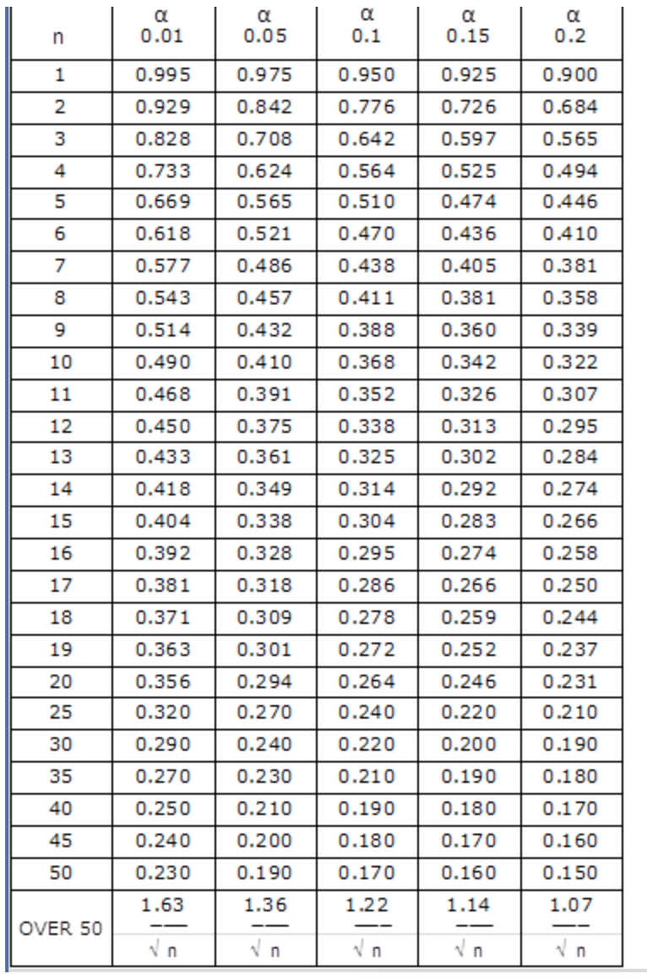
there is a plethora of tables / sampling distributions that are established and are the basis of all statistic tests

Slide 29
so 0.19 > 0.136 so null hypothesis rejected
H0: the samples come from a normal distribution
conclusion: the data do not come from a normal distribution
note KS is different than other tests we saw where we looked for a value below a critical level to reject the null, here it is the opposite (the larger the results the less likely is H0 so we reject it)

Slide 30
what if Dn < Dcrit?
here is a tricky bit … remember lecture on hypothesis testing, we cannot prove that two things are equal so we are going to assume that the normality is met
which is why we call this assumption of normality
more example on GitHub repository or at
http://www.real-statistics.com/tests-normality-and-symmetry/statistical-tests-normality-symmetry/kolmogorov-smirnov-test/

Slide 31
R
#sorting a table
y <-c(0.16,-0.68,-0.32,-0.85,0.89,-2.28,0.63,0.41,0.15,0.74,1.30,-0.13,0.80,-0.75,0.28,-1.00,0.14,-1.38,-0.04,-0.25,-0.17,1.29,0.47,-1.23,0.21,-0.04,0.07,-0.08,0.32,-0.17,0.13,-1.94,0.78,0.19,-0.12,-0.19,0.76,-1.48,-0.01,0.20,-1.97,-0.37,3.08,-0.40,0.80,0.01,1.32,-0.47,2.29,-0.26,-1.52,-0.06,-1.02,1.06,0.60,1.15,1.92,-0.06,-0.19,0.67,0.29,0.58,0.02,2.18,-0.04,-0.13,-0.79,-1.28,-1.41,-0.23,0.65,-0.26,-0.17,-1.53,-1.69,-1.60,0.09,-1.11,0.30,0.71,-0.88,-0.03,0.56,-3.68,2.40,0.62,0.52,-1.25,0.85,-0.09,-0.23,-1.16,0.22,-1.68,0.50,-0.35,-0.35,-0.33,-0.24,0.25)
ysorted <- sort(y)
X <- rnorm(100)
p = ecdf(X) #cumulative distribution function
X = sort(X) # trick to get fexp
fexp <- p(X)
fobs <- p(ysorted)
KS = max(abs(fexp-fobs))
Notes:
X <- rnorm(100)
p = ecdf(X)
X = sort(X)
fexp <- p(X)
fobs <- p(ysorted)
KS = max(abs(fexp-fobs))
KS
ks.test(X,y)

Slide 32
R
#or easier
ks.test(X,y)
Two-sample Kolmogorov-Smirnov test
data: X and y
D = 0.19, p-value = 0.05410262
alternative hypothesis: two-sided
#note that if you run the code you will have different D (because of the random rnorm generation) but likely that your pvalue will always be above 0.05

Slide 33
Kolmogorov-Smirnov works well with sample size > 50 but when the sample is smaller Shapiro-Wilks works best

Slide 34
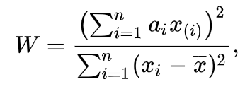
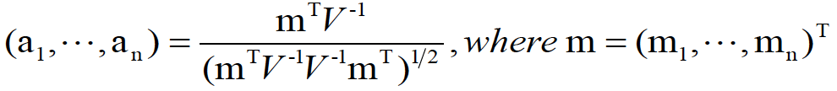
3
Shapiro-Wilks test
x(i) is the ith order statistic
SS (sum of squared difference)
m1, ..., mn are the expected values of the order
statistics of independent and identically
distributed random variables sampled from the
standard normal distribution, and V is the
covariance matrix of those order statistics.
can generate a p-value

Slide 35
a bit more beefy but let’s go steps by steps …

Slide 36
3.83 3.16 4.70 3.97 2.03 2.87 3.65 5.09
does the following sample comes from a normality distributed population?
1. order the data:
2.03 2.87 3.16 3.65 3.83 3.97 4.70 5.09
2. divide them in two
2.03 2.87 3.16 3.65 3.83 3.97 4.70 5.09

Slide 37
2.03 2.87 3.16 3.65 3.83 3.97 4.70 5.09
3. compute di the differences between both
3.06
1.83
0.81
0.18
4. multiply each of these by ai

Slide 38
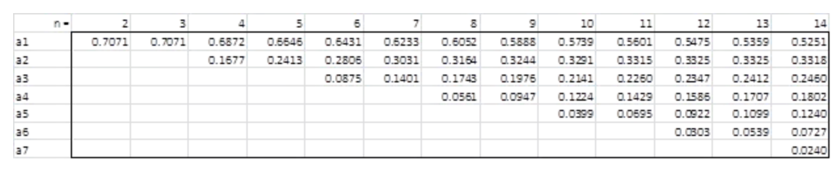
good new we have shapiro-wilk table
…
di
ai
=
=
=
=
3.06
1.83
0.81
0.18
0.6052
0.3164
0.1743
0.0561
1.851912
0.579012
0.141183
0.010098
*
*
*
*
total: 2.582205

Slide 39
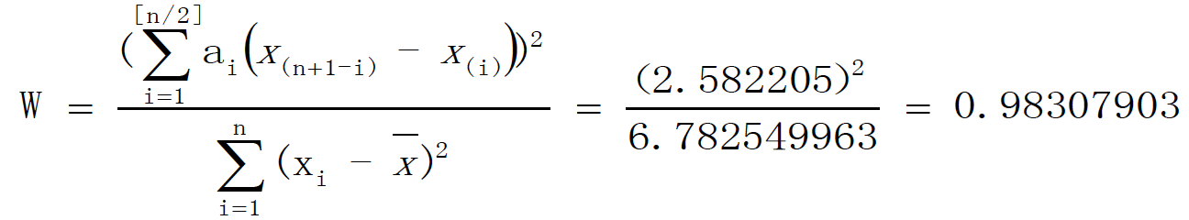
5. Divide the total by SS
6. from the reference table of W (another table yeah!),
Wcrit(n=8 at 0.05)=0.818
and 0.983>Wcrit

Slide 40
0.983>Wcrit, so we cannot reject null hypothesis, so we assume the data follows a normal distribution
otherwise (if <) we could rejected the null hypothesis and conclude with 95% confidence that that the data are not normally distributed
note we search for value below a critical level to reject the null, this is quite different from the results using the Kolmogorov-Smirnov test where this is the opposite
more example on GitHub repository or at
http://www.real-statistics.com/tests-normality-and-symmetry/statistical-tests-normality-symmetry/shapiro-wilk-test/

Slide 41
R
y <-c(3.83, 3.16, 4.70, 3.97, 2.03, 2.87, 3.65, 5.09)
shapiro.test(y)
Shapiro-Wilk normality test
data: y
W = 0.98317, p-value = 0.9769

Slide 42
ok so we know how to check our data, now what?

Slide 43
continuous independent variable
What type of data?
discrete independent variable
we can choose between parametric (normal) or non-parametric (skewed) test
continuous dependent variable
discrete dependent variable
Continuous dependent variable
Discrete/categorical dependent variable
regressions
logistic
regressions
normally distributed
skewed
2 grp
>2 grp
2 grp
>2 grp
2 grp
>2 grp
Non paired
paired
Non paired
paired
Non paired
paired
Non paired
paired
Counts >= 5 in >= 75% cells
Counts >= 5 in < 75% cells
T-test
ANOVA
Mann-Whitney Utest
Wilcoxon signed rank test
Kruskall-Wallis test
Chi-square test
Fisher’s exact test
Chi-square test
Paired-t-test
Friiedman test
McNemar’s test

Slide 44
but if your data is not normally distributed you could also try to make it normal using transformations
… more generally because parametric tests are more robust than non-parametric ones

Slide 45
transformations

Slide 46
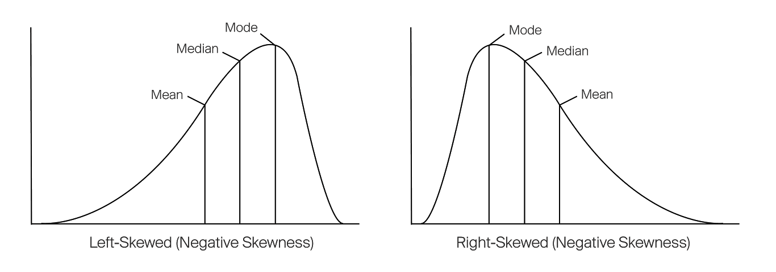

Slide 47
common transformations for left skewed::
square root, cube root, log

Slide 49
common transformations for right skewed::
square, cube root and logarithmic

Slide 50
R
y <-c(1.0, 1.2, 1.1, 1.1, 2.4, 2.2, 2.6, 4.1, 5.0, 10.0, 4.0, 4.1, 4.2, 4.1, 5.1, 4.5, 5.0, 15.2, 10.0, 20.0, 1.1, 1.1, 1.2, 1.6, 2.2, 3.0, 4.0, 10.5)
hist(y)
qqnorm(y)
qqline(y)
y_sqrt = sqrt(y) #cube root
y_cub = sign(y) * abs(y)^(1/3) #square root
y_log = log(y) #logarithm
# you can now try
qqnorm(y_log)
qqline(y_log)

Slide 51
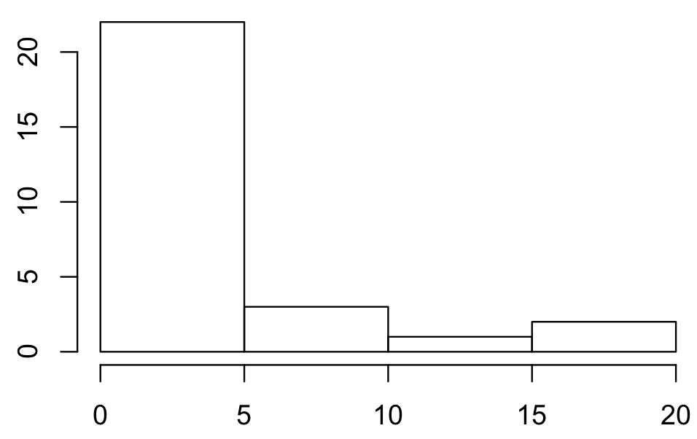
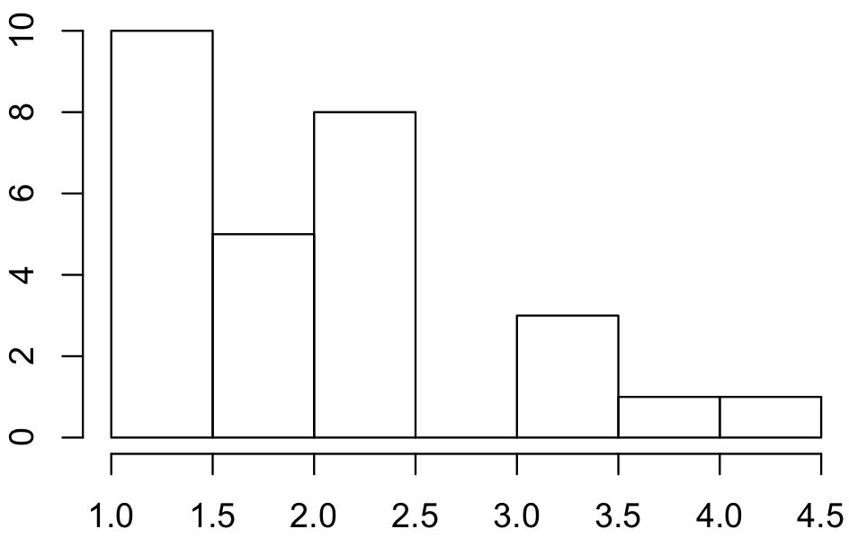
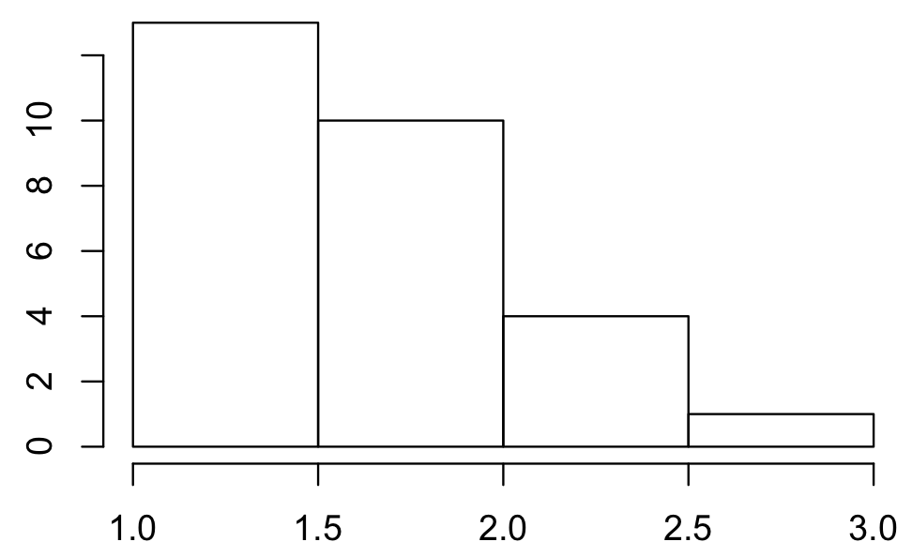
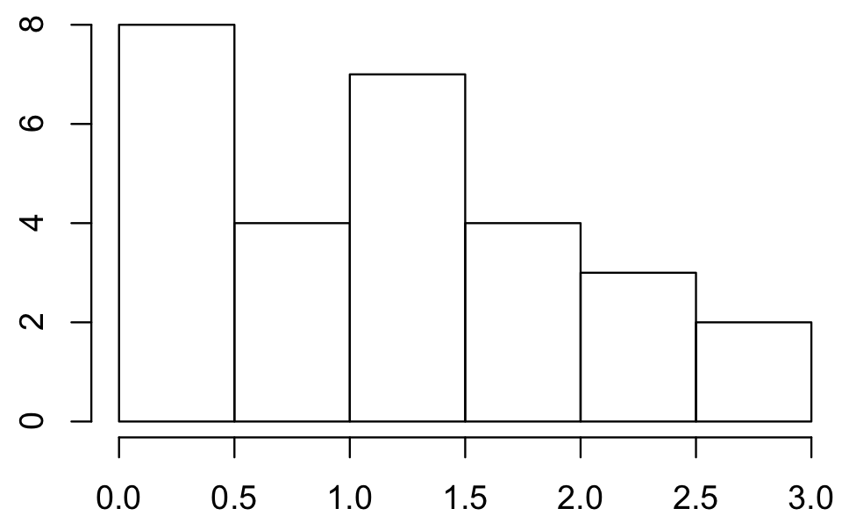
square root cube root logarithmic

Slide 52
sometimes it does not work and rather than trying a complex transformations it id better to use non parametric tests
also skewed distributions could come from outliers so make sure to get rid of them!

Slide 53
other assumptions

Slide 54
let’s have a look at the ANOVA we did when we tried to check if chocolate improves memorization

Slide 55
R
# first we run the one-way anova
dat = read.csv("HCIXP-anova.csv", header = TRUE)
library(ez)
ezANOVA(dat,id,between=group,dv=score)
Effect DFn DFd F p p<.05 ges
1 group 2 57 154.8886 9.056612e-24 * 0.8445923
$`Levene's Test for Homogeneity of Variance`
DFn DFd SSn SSd F p p<.05
1 2 57 1.433333 29.3 1.394198 0.2563608

Slide 56
the levene’s test checks for homogeneity of variances (null hypothesis is that all variances are equal)
we won’t go in detail with this test but the most important is this:
if p-value < 0.05 means variances not equal and parametric tests such as ANOVA are not suited (need non-parametric tests)

Slide 57
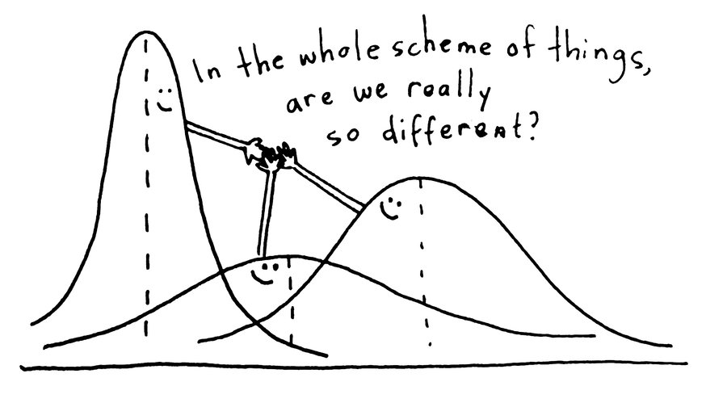
unfortunately ANOVAs do not work well in this case

Slide 58
summary

Slide 59
take away
Give the names of tests we can use to check normality and explain their differences and when to use them
I will not ask you to them by hand in the exam
Explain what to do if the data are not normal (either transforming the data or using non-parametric tests)
Explain what is the goal of a test of homogeneity of variance and what to do if the variances are not equal

Slide 60
next
continuous independent variable
What type of data?
discrete independent variable
continuous dependent variable
discrete dependent variable
Continuous dependent variable
Discrete/categorical dependent variable
regressions
logistic
regressions
normally distributed
skewed
2 grp
>2 grp
2 grp
>2 grp
2 grp
>2 grp
Non paired
paired
Non paired
paired
Non paired
paired
Non paired
paired
Counts >= 5 in >= 75% cells
Counts >= 5 in < 75% cells
T-test
ANOVA
Mann-Whitney Utest
Wilcoxon signed rank test
Kruskall-Wallis test
Chi-square test
Fisher’s exact test
Chi-square test
Paired-t-test
Friiedman test
McNemar’s test

Slide 61
end

