Slide 1


Nvidia GPU Scheduling Analysis
Group Member 13: Yiming Li, Ximing Chen
Estimated Total Hours: 50

Slide 2
Plans (Past Week)
Building the experimental code framework.
Reproduce experiments in previous paper.

Slide 3
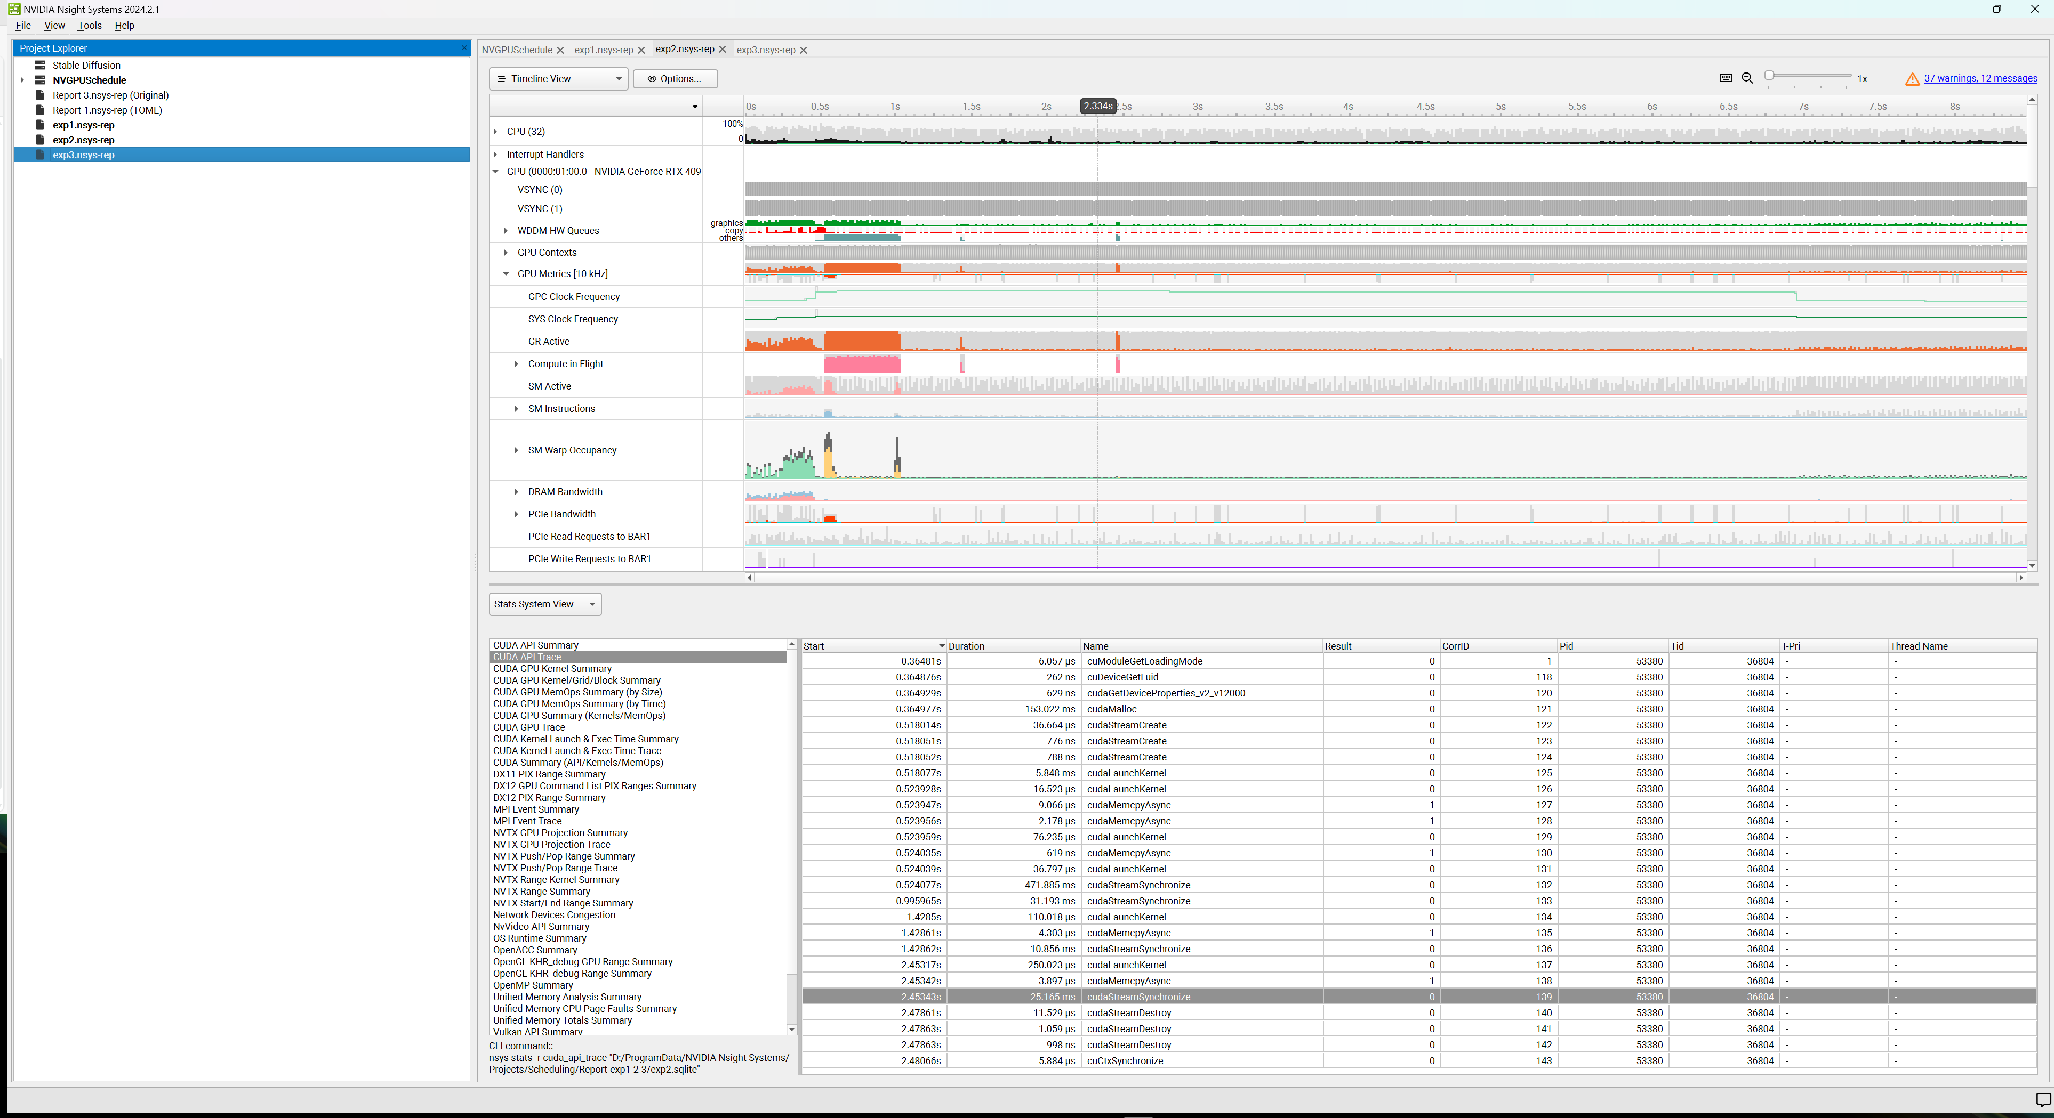
What Actually Happened

Slide 4

A kernel is enqueued on the EE queue when it reaches the head of its stream queue.
Enqueue according to the order in which the kernel starts.
A kernel is dequeued from the queue once all of its blocks complete execution.
A copy operation is enqueued on the CE queue when it reaches the head of its stream queue.

Slide 5
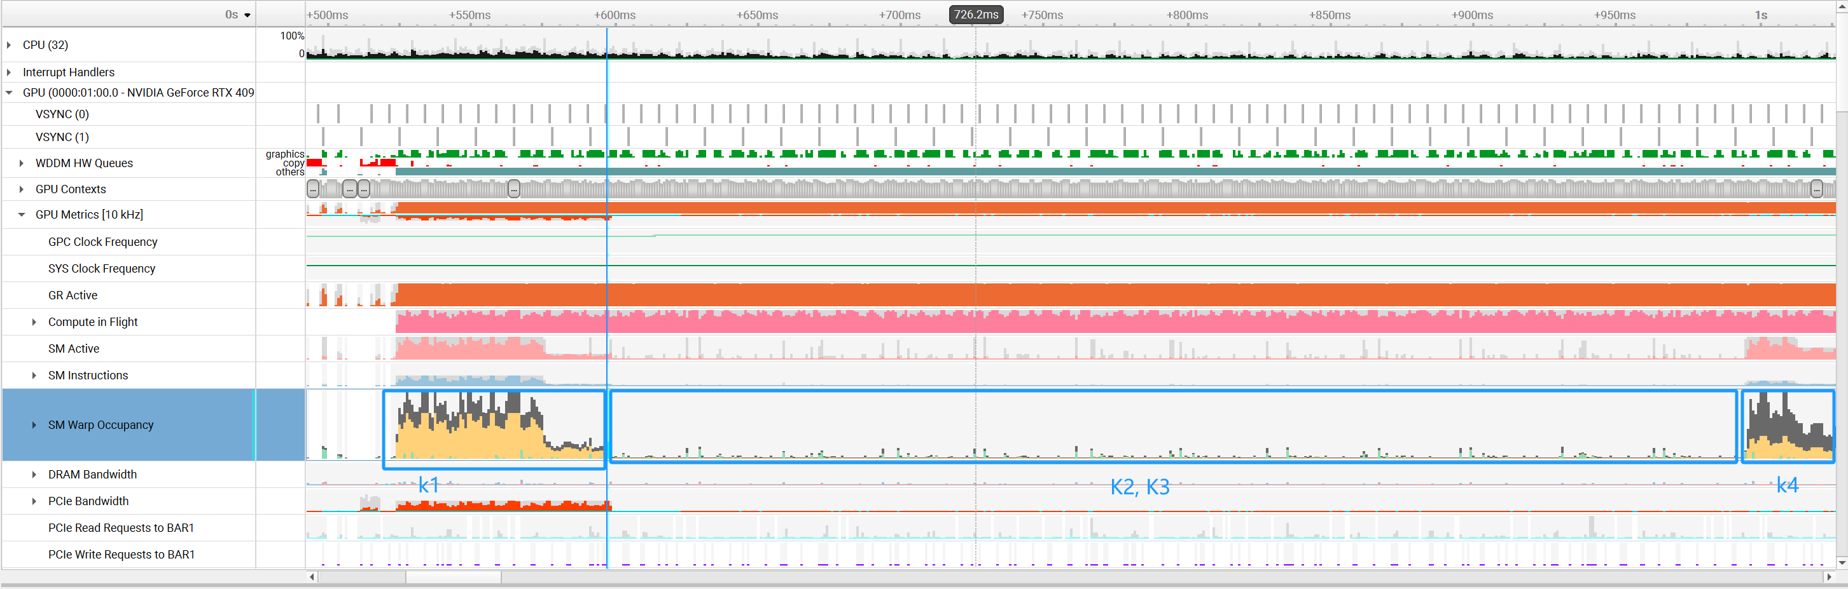
The GPU scheduling appears to be suboptimal, resulting in inefficient utilization of the SM resources.
Thread_K6 < SM_MAX_THREAD
Thread_K5 < SM_MAX_THREAD
Thread_K4 = 0.5 * GPU_MAX_THREAD
Thread_K3 < SM_MAX_THREAD
Thread_K2 < SM_MAX_THREAD
Thread_K1 = 1.5 * GPU_MAX_THREAD
K2, K3, K4 should be able to execute on the same time, but they didn’t.

Slide 6
Plans (Next Week)
Conduct a comprehensive analysis to understand the reasons behind the GPU's suboptimal utilization of SM resources.
Investigate additional factors that have an impact on GPU scheduling, aside from the number of threads, including examining shared memory usage, inter-kernel dependencies, and stream prioritization.

