Slide 1
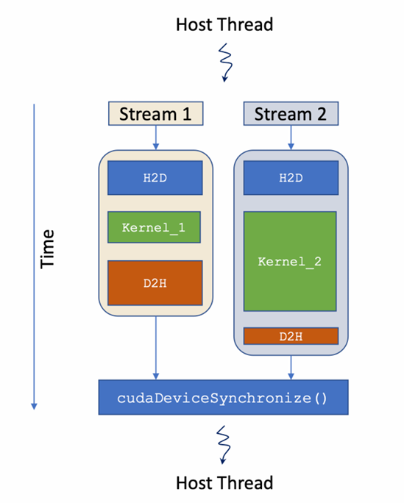
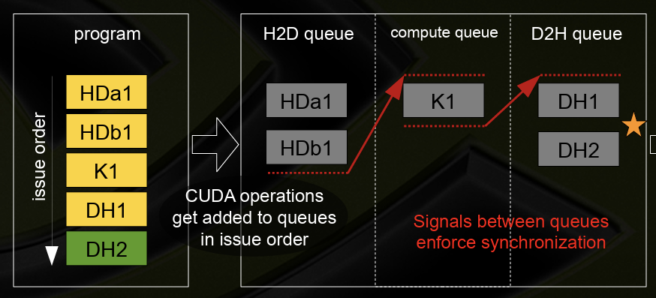
Research Background
Cuda Steam Model
A stream is a queue of device work.
Operations within the same stream are ordered (FIFO) and cannot overlap.
Operations in different streams are unordered and can overlap. – unknow
Co-scheduling Policy for different types of operations (kernel executions and memory transfers). – unknow
Hardware Engine Queue
CUDA operations are dispatched to HW in the sequence they were issued.
Scheduler: how to dispatch these operations.
Signals between queues ensure the synchronization of unordered operation.
1 |

Slide 2
Preconceived Experiments
Key Idea
Observe and benchmark the execution order and concurrency of GPU operations under different conditions.
Preliminary Designs
Concurrent execution from multiple CUDA streams
Observe any potential concurrency or dependencies between streams.
Mix kernel executions and memory transfers
Observe how the GPU co-schedules and synchronizes computations and data transfers.
Controlled execution
Isolate and observe specific aspects of the GPU's scheduling behavior.
2 |

