Slide 1


Nvidia GPU Scheduling Analysis
Group Member 13: Yiming Li, Ximing Chen
Estimated Total Hours: 50

Slide 2
Plans (Past Week)
Perform a thorough analysis to determine the causes of suboptimal utilization of SM resources in the GPU.
Examine the impact of Null stream and stream priority on the scheduling strategy.

Slide 3

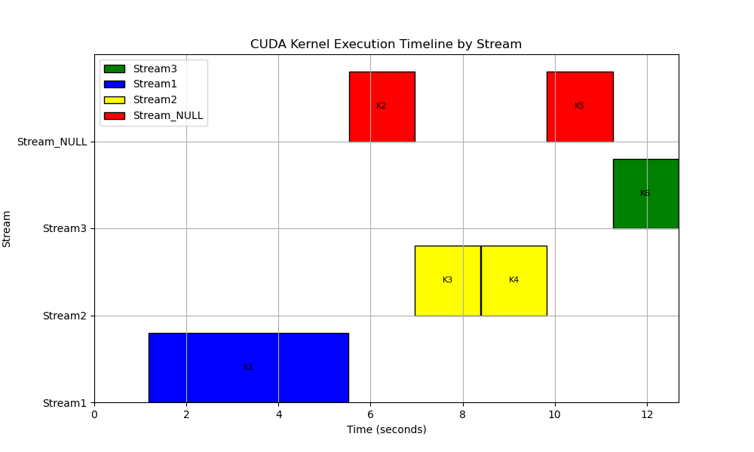
Experiment on Null Stream
No concurrent execution of two kernels if NULL stream operations occur between them.
Ki in NULL stream enqueued on EE queue if other streams empty or their head kernel launched after Ki.
Ki at head of non-NULL stream enqueued on EE queue if NULL stream empty or its head kernel launched after Ki.
Kernel Name | GridXYZ | BlockXYZ | KernelStartTime
kernel1() | 288,1,1 | 1024,1,1 | 0.330
kernel3() | 2,1,1 | 1024,1,1 | 0.542
kernel2() | 4,1,1 | 512,1,1 | 0.542
kernel4() | 9,1,1 | 256,1,1 | 0.751
kernel5() | 31,1,1 | 256,1,1 | 0.972
kernel6() | 31,1,1 | 256,1,1 | 1.186
Kernel1: 1.5 GPU thread resources
Kernel2: 1 SM threads
Kernel3: 1 SM threads
Kernel4: 1.5 SM threads
Kernel5: 0.5 SM threads
Kernel6: 2 SM threads

Slide 4

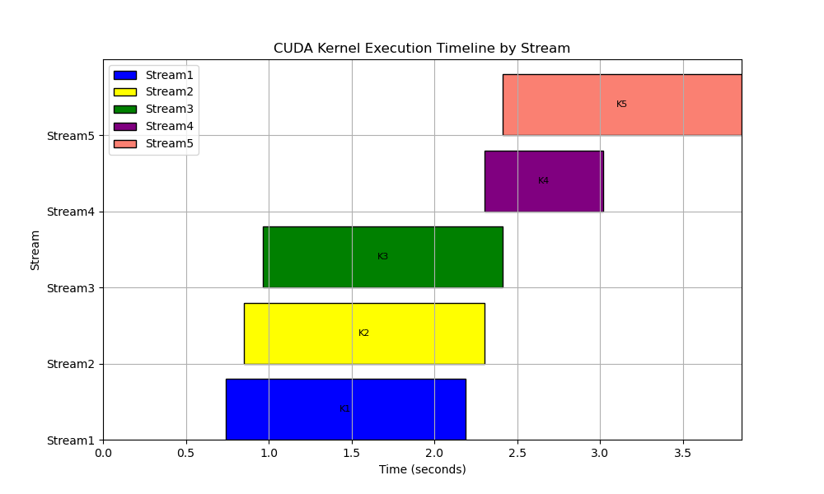
Experiment on Stream Priority
Kernels enqueue on EE queue based on their stream priority.
Blocks of the head kernel in EE queue assigned when higher-priority queues are empty.
Kernel Name | GridXYZ | BlockXYZ | KernelStartTime
kernel1() | 96,1,1 | 512,1,1 | 0.739
kernel3() | 96,1,1 | 512,1,1 | 0.851
kernel2() | 96,1,1 | 512,1,1 | 0.964
kernel4() | 96,1,1 | 1024,1,1 | 1.631
kernel5() | 96,1,1 | 256,1,1 | 1.631
Kernel1 (low): 1/4 thread resources
Kernel2 (low): 1/4 thread resources
Kernel3 (low): 1/4 thread resources
Kernel4 (high): 3/4 thread resources
Kernel5 (low): 1/8 thread resources

Slide 5
Plans (Next Week)
Conduct a comprehensive analysis to understand the reasons behind the GPU's suboptimal utilization of SM resources.
Explore the GPU block-to-SM distribution policy.

