Slide 1


Nvidia GPU Scheduling Analysis
Group Member 13: Yiming Li, Ximing Chen
Estimated Total Hours: 50

Slide 2
Plans (Past Week)
Explore the GPU block-to-SM distribution policy.

Slide 3
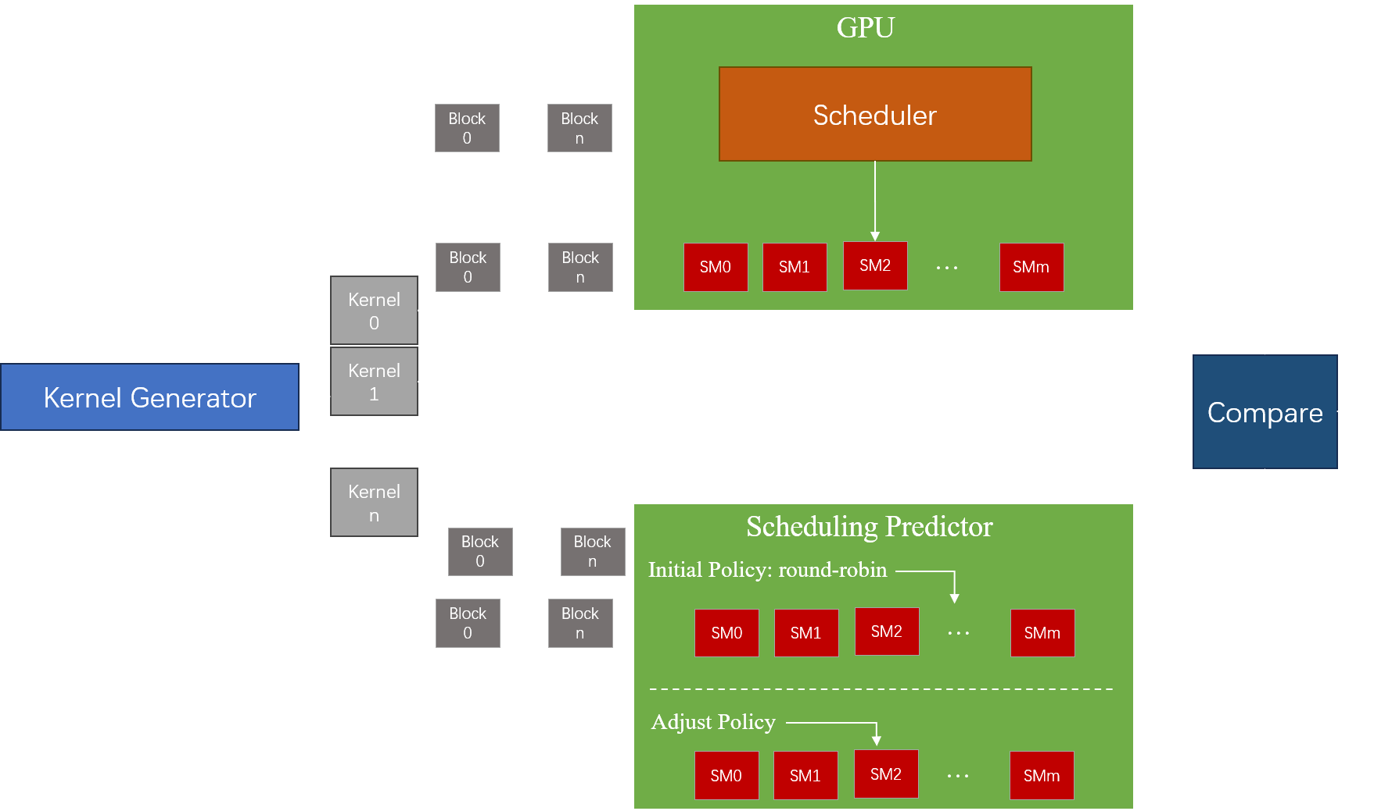
Testing Framework
Kernel Generation: Create and dispatch random kernel sequences to GPU until full.
Execution: Sequential execution of kernels; thread blocks assigned to specific SMs.
Prediction and Analysis: Predict SM assignments using a round-robin algorithm; analyze differences.
Iterative Refinement: Refine prediction algorithm based on discrepancies to match actual GPGPU behavior.

Slide 4
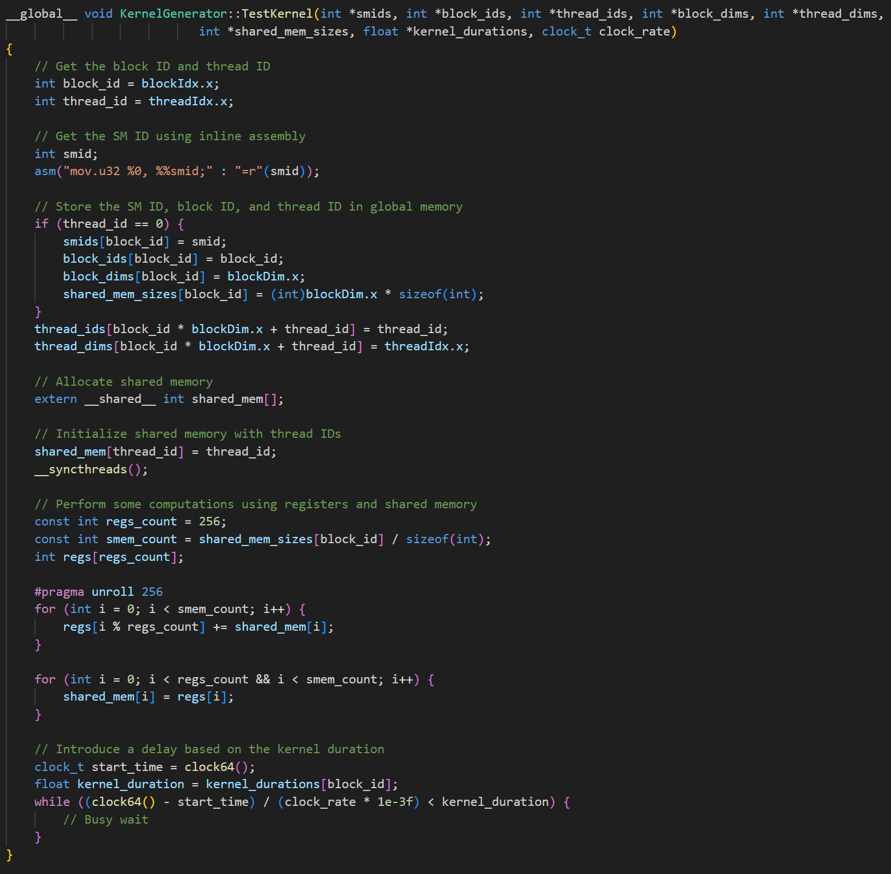
Testing Kernel
Kernel Functionality:
Gathers and logs block and thread IDs, SMIDs.
Simulates workloads using registers and shared memory.
Implements controlled execution delays.
Register Usage Control:
Employs `-maxrregcount` to limit and specify register usage.
65,536 registers per SM
Register Control’s Impact on Local Memory:
Inverse relationship between register and local memory usage.
Configures to minimize execution hindrance due to memory reconfiguration.

Slide 5
Plans (Next Week)
Conduct experiments on this testing framework and analyze the result.

