Slide 1


Nvidia GPU Scheduling Analysis
Group Member 13: Yiming Li, Ximing Chen
Estimated Total Hours: 50

Slide 2
Plans (Past Week)
Explore the GPU block-to-SM distribution policy.

Slide 3
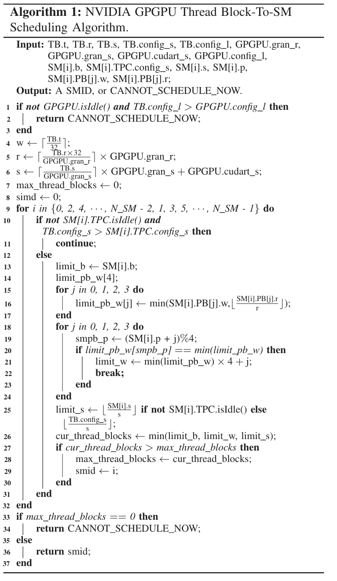
Reproduce the Scheduling Algorithm
Verification of Local Memory Configuration
Check if GPGPU's local memory meets thread block requirements.
Adjust memory only when GPGPU is idle, if required.
Calculation of SM Capacity
Calculate required warp slots, registers, and shared memory for the thread block.
Determine max thread blocks each SM can handle based on resources.
Verify SM’s shared memory matches thread block’s needs, reconfigure if idle.
Note: Total warps per SM may differ from sum of warps in four processing blocks due to warp-to-SM block scheduling.
SM Selection
Select SM with the highest capacity for thread blocks.
Prefer even-numbered SMs in ties.

Slide 4
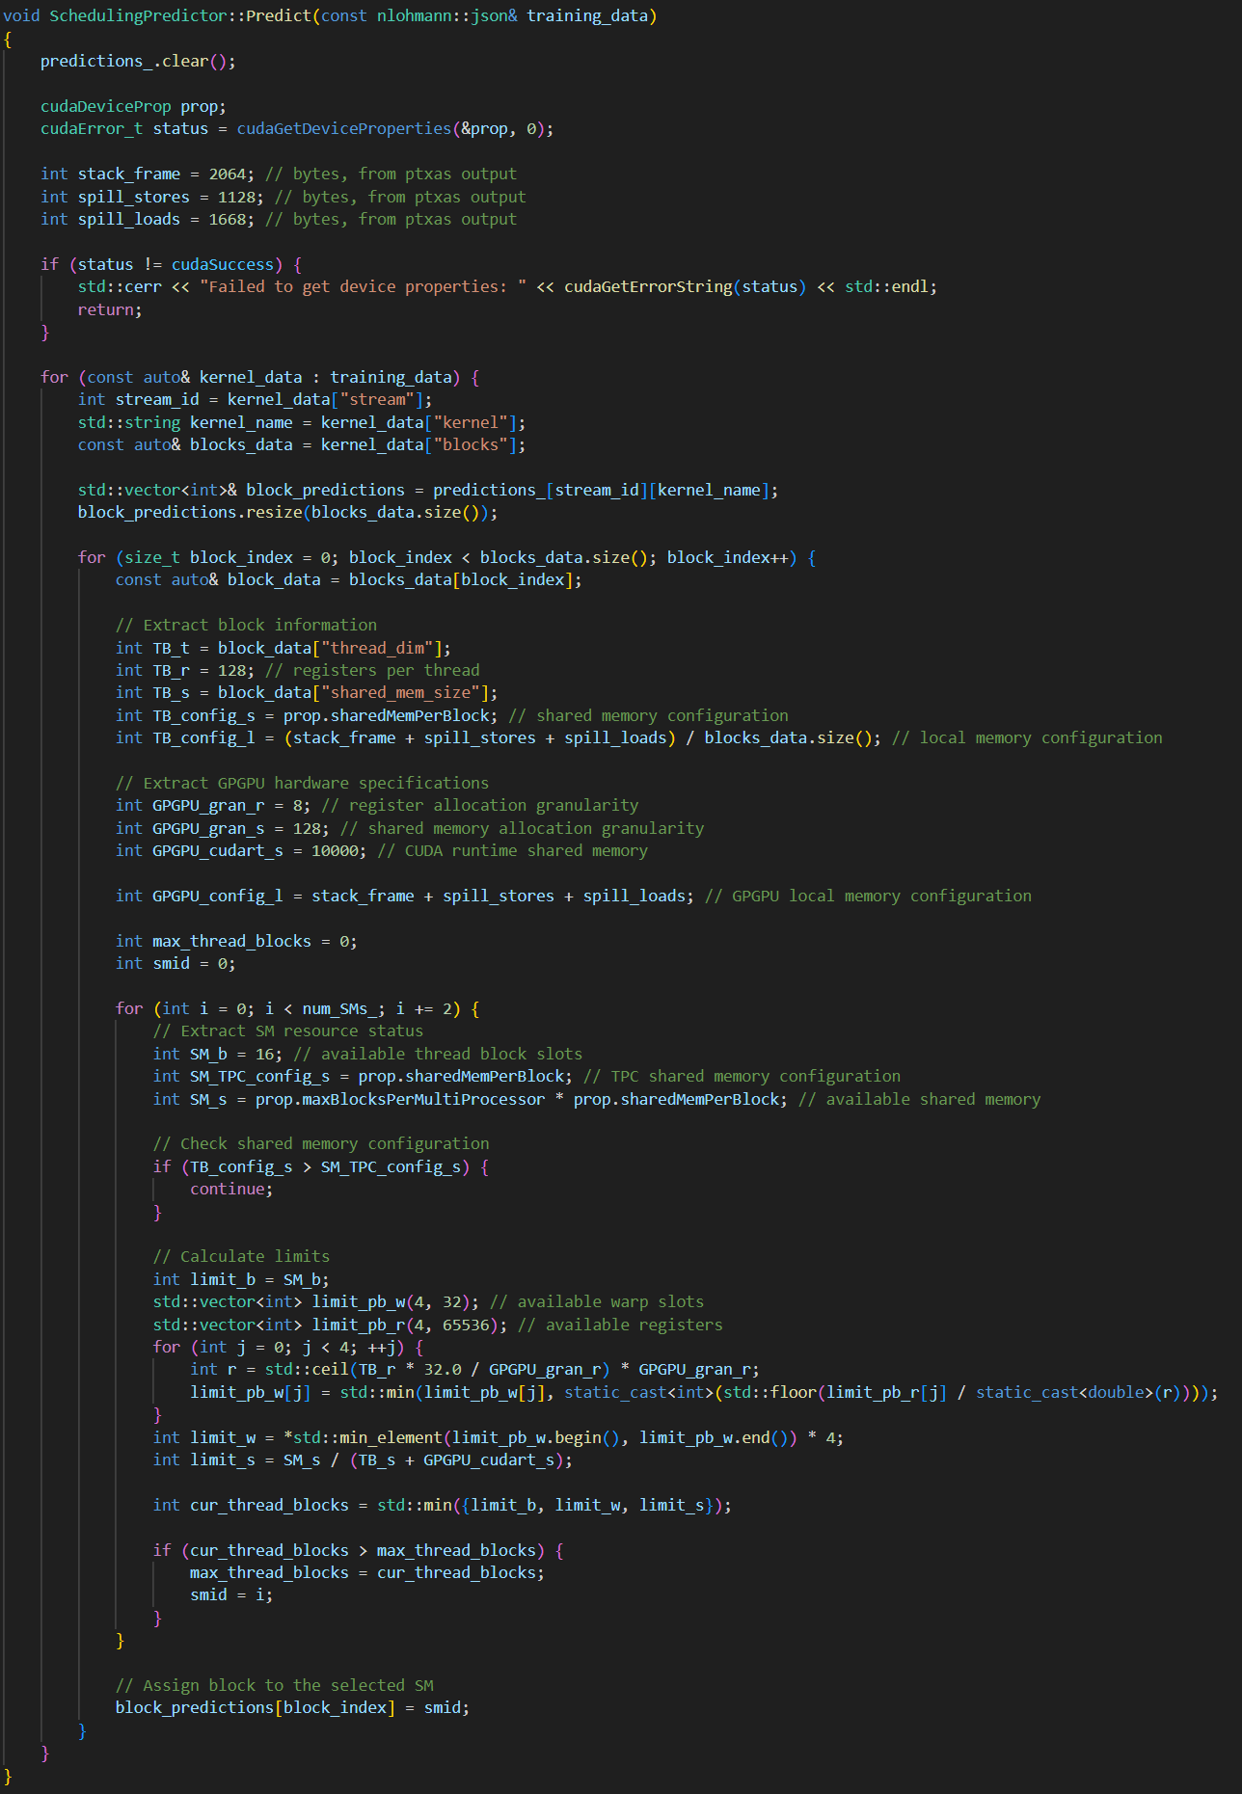
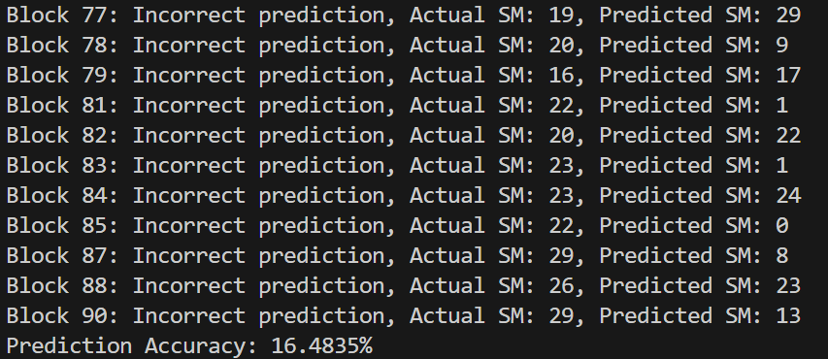
Result
Prediction Correctness: Only 15%
Issue
Algorithm Complexity: implementation correctness?
Uncertain Hardware Specification.
Granularity of Register and Shared Memory Allocation.
GPU Runtime State Retrieval?
Texture Processing Clusters (TPCs) Idle?
Local Memory Configuration.

Slide 5
Next Step
1. Further Analyzing the Reproduced Algorithm
2. Using Neural Network?
Simple MLP?
Block box, hard to analyze the scheduling policy
Hybrid Model
Explicit Round-Robin Implementation
Develop a clear, rule-based round-robin scheduling model.
Feature Engineering
Generate features for resource demand, historical deviations, and time-based allocation impacts
Machine Learning Model
Implement a machine learning model to predict adjustments based on resource usage.
Integration
Combine ML predictions with round-robin scheduling to optimize resource allocation
Resource Usage
Per SM Socre
Feature
Engieering
Round-Robin Scheduler
Machine Learning Model
After Iterate All SM
Selected SM

