Slide 1


Nvidia GPU Scheduling Analysis
Group Member 13: Yiming Li, Ximing Chen
Estimated Total Hours: 50

Slide 2
Plans (Past Week)
Examine additional factors influencing GPU scheduling
Investigate the reasons why the GPU's suboptimal utilization of SM resources

Slide 3
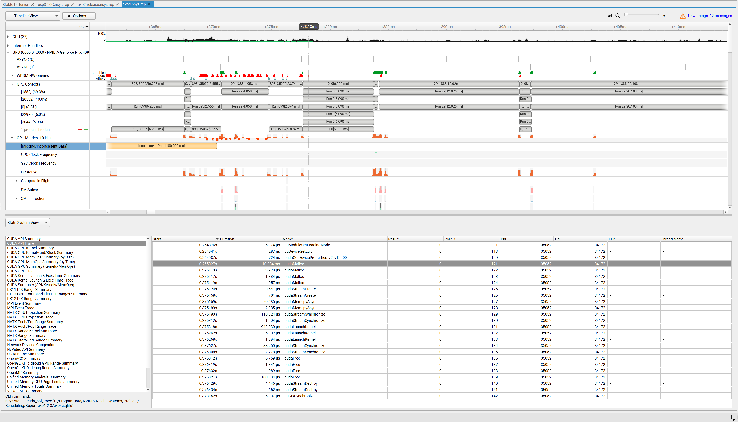
What Actually Happened
Experiment on Shared Memory

Slide 4

A block at the front of the EE queue can only be assigned if there are enough shared-memory resources on a SM.
The occupancy of a SM is determined by the maximum of thread occupancy, shared memory occupancy, and register occupancy (maybe?).
Scheduling decisions prioritize requested shared memory above 3KB. Below this threshold, thread count dominates the scheduling mechanism.

Slide 5
Plans (Next Week)
Conduct a comprehensive analysis to understand the reasons behind the GPU's suboptimal utilization of SM resources.
Investigate the influence of stream priority on the scheduling strategy.

