Slide 1


TZ - Password Manager
THARUN KUMAR JAYAPRAKASH(TJ2557)
HUGO MATEOUSK(HM2953)
Estimated Total Hours: 7

Slide 2
Plans (Past Week)
Rewriting the Hello World Application
Development pipeline setup
Application architecture
RPi4 implementation possibility verification

Slide 3
What Actually Happened
Work completed:
Basic application architecture (see next slide) (both)
Reworked Hello World application (see demo) (Hugo)
Development environment setup (see demo) (Tharun)
RPi 4 possibilities investigated (Hugo)
Major challenges+roadblocks:
Understanding the TA architecture and requirements needed for compilation

Slide 4
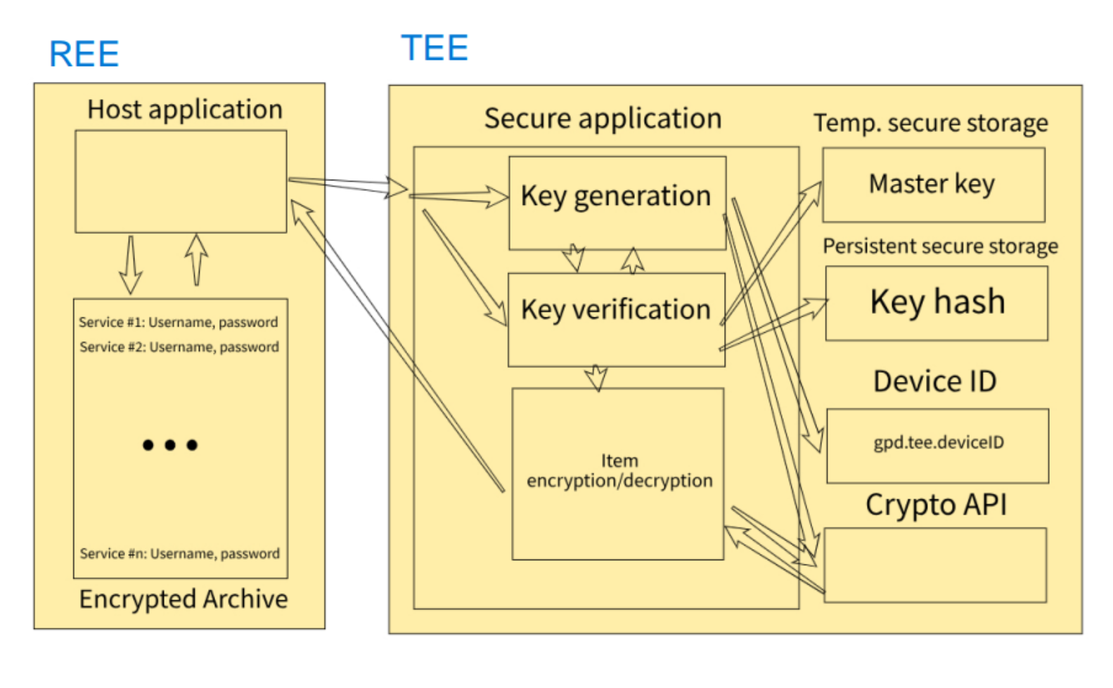

Slide 5
Plans (Next Week)
Architecture - detailed slides, threat model
Secure API definition
Basic “frontend” (unsecured application)
Basic “backend” (secured application)

Slide 6
Summary/Overall Progress
Working OP-TEE/QEMU environment
Basic application architecture
Working skeleton application
Documentation familiarity

