Slide 1
Univariate Analysis
Count & Mean
Social Media DL (Bytes) | Social Media UL (Bytes) | Google DL (Bytes) | Google UL (Bytes) | Email DL (Bytes) | Email UL (Bytes) | Youtube DL (Bytes) | Youtube UL (Bytes) | Netflix DL (Bytes) | Netflix UL (Bytes) | Gaming DL (Bytes) | Gaming UL (Bytes) | Other DL (Bytes) |  | Dur. (ms) | Total UL (Bytes) | Total DL (Bytes)
count | 1.500020e+05 | 1.500020e+05 | 1.500020e+05 | 1.500020e+05 | 1.500020e+05 | 1.500020e+05 | 1.500020e+05 | 1.500020e+05 | 1.500020e+05 | 1.500020e+05 | 1.500020e+05 | 1.500020e+05 |  | 1.500020e+05 | 1.500000e+05 | 1.500000e+05 | 1.500010e+05
mean | 1.865738e+06 | 3.423653e+04 | 5.977731e+06 | 2.137284e+06 | 1.861551e+06 | 4.854661e+05 | 1.208942e+07 | 1.144228e+07 | 1.208177e+07 | 1.143604e+07 | 4.385723e+08 | 8.611864e+06 |  | 8.591922e+06 | 1.046086e+05 | 4.112121e+07 | 4.724487e+08

Slide 2
Standard deviation & minimum
Social Media DL (Bytes) | Social Media UL (Bytes) | Google DL (Bytes) | Google UL (Bytes) | Email DL (Bytes) | Email UL (Bytes) | Youtube DL (Bytes) | Youtube UL (Bytes) | Netflix DL (Bytes) | Netflix UL (Bytes) | Gaming DL (Bytes) | Gaming UL (Bytes) | Other DL (Bytes) | Other UL (Bytes) | Dur. (ms) | Total UL (Bytes) | Total DL (Bytes)
std | 2.729197e+07 | 5.069829e+05 | 8.797113e+07 | 3.129402e+07 | 2.706187e+07 | 7.012487e+06 | 1.764844e+08 | 1.677726e+08 | 1.763205e+08 | 1.683193e+08 | 6.405815e+09 | 1.253698e+08 | 6.388329e+09 | 1.267844e+08 | 8.103762e+04 | 1.127639e+07 | 6.900283e+09
min | 1.200000e+01 | 0.000000e+00 | 2.070000e+02 | 3.000000e+00 | 1.400000e+01 | 2.000000e+00 | 5.300000e+01 | 1.050000e+02 | 4.200000e+01 | 3.500000e+01 | 2.516000e+03 | 5.900000e+01 | 3.290000e+03 | 1.480000e+02 | 7.142000e+03 | 2.866892e+06 | 7.114041e+06
25% | 8.991550e+05 | 1.644825e+04 | 2.882394e+06 | 1.024286e+06 | 8.927942e+05 | 2.333838e+05 | 5.833507e+06 | 5.517982e+06 | 5.777156e+06 | 5.476024e+06 | 2.104765e+08 | 4.128503e+06 | 2.101870e+08 | 4.145949e+06 | 5.744050e+04 | 3.322201e+07 | 2.431072e+08

Slide 3
Median, Interquartile range & Max
Social Media DL (Bytes) | Social Media UL (Bytes) | Google DL (Bytes) | Google UL (Bytes) | Email DL (Bytes) | Email UL (Bytes) | Youtube DL (Bytes) | Youtube UL (Bytes) | Netflix DL (Bytes) | Netflix UL (Bytes) | Gaming DL (Bytes) | Gaming UL (Bytes) | Other DL (Bytes) | Other UL (Bytes) | Dur. (ms) | Total UL (Bytes) | Total DL (Bytes)
50% | 1.794372e+06 | 3.292000e+04 | 5.765857e+06 | 2.054590e+06 | 1.793534e+06 | 4.662520e+05 | 1.161618e+07 | 1.101348e+07 | 1.164222e+07 | 1.099640e+07 | 4.234082e+08 | 8.291215e+06 | 4.218057e+08 | 8.267086e+06 | 8.639900e+04 | 4.114331e+07 | 4.558412e+08
75% | 2.694940e+06 | 4.933400e+04 | 8.623632e+06 | 3.088455e+06 | 2.689332e+06 | 7.004445e+05 | 1.744860e+07 | 1.651565e+07 | 1.747056e+07 | 1.650733e+07 | 6.331756e+08 | 1.243164e+07 | 6.317015e+08 | 1.238430e+07 | 1.324302e+05 | 4.903424e+07 | 6.657068e+08
max | 1.056439e+10 | 1.962499e+08 | 3.405294e+10 | 1.211349e+10 | 1.047520e+10 | 2.714397e+09 | 6.831479e+10 | 6.494299e+10 | 6.825102e+10 | 6.515467e+10 | 2.479600e+12 | 4.852877e+10 | 2.472833e+12 | 4.907724e+10 | 1.859336e+06 | 7.833131e+07 | 2.671258e+12

Slide 4
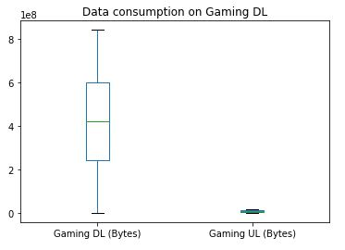
It can be noticed from the visual that most of the data were received from Gaming MS during this session compare to data received. And there tends to be no outlier in the dataset after cleaning.

Slide 5
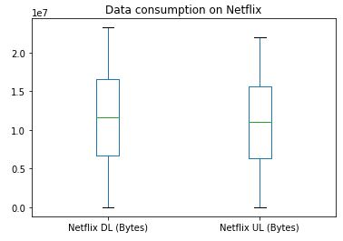
By visualizing Netflix data on the MS during this session, there tends to be a slight difference in the data sent and data received.

Slide 6
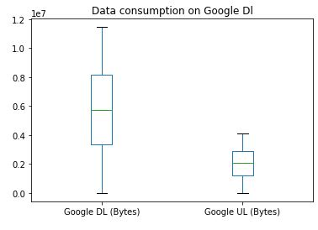
It could be noticed from the visualization that the amount of data spent on Google data volume (in Bytes) Received by the MS during this session is a way more than Google data volume (in Bytes) sent by the MS during this session

Slide 7
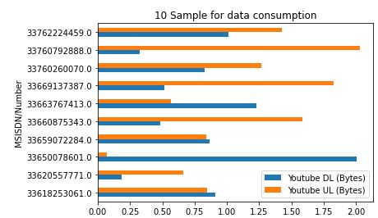
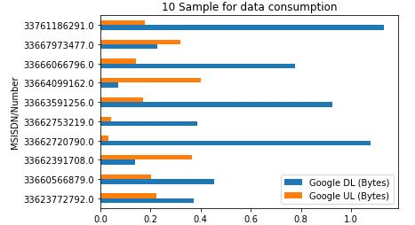
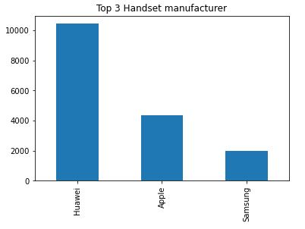
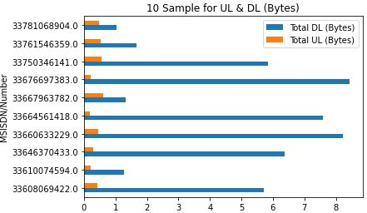
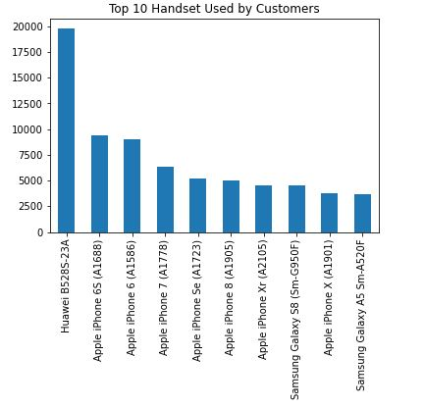
Bi-variate Data visualization

Slide 8
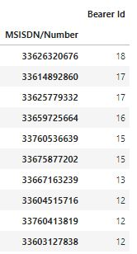
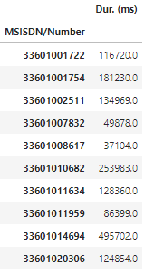
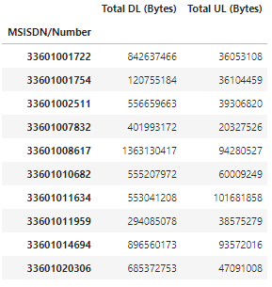
User Engagement analysis
Top 10 Session of Users
FREQUENCY
DURATION
TOTAL TRAFFIC DOWNLOAD AND UPLOAD (BYTES)

Slide 9
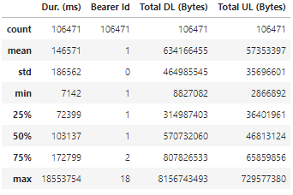
Description

Slide 10
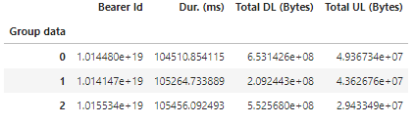
By generating three clusters from the dataset, the above table is the average of each cluster for the corresponding column.

Slide 11
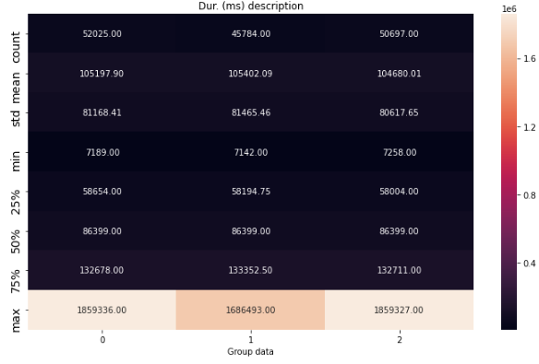
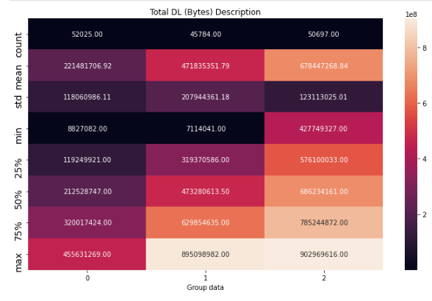
Data description for each cluster

Slide 12
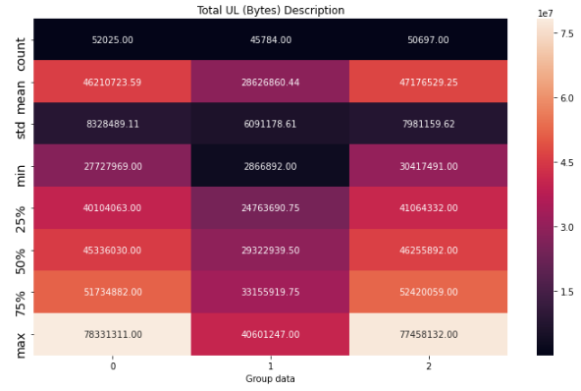

Slide 13
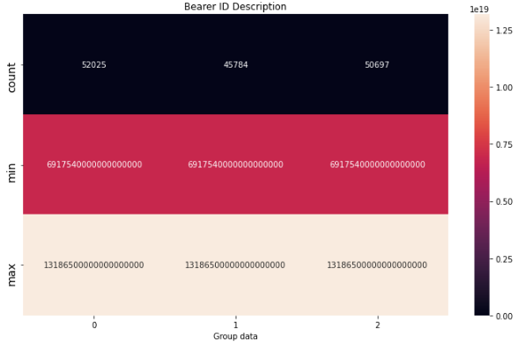
Clusters description on the Bearer ID

Slide 14
Top 10 most engaged users per application
Bearer Id
6.917540e+18
7.277830e+18
7.349880e+18
7.421940e+18
7.566060e+18
1.268210e+19
1.304240e+19
1.311450e+19
1.318650e+1

Slide 15
Group data |  | 0 | 1 | 2
Dur. (ms) | count | 5.202500e+04 | 4.578400e+04 | 5.069700e+04
 | mean | 1.051979e+05 | 1.054021e+05 | 1.046800e+05
 | std | 8.116841e+04 | 8.146546e+04 | 8.061765e+04
 | min | 7.189000e+03 | 7.142000e+03 | 7.258000e+03
 | 25% | 5.865400e+04 | 5.819475e+04 | 5.800400e+04
 | 50% | 8.639900e+04 | 8.639900e+04 | 8.639900e+04
 | 75% | 1.326780e+05 | 1.333525e+05 | 1.327110e+05
 | max | 1.859336e+06 | 1.686493e+06 | 1.859327e+06
Bearer Id | count | 5.202500e+04 | 4.578400e+04 | 5.069700e+04
 | mean | 1.013791e+19 | 1.016698e+19 | 1.013756e+19
 | std | 2.893096e+18 | 2.893308e+18 | 2.893346e+18
 | min | 6.917540e+18 | 6.917540e+18 | 6.917540e+18
 | 25% | 7.349880e+18 | 7.349880e+18 | 7.349880e+18
 | 50% | 7.349880e+18 | 7.349880e+18 | 7.349880e+18
 | 75% | 1.304240e+19 | 1.304240e+19 | 1.304240e+19
 | max | 1.318650e+19 | 1.318650e+19 | 1.318650e+19
Total DL (Bytes) | count | 5.202500e+04 | 4.578400e+04 | 5.069700e+04
 | mean | 2.214817e+08 | 4.718354e+08 | 6.784473e+08
 | std | 1.180610e+08 | 2.079444e+08 | 1.231130e+08
 | min | 8.827082e+06 | 7.114041e+06 | 4.277493e+08
 | 25% | 1.192499e+08 | 3.193706e+08 | 5.761000e+08
 | 50% | 2.125287e+08 | 4.732806e+08 | 6.862342e+08
 | 75% | 3.200174e+08 | 6.298546e+08 | 7.852449e+08
 | max | 4.556313e+08 | 8.950990e+08 | 9.029696e+08
Total UL (Bytes) | count | 5.202500e+04 | 4.578400e+04 | 5.069700e+04
 | mean | 4.621072e+07 | 2.862686e+07 | 4.717653e+07
 | std | 8.328489e+06 | 6.091179e+06 | 7.981160e+06
 | min | 2.772797e+07 | 2.866892e+06 | 3.041749e+07
 | 25% | 4.010406e+07 | 2.476369e+07 | 4.106433e+07
 | 50% | 4.533603e+07 | 2.932294e+07 | 4.625589e+07
 | 75% | 5.173488e+07 | 3.315592e+07 | 5.242006e+07
 | max | 7.833131e+07 | 4.060125e+07 | 7.745813e+07
Minimum, Maximum, Average & Total non- normalized metrics for each cluster

Slide 16
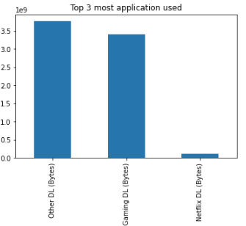

Slide 17
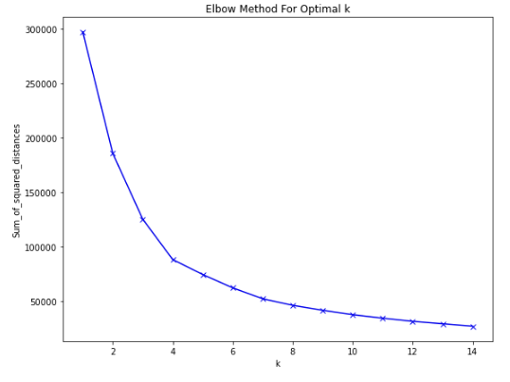
Using the elbow method to determine the Optimal K value for the clusters
Optimal value
K= 5

Slide 18
Summary
The Data were grouped using the MSISDN/Number in order to find the Total sessions traffic.
Using Sklearn (scikit learn) library in Python, the data were grouped into three cluster.
By finding the optimal k values using the elbow method, it can be noticed that k= 5 is said to group the clusters equally.

Slide 19
Experience Analytics

Slide 21
Top 10 frequent used Handset
 | Avg TCP Retrans. Vol (Bytes) | Avg RTT (ms)
Handset Type
Huawei B528S-23A | 2104948706428 | 3032785
Apple iPhone 6S (A1688) | 333848166839 | 735620
Apple iPhone 6 (A1586) | 295766715135 | 913033
undefined | 283764722445 | 1035696
Apple iPhone 7 (A1778) | 204236858350 | 702272
Apple iPhone Se (A1723) | 178893900463 | 427718
Apple iPhone 8 (A1905) | 168983865375 | 504782
Apple iPhone Xr (A2105) | 163834766921 | 311811
Samsung Galaxy S8 (Sm-G950F) | 134220880553 | 550637
Huawei E5180 | 131161287951 | 343046

