Slide 1
Designing Production Agentic Systems
Columbia · Fall 2026 · Lecture 2
Notes:
[40s] Course number, title, term. Say the room and the slot: Fridays 2:10 to 4:00, Hamilton 303, September 11 through December 11. Do not read the syllabus yet.

Slide 2
Logistics and Recap

Slide 3
About the Instructors
Senior Research Scientist IBM and I was a CS Postdoc at Columbia.
What I work on: Program Analysis • Distributed Systems • Security • Testing
Instructor | Rahul Krishna • rk3080@columbia.edu
Teaching Assistant | In Keun Kim • ik2619@columbia.edu
Office Hours | Friday 12:00—1:30 (and via zoom ad hoc)
TA | To be announced on CourseWorks
Discussion | Slack Channel
Website | rkrsn.us

Slide 4
Class Notifications
HW1 – released before next class
  Procuring API credits for everyone
  Assignment groups before next week so I can plan accordingly
Vergil registration closes at 9:00 PM tonight

Slide 5
The key question that motivates this course
How do we place a probabilistic model inside a software system without surrendering the guarantees expected of production software?
Phrase | Why it is in the question
Probabilistic | Two identical calls are not guaranteed to agree, and nothing downstream may assume they will
Inside a software system | It is one component among several. It is called, its output is validated, and it may be refused
Guarantees | The “promises” a system makes to its consumers. Things a caller is entitled to expect and rely on every time
The agent is a component of a larger system. It is not the entire system.

Slide 6
What I hope you will learn…
By the end of this semester, you will design a production agentic system like what you just saw from Anthropic
Unit | Weeks | What it covers | What you’ll learn | Homework
1 | 1–3 | Agent architectures and control | The orchestrator: who chooses the next operation, and who decides to stop | HW1
2 | 4–6 | Tool interfaces and concurrency | The tools and the subagents: contracts, dependencies, bounded fan-out | HW2
3 | 8–9 | Context, state, and persistence | Memory and context: what survives truncation, and what survives a restart | HW3
4 | 10–12 | Deployment, recovery, and observability | The service around all of it: partial failure, retries, traces

Slide 7

What I hope you will learn…
By the end of this semester, you will design a production agentic system like what you just saw from Anthropic
Unit | Weeks | What it covers | What you’ll learn | Homework
1 | 1–3 | Agent architectures and control | The orchestrator: who chooses the next operation, and who decides to stop | HW1
2 | 4–6 | Tool interfaces and concurrency | The tools and the subagents: contracts, dependencies, bounded fan-out | HW2
3 | 8–9 | Context, state, and persistence | Memory and context: what survives truncation, and what survives a restart | HW3
4 | 10–12 | Deployment, recovery, and observability | The service around all of it: partial failure, retries, traces
Today’s Lecture

Slide 8
Homework, Grades, and Exams
Item | Weight | When | Format
Homework 1 | 20% | Dates on the site (tentative) | Solo/Team submission
Homework 2 | 20% | Dates on the site (tentative) | Solo/Team submission
Midterm | 20% | October 23rd | 40 mins (closed book) covering units 1 and 2
Homework 3 | 20% | Dates on the site (tentative) | Solo/Team submission
Final | 20% | December 17th | 40 mins (closed book) covering units 1 to 4
Homework is done in alone or in teams (of 2-3), and a team keeps one codebase for the whole semester. Homework 2 builds on homework 1; homework 3 builds on homework 2 and so on.
Tests are always written and closed book. They assess conceptual understanding, architectural reasoning, and the ability to analyze system behavior.
A comprehensive reading list and lecture notes will be provided by the teaching staff.

Slide 9
Homework, Grades, and Exams
Item | Weight | When | Format
Homework 1 | 20% | Dates on the site (tentative) | Solo/Team submission
Homework 2 | 20% | Dates on the site (tentative) | Solo/Team submission
Midterm | 20% | October 23rd | 40 mins (closed book) covering units 1 and 2
Homework 3 | 20% | Dates on the site (tentative) | Solo/Team submission
Final | 20% | December 17th | 40 mins (closed book) covering units 1 to 4
HW1 announced next class
Homework is done in alone or in teams (of 2-3), and a team keeps one codebase for the whole semester. Homework 2 builds on homework 1; homework 3 builds on homework 2 and so on.
Tests are always written and closed book. They assess conceptual understanding, architectural reasoning, and the ability to analyze system behavior.
A comprehensive reading list and lecture notes will be provided by the teaching staff.

Slide 10
Lecture 2 – Part 1
Intelligent Agents

Slide 11

Rational agents
“For each possible percept sequence, a rational agent should select an action that is expected to maximize its performance measure, given the evidence provided by the percept sequence and whatever built-in knowledge the agent has.”
Russell and Norvig, §2.2.2
What is rational at any given time depends on four things:
The performance measure that defines the criterion of success
The agent’s prior knowledge of the environment
The actions that the agent can perform
The agent’s percept sequence to date
Notes:
Read the definition once, slowly. Then the four things it depends on. Two of the four are ours to write down before the agent runs: the performance measure and the action set. One is the world we put it in. The last one is the only thing that changes during a run, and every architecture in this lecture is a different answer to what to do with it.

Slide 12
Rational agents
“For each possible percept sequence, a rational agent should select an action that is expected to maximize its performance measure, given the evidence provided by the percept sequence and whatever built-in knowledge the agent has.”
Russell and Norvig, §2.2.2
What is rational at any given time depends on four things:
The performance measure that defines the criterion of success
The agent’s prior knowledge of the environment
The actions that the agent can perform
The agent’s percept sequence to date
Notes:
Read the definition once, slowly. Then the four things it depends on. Two of the four are ours to write down before the agent runs: the performance measure and the action set. One is the world we put it in. The last one is the only thing that changes during a run, and every architecture in this lecture is a different answer to what to do with it.

Slide 13
Rational agents
“For each possible percept sequence, a rational agent should select an action that is expected to maximize its performance measure, given the evidence provided by the percept sequence and whatever built-in knowledge the agent has.”
Russell and Norvig, §2.2.2
What is rational at any given time depends on four things:
The performance measure that defines the criterion of success
The agent’s prior knowledge of the environment
The actions that the agent can perform
The agent’s percept sequence to date
Notes:
Read the definition once, slowly. Then the four things it depends on. Two of the four are ours to write down before the agent runs: the performance measure and the action set. One is the world we put it in. The last one is the only thing that changes during a run, and every architecture in this lecture is a different answer to what to do with it.

Slide 14
Rational agents
“For each possible percept sequence, a rational agent should select an action that is expected to maximize its performance measure, given the evidence provided by the percept sequence and whatever built-in knowledge the agent has.”
Russell and Norvig, §2.2.2
What is rational at any given time depends on four things:
The performance measure that defines the criterion of success
The agent’s prior knowledge of the environment
The actions that the agent can perform
The agent’s percept sequence to date
Notes:
Read the definition once, slowly. Then the four things it depends on. Two of the four are ours to write down before the agent runs: the performance measure and the action set. One is the world we put it in. The last one is the only thing that changes during a run, and every architecture in this lecture is a different answer to what to do with it.

Slide 15
Rational agents
“For each possible percept sequence, a rational agent should select an action that is expected to maximize its performance measure, given the evidence provided by the percept sequence and whatever built-in knowledge the agent has.”
Russell and Norvig, §2.2.2
What is rational at any given time depends on four things:
The performance measure that defines the criterion of success
The agent’s prior knowledge of the environment
The actions that the agent can perform
The agent’s percept sequence to date
Notes:
Read the definition once, slowly. Then the four things it depends on. Two of the four are ours to write down before the agent runs: the performance measure and the action set. One is the world we put it in. The last one is the only thing that changes during a run, and every architecture in this lecture is a different answer to what to do with it.

Slide 16

Today’s demo agent: mini-swe-agent
One alert from OWASP BenchmarkPython, read as an issue report. mini-swe-agent localizes the flagged code, edits it, and submits a patch. The run ends when the submission is accepted.
Notes:
This is the whole agent, as a state machine. Three states and five transitions. The controller decides the next action; a tool executes it and hands back an observation; the controller can instead ask to submit, and the run ends only when that submission is accepted. Read the labels as event, then condition in brackets. Every architecture in the rest of this block is a change to this machine: a new state, a new edge, or a different component deciding.

Slide 17

One alert, one run, one patch
Before: the query is built by interpolation
46 sql = f'SELECT username from USERS where password = \'{bar}\''
49 cur.execute(sql)
After: the query carries a placeholder and the value is bound
46 sql = 'SELECT username from USERS where password = ?'
49 cur.execute(sql, (bar,))
Notes:
The alert points at line 46, where the query is built by interpolating a request value. The agent reads the region, edits two lines, and submits. The patch puts a placeholder in the query text and binds the value when the query runs, so the value can no longer change the shape of the statement. Two lines, one file, and the whole run is six exchanges.

Slide 18
One alert, one run, one patch
Before: the query is built by interpolation
46 sql = f'SELECT username from USERS where password = \'{bar}\''
49 cur.execute(sql)
After: the query carries a placeholder and the value is bound
46 sql = 'SELECT username from USERS where password = ?'
49 cur.execute(sql, (bar,))
Notes:
The alert points at line 46, where the query is built by interpolating a request value. The agent reads the region, edits two lines, and submits. The patch puts a placeholder in the query text and binds the value when the query runs, so the value can no longer change the shape of the statement. Two lines, one file, and the whole run is six exchanges.

Slide 19
One alert, one run, one patch
Before: the query is built by interpolation
46 sql = f'SELECT username from USERS where password = \'{bar}\''
49 cur.execute(sql)
After: the query carries a placeholder and the value is bound
46 sql = 'SELECT username from USERS where password = ?'
49 cur.execute(sql, (bar,))
Notes:
The alert points at line 46, where the query is built by interpolating a request value. The agent reads the region, edits two lines, and submits. The patch puts a placeholder in the query text and binds the value when the query runs, so the value can no longer change the shape of the statement. Two lines, one file, and the whole run is six exchanges.

Slide 20
Why this is a rational agent
It is rational given four things:
The performance measure: one point if the patch removes the reported weakness and leaves the endpoint behaving as it did
Prior knowledge: the application's layout, and what each tool returns
The actions available: read_file, search, edit, submit
The percepts: whatever the tools return, and nothing else
Reading the flagged lines before editing them is the action that maximizes expected performance.
Rationality is relative to those four!
Notes:
Rationality is not a property of the program alone. It is a property of the program against a measure, prior knowledge, an action set, and a percept sequence. Say the four out loud, and the claim becomes checkable. The agent reads before it edits because looking is how it maximizes expected performance.

Slide 21
When it is not
Circumstances under which the agent stops being rational:
Optimizing per tool call, and an agent that reads whole files fares poorly. A better agent reads the smallest range that answers its question (becomes relevant when we build better tools)
Patch only the flagged line and the weakness survives, because the unsafe value arrives from a helper the alert never names. A better agent follows the value first.(becomes relevant when we add a planner)
Keep editing after the submission is accepted, and every further call risks breaking behavior (becomes relevant when the runtime owns termination)
Budget, depth of investigation, and termination are the three we turn into decisions: the loop gets a budget, the planner sets the depth, and the runtime owns the ending.
And the Submit state checks less than the measure asks: Accepted is not Correct.
Notes:
Three circumstances, and each becomes a component later. The budget is the runtime refusing a call. The depth of investigation is what the planner decides. Termination is the stopping rule the runtime owns. Close on the gap: the Submit state can check that the patch applies and that the rescan is clean, which is not the same as the endpoint still behaving as it did.

Slide 22
When it is not
Circumstances under which the agent stops being rational:
Optimizing per tool call, and an agent that reads whole files fares poorly. A better agent reads the smallest range that answers its question (becomes relevant when we build better tools)
Patch only the flagged line and the weakness survives, because the unsafe value arrives from a helper the alert never names. A better agent follows the value first.(becomes relevant when we add a planner)
Keep editing after the submission is accepted, and every further call risks breaking behavior (becomes relevant when the runtime owns termination)
Budget, depth of investigation, and termination are the three we turn into decisions: the loop gets a budget, the planner sets the depth, and the runtime owns the ending.
And the Submit state checks less than the measure asks: Accepted is not Correct.
Notes:
Three circumstances, and each becomes a component later. The budget is the runtime refusing a call. The depth of investigation is what the planner decides. Termination is the stopping rule the runtime owns. Close on the gap: the Submit state can check that the patch applies and that the rescan is clean, which is not the same as the endpoint still behaving as it did.

Slide 23
When it is not
Circumstances under which the agent stops being rational:
Optimizing per tool call, and an agent that reads whole files fares poorly. A better agent reads the smallest range that answers its question (becomes relevant when we build better tools)
Patch only the flagged line and the weakness survives, because the unsafe value arrives from a helper the alert never names. A better agent follows the value first.(becomes relevant when we add a planner)
Keep editing after the submission is accepted, and every further call risks breaking behavior (becomes relevant when the runtime owns termination)
Budget, depth of investigation, and termination are the three we turn into decisions: the loop gets a budget, the planner sets the depth, and the runtime owns the ending.
And the Submit state checks less than the measure asks: Accepted is not Correct.
Notes:
Three circumstances, and each becomes a component later. The budget is the runtime refusing a call. The depth of investigation is what the planner decides. Termination is the stopping rule the runtime owns. Close on the gap: the Submit state can check that the patch applies and that the rescan is clean, which is not the same as the endpoint still behaving as it did.

Slide 24
When it is not
Circumstances under which the agent stops being rational:
Optimizing per tool call, and an agent that reads whole files fares poorly. A better agent reads the smallest range that answers its question (becomes relevant when we build better tools)
Patch only the flagged line and the weakness survives, because the unsafe value arrives from a helper the alert never names. A better agent follows the value first.(becomes relevant when we add a planner)
Keep editing after the submission is accepted, and every further call risks breaking behavior (becomes relevant when the runtime owns termination)
Budget, depth of investigation, and termination are the three we turn into decisions: the loop gets a budget, the planner sets the depth, and the runtime owns the ending.
And the Submit state checks less than the measure asks: Accepted is not Correct.
Notes:
Three circumstances, and each becomes a component later. The budget is the runtime refusing a call. The depth of investigation is what the planner decides. Termination is the stopping rule the runtime owns. Close on the gap: the Submit state can check that the patch applies and that the rescan is clean, which is not the same as the endpoint still behaving as it did.

Slide 25
The task environment
A task environment is a performance measure (P), an environment (E), actuators (A) and sensors (S), written down as a PEAS description.
Russell and Norvig, §2.3.1
 | For mini-swe-agent
Performance measure | The reported weakness is gone, and the endpoint still returns what it returned before, at bounded cost
Environment | OWASP BenchmarkPython at a pinned commit, one scanner alert read as an issue report, and the working tree the agent edits
Actuators | read_file(path, range), search(pattern), edit(path, old, new), submit(patch)
Sensors | The alert, file excerpts, search hits, edit confirmations, the validation result, and tool errors
Notes:
Write the task down before you design the program. The four slots are the whole specification: what counts as success, what world the agent acts in, what it can do, and what it can see. Everything later in the block is a choice about the program, not about these four.

Slide 26
The task environment
A task environment is a performance measure (P), an environment (E), actuators (A) and sensors (S), written down as a PEAS description.
Russell and Norvig, §2.3.1
 | For mini-swe-agent
Performance measure | The reported weakness is gone, and the endpoint still returns what it returned before, at bounded cost
Environment | OWASP BenchmarkPython at a pinned commit, one scanner alert read as an issue report, and the working tree the agent edits
Actuators | read_file(path, range), search(pattern), edit(path, old, new), submit(patch)
Sensors | The alert, file excerpts, search hits, edit confirmations, the validation result, and tool errors
In designing an agent, the first step is to try to specify the task environment as fully as possible.
Notes:
Write the task down before you design the program. The four slots are the whole specification: what counts as success, what world the agent acts in, what it can do, and what it can see. Everything later in the block is a choice about the program, not about these four.

Slide 27
Properties: Fully or partially observable
 | Fully observable | Partially observable
Definition | The sensors give the agent the complete state of the environment at each point in time, or at least every part that matters for the choice of action. | The sensors are noisy or inaccurate, or part of the state is simply missing. With no sensors at all, unobservable.
Examples | Crossword, chess with a clock, backgammon, image analysis | Poker, taxi driving, medical diagnosis, part-picking robot, refinery controller
Partially observable. Our agent sees only what it reads, and it never sees whether the endpoint still works. How or where the application is running, the OS or what other programs are running simultaneously.
Notes:
Fully or partially observable. Read the two definitions, then the blue box: that is where our agent sits, and why. Only the first property makes this task hard; the rest are the easy end.

Slide 28
Single agent or multiagent
 | Single agent | Multiagent
Definition | No other entity behaves as though it were maximising a measure that depends on what this agent does. | Another entity is best described as maximizing a measure whose value depends on this agent's behavior. It can compete, as in chess, or cooperate, as in traffic.
Examples | Crossword, medical diagnosis, image analysis, part-picking robot, refinery controller | Chess with a clock, poker, backgammon, taxi driving, English tutor
Single agent. Nothing in the architecture is trying to cooperate with or beat it.
Notes:
Single agent or multiagent. Read the two definitions, then the blue box: that is where our agent sits, and why. Only the first property makes this task hard; the rest are the easy end.

Slide 29
Deterministic or nondeterministic
 | Deterministic | Nondeterministic
Definition | The current state and the action the agent executes fix the next state completely. | They do not. A partly observable environment can look nondeterministic even when it is not. Stochastic is the narrower word, for models that put numbers on the possibilities.
Examples | Crossword, chess with a clock, image analysis | Poker, backgammon, taxi driving, medical diagnosis, refinery controller
Deterministic. The same read, and the same rescan, give the same answer every time.
Notes:
Deterministic or nondeterministic. Read the two definitions, then the blue box: that is where our agent sits, and why. Only the first property makes this task hard; the rest are the easy end.

Slide 30
Episodic or sequential
 | Episodic | Sequential
Definition | Experience divides into separate episodes. The agent perceives, then acts once, and the next episode owes nothing to the last. | The current decision can affect every decision that follows.
Examples | Image analysis, part-picking robot | Crossword, chess, poker, backgammon, taxi driving, medical diagnosis, refinery controller, English tutor
Both, at different scales. Sequential inside one alert, because what it reads next depends on what it just read. Episodic across alerts, because one alert teaches it nothing about the next.
Notes:
Episodic or sequential. Read the two definitions, then the blue box: that is where our agent sits, and why. Only the first property makes this task hard; the rest are the easy end.

Slide 31
Static or dynamic
 | Static | Dynamic
Definition | The environment cannot change while the agent is thinking, so the agent need not watch the clock. | The environment can change while the agent is thinking. Semidynamic if the world holds still but the score does not.
Examples | Crossword, poker, backgammon; chess with a clock and image analysis are semidynamic | Taxi driving, medical diagnosis, part-picking robot, refinery controller, English tutor
Static. The working tree changes only when our agent edits it.
Notes:
Static or dynamic. Read the two definitions, then the blue box: that is where our agent sits, and why. Only the first property makes this task hard; the rest are the easy end.

Slide 32
Discrete or continuous
 | Discrete | Continuous
Definition | The state, the handling of time, and the agent's percepts and actions all come in a finite number of distinct values. | State, time, percepts or actions sweep through a range of values.
Examples | Crossword, chess with a clock, poker, backgammon, English tutor | Taxi driving, medical diagnosis, image analysis, part-picking robot, refinery controller
Discrete. Files, lines, hunks and edits are countable. There is nothing here to measure.
Notes:
Discrete or continuous. Read the two definitions, then the blue box: that is where our agent sits, and why. Only the first property makes this task hard; the rest are the easy end.

Slide 33
Known or unknown
 | Known | Unknown
Definition | The outcomes of every action are given. This is about what the agent knows, not about the environment itself. | The agent has to learn how the world works before it can choose well. A new video game shows the whole screen and still will not say what the buttons do.
Examples | Chess and poker: the rules can be handed over in full | Driving a rented car in a country you have not driven in
Known. We know what each tool does. What we do not know is where the flaw is, and that is the other axis.
Notes:
Known or unknown. Read the two definitions, then the blue box: that is where our agent sits, and why. Only the first property makes this task hard; the rest are the easy end.

Slide 34

The agent, its tools, and its environment
Every label in magenta names a row of the vocabulary table (Table 2) in the lecture notes.
Notes:
The same state machine, with three things added. The dashed box says the agent runs inside an environment, which here is the working tree and the alert. The tool node is split into one box per tool, reached by dotted lines, because the controller asks for a tool by name. And each pink label names a row of the vocabulary table, so you can point at the picture and read the row: environment, agent program, working state, actions, percepts, architecture, performance measure. Note what the picture makes obvious: the tools are the only way the program reaches the environment, and the run ends only through Submit.

Slide 35
The rest of this lecture
We take mini-swe-agent through three architectures, escalating how much of the run it decides for itself.
Same agent, same alert. Only the architecture changes.
Fixed workflow: The steps are ours, written before the run
ReACT: The model chooses the next action
Planner: The plan is written into state and revised there
Validator: Acceptance is decoupled from the controller
Agent Architectures: What are some other agent architectures
Notes:
So here is the route. One agent, the one on the last slide, and five architectures. We start with the fixed workflow, where every step is ours and written before the run. Then a reactive loop, where the model chooses the next action and the graph gains an edge back. Then a planner, so the intended sequence is written into state where we can read it and revise it. Then a validator, which takes acceptance away from the thing that proposed the patch. Then reflexion, where a failed attempt changes the context of the next one. Keep your eye on what stays fixed: the same agent, the same alert, the same tools. The only thing that changes down this list is the architecture, which is what makes the comparison worth anything.

Slide 36

Fixed workflows
Fixed workflow: The steps are ours, written before the run
ReACT: The model chooses the next action
Planner: The plan is written into state and revised there
Validator: Acceptance is decoupled from the controller
Agent Architectures: What are some other agent architectures
Notes:
So here is the route. One agent, the one on the last slide, and five architectures. We start with the fixed workflow, where every step is ours and written before the run. Then a reactive loop, where the model chooses the next action and the graph gains an edge back. Then a planner, so the intended sequence is written into state where we can read it and revise it. Then a validator, which takes acceptance away from the thing that proposed the patch. Then reflexion, where a failed attempt changes the context of the next one. Keep your eye on what stays fixed: the same agent, the same alert, the same tools. The only thing that changes down this list is the architecture, which is what makes the comparison worth anything.

Slide 37
A fixed workflow
In a fixed workflow we make every control decision at design time, and the model supplies content at the points we choose.
The control decisions, all settled before the program sees a task:
Operations: which one runs next, and whether any follow
Model calls: how many the run makes
Termination: what ends the run
Artifacts: which ones each step reads and writes
An agent that relies on its designer’s prior knowledge, not its own percepts, lacks autonomy.
Russell and Norvig, §2.2.3
Notes:
The word to hold on to is control. Not which file to patch, not what the patch says — the model still decides those. Control is which operation runs next, how many times we call the model, and what ends the run. In a fixed workflow all of that is written before the program sees a task, and no model output can change it. The strip is the price: everything the program knows about this task, we put there. That is legitimate engineering, and it is also exactly what the rest of the lecture spends, one decision at a time.

Slide 38
Understanding design decision points
Decision | Who decides | When
Which operation runs next | Us | Design time
Whether anything runs after it | Us | Design time
How many model calls the run makes | Us | Design time
What ends the run | Us | Design time
What a model call returns | The model | Run time
Which values travel to the next step | The model | Run time
Notes:
The line through the middle of this table is the whole section. Above it, every decision is ours and every one is made before the run. Below it, the model decides, and it decides at run time — but only what a call returns, never what happens next. Worth saying out loud: the hard problem is below the line. Naming the file to patch is harder than deciding that a file is named before lines are read. Difficulty is not what the line sorts on. Authority is. And a fixed workflow may branch, filter, and repeat a step a set number of times: it is still fixed, because we wrote the predicate it branches on, so we can enumerate every path.

Slide 39
Understanding design decision points
Decision | Who decides | When
Which operation runs next | Us | Design time
Whether anything runs after it | Us | Design time
How many model calls the run makes | Us | Design time
What ends the run | Us | Design time
What a model call returns | The model | Run time
Which values travel to the next step | The model | Run time
No model output is read as an instruction. It is read as data.
Notes:
The line through the middle of this table is the whole section. Above it, every decision is ours and every one is made before the run. Below it, the model decides, and it decides at run time — but only what a call returns, never what happens next. Worth saying out loud: the hard problem is below the line. Naming the file to patch is harder than deciding that a file is named before lines are read. Difficulty is not what the line sorts on. Authority is. And a fixed workflow may branch, filter, and repeat a step a set number of times: it is still fixed, because we wrote the predicate it branches on, so we can enumerate every path.

Slide 40
What the fixed shape buys
Three properties come with fixing the control decisions:
Shape: the model calls are the ones we wrote, so we can budget a task before reading it
Failure mode: every artifact has a named producer, so a wrong answer belongs to a step
Termination: the run ends because the last operation returns, not because a counter ran out
Notes:
Three things, and they are worth having. We can price a thousand alerts before running any of them, because the number of model calls does not depend on what the model says. Debugging a bad patch means reading four artifacts, not reconstructing a forty-turn trajectory. And the run stops because the program ran out of operations — that is a fact about the text, not a hope about the model. Termination is the one the later versions never get back: they replace it with a step cap, which guarantees stopping but says nothing about finishing.

Slide 41
What the fixed shape buys
Three properties come with fixing the control decisions:
Shape: the model calls are the ones we wrote, so we can budget a task before reading it
Failure mode: every artifact has a named producer, so a wrong answer belongs to a step
Termination: the run ends because the last operation returns, not because a counter ran out
Each of these is a property of the program we have designed. It is not a prediction about what the model will do.
When we build autonomous agents, we’ll have to incorporate these into them. They don’t come for free.
Notes:
Three things, and they are worth having. We can price a thousand alerts before running any of them, because the number of model calls does not depend on what the model says. Debugging a bad patch means reading four artifacts, not reconstructing a forty-turn trajectory. And the run stops because the program ran out of operations — that is a fact about the text, not a hope about the model. Termination is the one the later versions never get back: they replace it with a step cap, which guarantees stopping but says nothing about finishing.

Slide 42
Fixed parts and open parts
Almost everything we build will be part fixed and part open, and where the split falls is a design decision.
Knowing which parts are fixed is what lets us:
Budget: price the fixed part, and reserve for the open one
Recover: checkpoint at a stage boundary, where artifacts have names
Transact: commit and roll back where we know the sequence
Run in parallel: a fixed stage declares what it reads and writes
Notes:
This is the part that outlives the lecture. Almost nothing we build will be all fixed or all open. HW1 is the example: its intake stage is a fixed chain, and its investigation loop is not. The reason to know which is which is not tidiness, it is that four hard engineering problems get their answer from the fixed part. A budget can be priced where the calls are ours and only reserved where they are not. A checkpoint needs named artifacts to write and to resume from, and a stage boundary is where those exist. A transaction needs to know the sequence before it can say where to commit and what to roll back. And concurrency needs a stage to declare what it reads and writes before anything can safely run beside it. Every one of those is harder in the open part, which is the bill the rest of the lecture runs up.

Slide 43
What the fixed shape costs
What a fixed workflow gives up:
No second look. Every read is scheduled before we know what the first one returns.
No sense of what is missing. Nothing in the run stands for evidence the agent has not seen.
No way to ask. If the fix depends on a file the alert never names, no step exists in which to go and get it.
The question a fixed workflow cannot ask are the ones it wasn’t designed for.
The run does not stall, and it does not report a gap. It writes a patch, and the checks pass. (a reactive loop gets us that feedback)
Notes:
This is the bill for the three properties on the last slide. A fixed workflow is rational exactly while our prior knowledge holds, and the failure is specific: when that knowledge is partial, nothing notices. There is no representation of what the program does not know. Our environment is partially observable, so a rational agent acts in order to see, and a fixed workflow does act to see. It just does its looking on a schedule we wrote before we knew what the looking would return. If the value the patch depends on comes from a helper the alert never named, there is no node in which to ask for it. The chain does not stall and it does not report a gap. It writes the patch, and the checks pass.

Slide 44

Agentless: A sample realization of a workflow
Three phases in a fixed order: the model fills in content at every step, and no output of its can redirect an arrow.
Redrawn after Figure 1, Xia et al., FSE 2025
Every arrow here was drawn before the issue arrived.
Notes:
A published system with exactly this shape, and not a toy: it resolved more SWE-bench Lite issues than any open-source agent of its day. Read the three phases left to right. Localization narrows three times, and each step gets a smaller input than the last: names only, then headers without bodies, then the source of just those elements. The model ranks and selects at every step and never asks for something the step did not hand it. Repair samples forty candidates in a search and replace format, so the model returns the block and the runtime writes the file. Then patch validation. Acceptance is a test outcome and a vote, not the model's opinion of its own work, so the thing that proposes a patch is not the thing that accepts one.

Slide 45
Agentless and SWE-agent
SWE-bench Lite | Agentless | SWE-agent
Control | Three phases in a fixed order | The model chooses the next action
Resolved | 96 of 300 (32.00%) | 55 of 300 (18.33%)
Cost per issue | $0.70 | $2.53
Tokens per issue | 78,165 | 498,346
Same model, different control structure. Agentless resolved more issues at about a quarter of the cost and a sixth of the tokens. The two systems differ in more than their control structure, so this is the strongest comparison available rather than a controlled experiment.
Xia et al., FSE 2025, Table 1
Notes:
This pair comes closest to isolating control structure: hold the model fixed, change who decides what runs next. Read the numbers off the table, then the caveat. The two systems differ in more than their control structure, so this is the strongest available comparison, not an experiment. Two more limits worth saying out loud: Agentless did not lead the full leaderboard, and several closed-source systems scored higher while publishing neither code nor trajectories; and SWE-bench Lite has known problems, including issue descriptions that contain the developer's own patch. That last one is why we strip the answer key out of our own fixture.

Slide 46
Grains of salt
Two limits on what that comparison shows:
It is not the leaderboard. CodeStory Aide resolved 129 of 300, and published neither code nor trajectories.
The benchmark leaks. 4.3% of issue descriptions carry the developer’s own patch, and 10.0% lack the information needed to solve the issue. A filtered set of 249 excludes those cases.
Xia et al., FSE 2025, Table 1 and §§6.1–6.2
None of this shows that fixed workflows win in general.
Notes:
Take all of it with a grain of salt, and say why out loud, because this is the habit the course is trying to build. Two limits. Agentless did not lead the full leaderboard: several closed-source systems scored higher, and the highest resolved 129 of the 300. Those systems released neither code nor execution trajectories, so there is no way to examine how their control structure contributed, which is the only thing we are trying to learn from the comparison. Second, the benchmark itself leaks. One issue description in twenty-three contains the developer's own patch. A filtered subset of 249 problems exists for exactly that reason. And that leakage is not somebody else's problem: our own fixture ships its expected results next to the test cases, so we strip them before the agent ever sees the tree. An agent that can read the answer key is not being measured on the ability we care about.

Slide 47
ReACT: Reactive Agents
Fixed workflow: The steps are ours, written before the run
ReACT: The model chooses the next action
Planner: The plan is written into state and revised there
Validator: Acceptance is decoupled from the controller
Agent Architectures: What are some other agent architectures
Notes:
So here is the route. One agent, the one on the last slide, and five architectures. We start with the fixed workflow, where every step is ours and written before the run. Then a reactive loop, where the model chooses the next action and the graph gains an edge back. Then a planner, so the intended sequence is written into state where we can read it and revise it. Then a validator, which takes acceptance away from the thing that proposed the patch. Then reflexion, where a failed attempt changes the context of the next one. Keep your eye on what stays fixed: the same agent, the same alert, the same tools. The only thing that changes down this list is the architecture, which is what makes the comparison worth anything.

Slide 48

A reactive loop
The model selects the next action from the percepts so far, and the runtime returns the observation the next selection reads.
Every turn is the same four steps:
Decide. One model call returns a tool call, or a thought.
Dispatch. The runtime checks the request against our signature.
Observe. The runtime writes what came back, never the model.
Route. A predicate we wrote picks the successor.
Yao et al., ReAct, ICLR 2023, §2
Language is part of the action space: a thought changes the context, not the world.
Notes:
The definition first, then the cycle it names. Decide is one model call, and it reads everything that has happened so far. Dispatch is the runtime checking the request against the signature we wrote, so a malformed call comes back as an observation instead of a crash. Observe is the step to be exact about: the runtime writes that field and the model never does, which is the whole of the security story later in this section. Route is a predicate over state. The language part is ReAct's actual contribution: the action space is the tools plus language, and an action drawn from the language part changes only the context the next decision reads.

Slide 49
A reactive loop
The model selects the next action from the percepts so far, and the runtime returns the observation the next selection reads.
Every turn is the same four steps:
Decide. One model call returns a tool call, or a thought.
Dispatch. The runtime checks the request against our signature.
Observe. The runtime writes what came back, never the model.
Route. A predicate we wrote picks the successor.
Yao et al., ReAct, ICLR 2023, §2
Language is part of the action space: a thought changes the context, not the world.
Notes:
The definition first, then the cycle it names. Decide is one model call, and it reads everything that has happened so far. Dispatch is the runtime checking the request against the signature we wrote, so a malformed call comes back as an observation instead of a crash. Observe is the step to be exact about: the runtime writes that field and the model never does, which is the whole of the security story later in this section. Route is a predicate over state. The language part is ReAct's actual contribution: the action space is the tools plus language, and an action drawn from the language part changes only the context the next decision reads.

Slide 50
A reactive loop
The model selects the next action from the percepts so far, and the runtime returns the observation the next selection reads.
Every turn is the same four steps:
Decide. One model call returns a tool call, or a thought.
Dispatch. The runtime checks the request against our signature.
Observe. The runtime writes what came back, never the model.
Route. A predicate we wrote picks the successor.
Yao et al., ReAct, ICLR 2023, §2
Language is part of the action space: a thought changes the context, not the world.
Notes:
The definition first, then the cycle it names. Decide is one model call, and it reads everything that has happened so far. Dispatch is the runtime checking the request against the signature we wrote, so a malformed call comes back as an observation instead of a crash. Observe is the step to be exact about: the runtime writes that field and the model never does, which is the whole of the security story later in this section. Route is a predicate over state. The language part is ReAct's actual contribution: the action space is the tools plus language, and an action drawn from the language part changes only the context the next decision reads.

Slide 51
A reactive loop
The model selects the next action from the percepts so far, and the runtime returns the observation the next selection reads.
Every turn is the same four steps:
Decide. One model call returns a tool call, or a thought.
Dispatch. The runtime checks the request against our signature.
Observe. The runtime writes what came back, never the model.
Route. A predicate we wrote picks the successor.
Yao et al., ReAct, ICLR 2023, §2
Language is part of the action space: a thought changes the context, not the world.
Notes:
The definition first, then the cycle it names. Decide is one model call, and it reads everything that has happened so far. Dispatch is the runtime checking the request against the signature we wrote, so a malformed call comes back as an observation instead of a crash. Observe is the step to be exact about: the runtime writes that field and the model never does, which is the whole of the security story later in this section. Route is a predicate over state. The language part is ReAct's actual contribution: the action space is the tools plus language, and an action drawn from the language part changes only the context the next decision reads.

Slide 52
A reactive loop
The model selects the next action from the percepts so far, and the runtime returns the observation the next selection reads.
Every turn is the same four steps:
Decide. One model call returns a tool call, or a thought.
Dispatch. The runtime checks the request against our signature.
Observe. The runtime writes what came back, never the model.
Route. A predicate we wrote picks the successor.
Yao et al., ReAct, ICLR 2023, §2
Language is part of the action space: a thought changes the context, not the world.
Notes:
The definition first, then the cycle it names. Decide is one model call, and it reads everything that has happened so far. Dispatch is the runtime checking the request against the signature we wrote, so a malformed call comes back as an observation instead of a crash. Observe is the step to be exact about: the runtime writes that field and the model never does, which is the whole of the security story later in this section. Route is a predicate over state. The language part is ReAct's actual contribution: the action space is the tools plus language, and an action drawn from the language part changes only the context the next decision reads.

Slide 53
A reactive loop
The model selects the next action from the percepts so far, and the runtime returns the observation the next selection reads.
Every turn is the same four steps:
Decide. One model call returns a tool call, or a thought.
Dispatch. The runtime checks the request against our signature.
Observe. The runtime writes what came back, never the model.
Route. A predicate we wrote picks the successor.
Yao et al., ReAct, ICLR 2023, §2
Language is part of the action space: a thought changes the context, not the world.
Notes:
The definition first, then the cycle it names. Decide is one model call, and it reads everything that has happened so far. Dispatch is the runtime checking the request against the signature we wrote, so a malformed call comes back as an observation instead of a crash. Observe is the step to be exact about: the runtime writes that field and the model never does, which is the whole of the security story later in this section. Route is a predicate over state. The language part is ReAct's actual contribution: the action space is the tools plus language, and an action drawn from the language part changes only the context the next decision reads.

Slide 54

The graph that our first demo builds
Three nodes, and only controller calls a model. Dashed edges carry a predicate over state; the solid edge back is the loop.
see: lec2_reactive_agent/graph.py
Notes:
This is not a drawing of the idea, it is the graph the demo compiles. Three nodes. The controller is the only place a model is called. Tools validates and executes and writes the observation. Submit runs three mechanical checks. Now look at the edges, because the edges are where the architecture lives. Two of them are unconditional: start into the controller, and tools back into the controller. That second one is the loop. Everything else is dashed, meaning a predicate over state picks the successor. Notice which predicates the model controls and which it does not: it chooses between tools and submit by emitting a tool call or not, and it has no say at all in the edge that ends the run.

Slide 55
The graph, in code: the nodes
lec2_reactive_agent/graph.py — compile()
graph = StateGraph(AgentState)
graph.add_node("controller", self.controller)
graph.add_node("tools", self.tools)
graph.add_node("submit", self.submit)
Three nodes, and each one is a method on the same class. Nothing here says what happens next.
A node is where work happens. An edge is where the decision happens.
Notes:
The same three nodes, the same four edges, in the code that builds them. Read it against the picture: node, node, node, then the edges. The line in magenta is the one that matters for this section, and it is one line. Take it out and you have the chain from the last section. Worth saying plainly: nothing in this file is rewritten between runs. The graph is fixed. What varies is which path a run takes through it, and that is decided at run time by predicates over state. Dynamic paths do not need a dynamic graph.

Slide 56
Then the edges
graph.py — compile()
graph.add_edge(START, "controller")
# The edge back. This one line is what makes the loop a loop.
graph.add_edge("tools", "controller")
Two edges that are always taken. The second one is the whole architecture.
Delete that line and the program is a chain again.
Notes:
Two unconditional edges, meaning the graph takes them every time it reaches them. The first is trivial: start at the controller. The second is the section. Tools always returns to the controller, which is what gives the model another turn with the observation in hand. The comment in the source is not decoration: delete that one line and every property from the last section comes back, because the program is a chain again. One line of wiring is the difference between the two architectures.

Slide 57
And the conditional ones
graph.py — compile()
graph.add_conditional_edges("controller", self.after_controller,
{"tools": "tools", "submit": "submit", END: END})
graph.add_conditional_edges("submit", self.after_submit,
{"controller": "controller", END: END})
A conditional edge is a function plus the set of successors it is allowed to name. The function returns a key; the dictionary turns that key into a node.
The run cannot go anywhere that is not in that dictionary.
Notes:
Two conditional edges, and they are the only places the graph branches. Read the shape: a source node, a function, and a dictionary. The function returns a key and the dictionary says which node that key means. That indirection is doing real work. The set of successors is closed at build time, so whatever the function returns, the run can only land somewhere named in that dictionary. An unrecognised key is an error, not an improvisation. So when we say the model chooses what happens next, we mean it chooses among three names we wrote down, and it chooses by calling a tool or not calling one. That is the whole of the autonomy this version has.

Slide 58
Then compile
graph.py — compile()
def compile(self):
graph = StateGraph(AgentState)
... # the nodes and edges, as above
return graph.compile()
Compiled once, before any alert is read. The same object runs every alert.
Dynamic paths do not need a dynamic graph.
Notes:
One line to finish. Compile takes the nodes and edges we just declared and freezes them into a runnable object, and that happens once, before the program has read a single alert. Every alert we ever run goes through the same compiled graph. Worth being blunt about why that matters, because it is the sentence people get wrong: a run that takes a different path is not a different graph. The paths vary because predicates over state vary. The structure does not move. If you find yourself wanting to rewrite the graph between runs, what you actually want is another predicate.

Slide 59
Who picks the edge
graph.py — after_controller
def after_controller(self, state) -> str:
if state["status"] != RUNNING:
return END
if state["messages"][-1].tool_calls:
return "tools"
return "submit"
The model picks its own successor by emitting a tool call, or not.
The trace records by="model" on these two edges, and by="runtime" on every other.
Notes:
Six lines, and this is the handover. The first branch is ours: if the status is not running, the run is over, and only the runtime writes that field. The second branch is the model's: if its last message carried a tool call we go to tools, and if it did not we go to submit. That is the entire mechanism by which the model chooses what happens next. No planner, no scheduler, no negotiation. And the trace is labelled accordingly, so when you read a trajectory you can see at a glance which decisions were the model's and which were ours. In the recorded run the model chose four edges and the runtime chose one.

Slide 60
Model’s autonomy increases
Decision | Fixed workflow | Reactive loop
Which operation runs next | Us, at design time | The model, at run time
Whether another runs after it | Us, at design time | The model, until the budget
How many model calls | Us, at design time | Bounded by the budget
What ends the run | Us, at design time | A predicate we wrote
Which artifacts a step touches | Us, at design time | The model, by using tools
What a model call returns | The model | The model
The model gains more rows of control.
Notes:
The same decisions as the fixed workflow, side by side. Read down the middle column and everything says design time. Read down the right and the top four have moved. But the rule under the fourth row is the thing to hold on to: the last two rows do not move. We still write the tool signatures, the state schema, the routing predicate and the budget, so the model selects its next action from a set we closed in advance. A reactive loop is not an agent we have stopped programming. It is an agent whose order of operations we have stopped writing down.

Slide 61
What the loop buys
Three things come back for the decisions we relinquished:
Reach. The agent can act to see: read the helper the flagged line names, then decide.
Proportion. A two-line fix costs two or three turns. The chain pays one price for every alert.
Recovery. A search that returns nothing can be followed by a different one.
All three come from the same edge. A loop needs no new node, because the edge back is the node.
The chain carries a bad read all the way to the patch.
Notes:
Three gains, and they are all the same gain seen from different sides. Reach: when the flagged line names a helper, the model can go and read it and only then decide. The chain has no node in which to ask that question. Proportion: cost now follows the alert instead of being fixed in advance, so an easy fix is cheap and a hard one is not. Recovery: an unhelpful observation is no longer fatal, because there is a next turn in which to try something else. Put them together and they are one property: the edge back is the node we would otherwise have had to write.

Slide 62
What the loop buys
Three things come back for the decisions we relinquished:
Reach. The agent can act to see: read the helper the flagged line names, then decide.
Proportion. A two-line fix costs two or three turns. The chain pays one price for every alert.
Recovery. A search that returns nothing can be followed by a different one.
All three come from the same edge. A loop needs no new node, because the edge back is the node.
The chain carries a bad read all the way to the patch.
Notes:
Three gains, and they are all the same gain seen from different sides. Reach: when the flagged line names a helper, the model can go and read it and only then decide. The chain has no node in which to ask that question. Proportion: cost now follows the alert instead of being fixed in advance, so an easy fix is cheap and a hard one is not. Recovery: an unhelpful observation is no longer fatal, because there is a next turn in which to try something else. Put them together and they are one property: the edge back is the node we would otherwise have had to write.

Slide 63
What the loop buys
Three things come back for the decisions we relinquished:
Reach. The agent can act to see: read the helper the flagged line names, then decide.
Proportion. A two-line fix costs two or three turns. The chain pays one price for every alert.
Recovery. A search that returns nothing can be followed by a different one.
All three come from the same edge. A loop needs no new node, because the edge back is the node.
The chain carries a bad read all the way to the patch.
Notes:
Three gains, and they are all the same gain seen from different sides. Reach: when the flagged line names a helper, the model can go and read it and only then decide. The chain has no node in which to ask that question. Proportion: cost now follows the alert instead of being fixed in advance, so an easy fix is cheap and a hard one is not. Recovery: an unhelpful observation is no longer fatal, because there is a next turn in which to try something else. Put them together and they are one property: the edge back is the node we would otherwise have had to write.

Slide 64
What the loop buys
Three things come back for the decisions we relinquished:
Reach. The agent can act to see: read the helper the flagged line names, then decide.
Proportion. A two-line fix costs two or three turns. The chain pays one price for every alert.
Recovery. A search that returns nothing can be followed by a different one.
All three come from the same edge. A loop needs no new node, because the edge back is the node.
The chain carries a bad read all the way to the patch.
Notes:
Three gains, and they are all the same gain seen from different sides. Reach: when the flagged line names a helper, the model can go and read it and only then decide. The chain has no node in which to ask that question. Proportion: cost now follows the alert instead of being fixed in advance, so an easy fix is cheap and a hard one is not. Recovery: an unhelpful observation is no longer fatal, because there is a next turn in which to try something else. Put them together and they are one property: the edge back is the node we would otherwise have had to write.

Slide 65
What it costs
The three guarantees of the fixed shape go, and they go together:
Shape. We cannot price a run before it starts. The budget is a worst case, not an estimate.
Address. A failure is spread over turns, each of which looks reasonable on its own.
Termination. The run stops because we made it stop, and stopping is not finishing.
The loop has no measure of progress. It counts turns, because turns are all it can count.
A run that hits the budget has paid for every call and has no patch to show. (a plan gives it something to aim at)
Notes:
This is the bill. Shape: the budget gives a worst case and nothing else, so a budget for one alert is a budget for the cap rather than for the work. Address: the failure is spread over turns, and finding the one that went wrong means reading the whole trajectory. Termination: the run ends because we made it end, and a run that reaches the cap has spent the budget with nothing accepted to show for it. Underneath all three is one thing. The loop cannot tell a turn that advanced the investigation from a turn that wasted a model call, because it has no representation of progress. It counts turns. Turns are all it can count. That gap is what the planner and the validator exist to fill.

Slide 66
What it costs
The three guarantees of the fixed shape go, and they go together:
Shape. We cannot price a run before it starts. The budget is a worst case, not an estimate.
Address. A failure is spread over turns, each of which looks reasonable on its own.
Termination. The run stops because we made it stop, and stopping is not finishing.
The loop has no measure of progress. It counts turns, because turns are all it can count.
A run that hits the budget has paid for every call and has no patch to show. (a plan gives it something to aim at)
Notes:
This is the bill. Shape: the budget gives a worst case and nothing else, so a budget for one alert is a budget for the cap rather than for the work. Address: the failure is spread over turns, and finding the one that went wrong means reading the whole trajectory. Termination: the run ends because we made it end, and a run that reaches the cap has spent the budget with nothing accepted to show for it. Underneath all three is one thing. The loop cannot tell a turn that advanced the investigation from a turn that wasted a model call, because it has no representation of progress. It counts turns. Turns are all it can count. That gap is what the planner and the validator exist to fill.

Slide 67
What it costs
The three guarantees of the fixed shape go, and they go together:
Shape. We cannot price a run before it starts. The budget is a worst case, not an estimate.
Address. A failure is spread over turns, each of which looks reasonable on its own.
Termination. The run stops because we made it stop, and stopping is not finishing.
The loop has no measure of progress. It counts turns, because turns are all it can count.
A run that hits the budget has paid for every call and has no patch to show. (a plan gives it something to aim at)
Notes:
This is the bill. Shape: the budget gives a worst case and nothing else, so a budget for one alert is a budget for the cap rather than for the work. Address: the failure is spread over turns, and finding the one that went wrong means reading the whole trajectory. Termination: the run ends because we made it end, and a run that reaches the cap has spent the budget with nothing accepted to show for it. Underneath all three is one thing. The loop cannot tell a turn that advanced the investigation from a turn that wasted a model call, because it has no representation of progress. It counts turns. Turns are all it can count. That gap is what the planner and the validator exist to fill.

Slide 68
What it costs
The three guarantees of the fixed shape go, and they go together:
Shape. We cannot price a run before it starts. The budget is a worst case, not an estimate.
Address. A failure is spread over turns, each of which looks reasonable on its own.
Termination. The run stops because we made it stop, and stopping is not finishing.
The loop has no measure of progress. It counts turns, because turns are all it can count.
A run that hits the budget has paid for every call and has no patch to show. (a plan gives it something to aim at)
Notes:
This is the bill. Shape: the budget gives a worst case and nothing else, so a budget for one alert is a budget for the cap rather than for the work. Address: the failure is spread over turns, and finding the one that went wrong means reading the whole trajectory. Termination: the run ends because we made it end, and a run that reaches the cap has spent the budget with nothing accepted to show for it. Underneath all three is one thing. The loop cannot tell a turn that advanced the investigation from a turn that wasted a model call, because it has no representation of progress. It counts turns. Turns are all it can count. That gap is what the planner and the validator exist to fill.

Slide 69
Where the failures live
Tool | Architecture | Where the failure appears | Share
Agentless-1.5 | Fixed workflow | Localization | 51.3%
OpenHands-CodeAct-2.1 | Reactive loop | Iteration and validation | 49.1%
Tools + Claude 3.5 Sonnet | Reactive loop | Iteration and validation | 51.7%
Liu et al., 150 hand-annotated failures, SWE-bench Verified, one backbone model
The fixed workflow fails where it commits earliest. The loop fails inside the iterations with model driven automation.
All three ran the same model, so this shows where each one fails.
Notes:
One study, 150 hand-annotated failures, one backbone model held fixed across three tools. Read the shares as shares of each tool's own failures, not of all issues. Over half of the fixed workflow's failures carry a localization error, which is exactly where it commits earliest and where no later node can revisit the choice: the rest of the run elaborates a mistake it cannot see. The two loops fail instead inside the iteration, a stage the fixed workflow does not possess at all. So the machinery we just bought is also where the new failures live. And the caveat matters: holding the model fixed removes one source of variation, but these tools differ in prompts and interfaces too, so this supports a description and not a causal claim about architecture.

Slide 70
Three shapes of failure
Roughly 65% come from flawed reasoning, in three named shapes:
Non-progressive iteration. Near-identical patches, regenerated, while the defect persists. (a plan answers it)
Validation retreat. The failing test is edited instead of the code. (a validator answers it)
Context amnesia. The original objective is lost over a long interaction. (reflection answers it)
None of the three is visible to the loop while it runs. Failed issues burn about 3.5 times the steps of successful ones.
While it is running, the loop cannot tell a good run from a bad one.
Notes:
Three named shapes, and each one is answered by a later section, which is why this slide is the hinge of the lecture. Non-progressive iteration is a loop that runs without going anywhere: the same patch regenerated with trivial differences. A plan answers it by giving the run something to measure a turn against. Validation retreat is the proposer grading its own work by editing the test instead of the code. A validator answers it by handing acceptance to something that did not write the patch. Context amnesia is losing the objective over a long interaction, and reflection answers it with memory that outlives an attempt. The cost of the blindness is legible in the step counts: failed issues take about three and a half times the steps, and where one tool covers eighty percent of its successes in twenty-five rounds it needs fifty-four to cover eighty percent of failures.

Slide 71
The stops are ours
graph.py — controller, before the model call
if state["model_calls"] >= self.config.budget:
return {"status": TerminalStatus.BUDGET_EXHAUSTED}
if self.stalled(state["observations"], ...):
return {"status": TerminalStatus.NO_PROGRESS}
We have two runtime stops that differ on where they sit.
Before the call, not after. Checked afterwards they are a post-mortem, not a control.
stalled compares results, not calls. Six distinct search patterns, all returning nothing, evade a same-call rule.
budget = 40 model calls. no_progress = 3 identical results.
Notes:
Two stops, both ours, and both inside the controller node before a model call is issued. That placement is the point: checked afterwards they would be a post-mortem rather than a control. The budget is forty model calls. The second one is more interesting. The obvious rule is to stop when the same call repeats, and it looks equivalent to this one and is not: a model that varies its pattern slightly on each attempt evades it completely while making no progress at all. That is not hypothetical. On our own isolated fixture, ten consecutive searches with six distinct patterns all came back with no matches and the same-call rule never fired once; only the budget stopped the run. So this rule compares what came back rather than what was asked, which also subsumes the identical-call case because identical calls to deterministic tools return identical results. This is the non-progressive iteration from the last slide, caught by four lines.

Slide 72
Demo </>

Slide 73

Some samples from our run
Accepted, in four model calls against a budget of forty.
Notes:
A real run, and short enough to read whole. Turn one, the model reads the flagged region. Turn two it reads the helper the query uses, which is the reach we paid for: nothing in the chain could have gone and got that. Turn three it edits, a parameterized query. Turn four it emits no tool call, which is how a submission is signalled in this graph, and the three mechanical checks pass: the patch applies, it touches the flagged line, the rescan is clean. Accepted. Four model calls against a budget of forty, so neither stop came near firing. Two things to point at. The model chose four of the five edges in this run and the runtime chose one, the acceptance. And search was offered on every call and never used, which is worth remembering when we look at what a plan would have changed.

Slide 74
Planning and Validation
Fixed workflow: The steps are ours, written before the run
ReACT: The model chooses the next action
Planner: The plan is written into state and revised there
Validator: Acceptance is decoupled from the controller
Agent Architectures: What are some other agent architectures
Notes:
So here is the route. One agent, the one on the last slide, and five architectures. We start with the fixed workflow, where every step is ours and written before the run. Then a reactive loop, where the model chooses the next action and the graph gains an edge back. Then a planner, so the intended sequence is written into state where we can read it and revise it. Then a validator, which takes acceptance away from the thing that proposed the patch. Then reflexion, where a failed attempt changes the context of the next one. Keep your eye on what stays fixed: the same agent, the same alert, the same tools. The only thing that changes down this list is the architecture, which is what makes the comparison worth anything.

Slide 75
Challenges with React Loop
Our reactive loop remembers everything it has seen but not the run set out to do, so the program cannot tell a turn that helped from a turn that merely happened.
There are three questions the loop cannot answer about itself:
Measure progress. Seeing that an observation is new is easy but not Knowing whether the step in hand has finished is not.
Show its intent. Halfway through a run the trace holds four thoughts but that says nothing about where the run was going.
Change course. When a step turns out to be impossible there is no remaining plan to revise, because no plan was ever written.
A plan is the smallest thing we can add that lets the program check its own progress.
Notes:
Close of section 3 said novelty is observable and progress is not. This is that gap, stated as three questions the program cannot answer about itself.

Slide 76

Shapes of Planning
Figure 1, Sun et al., AdaPlanner, NeurIPS 2023
Only the third sends feedback back to the plan itself. The other two change the next action alone.
Notes:
Left sends actions and hears nothing. Middle returns every observation but holds the plan at its initial value. Right sorts the observation and, when it contradicts the plan, strikes out the remaining actions and writes new ones.

Slide 77
What each shape does with an observation
The three shapes differ in one thing only: what a planner is allowed to change when the environment answers back: Nothing? The next action only?, or the rest of the plan?
Planner | What comes back | What changes
Open-loop | Nothing at all | Nothing
Implicit closed-loop | Every observation | The next action only
Explicit closed-loop | Every observation, sorted | The rest of the plan
A revision replaces the remainder of the plan. Our loop only ever adds to its context.
Notes:
The distinction that matters for the demo: our reactive loop sits closest to the middle row with the plan removed.

Slide 78

The graph our planner-based demo builds
Five nodes at locations where model makes decisions. Two edges are unconditional: the one that starts a run at the planner and the one that ends it at the judge. Every other edge is a predicate we wrote over state.
see: lec2_planning_and_validation_agent/graph.py
Notes:
Three model nodes now: plan, controller, validate. The two solid edges are the only unconditional ones in the file; every dashed edge is an add_conditional_edges call. The curve from tools back to plan is the one the reactive loop did not have.

Slide 79
The new nodes in our planner-based demo
graph.py
graph.add_node("plan", self.plan)
graph.add_node("controller", self.controller)
graph.add_node("tools", self.tools)
graph.add_node("submit", self.submit)
graph.add_node("validate", self.validate)
graph.add_edge(START, "plan")
graph.add_edge("validate", END)
Five nodes now. A run begins by planning, and the only way it can end accepted is through the validator.
Notes:
Teal marks what is new against the three-node loop of section 3. START no longer goes to the controller; it goes to the planner.

Slide 80
The edge from tools now has two destinations
In the reactive loop, tools -> controller was unconditional that made the agent reactive. Now, it chooses, and its other destination is the planner.
graph.py, after_tools
if state.get("failed_step"):
return "plan"
return "controller"
A run that has stopped learning now gets its plan replaced before it gets abandoned.
Notes:
In V1 this situation ended the run with no_progress. That terminal status still exists, but it is now reached only after a revision has been tried.

Slide 81
How the runtime decides the plan has failed
Let’s take the “stall" rule we had… how it gets triggered is new:
The runtime notices. When three consecutive tool calls return the same observation, the node that saw them writes one field, failed_step.
The predicate reads one field. A conditional edge can only read state, so the judgement is made where the observations are and the edge just looks it up.
The planner gets one chance. After a revision the window resets, and a second stall ends the run with the same terminal status the loop had.
The model never writes the field that decides whether its own plan is still working.
Notes:
replanned_at is the high-water mark. The stall check reads observations[replanned_at:], so the stall that caused a revision cannot go on to condemn the revision. It also doubles as the replan budget: one.

Slide 82
What a planner changes compared to a react
Decision | Reactive loop | With a planner
Who chooses the next operation? | The model, for the whole task | The model, inside the current subgoal
Where are subgoals recorded? | Nothing records them | In the plan, held in state
What does a step call for? | No explicit condition | The evidence the planner named
What happens when the run stops learning? | The run ends | The plan is replaced, once
Notes:
Same build-pair shape as the fixed-workflow tables: the artifact alone, then the identical slide with the claim added.

Slide 83
What a planner changes compared to a react
Decision | Reactive loop | With a planner
Who chooses the next operation? | The model, for the whole task | The model, inside the current subgoal
Where are subgoals recorded? | Nothing records them | In the plan, held in state
What does a step call for? | No explicit condition | The evidence the planner named
What happens when the run stops learning? | The run ends | The plan is replaced, once
The model now writes down what it is aiming at, and a turn can be measured against it.
Notes:
Same build-pair shape as the fixed-workflow tables: the artifact alone, then the identical slide with the claim added.

Slide 84
What one plan step records
one step, as the planner returns it
{"id": 2, "goal": "read the helper the flagged line calls",
"evidence": "the value that reaches line 46"}
Two things about that record are deliberate:
The goal is what to do. The evidence is what would show it was done, which is the part the loop had nowhere to put.
It arrives as input. The plan reaches the executor as a human message, so the executor never looks like it planned its own work.
A planner that fails to plan returns no steps, and the run continues without one. It cannot end the run.
Notes:
propose_plan is the only tool bound to the planner. A flat list of 'goal :: evidence' strings is asked for because small local models produce it far more reliably than a list of objects.

Slide 85
Where a run goes wrong
All four pick the next action, and differ only in what they score it against: the step itself, the same step with more candidates, the futures it leads to, or those futures fed back to revise the choice that led there.
How the next action is chosen | Dead end on move one | Step of first error | Recovers after it
One step at a time | 55.6% | 1.6 | 5.4%
Beam search | 71.9% | 2.0 | 11.4%
Lookahead | 23.6% | 2.8 | 22.4%
Lookahead with value propagation | 17.8% | 3.2 | 29.7%
Table 3, Wang et al., 2026 (arXiv:2601.22311), three benchmarks
Notes:
Four strategies that differ only in action selection, on two fixed frameworks across four backbones. The same table shows an 8B model with lookahead beating a frontier model without it.

Slide 86
Where a run goes wrong
All four pick the next action, and differ only in what they score it against: the step itself, the same step with more candidates, the futures it leads to, or those futures fed back to revise the choice that led there.
How the next action is chosen | Dead end on move one | Step of first error | Recovers after it
One step at a time | 55.6% | 1.6 | 5.4%
Beam search | 71.9% | 2.0 | 11.4%
Lookahead | 23.6% | 2.8 | 22.4%
Lookahead with value propagation | 17.8% | 3.2 | 29.7%
Table 3, Wang et al., 2026 (arXiv:2601.22311), three benchmarks
Lookahead with value propagation cuts the first-move dead end to a third, gets twice as far before the first error, and makes recovery five times more likely.
Notes:
Four strategies that differ only in action selection, on two fixed frameworks across four backbones. The same table shows an 8B model with lookahead beating a frontier model without it.

Slide 87
Why wider search does not fix myopia
Beam search explores more branches than choosing one step at a time, and it walks into the first-move trap more often.
The reason is worth carrying into your own agent:
The score is the problem. Beam search ranks more candidates, but it ranks them with the same next-step plausibility that misled the single-step run.
The fix: choose what you score with wisely. What moved every column in that table was evaluating an action by what follows it rather than by how good it looks now.
When your agent stalls, look at what it is scoring before you look at how much it is searching.
Notes:
This is the slide to spend a beat on. Students reach for wider search first and it is the wrong lever.

Slide 88
Why submit can no longer accept a patch
Acceptance is decoupled from the controller already, because submit runs three mechanical checks that no model writes. What changes here is that submit can no longer accept.
graph.py, after_submit
return "validate" if checks.passed else "controller"
So the three checks and the validator are not alternatives:
The checks are a gate. A patch that fails them never reaches the judge; it goes back to the controller with the reasons.
The validator is the only exit. It is the one node that can end a run accepted, and it is handed a patch that has already passed everything mechanical.
See: lec2_planning_and_validation_agent/graph.py:433
Notes:
Being handed a clean rescan and asked whether that establishes a correct fix is the entire point of the node.

Slide 89
Why the validator never sees the conversation
The validator sees four things:
It reads the alert, the patch, and the three check results. Those are what a reviewer would be given.
It reads the observations. That is the trajectory the runtime recorded: what the tools actually returned.
It never reads the messages. The conversation is what the model said about the evidence, and it is kept away from the judge on purpose.
A judge shouldn't take the defendant's account of the evidence. So the judge judges impartially.
the demo's own comment, graph.py
Notes:
This is the sharpest line in the demo source and it belongs on screen verbatim. It is also the answer to soliloquizing from section 3.

Slide 90
Self-review, measured: accuracy and cost
Who decides the answer is done | Accuracy | Model calls
Nobody: one call, no review | 95.5% | 1
The model reviews itself once | 91.5% | 3
The model reviews itself twice | 89.0% | 5
Table 3, Huang et al., ICLR 2024: GPT-4 on a grade-school maths benchmark
Accuracy fell and the bill went up five times over.
Notes:
Intrinsic self-correction: the model revises with no external signal. Give it the ground-truth label instead and it improves, which is exactly the signal you do not have at run time.

Slide 91
Model verifier against sound verifier
Who decides the answer is good enough | Graph colouring | Game of 24
Nobody: one attempt, no review | 16% | 5%
The model that produced it | 2% | 3%
A verifier that is always right | 38% | 36%
Table 1, Stechly et al., ICLR 2025: 100 instances per domain
Our rescan is a program, but it is not always right: a renamed expression clears the alert and leaves the weakness.
Notes:
Blocksworld is the honest exception: self-critique helped there, 40% to 55%, and a sound verifier still beat it. The notes carry that; the slide does not have room.

Slide 92
Planning and Validation
Fixed workflow: The steps are ours, written before the run
ReACT: The model chooses the next action
Planner: The plan is written into state and revised there
Validator: Acceptance is decoupled from the controller
Agent Architectures: What are some other agent architectures
Notes:
So here is the route. One agent, the one on the last slide, and five architectures. We start with the fixed workflow, where every step is ours and written before the run. Then a reactive loop, where the model chooses the next action and the graph gains an edge back. Then a planner, so the intended sequence is written into state where we can read it and revise it. Then a validator, which takes acceptance away from the thing that proposed the patch. Then reflexion, where a failed attempt changes the context of the next one. Keep your eye on what stays fixed: the same agent, the same alert, the same tools. The only thing that changes down this list is the architecture, which is what makes the comparison worth anything.

Slide 93
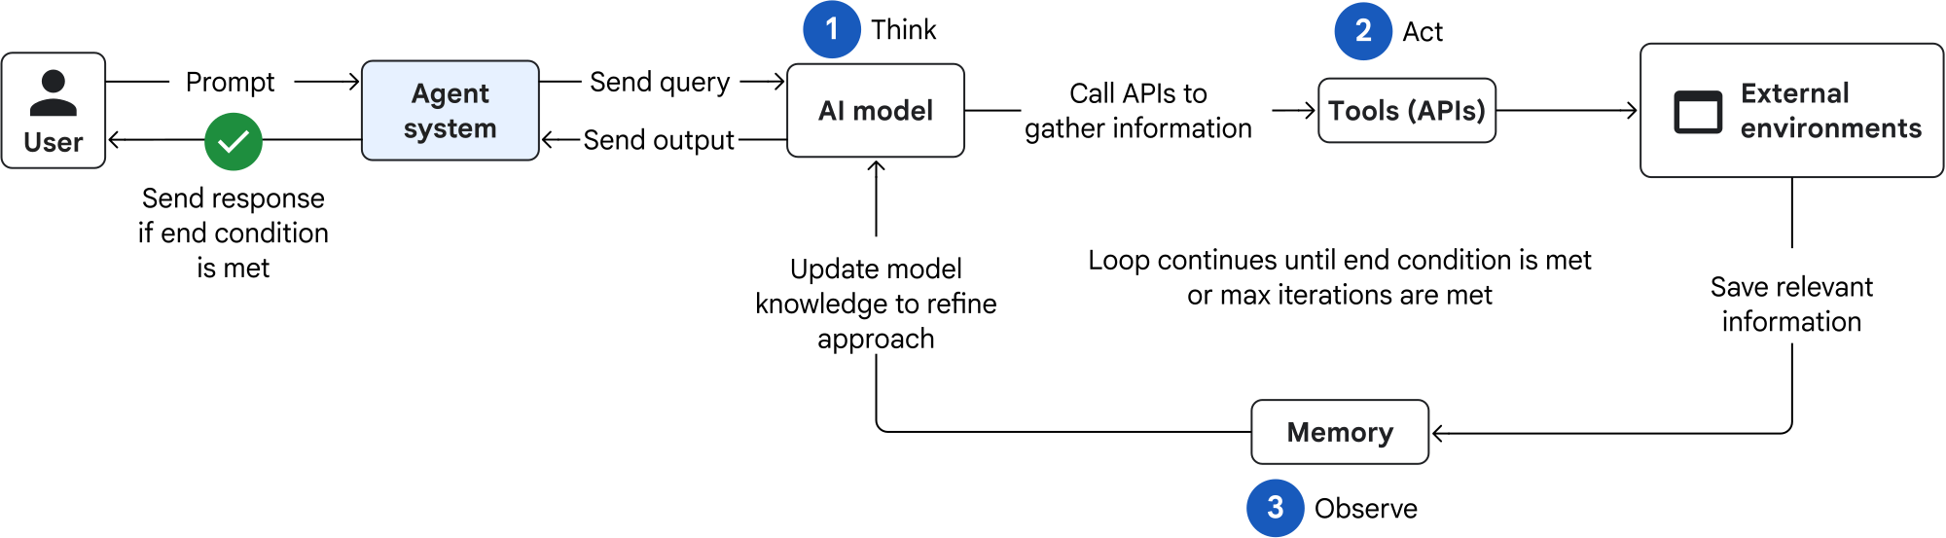
Reason and act
Thought, action and observation repeat until an answer, a cap or an error. Orchestrated by the model, inside one agent.
Use it when the task is dynamic and the next move depends on what the last one returned.
Think twice when one query would do: latency is higher and a misleading tool result reaches the answer.
Google Cloud Architecture Center, agentic design patterns, CC BY 4.0
Notes:
Row of the twelve-pattern catalogue. Sorting criterion for this block: does a model orchestrate, or does predefined logic? Here: the model, inside one agent.

Slide 94
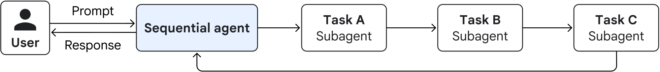
Sequential
Specialized agents run in a fixed linear order, each output feeding the next. Orchestrated by predefined logic.
Use it when the process is structured and repeatable, like extract, then clean, then load.
Think twice when a run needs to skip a step it does not need, or one slow step holds up the rest.
Google Cloud Architecture Center, agentic design patterns, CC BY 4.0
Notes:
Row of the twelve-pattern catalogue. Sorting criterion for this block: does a model orchestrate, or does predefined logic? Here: predefined logic.

Slide 95
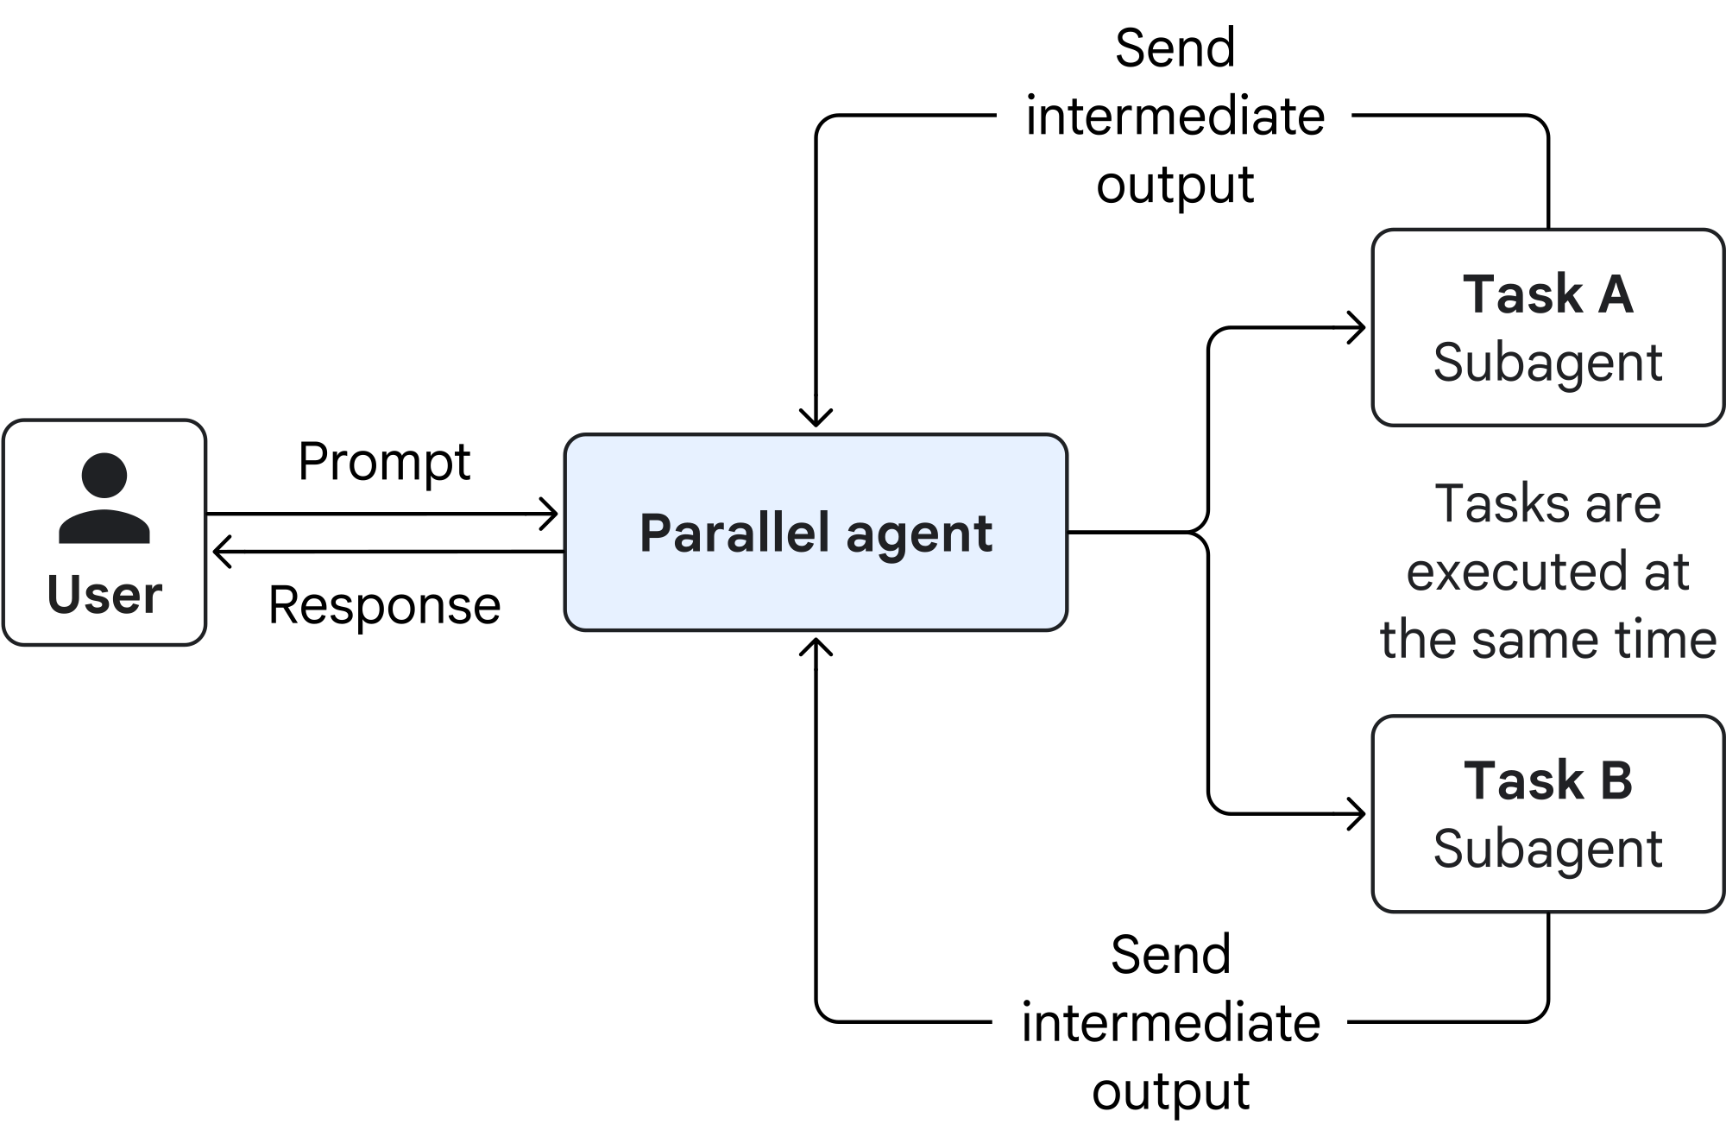
Parallel
Independent subagents run at the same time and a gather step synthesizes them. Orchestrated by predefined logic.
Use it when the work genuinely splits, like collecting from several sources at once.
Think twice when the results can conflict: cost and token use rise at once and the join gets hard.
Google Cloud Architecture Center, agentic design patterns, CC BY 4.0
Notes:
Row of the twelve-pattern catalogue. Sorting criterion for this block: does a model orchestrate, or does predefined logic? Here: predefined logic.

Slide 96
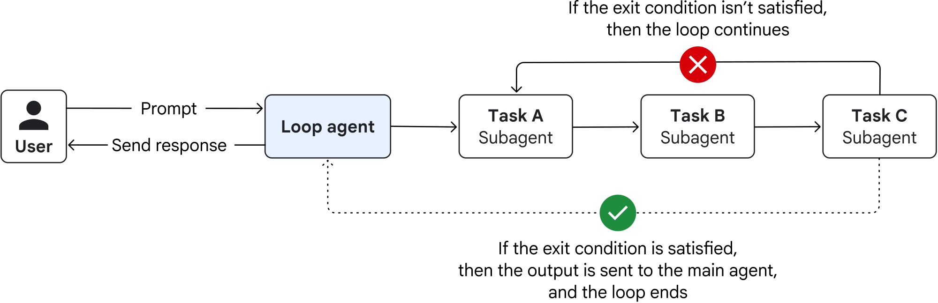
Loop
A sequence of subagents repeats until a termination condition is met. Orchestrated by predefined logic.
Use it when the work needs iterating or self-correction before it is good enough.
Think twice when the exit condition is not defined: the loop runs on and spends the budget doing it.
Google Cloud Architecture Center, agentic design patterns, CC BY 4.0
Notes:
Row of the twelve-pattern catalogue. Sorting criterion for this block: does a model orchestrate, or does predefined logic? Here: predefined logic.

Slide 97
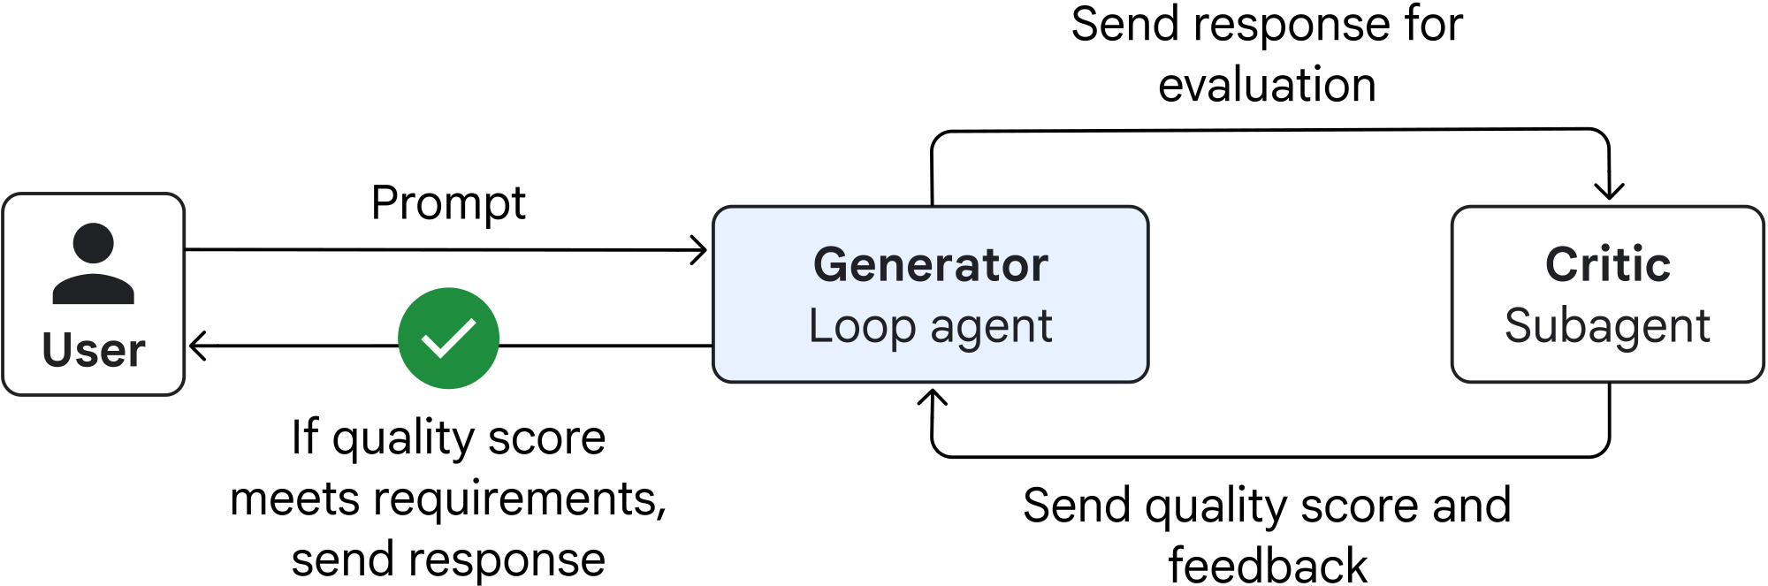
Review and critique
A generator produces, and a critic judges it against criteria and approves, rejects or returns feedback. Orchestrated by predefined logic, as a loop.
Use it when the output has to be accurate or meet strict rules, like code that needs an audit.
Think twice when speed matters: every evaluation is at least one more model call, and revisions stack.
Google Cloud Architecture Center, agentic design patterns, CC BY 4.0
Notes:
Row of the twelve-pattern catalogue. Sorting criterion for this block: does a model orchestrate, or does predefined logic? Here: predefined logic, as a loop.

Slide 98
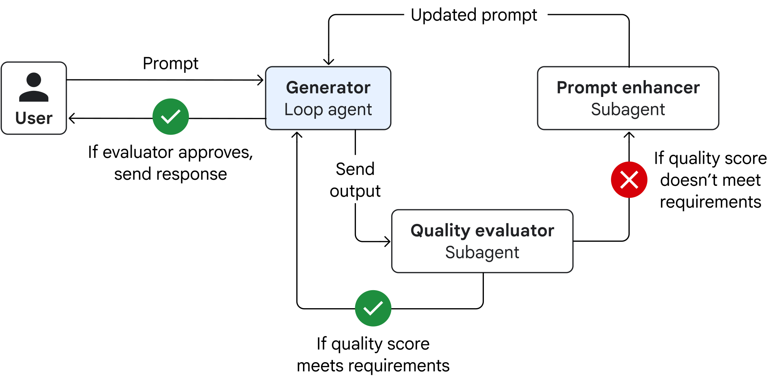
Iterative refinement
One or more agents improve a result held in state until a quality threshold or a cap. Orchestrated by predefined logic, as a loop.
Use it when the task is hard to get right in one pass, like drafting or debugging.
Think twice when the exit condition is vague: each cycle costs latency and money whether it helps or not.
Google Cloud Architecture Center, agentic design patterns, CC BY 4.0
Notes:
Row of the twelve-pattern catalogue. Sorting criterion for this block: does a model orchestrate, or does predefined logic? Here: predefined logic, as a loop.

Slide 99
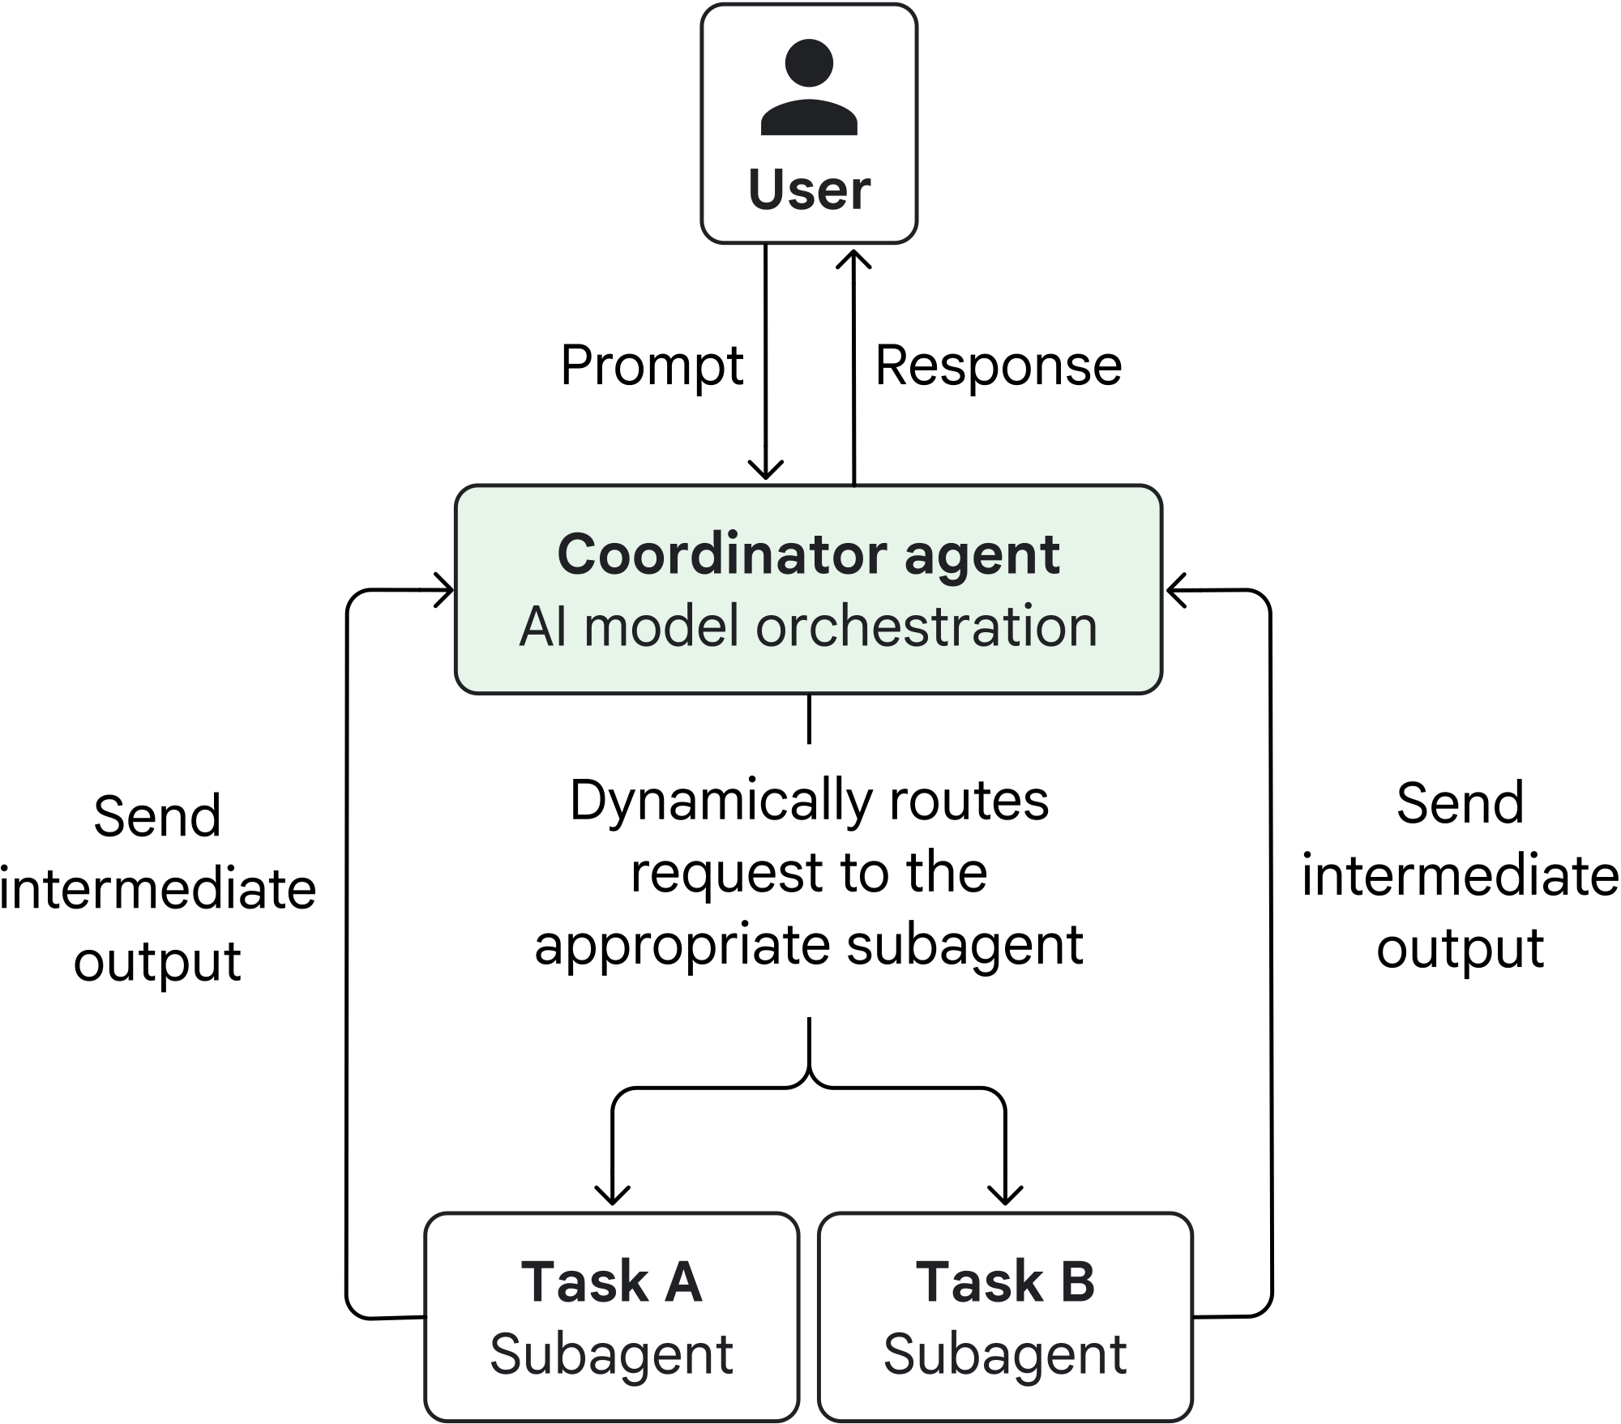
Coordinator
A central agent reads the request, splits it, and dispatches the parts to specialists. Orchestrated by the model.
Use it when a structured process needs routing that adapts to what the request turns out to be.
Think twice when a single agent would do: this costs more model calls, more tokens and more latency.
Google Cloud Architecture Center, agentic design patterns, CC BY 4.0
Notes:
Row of the twelve-pattern catalogue. Sorting criterion for this block: does a model orchestrate, or does predefined logic? Here: the model.

Slide 100
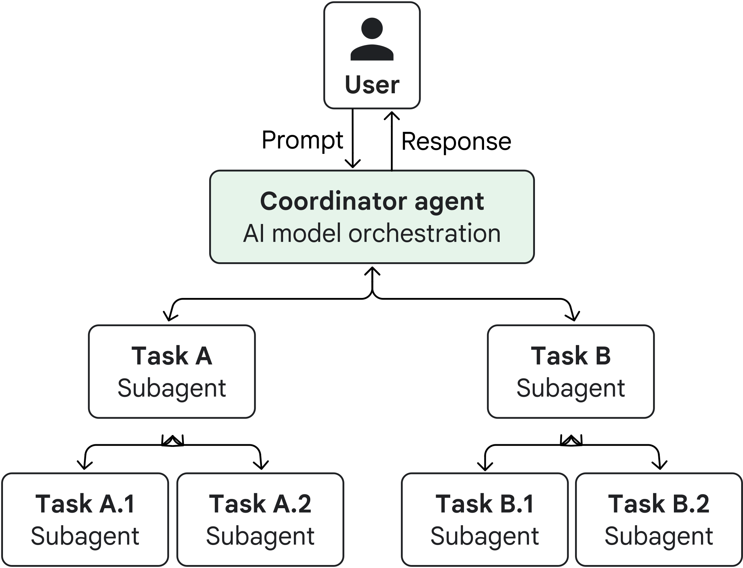
Hierarchical task decomposition
A root agent decomposes, and subagents decompose again until workers can execute. Orchestrated by the model, at several levels.
Use it when the problem is open-ended and needs research, planning and synthesis together.
Think twice when you have to debug it: the complexity is considerable and the model calls are many.
Google Cloud Architecture Center, agentic design patterns, CC BY 4.0
Notes:
Row of the twelve-pattern catalogue. Sorting criterion for this block: does a model orchestrate, or does predefined logic? Here: the model, at several levels.

Slide 101
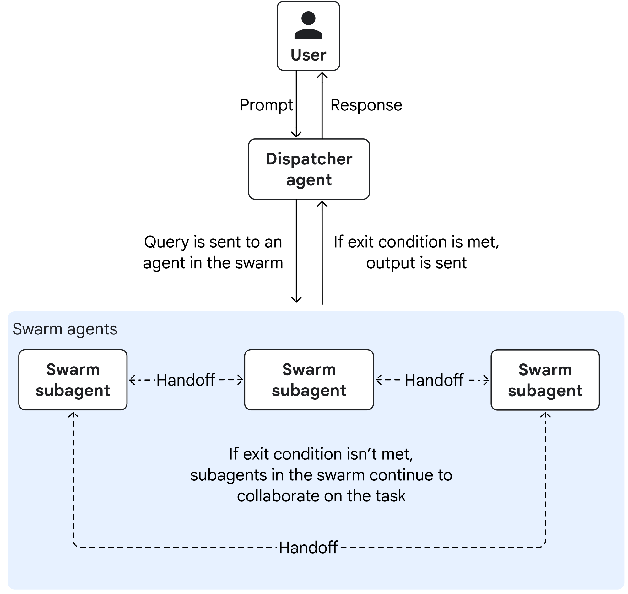
Swarm
Specialists talk to one another all-to-all and refine together, with an explicit exit condition. Orchestrated by no central orchestrator.
Use it when the problem is ambiguous and genuinely benefits from argument between perspectives.
Think twice when almost always: it is the costliest of the twelve and may never converge.
Google Cloud Architecture Center, agentic design patterns, CC BY 4.0
Notes:
Row of the twelve-pattern catalogue. Sorting criterion for this block: does a model orchestrate, or does predefined logic? Here: no central orchestrator.

Slide 102
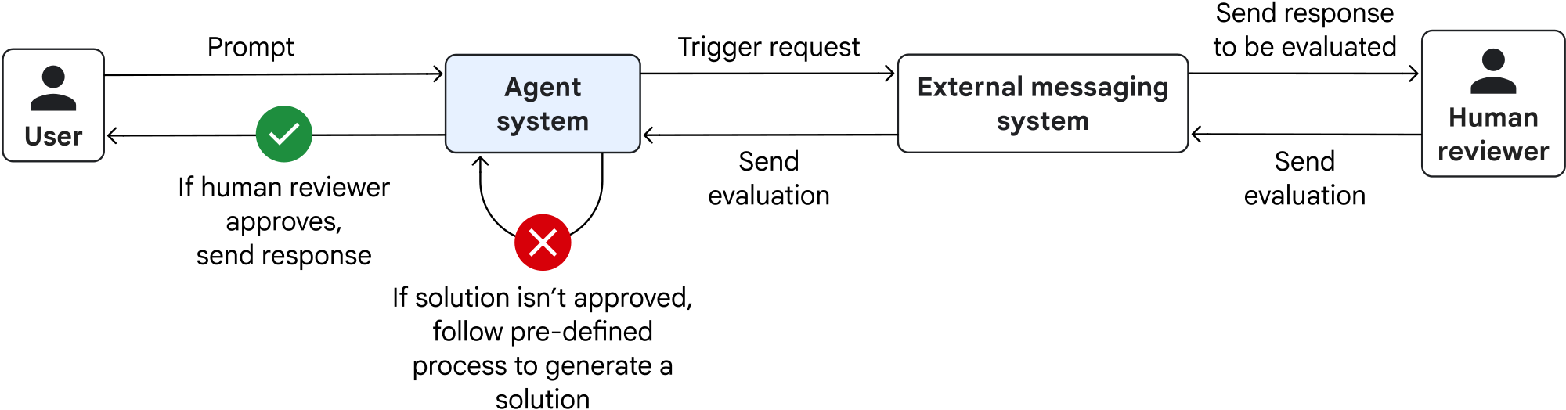
Human in the loop
The agent pauses at a checkpoint and waits for a person to approve, correct or supply input. Orchestrated by predefined checkpoints.
Use it when the decision is high-stakes or subjective, like a payment or a sensitive document.
Think twice when there is nobody to ask: it needs an interaction system built and then maintained.
Google Cloud Architecture Center, agentic design patterns, CC BY 4.0
Notes:
Row of the twelve-pattern catalogue. Sorting criterion for this block: does a model orchestrate, or does predefined logic? Here: predefined checkpoints.

Slide 103
Custom logic
Conditional orchestration written in code, mixing the other patterns as needed. Orchestrated by code the team writes.
Use it when the branching goes beyond a linear sequence, or fixed rules mix with model reasoning.
Think twice when a named pattern already fits: the team now owns and debugs the whole flow.
Notes:
Row of the twelve-pattern catalogue. Sorting criterion for this block: does a model orchestrate, or does predefined logic? Here: code the team writes.

Slide 104
Task ownership
Who owns the whole task, and who owns only a piece of it.
Coordinator
The coordinator owns the task and delegates pieces; a specialist owns only its piece.
Hierarchical
Ownership is nested: each level owns the decomposition it made.
Parallel
Each worker owns one independent piece; the gather step owns the whole.
Review and critique
The generator owns the candidate and the critic owns acceptance.
Notes:
One row of the axes table, across the four patterns the block discusses. The question behind every row is the same one the whole block has asked: does a model orchestrate, or does predefined logic?

Slide 105
State boundaries
What each component can see, and what has to cross from one to another.
Coordinator
The coordinator's context and each specialist's are separate; what crosses is what the coordinator passes.
Hierarchical
A state boundary per level, and partial results cross upward.
Parallel
One state record per worker; the join reads all of them.
Review and critique
Unchanged: one record, with the critic's reasons added to it.
Notes:
One row of the axes table, across the four patterns the block discusses. The question behind every row is the same one the whole block has asked: does a model orchestrate, or does predefined logic?

Slide 106
Model-call overhead
How many model calls the shape adds on top of the work itself.
Coordinator
One routing call per request, plus the specialists' calls.
Hierarchical
Multiplied by the depth of the hierarchy.
Parallel
The sum of the workers' calls, run concurrently.
Review and critique
One evaluator call per candidate, plus one per revision.
Notes:
One row of the axes table, across the four patterns the block discusses. The question behind every row is the same one the whole block has asked: does a model orchestrate, or does predefined logic?

Slide 107
Latency
How much wall-clock time the shape adds to a single request.
Coordinator
The routing call sits on the critical path.
Hierarchical
Each level adds a round trip.
Parallel
Reduced to the slowest worker plus the join.
Review and critique
Each revision adds a round trip.
Notes:
One row of the axes table, across the four patterns the block discusses. The question behind every row is the same one the whole block has asked: does a model orchestrate, or does predefined logic?

Slide 108
Failure propagation
Where a mistake goes after it is made, and who is in a position to notice.
Coordinator
A misrouted task fails inside the wrong specialist, and the coordinator may not notice.
Hierarchical
A wrong decomposition propagates downward and its cost multiplies.
Parallel
Contained per worker until the join, where a missing piece blocks the whole.
Review and critique
A critic that accepts a wrong candidate passes it on; one that rejects a right one costs a revision.
Notes:
One row of the axes table, across the four patterns the block discusses. The question behind every row is the same one the whole block has asked: does a model orchestrate, or does predefined logic?

Slide 109
Inspectability
What someone reading the trace afterwards can reconstruct about who decided what.
Coordinator
The routing decision and its reasons are in the trace, if we recorded them.
Hierarchical
Traces nest, so which level decided what has to stay recoverable.
Parallel
Traces interleave, so which worker wrote what has to stay recoverable.
Review and critique
Improved: acceptance now carries its reasons.
Notes:
One row of the axes table, across the four patterns the block discusses. The question behind every row is the same one the whole block has asked: does a model orchestrate, or does predefined logic?

Slide 110
Break
Notes:
Part A asked which decisions we fix at design time. Part B is the machinery that carries a decision from one step to the next: the record the runtime keeps, the code that reads it to choose the next node or to stop, and the boundary where a requested action becomes an executed one.

Slide 111
Lecture 2 Part 2
Notes:
Part A asked which decisions we fix at design time. Part B is the machinery that carries a decision from one step to the next: the record the runtime keeps, the code that reads it to choose the next node or to stop, and the boundary where a requested action becomes an executed one.

Slide 112
Execution machinery
States, Records, and Reducers
Routing, feedback loops, and termination
The tool boundary
Notes:
Part A asked which decisions we fix at design time. Part B is the machinery that carries a decision from one step to the next: the record the runtime keeps, the code that reads it to choose the next node or to stop, and the boundary where a requested action becomes an executed one.

Slide 113
States, Records, and Reducers
States, Records, and Reducers
Routing, feedback loops, and termination
The tool boundary
Notes:
Part A asked which decisions we fix at design time. Part B is the machinery that carries a decision from one step to the next: the record the runtime keeps, the code that reads it to choose the next node or to stop, and the boundary where a requested action becomes an executed one.

Slide 114
The record every node reads and writes
A graph shows where control may go a record is what travels that edge.
Declared as a schema. A named set of fields with their types.
Every node receives it as input and returns an update as output.
Routing and dispatch are both defined over it, so the rest of Part B reads this record.
State is a shared data structure that represents the current snapshot of your application.
LangGraph, Graph API
A node returns only the keys it touched.
Notes:
The picture we drew for each version says where control is allowed to go. It says nothing about what moves along the edges. What moves is one record, and every mechanism in the rest of Part B is defined over it. Our controller returns three keys out of the loop's ten.

Slide 115
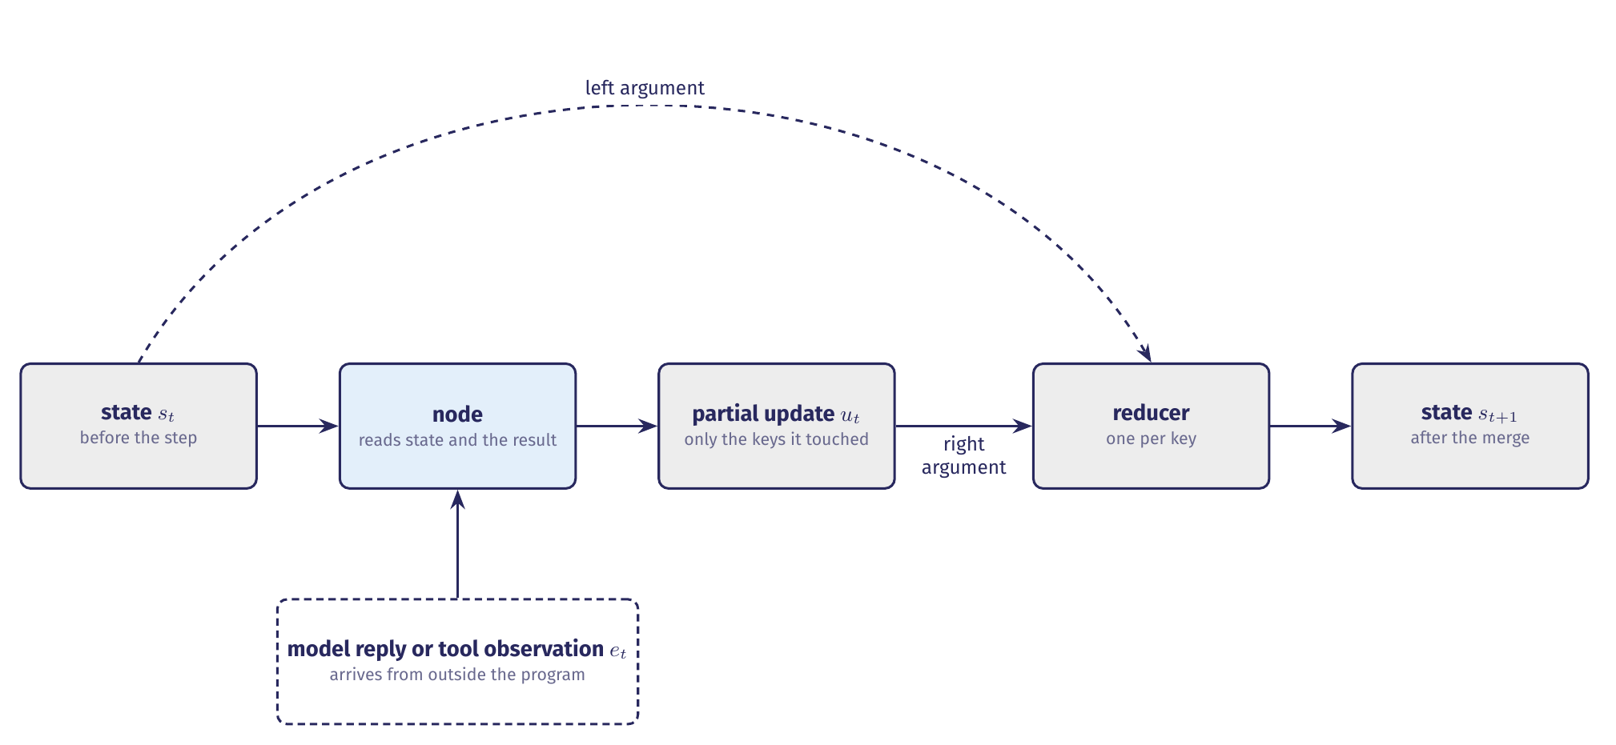
A simple transition--Propose, then Merge
The node proposes an update; the runtime merges it, one reducer per key.
Notes:
Two operations, not one. The node reads the current state together with a result that arrived from outside the program, and it returns a partial update. The runtime then merges that update key by key. Each reducer takes two arguments: the value already in state on the left, the value the node returned on the right. A node can be written without knowing which of the two its contribution will be.

Slide 116
Why two runs from one state diverge
A transition consumes a result that arrives from outside the program.
A model reply is sampled from a distribution.
A tool observation depends on a fixture the run itself may have modified.
Neither is determined by the current state alone.
The same state can produce different successors, so a run can go wrong here even when every node behaves correctly.
This is the nondeterminism of the task environment, arriving at one point.
Notes:
This is the term that makes the transition honest. Section 1 called the environment nondeterministic; here is where that shows up in the code. Same state, same node, different successor, and nothing has misbehaved.

Slide 117
Three records, and who reads each
Record | What it holds | Who reads it
Model context | Instructions, the selected history, and the observations for one call | The model
Runtime state | The record kept between steps, including fields that enter no model call | Nodes, routers, our limits
Durable state | State written where it survives the end of the process | A resumed run
Model context is assembled from runtime state at every call.
Notes:
These two are easy to confuse because most of their content overlaps. The model sees what it needs for the current call. The runtime also tracks counters and other fields used to control execution. Durability: kill the process mid-run and start again, and for the loop as it stands the agent knows nothing. Checkpointers are a later unit; what the record has to carry here is the run, not the restart.

Slide 118
The counters the model never sees
Two limits live in fields that enter no model call.
Forty model calls. The controller refuses a call once model_calls reaches forty.
Three identical observations. The run stops when the last three came back the same.
Neither number is shown to the model. The check is a comparison in the controller.
A limit the model can read is a limit the model can argue with.
We keep them out on purpose.
Notes:
The clearest case of a field that stays behind. We want the check to be a comparison in the controller rather than an instruction in a prompt. Ask the room what happens if you put the budget in the system prompt instead: which record would you inspect to tell the two designs apart?

Slide 119
How mini-swe-agent represents a state
Three representations of increasing expressive power, all in one agent.
Atomic. The run's outcome. Accepted or stopped is a label with no internal structure.
Factored. The record itself. Named fields with values, so two states can agree on some and differ on others.
Structured. The patch and the rejection. A patch is a set of hunks, each over a file and a range of lines.
The expressive representation is the exception, because reasoning over structure is harder for us and for the model both.
Russell and Norvig, §2.4.7
Keeping the record factored is what buys us reducers, routing and limits.
Notes:
Atomic, factored, structured is the AIMA axis. The number a benchmark reports is a count of atomic labels. Structure is confined to the two values where the model has to defend its work: the patch it proposes and the rejection it gets back.

Slide 120
The state schema, field by field
Field | Reducer | What it holds
alert, repo, commit, workspace | none | Set once: the alert, the fixture, the pinned commit, the workspace
messages | append | The conversation, in provider form
observations | append | One record per dispatched tool call, refused or not
candidate_patch | replace | The patch currently proposed
model_calls, usage | accumulate | Calls issued and tokens spent
status | replace | Running, or the terminal status that ended the run
Notes:
This is what state.py declares today, and what the loop populates. Ten keys. Walk the reducer column rather than the description: it is the column that decides what a later step can see.

Slide 121
The state schema, field by field
Field | Reducer | What it holds
alert, repo, commit, workspace | none | Set once: the alert, the fixture, the pinned commit, the workspace
messages | append | The conversation, in provider form
observations | append | One record per dispatched tool call, refused or not
candidate_patch | replace | The patch currently proposed
model_calls, usage | accumulate | Calls issued and tokens spent
status | replace | Running, or the terminal status that ended the run
plan | replace | The subgoals and their status
validation | replace | The latest acceptance decision
reflections | append | Guidance kept from rejected attempts
attempt | explicit | Which attempt is running
The four below the rule arrive with the planner, the validator and the reflection step.
Notes:
Below the rule are the fields the later versions add. Each arrives with the node that fills it, so a version's diff shows one change rather than a field that was always waiting. These four are designed and not yet built, which is what the colour marks throughout Part B.

Slide 122
A TypedDict checks nothing at run time
The annotation is for a type checker, and nothing else
class AgentState(TypedDict, total=False):
model_calls: Annotated[int, operator.add]
# a model reply puts "forty" here: type-checks, and is wrong at run time
Every guarantee about the contents of state rests on code we write.
PEP 589
The check that catches it is the argument validation at the tool boundary.
Notes:
A TypedDict returns an ordinary dictionary at run time. Its types cannot be used in isinstance tests. So a model reply that puts a string where the schema declares an integer produces a state that type-checks in the editor and is wrong in the run. Section 8 is where the check that catches it lives.

Slide 123
Three reducers, three kinds of visibility
A reducer decides what every later step is allowed to see.
Append. observations and messages keep the whole attempt, which is what the stall check compares.
Replace. candidate_patch, plan and status each name what is true now.
Accumulate. usage sums four token counters and produces no total, so no node ever holds the running total.
“Each key in the State has its own independent reducer function.”
LangGraph, Graph API
The four token counters stay apart because they are not interchangeable.
Notes:
Each of the three answers a question about visibility rather than about storage. The stall check needs append: it compares the last three observations, which is a question no replaced field could answer. And a single usage total cannot tell you whether cache reads rose while fresh input fell.

Slide 124
Clearing a field that appends
The reset that does not reset
# the reflection step, starting a new attempt
return {"observations": []}
# merged: every earlier observation is still exactly where it was
An append reducer given an empty update leaves every earlier observation exactly where it was.
Clearing an appended field takes an explicit assignment the runtime owns.
Notes:
This is the one to slow down on. The next attempt is supposed to begin free of the reasoning that failed, and returning an empty list does not do it. The runtime has to assign the field explicitly, and it records that assignment in the trace as a state change. Identity, reflections and the counters survive the reset by design: an attempt limit enforced on a counter that resets with the attempt is not a limit at all.

Slide 125
One tool result becoming state
Four events in, the dispatcher returns 1,665 characters of source
# before: observations [], messages 3, model_calls 1
return {"observations": [{"tool": "read_file", "ok": True,
"result": "<1665 chars of source>"}],
"messages": [ToolMessage(...)]}
# merged: observations +1, messages +1, every other key untouched
# the next model input is built from messages alone
The observation the runtime stored is richer than the message the model receives.
State answers what the run knows now; the trace answers what the run did.
Notes:
From runs/v1-bc284c6b.jsonl, steps 3 and 4. Three things to hold on to. The node named two keys and the record has ten, so the counters advanced only where a node said so. The stored observation keeps the arguments and the ok flag alongside the text, and routing and accounting read those fields rather than the prose. And model_calls stood at one throughout and was never shown, which is how a budget stays a runtime control. The trace is a fourth record, and it is what section 7 rests on.

Slide 126
Execution machinery
Notes:
Part A asked which decisions we fix at design time. Part B is the machinery that carries a decision from one step to the next: the record the runtime keeps, the code that reads it to choose the next node or to stop, and the boundary where a requested action becomes an executed one.

Slide 127
Where the next node is chosen
Three responsibilities, on three different components.
The model proposes. A tool call, a plan, a candidate, a judgement. Every one of those is a value.
The runtime records. It merges the proposal through the reducers and writes what happened to the trace.
The router decides. It reads named fields and returns a node name.
A conditional edge is a function that receives the current state and returns the name of the next node.
LangGraph, Graph API
It runs in the runtime's process, and its return value is the transition.
Notes:
Both things are true at once, and that is what makes the arrangement worth describing carefully. The model's output decides which way the comparison comes out. The comparison decides where the run goes. A router that reads the model's prose has handed the control decision back to the model.

Slide 128
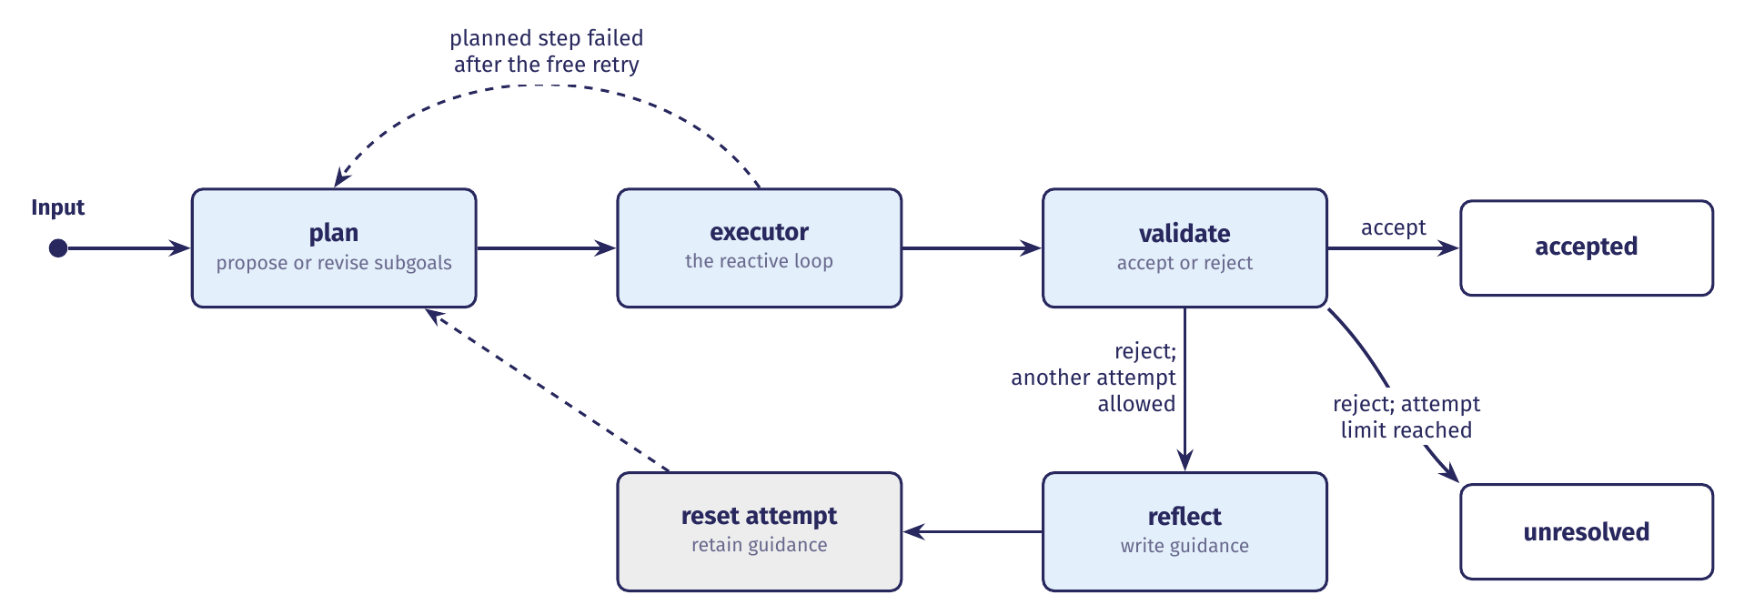
The complete graph, with both back edges
Every edge is a line of wiring code, and every label is a predicate over state.
Notes:
The upper back edge revises a plan inside an attempt. The lower path runs the reflection step and begins a new attempt. Compilation fixes this object; what differs between two runs on the same alert is the sequence of states, and therefore the sequence of edges the routers select.

Slide 129
What the router actually reads
after_controller, the loop's only branch
def after_controller(self, state) -> str:
if state["status"] != RUNNING:
return END
if state["messages"][-1].tool_calls:
return "tools"
return "submit"
A model that writes “I am confident, submit it” moves the run exactly as far as a model that writes nothing.
The branch is taken on the presence of a tool call.
Notes:
Two fields, and there is no third condition. It never reads the model's prose. after_submit is one line: END when the submission was accepted, the controller otherwise.

Slide 130
Reading who decided from the trace
A routing event names who supplied the value the predicate tested.
by="runtime" when a limit fired before any call was issued.
by="model" when the model's output selected the branch.
Neither means the model chose the edge. The edge was chosen when we wrote the predicate.
The routing event names the origin of the value, and the predicate stays ours.
This is the field to read when a run surprises us.
Notes:
When a run does something unexpected, this is the first thing to open. The decision field tells you which branch was taken; the by field tells you whether a limit fired or a model output selected it.

Slide 131
One compiled graph, different paths
compile() wires it once, and the object is the same on every run
graph.add_edge(START, "controller")
graph.add_conditional_edges("controller", self.after_controller, ...)
graph.add_edge("tools", "controller") # the loop's one back edge
graph.add_conditional_edges("submit", self.after_submit, ...)
Delete that one line and the same three nodes become a chain.
The recorded run enters the controller four times, and the graph never changes.
Notes:
Three nodes, two conditional edge sets, one unconditional edge. The conditional edges are what give one compiled graph its different shapes at run time. A dynamic path does not require a dynamic graph.

Slide 132
Two returns to the planner
Back edge | Trigger | Retained | Reset
In-run plan revision | A planned step still fails after the runtime's free retry | The attempt's observations and its accounting | The remaining subgoals, which the planner rewrites
New attempt after reflection | The validator rejects and the attempt limit permits another try | Reflections, identity, the counters, the usage ledger | Observations, plan, candidate patch, validation
Collapse them and the system rewrites its plan over every transient tool error.
Notes:
One asks what to do about a step that did not work. The other asks what to do about an attempt that did not work. Both edges arrive with the planner and the reflection step, which is what the colour on the labels marks.

Slide 133
Who owns each return
Ownership divides on the same line as the two edges.
The free retry is ours. The runtime reissues a failed tool call once, because a transient failure is not evidence about the plan.
The revision is the model's proposal. The runtime records it and merges it into plan.
The new attempt is ours. It is a comparison on the attempt counter.
A limit that the model can talk its way past is not a limit.
The retry before the upper edge costs no model call.
Notes:
That last point is what makes the retry the runtime's decision rather than the model's: nobody is consulted, and nothing is paid for.

Slide 134
Three limits the runtime checks
An acceptance condition says when a loop may stop. It does not establish that it will.
The model-call budget. Forty per run, checked before the call is issued rather than after.
The stall check. Three consecutive observations with identical results end the run.
The attempt limit. Two attempts, counted in a field that survives the reflection reset.
All three are comparisons the runtime performs on fields it owns.
The framework's recursion limit sits underneath, as a failsafe on wiring.
Notes:
A limit checked afterwards is a post-mortem: the call has already been paid for. The stall check compares results rather than requests, because that also catches six distinct searches that all return nothing, which is the repeated-action failure ReAct reports for its own trajectories. And an attempt counter that reset with the attempt would bound nothing.

Slide 135
The five terminal statuses
The vocabulary is closed on purpose.
Set by the loop. accepted, budget_exhausted, no_progress and error.
Arrives with the attempt limit. unresolved.
The trace writer refuses both mistakes. A status outside the set, and a trace closed with no terminal event.
A run that never said how it ended is a defect in our instrumentation rather than an outcome we can report.
Reaching END establishes only that the graph stopped.
Notes:
Errors and outcomes are not the same thing: a refused tool call is an observation inside a run that can still end accepted, and a process killed between two events leaves a run with no status at all. The reason lives in status, which we set.

Slide 136
What a trace lets you conclude
What the trace records | What it supports
A verdict, then a terminal event with status accepted | A completed assessment under the runtime's acceptance rules, whose quality is a separate question
A terminal event with a stop status and its reason | A declared end to execution, with whatever partial evidence the run had gathered
No terminal event | Completion has not been established by this record
The third is a statement about the evidence. Treating it as an error attributes a cause the record does not carry.
Notes:
Five statuses, three readings. The run in the third row may still be active, may have been interrupted, or may have written an incomplete trace, and the record does not say which.

Slide 137
Three endings, in the recorded runs
The difference between them is where the last event sits.
Accepted. Event seventeen is a terminal record with the usage totals, written after submit reported three passing checks.
Budget exhausted. The check fires before the call, so no fifth model call sits between the routing event and the terminal one.
No ending observed. Interrupt between a tool result and the next model call: every event is valid and no terminal record arrives.
What we may not say is which ending would have arrived.
An excerpt used in teaching is worth marking with how it was produced.
Notes:
The first ending is the recorded run, runs/v1-bc284c6b.jsonl. The routing event just before the terminal one carries by=runtime: nothing in that trace is a model's opinion about whether the work was done. In the second, the evidence the run gathered is still in observations, and the absence of a finding is not the absence of work.

Slide 138
What a tool contract contains
A tool has two faces, and only one of them is visible to the model.
The model reads a name, a description, and an argument schema.
The runtime holds the result type, the side-effect class, and the constraints on where the tool may operate.
Calling the first face the tool is the mistake this section exists to prevent.
A tool contract is the complete specification of one tool, and it has five parts.
Two of the five reach the model. Three are properties of the implementation.
Notes:
Name and purpose; the typed arguments and their constraints; the typed success result and the error representation; the side-effect class; the execution constraints. The model-facing definition covers the first two. A model that has read the description knows nothing about the other three.

Slide 139
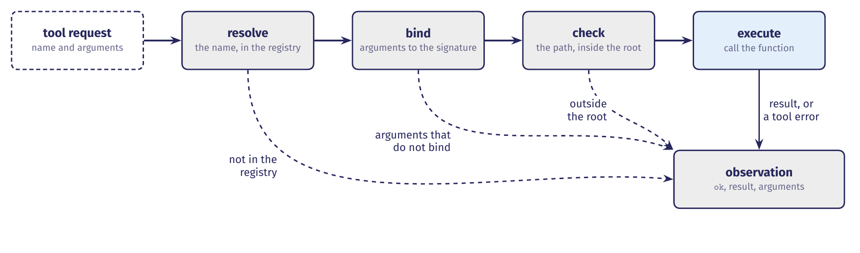
One request through the dispatcher
Every path produces an observation, which is what lets a run continue after a refusal.
Notes:
Five operations, and each of them can end the cycle. The two dashed branches are refusals, and they rejoin at the same object the successful path produces. What state and the trace do with that observation is the previous section's material.

Slide 140
Five operations, each able to stop
Between a model's request and a result, five things happen.
Resolve the name. A request naming a tool outside the registry is refused, and the refusal names the tools that do exist.
Bind the arguments. Binding checks names and arity, so a wrong argument name becomes a readable refusal.
Check the policy. Every path argument is resolved inside the workspace root before any file is opened.
Execute, then observe. Success and failure alike become an observation and a tool_result event.
The registry is built from the tool enumeration, so there is one list and no way to advertise a tool without registering it.
Notes:
Binding checks names and arity and not types, so unambiguous type mismatches are coerced rather than spending a model call to complain about a string where an integer was wanted.

Slide 141
Why a refusal is an observation
A refused request and a permitted call that fails have the same shape.
An exception ends the run. It stays for the genuinely unrecoverable, such as a trace that cannot be written.
An observation goes back to the model, which reads what went wrong and chooses again.
When edit refuses an ambiguous target, the model retries with more context.
A run that raised instead would die on its first imprecise edit.
Only one of the two ever reached the implementation.
Notes:
This difference is what keeps the reactive loop alive. Both events become observations the model can read, and the ok flag is what tells them apart.

Slide 142
Why config is not a parameter
The dispatcher binds the model's arguments against the signature
def read_file(ws: Path, path: str, start: int | None = None,
end: int | None = None) -> str:
inspect.signature(function).bind(self.ws, **args)
# add a config parameter and the model can set it
Every parameter in a tool's signature is a value the model is permitted to supply.
The workspace root is a parameter, and the dispatcher is what supplies it.
Notes:
Which is why tools read the run's configuration from the module rather than accepting it as a parameter. A config parameter would be bindable, and a bindable parameter is one the model can set. The model never sees the workspace root in the schema and cannot pass it.

Slide 143
Six artifacts, six different claims
Artifact | What it contains | What it establishes
Model input | The tool definitions and the conversation so far | Which operations were offered, and on what description
Model response | A tool call: an identifier, a name, arguments | That the model requested an operation. Nothing more
tool_request | The name and arguments as the dispatcher received them | That the request reached the dispatcher
Dispatcher | Registry lookup, argument binding, path resolution | That the request satisfied the contract, or why it did not
tool_result | ok=true, 1,665 characters | That the function ran and returned
State and next input | One observation appended, one tool message appended | What the next model call was allowed to see
Rows two and five are the pair worth separating.
Notes:
One read_file call on testcode/BenchmarkTest00283.py, through the artifacts it leaves, from runs/v1-bc284c6b.jsonl, steps 3 and 4. The provider's raw request stays in the message history; the trace records the dispatcher's view of it.

Slide 144
What proves a function ran
A model response establishes that a tool was requested.
A tool call in a response is evidence about the model, and not about the file system.
A transcript showing a request and a plausible result establishes nothing, because the model produced both.
The tool_result event is our record of entering the function.
The evidence that a function was entered is the runtime's own record of entering it.
Several tool calls in one response are dispatched one at a time, each answered.
Notes:
A tool call left without an answer makes the next model message malformed, which is why the dispatcher returns one observation for each, including the ones that failed.

Slide 145
The agent-computer interface
Four principles come out of that work, and each has a counterpart in our dispatcher.
Actions are simple and few.
Important operations are consolidated, so that one action makes real progress.
Feedback is informative and concise.
Guardrails catch the mistakes models make, so an error does not propagate through the turns that follow.
An agent-computer interface specifies the commands available to the model, and how environment state is communicated back to it.
Yang et al., §2
Notes:
SWE-agent is the clearest evidence that the action set and the shape of the feedback move outcomes, because it holds the model fixed and varies the interface. With GPT-4 Turbo the resulting system resolves 12.47% of the 2,294 SWE-bench test instances, against 3.8% for the previous best non-interactive retrieval-augmented system, and the same interface carries to another model, with Claude 3 Opus resolving 10.5%.

Slide 146
What each interface component is worth
Component | Variant | Resolved | Change
SWE-agent | as configured | 18.0
Editor | edit action without linting | 15.0 | −3.0
 | no edit action at all | 10.3 | −7.7
Search | iterative search | 12.0 | −6.0
 | no search tools | 15.7 | −2.3
File viewer | 30-line window | 14.3 | −3.7
 | whole file | 12.7 | −5.3
Context | full history | 15.0 | −3.0
 | no demonstration | 16.3 | −1.7
Percent of SWE-bench Lite resolved, with the base model held fixed.
Notes:
Table 3 of the SWE-agent paper. Read down the Change column rather than across: each row varies one component of one system.

Slide 147
What the ablation table does not say
Two readings of that table are worth separating.
It supports the claim that interface choices move outcomes by several points each, and the 7.7-point edit gap is larger than the gap between many published systems.
It does not support a general ranking of interfaces: one system, one base model, a 300-instance subset.
The row to dwell on is search, where returning results one at a time scores 12.0, below having no search tool at all at 15.7.
A well-intentioned interface can be worse than nothing when it invites the model to work through every match in turn.
Notes:
A variant that helps this agent with this model on these instances may not transfer. That is the discipline to carry into HW1: an ablation tells you about the system it was run on.

Slide 148
Each guarantee, and what enforces it
Guarantee | Where it is enforced
Only registered tools run | The registry, consulted before anything is called
Arguments satisfy the contract | Signature binding and coercion, before the call
No file outside the workspace is touched | workspace.resolve, on every path argument
Inspection does not modify the fixture | The tool implementations, and the pinned commit
An exhausted budget prevents another call | The controller's check, made before the call
A back edge obeys the attempt limit | The routing function and the attempt counter
No row is enforced by a sentence in a prompt.
Notes:
workspace.resolve is where an ordinary-looking shortcut fails. It resolves both the root and the candidate path fully before comparing them, so .. segments collapse and symlinks are followed. Comparing the two as strings would look equivalent and would not be, because /tmp/ws is a prefix of the unrelated directory /tmp/ws-evil.

Slide 149
A refused request, side by side
Two requests, the same dispatcher, and only the arguments differ.
The request. read_file on ../../etc/passwd, constructed rather than one the model made.
The check. workspace.resolve raises PathEscapeException, the dispatcher catches it, and no file is opened.
The evidence. A tool_request event, a failed tool_result, and no entry recorded in the implementation.
The model proposes, the runtime executes, and the runtime may refuse.
Name the component that made each decision, and the artifact that proves it.
Notes:
Waiting for a model to produce a forbidden request is a poor way to demonstrate a boundary, so we construct one. Set beside the permitted request, the pair shows the branch: identical tool, identical dispatcher, and the argument decides whether execution happens. That is the question HW1 puts to you, on the same fixture and the same tools.

