Slide 1

Scheduling, tools, and execution authority
Agents as state machines
State, records and reducers
Routing, feedback and stopping
Scheduling and tool execution
Notes:
This lecture describes agents as state machines, then examines state records, routing, scheduling and tool execution.

Slide 2
Supersteps: when an update becomes visible
Routing selects the next graph node. Scheduling determines when the node runs and which version of the state record it reads.
Planning selects the nodes to run from the inputs updated in the previous superstep.
Execution runs the selected nodes. Other nodes cannot read their returned state updates during this phase.
Update merges the nodes' returned values into the state record using its reducers.
A superstep is one round of planning, execution and update. Nodes read the updated state in the next round.
A tool can change a file during execution, before the runtime updates the state record.
Notes:
LangGraph organizes execution into Pregel supersteps. Multiple writes to one field in the same superstep require a reducer that combines them. Without one, the runtime rejects the competing writes.

Slide 3
Two supersteps in the recorded run
The controller's superstep contains events 3 and 4. The next superstep runs tools and contains events 5 and 6.
bc284c6b, events 3 to 6. Timestamp, run identifier and thinking omitted.
{"step": 3, "kind": "model_call", "role": "controller",
"tool_calls": ["read_file"], "usage": {"input": 1284, "output": 51}}
{"step": 4, "kind": "routing", "decision": "tools", "by": "model"}
# ours: the next superstep starts here
{"step": 5, "kind": "tool_request", "tool": "read_file",
"args": {"path": "testcode/BenchmarkTest00283.py"}}
{"step": 6, "kind": "tool_result", "tool": "read_file",
"ok": true, "chars": 1665}
The dispatcher logs both tool events while the tools node runs. After the node returns, the runtime stores the observation in state.
Notes:
Our graph has no parallel branches, so each superstep runs one node. The routing function reads the record after the controller's reply has been merged.

Slide 4
Tool preconditions and postconditions
A method specification states what the caller must provide and what the implementation must guarantee.
The precondition states what must be true before a call, such as its path resolving inside the workspace.
The postcondition states what the call guarantees if the precondition holds, including results, errors and side effects.
The contract also specifies which invalid requests the runtime detects and how it refuses them without side effects.
The caller must satisfy the precondition. The implementer must ensure the postcondition whenever the precondition holds.
The tool contract must also define what happens when a request violates a precondition.
Notes:
MIT 6.031’s specification structure assigns obligations to the caller and implementer. A method specification may make no promises after a precondition violation. Because models can supply invalid arguments, tool contracts must specify how the runtime detects violations, reports refusal and prevents side effects from refused requests.

Slide 5
Checking paths against the workspace root
The tool follows symlinks and resolves .. segments before checking whether the path lies inside the workspace.
workspace.py, resolve, lines 50 to 68. Docstring and comments omitted.
def resolve(root: Path, path: str) -> Path:
root = Path(root).resolve()
candidate = (root / path).resolve()
if not candidate.is_relative_to(root):
raise PathEscapeException(
f"{path!r} resolves outside the workspace root")
return candidate
Both /tmp/ws and /tmp/ws-evil start with /tmp/ws. A prefix comparison would wrongly accept the second directory.
Notes:
Joining an absolute path to the root yields the absolute path itself, which the check then refuses if its resolved destination lies outside the root.

Slide 6
Event-Driven Agents

Slide 7
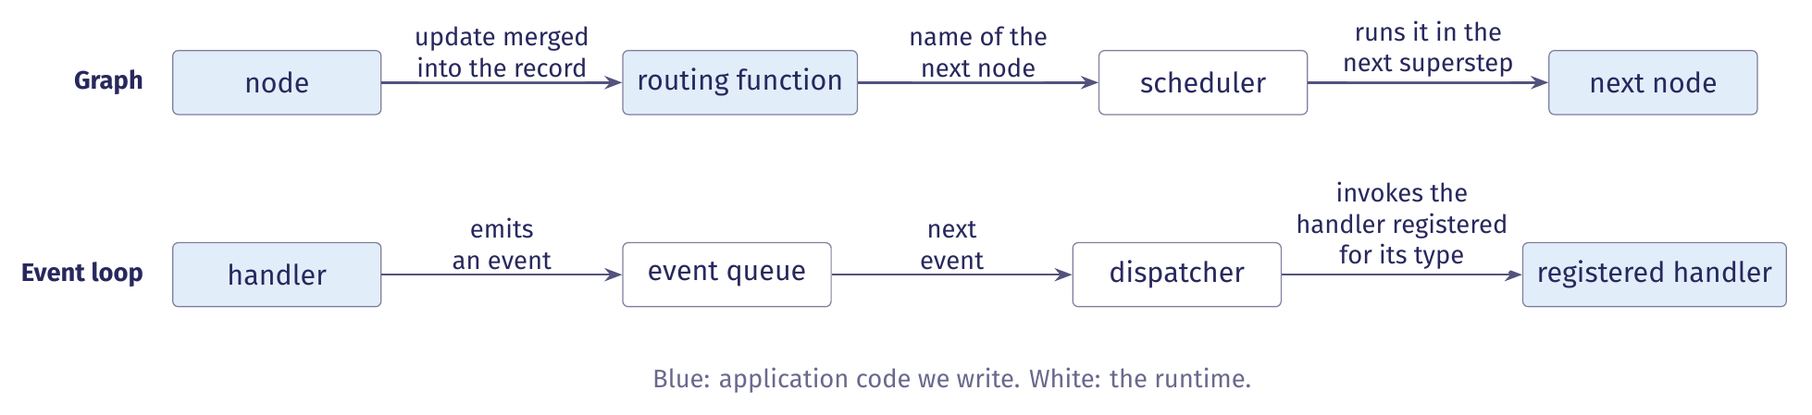
Two ways to invoke the next computation
A graph and an event loop can run the same machine with different mechanisms for invoking application code.
In the graph, a routing function selects the next node and the scheduler runs it next. In an event loop, a computation emits an event and the runtime invokes the registered handler.
Notes:
Section 5.1 of the notes. The machine, its record, the tool contract and the dispatcher are unchanged; only the mechanism that invokes the next computation differs. The scheduler runs the selected node in the next superstep.

Slide 8
Event, handler and event loop
Three definitions describe the arrangement. Definitions 5.1 to 5.3 in the lecture notes.
Term | Definition
Event | Any occurrence that could necessitate a change in the program's state.
Handler | A piece of code that understands how to respond to a particular event. For events to reach it, it must register with the event loop.
Event loop | A piece of code that repeatedly checks whether a new event has occurred and dispatches any detected events to code that can handle them.
For an agent, an event is either an occurrence, such as the plan is ready, or a request, such as run these tools. Both are values.
Notes:
The wording follows the Cornell CS 2110 lecture the notes cite. A tool request event records a request to a handler; it does not establish that the handler ran, exactly as a model's tool request in section 4 does not establish that the read occurred.

Slide 9
Inversion of control
We write the subroutines. A framework controls when they run.
Application code defines a handler's response: the fields it writes and the event it emits.
The framework decides which handler runs, when, and in what order pending events are processed.
The graph divides the same way: we write nodes and routing functions, and the scheduler runs them.
Application code defines the response to an event. The framework controls its invocation.
A graph chooses the next computation in a routing function. A handler chooses the event type it emits.
Notes:
Definition 5.4 and section 5.1 of the notes. The registrations map an event type to its handler, so the two realizations express the choice of the next computation in different places. If the loop does not check its registrations, an event can leave the queue with no handler: nothing runs, although no component decided to stop. We treat that as a defect rather than a terminal outcome.

Slide 10
Event-triggered and time-triggered reactions
The realization changes when a transition is taken. The set of transitions stays the same.
A state-machine diagram does not specify when a reaction occurs.
Event-triggered means a reaction when an input is present. Time-triggered means one on each clock tick.
Our graph uses no clock, so both realizations are event-triggered: they react when an input is present.
The planning agent's machine retains its locations, guards and set actions under either choice.
A transition such as no reply within thirty seconds needs a timer to emit its event. Otherwise it is never taken.
Notes:
Section 5.2 of the notes, after Seshia and Lee's slides 23 to 25. In the graph, each superstep begins when the preceding one finishes. A guard requiring every triggering input to be absent cannot fire when reactions require an input to be present.

Slide 11
The configuration under an event loop
The event realization requires a larger configuration than the graph realization.
Realization | Configuration | Maintained by
Graph | A control location and a valuation of the variables, (q, v). | The runtime tracks q. The record holds v.
Event loop | The sequence of pending events E, the set of running handlers H and the record v, as the triple (E, H, v). | The runtime maintains E and H. The record holds v and contains neither.
In a serial realization at most one event is in flight, so the location q is recoverable from the pending event's handler or the running handler. With two handlers running at once there is no single location: our demo's validators are such a case.
Notes:
Section 5.2 of the notes. During active execution, either one event is pending and no handler runs, or one handler runs and no event is pending. The machine in Figure 1 no longer describes configurations with two running handlers; the demo's validate step runs three at once (section 5.4).

Slide 12
Ordering rules: apply once, then enable
Four rules preserve the machine's behaviour when an event loop realizes it. Two concern ordering.
Apply once, then enable. Merge a handler's contribution before its emitted event is dispatched.
Emit first, and the successor reads a stale record. Deliver twice, and observations append twice.
Distinguish idle from success. An empty queue and an idle runtime mean only that nothing is scheduled.
Only a terminal event carrying a status establishes termination, as a terminal record does in the trace.
An event loop keeps this ordering only if handlers write before they emit and no event is delivered twice.
Notes:
Section 5.2 of the notes, rules 1 and 2 of four. The graph's superstep model provides this ordering. An empty queue does not establish how the run ended or whether termination was intentional.

Slide 13
Termination rules and log events
The last two rules concern termination.
Stop dispatch at termination. After the terminal event no handler starts, even if an event is pending.
A realization with concurrent handlers must discard or refuse the remaining events.
Separate triggering from log events. A triggering event runs a handler. A log event only records.
An event that requests tools triggers the tools handler. A trace record of the same request documents that the handler was invoked, and triggers nothing.
Dispatch can end without a terminal record if the process fails first. Table 5's three readings still apply.
Notes:
Section 5.2 of the notes, rules 3 and 4 of four. In a serial realization no event can be pending at termination. A log event records an occurrence in the trace and triggers no computation. The terminal event ends dispatch; the terminal record in the trace records its status.

Slide 14
LlamaIndex Workflows: steps and events
In LlamaIndex Workflows, dispatch is by event type. A step is a method decorated with @step.
A step receives an event, does some work, and returns another event.
The returned event triggers the next step whose type annotation accepts it.
Events are user-defined Pydantic classes. The framework supplies StartEvent and StopEvent.
The step signatures declare the event types each step consumes and produces.
StartEvent's fields are run()'s keyword arguments. Returning StopEvent ends the workflow with its result.
Notes:
Section 5.3 of the notes, from the LlamaIndex Workflows introduction.

Slide 15
LlamaIndex Workflows: validation and state
Before a run, the framework validates the event graph that the step signatures declare.
It checks that the graph contains a start and a stop event and that every produced event has a consumer.
These checks do not establish that a particular run will reach StopEvent.
A store on the workflow's Context holds per-run state. Steps read and write it through ctx.store.
edit_state() is for updates that must not interleave with another step's updates.
Our demo, cyberbird/event_driven, is written in this framework (section 5.4).
Notes:
Section 5.3 of the notes. The pre-run validation is what catches an event type with no handler, which section 5.1 treats as a defect rather than a terminal outcome.

Slide 16
Idle and success in LlamaIndex and in CrewAI
The two frameworks differ in how we distinguish idle from success.
Question | LlamaIndex Workflows | CrewAI Flows
Dispatch | By event type, declared in the step signatures. | By method completion and router labels: @listen(m) runs when m completes.
Terminal event | StopEvent, whose result carries the outcome. Pre-run validation checks for a start and a stop event. | None. The final output is determined by the last method that completes.
The outcome σ | Carried by the StopEvent's result. | Each event type becomes a router label, and σ must be written to state by our code.
LlamaIndex has an explicit terminal event. In CrewAI a flow ends when no method remains to run, which corresponds to an empty queue.
Notes:
Section 5.3 of the notes. LlamaIndex's validation does not establish that a particular run will reach StopEvent. In CrewAI the outcome must be in the record before the last method completes. CrewAI's @start(), @listen(), @router() and the or_ and and_ operators are HW1 reference material.

Slide 17
Comparing the realizations: the design
Neither framework establishes that an event realization preserves the machine's behaviour.
We compare the realizations after each computation completes and its contribution is applied.
These boundaries are the points of comparison. Handler internals and wall-clock order are not.
We script the model's replies and control the tool results: both get the same inputs in the same order.
The design isolates the scheduling mechanism: a graph superstep or an event dispatch.
A faithful translation preserves observations, workspace effects, check results and terminal status.
Notes:
Section 5.3 of the notes. Comparing an event realization with the graph realization requires a controlled design. The four properties: the observations appended to the record, the effects on the workspace, the results of the acceptance checks, and the terminal status and its meaning.

Slide 18
What agreement under scripted inputs shows
Agreement under scripted inputs supports a limited conclusion.
The two realizations implement the same transition rules for the scripted replies.
It does not establish equivalent behaviour with a live model.
How a handler formats messages changes the model's inputs, even when the transition rules are unchanged.
The comparison also excludes concurrency.
The result holds for the scripted replies. It is a statement about transition rules.
Notes:
Section 5.3 of the notes. Model replies depend on the messages each realization constructs, so changing how a handler formats messages changes the input distribution even when the transition rules stay the same.

Slide 19
The demo as a LlamaIndex workflow
Our event-driven agent runs the planning agent's machine as a LlamaIndex workflow.
It keeps the machine's locations and guards, a budget of forty calls per alert, and one replan.
The run's data sit in a store on the workflow's context: a RunState, and one AlertState per alert.
Two steps are stubs: submit runs no checks, and each validator accepts after a delay. No run is recorded.
One AlertState per alert holds its plan, messages, observations, calls and usage.
Section 5.4 of the notes. The stall check uses three identical results, and the alert may replan once.
Notes:
cyberbird/event_driven. The budget is checked before each call. The RunState holds the run's bookkeeping: the filters, the queue, the current alert and the results. Nothing in an AlertState is shared with any other alert.

Slide 20
The demo's steps and their events
Table 8 in the notes: one row per step.
Step | Accepts | Emits
start | RunRequested | ScanRequested
scan | ScanRequested | AlertFound per alert, StopEvent
gate | AlertFound, AlertDone | AlertStarted, StopEvent
plan | AlertStarted, Stalled | PlanCreated, AlertDone
controller | PlanCreated, Observed, ChecksFailed | ToolsRequested, Submitted, AlertDone
tools | ToolsRequested | Observed, Stalled, AlertDone
submit | Submitted | ChecksFailed, ValidateRequested ×V
validate | ValidateRequested | Verdict
judge | Verdict ×V | AlertDone
No step names another: the signatures are the wiring. plan, controller and validate ask a model. The other six are runtime steps.
Notes:
Table 8 of the notes, from the wiring table in workflow.py, without its Decided-by column: plan, controller and validate are decided by a model, the rest by the runtime. Each step's signature names the events it accepts, and its return annotation names the events it emits. The rows below the rule are the machine of Figure 1; the rows above it are new. gate releases one alert at a time. V is the number of validators, three by default. The guards now sit inside the steps and choose which event to return.

Slide 21
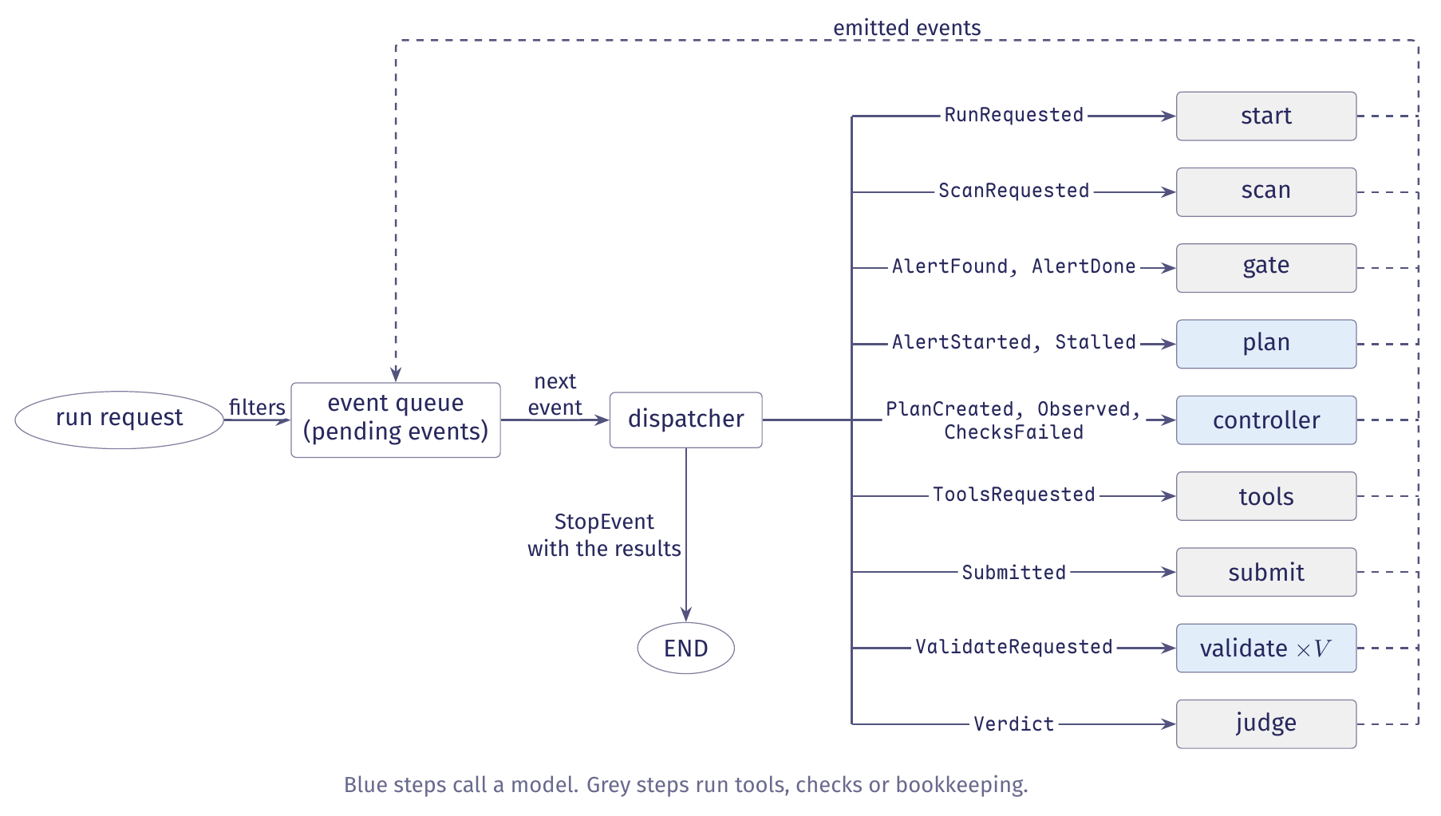
The event-driven agent as an event loop
Figure 8 in the notes. Emitted events return to the queue.
Notes:
White boxes are runtime components. Blue steps call a model (the validators will, once they are no longer stubs), and grey steps run tools, checks or bookkeeping. The ellipses are the run request that starts the run and END. Each solid arrow from the dispatcher names the event types its step accepts. Every event a step emits returns to the queue along the dashed path. V validators run at the same time.

Slide 22
Admission, acting and revising in the steps
The guards now sit inside the steps and choose which event to return.
Admission: plan and controller reserve one model call first. A spent budget returns AlertDone.
Acting: the controller returns ToolsRequested for a reply with tool calls, and Submitted for one without.
Revising: tools returns Observed while work moves, Stalled on a first stall, AlertDone on a second.
On Stalled, plan writes a new plan and moves replanned_at, the handoff and window of section 2.4.
AlertDone carries budget_exhausted from plan or controller, and no_progress from tools.
Notes:
Section 5.4 of the notes. When the alert has spent its budget, the step returns AlertDone with status budget_exhausted and makes no call. A second stall returns AlertDone with status no_progress.

Slide 23
One run handles many alerts
One run handles many alerts, the first of three things the graph agent does not do.
scan runs Bandit once and emits one AlertFound per alert.
gate queues each alert it receives and releases one at a time.
Every event about an alert carries its alert_id, which correlates it with the alert's store entry.
The gate starts the next alert only after the current alert's AlertDone arrives.
The run's bookkeeping sits in the RunState, and each alert's data in its own AlertState.
Notes:
Section 5.4 of the notes. The alert_id is the correlation key: one workflow run handles many alerts, and every event after AlertFound carries it.

Slide 24
Validation fans out and back in
submit sends one ValidateRequested per lens, because a step can return only one event.
validate runs three workers, so the correctness, behaviour and scope validators run at once.
This is the configuration of section 5.2 with several running handlers and no single location.
judge holds each Verdict until all V arrive, and accepts only when every validator accepted.
The gate serializes alerts. It does not serialize validators.
judge does not key verdicts by alert. That is safe only because the gate admits one alert at a time.
Notes:
Section 5.4 of the notes. submit uses ctx.send_event for the fan-out. judge uses ctx.collect_events, which holds each verdict and returns None until all V have arrived, in any order.

Slide 25
Two kinds of ending
An alert ends with an AlertDone carrying one of four statuses. The run ends with a StopEvent.
The statuses are accepted, rejected, no_progress and budget_exhausted.
AlertDone returns to the gate, which records the status and starts the next alert.
When the gate has a result for every alert the scan found, it returns a StopEvent carrying the results.
Only the gate's StopEvent ends the run.
A scan that finds no alert ends the run at once with an empty result.
Notes:
Section 5.4 of the notes. accepted and rejected come from judge, no_progress from tools, budget_exhausted from plan or controller.

Slide 26
Events as classes, in code
Every event is a class. The StartEvent subclass carries the run's input, and every event about one alert carries its alert_id.
event_driven/events.py, RunRequested and AlertEvent. Docstrings omitted
from workflows.events import Event, StartEvent
class RunRequested(StartEvent):
rule: str | None = None
alert_id: str | None = None
limit: int | None = None
class AlertEvent(Event):
alert_id: str
StartEvent's fields are run()'s keyword arguments. alert_id is the correlation key across alerts.
Notes:
Section 5.3 of the notes: events are user-defined Pydantic classes, and the framework supplies StartEvent and StopEvent. The other twelve event classes subclass AlertEvent.

Slide 27
A step's signature declares its events
The signature names the event the step accepts and the event it returns. The store on the Context holds per-run state.
event_driven/workflow.py, start. Docstring omitted
@step
async def start(self, ctx: Context[RunState],
ev: RunRequested) -> ScanRequested:
async with ctx.store.edit_state() as s:
s.filters = {"rule": ev.rule, "alert_id": ev.alert_id,
"limit": ev.limit}
# The runtime decides to scan; no model is asked.
return ScanRequested(root=str(self.config.fixture))
The returned event triggers the next step whose annotation accepts it. edit_state() guards an update that must not interleave with another step's.
Notes:
The two long lines are broken at a comma to fit the window; nothing is paraphrased. The comment is the file's own.

Slide 28
Admission: reserving a call under the lock
plan and controller call _admit before every model call.
event_driven/workflow.py, _admit. Docstring omitted
async def _admit(self, ctx: Context[RunState],
alert_id: str) -> bool:
async with ctx.store.edit_state() as s:
a = s.alerts[alert_id]
if a.model_calls >= self.config.budget:
return False
a.model_calls += 1
return True
The check and the reservation happen under one lock, so two steps admitted at the same moment cannot both take the last call.
Notes:
Section 5.4 of the notes, rule 1 in the code. When _admit returns False, plan and controller return AlertDone with status budget_exhausted and make no call. The signature is broken at a comma to fit the window.

Slide 29
Fan-out: send_event and the annotation
A step can return only one event, so submit sends one ValidateRequested per lens.
event_driven/workflow.py, submit. Docstring omitted; one call over three lines
@step
async def submit(self, ctx: Context[RunState], ev: Submitted
) -> ChecksFailed | ValidateRequested | None:
for lens in list(Lens)[:self.validators]:
ctx.send_event(ValidateRequested(alert_id=ev.alert_id,
lens=lens, patch="",
checks={"passed": True}))
return None
submit still lists ValidateRequested in its return annotation, because the pre-run check requires every emitted event to have a consumer.
Notes:
Section 5.4 of the notes, rule 2 in the code. submit is a stub: the checks are not yet real, so patch and checks are placeholders. The step returns None; the events it sent carry the run forward.

Slide 30
The StopEvent: how the run ends
The gate step returns the StopEvent.
event_driven/workflow.py, gate. Queueing and bookkeeping omitted
@step(num_workers=1)
async def gate(self, ctx: Context[RunState],
ev: AlertFound | AlertDone
) -> AlertStarted | StopEvent | None:
async with ctx.store.edit_state() as s:
# ours: enqueue the alert or record its result, omitted
if len(s.results) == s.expected:
return StopEvent(result=dict(s.results))
if s.current is not None or not s.queue:
return None
Returning None means busy or waiting. Only the gate's StopEvent ends the run.
Notes:
Section 5.4 of the notes, rules 2 and 3 in the code: the gate emits StopEvent only when the count of results equals the count of alerts, so no alert is still in progress when the run ends. gate also returns AlertStarted when it releases the next alert; that branch is cut.

Slide 31
The four rules in the code
The code keeps the four rules of section 5.2 in these forms.
Rule | How the code keeps it
Apply once, then enable | Every write goes through ctx.store.edit_state(), which locks the store, and each step writes its data before it emits the event that lets another step read them.
Distinguish idle from success | Only the gate's StopEvent ends the run. Before the first run, the framework checks that every event a step emits has a step that accepts it.
Stop dispatch at termination | The gate emits StopEvent only when the count of results equals the count of alerts, so no alert is still in progress when the run ends.
Separate triggering from log events | This agent writes no trace. Its events trigger steps, and no event records one.
Our graph agents write a trace alongside their events. The event-driven agent does not yet have one.
Notes:
Section 5.4 of the notes. The budget check reserves its call under the same lock, so two steps admitted at the same moment cannot both take the last call. submit lists ValidateRequested in its return annotation although it sends those events rather than returning them.

