Slide 1
Who must ask the user before a tool runs?
A tool is about to run. Which party must obtain the user's consent first?
a
The model
b
The host
c
The client
d
The server
Notes:
The answer is (b). Specification index: hosts must obtain explicit user consent before invoking any tool. The server never sees the user, and the client only carries requests for the host.

Slide 2
Who must ask the user before a tool runs?
A tool is about to run. Which party must obtain the user's consent first?
a
The model
b
The host
c
The client
d
The server
The host must obtain explicit user consent before invoking any tool.
Notes:
The answer is (b). Specification index: hosts must obtain explicit user consent before invoking any tool. The server never sees the user, and the client only carries requests for the host.

Slide 3
Tools, contracts, and execution boundaries
Tool usage in Agents: An Overview
The tool dispatcher
Native tool calls
The Model Context Protocol
Failure and recovery
Notes:
This roadmap names the segments of the lecture. The overview of tool usage in agents comes first, then the tool dispatcher, native tool calls, the Model Context Protocol, and failure and recovery.

Slide 4

Failure and recovery
Tool usage in Agents: An Overview
The tool dispatcher
Native tool calls
The Model Context Protocol
Failure and recovery
Notes:
This segment opens with what can go wrong once a tool runs behind a protocol: three design problems, then six failures, one for each property of a local call. The restoration of each property follows.

Slide 5
Tool calls across a boundary can go wrong.
This section examines what can go wrong once a tool runs behind a protocol, first in design and then at run time.
Design problems that arise
Server design shapes what the model can call.
Most tool descriptions have defects.
Strict decoding fixes structure, not values.
Notes:
Opener of the what-could-go-wrong section. The first three slides concern design: what a server exposes, how its descriptions steer the model, and what strict schemas guarantee. The six slides that follow take the six properties of a local call from the native tool calls segment one at a time and show how each fails when the tool runs in another process; the last slide of the section summarizes them in one table. The failure and recovery segment then restores each property.

Slide 6
Tool calls across a boundary can go wrong.
This section examines what can go wrong once a tool runs behind a protocol, first in design and then at run time.
Design problems that arise
Failures at run time that follow...
Server design shapes what the model can call.
Most tool descriptions have defects.
Strict decoding fixes structure, not values.
A lost request and a lost reply look the same.
A new request defeats duplicate suppression.
A callee in another process can fail alone.
A late reply and a lost reply look alike.
A remote caller cannot repair partial effects.
Parallel requests can take effect out of order.
Notes:
Opener of the what-could-go-wrong section. The first three slides concern design: what a server exposes, how its descriptions steer the model, and what strict schemas guarantee. The six slides that follow take the six properties of a local call from the native tool calls segment one at a time and show how each fails when the tool runs in another process; the last slide of the section summarizes them in one table. The failure and recovery segment then restores each property.

Slide 7
Tool calls across a boundary can go wrong.
This section examines what can go wrong once a tool runs behind a protocol, first in design and then at run time.
Design problems that arise
Failures at run time that follow...
Server design shapes what the model can call.
Most tool descriptions have defects.
Strict decoding fixes structure, not values.
A lost request and a lost reply look the same.
A new request defeats duplicate suppression.
A callee in another process can fail alone.
A late reply and a lost reply look alike.
A remote caller cannot repair partial effects.
Parallel requests can take effect out of order.
Each failure removes one guarantee of a local call, and the failure and recovery segment restores it.
Notes:
Opener of the what-could-go-wrong section. The first three slides concern design: what a server exposes, how its descriptions steer the model, and what strict schemas guarantee. The six slides that follow take the six properties of a local call from the native tool calls segment one at a time and show how each fails when the tool runs in another process; the last slide of the section summarizes them in one table. The failure and recovery segment then restores each property.

Slide 8
Server design shapes what the model can call.
Servers expose a median of 19% of the underlying API's operations (116 official servers; Mastouri et al.^{[1]}, preprint).
Less is more when it comes to tools: GitHub Copilot^{[2]} from about 40 to 13 tools, and Block's Linear server^{[3]} from more than 30 to 2.
Rodrigues and Vas^{[4]} (preprint) name four anti-patterns, and each blurs one part of the contract.
[1] M. Mastouri et al. From REST to MCP: An empirical study of API wrapping and automated server generation for LLM agents. arXiv:2507.16044, 2025. [2] A. Agarwal and C. Peet. How we're making GitHub Copilot smarter with fewer tools. GitHub Blog, Nov 2025. [3] S. Mohammed and K. Chau. Block's playbook for designing MCP servers. Block Engineering, Jun 2025. [4] C. Rodrigues and O. Vas. MCP server architecture patterns for LLM-integrated applications. arXiv:2606.30317, 2026.
Notes:
Mastouri, Ksontini, Barrak and Kessentini, From REST to MCP: An Empirical Study of API Wrapping and Automated Server Generation for LLM Agents, arXiv 2507.16044 (2025, revised 2026): MCP servers expose a median of 19% of available operations, over 116 official servers and 80 OpenAPI contracts. Agarwal and Peet, How we're making GitHub Copilot smarter with fewer tools, GitHub Blog, 19 November 2025: a core toolset of 13 essential tools, cut from about 40 built-in tools. Mohammed and Chau, Block's Playbook for Designing MCP Servers, Block Engineering, 16 June 2025: the Linear server went from 30+ tools to execute_readonly_query and execute_mutation_query. These two are practitioner reports, not measurements. Rodrigues and Vas, MCP Server Architecture Patterns for LLM-Integrated Applications, arXiv 2606.30317 (June 2026): five patterns (resource gateway, tool orchestrator, stateful session server, proxy aggregator, domain-specific adapter) and the four anti-patterns in the table. For a later lecture on security: the NSA Cybersecurity Information Sheet Model Context Protocol (MCP): Security Design Considerations for AI-Driven Automation (May 2026).

Slide 9
Server design shapes what the model can call.
Servers expose a median of 19% of the underlying API's operations (116 official servers; Mastouri et al.^{[1]}, preprint).
Less is more when it comes to tools: GitHub Copilot^{[2]} from about 40 to 13 tools, and Block's Linear server^{[3]} from more than 30 to 2.
Rodrigues and Vas^{[4]} (preprint) name four anti-patterns, and each blurs one part of the contract.
[1] M. Mastouri et al. From REST to MCP: An empirical study of API wrapping and automated server generation for LLM agents. arXiv:2507.16044, 2025. [2] A. Agarwal and C. Peet. How we're making GitHub Copilot smarter with fewer tools. GitHub Blog, Nov 2025. [3] S. Mohammed and K. Chau. Block's playbook for designing MCP servers. Block Engineering, Jun 2025. [4] C. Rodrigues and O. Vas. MCP server architecture patterns for LLM-integrated applications. arXiv:2606.30317, 2026.
Notes:
Mastouri, Ksontini, Barrak and Kessentini, From REST to MCP: An Empirical Study of API Wrapping and Automated Server Generation for LLM Agents, arXiv 2507.16044 (2025, revised 2026): MCP servers expose a median of 19% of available operations, over 116 official servers and 80 OpenAPI contracts. Agarwal and Peet, How we're making GitHub Copilot smarter with fewer tools, GitHub Blog, 19 November 2025: a core toolset of 13 essential tools, cut from about 40 built-in tools. Mohammed and Chau, Block's Playbook for Designing MCP Servers, Block Engineering, 16 June 2025: the Linear server went from 30+ tools to execute_readonly_query and execute_mutation_query. These two are practitioner reports, not measurements. Rodrigues and Vas, MCP Server Architecture Patterns for LLM-Integrated Applications, arXiv 2606.30317 (June 2026): five patterns (resource gateway, tool orchestrator, stateful session server, proxy aggregator, domain-specific adapter) and the four anti-patterns in the table. For a later lecture on security: the NSA Cybersecurity Information Sheet Model Context Protocol (MCP): Security Design Considerations for AI-Driven Automation (May 2026).

Slide 10
Server design shapes what the model can call.
Servers expose a median of 19% of the underlying API's operations (116 official servers; Mastouri et al.^{[1]}, preprint).
Less is more when it comes to tools: GitHub Copilot^{[2]} from about 40 to 13 tools, and Block's Linear server^{[3]} from more than 30 to 2.
Rodrigues and Vas^{[4]} (preprint) name four anti-patterns, and each blurs one part of the contract.
[1] M. Mastouri et al. From REST to MCP: An empirical study of API wrapping and automated server generation for LLM agents. arXiv:2507.16044, 2025. [2] A. Agarwal and C. Peet. How we're making GitHub Copilot smarter with fewer tools. GitHub Blog, Nov 2025. [3] S. Mohammed and K. Chau. Block's playbook for designing MCP servers. Block Engineering, Jun 2025. [4] C. Rodrigues and O. Vas. MCP server architecture patterns for LLM-integrated applications. arXiv:2606.30317, 2026.
Notes:
Mastouri, Ksontini, Barrak and Kessentini, From REST to MCP: An Empirical Study of API Wrapping and Automated Server Generation for LLM Agents, arXiv 2507.16044 (2025, revised 2026): MCP servers expose a median of 19% of available operations, over 116 official servers and 80 OpenAPI contracts. Agarwal and Peet, How we're making GitHub Copilot smarter with fewer tools, GitHub Blog, 19 November 2025: a core toolset of 13 essential tools, cut from about 40 built-in tools. Mohammed and Chau, Block's Playbook for Designing MCP Servers, Block Engineering, 16 June 2025: the Linear server went from 30+ tools to execute_readonly_query and execute_mutation_query. These two are practitioner reports, not measurements. Rodrigues and Vas, MCP Server Architecture Patterns for LLM-Integrated Applications, arXiv 2606.30317 (June 2026): five patterns (resource gateway, tool orchestrator, stateful session server, proxy aggregator, domain-specific adapter) and the four anti-patterns in the table. For a later lecture on security: the NSA Cybersecurity Information Sheet Model Context Protocol (MCP): Security Design Considerations for AI-Driven Automation (May 2026).

Slide 11
Server design shapes what the model can call.
Servers expose a median of 19% of the underlying API's operations (116 official servers; Mastouri et al.^{[1]}, preprint).
Less is more when it comes to tools: GitHub Copilot^{[2]} from about 40 to 13 tools, and Block's Linear server^{[3]} from more than 30 to 2.
Rodrigues and Vas^{[4]} (preprint) name four anti-patterns, and each blurs one part of the contract.
Anti-pattern | Contract part it blurs
The God Tool: do_anything(action: string, params: object) | accepted arguments
[1] M. Mastouri et al. From REST to MCP: An empirical study of API wrapping and automated server generation for LLM agents. arXiv:2507.16044, 2025. [2] A. Agarwal and C. Peet. How we're making GitHub Copilot smarter with fewer tools. GitHub Blog, Nov 2025. [3] S. Mohammed and K. Chau. Block's playbook for designing MCP servers. Block Engineering, Jun 2025. [4] C. Rodrigues and O. Vas. MCP server architecture patterns for LLM-integrated applications. arXiv:2606.30317, 2026.
Notes:
Mastouri, Ksontini, Barrak and Kessentini, From REST to MCP: An Empirical Study of API Wrapping and Automated Server Generation for LLM Agents, arXiv 2507.16044 (2025, revised 2026): MCP servers expose a median of 19% of available operations, over 116 official servers and 80 OpenAPI contracts. Agarwal and Peet, How we're making GitHub Copilot smarter with fewer tools, GitHub Blog, 19 November 2025: a core toolset of 13 essential tools, cut from about 40 built-in tools. Mohammed and Chau, Block's Playbook for Designing MCP Servers, Block Engineering, 16 June 2025: the Linear server went from 30+ tools to execute_readonly_query and execute_mutation_query. These two are practitioner reports, not measurements. Rodrigues and Vas, MCP Server Architecture Patterns for LLM-Integrated Applications, arXiv 2606.30317 (June 2026): five patterns (resource gateway, tool orchestrator, stateful session server, proxy aggregator, domain-specific adapter) and the four anti-patterns in the table. For a later lecture on security: the NSA Cybersecurity Information Sheet Model Context Protocol (MCP): Security Design Considerations for AI-Driven Automation (May 2026).

Slide 12
Server design shapes what the model can call.
Servers expose a median of 19% of the underlying API's operations (116 official servers; Mastouri et al.^{[1]}, preprint).
Less is more when it comes to tools: GitHub Copilot^{[2]} from about 40 to 13 tools, and Block's Linear server^{[3]} from more than 30 to 2.
Rodrigues and Vas^{[4]} (preprint) name four anti-patterns, and each blurs one part of the contract.
Anti-pattern | Contract part it blurs
The God Tool: do_anything(action: string, params: object) | accepted arguments
Unsanitized resource content | results
[1] M. Mastouri et al. From REST to MCP: An empirical study of API wrapping and automated server generation for LLM agents. arXiv:2507.16044, 2025. [2] A. Agarwal and C. Peet. How we're making GitHub Copilot smarter with fewer tools. GitHub Blog, Nov 2025. [3] S. Mohammed and K. Chau. Block's playbook for designing MCP servers. Block Engineering, Jun 2025. [4] C. Rodrigues and O. Vas. MCP server architecture patterns for LLM-integrated applications. arXiv:2606.30317, 2026.
Notes:
Mastouri, Ksontini, Barrak and Kessentini, From REST to MCP: An Empirical Study of API Wrapping and Automated Server Generation for LLM Agents, arXiv 2507.16044 (2025, revised 2026): MCP servers expose a median of 19% of available operations, over 116 official servers and 80 OpenAPI contracts. Agarwal and Peet, How we're making GitHub Copilot smarter with fewer tools, GitHub Blog, 19 November 2025: a core toolset of 13 essential tools, cut from about 40 built-in tools. Mohammed and Chau, Block's Playbook for Designing MCP Servers, Block Engineering, 16 June 2025: the Linear server went from 30+ tools to execute_readonly_query and execute_mutation_query. These two are practitioner reports, not measurements. Rodrigues and Vas, MCP Server Architecture Patterns for LLM-Integrated Applications, arXiv 2606.30317 (June 2026): five patterns (resource gateway, tool orchestrator, stateful session server, proxy aggregator, domain-specific adapter) and the four anti-patterns in the table. For a later lecture on security: the NSA Cybersecurity Information Sheet Model Context Protocol (MCP): Security Design Considerations for AI-Driven Automation (May 2026).

Slide 13
Server design shapes what the model can call.
Servers expose a median of 19% of the underlying API's operations (116 official servers; Mastouri et al.^{[1]}, preprint).
Less is more when it comes to tools: GitHub Copilot^{[2]} from about 40 to 13 tools, and Block's Linear server^{[3]} from more than 30 to 2.
Rodrigues and Vas^{[4]} (preprint) name four anti-patterns, and each blurs one part of the contract.
Anti-pattern | Contract part it blurs
The God Tool: do_anything(action: string, params: object) | accepted arguments
Unsanitized resource content | results
Synchronous long-running operations | execution constraints
[1] M. Mastouri et al. From REST to MCP: An empirical study of API wrapping and automated server generation for LLM agents. arXiv:2507.16044, 2025. [2] A. Agarwal and C. Peet. How we're making GitHub Copilot smarter with fewer tools. GitHub Blog, Nov 2025. [3] S. Mohammed and K. Chau. Block's playbook for designing MCP servers. Block Engineering, Jun 2025. [4] C. Rodrigues and O. Vas. MCP server architecture patterns for LLM-integrated applications. arXiv:2606.30317, 2026.
Notes:
Mastouri, Ksontini, Barrak and Kessentini, From REST to MCP: An Empirical Study of API Wrapping and Automated Server Generation for LLM Agents, arXiv 2507.16044 (2025, revised 2026): MCP servers expose a median of 19% of available operations, over 116 official servers and 80 OpenAPI contracts. Agarwal and Peet, How we're making GitHub Copilot smarter with fewer tools, GitHub Blog, 19 November 2025: a core toolset of 13 essential tools, cut from about 40 built-in tools. Mohammed and Chau, Block's Playbook for Designing MCP Servers, Block Engineering, 16 June 2025: the Linear server went from 30+ tools to execute_readonly_query and execute_mutation_query. These two are practitioner reports, not measurements. Rodrigues and Vas, MCP Server Architecture Patterns for LLM-Integrated Applications, arXiv 2606.30317 (June 2026): five patterns (resource gateway, tool orchestrator, stateful session server, proxy aggregator, domain-specific adapter) and the four anti-patterns in the table. For a later lecture on security: the NSA Cybersecurity Information Sheet Model Context Protocol (MCP): Security Design Considerations for AI-Driven Automation (May 2026).

Slide 14
Server design shapes what the model can call.
Servers expose a median of 19% of the underlying API's operations (116 official servers; Mastouri et al.^{[1]}, preprint).
Less is more when it comes to tools: GitHub Copilot^{[2]} from about 40 to 13 tools, and Block's Linear server^{[3]} from more than 30 to 2.
Rodrigues and Vas^{[4]} (preprint) name four anti-patterns, and each blurs one part of the contract.
Anti-pattern | Contract part it blurs
The God Tool: do_anything(action: string, params: object) | accepted arguments
Unsanitized resource content | results
Synchronous long-running operations | execution constraints
Missing or vague tool descriptions | what the tool does
[1] M. Mastouri et al. From REST to MCP: An empirical study of API wrapping and automated server generation for LLM agents. arXiv:2507.16044, 2025. [2] A. Agarwal and C. Peet. How we're making GitHub Copilot smarter with fewer tools. GitHub Blog, Nov 2025. [3] S. Mohammed and K. Chau. Block's playbook for designing MCP servers. Block Engineering, Jun 2025. [4] C. Rodrigues and O. Vas. MCP server architecture patterns for LLM-integrated applications. arXiv:2606.30317, 2026.
Notes:
Mastouri, Ksontini, Barrak and Kessentini, From REST to MCP: An Empirical Study of API Wrapping and Automated Server Generation for LLM Agents, arXiv 2507.16044 (2025, revised 2026): MCP servers expose a median of 19% of available operations, over 116 official servers and 80 OpenAPI contracts. Agarwal and Peet, How we're making GitHub Copilot smarter with fewer tools, GitHub Blog, 19 November 2025: a core toolset of 13 essential tools, cut from about 40 built-in tools. Mohammed and Chau, Block's Playbook for Designing MCP Servers, Block Engineering, 16 June 2025: the Linear server went from 30+ tools to execute_readonly_query and execute_mutation_query. These two are practitioner reports, not measurements. Rodrigues and Vas, MCP Server Architecture Patterns for LLM-Integrated Applications, arXiv 2606.30317 (June 2026): five patterns (resource gateway, tool orchestrator, stateful session server, proxy aggregator, domain-specific adapter) and the four anti-patterns in the table. For a later lecture on security: the NSA Cybersecurity Information Sheet Model Context Protocol (MCP): Security Design Considerations for AI-Driven Automation (May 2026).

Slide 15
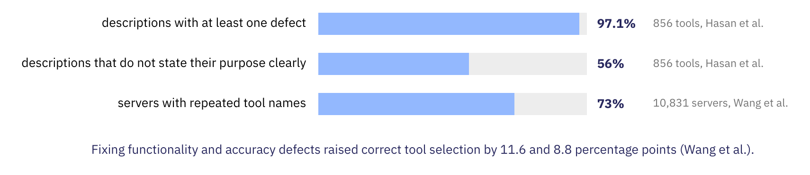
Most tool descriptions have defects.^{[2][3]}
The description field has no enforcer, yet its defects change which tool the model selects.
Descriptions inside a schema can even override the prompt (Lin, preprint, 2026^{[1]}).
[1] S.-Y. Lin. Your prompt is not the only prompt. arXiv:2608.08254, 2026. [2] M. M. Hasan et al. Model Context Protocol (MCP) tool descriptions are smelly! arXiv:2602.14878, 2026. [3] P. Wang et al. From docs to descriptions: Smell-aware evaluation of MCP server descriptions. arXiv:2602.18914, 2026.
Notes:
Hasan, Li, Rajbahadur, Adams and Hassan, Model Context Protocol (MCP) Tool Descriptions Are Smelly!, arXiv 2602.14878 (February 2026): 103 servers with 856 tools; 97.1% of descriptions contain at least one smell, and 56% fail to state their purpose clearly. Wang, Li, Sun, Liu, Liu and Tian, From Docs to Descriptions: Smell-Aware Evaluation of MCP Server Descriptions, arXiv 2602.18914 (February 2026): 10,831 servers and 18 smell categories; 73% repeated tool names; fixing functionality and accuracy smells raised selection probability by 11.6 and 8.8 percentage points. Lin, Your Prompt Is Not the Only Prompt, arXiv 2608.08254 (August 2026): across ten GPT and Claude configurations, schema descriptions that conflict with the prompt can override it, with accuracy drops of 5 to 45 points. All three are preprints.

Slide 16
Strict decoding fixes structure, not values.
JSONSchemaBench (2025)^{[1]} runs about 10,000 real schemas against six engines, including OpenAI and Gemini, and their coverage of schema features differs.
Constrained decoding raised schema validity to 100% in models of 0.6 to 4 billion parameters, but a gap in content accuracy remained and only narrowed with size (Chavan, preprint, 2026^{[2]}).
Whether format restrictions hurt reasoning is contested: Tam et al. (EMNLP 2024)^{[3]} report a decline, and a rebuttal by .txt^{[4]} attributes it to different prompts.
[1] S. Geng et al. Generating structured outputs from language models: Benchmark and studies. arXiv:2501.10868, 2025. [2] A. Chavan. Constrained decoding eliminates structural failures in small LLMs but reveals a scale-dependent semantic gap. arXiv:2609.23742, 2026. [3] Z. R. Tam et al. Let me speak freely? A study on the impact of format restrictions on LLMs. EMNLP 2024 Industry Track. [4] W. Kurt. Say what you mean: A response to 'Let me speak freely'. blog.dottxt.ai.
Notes:
Geng et al., Generating Structured Outputs from Language Models: Benchmark and Studies, arXiv 2501.10868 (2025): 10K real-world JSON schemas plus the official JSON Schema Test Suite, six frameworks (Guidance, Outlines, llama.cpp, XGrammar, OpenAI, Gemini). Chavan, Constrained Decoding Eliminates Structural Failures in Small LLMs but Reveals a Scale-Dependent Semantic Gap, arXiv 2609.23742 (September 2026): schema validity rose from 78.6-92.9% to 100%, and the semantic gap narrows but does not close. Lu et al., Learning to Generate Structured Output with Schema Reinforcement Learning, ACL 2025, trains models to follow schemas instead of constraining decoding. Tam et al., Let Me Speak Freely?, EMNLP 2024 Industry Track, report a decline in reasoning under format restrictions; Will Kurt, Say What You Mean (dottxt blog), argues the prompts differed and reports 77% structured against 73% unstructured with matched prompts. The question is open.

Slide 17
Strict decoding fixes structure, not values.
JSONSchemaBench (2025)^{[1]} runs about 10,000 real schemas against six engines, including OpenAI and Gemini, and their coverage of schema features differs.
Constrained decoding raised schema validity to 100% in models of 0.6 to 4 billion parameters, but a gap in content accuracy remained and only narrowed with size (Chavan, preprint, 2026^{[2]}).
Whether format restrictions hurt reasoning is contested: Tam et al. (EMNLP 2024)^{[3]} report a decline, and a rebuttal by .txt^{[4]} attributes it to different prompts.
[1] S. Geng et al. Generating structured outputs from language models: Benchmark and studies. arXiv:2501.10868, 2025. [2] A. Chavan. Constrained decoding eliminates structural failures in small LLMs but reveals a scale-dependent semantic gap. arXiv:2609.23742, 2026. [3] Z. R. Tam et al. Let me speak freely? A study on the impact of format restrictions on LLMs. EMNLP 2024 Industry Track. [4] W. Kurt. Say what you mean: A response to 'Let me speak freely'. blog.dottxt.ai.
Notes:
Geng et al., Generating Structured Outputs from Language Models: Benchmark and Studies, arXiv 2501.10868 (2025): 10K real-world JSON schemas plus the official JSON Schema Test Suite, six frameworks (Guidance, Outlines, llama.cpp, XGrammar, OpenAI, Gemini). Chavan, Constrained Decoding Eliminates Structural Failures in Small LLMs but Reveals a Scale-Dependent Semantic Gap, arXiv 2609.23742 (September 2026): schema validity rose from 78.6-92.9% to 100%, and the semantic gap narrows but does not close. Lu et al., Learning to Generate Structured Output with Schema Reinforcement Learning, ACL 2025, trains models to follow schemas instead of constraining decoding. Tam et al., Let Me Speak Freely?, EMNLP 2024 Industry Track, report a decline in reasoning under format restrictions; Will Kurt, Say What You Mean (dottxt blog), argues the prompts differed and reports 77% structured against 73% unstructured with matched prompts. The question is open.

Slide 18
Strict decoding fixes structure, not values.
JSONSchemaBench (2025)^{[1]} runs about 10,000 real schemas against six engines, including OpenAI and Gemini, and their coverage of schema features differs.
Constrained decoding raised schema validity to 100% in models of 0.6 to 4 billion parameters, but a gap in content accuracy remained and only narrowed with size (Chavan, preprint, 2026^{[2]}).
Whether format restrictions hurt reasoning is contested: Tam et al. (EMNLP 2024)^{[3]} report a decline, and a rebuttal by .txt^{[4]} attributes it to different prompts.
[1] S. Geng et al. Generating structured outputs from language models: Benchmark and studies. arXiv:2501.10868, 2025. [2] A. Chavan. Constrained decoding eliminates structural failures in small LLMs but reveals a scale-dependent semantic gap. arXiv:2609.23742, 2026. [3] Z. R. Tam et al. Let me speak freely? A study on the impact of format restrictions on LLMs. EMNLP 2024 Industry Track. [4] W. Kurt. Say what you mean: A response to 'Let me speak freely'. blog.dottxt.ai.
Notes:
Geng et al., Generating Structured Outputs from Language Models: Benchmark and Studies, arXiv 2501.10868 (2025): 10K real-world JSON schemas plus the official JSON Schema Test Suite, six frameworks (Guidance, Outlines, llama.cpp, XGrammar, OpenAI, Gemini). Chavan, Constrained Decoding Eliminates Structural Failures in Small LLMs but Reveals a Scale-Dependent Semantic Gap, arXiv 2609.23742 (September 2026): schema validity rose from 78.6-92.9% to 100%, and the semantic gap narrows but does not close. Lu et al., Learning to Generate Structured Output with Schema Reinforcement Learning, ACL 2025, trains models to follow schemas instead of constraining decoding. Tam et al., Let Me Speak Freely?, EMNLP 2024 Industry Track, report a decline in reasoning under format restrictions; Will Kurt, Say What You Mean (dottxt blog), argues the prompts differed and reports 77% structured against 73% unstructured with matched prompts. The question is open.

Slide 19
Strict decoding fixes structure, not values.
JSONSchemaBench (2025)^{[1]} runs about 10,000 real schemas against six engines, including OpenAI and Gemini, and their coverage of schema features differs.
Constrained decoding raised schema validity to 100% in models of 0.6 to 4 billion parameters, but a gap in content accuracy remained and only narrowed with size (Chavan, preprint, 2026^{[2]}).
Whether format restrictions hurt reasoning is contested: Tam et al. (EMNLP 2024)^{[3]} report a decline, and a rebuttal by .txt^{[4]} attributes it to different prompts.
A schema guarantee covers the shape of the arguments, not whether they are right.
[1] S. Geng et al. Generating structured outputs from language models: Benchmark and studies. arXiv:2501.10868, 2025. [2] A. Chavan. Constrained decoding eliminates structural failures in small LLMs but reveals a scale-dependent semantic gap. arXiv:2609.23742, 2026. [3] Z. R. Tam et al. Let me speak freely? A study on the impact of format restrictions on LLMs. EMNLP 2024 Industry Track. [4] W. Kurt. Say what you mean: A response to 'Let me speak freely'. blog.dottxt.ai.
Notes:
Geng et al., Generating Structured Outputs from Language Models: Benchmark and Studies, arXiv 2501.10868 (2025): 10K real-world JSON schemas plus the official JSON Schema Test Suite, six frameworks (Guidance, Outlines, llama.cpp, XGrammar, OpenAI, Gemini). Chavan, Constrained Decoding Eliminates Structural Failures in Small LLMs but Reveals a Scale-Dependent Semantic Gap, arXiv 2609.23742 (September 2026): schema validity rose from 78.6-92.9% to 100%, and the semantic gap narrows but does not close. Lu et al., Learning to Generate Structured Output with Schema Reinforcement Learning, ACL 2025, trains models to follow schemas instead of constraining decoding. Tam et al., Let Me Speak Freely?, EMNLP 2024 Industry Track, report a decline in reasoning under format restrictions; Will Kurt, Say What You Mean (dottxt blog), argues the prompts differed and reports 77% structured against 73% unstructured with matched prompts. The question is open.

Slide 20
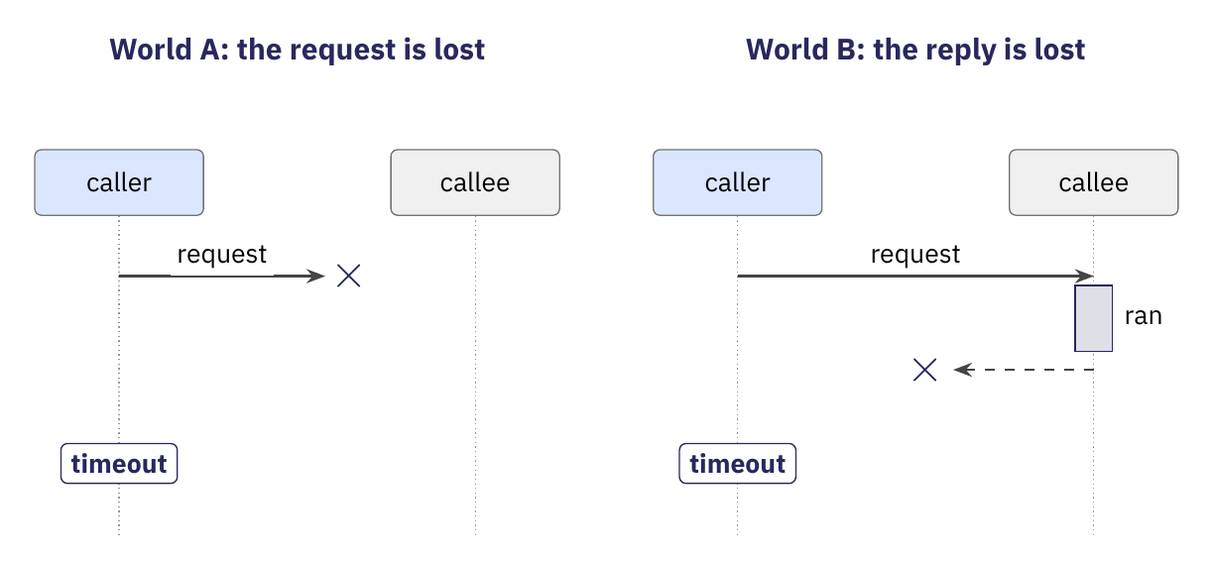
A lost request and a lost reply look the same.
Locally, a returned call shows that the callee ran, and an exception reports why it did not.
Across a boundary, the caller sees only a timeout, and no exchange of messages over an unreliable channel removes the doubt (Gray^{[1]}, 1978).
For a tool call, a missing reply to edit leaves open whether the patch was applied.
[1] J. N. Gray. Notes on data base operating systems. In Operating Systems: An Advanced Course, Springer, 1978.
Notes:
Over an unreliable channel, no finite exchange of messages gives both sides certainty (the Two Generals problem; Akkoyunlu et al., 1975, and Gray, 1978). Cristian (1991) classifies a lost reply as an omission failure. The request alone cannot separate the two worlds, which is why the evidence slide later insists that the request alone does not establish that the tool ran.

Slide 21
A lost request and a lost reply look the same.
Locally, a returned call shows that the callee ran, and an exception reports why it did not.
Across a boundary, the caller sees only a timeout, and no exchange of messages over an unreliable channel removes the doubt (Gray^{[1]}, 1978).
For a tool call, a missing reply to edit leaves open whether the patch was applied.
[1] J. N. Gray. Notes on data base operating systems. In Operating Systems: An Advanced Course, Springer, 1978.
Notes:
Over an unreliable channel, no finite exchange of messages gives both sides certainty (the Two Generals problem; Akkoyunlu et al., 1975, and Gray, 1978). Cristian (1991) classifies a lost reply as an omission failure. The request alone cannot separate the two worlds, which is why the evidence slide later insists that the request alone does not establish that the tool ran.

Slide 22
A lost request and a lost reply look the same.
Locally, a returned call shows that the callee ran, and an exception reports why it did not.
Across a boundary, the caller sees only a timeout, and no exchange of messages over an unreliable channel removes the doubt (Gray^{[1]}, 1978).
For a tool call, a missing reply to edit leaves open whether the patch was applied.
[1] J. N. Gray. Notes on data base operating systems. In Operating Systems: An Advanced Course, Springer, 1978.
Notes:
Over an unreliable channel, no finite exchange of messages gives both sides certainty (the Two Generals problem; Akkoyunlu et al., 1975, and Gray, 1978). Cristian (1991) classifies a lost reply as an omission failure. The request alone cannot separate the two worlds, which is why the evidence slide later insists that the request alone does not establish that the tool ran.

Slide 23
A lost request and a lost reply look the same.
Locally, a returned call shows that the callee ran, and an exception reports why it did not.
Across a boundary, the caller sees only a timeout, and no exchange of messages over an unreliable channel removes the doubt (Gray^{[1]}, 1978).
For a tool call, a missing reply to edit leaves open whether the patch was applied.
The caller's observation is identical in both worlds, so the caller cannot infer which one occurred.
[1] J. N. Gray. Notes on data base operating systems. In Operating Systems: An Advanced Course, Springer, 1978.
Notes:
Over an unreliable channel, no finite exchange of messages gives both sides certainty (the Two Generals problem; Akkoyunlu et al., 1975, and Gray, 1978). Cristian (1991) classifies a lost reply as an omission failure. The request alone cannot separate the two worlds, which is why the evidence slide later insists that the request alone does not establish that the tool ran.

Slide 24
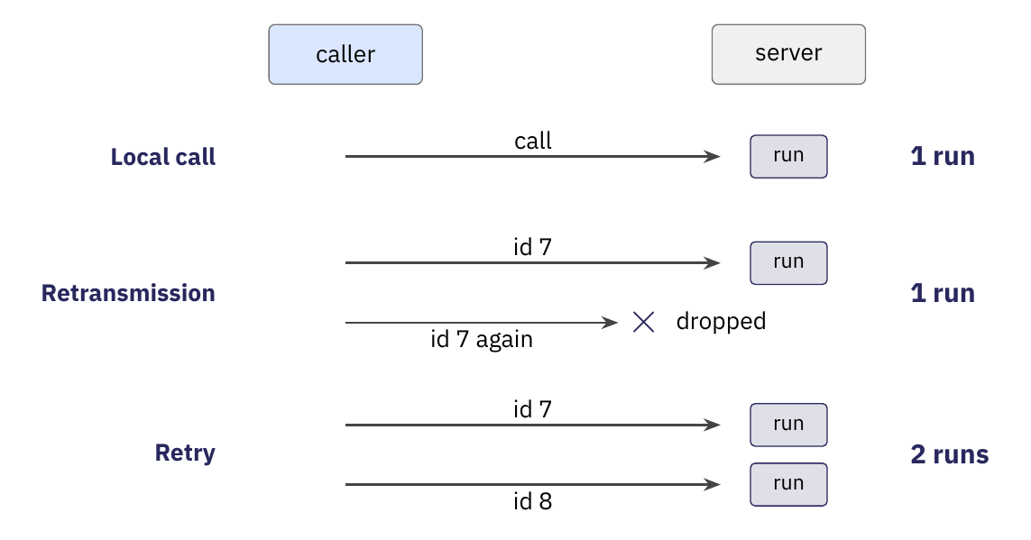
A new request defeats duplicate suppression.
Locally, one call runs the callee once, because no message passes between them.
Across a boundary, a transport can drop duplicates (Birrell and Nelson^{[1]}, 1984), but only the endpoints can complete the guarantee (Saltzer et al.^{[2]}, 1984).
For a tool call, a retry from the harness is a new request with a new id, so the server runs the edit again.
[1] A. D. Birrell and B. J. Nelson. Implementing remote procedure calls. ACM TOCS 2(1), 1984. [2] J. H. Saltzer, D. P. Reed and D. D. Clark. End-to-end arguments in system design. ACM TOCS 2(4), 1984.
Notes:
Birrell and Nelson's RPC numbered calls so that a retransmitted packet could not run the procedure twice: a returned call ran the procedure once, and an exception means once or not at all. Saltzer, Reed and Clark (1984) argue that duplicate suppression and delivery acknowledgment are complete only at the endpoints, with the help of the application. A retry that the harness issues as a new request defeats transport-level suppression unless the request carries an idempotency key, which the failure and recovery segment covers.

Slide 25
A new request defeats duplicate suppression.
Locally, one call runs the callee once, because no message passes between them.
Across a boundary, a transport can drop duplicates (Birrell and Nelson^{[1]}, 1984), but only the endpoints can complete the guarantee (Saltzer et al.^{[2]}, 1984).
For a tool call, a retry from the harness is a new request with a new id, so the server runs the edit again.
[1] A. D. Birrell and B. J. Nelson. Implementing remote procedure calls. ACM TOCS 2(1), 1984. [2] J. H. Saltzer, D. P. Reed and D. D. Clark. End-to-end arguments in system design. ACM TOCS 2(4), 1984.
Notes:
Birrell and Nelson's RPC numbered calls so that a retransmitted packet could not run the procedure twice: a returned call ran the procedure once, and an exception means once or not at all. Saltzer, Reed and Clark (1984) argue that duplicate suppression and delivery acknowledgment are complete only at the endpoints, with the help of the application. A retry that the harness issues as a new request defeats transport-level suppression unless the request carries an idempotency key, which the failure and recovery segment covers.

Slide 26
A new request defeats duplicate suppression.
Locally, one call runs the callee once, because no message passes between them.
Across a boundary, a transport can drop duplicates (Birrell and Nelson^{[1]}, 1984), but only the endpoints can complete the guarantee (Saltzer et al.^{[2]}, 1984).
For a tool call, a retry from the harness is a new request with a new id, so the server runs the edit again.
[1] A. D. Birrell and B. J. Nelson. Implementing remote procedure calls. ACM TOCS 2(1), 1984. [2] J. H. Saltzer, D. P. Reed and D. D. Clark. End-to-end arguments in system design. ACM TOCS 2(4), 1984.
Notes:
Birrell and Nelson's RPC numbered calls so that a retransmitted packet could not run the procedure twice: a returned call ran the procedure once, and an exception means once or not at all. Saltzer, Reed and Clark (1984) argue that duplicate suppression and delivery acknowledgment are complete only at the endpoints, with the help of the application. A retry that the harness issues as a new request defeats transport-level suppression unless the request carries an idempotency key, which the failure and recovery segment covers.

Slide 27
A new request defeats duplicate suppression.
Locally, one call runs the callee once, because no message passes between them.
Across a boundary, a transport can drop duplicates (Birrell and Nelson^{[1]}, 1984), but only the endpoints can complete the guarantee (Saltzer et al.^{[2]}, 1984).
For a tool call, a retry from the harness is a new request with a new id, so the server runs the edit again.
Duplicate suppression works only where the receiver can recognize the repeat.
[1] A. D. Birrell and B. J. Nelson. Implementing remote procedure calls. ACM TOCS 2(1), 1984. [2] J. H. Saltzer, D. P. Reed and D. D. Clark. End-to-end arguments in system design. ACM TOCS 2(4), 1984.
Notes:
Birrell and Nelson's RPC numbered calls so that a retransmitted packet could not run the procedure twice: a returned call ran the procedure once, and an exception means once or not at all. Saltzer, Reed and Clark (1984) argue that duplicate suppression and delivery acknowledgment are complete only at the endpoints, with the help of the application. A retry that the harness issues as a new request defeats transport-level suppression unless the request carries an idempotency key, which the failure and recovery segment covers.

Slide 28
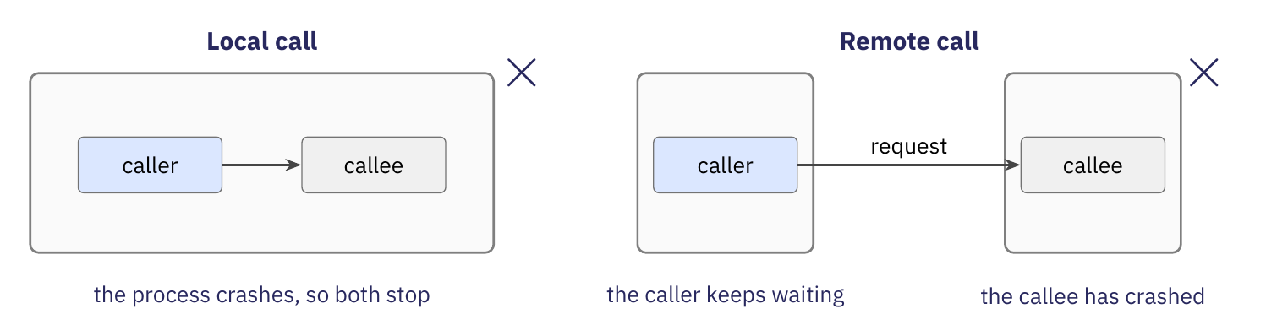
A callee in another process can fail alone.
Locally, caller and callee share one process, so a crash stops both.
Across a boundary, the callee can fail while the caller keeps running, which Waldo et al.^{[1]} (1994) call partial failure.
For a tool call, the harness keeps running after a tool server dies and sees only a missing reply.
[1] J. Waldo, G. Wyant, A. Wollrath and S. Kendall. A note on distributed computing. Sun Microsystems Laboratories TR-94-29, 1994.
Notes:
Cristian (1991) classifies omission, timing, response, crash and arbitrary failures. Waldo et al. (1994) argue that partial failure cannot be masked. With one process, a crash is total. With two processes, the caller must decide what to do about a callee that it cannot reach.

Slide 29
A callee in another process can fail alone.
Locally, caller and callee share one process, so a crash stops both.
Across a boundary, the callee can fail while the caller keeps running, which Waldo et al.^{[1]} (1994) call partial failure.
For a tool call, the harness keeps running after a tool server dies and sees only a missing reply.
[1] J. Waldo, G. Wyant, A. Wollrath and S. Kendall. A note on distributed computing. Sun Microsystems Laboratories TR-94-29, 1994.
Notes:
Cristian (1991) classifies omission, timing, response, crash and arbitrary failures. Waldo et al. (1994) argue that partial failure cannot be masked. With one process, a crash is total. With two processes, the caller must decide what to do about a callee that it cannot reach.

Slide 30
A callee in another process can fail alone.
Locally, caller and callee share one process, so a crash stops both.
Across a boundary, the callee can fail while the caller keeps running, which Waldo et al.^{[1]} (1994) call partial failure.
For a tool call, the harness keeps running after a tool server dies and sees only a missing reply.
[1] J. Waldo, G. Wyant, A. Wollrath and S. Kendall. A note on distributed computing. Sun Microsystems Laboratories TR-94-29, 1994.
Notes:
Cristian (1991) classifies omission, timing, response, crash and arbitrary failures. Waldo et al. (1994) argue that partial failure cannot be masked. With one process, a crash is total. With two processes, the caller must decide what to do about a callee that it cannot reach.

Slide 31
A callee in another process can fail alone.
Locally, caller and callee share one process, so a crash stops both.
Across a boundary, the callee can fail while the caller keeps running, which Waldo et al.^{[1]} (1994) call partial failure.
For a tool call, the harness keeps running after a tool server dies and sees only a missing reply.
Waldo and colleagues argued that partial failure cannot be hidden.
[1] J. Waldo, G. Wyant, A. Wollrath and S. Kendall. A note on distributed computing. Sun Microsystems Laboratories TR-94-29, 1994.
Notes:
Cristian (1991) classifies omission, timing, response, crash and arbitrary failures. Waldo et al. (1994) argue that partial failure cannot be masked. With one process, a crash is total. With two processes, the caller must decide what to do about a callee that it cannot reach.

Slide 32
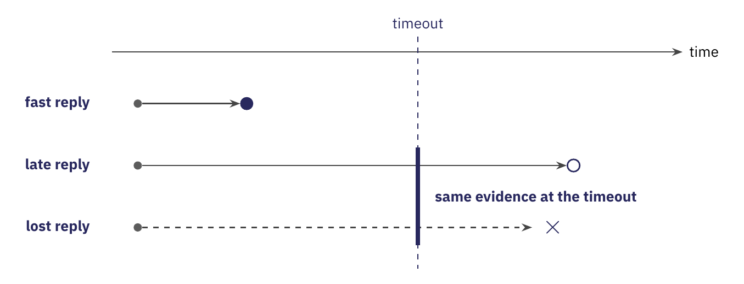
A late reply and a lost reply look alike.
Locally, a tool that hangs also hangs the caller, so the caller never has to decide whether a slow call failed.
Across a boundary, the caller must choose a timeout, and at the deadline a late reply looks like a lost reply (Cristian, 1991^{[1]}).
For a tool call, a short timeout causes needless retries, and a long timeout leaves the agent idle.
[1] F. Cristian. Understanding fault-tolerant distributed systems. CACM 34(2), 1991.
Notes:
Cristian (1991) separates timing failures from omission failures, but a caller cannot tell them apart at the deadline. Any timeout is therefore a guess, and the harness must be written to survive either outcome. The eight fallacies of distributed computing list "latency is zero" as the second fallacy.

Slide 33
A late reply and a lost reply look alike.
Locally, a tool that hangs also hangs the caller, so the caller never has to decide whether a slow call failed.
Across a boundary, the caller must choose a timeout, and at the deadline a late reply looks like a lost reply (Cristian, 1991^{[1]}).
For a tool call, a short timeout causes needless retries, and a long timeout leaves the agent idle.
[1] F. Cristian. Understanding fault-tolerant distributed systems. CACM 34(2), 1991.
Notes:
Cristian (1991) separates timing failures from omission failures, but a caller cannot tell them apart at the deadline. Any timeout is therefore a guess, and the harness must be written to survive either outcome. The eight fallacies of distributed computing list "latency is zero" as the second fallacy.

Slide 34
A late reply and a lost reply look alike.
Locally, a tool that hangs also hangs the caller, so the caller never has to decide whether a slow call failed.
Across a boundary, the caller must choose a timeout, and at the deadline a late reply looks like a lost reply (Cristian, 1991^{[1]}).
For a tool call, a short timeout causes needless retries, and a long timeout leaves the agent idle.
[1] F. Cristian. Understanding fault-tolerant distributed systems. CACM 34(2), 1991.
Notes:
Cristian (1991) separates timing failures from omission failures, but a caller cannot tell them apart at the deadline. Any timeout is therefore a guess, and the harness must be written to survive either outcome. The eight fallacies of distributed computing list "latency is zero" as the second fallacy.

Slide 35
A late reply and a lost reply look alike.
Locally, a tool that hangs also hangs the caller, so the caller never has to decide whether a slow call failed.
Across a boundary, the caller must choose a timeout, and at the deadline a late reply looks like a lost reply (Cristian, 1991^{[1]}).
For a tool call, a short timeout causes needless retries, and a long timeout leaves the agent idle.
At the deadline, the caller holds the same evidence for a late reply and a lost reply.
[1] F. Cristian. Understanding fault-tolerant distributed systems. CACM 34(2), 1991.
Notes:
Cristian (1991) separates timing failures from omission failures, but a caller cannot tell them apart at the deadline. Any timeout is therefore a guess, and the harness must be written to survive either outcome. The eight fallacies of distributed computing list "latency is zero" as the second fallacy.

Slide 36
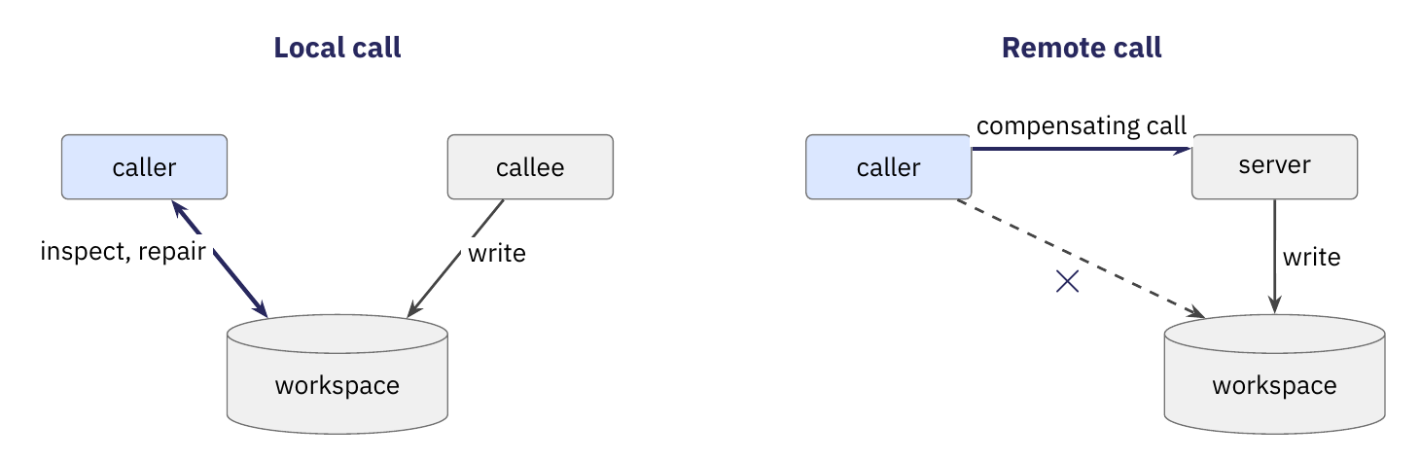
A remote caller cannot repair partial effects.
Locally, caller and callee share files, so the caller can inspect a partial change and repair it.
Across a boundary, the callee owns the state, so repair needs a compensating action that the callee provides (Garcia-Molina and Salem^{[1]}, 1987).
For a tool call, a half-applied edit on a remote server can be undone only through further tool calls.
[1] H. Garcia-Molina and K. Salem. Sagas. SIGMOD 1987.
Notes:
Waldo et al. (1994) name memory access as one of four differences between local and remote calls: a local callee shares memory with the caller. Garcia-Molina and Salem (1987) describe sagas, in which each step has a compensating action. For a remote tool, the compensating action must exist as another tool call.

Slide 37
A remote caller cannot repair partial effects.
Locally, caller and callee share files, so the caller can inspect a partial change and repair it.
Across a boundary, the callee owns the state, so repair needs a compensating action that the callee provides (Garcia-Molina and Salem^{[1]}, 1987).
For a tool call, a half-applied edit on a remote server can be undone only through further tool calls.
[1] H. Garcia-Molina and K. Salem. Sagas. SIGMOD 1987.
Notes:
Waldo et al. (1994) name memory access as one of four differences between local and remote calls: a local callee shares memory with the caller. Garcia-Molina and Salem (1987) describe sagas, in which each step has a compensating action. For a remote tool, the compensating action must exist as another tool call.

Slide 38
A remote caller cannot repair partial effects.
Locally, caller and callee share files, so the caller can inspect a partial change and repair it.
Across a boundary, the callee owns the state, so repair needs a compensating action that the callee provides (Garcia-Molina and Salem^{[1]}, 1987).
For a tool call, a half-applied edit on a remote server can be undone only through further tool calls.
[1] H. Garcia-Molina and K. Salem. Sagas. SIGMOD 1987.
Notes:
Waldo et al. (1994) name memory access as one of four differences between local and remote calls: a local callee shares memory with the caller. Garcia-Molina and Salem (1987) describe sagas, in which each step has a compensating action. For a remote tool, the compensating action must exist as another tool call.

Slide 39
A remote caller cannot repair partial effects.
Locally, caller and callee share files, so the caller can inspect a partial change and repair it.
Across a boundary, the callee owns the state, so repair needs a compensating action that the callee provides (Garcia-Molina and Salem^{[1]}, 1987).
For a tool call, a half-applied edit on a remote server can be undone only through further tool calls.
Without shared state, undoing an effect means asking the callee to undo it.
[1] H. Garcia-Molina and K. Salem. Sagas. SIGMOD 1987.
Notes:
Waldo et al. (1994) name memory access as one of four differences between local and remote calls: a local callee shares memory with the caller. Garcia-Molina and Salem (1987) describe sagas, in which each step has a compensating action. For a remote tool, the compensating action must exist as another tool call.

Slide 40
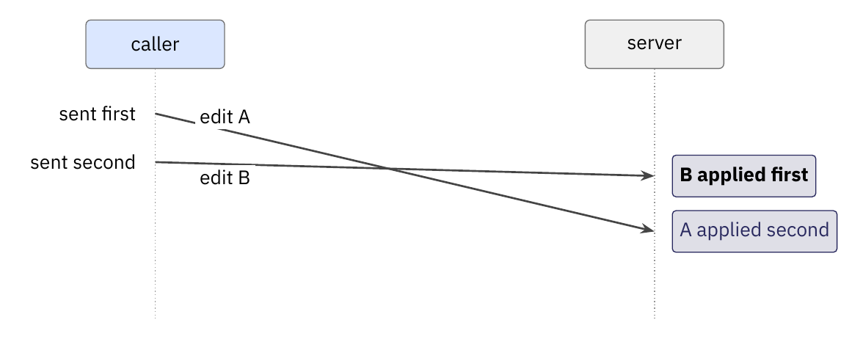
Parallel requests can take effect out of order.
Locally, one call finishes before the next one begins, so effects follow program order.
Across a boundary, two requests in flight have no inherent order unless the system imposes one (Lamport, 1978^{[1]}).
For a tool call, a model may emit several calls in one turn (November 2023), and their effects can interleave.
[1] L. Lamport. Time, clocks, and the ordering of events in a distributed system. CACM 21(7), 1978.
Notes:
Lamport (1978) defines the happens-before relation. Two requests that the caller sends in order have no guaranteed delivery order unless the system adds one. Parallel tool calls appeared in November 2023 (slide 8). In the patch agent the loop is sequential, so the course code does not exhibit this problem.

Slide 41
Parallel requests can take effect out of order.
Locally, one call finishes before the next one begins, so effects follow program order.
Across a boundary, two requests in flight have no inherent order unless the system imposes one (Lamport, 1978^{[1]}).
For a tool call, a model may emit several calls in one turn (November 2023), and their effects can interleave.
[1] L. Lamport. Time, clocks, and the ordering of events in a distributed system. CACM 21(7), 1978.
Notes:
Lamport (1978) defines the happens-before relation. Two requests that the caller sends in order have no guaranteed delivery order unless the system adds one. Parallel tool calls appeared in November 2023 (slide 8). In the patch agent the loop is sequential, so the course code does not exhibit this problem.

Slide 42
Parallel requests can take effect out of order.
Locally, one call finishes before the next one begins, so effects follow program order.
Across a boundary, two requests in flight have no inherent order unless the system imposes one (Lamport, 1978^{[1]}).
For a tool call, a model may emit several calls in one turn (November 2023), and their effects can interleave.
[1] L. Lamport. Time, clocks, and the ordering of events in a distributed system. CACM 21(7), 1978.
Notes:
Lamport (1978) defines the happens-before relation. Two requests that the caller sends in order have no guaranteed delivery order unless the system adds one. Parallel tool calls appeared in November 2023 (slide 8). In the patch agent the loop is sequential, so the course code does not exhibit this problem.

Slide 43
Parallel requests can take effect out of order.
Locally, one call finishes before the next one begins, so effects follow program order.
Across a boundary, two requests in flight have no inherent order unless the system imposes one (Lamport, 1978^{[1]}).
For a tool call, a model may emit several calls in one turn (November 2023), and their effects can interleave.
The caller must impose an order, or the effects of parallel calls must not depend on it.
[1] L. Lamport. Time, clocks, and the ordering of events in a distributed system. CACM 21(7), 1978.
Notes:
Lamport (1978) defines the happens-before relation. Two requests that the caller sends in order have no guaranteed delivery order unless the system adds one. Parallel tool calls appeared in November 2023 (slide 8). In the patch agent the loop is sequential, so the course code does not exhibit this problem.

Slide 44
Another process puts six guarantees at risk.
Guarantee | Locally | When the tool runs in another process
Completion is known. | A returned call shows that the callee ran, and an exception reports why it did not. | A lost reply leaves open whether the callee ran.
Notes:
Each right-hand cell summarizes one of the six guarantee slides. The failure and recovery segment returns to each of these properties. The end-to-end argument (Saltzer, Reed and Clark, 1984) predicts where exactly-once can live: at the endpoints, with the help of the application.

Slide 45
Another process puts six guarantees at risk.
Guarantee | Locally | When the tool runs in another process
Completion is known. | A returned call shows that the callee ran, and an exception reports why it did not. | A lost reply leaves open whether the callee ran.
Execution happens once. | One call runs the callee once, because no retry exists between caller and callee. | A retry can run the callee a second time.
Notes:
Each right-hand cell summarizes one of the six guarantee slides. The failure and recovery segment returns to each of these properties. The end-to-end argument (Saltzer, Reed and Clark, 1984) predicts where exactly-once can live: at the endpoints, with the help of the application.

Slide 46
Another process puts six guarantees at risk.
Guarantee | Locally | When the tool runs in another process
Completion is known. | A returned call shows that the callee ran, and an exception reports why it did not. | A lost reply leaves open whether the callee ran.
Execution happens once. | One call runs the callee once, because no retry exists between caller and callee. | A retry can run the callee a second time.
Failures are shared. | Caller and callee fail together, so neither outlives the other. | The callee can fail while the caller keeps running.
Notes:
Each right-hand cell summarizes one of the six guarantee slides. The failure and recovery segment returns to each of these properties. The end-to-end argument (Saltzer, Reed and Clark, 1984) predicts where exactly-once can live: at the endpoints, with the help of the application.

Slide 47
Another process puts six guarantees at risk.
Guarantee | Locally | When the tool runs in another process
Completion is known. | A returned call shows that the callee ran, and an exception reports why it did not. | A lost reply leaves open whether the callee ran.
Execution happens once. | One call runs the callee once, because no retry exists between caller and callee. | A retry can run the callee a second time.
Failures are shared. | Caller and callee fail together, so neither outlives the other. | The callee can fail while the caller keeps running.
No timeout is needed. | A callee that hangs also hangs the caller, so slowness and failure need no distinction. | A late reply looks the same as a lost reply.
Notes:
Each right-hand cell summarizes one of the six guarantee slides. The failure and recovery segment returns to each of these properties. The end-to-end argument (Saltzer, Reed and Clark, 1984) predicts where exactly-once can live: at the endpoints, with the help of the application.

Slide 48
Another process puts six guarantees at risk.
Guarantee | Locally | When the tool runs in another process
Completion is known. | A returned call shows that the callee ran, and an exception reports why it did not. | A lost reply leaves open whether the callee ran.
Execution happens once. | One call runs the callee once, because no retry exists between caller and callee. | A retry can run the callee a second time.
Failures are shared. | Caller and callee fail together, so neither outlives the other. | The callee can fail while the caller keeps running.
No timeout is needed. | A callee that hangs also hangs the caller, so slowness and failure need no distinction. | A late reply looks the same as a lost reply.
Partial effects are visible. | Shared memory and files let the caller inspect and repair what the callee changed. | The caller can no longer inspect or repair the callee's partial effects.
Notes:
Each right-hand cell summarizes one of the six guarantee slides. The failure and recovery segment returns to each of these properties. The end-to-end argument (Saltzer, Reed and Clark, 1984) predicts where exactly-once can live: at the endpoints, with the help of the application.

Slide 49
Another process puts six guarantees at risk.
Guarantee | Locally | When the tool runs in another process
Completion is known. | A returned call shows that the callee ran, and an exception reports why it did not. | A lost reply leaves open whether the callee ran.
Execution happens once. | One call runs the callee once, because no retry exists between caller and callee. | A retry can run the callee a second time.
Failures are shared. | Caller and callee fail together, so neither outlives the other. | The callee can fail while the caller keeps running.
No timeout is needed. | A callee that hangs also hangs the caller, so slowness and failure need no distinction. | A late reply looks the same as a lost reply.
Partial effects are visible. | Shared memory and files let the caller inspect and repair what the callee changed. | The caller can no longer inspect or repair the callee's partial effects.
Effects happen in program order. | One call finishes before the next one begins. | Requests in flight can take effect out of order.
Notes:
Each right-hand cell summarizes one of the six guarantee slides. The failure and recovery segment returns to each of these properties. The end-to-end argument (Saltzer, Reed and Clark, 1984) predicts where exactly-once can live: at the endpoints, with the help of the application.

Slide 50
Another process puts six guarantees at risk.
Guarantee | Locally | When the tool runs in another process
Completion is known. | A returned call shows that the callee ran, and an exception reports why it did not. | A lost reply leaves open whether the callee ran.
Execution happens once. | One call runs the callee once, because no retry exists between caller and callee. | A retry can run the callee a second time.
Failures are shared. | Caller and callee fail together, so neither outlives the other. | The callee can fail while the caller keeps running.
No timeout is needed. | A callee that hangs also hangs the caller, so slowness and failure need no distinction. | A late reply looks the same as a lost reply.
Partial effects are visible. | Shared memory and files let the caller inspect and repair what the callee changed. | The caller can no longer inspect or repair the callee's partial effects.
Effects happen in program order. | One call finishes before the next one begins. | Requests in flight can take effect out of order.
Across a boundary, the contract and the harness must supply what a local call gave for free.
Notes:
Each right-hand cell summarizes one of the six guarantee slides. The failure and recovery segment returns to each of these properties. The end-to-end argument (Saltzer, Reed and Clark, 1984) predicts where exactly-once can live: at the endpoints, with the help of the application.

