Slide 1
Designing Production Agentic Systems
Columbia · Fall 2026 · Lecture 1
Notes:
[40s] Course number, title, term. Say the room and the slot: Fridays 2:10 to 4:00, Hamilton 303, September 11 through December 11. Do not read the syllabus yet.

Slide 2
Welcome!
COMS 6998-019 • Designing Production Agentic Systems • Fall 2026
When | Fridays 2:10 PM — 4:00 PM
Location | Hamilton Hall 303
Term Dates | September 11th to December 11th
Course website | https://COMS6998-E019.github.io
Today’s Agenda | Orientation, the course map, and one production trace read end to end

Slide 3
About the Instructors
Senior Research Scientist IBM and I was a CS Postdoc at Columbia.
What I work on: Program Analysis • Distributed Systems • Security • Testing
Instructor | Rahul Krishna • rk3080@columbia.edu
Teaching Assistant | In Keun Kim • ik2619@columbia.edu
Office Hours | Friday 12:00—1:30 (and via zoom ad hoc)
TA | To be announced on CourseWorks
Discussion | Slack Channel
Website | rkrsn.us

Slide 4
Why This Course Exists

Slide 5
The key question that motivates this course
How do we place a probabilistic model inside a software system without surrendering the guarantees expected of production software?

Slide 6
The key question that motivates this course
How do we place a probabilistic model inside a software system without surrendering the guarantees expected of production software?
Phrase | Why it is in the question
Probabilistic | Two identical calls are not guaranteed to agree, and nothing downstream may assume they will
Inside a software system | It is one component among several. It is called, its output is validated, and it may be refused
Guarantees | The “promises” a system makes to its consumers. Things a caller is entitled to expect and rely on every time

Slide 7
The key question that motivates this course
How do we place a probabilistic model inside a software system without surrendering the guarantees expected of production software?
Phrase | Why it is in the question
Probabilistic | Two identical calls are not guaranteed to agree, and nothing downstream may assume they will
Inside a software system | It is one component among several. It is called, its output is validated, and it may be refused
Guarantees | The “promises” a system makes to its consumers. Things a caller is entitled to expect and rely on every time
The agent is a component of a larger system. It is not the entire system.

Slide 8
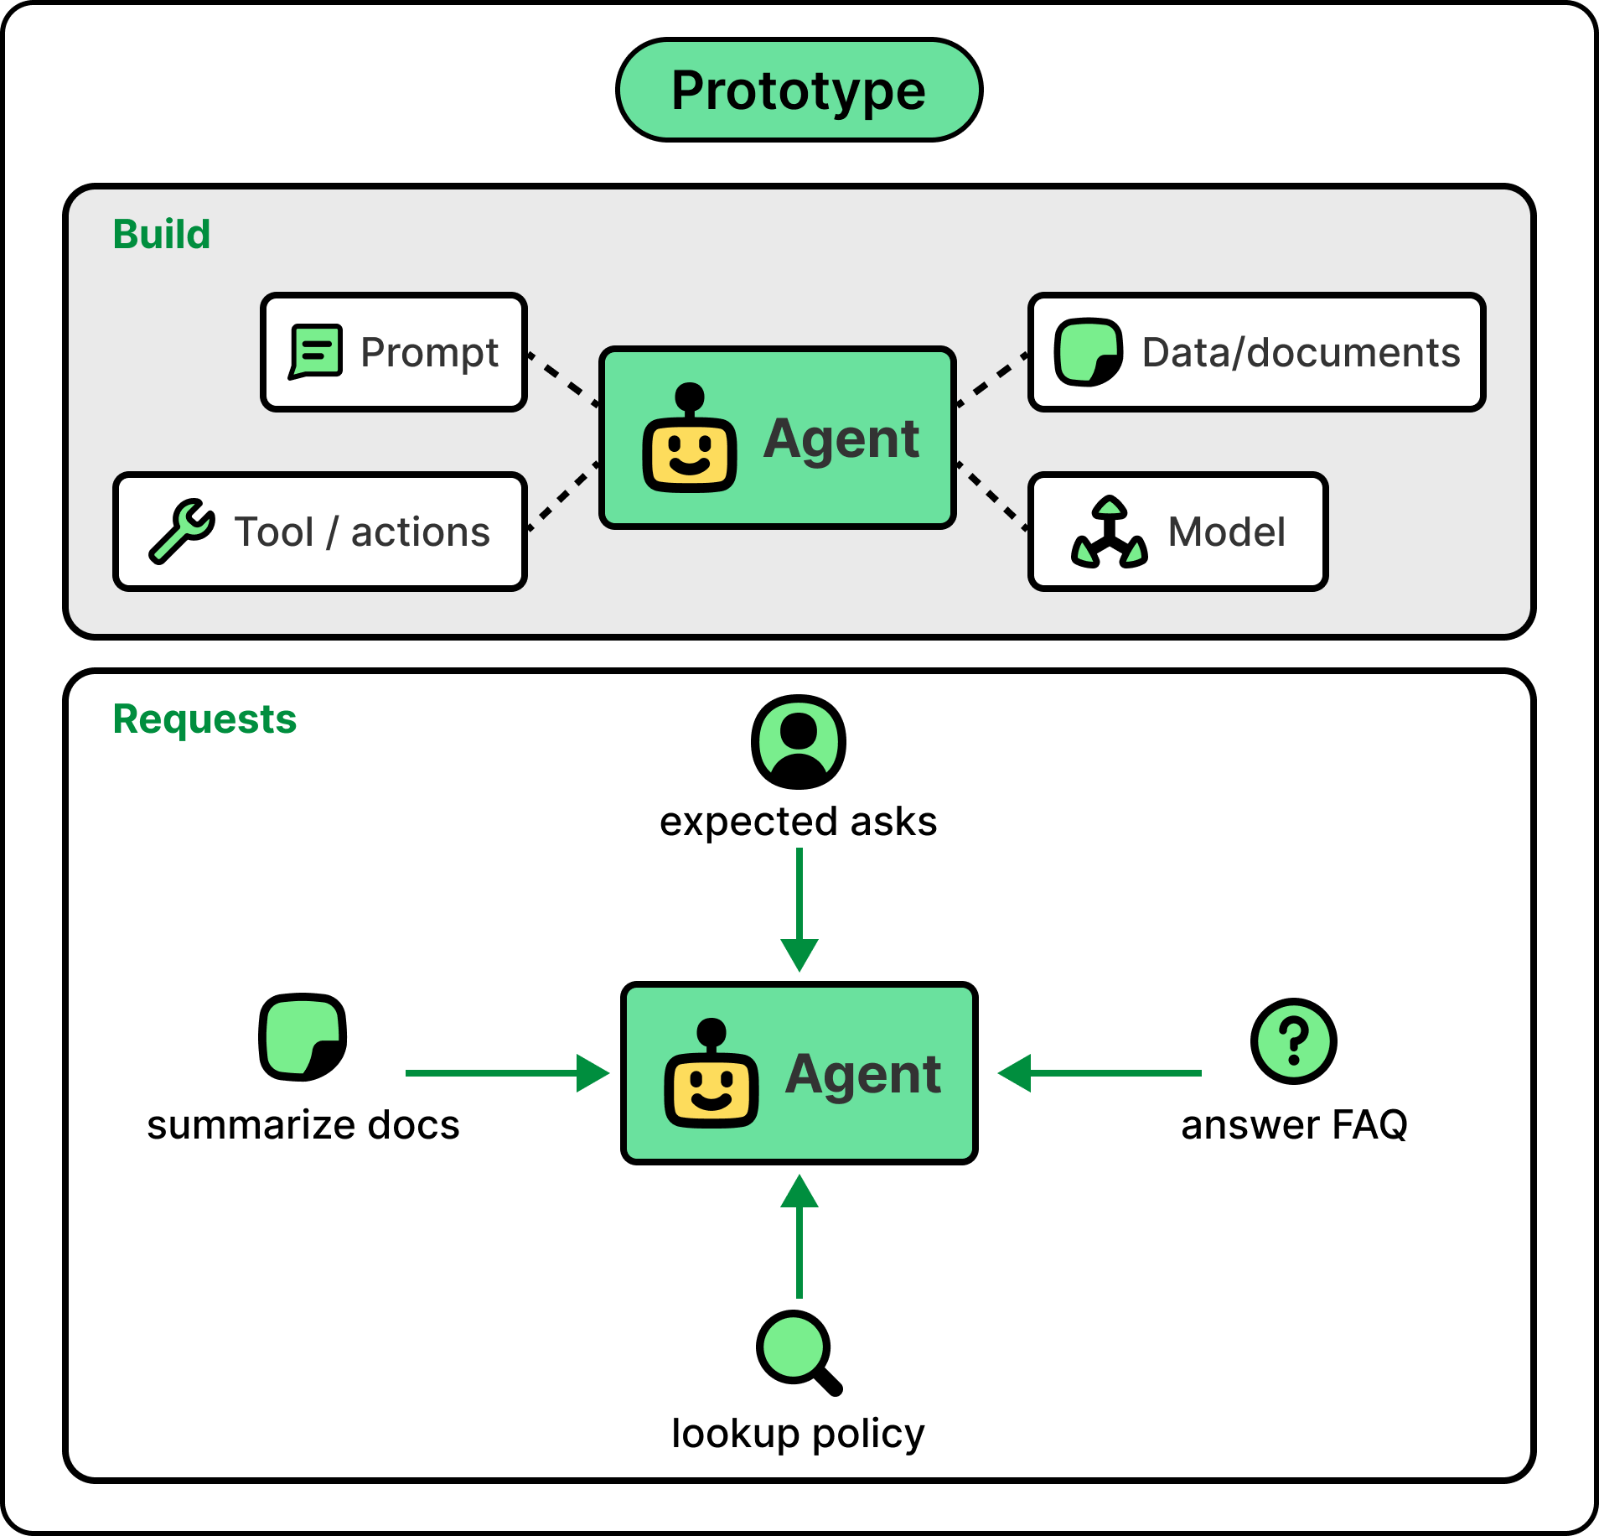
Prototype vs Production
The first prototype is easy. You can build one in an afternoon. The model is smart, your test prompts work, the demo is impressive, and the pilot ships in a week.
Courtesy: https://blog.bytebytego.com/p/ep218-the-typical-ai-agent-stack

Slide 9
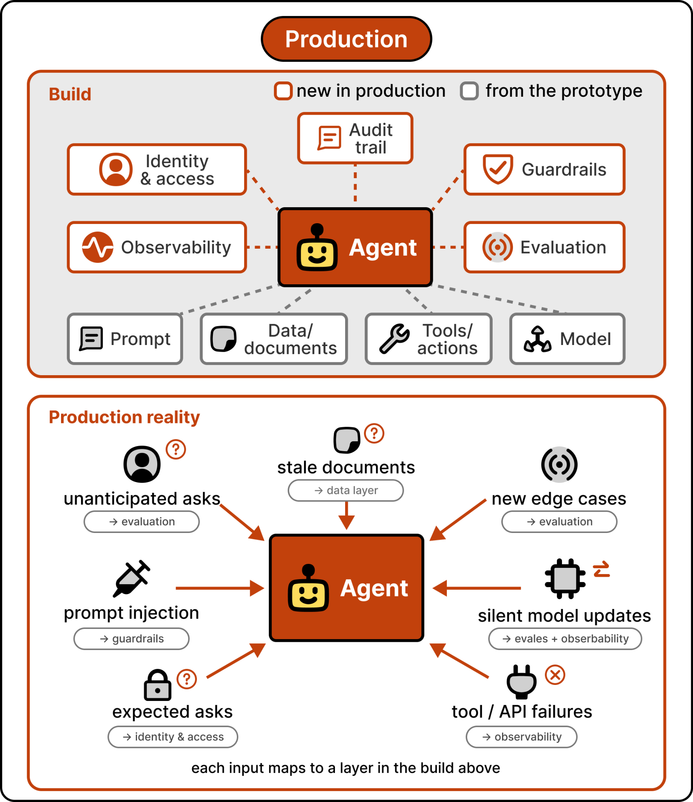
Prototype vs Production
Production is where the challenges arise!
Without identity controls, the agent runs as a shared system principal and there’s no audit trail when something goes wrong.
Without guardrails, it discloses and/or emits something it shouldn’t.
Without observability, you can’t tell whether quality is improving or degrading.
None of these problems showed up in the prototype. All of them show up in production.
Courtesy: https://blog.bytebytego.com/p/ep218-the-typical-ai-agent-stack

Slide 10
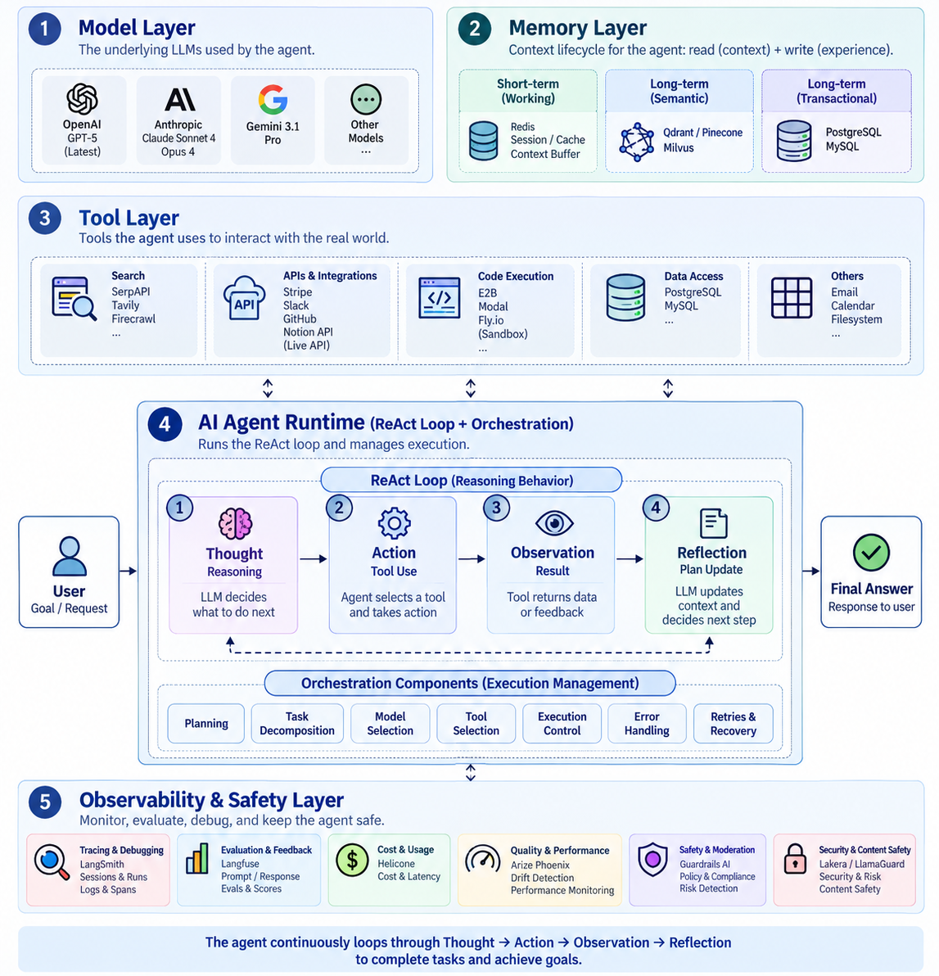
An AI Agent Stack: All its moving parts
Courtesy: https://blog.bytebytego.com/p/ep218-the-typical-ai-agent-stack

Slide 11
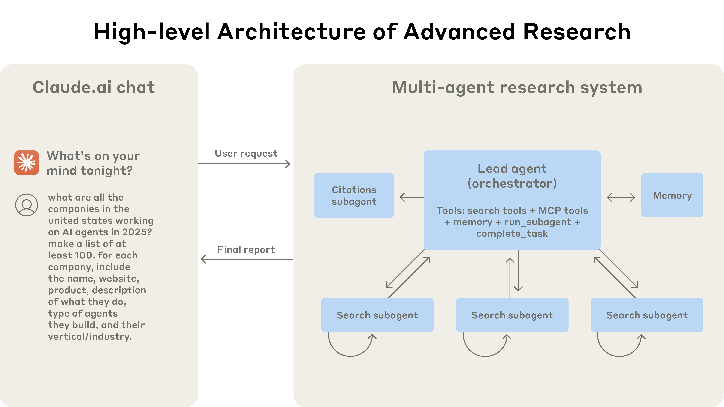
Production agentic system in action
Anthropic, How we built our multi-agent research system

Slide 12
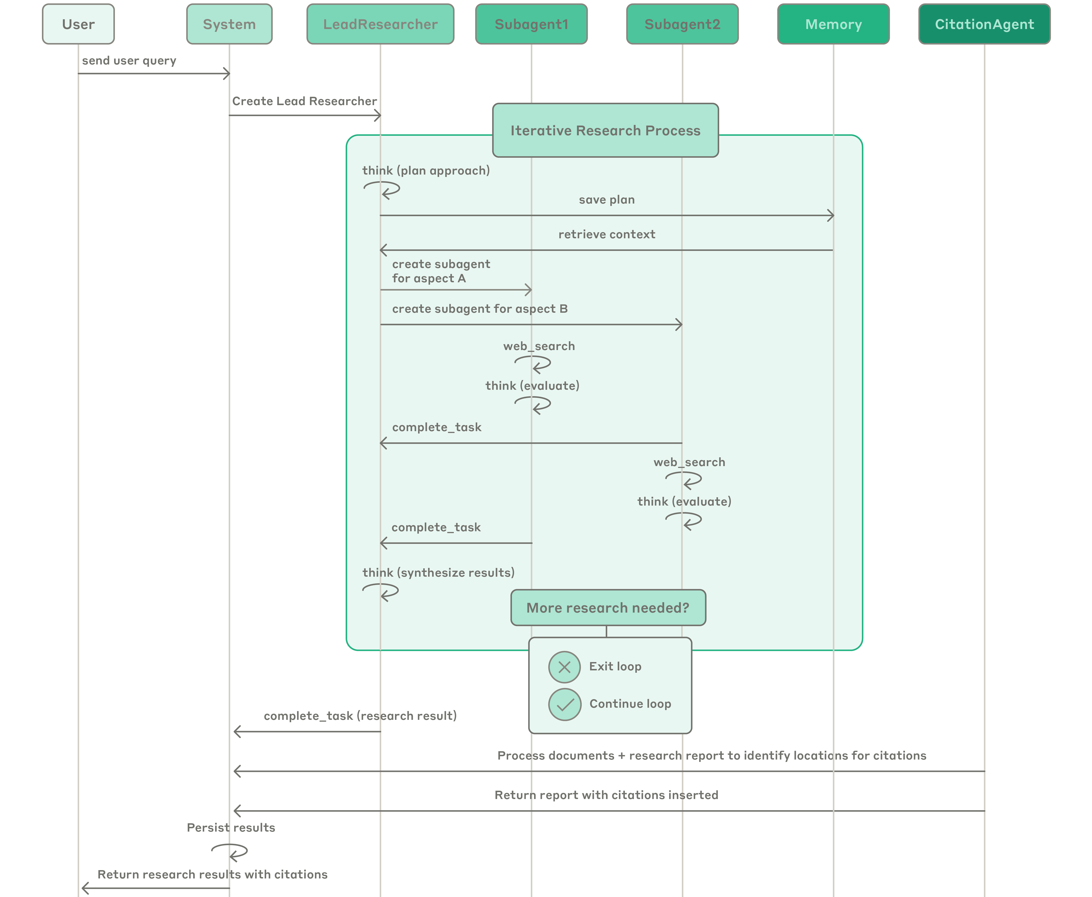
Production agentic system in action

Slide 13
What I hope you will learn…
By the end of this semester, you will design a production agentic system like what you just saw from Anthropic
Unit | Weeks | What it covers | What you’ll learn | Homework
1 | 1–3 | Agent architectures and control | The orchestrator: who chooses the next operation, and who decides to stop | HW1
2 | 4–6 | Tool interfaces and concurrency | The tools and the subagents: contracts, dependencies, bounded fan-out | HW2
3 | 8–9 | Context, state, and persistence | Memory and context: what survives truncation, and what survives a restart | HW3
4 | 10–12 | Deployment, recovery, and observability | The service around all of it: partial failure, retries, traces

Slide 14
Course Logistics

Slide 15
Where the course lives
Course website | https://COMS6998-E019.github.io
CourseWorks | Discussions for anything the class benefits from; TA announcement; grades
Course Hours | Fridays 2:10PM to 4:00PM • Structured as two 45-50 min lectures • A 15 min break in between the two lectures
Office Hours | Fridays 12:00–13:30, immediately before lecture. And happy to meet via zoom in this time doesn’t work
Email | rk3080@columbia.edu for everything else incl. accommodations, illness, extensions beyond the late-day policy

Slide 16
Where the course lives
Course website | https://COMS6998-E019.github.io
CourseWorks | Discussions for anything the class benefits from; TA announcement; grades
Course Hours | Fridays 2:10PM to 4:00PM • Structured as two 45-50 min lectures* • A 15 min break in between the two lectures
Office Hours | Fridays 12:00–13:30, immediately before lecture. And happy to meet via zoom in this time doesn’t work
Email | rk3080@columbia.edu for everything else incl. accommodations, illness, extensions beyond the late-day policy
except today

Slide 17
Homework, Grades, and Exams
Item | Weight | When | Format
Homework 1 | 20% | Dates on the site (tentative) | Team submission
Homework 2 | 20% | Dates on the site (tentative) | Team submission
Midterm | 20% | October 23rd | 40 mins (closed book) covering units 1 and 2
Homework 3 | 20% | Dates on the site (tentative) | Team submission
Final | 20% | December 17th | 40 mins (closed book) covering units 1 to 4
Homework is done in teams (of 2-3), and a team keeps one codebase for the whole semester. Homework 2 builds on homework 1; homework 3 builds on homework 2 and so on.
Tests are always written and closed book. They assess conceptual understanding, architectural reasoning, and the ability to analyze system behavior.
A comprehensive reading list and lecture notes will be provided by the teaching staff.

Slide 18
Prerequisites, Tech Stack, and Late days
Python/Typescript | You will read and write a moderate amount of it every week and read/debug it
Agent knowledge | Honestly, not required. You’ll be learning it as you work through the course.
Systems background | Not required. We’ll talk about processes, memory, concurrency, failure, etc. You’ll learn these along the way.
Kubernetes will be taught. Big parts of units 3 and 4 run on it, and no prior Kubernetes experience is expected. If you already know it, great! Some of unit 4 will be a revision.
Agent Framework. LangGraph is used for pedagogical reasons. Another framework is acceptable provided it meets the same behavioral expectations that each assignment explores.
Late days. Six per student for the semester, at most three on any one assignment. No need to request days if within these windows. For a longer extension, I’ll see what I can do. Please email me.

Slide 19
Generative AI policy
What’s allowed | What isn’t
Using an assistant to learn—explain a concept, debug your own code, review a design you wrote, critique, etc. | Handing an assignment to an agent and submitting what it produces
Scoped autocomplete while you write | Submitting work you cannot explain.
What does this mean to you: Ask yourself—”can every member of your team explain every part of what you submitted?” In other words, if a design choice, lines of code etc., in your submission cannot be defended by the team that submitted it, the policy has been violated.
Beyond this, Columbia University Generative AI policy is strictly enforced. See: https://provost.columbia.edu/content/office-senior-vice-provost/ai-policy

Slide 20
Questions?

Slide 21
Control Loops to LLMs: The Evolution of Agents
1950s
1970-80s
1980-’10s
2022+
Control Theory
Controller,
environment,
feedback, and
observability
Symbolic AI
Agents
Percepts
Actions
Belief state
Cognitive Arch & RL
Long-term memory,
Decision procedure,
Action selection
Trajectory, reward
LLM-based
Same structure
with a language
model in the
decision box
What LLM-based agents bring | What we still need to engineer
Interpret natural-language instructions and observations. | Maintain trustworthy state and manage memory.
Generate plans and propose tool calls. | Enforce permissions and validate actions.
Revise plans using feedback from the environment. | Verify outcomes, recover from failures, and enforce budgets.
While the capacity of the decision maker has evolved. The problems we need to engineer around remain the same.

Slide 22
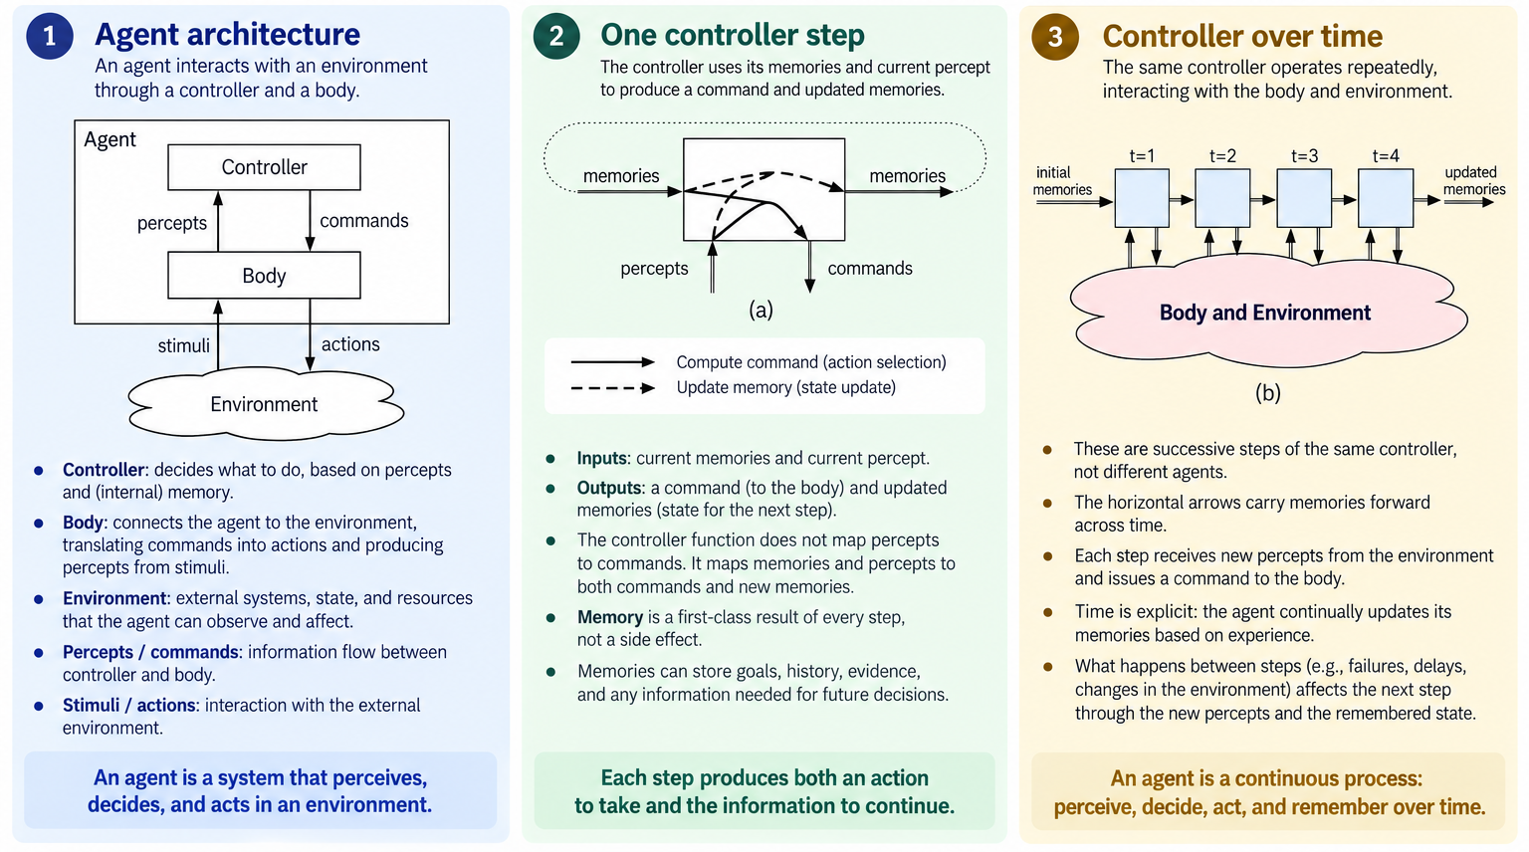
What was an Agent? A pre-LLM view
This is the classical view of agents from Poole & Mackworth (2010) ^{[1]}
^{[1]} Poole & Mackworth, Artificial Intelligence: Foundations of Computational Agents

Slide 23
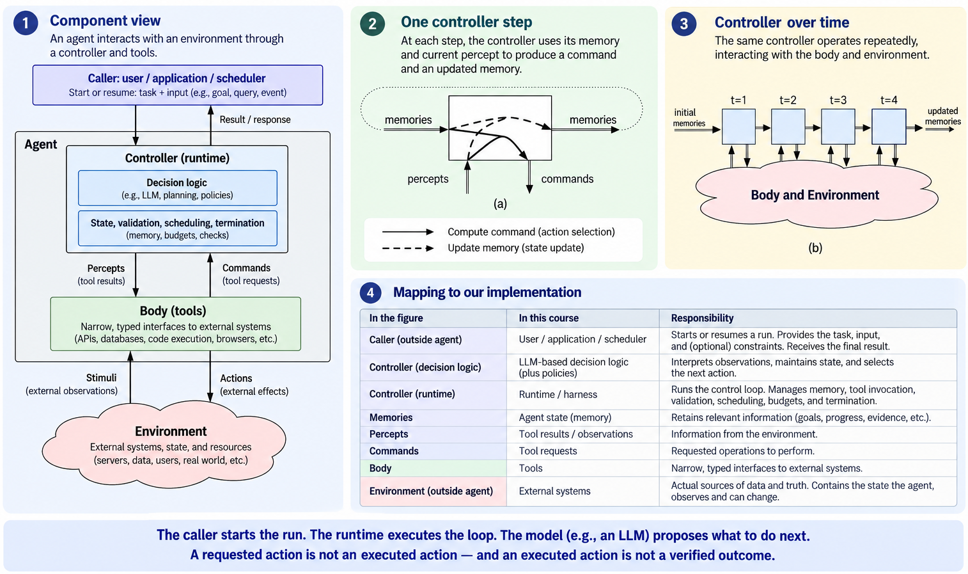
What changed: The model proposes the work
In this updated view, LLMs are a core part of the controller loop
^{[1]} Poole & Mackworth, Artificial Intelligence: Foundations of Computational Agents

Slide 24

What changed: The model proposes the work
In this updated view, LLMs are a core part of the controller loop
The LLM based controller interacts with the environment through the body. In our implementation, this means tools.
Asking for a service restart =/= restarting it, and
Restarting it is =/= restoring service.
Observations must come back from the environment before we can establish what happened.
Units 1 and 2 teaches you how to build this structure
An entry point, a controller, tools, and a feedback loop. Our first assignment deliverable is a working system that can receive a task, attempt an action, observe the result, and decide whether to continue.

Slide 25
What changed: The model proposes the work
In this updated view, LLMs are a core part of the controller loop
Each step takes memory and an observation and produces a command and updated memory. Memory includes more than a transcript: goals, evidence, previous attempts, and unresolved work.
Unit 3 covers what state to retain, where to store it, and how to preserve it across steps, what to do when we run out of context space and process restarts.

Slide 26
What changed: The model proposes the work
In this updated view, LLMs are a core part of the controller loop
These are successive steps of the same controller. Memory connects them; observations and commands connect each step to the environment.
Suppose a tool creates a ticket, but the process crashes before recording its ID. Should recovery retry, look up the ticket, or pause?
Unit 4 addresses that gap: deploying the loop as a service, recovering from partial failures, retrying safely, and using traces to understand what happened across steps.

Slide 27
What didn’t change: New problems, old names
What goes wrong in a run | The name it already has
An agent (sub-agent) with no step cap holds its worker for as long as it likes: the agents around it stall, no latency can be promised to a caller. | Bounded execution — admission control, step and token budgets, stopping rules; Nygard's blocked threads
A tool call that half-succeeded, and a retry that repeats the effect | Partial failure; idempotence
The process dies at step N, and the accepted work dies with it | Durable state
A restart that re-runs from zero instead of resuming what was accepted | Recovery, checkpointing
No way to say, from outside, what the run is doing right now | Observability
What is new is exactly one thing: a probabilistic component that
now proposes the work, probabilistically and we are responsible to
hold it to a guarantee.
^{[1]} Poole & Mackworth, Artificial Intelligence: Foundations of Computational Agents

Slide 28
Anatomy of an agentic system

Slide 29
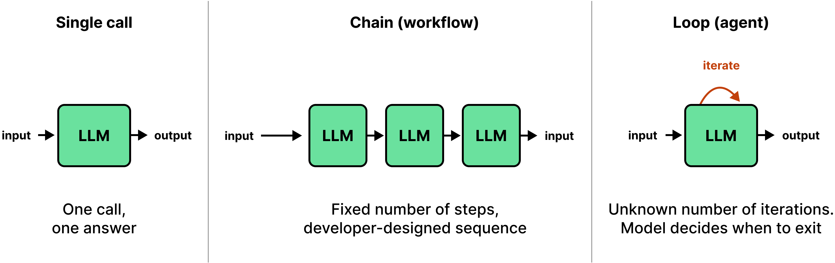
Agentic Systems: A Working Vocabulary
Term | Precisely | Actor that can fail
Model call | A single request and its response. Non-deterministic by construction; determinism is conditional on the sampling parameters and the seed | The model
Fixed workflow | A predetermined sequence of operations, one or more of which are model calls. Control flow is specified in source | Each step's contract, and the sequence's assumptions
Autonomous agent | The model selects the next operation. Control flow is therefore determined at run time, by a non-deterministic component | Termination, and the validity of the chosen operation

Slide 30
Components of a Model Invocation
In all three previous modalities, the model is a central part of the of the agentic pipeline. Below are its core components. Getting any of these wrong can lead to cascading failures downstream.
Component | What it is…
Context construction | Instructions, conversation history, and retrieved material constitute the input context. Its composition determines which task-specific information is explicitly available to the model.
Tool Specification | Tool schemas describe the operations the model may request and the expected structure of their arguments. A generated tool request is a proposed operation, not authorization to execute it.
Response generation | The model produces a response under the configured decoding procedure. Repeated invocations may yield different outputs; downstream components must accommodate this variability.
Output interpretation and validation | Model outputs are converted into application data or proposed operations. Structural and semantic validation must occur before those outputs are permitted to modify application state or trigger external effects.

Slide 31
Systems Properties of the Model
The model is a central part of the of the agentic pipeline. It converts a goal and a context into an intent. This is the responsibility no other component can discharge. But it has some peculiar systems property to design around.
Property | Constraints
Unbounded output space | The model's output space is the set of representable strings rather than the set of valid operations. Restriction is performed by the exposed schema, the validator, and the permissions the tool holds.
Non-reproducibility | Identical inputs may yield unidentical outputs. A test asserting on model output tests a sample; a test asserting on the validator's response to an output tests the system, and the second kind is required.
No execution guarantee | The model cannot establish that an effect occurred, occurred once, or occurred at all. Permission belongs to the controller, durability to state, and execution guarantees to tools and the environment.
Non-observability | The component's intent is not observable; its proposals and their outcomes are. The measurement at slide 2.6 has exactly that form: which argument was passed, and whether the database reached the goal state.

Slide 32
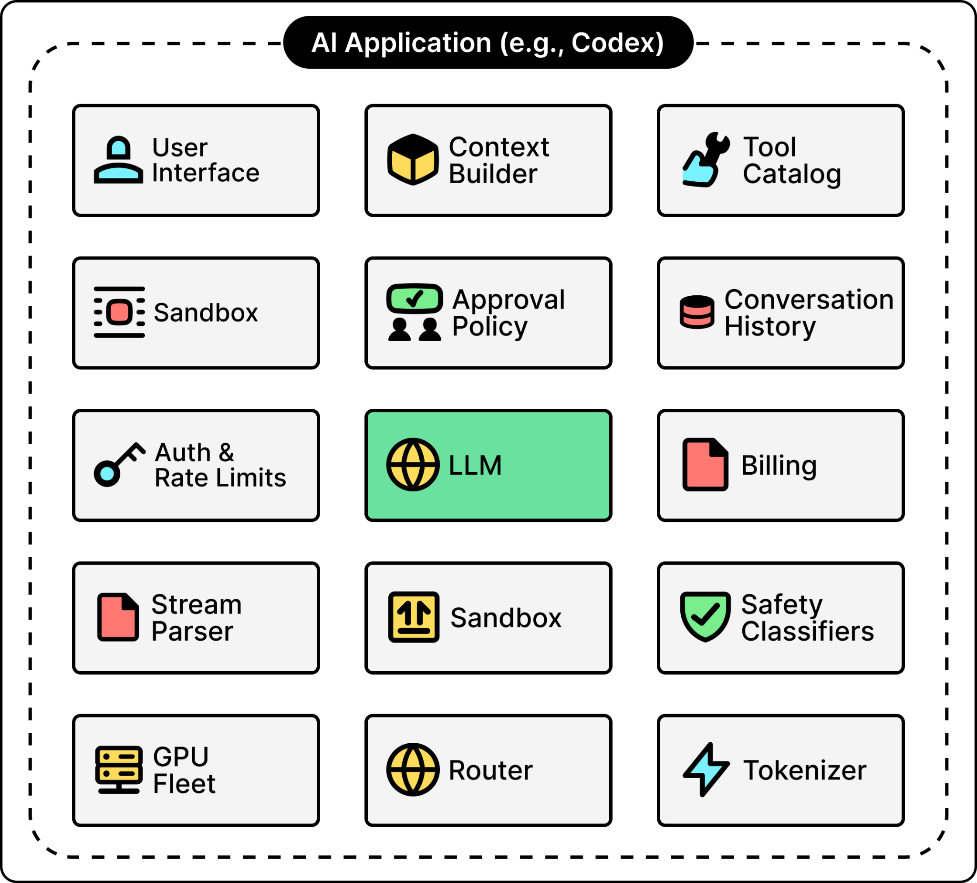
The Agent Harness
Harness is the surrounding system's decision-making component: it assembles context, admits or refuses each proposed operation, schedules execution, and determines that the run has ended.

Slide 33
The Agent Harness
The harness is essentially a controller. It owns control flow, admission, scheduling and termination. We’ll build these out over the semester.
Control flow. The controller determines what happens next and in what order. To maintain guarantees, this is often explicit and is not delegated to the model.
Admission. Every proposal is admitted or refused against types, permissions and budget, and both outcomes are recorded.
Budget. Tokens, wall-clock, tool calls and expenditure are checked before a call is issued. A budget verified only afterwards is a post-mortem.
HW1 requires pre-call admission with an output allowance and post-call reconciliation.
Scheduling. Serial or concurrent execution is the controller's choice, and a concurrent bound is a number the designer selects and can state.
Termination. Named conditions end a run: the goal test passed, the budget is spent (a failsafe), no progress occurred over N steps, or an unrecoverable error was raised. Each writes a distinct event.

Slide 34
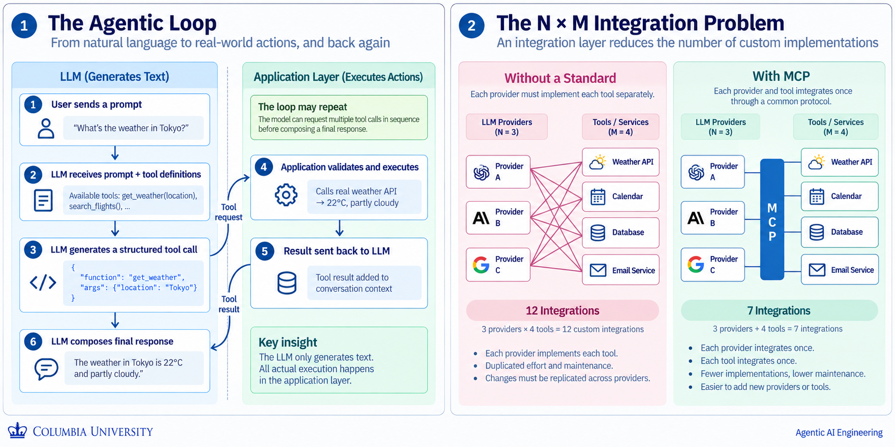
Tools
A tool is the only path from a proposed operation to a real effect. The model emits a structured call, the application layer executes it, and the result returns as data. A narrow and a strongly typed surface is the cheapest safety mechanism available.

Slide 35
Tools
A tool is the only path from a proposed operation to a real effect. The model emits a structured call, the application layer executes it, and the result returns as data. A narrow and a strongly typed surface is the cheapest safety mechanism available.
Property | Constraints
Narrow* | One operation with one purpose, and arguments that are types rather than prose. A tool accepting a free-text command re-exports the whole environment through a single schema.
Typed* | Types are the cheapest available validator and they run before the proposal reaches anything. In assignment 2, you’ll be building variants of these.
Idempotent | Idempotency requires that a repeated call carrying the same caller-supplied key return the first outcome rather than produce a second effect
Transactional | A retry is unavoidable, and its safety rests on transactionality that requires that the effect and the record of that key commit together or rollback together—partial effects not tolerable.
Guarded at the* boundary | Content returned by a tool is data and never instruction. Authority derives from the caller and never from the content.
* explored in HW2

Slide 36
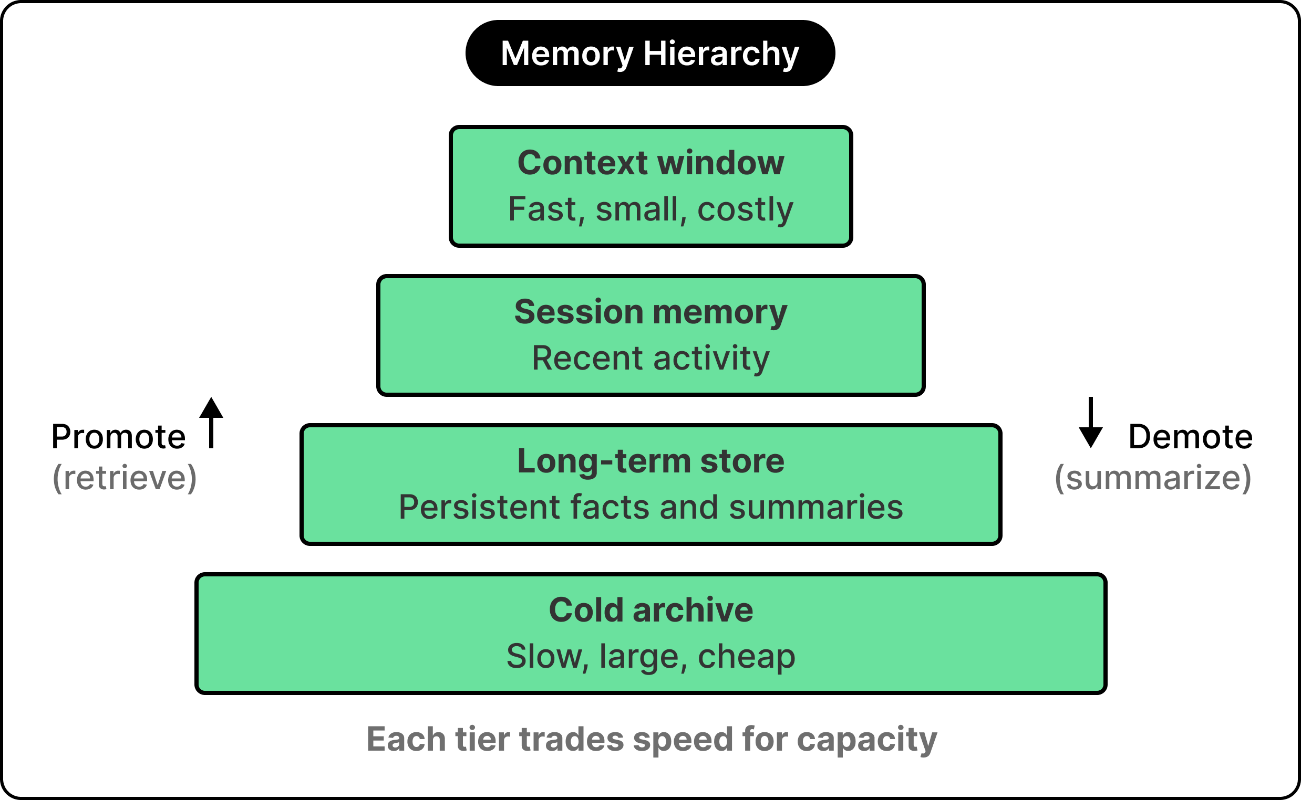
State
Context is the bounded input to one model call. Durable state preserves progress, evidence, and accounting beyond the process so a run can resume after failure instead of restarting.

Slide 37
State: Systems Properties and Guarantees
Agent state depends on durability, provenance, bounded working sets, resource accounting, and crash recovery. HW2 touches upon context compaction: managing a bounded working set by condensing prior context while preserving task-relevant information.
Property | Required guarantee
Durability | Accepted work and committed progress survive process termination.
Provenance | Conclusions remain linked to persistent, addressable supporting artifacts.
Bounded working set* | Each model input respects its token limit; context selection and truncation are explicit.
Resource accounting | Token usage is recorded per call, preserving distinct usage categories rather than conflating counters.
Crash recovery | Execution resumes from committed state after failure, preserving accepted work.
* explored in HW2

Slide 38
Environment
The environment can change state, exhaust resources, or interrupt execution independently of the run. Reliable agents therefore require verified outcomes, bounded resource use, explicit failure handling, and recoverable execution. Unit 4 addresses these obligations through deployment, recovery, and observability.
Property | Required guarantee
Outcome verification | Ground outcome claims in authoritative observations and account for stale reads or concurrent changes.
Resource control* | Bound consumption; apply backpressure, deferral, or rejection when capacity is exhausted.
Effect safety | Account for effects that may already have committed; use idempotency or reconciliation to prevent unintended duplication.
Failure handling* | Enforce explicit deadlines, distinguish retryable failures from refusals, and treat timeouts as uncertain outcomes.
Crash recovery* | Detect interrupted runs and recover accepted work from durable state, reconciling incomplete operations.
* explored in HW3

Slide 39
A summary of Roles and Guarantees
Six core guarantees are required of a production agentic system, and none resides within a single component.
Component | Guarantees it owns | Guarantees it doesn’t own
Model | None. The model proposes, and a proposal is not a guarantee | All six. Permission, durability and execution are held by other components.
Controller | Bounded execution (will this run stop, and at what cost?) • Recovery (can accepted work be resumed rather than restarted?) | External facts, the tool boundary's security, and the trace itself.
Tools | Partial failure (what happened when the call half-succeeded?) • Security and permissions (what may this run do, and to what may it not?) | Goals, global policy, and whether the call should be issued at all.
State | Observability (what is this run doing, observed from outside it?) • Reproducibility (could a third party obtain a compatible result?) | Decision-making. State records what happened and never selects what happens next
Environment | None. The environment is what the guarantees are held against | -

Slide 40
Assignments and what you will build

Slide 41
Problem Statement
Develop an agentic system that analyzes a reference application, identifies potential vulnerabilities, and produces a prioritized set of evidence-backed findings for human review. The application is pinned to a specific repository commit, and a course-provided catalogue of known vulnerabilities establishes the ground truth for evaluation.
The system must perform three functions:
1. Discover candidate vulnerabilities,
2. Triage candidates to reduce unnecessary human review, and
3. Validate retained candidates against inspectable evidence.
Each verdict must identify the relevant source locations, explain what was established, and reference artifacts that a reviewer can open independently of the agent’s conversation.

Slide 42
Cumulative assignments over the same system
Each assignment introduces a new engineering focus while preserving the mechanisms established in earlier assignments.
Assignment | Engineering objective | Required mechanisms
HW1 — Bounded execution | Establish a working agent whose execution is explicit and resource-bounded. | One sequential reactive agent; local read and search tools; explicit state transitions; structured findings and evidence; and a configurable per-run model-token budget enforced before every invocation.
HW2 — Tool interfaces and coordinated execution | Extend the agent with structured program-analysis tools (CLDK) and controlled workflow execution. | An MCP server exposing read-only CLDK operations; integration with the existing agent; a staged workflow with conditional routing; and sequential and bounded-concurrent execution modes.
HW3 — Recoverable deployment | Integrate context management, durable state, and recovery in a deployed prototype. | Explore context-selection and compaction mechanism that preserves artifact references and source identity; persisted run, progress, and accounting state; one durably committed stage checkpoint; and deployment on a local KIND cluster.

Slide 43
What the Course Provides
The course provides the application, analysis tools, model access, and experimental scaffolding needed to begin. Students are responsible for designing the agent architecture, integrating its components, and implementing and evaluating the required systems mechanisms.
Support | What students receive
Reference applications | A course-selected OWASP application in Python and Typescript, pinned to a specific commit, with setup instructions, test data, and a clearly defined testing scope.
Code analysis tools | Access to CLDK, installation guidance, API documentation, and examples of the read-only analysis operations used in the project. Students only implement the required MCP interface and agent integration.
Model API access | Course-provided model credentials.
Domain foundations | An introduction to the vulnerability classes, evidence requirements, and validation criteria needed for the assignments. Prior security expertise is not assumed.
Design support and feedback | Office hours for architectural brainstorming, trade-off discussions, experiment design, and debugging guidance. Published rubrics and submission checklists clarify the expected mechanisms, artifacts, and analysis.

Slide 44
Evaluation and grading
Grades are based on the completeness of the implementation, experiments, and analysis and not on the percentage of known vulnerabilities discovered. The primary objective is to build and experiment with agent architectures, study their systems properties, and evaluate their behavior using reproducible evidence.
Assessment dimension | What matters
Implementation completeness | Deliver one integrated system containing the required mechanisms from all three assignments. Earlier capabilities remain integrated as new ones are introduced.
Architectural reasoning | Explain the choices behind the agent loop, tool interfaces, workflow, context management, and persistence. Analyze their trade-offs rather than merely listing the components used.
Experimental completeness | Conduct each prescribed runs, document the controlled conditions, retain the resulting artifacts, and compare the observed behavior.
Systems evaluation | Investigate execution bounds, concurrency, context limits, resource accounting, observability, and recovery. Support claims with measurements and records, including cases where observed behavior differs from the intended design.
Each Homework is 20 Points. Actual distribution per task will be clearly specified

Slide 45
Questions

Slide 46
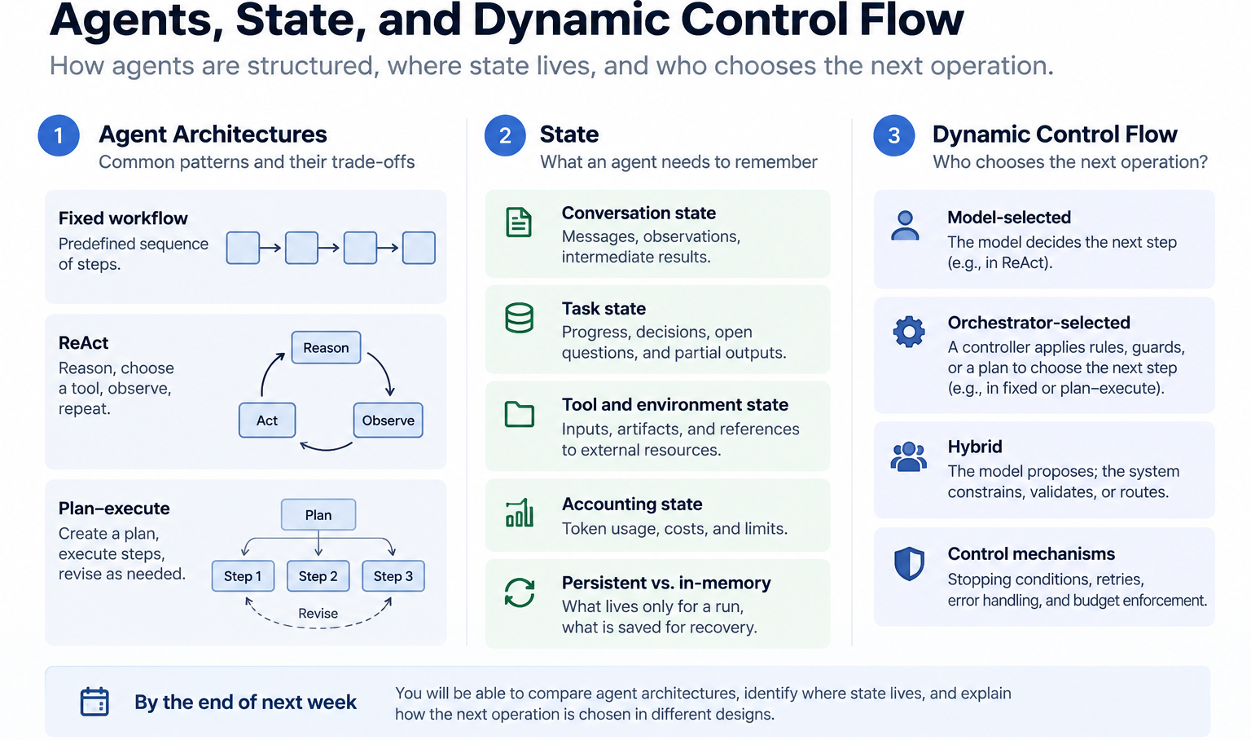
Next week…

