Slide 1
Designing Production Agentic Systems
Columbia · Fall 2026 · Lecture 3
Notes:
Introduce Lecture 3: execution machinery for agentic systems.

Slide 2
Lecture 2: Recap

Slide 3
Class announcements
HW1 is released today.
  Assignment groups after class today so I can plan accordingly

Slide 4
Lecture 3: Execution Machinery
Notes:
This lecture describes agents as state machines, then examines state records, routing, scheduling and tool execution.

Slide 5

Execution machinery
Agents as state machines
State, records and reducers
Routing, feedback and stopping
Scheduling and tool execution
Notes:
This lecture describes agents as state machines, then examines state records, routing, scheduling and tool execution.

Slide 6
Agents as state machines
Agents as state machines
State, records and reducers
Routing, feedback and stopping
Scheduling and tool execution
Notes:
This lecture describes agents as state machines, then examines state records, routing, scheduling and tool execution.

Slide 7
A state machine as a description of an agent
An agent runs in discrete steps: model calls, tool calls and checks.
Between steps, the agent retains information. The program determines permitted data changes and continuations.
A state machine specifies states, inputs, outputs and an initial configuration. A transition maps a state and input to a next state and output.
A workflow intended to terminate also specifies terminal configurations, from which no further step is scheduled.
A state machine is a simplified description of an agent. It omits the prompts, the model and the tool code.
This description lets us examine execution without describing the whole program.
Notes:
Section 1.1 describes five components: states, inputs, outputs, an initial configuration and a transition rule. A workflow intended to terminate also specifies terminal configurations.

Slide 8
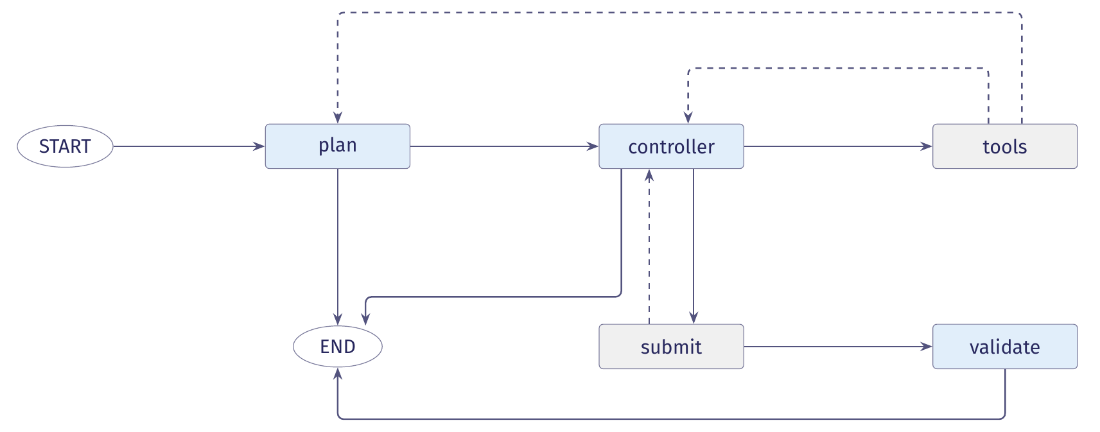
The planning agent's control locations
Each node names a control location. Arrows show the transitions the program permits.
Blue nodes call a model. Grey nodes run tools or checks.
Notes:
The diagram represents plan_and_validation/graph.py when the two runs were recorded. As Section 1.5 explains, the current code adds scan and normalize before plan.

Slide 9
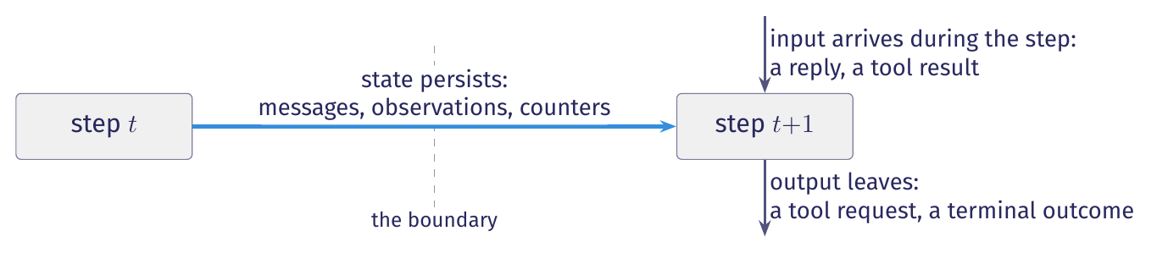
State: what the agent keeps between steps
An agent runs in discrete steps. Between two steps, some information persists.
The controller's next action depends on its instructions and earlier observations. The runtime's next decision may depend on how many model calls have been used.
Two visits to the controller can therefore lead to different next steps, because the retained data differ.
State contains the information the program retains between steps that can affect the next step.

Slide 10
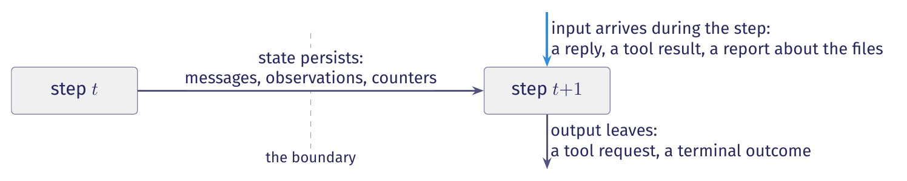
Inputs: what arrives during a step
Model replies and tool results arrive during a step. The program cannot compute them from its retained data.
A model reply is an input. The same state can receive a different reply next time.
We treat a tool's report about workspace files as an input observation.
State determines which transitions are permitted. It does not determine which result arrives.

Slide 11
Determinism: two ways to treat the reply
Whether the agent is deterministic depends on how we treat the model's reply.
 | The reply is an input | The reply is an internal choice
A model reply | The reply arrives as an input. | The model makes an unobserved internal choice.
Transitions | Exactly one transition is enabled for each state and reply. | One state permits a tool call or a submission.
Behaviours | A fixed input sequence gives one behaviour. | A fixed input sequence permits a set of behaviours.
Probabilities | This description assigns no probabilities. | This description assigns no probabilities.
Notes:
A probabilistic machine assigns a probability to each transition. A nondeterministic machine permits any enabled transition without assigning probabilities. We use nondeterminism to represent unobserved choices.

Slide 12
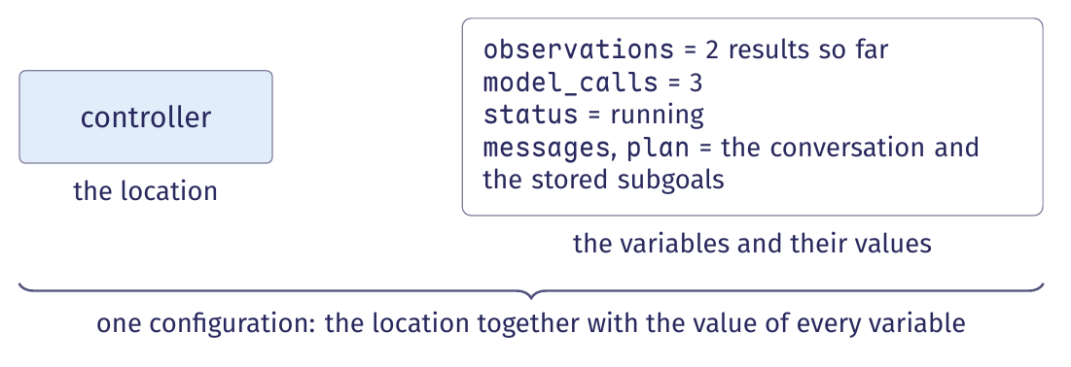
Extended state machines and configurations
An agent has a small number of control locations and a large amount of data.
An extended state machine adds variables to a finite set of control locations. A configuration pairs the current location with the values of all variables.
In run bc284c6b, the controller is visited five times, with a different configuration at each visit.
Notes:
The displayed values describe run bc284c6b before its third controller call: two observations have been recorded, three model calls have completed, and the status is running.

Slide 13
Configurations: finite control, unbounded data
Finite control does not give a finite set of configurations.
With model_calls as the only variable and a budget of N, each location has at most N+1 configurations.
A message list without a length bound gives no finite bound on the number of configurations.
Enumerating all reachable configurations may therefore fail to terminate.
An extended state machine can have finitely many control locations and infinitely many configurations.
The set of control locations and guards remains finite.

Slide 14
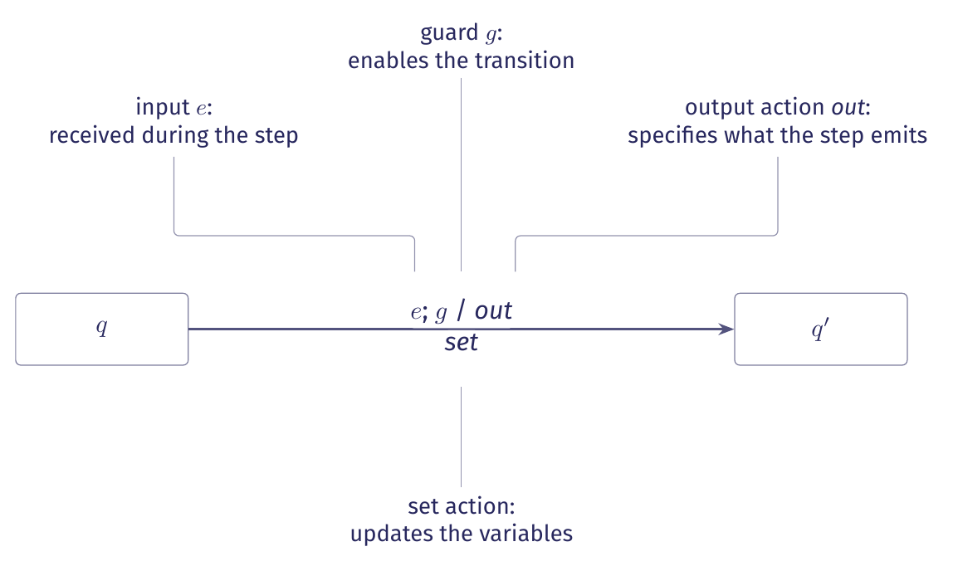
Transitions: guard, output action, set action
An edge specifies a guard, an output action and a set action.
(q, v) -- e ; g / out ; set --> (q', v')
From (q, v), the transition reads input e, tests g, emits out and applies set to reach (q', v').
Notes:
This slide introduces the transition notation. Later slides describe the same operations in prose.

Slide 15
The elements of a transition (for an agent)
Element | In an agent
Control location | A control location names the computation ready to run: a model call, tool dispatch or check.
Variables | Variables hold messages, observations, a plan, counters, check results and a status between steps.
Input | An input is a result received during a step, such as a model reply, tool result or check result.
Guard | A guard is a predicate over the variables and input, such as “the reply requests a tool”.
Output action | An output action requests an operation or reports a terminal outcome.
Set action | A set action updates variables, such as storing a reply, extending observations or incrementing a counter.
Initial configuration | The first location has the initial variable values: opening messages, zero counters, no observations and running status.
Terminal configuration | No further computation is scheduled from a terminal configuration. The state stores the reason for ending.
Table 1 in the lecture notes gives each element its symbol.

Slide 16
One transition in code: controller to tools
graph.py, controller and after_controller (excerpt)
# ours: the model reply is the input
reply = self._call(model, state["messages"], role="controller")
# ours: append the reply and increment the call count
return {"messages": [reply], "model_calls": 1,
"usage": self._usage(reply)}
# ours: the guard tests whether the reply has tool calls
if state["messages"][-1].tool_calls:
return "tools"
return "submit"
The reply is the input, the tool-call test is the guard, and the returned dictionary specifies the set action.
Notes:
The excerpts come from controller at graph.py line 296 and after_controller at line 452. Trace calls and the admission check are omitted. The model_calls field uses operator.add, so returning 1 increments the stored count by one.

Slide 17
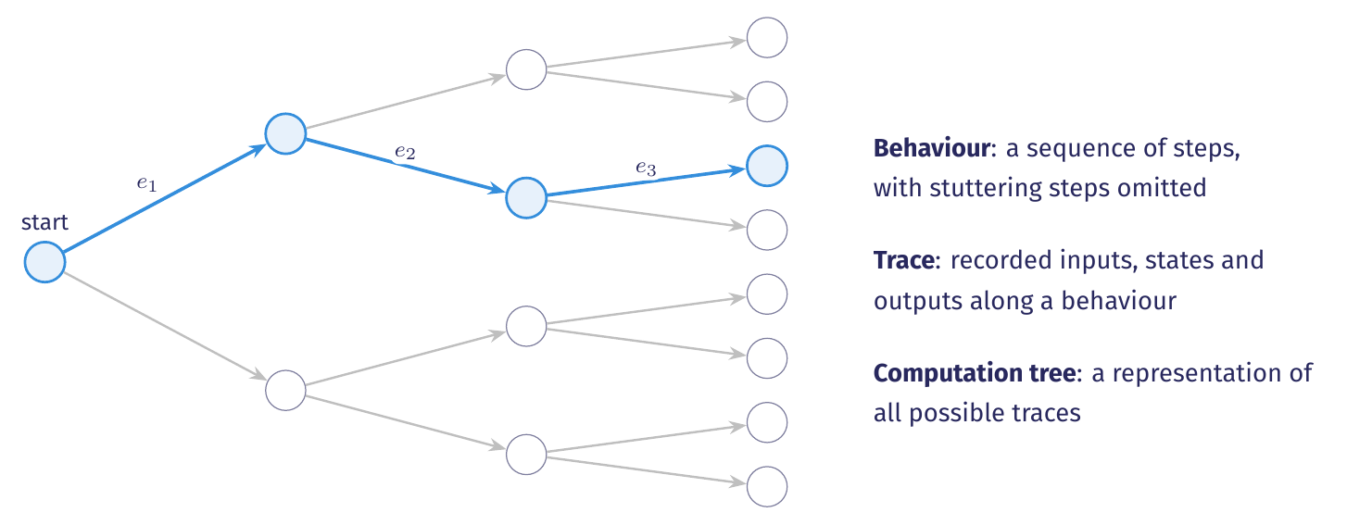
Behaviour, trace and computation tree
A behaviour omits steps with no input, state change or output.
For a fixed input sequence, a deterministic machine exhibits one behaviour. A nondeterministic machine may exhibit several. The computation tree represents all possible traces.

Slide 18
The event log as a trace
Saved logs and workspace artifacts can survive the process. Unsaved state is lost when the process exits.
bc284c6b, events 19 to 22 (selected fields)
{"step": 19, "kind": "model_call", "role": "controller",
"tool_calls": []}
{"step": 20, "kind": "routing", "decision": "submit",
"by": "model"}
{"step": 21, "kind": "state_change", "node": "submit",
"checks": {"applies": true, "touches_line": true,
"rescan_clean": true}}
{"step": 22, "kind": "routing", "decision": "validate",
"by": "runtime"}
State records what the run currently knows. The trace records what the run did.
Notes:
The trace contains six kinds of event: tool_request, tool_result, model_call, routing, state_change and terminal. While the run is active, an empty tool_calls list causes after_controller to return submit.

Slide 19
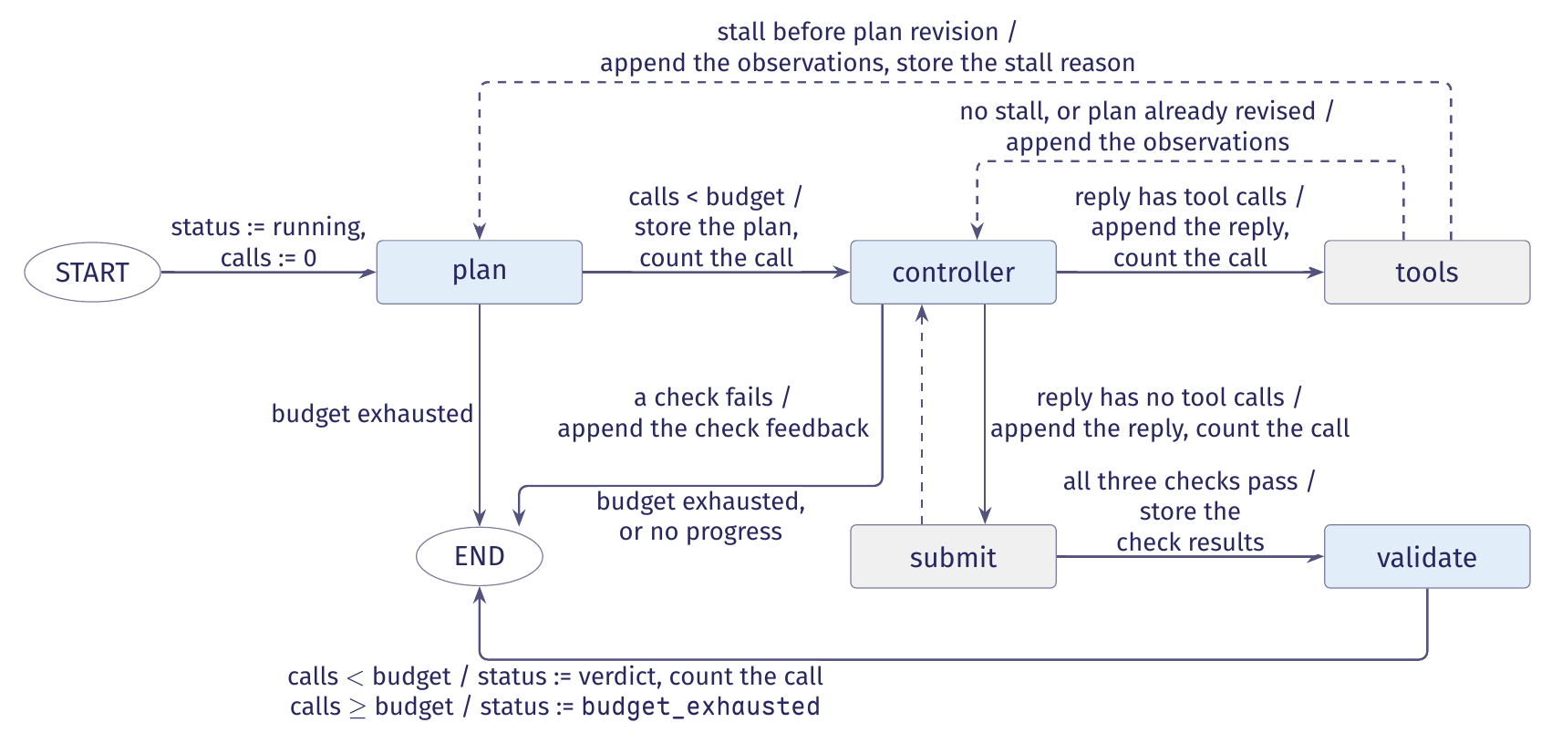
The planning agent's state machine
Each arrow shows its guard and set action. Output actions are omitted.
Figure 1 in the lecture notes gives the full guards and state updates.
Notes:
The plan, controller and validate nodes call a model. The tools and submit nodes perform runtime work. Each model node checks the forty-call budget before making a call.

Slide 20
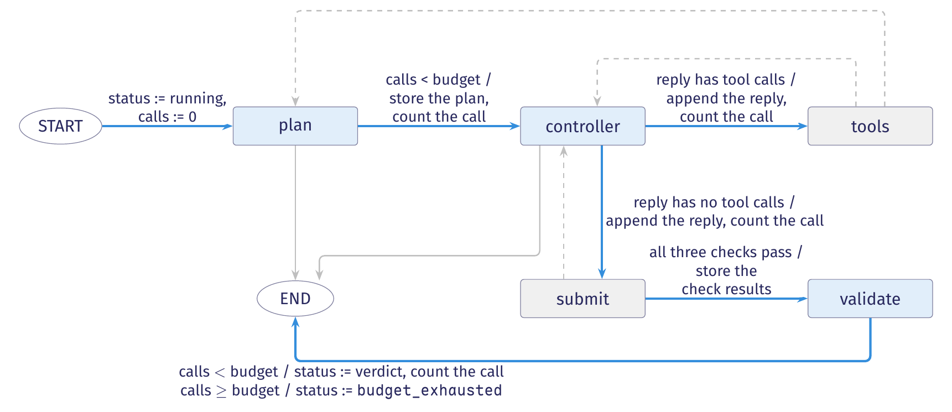
The planning agent's forward path
The agent plans, acts, submits a candidate and judges it.
The agent stores the plan in its state. It carries out the plan’s subgoals through the control locations already defined in the graph.
Notes:
The three checks test whether the patch applies, whether it touches the flagged line, and whether a rescan reports no finding. The controller receives the plan as a message. Routing does not test which subgoal is current.

Slide 21
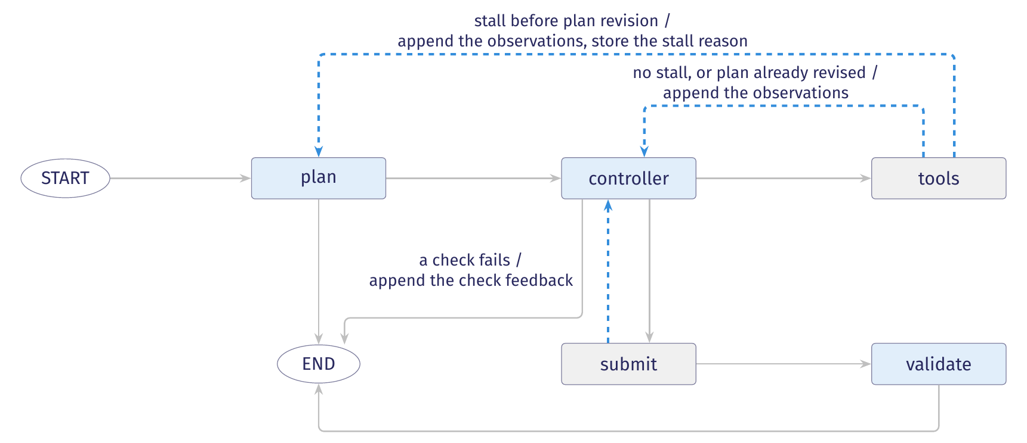
The planning agent's feedback edges
The figure shows the tool loop, plan revision and candidate repair.
On a stall before any revision, tools returns to plan. When a check fails, submit appends feedback and returns to controller.
Notes:
The stall guard holds when the last three observations in the current plan’s window are identical and none records a successful edit. Plan revision sets replanned_at, and later stall checks read only observations from that index onward.

Slide 22
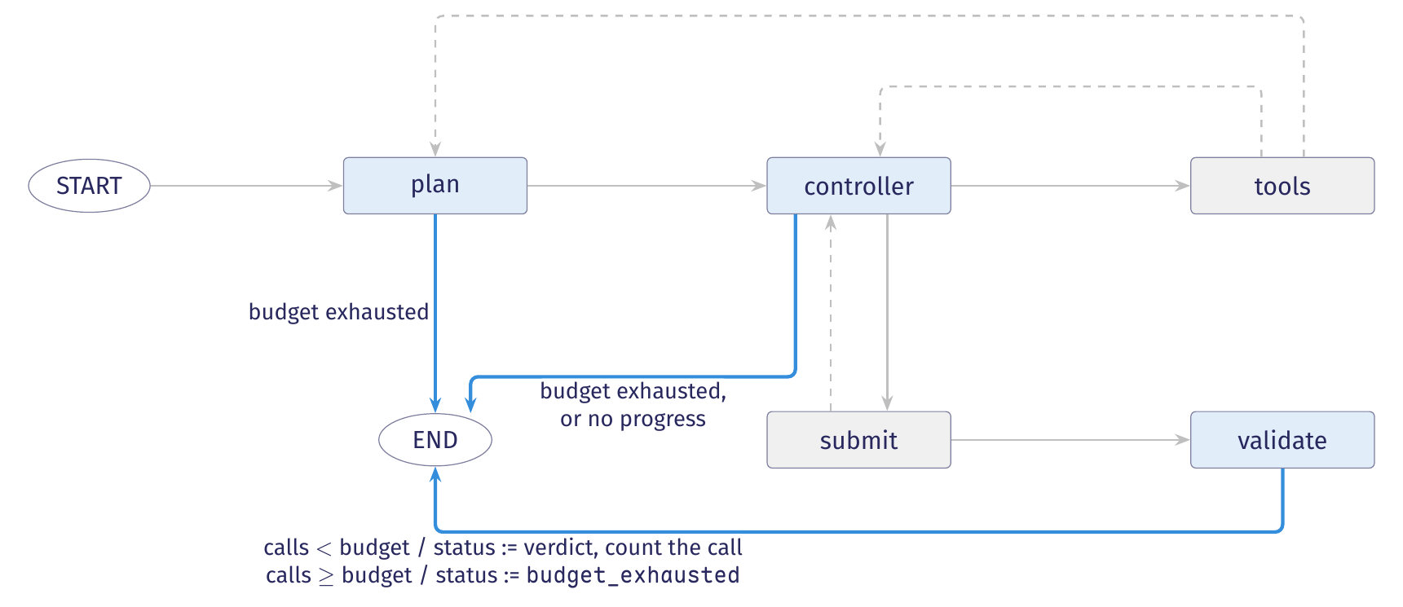
The planning agent's exits
Three locations can end the run before a verdict.
Before each model call, plan, controller and validate compare the call count with the budget of 40. The controller also stops a run that stalls after revising its plan.

Slide 23
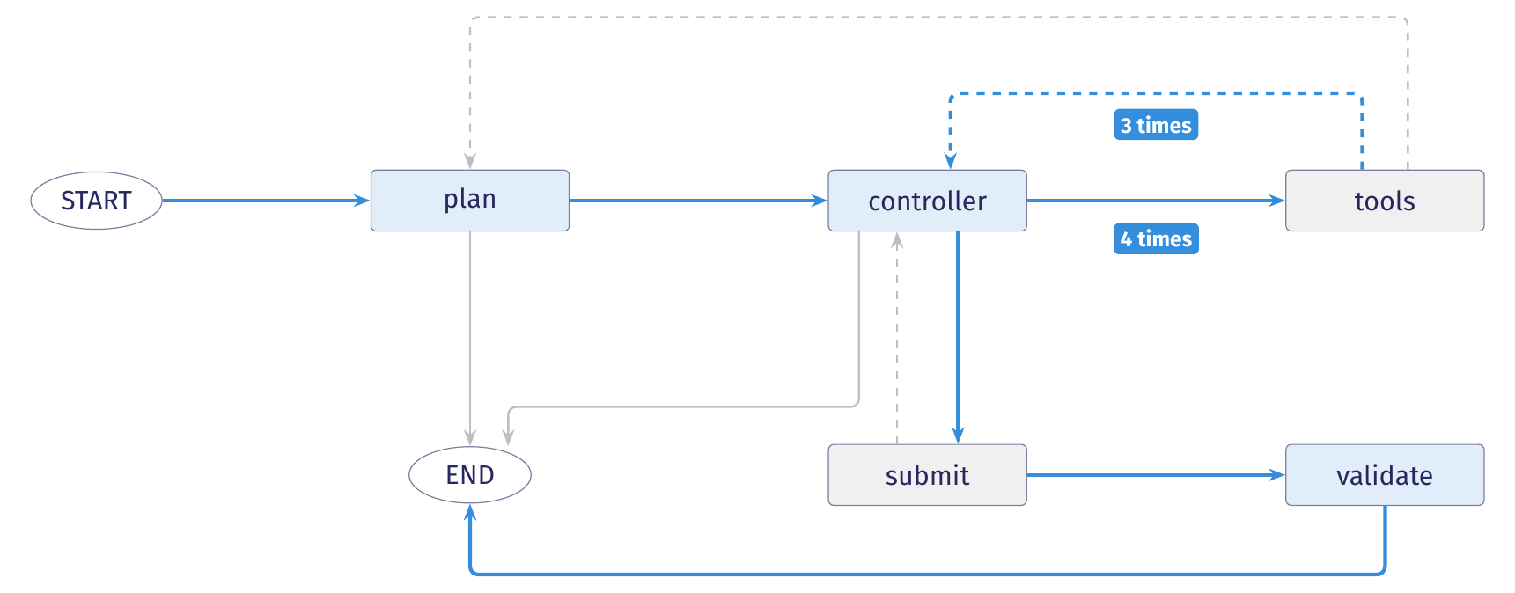
The recorded run through the planning agent
Blue edges show the trajectory of run bc284c6b.
The run repairs a Bandit B608 alert at line 46 of testcode/BenchmarkTest00283.py in seven model calls: one in plan, five in controller and one in validate.
Notes:
Events 1 and 2 record planning. Events 3–18 record four tool rounds: read_file, search, read_file and edit. Events 19–22 record submission. Events 23–25 record validation and the terminal event. The run logged 12,693 input tokens and 3,755 output tokens.

Slide 24
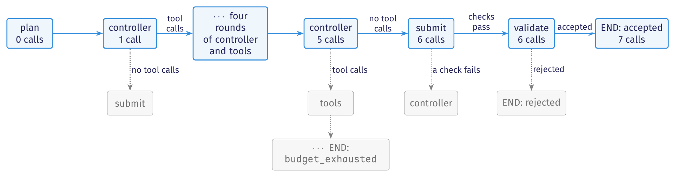
The recorded run in the computation tree
A trajectory is one path through the computation tree. Each controller visit creates a new node with branches for possible replies.
The machine diagram shows permitted transitions. The tree shows possible sequences of transitions from the initial configuration.
Figure 2 in the lecture notes shows a larger fragment of the same tree.

Slide 25
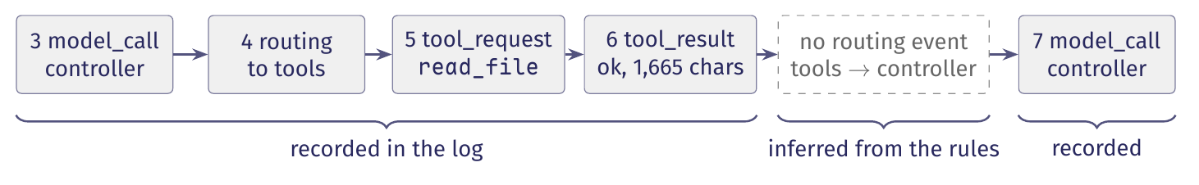
What the event log records and omits
An event log records selected inputs, outputs and state. It meets the definition of a trace only partly.
A successful tool_result records success and result length. It omits the observation itself.
The routes from tools to controller and plan to controller have no routing event. We infer them from the transition rules.
The log omits counters. The call counts in the tree are derived from logged calls and set actions.
We reconstruct the trajectory using logged facts and transition rules. A claim about the run must identify which of these supports it.

Slide 26
State records and transitions

Slide 27
State records and schemas
The machine diagram shows permitted control flow. The state record stores information passed between steps.
Each record instance holds current variable values. The runtime separately tracks the control location.
The schema declares each field's name and type. Nodes read the record and propose partial updates.
In our agent, StateGraph(AgentState) constructs the graph with AgentState as its schema.
A state record is a collection of named fields and their values that represents the state retained between steps.
Routing and dispatch both read this record.
Notes:
Section 2.1 connects the EFSM variable values to the state record. The schema declares field names and types. A record instance supplies their current values.

Slide 28
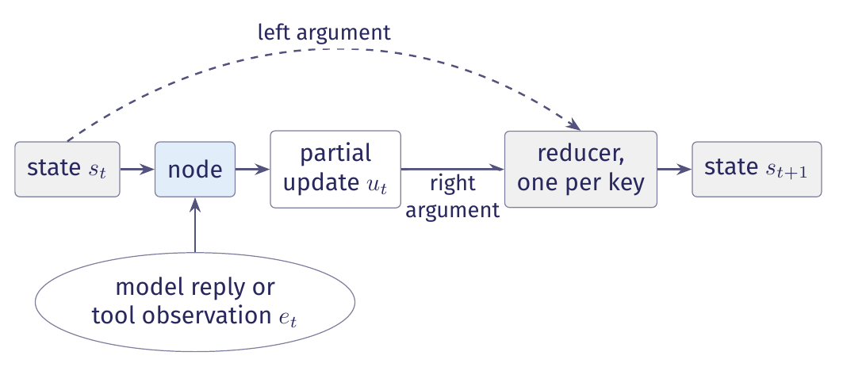
Partial updates and state transitions
A node returns a partial update. The runtime merges it into the record, key by key.
In Figure 3 of the lecture notes, the runtime preserves each field omitted from the partial update.
Notes:
The node's parameter is the state alone; the external result is what arrives during the step, a model reply or a tool observation.

Slide 29
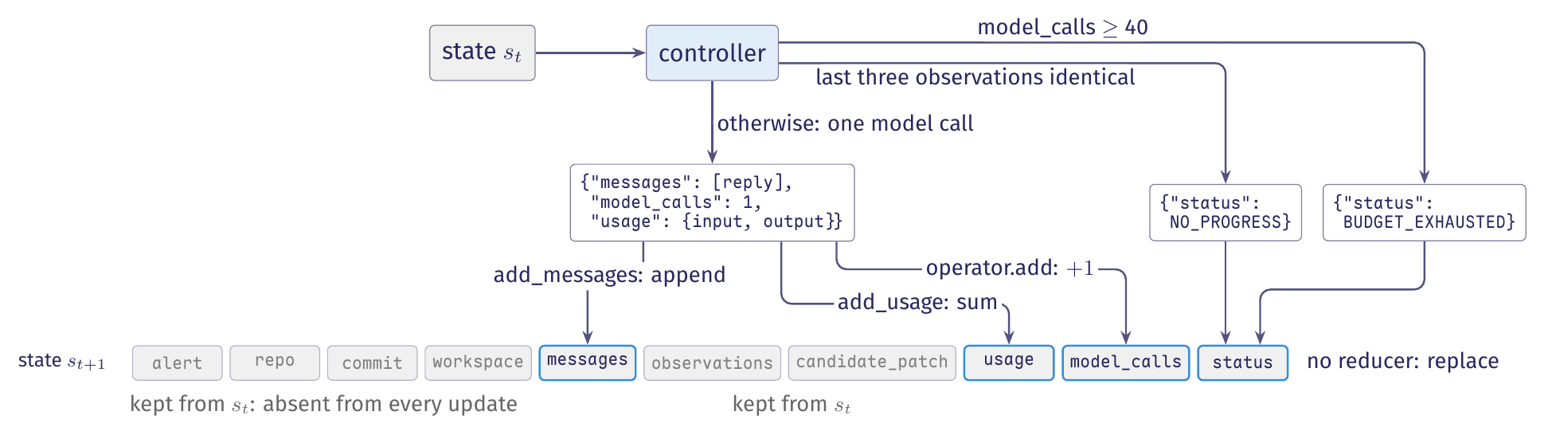
The controller's three return sites
The loop's controller has three return sites. Each returns only the keys it updates.
In Figure 4 of the notes, a model call updates three keys. Each stopping path updates one. Six keys are absent from every update.
Notes:
The figure shows the loop’s ten-key record. The status field has no reducer. When a node returns status, the returned value replaces the stored one.

Slide 30
The controller's return sites, in code
Each controller return supplies a partial update containing only the fields that the path updates.
graph.py, controller, lines 298 to 313. Stall test and model setup omitted
spent = self._admit(state)
if spent:
return spent
# ours: The stall test and its trace event are omitted.
return {"status": TerminalStatus.NO_PROGRESS}
reply = self._call(model, state["messages"], role="controller")
return {"messages": [reply], "model_calls": 1,
"usage": self._usage(reply)}
Reducers append the reply and accumulate the call and token counters.
Notes:
The controller begins at graph.py line 296. When the call budget is exhausted, _admit returns a terminal update. Otherwise, it returns None.

Slide 31
Model context, runtime state, durable state
Each model context is derived from runtime state. Saving state beyond the process lifetime supports resumption.
State or context | What it holds | Who reads it
Model context | It holds instructions, selected history and observations for one model call. | The model reads it.
Runtime state | It is the record retained between steps, including fields excluded from model calls. | Nodes, routing functions and limit checks read it.
Durable state | It is runtime state saved beyond the process lifetime in a form that supports resumption. | The runtime loads it to resume.
Table 2 in the notes also requires the matching workspace and pending work for resumption. Our graphs have no checkpointer.
Notes:
The JSONL trace can survive process exit, but it does not contain enough information to resume the run. A later unit covers checkpointers.

Slide 32
Model context and admission checks
The model receives the conversation. Admission compares the call counter with the configured budget.
graph.py, controller line 312 and _admit lines 183 to 186. Trace event omitted
# ours: The controller supplies the conversation to the model.
reply = self._call(model, state["messages"], role="controller")
# ours: Admission runs before every model call.
if state["model_calls"] >= self.config.budget:
return {"status": TerminalStatus.BUDGET_EXHAUSTED}
Admission reads the call budget. The controller's context does not contain it.
Notes:
Section 2.6 explains that none of the planning agent’s prompts mentions the call budget. Admission enforces it by comparing the call counter with the configured limit before each call.

Slide 33
Reducers: append, replace, accumulate
A reducer defines how a field's stored value and its update produce the next value.
Append adds the update to the stored list and retains earlier values.
Replace overwrites the stored value with the update.
Accumulate combines the stored value and update, usually by summing.
A merge function takes the stored value and the update's value and returns the field's next value.
An empty update leaves an appended field unchanged.
Notes:
LangGraph calls a field’s merge function a reducer and attaches it with Annotated[T, fn]. Clearing an appended field requires Overwrite. A separate trace event should record that reset because it bypasses the ordinary merge rule.

Slide 34
The reducers in the schema
Annotated[T, fn] attaches a reducer to a field. Without a reducer, an update replaces the stored value.
state.py, AgentState, lines 76 to 98 (selected fields)
class AgentState(TypedDict, total=False):
# ours: other fields are omitted
messages: Annotated[list, add_messages]
observations: Annotated[list, operator.add]
usage: Annotated[Usage, add_usage]
model_calls: Annotated[int, operator.add]
status: str
Four fields use reducers. Fields without reducers retain their value until an update replaces it.
Notes:
add_usage maintains four separate token counters. Keeping the counters separate preserves the distinction between cache reads and fresh input tokens.

Slide 35
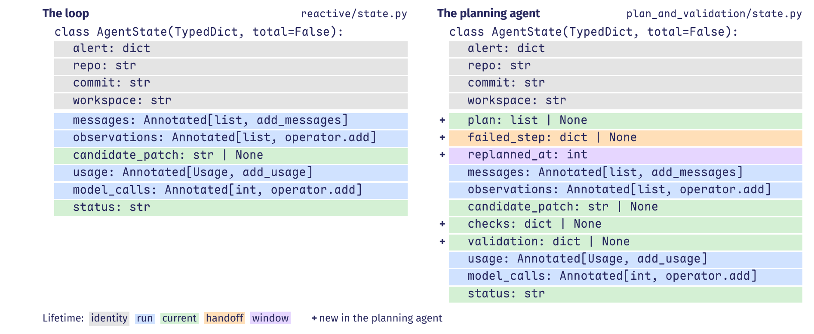
State schemas and field lifetimes
The planning agent has five additional fields. Shading indicates each field's lifetime.
Figure 5 of the lecture notes shows no attempt-lifetime fields because neither agent retries.
Notes:
The planning agent adds three fields with the current lifetime: plan, checks and validation. The failed_step field has the handoff lifetime, and replanned_at has the window lifetime.

Slide 36
Field lifetimes
A field's lifetime is the part of a run during which its value is valid evidence for its readers.
Lifetime | Definition and use
Identity | Identity fields identify the task, target and workspace and remain unchanged.
Run | Run fields retain histories and counters that grow throughout the run.
Current | Current fields hold the latest plan, candidate, check result or status until the writer replaces them.
Handoff | A handoff field carries a reason to one reader, which clears it after acting.
Window | A window field stores the starting index of a span of run history.
Attempt | Attempt fields hold results for one attempt and permit clearing before a retry.
The runtime enforces the reducer. A field's writers must also follow its lifetime rules.
Notes:
Section 2.4 explains why a limit across attempts requires a counter with the run lifetime. A counter with the attempt lifetime resets after failure and cannot enforce that limit.

Slide 37
Handoff and window, in the planning agent
The tools node writes a stall reason. The plan node reads it, clears it and updates the window.
graph.py, tools lines 361 to 367 and plan lines 260 to 270. Excerpts
if (not state.get("replanned_at")
and self.stalled(window, self.config.no_progress_steps)):
update["failed_step"] = { # ours: remaining entries omitted
# ours: The plan node returns this partial update.
update = {"plan": steps,
"failed_step": None,
if failed:
update["replanned_at"] = len(state["observations"])
If the plan node leaves failed_step set, routing selects it again after the next tools step.
Notes:
The stall check reads observations[replanned_at:]. Updating replanned_at after plan revision excludes the observations that triggered revision from later stall checks.

Slide 38
Proving invariants over configurations
A spending limit is a property of the whole run. Its proof must cover every permitted transition.
The predicate holds in the initial configuration.
Every transition from a configuration satisfying the predicate preserves it, including unreachable configurations.
A stronger predicate may be needed to prove preservation by every transition.
An invariant holds initially. Every transition from a configuration satisfying it must lead to another configuration satisfying it.
The proof establishes the property for every reachable configuration.
Notes:
Section 2.5 applies the MIT 6.042 invariant theorem to configurations of an extended state machine. Each arrow denotes one transition.

Slide 39
The call budget as an invariant
We prove that the counter equals the number of completed calls and does not exceed the budget.
Admission. A transition may issue a model call only when the call counter is below the budget.
Counting. Each completed model call must add exactly one to the call counter.
Preservation. Transitions without calls leave the counter unchanged. No transition decreases it.
The reducer accumulates reported calls. Each caller must check the budget before calling and report each completed call exactly once.
In our agent, model_calls must remain at most forty.
Notes:
The argument covers completed calls only. An interrupted call may consume tokens without being counted.

Slide 40
Constructing and compiling the state graph
StateGraph creates one channel per schema field. Nodes and edges define the graph before compilation.
graph.py, compile, lines 493 to 521. Selected declarations
graph = StateGraph(AgentState)
graph.add_node("plan", self.plan)
graph.add_node("tools", self.tools)
# ours: Five node and five edge declarations are omitted.
graph.add_edge(START, "scan")
graph.add_conditional_edges("tools", self.after_tools,
{"controller": "controller", "plan": "plan"})
graph.add_edge("validate", END)
return graph.compile()
compile() checks the wiring and returns a runnable graph.
Notes:
add_node registers a function that receives the whole state and returns a partial update. add_edge declares a fixed transition. add_conditional_edges registers a routing function that returns the selected destination’s name.

Slide 41
Designing a state graph
We define the state graph in this order. Each schema field is added with the node that populates it.
Name the nodes and the routing decisions between them.
List the values that nodes and routing functions read to define the schema.
Identify each field's writer and when its value becomes invalid.
Choose each field's lifetime and the corresponding reducer.
Write the initial state with a value for every key.
Write each node to return only its own keys.
Each field retains a value that a later computation needs to read.
Notes:
The six steps appear at the end of Section 2.6. Omit fields that no computation reads.

Slide 42
Routing functions and conditional edges
A routing function reads the record after the runtime merges the node's update. It selects the next node or ends execution.
The next section examines conditional edges, feedback to the plan node or controller, and three interpretations of a trace: recorded acceptance, a declared stop, and no recorded ending.

Slide 43
Routing, feedback, and stopping

Slide 44
Routing functions and conditional edges
The routing function selects the next step by testing values in the record.
Proposal. The model emits a tool request, plan, candidate patch, or verdict.
Record. The runtime merges the proposal into state through reducers and records what happened in the trace.
Decision. The routing function tests fields of the merged record using the programmer's guards and limits.
A conditional edge consists of a location's outgoing transitions and a routing function that selects the destination whose guard holds.
The by field identifies the source of the value tested by the routing function.
Notes:
A routing guard can test information retained in the merged record. Information discarded by the node is unavailable to that guard. END is LangGraph’s terminal node. The record supplies the reason for ending.

Slide 45
Routing after the controller
The routing function reads the merged record and returns the name of the next node.
graph.py, after_controller, lines 452 to 460. Trace calls omitted
def after_controller(self, state: AgentState) -> str:
if state["status"] != RUNNING:
return END
if state["messages"][-1].tool_calls:
return "tools"
return "submit"
The routing function tests status, then tool_calls in the last reply.
Notes:
If the run remains active, a reply that both claims the patch is correct and requests a tool routes to tools. The after_controller function tests tool_calls and does not read the reply’s prose.

Slide 46
The same graph, different paths
The compiled graph stays fixed across runs. Values in the merged record determine the path.
A run that calls the controller twelve times passes through twelve branch points without changing the graph.
Notes:
Each visit to a location is a new node of the computation tree, with its own configuration.

Slide 47
Feedback edges: revision and repair
A feedback edge returns control to a visited location. It specifies a trigger and the information passed back.
A stall returns control to plan once. Failed checks return control and their reasons to controller.
Notes:
Revision identifies a problem with the plan; repair identifies a problem with the artifact. Both continue the run and need a bound.

Slide 48
Feedback edges and their bounds
Two feedback edges are implemented. A third, for new attempts, is proposed.
Feedback edge | Trigger | Information and reset | Bound
Revision: tools to plan | The current plan's last three observations are identical. None is a successful edit. | The plan node reads the stall reason and old plan. It replaces the plan, clears the handoff and moves the window. | One revision is allowed. A second stall ends the run.
Repair: submit to controller | At least one of the three checks fails. | The conversation receives the check reasons. The next submission replaces the patch and check results. Nothing is reset. | The call budget bounds repair.
New attempt (proposed) | The validator rejects, and attempts remain. | The reflection is retained. Each attempt-lifetime field is cleared explicitly. | A counter with the run lifetime limits attempts. The call budget also applies.
Table 4 in the notes. Each feedback edge needs a limit.

Slide 49
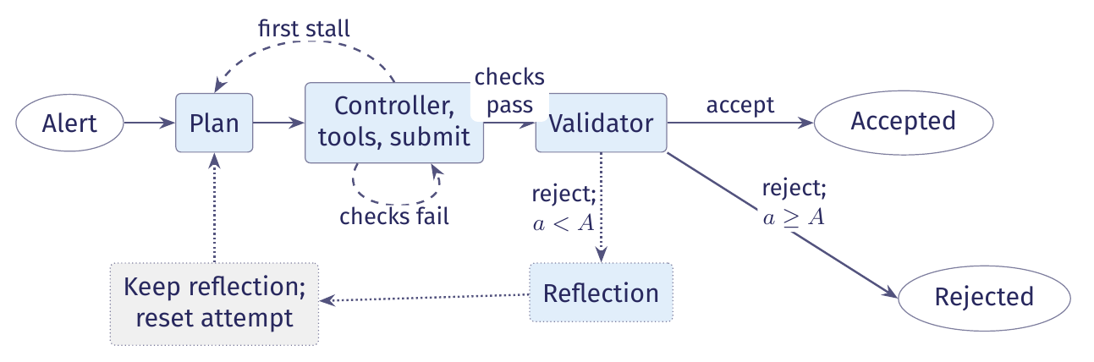
A proposed feedback edge for new attempts
In the current agent, rejection ends the run. The extension would record a reflection and start a new attempt.
Figure 6 in the notes. A new attempt clears attempt-lifetime fields and retains run-lifetime fields.
Notes:
The attempt counter has the run lifetime. Resetting it at the start of each attempt prevents it from enforcing the attempt limit.

Slide 50
Loop bounds and termination
An acceptance predicate identifies a successful ending. It does not ensure that one occurs.
Remaining calls is a variant if every cycle consumes a call and each step between calls returns or times out.
A cycle that consumes no model calls needs its own bound.
A stall check detects a particular pattern of non-progress. Other patterns can occur.
A variant is a quantity that strictly decreases on every continuing cycle and cannot decrease indefinitely.
Detecting one failure pattern does not prove termination.
Notes:
Cornell CS 2112 calls the decreasing quantity a decrementing function or loop variant. ReACT’s recorded trajectories contain repeated actions that make no progress. Our stall check detects repeated identical observations.

Slide 51
Checking the budget before each model call
Three runtime checks can end a run before a verdict. The budget is checked before each call.
graph.py, _admit, lines 174 to 187. config.py, line 41. Comments omitted.
def _admit(self, state: AgentState) -> dict | None:
if state["model_calls"] >= self.config.budget:
# ours: budget_exhausted routing event omitted
return {"status": TerminalStatus.BUDGET_EXHAUSTED}
return None
budget: int = 40
The first stall triggers revision. The second ends the run. The recursion limit caps supersteps.
Notes:
Admission checks the budget before each model call. Checking afterwards would allow the call to incur cost before enforcing the limit. The recursion limit is four times the call budget and uses no information about the task.

Slide 52
What a trace establishes
We distinguish termination, acceptance, and the task's postcondition.
Execution terminated. A terminal event establishes this.
The acceptance procedure passed. An accepting terminal status establishes this.
The artifact satisfies the task's postcondition. No trace event establishes this.
The trace records the outcome of the acceptance checks. It does not establish that the patch is correct.
A model's claim that it has finished is a proposal. The runtime applies completion rules and sets the status.
Notes:
Section 3.5 explains what a trace establishes.

Slide 53
Terminal statuses and trace closure
The trace writer accepts five terminal statuses. Normal closure without a terminal event raises NoTerminalStatus.
trace.py, lines 36 to 47 and 100 to 101. Comments omitted.
class TerminalStatus(str, Enum):
ACCEPTED = "accepted"
REJECTED = "rejected"
BUDGET_EXHAUSTED = "budget_exhausted"
NO_PROGRESS = "no_progress"
ERROR = "error"
class NoTerminalStatus(Exception):
"""A run was closed without stating how it ended."""
A missing terminal event at normal trace closure indicates an instrumentation defect.
Notes:
When an exception escapes the run, the trace writer records terminal status error, followed by a record naming the exception.

Slide 54
Three interpretations of a trace
When an exception escapes, the writer records error, then names the exception. SIGKILL runs no handler.
What the trace records | What it supports
A verdict, then a terminal event with status accepted | Execution terminated and the acceptance procedure passed. The trace does not establish that the patch meets the task's postcondition.
A terminal event with a stop status | Execution terminated without acceptance, with partial evidence and the stated reason. For error, the next record names the exception.
No terminal event | The trace does not establish termination. The run may still be active, or the process may have been killed without running a handler.
Table 5 in the notes. Calling a missing terminal event error assigns a cause without evidence.

Slide 55
A recorded repair after failed checks
In run 28e37a00, the first patch applies but misses the flagged line, and the rescan still reports the finding.
28e37a00, steps 25–26. Reasons abbreviated
{"step": 25, "kind": "state_change", "node": "submit",
"checks": {"applies": true, "touches_line": false,
"rescan_clean": false, "reasons": [...]}}
{"step": 26, "kind": "routing", "decision": "controller",
"by": "runtime", "reason": "mechanical checks failed",
"reasons": ["the edit did not touch
testcode/BenchmarkTest01179.py:31 ...",
"semgrep: ... path-traversal-open is still ..."]}
The controller receives both reasons as a conversation message and submits again after three tool rounds.
Notes:
Steps 27–38 record three tool rounds. At step 41 the rescan reports no finding, but the flagged-line check still fails. Step 42 routes to the controller with that reason.

Slide 56
A recorded keyboard interruption
After the second failed submission and two more tool rounds, the run is interrupted from the keyboard.
28e37a00, steps 50–52. Ts and run_id omitted
{"step": 50, "kind": "tool_result", "tool": "read_file",
"ok": true, "chars": 1081}
{"step": 51, "kind": "terminal", "status": "error",
"usage_total": {"input": 67586, "output": 10380,
"cache_read": 0, "cache_write": 0}}
{"step": 52, "kind": "state_change",
"exception": "KeyboardInterrupt", "message": ""}
A SIGKILL at the same point would leave the file ending at step 50, without terminal or exception records.
Notes:
The trace does not establish what the process was doing between event 50 and the interrupt. Neither recorded run ends with status budget_exhausted. The description of that ending comes from the code.

Slide 57
Scheduling, tools, and execution authority

Slide 58
Supersteps: when an update becomes visible
Routing selects the next location. Scheduling determines when it runs and which state it reads.
Planning selects the computations whose inputs were written in the previous superstep.
Execution runs these computations. Their record updates remain invisible to other computations during this phase.
Update applies the writes through the reducers. The next superstep uses the updated state.
A superstep has planning, execution and update phases. Record updates become visible to other nodes in the next superstep.
A tool can change a file before the superstep ends.
Notes:
LangGraph organizes execution into Pregel supersteps. Multiple writes to one field in the same superstep require a reducer that combines them. Without one, the runtime rejects the competing writes.

Slide 59
Two supersteps in the recorded run
Events 3 and 4 belong to the controller's superstep, and events 5 and 6 to the tools node's.
bc284c6b, events 3 to 6. Timestamp, run identifier and thinking omitted.
{"step": 3, "kind": "model_call", "role": "controller",
"tool_calls": ["read_file"], "usage": {"input": 1284, "output": 51}}
{"step": 4, "kind": "routing", "decision": "tools", "by": "model"}
# ours: the next superstep starts here
{"step": 5, "kind": "tool_request", "tool": "read_file",
"args": {"path": "testcode/BenchmarkTest00283.py"}}
{"step": 6, "kind": "tool_result", "tool": "read_file",
"ok": true, "chars": 1665}
The dispatcher logs both tool events during execution. The update phase then stores the observation.
Notes:
Our graph has no parallel branches, so each superstep runs one node. The routing function reads the record after the controller's reply has been merged.

Slide 60
The five parts of a tool contract
The model receives the tool's name, description and argument schema.
The model’s tool definition covers the name and purpose, and typed arguments with their constraints.
The implementation and dispatcher determine results, errors, side effects and execution constraints.
A description alone does not enforce the tool's constraints.
A tool contract specifies name and purpose, typed arguments, success results and errors, side-effect class, and execution constraints.
The runtime enforces the tool's execution constraints.
Notes:
The three tools are read_file, search and edit. Only edit writes files, and all three receive the workspace root as their first parameter.

Slide 61
Tool preconditions and postconditions
A method specification assigns obligations to the caller and the implementer.
The precondition covers the arguments and their constraints, such as a path that resolves inside the workspace.
The postcondition covers the result, errors and side effects, assuming the precondition held.
The contract must state which violations the runtime detects and how it reports refusal without side effects.
The precondition states when the tool’s promises apply. The postcondition states what the implementer must ensure when the precondition holds.
The contract defines how the runtime handles invalid requests.
Notes:
MIT 6.031’s specification structure assigns obligations to the caller and implementer. A method specification may make no promises after a precondition violation. Because models can supply invalid arguments, tool contracts must specify how the runtime detects violations, reports refusal and prevents side effects from refused requests.

Slide 62
Arguments supplied by the dispatcher
The dispatcher supplies the workspace root. It binds model arguments against the remaining parameters.
tools.py, read_file, lines 28 to 29. dispatch.py, line 143.
def read_file(ws: Path, path: str, start: int | None = None,
end: int | None = None) -> str:
# ours: the dispatcher supplies ws before the model's arguments
inspect.signature(function).bind(self.ws, **args)
Tools read configuration from the module. A config parameter would allow the model to supply its value.
Notes:
Tools read the run's configuration from the module. A request that names ws fails to bind, because the dispatcher has already supplied that argument.

Slide 63
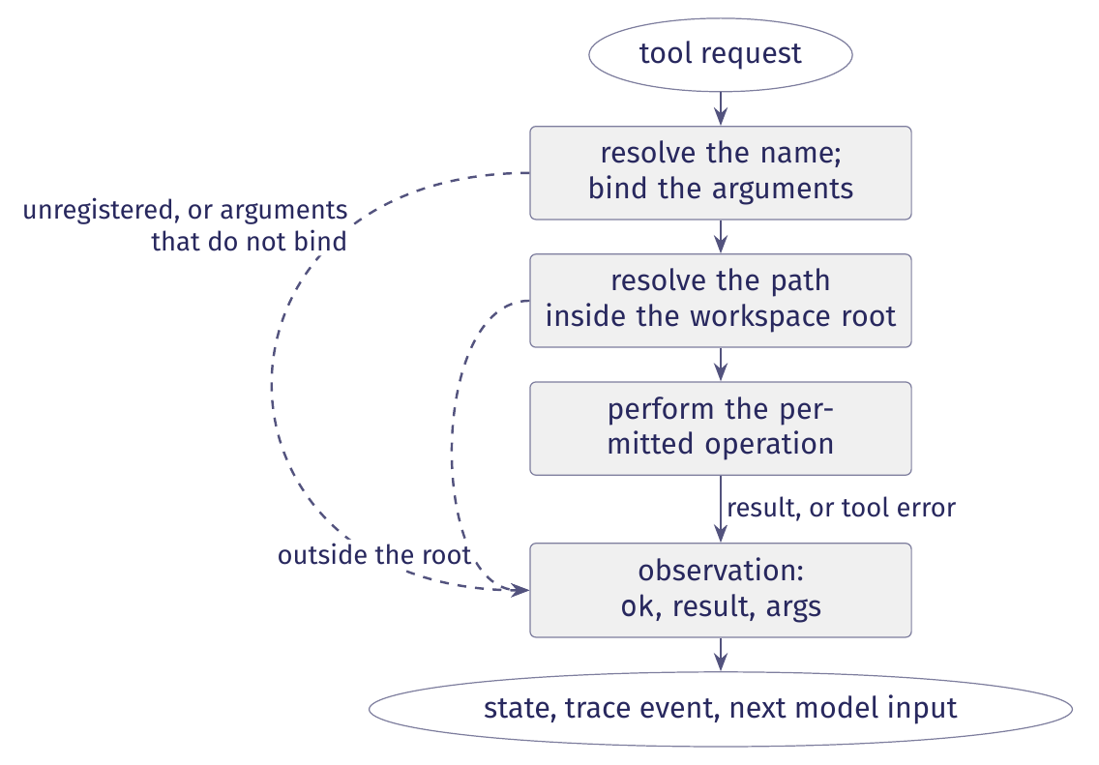
The five operations of the dispatch cycle
The dispatch cycle resolves the name, binds arguments, checks policy, performs the operation and records an observation.
Figure 7 in the lecture notes. Success and refusal both produce observations that the model can read.
Notes:
The dispatch cycle resolves the name, binds the arguments, checks the policy, performs the permitted operation and produces an observation. The two dashed branches show refusals, which also produce observations.

Slide 64
Returning a refusal as an observation
dispatch.py, lines 134 to 164. Coercion and other exception handlers omitted.
function = self.registry.get(name)
if function is None:
# ours: return a refusal listing the registered tools
try:
inspect.signature(function).bind(self.ws, **args)
except TypeError as exc:
return self._refuse(name, args, f"bad arguments for {name}: {exc}")
try:
value = function(self.ws, **args)
except PathEscapeException as exc:
return self._refuse(name, args, f"refused: {exc}")
return self._observe(name, args, self._render(name, value))
An unhandled exception ends the run. A refusal returns an observation so the model can revise its request.
Notes:
Binding checks argument names and arity. The dispatcher coerces unambiguous type mismatches. Exceptions that escape the dispatcher are reserved for unrecoverable failures, such as an unwritable trace.

Slide 65
Evidence of a tool request and execution
The first read_file call in run bc284c6b has evidence at each stage from request to result.
Record or processing stage | What it establishes
Model input | It shows which operations and descriptions were supplied to the model. The trace omits this input.
Model response and model_call event, step 3 | The model requested an operation. This does not establish execution.
tool_request event, step 5 | The request reached the dispatcher and began the dispatch cycle.
Dispatcher | It checks the request and reports refusals in result events. It has no separate trace event.
tool_result event, step 6 | The function ran and returned 1,665 characters. The event omits the returned text.
State and next input | The observation and tool message become available to the next model call, at step 7.
Table 6 in the lecture notes. The successful tool_result event establishes that the function ran and returned.
Notes:
Step 4 is the routing event between the model response and the tool request. It records decision tools and by="model", identifying the selected control location. It does not describe tool execution.

Slide 66
Complete mediation of resource access
The model proposes actions. Components on the execution path check whether the runtime may perform them.
Every route to a protected resource must pass through the required checks.
A new tool, or a file argument such as a glob, can bypass an existing path check.
Mediation ensures the policy is consulted. It does not establish that the policy is correct.
Complete mediation requires every request for a protected resource to pass through a guard that checks the access policy.
Routing functions and limit checks apply rules the programmer wrote.
Notes:
The guard model from MIT 6.033 concerns checks on every resource access. Distinguish decision timing from ownership, and proposed actions from execution. A model’s claim to have run tests does not establish that tests executed.

Slide 67
Guarantees and their enforcing components
Each guarantee depends on a runtime component. The implementation leaves one guarantee unenforced.
Guarantee | Where it is enforced
Only registered tools run | The dispatcher checks the registry before calling a tool.
Arguments bind to the signature | The dispatcher binds and coerces arguments before the call.
Writes stay inside the workspace | The edit tool, the only writer, checks paths with workspace.resolve.
Reads stay inside the workspace | This is unenforced. The search glob bypasses workspace.resolve.
The pinned fixture is unchanged | Tools use a disposable copy. The diff compares it with the fixture.
No call after budget exhaustion | Each model node checks the budget before calling.
At most one plan revision per run | The tools node requests revision only while replanned_at is unset.
Table 7 in the notes. The search tool bypasses the path check.

Slide 68
Checking paths against the workspace root
Path resolution removes .. segments and follows symlinks before the containment check.
workspace.py, resolve, lines 50 to 68. Docstring and comments omitted.
def resolve(root: Path, path: str) -> Path:
root = Path(root).resolve()
candidate = (root / path).resolve()
if not candidate.is_relative_to(root):
raise PathEscapeException(
f"{path!r} resolves outside the workspace root")
return candidate
A string prefix cannot establish containment: /tmp/ws also prefixes /tmp/ws-evil.
Notes:
Joining an absolute path to the root yields the absolute path itself, which the check then refuses if its resolved destination lies outside the root.

Slide 69
A refused read and an unchecked search
The recorded runs contain no refusals. This demonstration sends requests directly to the dispatcher.
read_file refuses ../../etc/passwd. The dispatcher returns an observation with ok=false and the reason.
search with ../*-withheld/testcode/*.py returns lines from withheld cases with ok=true.
The path check guards read_file and edit. The search glob bypasses this check.
The repair is to pass every file matched by search through workspace.resolve before reading it.
The implementation mediates all writes. It leaves a route for unchecked reads.
Notes:
Section 4.6 describes a constructed dispatcher test. The permitted read returns 1,665 characters, matching step 6 of the recorded run. The refused request produces a tool_request and a failed tool_result with a reason and no character count.

Slide 70
Event-driven scheduling
In this execution model, routing selects a node and the scheduler runs it in the next superstep.
In event-driven scheduling, a computation emits an event and the runtime invokes its registered handler. The tool contract and dispatcher remain the same.

