Slide 1
Designing Production Agentic Systems
Columbia · Fall 2026 · Lecture 3
Notes:
Introduce Lecture 3: execution machinery for agentic systems.

Slide 2
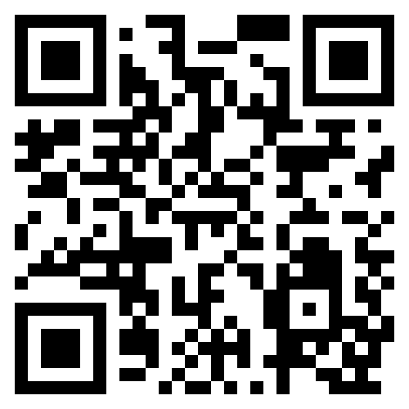
Class announcements
HW1 is released EOD today.
  Assignment groups after class today so I can plan accordingly.
We’ll talk about the HWs in class + all your questions.
Here’s the course website:
  Lectures, notes, slides
  HWs
  Semester wide demo
But also on canvas…
https://github.com/comse6998-019

Slide 3
Lecture 3: Execution Machinery
Notes:
This lecture describes agents as state machines, then examines state records, routing, scheduling and tool execution.

Slide 4

Execution machinery
Agents as state machines
State, records and reducers
Routing, feedback and stopping
Scheduling and tool execution
Notes:
This lecture describes agents as state machines, then examines state records, routing, scheduling and tool execution.

Slide 5
Agents as state machines
Agents as state machines
State, records and reducers
Routing, feedback and stopping
Scheduling and tool execution
Notes:
This lecture describes agents as state machines, then examines state records, routing, scheduling and tool execution.

Slide 6
A state machine as a description of an agent
An agent runs in discrete steps: model calls, tool calls and checks.
Between steps, the agent retains information. The program decides which stored values may change and which computation may run next.
The initial configuration describes how the agent starts. A transition rule specifies how its state changes in response to an input and what output it produces.
A terminal configuration is one from which the runtime schedules no further step. It marks the end of the run.
A state machine is a simplified description of an agent. It omits the prompts, the model and the tool code.
This description lets us examine execution without describing the whole program.
Notes:
Section 1.1 describes five components: states, inputs, outputs, an initial configuration and a transition rule. A workflow intended to terminate also specifies terminal configurations.

Slide 7
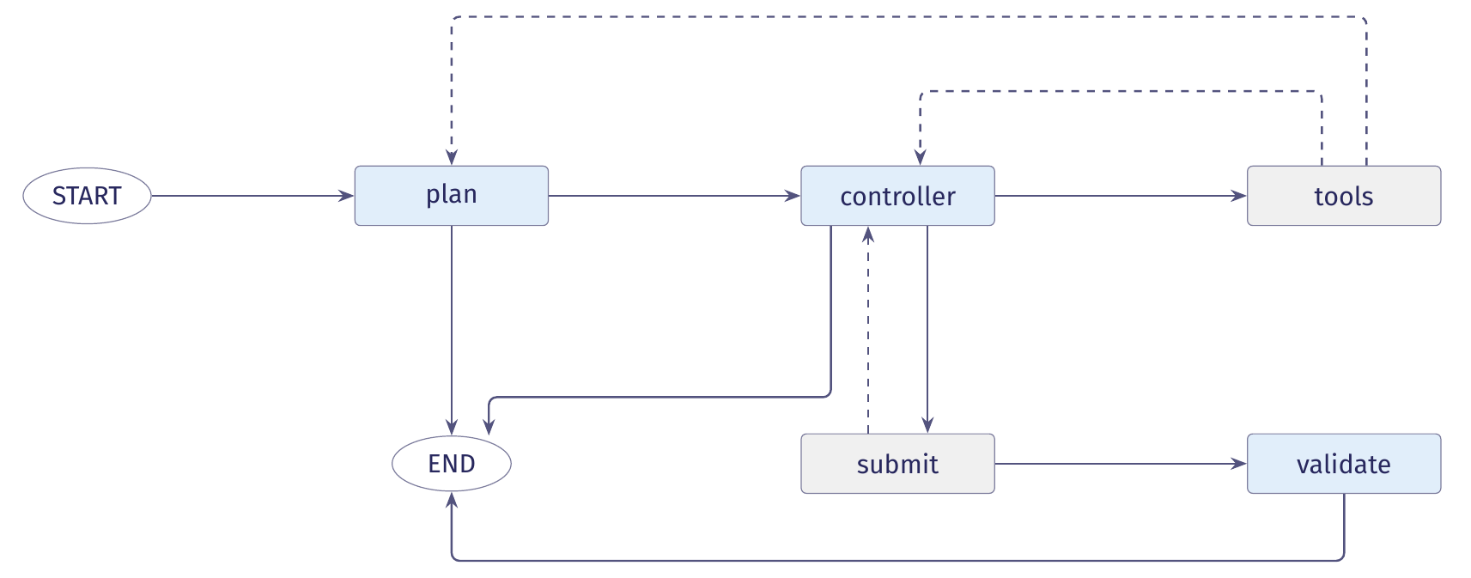
The planning agent's control locations
A control location names the computation to run next or marks the end of the run. Nodes show locations, and arrows show allowed transitions.
Blue nodes call a model. Grey nodes run tools or checks.
Notes:
The diagram represents plan_and_validation/graph.py when the two runs were recorded. As Section 1.5 explains, the current code adds scan and normalize before plan.

Slide 8
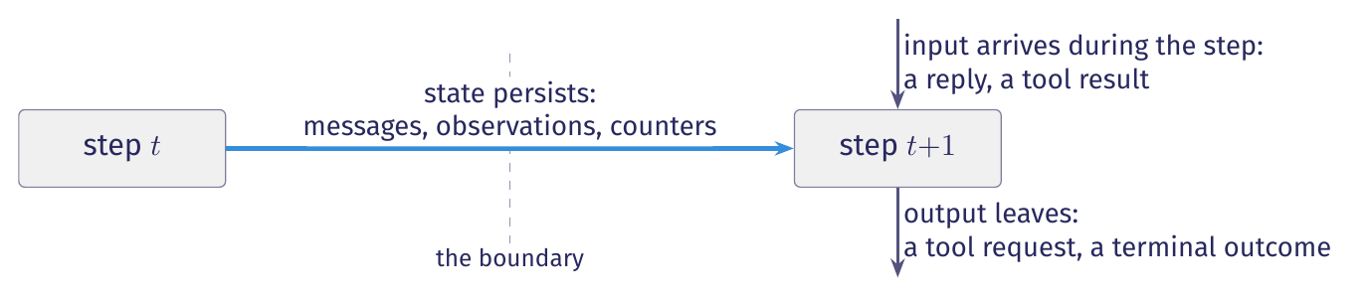
State: what the agent keeps between steps
An agent runs in discrete steps. Between two steps, some information persists.
The controller uses its instructions and earlier observations to choose an action. The runtime uses the call count to decide whether another model call is allowed.
Two visits to the controller can therefore lead to different next steps, because the retained data differ.
State is the information retained between steps that can affect what the agent does next.

Slide 9
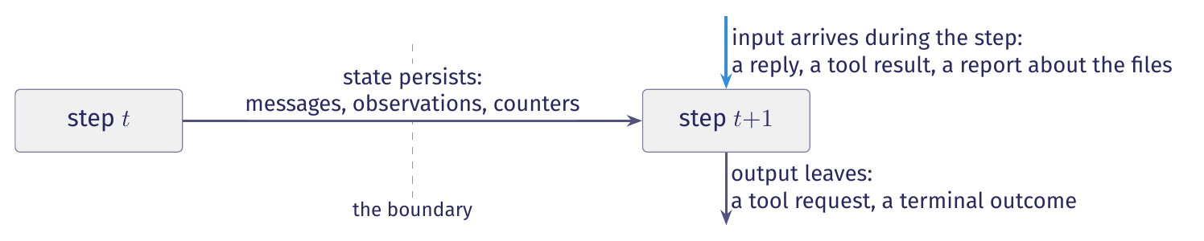
Inputs: what arrives during a step
The runtime receives model replies and tool results during a step. Its stored state alone does not determine those results.
A model reply is an input. The same state can receive a different reply next time.
Workspace files are outside the state in this description. A tool's report about those files enters the state machine as an input observation.
State determines which transitions are permitted. It does not determine which result arrives.

Slide 10
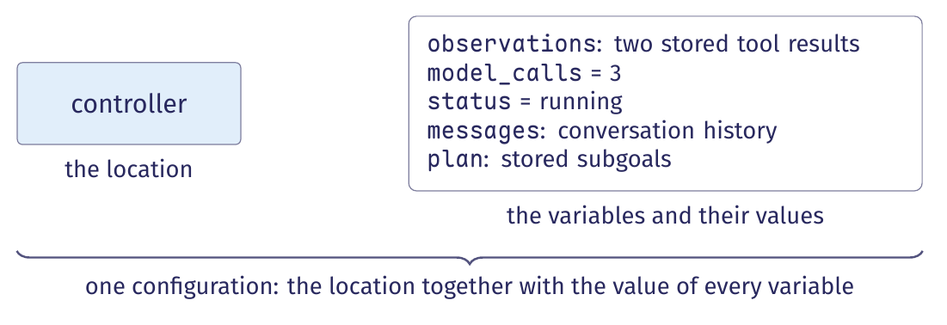
Extended state machines and configurations
An agent has a small number of control locations and a large amount of data.
An extended state machine has finitely many control locations and variables that store data. A configuration pairs the current location with the current value of every variable.
Run bc284c6b visits the controller five times. Each visit has a different configuration because the stored values have changed.
Notes:
The displayed values describe run bc284c6b before its third controller call: two observations have been recorded, three model calls have completed, and the status is running.

Slide 11
Configurations: finite control, unbounded data
A graph can have finitely many control locations even when its variables can take infinitely many values.
If model_calls is the only variable and its budget is N, it can hold 0 through N. Each location then has at most N+1 configurations.
If a message list can grow without a length bound, one control location can have infinitely many configurations.
A procedure that tries to list every reachable configuration may therefore never finish.
An extended state machine can have finitely many control locations and infinitely many configurations.
The set of control locations and guards remains finite.

Slide 12
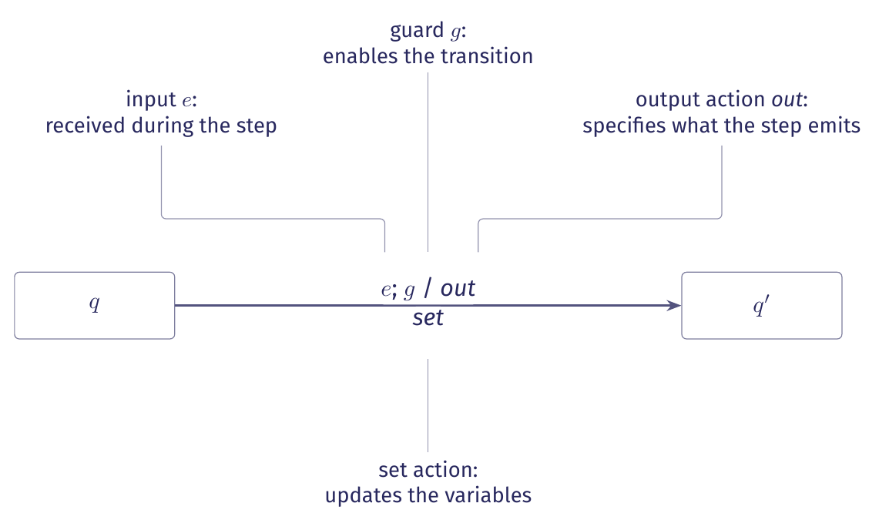
Transitions: guard, output action, set action
The guard states when a transition is allowed. Its actions emit output and update variables.
(q, v) -- e ; g / out ; set --> (q', v')
At location q with variable values v, input e arrives. If guard g holds, the transition emits out, applies set to the variables and moves to location q' with values v'.
Notes:
This slide introduces the transition notation. Later slides describe the same operations in prose.

Slide 13
The elements of a transition (for an agent)
Element | In an agent
Control location | A control location names the computation ready to run: a model call, tool dispatch or check.
Variables | Variables hold messages, observations, a plan, counters, check results and a status between steps.
Input | An input is a result received during a step, such as a model reply, tool result or check result.
Guard | A guard is a predicate: a true-or-false test of the variables and input, such as whether the reply requests a tool.
Output action | An output action requests an operation or reports a terminal outcome.
Set action | A set action updates variables, such as storing a reply, extending observations or incrementing a counter.
Initial configuration | The initial configuration pairs the first control location with starting variable values: opening messages, zero counters, no observations and running status.
Terminal configuration | No further computation is scheduled from a terminal configuration. The state stores the reason for ending.
Table 1 in the lecture notes gives each element its symbol.

Slide 14
One transition in code: controller to tools
graph.py, controller and after_controller (excerpt)
# ours: the model reply is the input
reply = self._call(model, state["messages"], role="controller")
# ours: append the reply and increment the call count
return {"messages": [reply], "model_calls": 1,
"usage": self._usage(reply)}
# ours: the guard tests whether the reply has tool calls
if state["messages"][-1].tool_calls:
return "tools"
return "submit"
The reply is the input. The tool-call test is the guard. The runtime applies the set action by appending the reply and adding one to model_calls.
Notes:
The excerpts come from controller at graph.py line 296 and after_controller at line 452. Trace calls and the admission check are omitted. The model_calls field uses operator.add, so returning 1 increments the stored count by one.

Slide 15
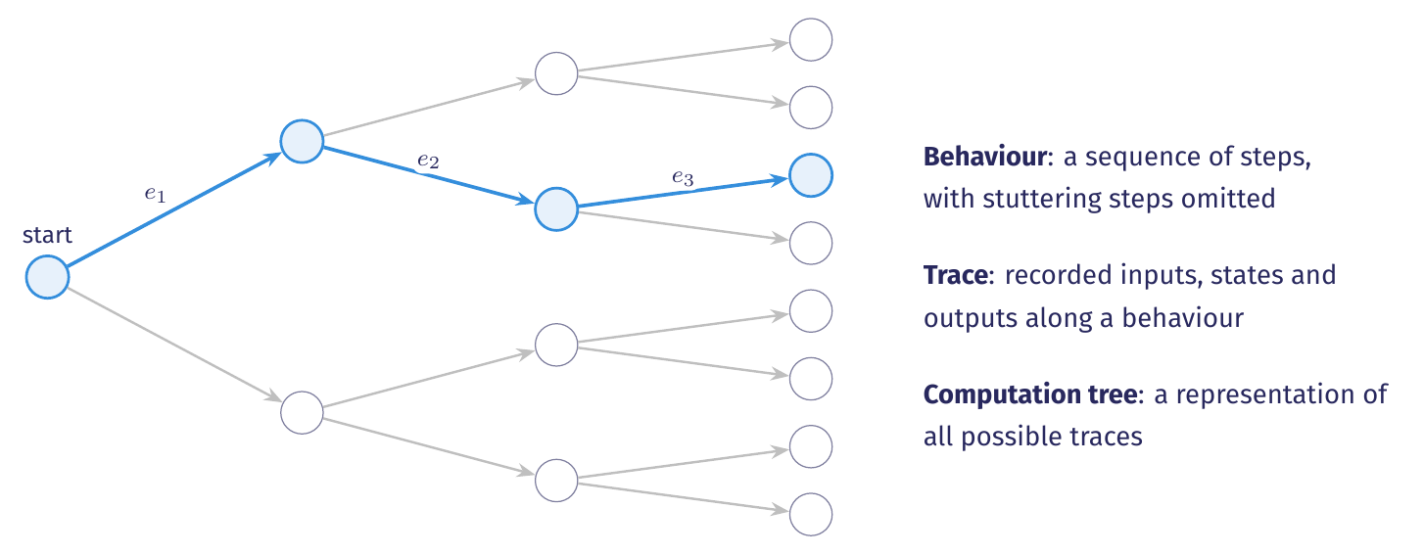
Behaviour, trace and computation tree
A behaviour is a sequence of steps. It excludes stuttering steps, which have no input, state change or output.
With the same inputs, a deterministic machine follows one sequence of steps. A nondeterministic machine can allow several next steps, so its computation tree branches.

Slide 16
The event log as a trace
When the program exits, unsaved state is lost. Saved logs and workspace files can remain available.
bc284c6b, events 19 to 22 (selected fields)
{"step": 19, "kind": "model_call", "role": "controller",
"tool_calls": []}
{"step": 20, "kind": "routing", "decision": "submit",
"by": "model"}
{"step": 21, "kind": "state_change", "node": "submit",
"checks": {"applies": true, "touches_line": true,
"rescan_clean": true}}
{"step": 22, "kind": "routing", "decision": "validate",
"by": "runtime"}
State holds the run's current information. A trace records its inputs, states and outputs over time.
Notes:
The trace contains six kinds of event: tool_request, tool_result, model_call, routing, state_change and terminal. When status is running, after_controller routes to submit if the last reply has no tool calls.

Slide 17
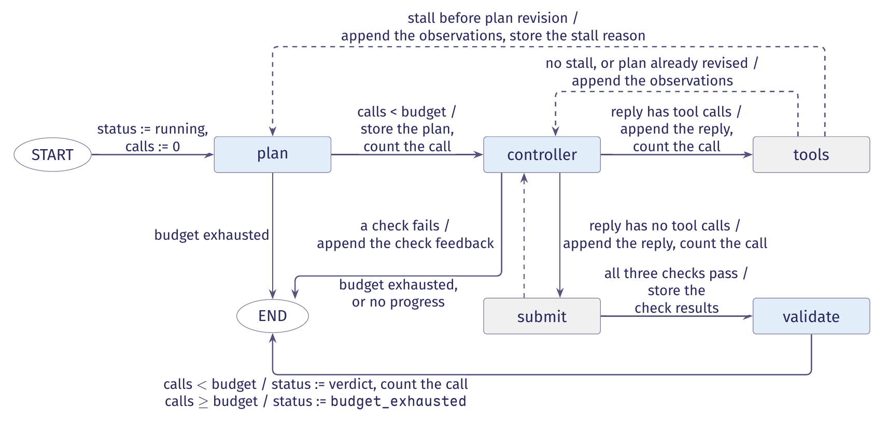
The planning agent's state machine
Each arrow shows its guard and set action. Output actions are omitted.
Figure 1 in the lecture notes gives the full guards and state updates.
Notes:
The plan, controller and validate nodes call a model. The tools and submit nodes perform runtime work. Each model node checks the forty-call budget before making a call.

Slide 18
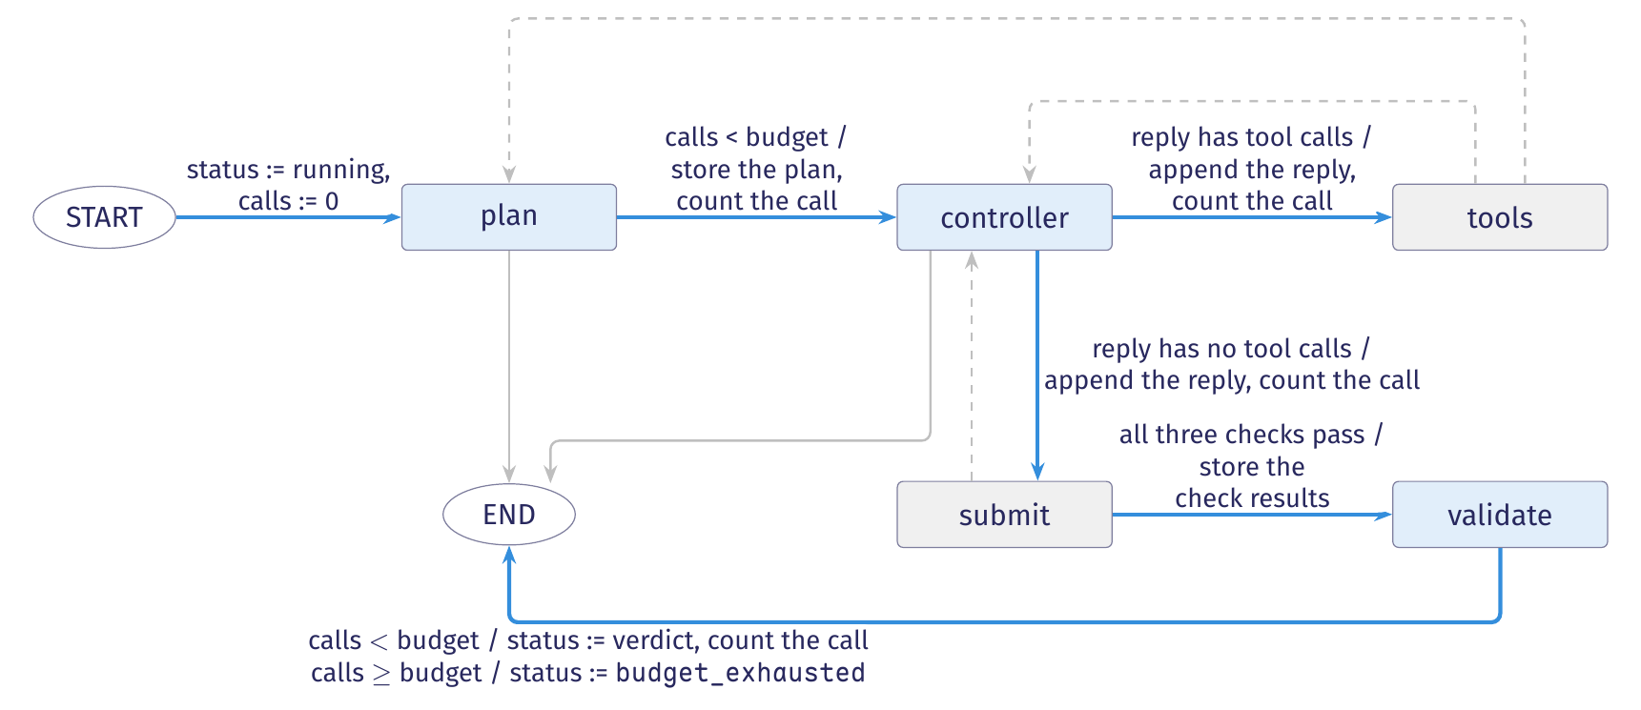
The planning agent's forward path
After the candidate patch passes the checks in submit, validate decides whether to accept it.
The agent stores the plan in its state. It carries out the plan’s subgoals through the control locations already defined in the graph.
Notes:
The controller receives the plan as a message. When the status is running, the runtime uses the controller's reply to choose tools or submit. The routing function does not inspect the plan's subgoal list. The submit node checks whether the patch applies, touches the flagged line and produces no finding on a rescan.

Slide 19
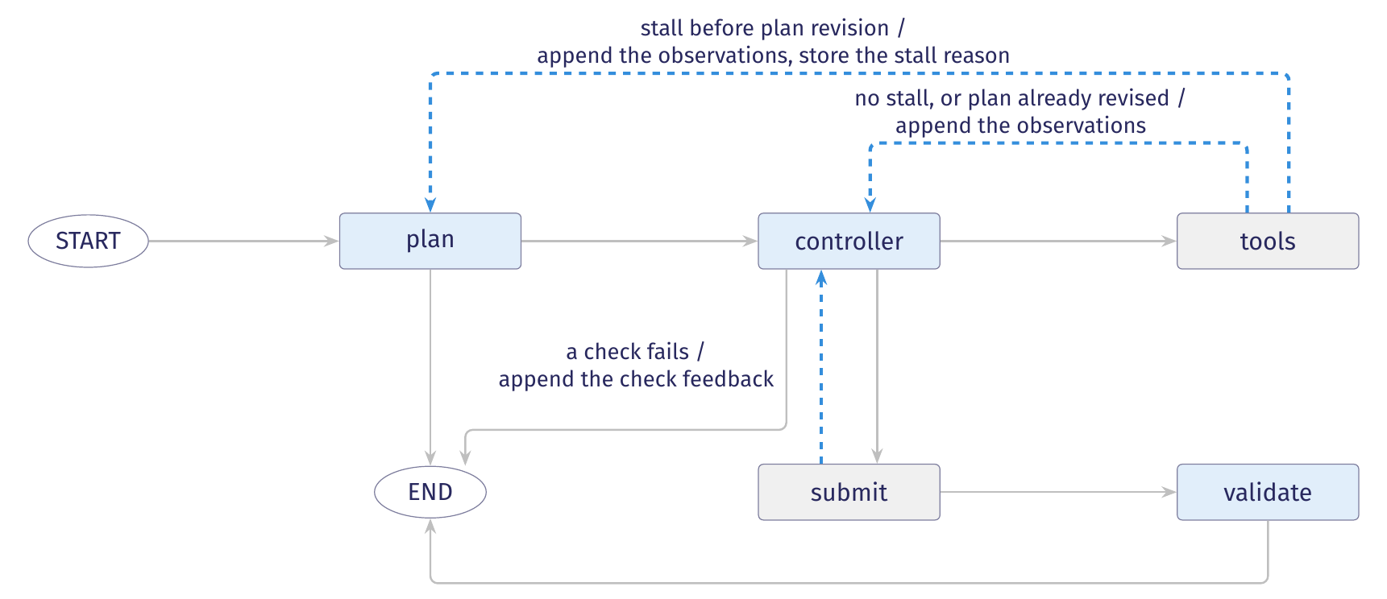
The planning agent's feedback edges
The figure shows the tool loop, plan revision and candidate repair.
If tools detects a stall before the plan has been revised, control returns to plan. If a check fails, submit adds the failure reasons to the messages and returns control to controller.
Notes:
The stall test examines the last three observations since the most recent plan revision, or since the run began if no revision has occurred. It reports a stall when all three are identical and none records a successful edit. After revising the plan, the plan node sets replanned_at to the current number of observations. Later stall tests start from this stored index.

Slide 20
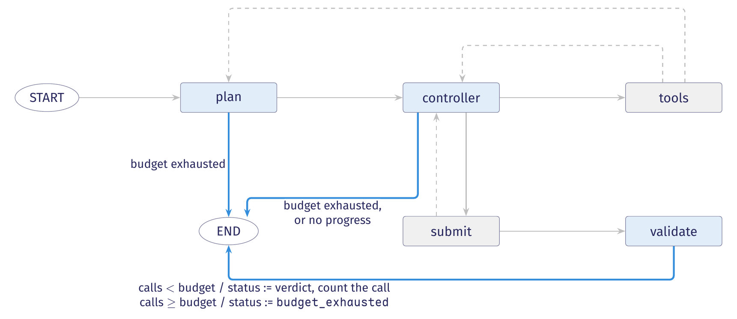
The planning agent's exits
A run may end because it exhausts its call budget or stalls again after a plan revision.
Before each model call, plan, controller and validate end the run if the count has reached 40. The controller also ends the run if another stall occurs after plan revision.

Slide 21
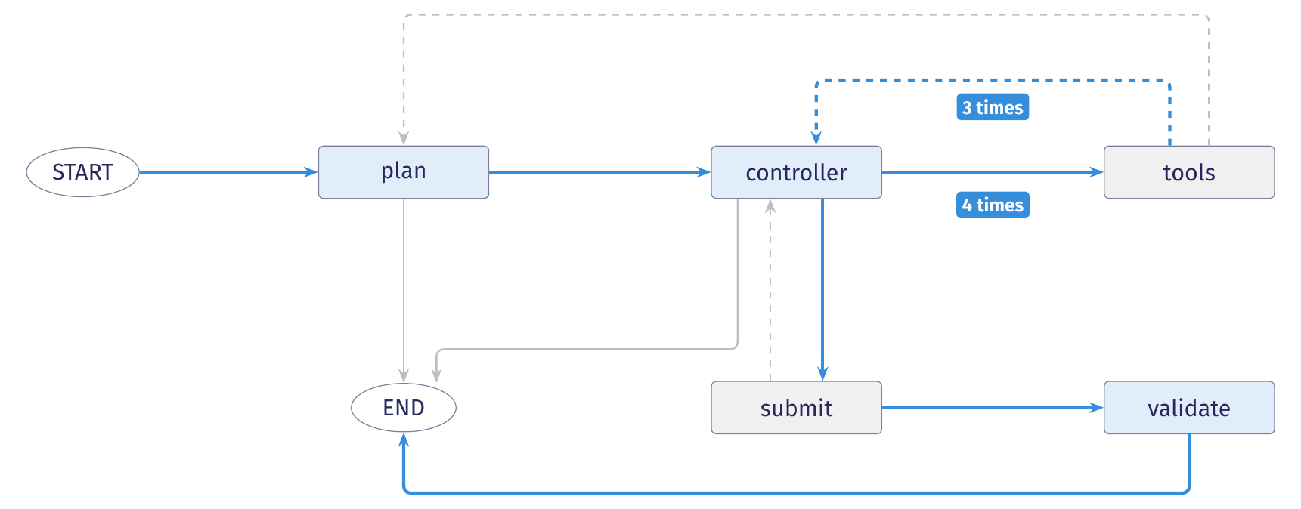
The recorded run through the planning agent
The blue arrows show the recorded trajectory: the sequence of transitions taken by run bc284c6b.
The run repairs a Bandit B608 alert at line 46 of testcode/BenchmarkTest00283.py in seven model calls: one in plan, five in controller and one in validate.
Notes:
Events 1 and 2 record planning. Events 3–18 record four tool rounds: read_file, search, read_file and edit. Events 19–22 record submission. Events 23–25 record validation and the terminal event. The run logged 12,693 input tokens and 3,755 output tokens.

Slide 22
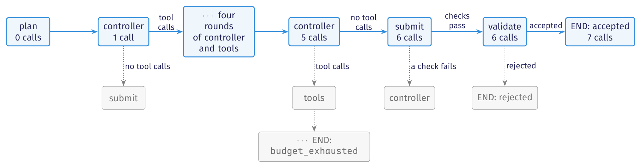
The recorded run in the computation tree
A trajectory is the path a run follows through the computation tree. Every visit to controller gets a separate node showing that visit's configuration and possible replies.
The machine diagram shows permitted transitions. The tree shows possible sequences of transitions from the initial configuration.
Figure 2 in the notes shows more of the tree. Each count is the number of model calls completed on reaching that node.

Slide 23
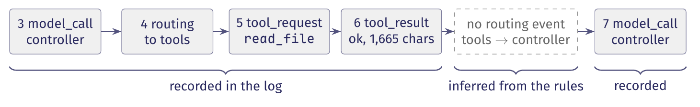
What the event log records and omits
The event log records selected inputs, outputs and state values.
A successful tool_result event records the result’s length, in characters. It omits the returned text.
The log omits routing events from tools and plan to controller. We infer these routes from the next controller call and transition rules.
The log omits the call counter. We start at zero and add one for each logged model call.
A claim about a run must say whether it is recorded directly in the log or inferred from logged events and transition rules.

Slide 24
State records and transitions
Agents as state machines
State, records and reducers
Routing, feedback and stopping
Scheduling and tool execution
Notes:
This lecture describes agents as state machines, then examines state records, routing, scheduling and tool execution.

Slide 25
State records and schemas
The diagram shows control flow: which computation may run next. The state record supplies the values it reads.
Each record instance holds current values. The runtime tracks the control location, which identifies the next computation.
The schema declares field names and types. Nodes return partial updates containing only the fields they update.
StateGraph(AgentState) uses the field declarations in AgentState to define the graph's shared state.
A state record stores the information retained between steps as named fields and their current values. For example, model_calls: 2 records two completed model calls.
Routing functions use the updated record to select the next node.
Notes:
Section 2.1 separates the EFSM configuration into a control location and variable values. The runtime tracks the location. The state record holds values such as messages and model_calls. AgentState declares their names and types. The record for a particular run supplies their current values.

Slide 26
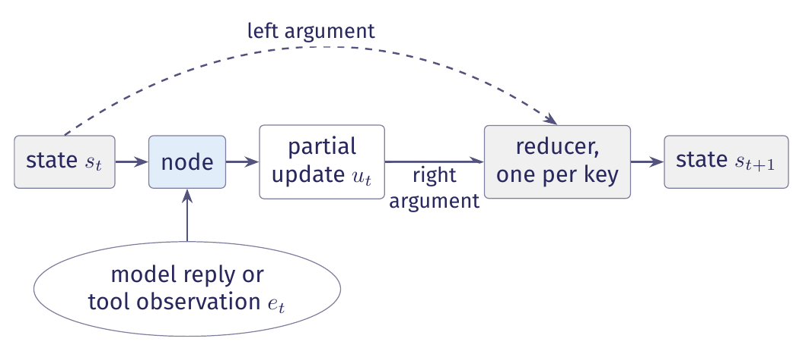
Partial updates and state transitions
A node returns a partial update mapping selected fields to values. The runtime applies each field’s update rule.
A field omitted from the partial update keeps its stored value (Figure 3 in the lecture notes).
Notes:
The runtime passes the current state s_t to the node. During execution, the node obtains a model reply or tool observation e_t and returns a partial update u_t. For each updated field, the reducer receives the stored value as its left argument and the returned value as its right argument. The merged record is the next state s_(t+1).

Slide 27
Partial updates and state transitions
See agent state in demo
Notes:
The runtime passes the current state s_t to the node. During execution, the node obtains a model reply or tool observation e_t and returns a partial update u_t. For each updated field, the reducer receives the stored value as its left argument and the returned value as its right argument. The merged record is the next state s_(t+1).

Slide 28
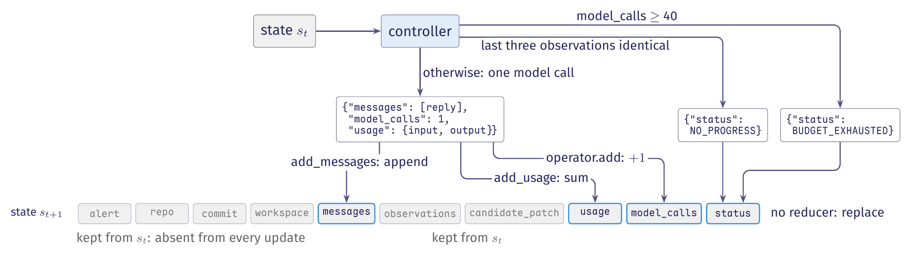
The controller's three return sites
The loop's controller returns either an update from a completed model call or a status explaining why the run must stop.
The controller returns messages, model_calls and usage after a model call, or status when a limit stops the run. Six fields remain unchanged (Figure 4).
Notes:
Figure 4 applies the three controller return paths to the loop’s ten-key record. After a model call, the update contains the reply, one completed call and its token usage. A stopping path returns only status, whose update replaces the stored status string. The six fields untouched by every path keep their previous values.

Slide 29
The controller's return sites, in code
Each return gives the runtime a partial update: either a stopping status or the reply and accounting data from one model call.
graph.py, controller, lines 298 to 313. Trace event and model setup omitted
spent = self._admit(state)
if spent:
return spent
if self.stalled(self.planning_window(state),
self.config.no_progress_steps):
return {"status": TerminalStatus.NO_PROGRESS}
reply = self._call(model, state["messages"], role="controller")
return {"messages": [reply], "model_calls": 1,
"usage": self._usage(reply)}
The runtime uses reducers to append the reply, add one to model_calls and add each token count to its running total.
Notes:
The controller begins at graph.py line 296. When the call budget is exhausted, _admit returns a status update that ends the run. Otherwise, it returns None and the controller continues. After a model call, returning model_calls: 1 contributes one to the accumulated count. For example, a stored count of 2 becomes 3.

Slide 30
Model context, runtime state, durable state
For each model call, the runtime builds a context from retained state. To resume after the process exits, it must save enough state to reconstruct execution.
State or context | What it holds | Who reads it
Model context | Model context contains the instructions, selected history and observations supplied to one model call. | The model reads it.
Runtime state | Runtime state holds the fields retained between steps, including counters that the model never sees. | Nodes, routing functions and limit checks read it.
Durable state | Durable state survives the process lifetime in a form that another process can load to resume the run. | A new runtime process loads it to resume execution.
A checkpointer saves runtime state for resumption. Our graphs have none. Resuming also requires matching workspace files and pending work (Table 2).
Notes:
Our graphs keep state in memory and are compiled without a checkpointer. After process exit, a new process cannot recover that state from the JSONL trace: the trace records selected events and omits values needed for resumption. A later unit covers saved state, pending work and the external workspace needed to resume.

Slide 31
Model context and admission checks
The admission check, _admit, compares model_calls with the budget before each model call. The controller passes the conversation to the model.
graph.py, controller line 312 and _admit lines 183 to 186. Trace event omitted
# ours: The controller supplies the conversation to the model.
reply = self._call(model, state["messages"], role="controller")
# ours: Admission runs before every model call.
if state["model_calls"] >= self.config.budget:
return {"status": TerminalStatus.BUDGET_EXHAUSTED}
The runtime enforces the budget before each call. This check works even though the model never receives the budget in its context.
Notes:
Section 2.6 explains that none of the planning agent’s prompts mentions the call budget. Admission enforces it by comparing the call counter with the configured limit before each call.

Slide 32
Reducers: append, replace, accumulate
When a node returns a value for a field, the runtime calls that field's reducer with the stored value and the returned value.
Append adds the returned items to the end of the stored list, so later nodes can read the full history.
Replace stores the returned value as the field’s new value, as when the plan node writes a revised plan.
Accumulate combines the returned contribution with the stored total, such as adding 1 to model_calls.
The reducer's result becomes the field's next stored value.
Returning [] to an append reducer adds no items, so the stored list keeps its existing contents.
Notes:
A reducer combines a field’s stored value with the value returned for that field. Annotated[T, fn] attaches the reducer fn to a field of type T. An append reducer treats [] as zero new items. Clearing the list therefore requires Overwrite to replace its contents directly. The reset should receive a separate trace event.

Slide 33
The controller's three return sites
The loop's controller returns either an update from a completed model call or a status explaining why the run must stop.
The controller returns messages, model_calls and usage after a model call, or status when a limit stops the run. Six fields remain unchanged (Figure 4).
Notes:
Figure 4 applies the three controller return paths to the loop’s ten-key record. After a model call, the update contains the reply, one completed call and its token usage. A stopping path returns only status, whose update replaces the stored status string. The six fields untouched by every path keep their previous values.

Slide 34
The reducers in the schema
In Annotated[T, fn], T names the field's type and fn names the reducer that merges returned values into that field.
state.py, AgentState, lines 76 to 98 (selected fields)
class AgentState(TypedDict, total=False):
# ours: other fields are omitted
messages: Annotated[list, add_messages]
observations: Annotated[list, operator.add]
usage: Annotated[Usage, add_usage]
model_calls: Annotated[int, operator.add]
status: str
For status, an update replaces the stored string. If a node returns no status value, the runtime keeps the previous string.
Notes:
add_usage maintains four separate token counters. Keeping the counters separate preserves the distinction between cache reads and fresh input tokens.

Slide 35
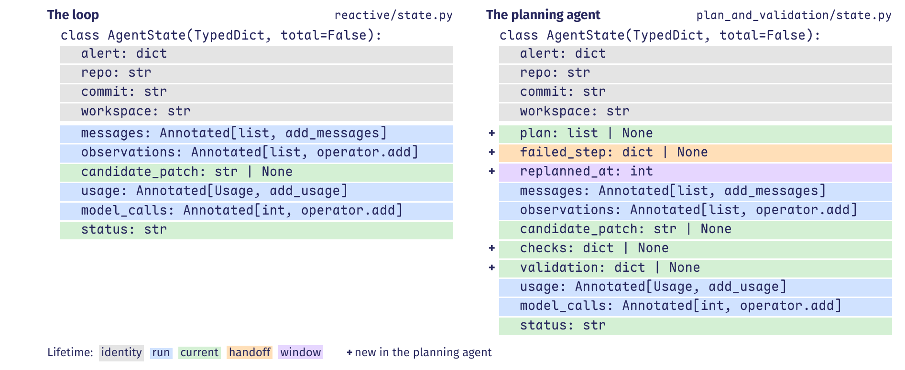
State schemas and field lifetimes
The planning agent adds five fields to the loop's schema. Shading marks field lifetimes: when stored values remain valid for later steps.
Neither agent retries after rejection, so neither schema needs attempt-lifetime fields to clear before a new attempt (Figure 5).
Notes:
The plan node writes plan, submit writes checks, and validate writes validation. Each field holds the latest value until its writer replaces it. The tools node writes failed_step for the plan node to read and clear. The replanned_at index marks where observations under the current plan begin.

Slide 36
Field lifetimes
A field's lifetime is the interval during which later nodes may rely on its stored value. The lifetime ends when an event makes that value obsolete.
Lifetime | Definition and use
Identity | Identity fields identify the task, target and workspace and remain unchanged.
Run | Run fields retain histories and counters that grow throughout the run.
Current | Current fields hold the latest plan, candidate, check result or status until the writer replaces them.
Handoff | One node writes a reason for invoking another node. The receiving node reads that handoff field and clears it after acting.
Window | An index field marks where a selected window of history begins. Checks read from that index onward while the complete history remains stored.
Attempt | An attempt field holds one attempt’s results. Nodes clear the field before a retry so later steps cannot treat old results as current.
The runtime merges updates according to reducers. Node code must enforce lifetime rules by retaining, replacing or clearing each field when required.
Notes:
A counter that limits the entire run must keep its total across attempts. For example, resetting model_calls to zero after a failed attempt would allow later calls to ignore the calls already spent. Section 2.4 calls this the run lifetime. Attempt-lifetime fields are cleared before a retry because their old results no longer apply.

Slide 37
Handoff and window, in the planning agent
When tools detects a stall, it stores the reason in failed_step. The plan node uses that reason to revise the plan, then clears failed_step and sets replanned_at.
graph.py, tools lines 361 to 367 and plan lines 260 to 270. Excerpts
if (not state.get("replanned_at")
and self.stalled(window, self.config.no_progress_steps)):
update["failed_step"] = { # ours: remaining entries omitted
# ours: The plan node returns this partial update.
update = {"plan": steps,
"failed_step": None,
if failed:
update["replanned_at"] = len(state["observations"])
If failed_step remained set, after_tools would select plan again on the next tools step.
Notes:
The plan node sets replanned_at to the number of observations stored when revision completes. The slice observations[replanned_at:] therefore starts with observations made under the revised plan. Earlier observations remain in the full history, while the stall check reads only observations made since revision. Clearing failed_step removes the request for the revision just completed.

Slide 38
Proving invariants over configurations
To prove that every run obeys a limit, we express the limit as a predicate: a condition that is true or false for a configuration.
Initial case. Show that the predicate is true for the initial control location and variable values.
Preservation. For each permitted transition, assume the predicate is true before the step and show that it is still true afterward.
A stronger predicate adds conditions to the desired property. For the call budget, we also require the counter to equal the number of completed calls.
A predicate that holds initially and remains true after every transition is an invariant. It is therefore true at every configuration that a run can reach.
An invariant proof applies to every possible run, including runs we have never executed.
Notes:
The preservation proof considers every configuration satisfying the predicate, including configurations that no run reaches. This can make the desired property alone too weak for an induction proof. In the call-budget example, we add the condition that the stored counter equals the number of completed calls. The next slide explains how admission, counting and preservation maintain both conditions.

Slide 39
The call budget as an invariant
To bound completed model calls, we prove that model_calls counts them exactly and never exceeds the budget.
Admission. Each node checks that the stored call counter is below the budget before issuing a model call.
Counting. After a call completes, the node returns model_calls: 1, and the reducer adds one to the stored count.
Preservation. A step without a call leaves the counter unchanged. No transition resets or decreases it.
The reducer accumulates reported calls. Each caller must check the budget before calling and report each completed call exactly once.
In our agent, model_calls must remain at most forty.
Notes:
The argument covers completed calls only. An interrupted call may consume tokens without being counted.

Slide 40
Constructing and compiling the state graph
StateGraph creates one channel per schema field to store its value and merge updates.
graph.py, compile, lines 493 to 521. Selected declarations
graph = StateGraph(AgentState)
graph.add_node("plan", self.plan)
graph.add_node("tools", self.tools)
# ours: Five node and five edge declarations are omitted.
graph.add_edge(START, "scan")
graph.add_conditional_edges("tools", self.after_tools,
{"controller": "controller", "plan": "plan"})
graph.add_edge("validate", END)
return graph.compile()
compile() checks the declared graph connections and returns a graph that the runtime can execute.
Notes:
add_node associates a node name with the function that the runtime will call. That function receives the state and returns a partial update. add_edge names the node to run after a source node finishes. add_conditional_edges instead calls a routing function after the source node’s update is merged. The function reads the updated record and selects the destination.

Slide 41
Designing a state graph
Declare each field when you add the node that writes it.
Specify the nodes and the rules that select which node runs next.
Declare fields for values that nodes and routing functions read.
Name the node that writes each field and when later nodes must stop using its old value.
Choose each field's lifetime, then choose whether updates append, replace or accumulate values.
Write the initial state with a value for every key.
Make each node return a partial update containing only the fields it proposes to update.
Each field retains a value that a later computation needs to read.
Notes:
The six steps appear at the end of Section 2.6. Omit fields that no computation reads.

Slide 42
Routing, feedback, and stopping
Agents as state machines
State, records and reducers
Routing, feedback and stopping
Scheduling and tool execution
Notes:
This lecture describes agents as state machines, then examines state records, routing, scheduling and tool execution.

Slide 43
Routing functions and conditional edges
The routing function selects the next step by testing values in the record.
Proposal. The model emits a tool request, plan, candidate patch, or verdict.
Record. The runtime merges the node's update into state using reducers. It also records what happened in the trace.
Decision. The routing function tests fields in the merged record. The programmer's guards and limits determine which destination it returns.
A conditional edge combines a location's outgoing transitions with a routing function. The function selects one destination by testing guards, conditions on the merged record.
The trace field by identifies whether the tested value came from the model or the runtime.
Notes:
A routing guard tests information in the merged record, including values retained from earlier steps. The trace field by records model for a value from model output, and runtime for a value from a check, limit, or default. The programmer defines the edge and its guard in both cases. Returning END stops the run. The status field records why it stopped.

Slide 44
Routing after the controller
The routing function reads the merged record and returns the next node's name, or END to stop the run.
graph.py, after_controller, lines 452 to 460. Trace calls omitted
def after_controller(self, state: AgentState) -> str:
if state["status"] != RUNNING:
return END
if state["messages"][-1].tool_calls:
return "tools"
return "submit"
For an active run, the routing function returns tools if the last reply contains tool requests, and submit otherwise.
Notes:
If the run remains active, a reply that both claims the patch is correct and requests a tool routes to tools. The after_controller function tests tool_calls and does not read the reply’s prose.

Slide 45
The same graph, different paths
The compiled graph fixes the possible transitions. During a run, routing functions use the current record to select destinations.
A run can visit the controller twelve times. Each visit leads to a new routing decision within the same graph.
Notes:
The computation tree has a separate node for each visit to a control location. Each node represents that visit's configuration: the location and the record's values.

Slide 46
Feedback edges: revision and repair
A feedback edge sends execution back to a location visited earlier in the run. Its trigger and the information passed back must be specified.
Revision returns execution to plan after the first stall. Repair returns execution to controller with the reasons a patch failed its checks.
Notes:
Revision replaces a stalled plan. Repair asks the controller for another patch after a failed check. Both add work to the run, so each needs a limit on how often it can occur.

Slide 47
Feedback edges and their bounds
Two feedback edges are implemented. A third, for new attempts, is proposed.
Feedback edge | Trigger | Information and reset | Bound
Revision: tools to plan | The last three observations under the current plan are identical and include no successful edit. | The plan node uses the stall reason to revise the old plan, clears the handoff field, and limits later stall checks to the new plan's observations. | The runtime permits one revision per run. A second stall ends the run.
Repair: submit to controller | At least one of the three checks fails. | The runtime adds reasons to the conversation. No fields are reset. Later submissions replace the patch and check results. | The call budget limits the number of repairs.
New attempt (proposed) | The validator rejects the patch, and the attempt count is below its limit. | The runtime keeps the reflection and clears all attempt-lifetime fields, including the plan, patch and check results. | The attempt counter survives resets. The call budget also applies.
Table 4 in the notes. A feedback edge must have its own limit or rely on a limit for the whole run.

Slide 48
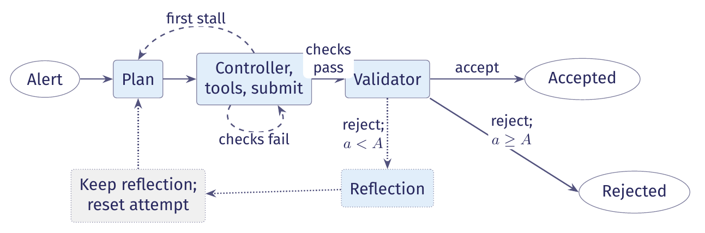
A proposed feedback edge for new attempts
The current agent stops when the validator rejects a patch. The extension would write a reflection describing the failure, then start a new attempt.
Figure 6 in the notes. The reset clears the plan, patch and checks, while the reflection and the attempt and call counters persist.
Notes:
The attempt counter must count attempts across the whole run. If each reset erases that count, the runtime cannot enforce a limit on the total number of attempts.

Slide 49
Loop bounds and termination
An acceptance predicate is a condition for declaring success. It does not ensure that the run will reach that condition.
The number of calls remaining is a variant when every cycle makes a model call and each step between calls returns or times out.
If a cycle makes no model call, the remaining call budget stays unchanged. That cycle needs its own limit.
The stall check detects identical results. A run that returns different irrelevant results can continue without progress.
Here, the loop variant is a nonnegative integer that decreases on every continuing cycle. It bounds the number of cycles because it cannot fall below zero.
Detecting one failure pattern does not prove termination.
Notes:
The example variant is B − c: the call budget minus calls already made. The admission check keeps this quantity nonnegative. Every continuing cycle must reduce it, and each step must return or time out. These conditions bound the number of cycles. They do not by themselves bound the duration of a step. Our stall check detects repeated identical observations, one form of non-progress described in ReACT's recorded trajectories.

Slide 50
Checking the budget before each model call
The budget, stall check and recursion limit can end a run before a verdict. Each model node checks the call budget before calling the model.
graph.py, _admit, lines 174 to 187. config.py, line 41. Comments omitted.
def _admit(self, state: AgentState) -> dict | None:
if state["model_calls"] >= self.config.budget:
# ours: budget_exhausted routing event omitted
return {"status": TerminalStatus.BUDGET_EXHAUSTED}
return None
budget: int = 40
The first stall triggers plan revision. The second ends the run. The recursion limit bounds the number of runtime steps, called supersteps.
Notes:
The runtime checks the budget before each model call. Checking afterwards would allow the call to incur cost before enforcing the limit. The recursion limit is four times the call budget and counts supersteps without considering the task or the cost of a step.

Slide 51
What a trace establishes
The three claims are that execution stopped, acceptance passed, and the artifact meets the task's postcondition.
A terminal event establishes that execution terminated.
A terminal event with status accepted establishes that the acceptance procedure passed.
No trace event establishes that the artifact meets the task's postcondition, the condition the finished artifact must satisfy.
The trace records the outcome of the acceptance checks. It does not establish that the patch is correct.
The model may propose that the work is finished. The runtime checks its completion rules and sets the run's terminal status.
Notes:
The acceptance procedure produces evidence about the patch. Passing that procedure does not prove that the patch satisfies the task's postcondition.

Slide 52
Terminal statuses and trace closure
When a run ends normally, its trace must contain a terminal event. Otherwise, closing the trace raises NoTerminalStatus.
trace.py, lines 36 to 47 and 100 to 101. Comments omitted.
class TerminalStatus(str, Enum):
ACCEPTED = "accepted"
REJECTED = "rejected"
BUDGET_EXHAUSTED = "budget_exhausted"
NO_PROGRESS = "no_progress"
ERROR = "error"
class NoTerminalStatus(Exception):
"""A run was closed without stating how it ended."""
At normal closure, a missing terminal event is an instrumentation defect: the code did not record how the run ended.
Notes:
If an exception escapes the run, the trace writer records terminal status error. It then writes a separate record naming the exception.

Slide 53
Three interpretations of a trace
When an exception escapes the run, the writer records error, then the exception's name in a separate event. SIGKILL stops the process without running a handler.
What the trace records | What it supports
A verdict, then a terminal event with status accepted | Execution terminated and the acceptance procedure passed. The trace does not establish that the patch meets the task's postcondition.
A terminal event with status rejected, budget_exhausted, no_progress or error | Execution terminated without acceptance, with partial evidence and the stated reason. For error, the next record names the exception.
No terminal event | The trace does not establish termination. The run may still be active, or the process may have been killed without running a handler.
Table 5 in the notes. Calling a missing terminal event error assigns a cause without evidence.

Slide 54
A recorded repair after failed checks
In run 28e37a00, the first patch applies successfully. It leaves the flagged line unchanged, and the rescan still reports the finding.
28e37a00, steps 25–26. Reasons abbreviated
{"step": 25, "kind": "state_change", "node": "submit",
"checks": {"applies": true, "touches_line": false,
"rescan_clean": false, "reasons": [...]}}
{"step": 26, "kind": "routing", "decision": "controller",
"by": "runtime", "reason": "mechanical checks failed",
"reasons": ["the edit did not touch
testcode/BenchmarkTest01179.py:31 ...",
"semgrep: ... path-traversal-open is still ..."]}
The controller receives both reasons as a conversation message and submits again after three tool rounds.
Notes:
Steps 27–38 contain three rounds in which the controller requests tools and receives their results. It then submits again. At step 41, the rescan is clean, but the patch still leaves the flagged line unchanged. At step 42, the runtime returns that reason to the controller.

Slide 55
A recorded keyboard interruption
After the second failed submission and two more tool rounds, a keyboard interrupt stops the run.
28e37a00, steps 50–52. Timestamp and run identifier omitted.
{"step": 50, "kind": "tool_result", "tool": "read_file",
"ok": true, "chars": 1081}
{"step": 51, "kind": "terminal", "status": "error",
"usage_total": {"input": 67586, "output": 10380,
"cache_read": 0, "cache_write": 0}}
{"step": 52, "kind": "state_change",
"exception": "KeyboardInterrupt", "message": ""}
A SIGKILL at the same point would leave the file ending at step 50, without terminal or exception records.
Notes:
The trace does not establish what the process was doing between event 50 and the interrupt. Neither recorded run ends with status budget_exhausted. The description of that ending comes from the code.

Slide 56
Scheduling, tools, and execution authority
Agents as state machines
State, records and reducers
Routing, feedback and stopping
Scheduling and tool execution
Notes:
This lecture describes agents as state machines, then examines state records, routing, scheduling and tool execution.

Slide 57
Supersteps: when an update becomes visible
Routing selects the next graph node. Scheduling determines when the node runs and which version of the state record it reads.
Planning selects the nodes to run from the inputs updated in the previous superstep.
Execution runs the selected nodes. Other nodes cannot read their returned state updates during this phase.
Update merges the nodes' returned values into the state record using its reducers.
A superstep is one round of planning, execution and update. Nodes read the updated state in the next round.
A tool can change a file during execution, before the runtime updates the state record.
Notes:
LangGraph organizes execution into Pregel supersteps. Multiple writes to one field in the same superstep require a reducer that combines them. Without one, the runtime rejects the competing writes.

Slide 58
Two supersteps in the recorded run
The controller's superstep contains events 3 and 4. The next superstep runs tools and contains events 5 and 6.
bc284c6b, events 3 to 6. Timestamp, run identifier and thinking omitted.
{"step": 3, "kind": "model_call", "role": "controller",
"tool_calls": ["read_file"], "usage": {"input": 1284, "output": 51}}
{"step": 4, "kind": "routing", "decision": "tools", "by": "model"}
# ours: the next superstep starts here
{"step": 5, "kind": "tool_request", "tool": "read_file",
"args": {"path": "testcode/BenchmarkTest00283.py"}}
{"step": 6, "kind": "tool_result", "tool": "read_file",
"ok": true, "chars": 1665}
The dispatcher logs both tool events while the tools node runs. After the node returns, the runtime stores the observation in state.
Notes:
Our graph has no parallel branches, so each superstep runs one node. The routing function reads the record after the controller's reply has been merged.

Slide 59
The five parts of a tool contract
The model receives the tool's name, description and argument schema.
The model's tool definition gives the name, purpose, argument types and argument constraints.
The implementation and dispatcher define results, errors, side effects such as file changes, and execution constraints.
A description alone does not enforce the tool's constraints.
A tool contract specifies what a tool does, its accepted arguments, its results and errors, its side effects, and its execution constraints.
Checks in the implementation and dispatcher enforce the tool's execution constraints.
Notes:
The three tools are read_file, search and edit. Only edit writes files, and all three receive the workspace root as their first parameter.

Slide 60
Tool preconditions and postconditions
A method specification states what the caller must provide and what the implementation must guarantee.
The precondition states what must be true before a call, such as its path resolving inside the workspace.
The postcondition states what the call guarantees if the precondition holds, including results, errors and side effects.
The contract also specifies which invalid requests the runtime detects and how it refuses them without side effects.
The caller must satisfy the precondition. The implementer must ensure the postcondition whenever the precondition holds.
The tool contract must also define what happens when a request violates a precondition.
Notes:
MIT 6.031’s specification structure assigns obligations to the caller and implementer. A method specification may make no promises after a precondition violation. Because models can supply invalid arguments, tool contracts must specify how the runtime detects violations, reports refusal and prevents side effects from refused requests.

Slide 61
Arguments supplied by the dispatcher
The dispatcher binds arguments to parameters: it supplies the workspace root and matches the model's arguments to the remaining parameters.
tools.py, read_file, lines 28 to 29. dispatch.py, line 143.
def read_file(ws: Path, path: str, start: int | None = None,
end: int | None = None) -> str:
# ours: the dispatcher supplies ws before the model's arguments
inspect.signature(function).bind(self.ws, **args)
Tools read configuration from the module. A config parameter would allow the model to supply its value.
Notes:
Tools read the run's configuration from the module. A request that names ws fails to bind, because the dispatcher has already supplied that argument.

Slide 62
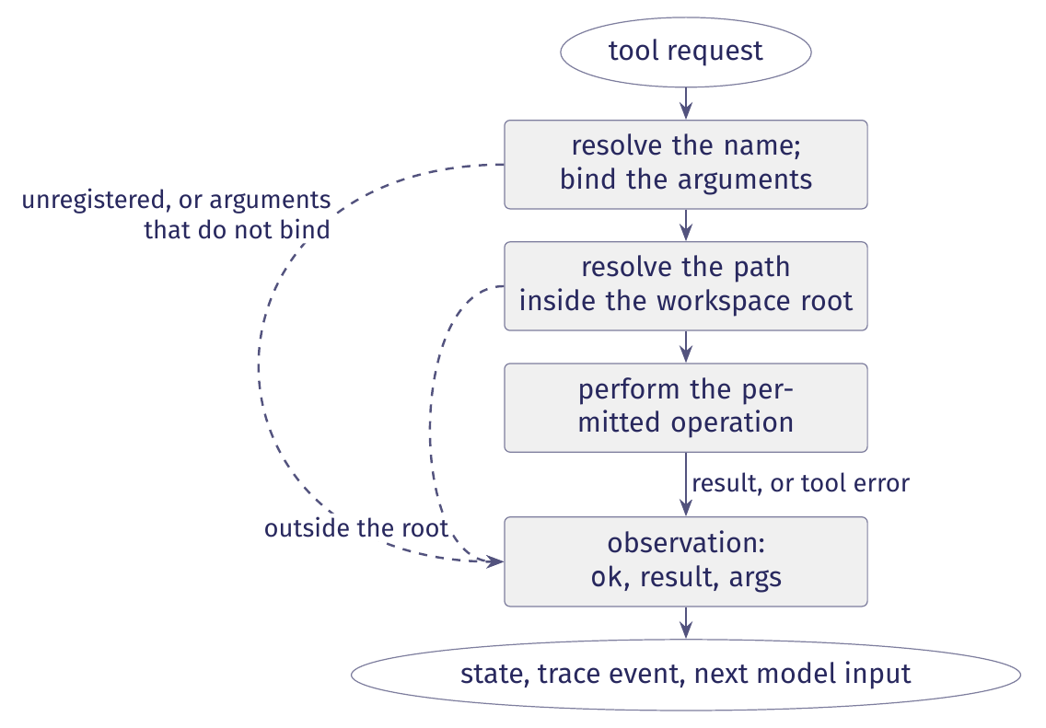
The five operations of the dispatch cycle
The runtime finds the tool, binds arguments, checks policy, runs the operation and records an observation.
Figure 7 in the lecture notes. The dispatcher returns an observation after a successful operation or a refused request.
Notes:
The dispatch cycle finds the requested tool, binds arguments to its parameters, checks the access policy, performs the permitted operation and produces an observation. The dashed branches show refused requests, which also produce observations.

Slide 63
Returning a refusal as an observation
dispatch.py, lines 134 to 164. Coercion and other exception handlers omitted.
function = self.registry.get(name)
if function is None:
# ours: return a refusal listing the registered tools
try:
inspect.signature(function).bind(self.ws, **args)
except TypeError as exc:
return self._refuse(name, args, f"bad arguments for {name}: {exc}")
try:
value = function(self.ws, **args)
except PathEscapeException as exc:
return self._refuse(name, args, f"refused: {exc}")
return self._observe(name, args, self._render(name, value))
An unhandled exception ends the run. A refusal returns an observation so the model can revise its request.
Notes:
Binding checks argument names and the number of arguments. The dispatcher converts unambiguous type mismatches, such as a string supplied where an integer is required. Exceptions that escape the dispatcher end the run and are reserved for unrecoverable failures, such as an unwritable trace.

Slide 64
Evidence of a tool request and execution
The first read_file call in run bc284c6b shows what each record or processing stage can establish about execution.
Record or processing stage | What it establishes
Model input | The model input contains the available tool definitions. The trace does not record this input.
Model response and model_call event, step 3 | The model asked to call a tool. The request alone does not establish that the tool ran.
tool_request event, step 5 | The dispatcher received the request and began checking it.
Dispatcher | The dispatcher checks the request. Refusal reasons appear in tool_result, with no separate event for each check.
tool_result event, step 6 | The tool returned 1,665 characters. The event records their count and omits the text.
State and next input | The runtime stores the observation in state and adds a tool message to the next model input, at step 7.
Table 6 in the lecture notes. The successful tool_result event establishes that the function ran and returned.
Notes:
Step 4 is the routing event between the model response and the tool request. It records decision tools and by="model", identifying the selected control location. It does not describe tool execution.

Slide 65
Complete mediation of resource access
The model requests an action. Before executing it, the runtime checks whether the action is permitted.
Every way of reaching a protected resource, such as a file, must pass through the required checks.
A new tool or a wildcard file pattern (glob) may reach files without passing through the existing path check.
Checking every request establishes that the policy is applied. The policy may still contain errors.
Complete mediation requires every request for a protected resource to pass through a guard, which checks whether access is permitted.
We must check every route by which a tool can reach the resource.
Notes:
The guard model from MIT 6.033 requires a check on every resource access. A routing function can select an edge during execution while applying a rule fixed by the programmer. A model’s request or claim of a result does not establish that the runtime performed the action.

Slide 66
Guarantees and their enforcing components
This table shows how the runtime enforces each desired guarantee. The row about reads identifies a missing path check.
Guarantee | Where it is enforced
Only registered tools run | The dispatcher checks the registry before calling a tool.
Arguments match the tool's parameters | The dispatcher binds arguments and converts unambiguous type mismatches.
Writes stay inside the workspace | The edit tool, the only writer, checks paths with workspace.resolve.
Reads stay inside the workspace | This is unenforced. The search glob bypasses workspace.resolve.
The benchmark fixture stays unchanged | Tools work on a disposable copy of the fixture. The diff compares the copy with the original.
No model call after budget exhaustion | Each model node checks the budget before calling.
At most one plan revision per run | On a stall, tools requests plan revision only if replanned_at is unset.
Table 7 in the notes. The search tool can read outside the workspace because it skips the path check.

Slide 67
Checking paths against the workspace root
The tool follows symlinks and resolves .. segments before checking whether the path lies inside the workspace.
workspace.py, resolve, lines 50 to 68. Docstring and comments omitted.
def resolve(root: Path, path: str) -> Path:
root = Path(root).resolve()
candidate = (root / path).resolve()
if not candidate.is_relative_to(root):
raise PathEscapeException(
f"{path!r} resolves outside the workspace root")
return candidate
Both /tmp/ws and /tmp/ws-evil start with /tmp/ws. A prefix comparison would wrongly accept the second directory.
Notes:
Joining an absolute path to the root yields the absolute path itself, which the check then refuses if its resolved destination lies outside the root.

Slide 68
A refused read and an unchecked search
The recorded runs contain no refusals. This demonstration sends requests directly to the dispatcher.
read_file refuses ../../etc/passwd. The dispatcher returns an observation with ok=false and the reason.
search with ../*-withheld/testcode/*.py reads benchmark files in a sibling directory outside the workspace and reports ok=true.
read_file and edit check paths with workspace.resolve. The search tool uses its glob without this check.
The repair is to check every file matched by search with workspace.resolve before opening it.
All writes pass through the path check. The search tool can still read files outside the workspace.
Notes:
Section 4.6 describes a constructed dispatcher test. The permitted read returns 1,665 characters, matching step 6 of the recorded run. The refused request produces a tool_request and a failed tool_result with a reason and no character count.

Slide 69
Event-Driven Agents

Slide 70
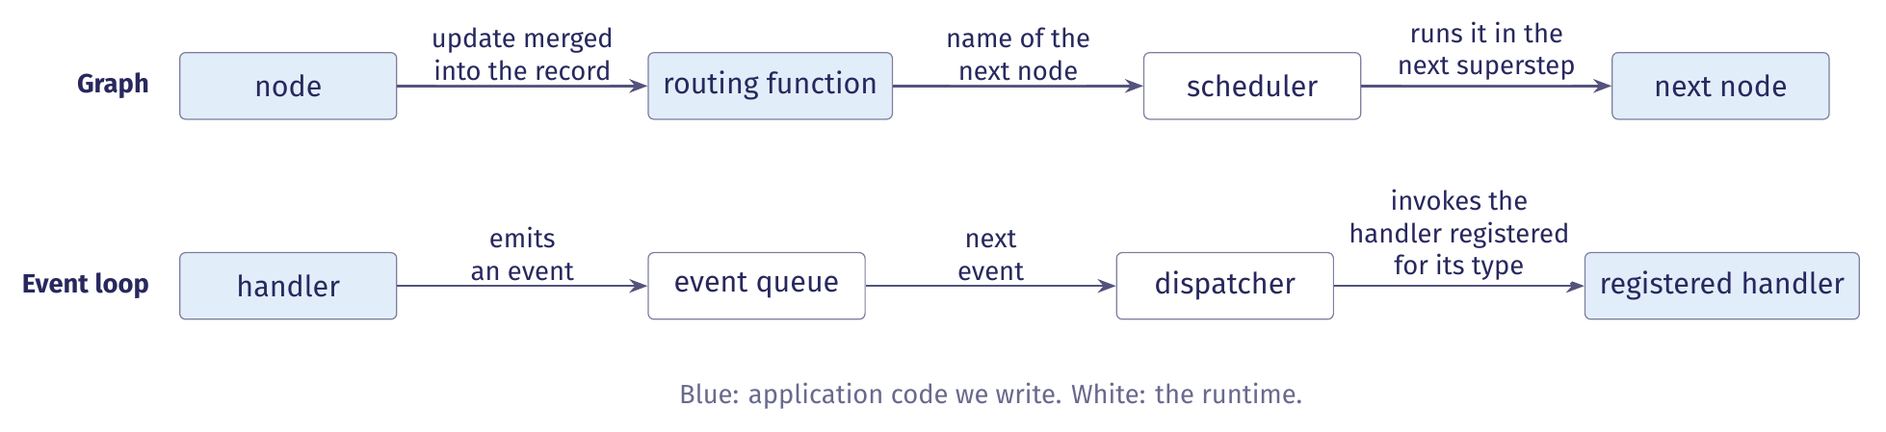
Two ways to invoke the next computation
A graph and an event loop can run the same machine with different mechanisms for invoking application code.
In the graph, a routing function selects the next node and the scheduler runs it next. In an event loop, a computation emits an event and the runtime invokes the registered handler.
Notes:
Section 5.1 of the notes. The machine, its record, the tool contract and the dispatcher are unchanged; only the mechanism that invokes the next computation differs. The scheduler runs the selected node in the next superstep.

Slide 71
Event, handler and event loop
Three definitions describe the arrangement. Definitions 5.1 to 5.3 in the lecture notes.
Term | Definition
Event | Any occurrence that could necessitate a change in the program's state.
Handler | A piece of code that understands how to respond to a particular event. For events to reach it, it must register with the event loop.
Event loop | A piece of code that repeatedly checks whether a new event has occurred and dispatches any detected events to code that can handle them.
For an agent, an event is either an occurrence, such as the plan is ready, or a request, such as run these tools. Both are values.
Notes:
The wording follows the Cornell CS 2110 lecture the notes cite. A tool request event records a request to a handler; it does not establish that the handler ran, exactly as a model's tool request in section 4 does not establish that the read occurred.

Slide 72
Inversion of control
We write the subroutines. A framework controls when they run.
Application code defines a handler's response: the fields it writes and the event it emits.
The framework decides which handler runs, when, and in what order pending events are processed.
The graph divides the same way: we write nodes and routing functions, and the scheduler runs them.
Application code defines the response to an event. The framework controls its invocation.
A graph chooses the next computation in a routing function. A handler chooses the event type it emits.
Notes:
Definition 5.4 and section 5.1 of the notes. The registrations map an event type to its handler, so the two realizations express the choice of the next computation in different places. If the loop does not check its registrations, an event can leave the queue with no handler: nothing runs, although no component decided to stop. We treat that as a defect rather than a terminal outcome.

Slide 73
Event-triggered and time-triggered reactions
The realization changes when a transition is taken. The set of transitions stays the same.
A state-machine diagram does not specify when a reaction occurs.
Event-triggered means a reaction when an input is present. Time-triggered means one on each clock tick.
Our graph uses no clock, so both realizations are event-triggered: they react when an input is present.
The planning agent's machine retains its locations, guards and set actions under either choice.
A transition such as no reply within thirty seconds needs a timer to emit its event. Otherwise it is never taken.
Notes:
Section 5.2 of the notes, after Seshia and Lee's slides 23 to 25. In the graph, each superstep begins when the preceding one finishes. A guard requiring every triggering input to be absent cannot fire when reactions require an input to be present.

Slide 74
The configuration under an event loop
The event realization requires a larger configuration than the graph realization.
Realization | Configuration | Maintained by
Graph | A control location and a valuation of the variables, (q, v). | The runtime tracks q. The record holds v.
Event loop | The sequence of pending events E, the set of running handlers H and the record v, as the triple (E, H, v). | The runtime maintains E and H. The record holds v and contains neither.
In a serial realization at most one event is in flight, so the location q is recoverable from the pending event's handler or the running handler. With two handlers running at once there is no single location: our demo's validators are such a case.
Notes:
Section 5.2 of the notes. During active execution, either one event is pending and no handler runs, or one handler runs and no event is pending. The machine in Figure 1 no longer describes configurations with two running handlers; the demo's validate step runs three at once (section 5.4).

Slide 75
Ordering rules: apply once, then enable
Four rules preserve the machine's behaviour when an event loop realizes it. Two concern ordering.
Apply once, then enable. Merge a handler's contribution before its emitted event is dispatched.
Emit first, and the successor reads a stale record. Deliver twice, and observations append twice.
Distinguish idle from success. An empty queue and an idle runtime mean only that nothing is scheduled.
Only a terminal event carrying a status establishes termination, as a terminal record does in the trace.
An event loop keeps this ordering only if handlers write before they emit and no event is delivered twice.
Notes:
Section 5.2 of the notes, rules 1 and 2 of four. The graph's superstep model provides this ordering. An empty queue does not establish how the run ended or whether termination was intentional.

Slide 76
Termination rules and log events
The last two rules concern termination.
Stop dispatch at termination. After the terminal event no handler starts, even if an event is pending.
A realization with concurrent handlers must discard or refuse the remaining events.
Separate triggering from log events. A triggering event runs a handler. A log event only records.
An event that requests tools triggers the tools handler. A trace record of the same request documents that the handler was invoked, and triggers nothing.
Dispatch can end without a terminal record if the process fails first. Table 5's three readings still apply.
Notes:
Section 5.2 of the notes, rules 3 and 4 of four. In a serial realization no event can be pending at termination. A log event records an occurrence in the trace and triggers no computation. The terminal event ends dispatch; the terminal record in the trace records its status.

Slide 77
LlamaIndex Workflows: steps and events
In LlamaIndex Workflows, dispatch is by event type. A step is a method decorated with @step.
A step receives an event, does some work, and returns another event.
The returned event triggers the next step whose type annotation accepts it.
Events are user-defined Pydantic classes. The framework supplies StartEvent and StopEvent.
The step signatures declare the event types each step consumes and produces.
StartEvent's fields are run()'s keyword arguments. Returning StopEvent ends the workflow with its result.
Notes:
Section 5.3 of the notes, from the LlamaIndex Workflows introduction.

Slide 78
LlamaIndex Workflows: validation and state
Before a run, the framework validates the event graph that the step signatures declare.
It checks that the graph contains a start and a stop event and that every produced event has a consumer.
These checks do not establish that a particular run will reach StopEvent.
A store on the workflow's Context holds per-run state. Steps read and write it through ctx.store.
edit_state() is for updates that must not interleave with another step's updates.
Our demo, cyberbird/event_driven, is written in this framework (section 5.4).
Notes:
Section 5.3 of the notes. The pre-run validation is what catches an event type with no handler, which section 5.1 treats as a defect rather than a terminal outcome.

Slide 79
Idle and success in LlamaIndex and in CrewAI
The two frameworks differ in how we distinguish idle from success.
Question | LlamaIndex Workflows | CrewAI Flows
Dispatch | By event type, declared in the step signatures. | By method completion and router labels: @listen(m) runs when m completes.
Terminal event | StopEvent, whose result carries the outcome. Pre-run validation checks for a start and a stop event. | None. The final output is determined by the last method that completes.
The outcome σ | Carried by the StopEvent's result. | Each event type becomes a router label, and σ must be written to state by our code.
LlamaIndex has an explicit terminal event. In CrewAI a flow ends when no method remains to run, which corresponds to an empty queue.
Notes:
Section 5.3 of the notes. LlamaIndex's validation does not establish that a particular run will reach StopEvent. In CrewAI the outcome must be in the record before the last method completes. CrewAI's @start(), @listen(), @router() and the or_ and and_ operators are HW1 reference material.

Slide 80
Comparing the realizations: the design
Neither framework establishes that an event realization preserves the machine's behaviour.
We compare the realizations after each computation completes and its contribution is applied.
These boundaries are the points of comparison. Handler internals and wall-clock order are not.
We script the model's replies and control the tool results: both get the same inputs in the same order.
The design isolates the scheduling mechanism: a graph superstep or an event dispatch.
A faithful translation preserves observations, workspace effects, check results and terminal status.
Notes:
Section 5.3 of the notes. Comparing an event realization with the graph realization requires a controlled design. The four properties: the observations appended to the record, the effects on the workspace, the results of the acceptance checks, and the terminal status and its meaning.

Slide 81
What agreement under scripted inputs shows
Agreement under scripted inputs supports a limited conclusion.
The two realizations implement the same transition rules for the scripted replies.
It does not establish equivalent behaviour with a live model.
How a handler formats messages changes the model's inputs, even when the transition rules are unchanged.
The comparison also excludes concurrency.
The result holds for the scripted replies. It is a statement about transition rules.
Notes:
Section 5.3 of the notes. Model replies depend on the messages each realization constructs, so changing how a handler formats messages changes the input distribution even when the transition rules stay the same.

Slide 82
The demo as a LlamaIndex workflow
Our event-driven agent runs the planning agent's machine as a LlamaIndex workflow.
It keeps the machine's locations and guards, a budget of forty calls per alert, and one replan.
The run's data sit in a store on the workflow's context: a RunState, and one AlertState per alert.
Two steps are stubs: submit runs no checks, and each validator accepts after a delay. No run is recorded.
One AlertState per alert holds its plan, messages, observations, calls and usage.
Section 5.4 of the notes. The stall check uses three identical results, and the alert may replan once.
Notes:
cyberbird/event_driven. The budget is checked before each call. The RunState holds the run's bookkeeping: the filters, the queue, the current alert and the results. Nothing in an AlertState is shared with any other alert.

Slide 83
The demo's steps and their events
Table 8 in the notes: one row per step.
Step | Accepts | Emits
start | RunRequested | ScanRequested
scan | ScanRequested | AlertFound per alert, StopEvent
gate | AlertFound, AlertDone | AlertStarted, StopEvent
plan | AlertStarted, Stalled | PlanCreated, AlertDone
controller | PlanCreated, Observed, ChecksFailed | ToolsRequested, Submitted, AlertDone
tools | ToolsRequested | Observed, Stalled, AlertDone
submit | Submitted | ChecksFailed, ValidateRequested ×V
validate | ValidateRequested | Verdict
judge | Verdict ×V | AlertDone
No step names another: the signatures are the wiring. plan, controller and validate ask a model. The other six are runtime steps.
Notes:
Table 8 of the notes, from the wiring table in workflow.py, without its Decided-by column: plan, controller and validate are decided by a model, the rest by the runtime. Each step's signature names the events it accepts, and its return annotation names the events it emits. The rows below the rule are the machine of Figure 1; the rows above it are new. gate releases one alert at a time. V is the number of validators, three by default. The guards now sit inside the steps and choose which event to return.

Slide 84
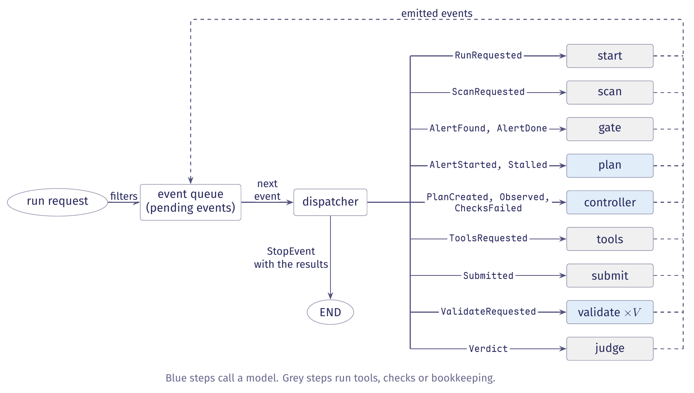
The event-driven agent as an event loop
Figure 8 in the notes. Emitted events return to the queue.
Notes:
White boxes are runtime components. Blue steps call a model (the validators will, once they are no longer stubs), and grey steps run tools, checks or bookkeeping. The ellipses are the run request that starts the run and END. Each solid arrow from the dispatcher names the event types its step accepts. Every event a step emits returns to the queue along the dashed path. V validators run at the same time.

Slide 85
Admission, acting and revising in the steps
The guards now sit inside the steps and choose which event to return.
Admission: plan and controller reserve one model call first. A spent budget returns AlertDone.
Acting: the controller returns ToolsRequested for a reply with tool calls, and Submitted for one without.
Revising: tools returns Observed while work moves, Stalled on a first stall, AlertDone on a second.
On Stalled, plan writes a new plan and moves replanned_at, the handoff and window of section 2.4.
AlertDone carries budget_exhausted from plan or controller, and no_progress from tools.
Notes:
Section 5.4 of the notes. When the alert has spent its budget, the step returns AlertDone with status budget_exhausted and makes no call. A second stall returns AlertDone with status no_progress.

Slide 86
One run handles many alerts
One run handles many alerts, the first of three things the graph agent does not do.
scan runs Bandit once and emits one AlertFound per alert.
gate queues each alert it receives and releases one at a time.
Every event about an alert carries its alert_id, which correlates it with the alert's store entry.
The gate starts the next alert only after the current alert's AlertDone arrives.
The run's bookkeeping sits in the RunState, and each alert's data in its own AlertState.
Notes:
Section 5.4 of the notes. The alert_id is the correlation key: one workflow run handles many alerts, and every event after AlertFound carries it.

Slide 87
Validation fans out and back in
submit sends one ValidateRequested per lens, because a step can return only one event.
validate runs three workers, so the correctness, behaviour and scope validators run at once.
This is the configuration of section 5.2 with several running handlers and no single location.
judge holds each Verdict until all V arrive, and accepts only when every validator accepted.
The gate serializes alerts. It does not serialize validators.
judge does not key verdicts by alert. That is safe only because the gate admits one alert at a time.
Notes:
Section 5.4 of the notes. submit uses ctx.send_event for the fan-out. judge uses ctx.collect_events, which holds each verdict and returns None until all V have arrived, in any order.

Slide 88
Two kinds of ending
An alert ends with an AlertDone carrying one of four statuses. The run ends with a StopEvent.
The statuses are accepted, rejected, no_progress and budget_exhausted.
AlertDone returns to the gate, which records the status and starts the next alert.
When the gate has a result for every alert the scan found, it returns a StopEvent carrying the results.
Only the gate's StopEvent ends the run.
A scan that finds no alert ends the run at once with an empty result.
Notes:
Section 5.4 of the notes. accepted and rejected come from judge, no_progress from tools, budget_exhausted from plan or controller.

Slide 89
Events as classes, in code
Every event is a class. The StartEvent subclass carries the run's input, and every event about one alert carries its alert_id.
event_driven/events.py, RunRequested and AlertEvent. Docstrings omitted
from workflows.events import Event, StartEvent
class RunRequested(StartEvent):
rule: str | None = None
alert_id: str | None = None
limit: int | None = None
class AlertEvent(Event):
alert_id: str
StartEvent's fields are run()'s keyword arguments. alert_id is the correlation key across alerts.
Notes:
Section 5.3 of the notes: events are user-defined Pydantic classes, and the framework supplies StartEvent and StopEvent. The other twelve event classes subclass AlertEvent.

Slide 90
A step's signature declares its events
The signature names the event the step accepts and the event it returns. The store on the Context holds per-run state.
event_driven/workflow.py, start. Docstring omitted
@step
async def start(self, ctx: Context[RunState],
ev: RunRequested) -> ScanRequested:
async with ctx.store.edit_state() as s:
s.filters = {"rule": ev.rule, "alert_id": ev.alert_id,
"limit": ev.limit}
# The runtime decides to scan; no model is asked.
return ScanRequested(root=str(self.config.fixture))
The returned event triggers the next step whose annotation accepts it. edit_state() guards an update that must not interleave with another step's.
Notes:
The two long lines are broken at a comma to fit the window; nothing is paraphrased. The comment is the file's own.

Slide 91
Admission: reserving a call under the lock
plan and controller call _admit before every model call.
event_driven/workflow.py, _admit. Docstring omitted
async def _admit(self, ctx: Context[RunState],
alert_id: str) -> bool:
async with ctx.store.edit_state() as s:
a = s.alerts[alert_id]
if a.model_calls >= self.config.budget:
return False
a.model_calls += 1
return True
The check and the reservation happen under one lock, so two steps admitted at the same moment cannot both take the last call.
Notes:
Section 5.4 of the notes, rule 1 in the code. When _admit returns False, plan and controller return AlertDone with status budget_exhausted and make no call. The signature is broken at a comma to fit the window.

Slide 92
Fan-out: send_event and the annotation
A step can return only one event, so submit sends one ValidateRequested per lens.
event_driven/workflow.py, submit. Docstring omitted; one call over three lines
@step
async def submit(self, ctx: Context[RunState], ev: Submitted
) -> ChecksFailed | ValidateRequested | None:
for lens in list(Lens)[:self.validators]:
ctx.send_event(ValidateRequested(alert_id=ev.alert_id,
lens=lens, patch="",
checks={"passed": True}))
return None
submit still lists ValidateRequested in its return annotation, because the pre-run check requires every emitted event to have a consumer.
Notes:
Section 5.4 of the notes, rule 2 in the code. submit is a stub: the checks are not yet real, so patch and checks are placeholders. The step returns None; the events it sent carry the run forward.

Slide 93
The StopEvent: how the run ends
The gate step returns the StopEvent.
event_driven/workflow.py, gate. Queueing and bookkeeping omitted
@step(num_workers=1)
async def gate(self, ctx: Context[RunState],
ev: AlertFound | AlertDone
) -> AlertStarted | StopEvent | None:
async with ctx.store.edit_state() as s:
# ours: enqueue the alert or record its result, omitted
if len(s.results) == s.expected:
return StopEvent(result=dict(s.results))
if s.current is not None or not s.queue:
return None
Returning None means busy or waiting. Only the gate's StopEvent ends the run.
Notes:
Section 5.4 of the notes, rules 2 and 3 in the code: the gate emits StopEvent only when the count of results equals the count of alerts, so no alert is still in progress when the run ends. gate also returns AlertStarted when it releases the next alert; that branch is cut.

Slide 94
The four rules in the code
The code keeps the four rules of section 5.2 in these forms.
Rule | How the code keeps it
Apply once, then enable | Every write goes through ctx.store.edit_state(), which locks the store, and each step writes its data before it emits the event that lets another step read them.
Distinguish idle from success | Only the gate's StopEvent ends the run. Before the first run, the framework checks that every event a step emits has a step that accepts it.
Stop dispatch at termination | The gate emits StopEvent only when the count of results equals the count of alerts, so no alert is still in progress when the run ends.
Separate triggering from log events | This agent writes no trace. Its events trigger steps, and no event records one.
Our graph agents write a trace alongside their events. The event-driven agent does not yet have one.
Notes:
Section 5.4 of the notes. The budget check reserves its call under the same lock, so two steps admitted at the same moment cannot both take the last call. submit lists ValidateRequested in its return annotation although it sends those events rather than returning them.

