Slide 1
Designing Production Agentic Systems
Columbia · Fall 2026 · Lecture 2
Notes:
[40s] Course number, title, term. Say the room and the slot: Fridays 2:10 to 4:00, Hamilton 303, September 11 through December 11. Do not read the syllabus yet.

Slide 2
Logistics and Recap

Slide 3
About the Instructors
Senior Research Scientist IBM and I was a CS Postdoc at Columbia.
What I work on: Program Analysis • Distributed Systems • Security • Testing
Instructor | Rahul Krishna • rk3080@columbia.edu
Teaching Assistant | In Keun Kim • ik2619@columbia.edu
Office Hours | Friday 12:00—1:30 (and via zoom ad hoc)
TA | To be announced on CourseWorks
Discussion | Slack Channel
Website | rkrsn.us

Slide 4
The key question that motivates this course
How do we place a probabilistic model inside a software system without surrendering the guarantees expected of production software?
Phrase | Why it is in the question
Probabilistic | Two identical calls are not guaranteed to agree, and nothing downstream may assume they will
Inside a software system | It is one component among several. It is called, its output is validated, and it may be refused
Guarantees | The “promises” a system makes to its consumers. Things a caller is entitled to expect and rely on every time
The agent is a component of a larger system. It is not the entire system.

Slide 5
What I hope you will learn…
By the end of this semester, you will design a production agentic system like what you just saw from Anthropic
Unit | Weeks | What it covers | What you’ll learn | Homework
1 | 1–3 | Agent architectures and control | The orchestrator: who chooses the next operation, and who decides to stop | HW1
2 | 4–6 | Tool interfaces and concurrency | The tools and the subagents: contracts, dependencies, bounded fan-out | HW2
3 | 8–9 | Context, state, and persistence | Memory and context: what survives truncation, and what survives a restart | HW3
4 | 10–12 | Deployment, recovery, and observability | The service around all of it: partial failure, retries, traces

Slide 6

What I hope you will learn…
By the end of this semester, you will design a production agentic system like what you just saw from Anthropic
Unit | Weeks | What it covers | What you’ll learn | Homework
1 | 1–3 | Agent architectures and control | The orchestrator: who chooses the next operation, and who decides to stop | HW1
2 | 4–6 | Tool interfaces and concurrency | The tools and the subagents: contracts, dependencies, bounded fan-out | HW2
3 | 8–9 | Context, state, and persistence | Memory and context: what survives truncation, and what survives a restart | HW3
4 | 10–12 | Deployment, recovery, and observability | The service around all of it: partial failure, retries, traces
Today’s Lecture

Slide 7
Homework, Grades, and Exams
Item | Weight | When | Format
Homework 1 | 20% | Dates on the site (tentative) | Solo/Team submission
Homework 2 | 20% | Dates on the site (tentative) | Solo/Team submission
Midterm | 20% | October 23rd | 40 mins (closed book) covering units 1 and 2
Homework 3 | 20% | Dates on the site (tentative) | Solo/Team submission
Final | 20% | December 17th | 40 mins (closed book) covering units 1 to 4
Homework is done in alone or in teams (of 2-3), and a team keeps one codebase for the whole semester. Homework 2 builds on homework 1; homework 3 builds on homework 2 and so on.
Tests are always written and closed book. They assess conceptual understanding, architectural reasoning, and the ability to analyze system behavior.
A comprehensive reading list and lecture notes will be provided by the teaching staff.

Slide 8
Homework, Grades, and Exams
Item | Weight | When | Format
Homework 1 | 20% | Dates on the site (tentative) | Solo/Team submission
Homework 2 | 20% | Dates on the site (tentative) | Solo/Team submission
Midterm | 20% | October 23rd | 40 mins (closed book) covering units 1 and 2
Homework 3 | 20% | Dates on the site (tentative) | Solo/Team submission
Final | 20% | December 17th | 40 mins (closed book) covering units 1 to 4
End of day today
Homework is done in alone or in teams (of 2-3), and a team keeps one codebase for the whole semester. Homework 2 builds on homework 1; homework 3 builds on homework 2 and so on.
Tests are always written and closed book. They assess conceptual understanding, architectural reasoning, and the ability to analyze system behavior.
A comprehensive reading list and lecture notes will be provided by the teaching staff.

Slide 9
Logistics and Recap

Slide 11
Rational agents
“For each possible percept sequence, a rational agent should select an action that is expected to maximize its performance measure, given the evidence provided by the percept sequence and whatever built-in knowledge the agent has.”
Russell and Norvig, §2.2.2
What is rational at any given time depends on four things:
The performance measure that defines the criterion of success
The agent’s prior knowledge of the environment
The actions that the agent can perform
The agent’s percept sequence to date
Notes:
Read the definition once, slowly. Then the four things it depends on. Two of the four are ours to write down before the agent runs: the performance measure and the action set. One is the world we put it in. The last one is the only thing that changes during a run, and every architecture in this lecture is a different answer to what to do with it.

Slide 12
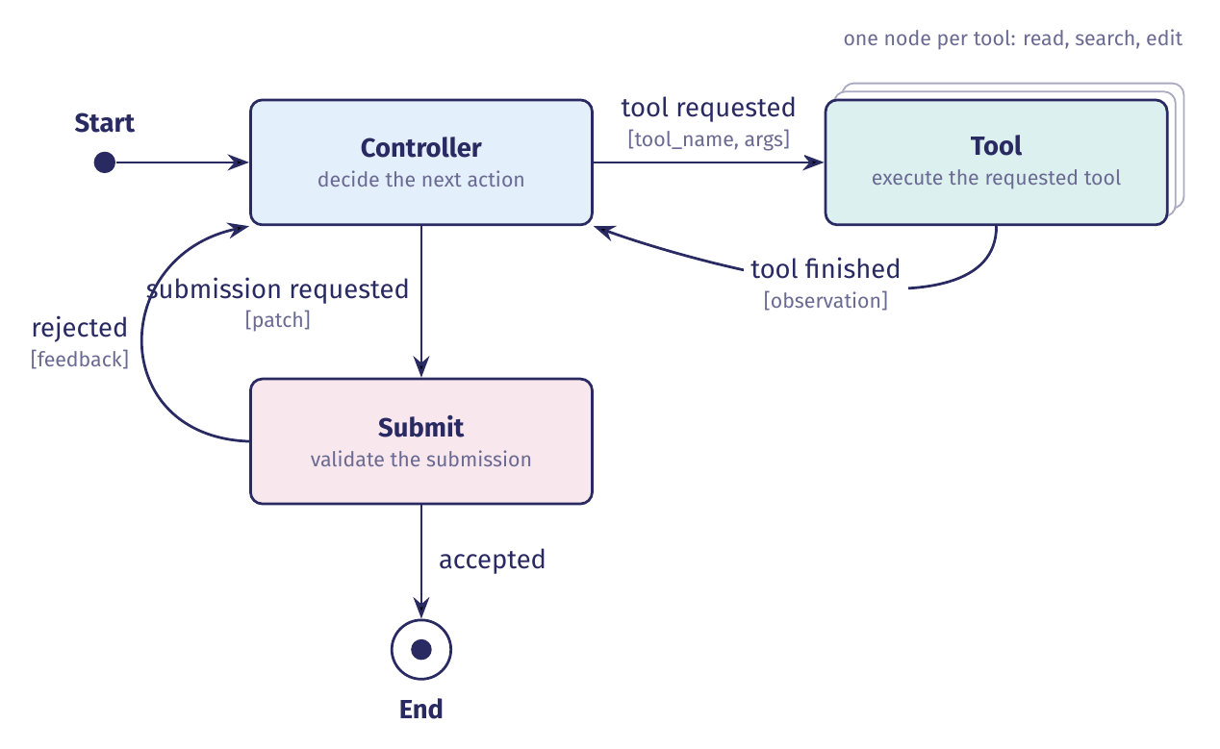
A demo agent: mini-swe-agent
One alert from OWASP BenchmarkPython, read as an issue report. mini-swe-agent localizes the flagged code, edits it, and submits a patch. The run ends when the submission is accepted.
Notes:
This is the whole agent, as a state machine. Three states and five transitions. The controller decides the next action; a tool executes it and hands back an observation; the controller can instead ask to submit, and the run ends only when that submission is accepted. Read the labels as event, then condition in brackets. Every architecture in the rest of this block is a change to this machine: a new state, a new edge, or a different component deciding.

Slide 13
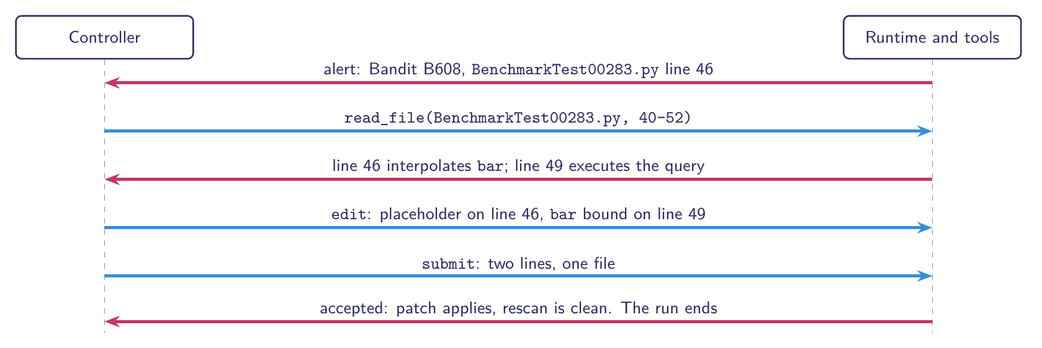
One alert, one run, one patch
Before: the query is built by interpolation
46 sql = f'SELECT username from USERS where password = \'{bar}\''
49 cur.execute(sql)
After: the query carries a placeholder and the value is bound
46 sql = 'SELECT username from USERS where password = ?'
49 cur.execute(sql, (bar,))
Notes:
The alert points at line 46, where the query is built by interpolating a request value. The agent reads the region, edits two lines, and submits. The patch puts a placeholder in the query text and binds the value when the query runs, so the value can no longer change the shape of the statement. Two lines, one file, and the whole run is six exchanges.

Slide 14
Why this is a rational agent
It is rational, but only given four things we must state:
The performance measure: one point if the patch removes the reported weakness and leaves the endpoint behaving as it did
Prior knowledge: the application's layout, and what each tool returns
The actions available: read_file, search, edit, submit
The percepts: whatever the tools return, and nothing else
Reading the flagged lines before editing them is the action that maximizes expected performance.
Rationality is relative to those four!
Notes:
Rationality is not a property of the program alone. It is a property of the program against a measure, prior knowledge, an action set, and a percept sequence. Say the four out loud, and the claim becomes checkable. The agent reads before it edits because looking is how it maximizes expected performance.

Slide 15
When it is not
Circumstances under which the agent stops being rational:
Optimizing per tool call, and an agent that reads whole files fares poorly. A better agent reads the smallest range that answers its question (becomes relevant when we build better tools)
Patching only the flagged line, and the weakness survives when the unsafe value comes from a helper the alert never names. A better agent follows the value first (becomes relevant when we add a planner)
Keep editing after the submission is accepted, and every further call risks breaking behavior (becomes relevant when the runtime owns termination)
Budget, depth of investigation, termination. Each later section makes one of them a decision.
And the Submit state checks less than the measure asks: Accepted is not Correct.
Notes:
Three circumstances, and each becomes a component later. The budget is the runtime refusing a call. The depth of investigation is what the planner decides. Termination is the stopping rule the runtime owns. Close on the gap: the Submit state can check that the patch applies and that the rescan is clean, which is not the same as the endpoint still behaving as it did.

Slide 16
The task environment
A task environment is a performance measure (P), an environment (E), actuators (A) and sensors (S), written down as a PEAS description.
Russell and Norvig, §2.3.1
 | For mini-swe-agent
Performance measure | The reported weakness is gone, and the endpoint still returns what it returned before, at bounded cost
Environment | OWASP BenchmarkPython at a pinned commit, one scanner alert read as an issue report, and the working tree the agent edits
Actuators | read_file(path, range), search(pattern), edit(path, old, new), submit(patch)
Sensors | The alert, file excerpts, search hits, edit confirmations, the validation result, and tool errors
In designing an agent, the first step is to try to specify the task environment as fully as possible.
Notes:
Write the task down before you design the program. The four slots are the whole specification: what counts as success, what world the agent acts in, what it can do, and what it can see. Everything later in the block is a choice about the program, not about these four.

Slide 17
Fully or partially observable
 | Fully observable | Partially observable
Definition | The sensors give the agent the complete state of the environment at each point in time, or at least every part that matters for the choice of action. | The sensors are noisy or inaccurate, or part of the state is simply missing. With no sensors at all, unobservable.
Examples | Crossword, chess with a clock, backgammon, image analysis | Poker, taxi driving, medical diagnosis, part-picking robot, refinery controller
Partially observable. Our agent sees only what it reads, and it never sees whether the endpoint still works. How or where the application is running, the OS or what other programs are running simultaneously.
Notes:
Fully or partially observable. Read the two definitions, then the blue box: that is where our agent sits, and why. Only the first property makes this task hard; the rest are the easy end.

Slide 18
Single agent or multiagent
 | Single agent | Multiagent
Definition | No other entity behaves as though it were maximising a measure that depends on what this agent does. | Another entity is best described as maximizing a measure whose value depends on this agent's behavior. It can compete, as in chess, or cooperate, as in traffic.
Examples | Crossword, medical diagnosis, image analysis, part-picking robot, refinery controller | Chess with a clock, poker, backgammon, taxi driving, English tutor
Single agent. Nothing in the architecture is trying to cooperate with or beat it.
Notes:
Single agent or multiagent. Read the two definitions, then the blue box: that is where our agent sits, and why. Only the first property makes this task hard; the rest are the easy end.

Slide 19
Deterministic or nondeterministic
 | Deterministic | Nondeterministic
Definition | The current state and the action the agent executes fix the next state completely. | They do not. A partly observable environment can look nondeterministic even when it is not. Stochastic is the narrower word, for models that put numbers on the possibilities.
Examples | Crossword, chess with a clock, image analysis | Poker, backgammon, taxi driving, medical diagnosis, refinery controller
Deterministic. The same read, and the same rescan, give the same answer every time.
Notes:
Deterministic or nondeterministic. Read the two definitions, then the blue box: that is where our agent sits, and why. Only the first property makes this task hard; the rest are the easy end.

Slide 20
Episodic or sequential
 | Episodic | Sequential
Definition | Experience divides into separate episodes. The agent perceives, then acts once, and the next episode owes nothing to the last. | The current decision can affect every decision that follows.
Examples | Image analysis, part-picking robot | Crossword, chess, poker, backgammon, taxi driving, medical diagnosis, refinery controller, English tutor
Both, at different scales. Sequential inside one alert, because what it reads next depends on what it just read. Episodic across alerts, because one alert teaches it nothing about the next.
Notes:
Episodic or sequential. Read the two definitions, then the blue box: that is where our agent sits, and why. Only the first property makes this task hard; the rest are the easy end.

Slide 21
Static or dynamic
 | Static | Dynamic
Definition | The environment cannot change while the agent is thinking, so the agent need not watch the clock. | The environment can change while the agent is thinking. Semidynamic if the world holds still but the score does not.
Examples | Crossword, poker, backgammon; chess with a clock and image analysis are semidynamic | Taxi driving, medical diagnosis, part-picking robot, refinery controller, English tutor
Static. The working tree changes only when our agent edits it.
Notes:
Static or dynamic. Read the two definitions, then the blue box: that is where our agent sits, and why. Only the first property makes this task hard; the rest are the easy end.

Slide 22
Discrete or continuous
 | Discrete | Continuous
Definition | The state, the handling of time, and the agent's percepts and actions all come in a finite number of distinct values. | State, time, percepts or actions sweep through a range of values.
Examples | Crossword, chess with a clock, poker, backgammon, English tutor | Taxi driving, medical diagnosis, image analysis, part-picking robot, refinery controller
Discrete. Files, lines, hunks and edits are countable. There is nothing here to measure.
Notes:
Discrete or continuous. Read the two definitions, then the blue box: that is where our agent sits, and why. Only the first property makes this task hard; the rest are the easy end.

Slide 23
Known or unknown
 | Known | Unknown
Definition | The outcomes of every action are given. This is about what the agent knows, not about the environment itself. | The agent has to learn how the world works before it can choose well. A new video game shows the whole screen and still will not say what the buttons do.
Examples | Chess and poker: the rules can be handed over in full | Driving a rented car in a country you have not driven in
Known. We know what each tool does. What we do not know is where the flaw is, and that is the other axis.
Notes:
Known or unknown. Read the two definitions, then the blue box: that is where our agent sits, and why. Only the first property makes this task hard; the rest are the easy end.

Slide 24

The agent, its tools, and its environment
Every label in magenta names a row of the vocabulary table (Table 2) in the lecture notes.
Notes:
The same state machine, with three things added. The dashed box says the agent runs inside an environment, which here is the working tree and the alert. The tool node is split into one box per tool, reached by dotted lines, because the controller asks for a tool by name. And each pink label names a row of the vocabulary table, so you can point at the picture and read the row: environment, agent program, working state, actions, percepts, architecture, performance measure. Note what the picture makes obvious: the tools are the only way the program reaches the environment, and the run ends only through Submit.

Slide 25
Fixed workflows
Notes:
Section 2. We have a definition of a rational agent and a machine to point at. Now the first architecture, and it is the one that gives the model the least: every control decision is ours, made before the program sees a task.

Slide 26
A fixed workflow
In a fixed workflow we make every control decision at design time, and the model supplies content at the points we choose.
The control decisions, all settled before the program sees a task:
Operations: which one runs next, and whether any follow
Model calls: how many the run makes
Termination: what ends the run
Artifacts: which ones each step reads and writes
An agent that relies on its designer’s prior knowledge, not its own percepts, lacks autonomy.
Russell and Norvig, §2.2.3
Notes:
The word to hold on to is control. Not which file to patch, not what the patch says — the model still decides those. Control is which operation runs next, how many times we call the model, and what ends the run. In a fixed workflow all of that is written before the program sees a task, and no model output can change it. The strip is the price: everything the program knows about this task, we put there. That is legitimate engineering, and it is also exactly what the rest of the lecture spends, one decision at a time.

Slide 27
Understanding design decision points
Decision | Who decides | When
Which operation runs next | Us | Design time
Whether anything runs after it | Us | Design time
How many model calls the run makes | Us | Design time
What ends the run | Us | Design time
What a model call returns | The model | Run time
Which values travel to the next step | The model | Run time
Notes:
The line through the middle of this table is the whole section. Above it, every decision is ours and every one is made before the run. Below it, the model decides, and it decides at run time — but only what a call returns, never what happens next. Worth saying out loud: the hard problem is below the line. Naming the file to patch is harder than deciding that a file is named before lines are read. Difficulty is not what the line sorts on. Authority is. And a fixed workflow may branch, filter, and repeat a step a set number of times: it is still fixed, because we wrote the predicate it branches on, so we can enumerate every path.

Slide 28
Understanding design decision points
Decision | Who decides | When
Which operation runs next | Us | Design time
Whether anything runs after it | Us | Design time
How many model calls the run makes | Us | Design time
What ends the run | Us | Design time
What a model call returns | The model | Run time
Which values travel to the next step | The model | Run time
No model output is read as an instruction. It is read as data.
Notes:
The line through the middle of this table is the whole section. Above it, every decision is ours and every one is made before the run. Below it, the model decides, and it decides at run time — but only what a call returns, never what happens next. Worth saying out loud: the hard problem is below the line. Naming the file to patch is harder than deciding that a file is named before lines are read. Difficulty is not what the line sorts on. Authority is. And a fixed workflow may branch, filter, and repeat a step a set number of times: it is still fixed, because we wrote the predicate it branches on, so we can enumerate every path.

Slide 29
What the fixed shape buys
Three properties come with fixing the control decisions:
Shape: the model calls are the ones we wrote, so we can budget a task before reading it
Failure mode: every artifact has a named producer, so a wrong answer belongs to a step
Termination: the run ends because the last operation returns, not because a counter ran out
Notes:
Three things, and they are worth having. We can price a thousand alerts before running any of them, because the number of model calls does not depend on what the model says. Debugging a bad patch means reading four artifacts, not reconstructing a forty-turn trajectory. And the run stops because the program ran out of operations — that is a fact about the text, not a hope about the model. Termination is the one the later versions never get back: they replace it with a step cap, which guarantees stopping but says nothing about finishing.

Slide 30
What the fixed shape buys
Three properties come with fixing the control decisions:
Shape: the model calls are the ones we wrote, so we can budget a task before reading it
Failure mode: every artifact has a named producer, so a wrong answer belongs to a step
Termination: the run ends because the last operation returns, not because a counter ran out
Each of these is a property of the program we have designed. It is not a prediction about what the model will do.
When we build autonomous agents, we’ll have to incorporate these into them. They don’t come for free.
Notes:
Three things, and they are worth having. We can price a thousand alerts before running any of them, because the number of model calls does not depend on what the model says. Debugging a bad patch means reading four artifacts, not reconstructing a forty-turn trajectory. And the run stops because the program ran out of operations — that is a fact about the text, not a hope about the model. Termination is the one the later versions never get back: they replace it with a step cap, which guarantees stopping but says nothing about finishing.

